Slide 1





European Spallation Source
Diagnostics Challenges
Lali Tchelidze
AD retreat, Lund, Sweden, 2011-12-05

Slide 2
Basic quantities to be measured
Beam loss (IC, PMT, ND);
Beam current (current transformer);
Beam position and phase (time of arrival) (buttons, stripline);
Beam size (wire scanner);
Transverse profile and halo (wire scanner, IPM);
Bunch length/shape (Feschenko monitor);
Beam distribution on target.
  The specifications for the instruments are preliminary and will evolve during the design update phase!

Slide 3
Requirements
Beam loss:
  sensitivity (0.01 W/m) (for activation);
  time resolution – 2-3 μs (for MPS);
  dynamic range – 10⁶ (for MPS);
  No blind spots.
Beam current:
  measurement at a percent level.

Slide 4
Requirements (cont.)
Beam position:
  position measurement at a couple of percent of the beam size – 100 μm;
  enough time response to observe transients – 1 μs.
Time of arrival (phase):
  measured to a fraction of a degree of RF period – 2-4 ps (fast resp. useful for LLRF studies).
Beam size:
  measured with an accuracy of 10% (of 1-3 mm);
  can be average over a pulse.

Slide 5
Requirements (cont.)
Halo:
  Halo at the level of 10⁻⁵ or less of the total beam.
Bunch length/bunch shape:
  measured with an accuracy of 10%;
  can be an average over a pulse, or measured in a single bunch.
Beam density distribution on target:
  to be measured with an accuracy of 10% of the nominal peak density.

Slide 6
Warm vs. Cold quads
Two designs are foreseen:
This affects the diagnostic tools that might need to be redeveloped for the cold environment.
2 K
2 K
2 K
70 K
2 K

Slide 7
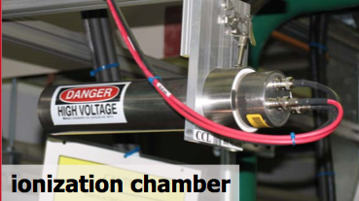
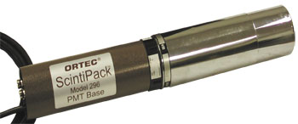
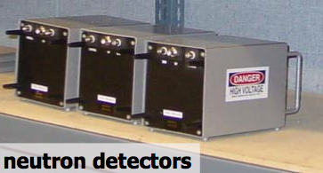
BLM – part of the MPS system
Sensitivity – for low, continuous loss monitoring;
Speed/dynamic range – for high, fast losses.
Detector of choice:
  Ionization chamber
  Scintillator/PMT
  Neutron detector
  Diamond detector
scintillator detector

Slide 8
Loss monitors
Loss monitor system must not have “blind spots”!
Need to determine optimal BLM system layout by simulations
  Simulate secondary particle showers all along accelerator (using e.g. Geant4, MARS, FLUKA)
  Includes both detector location and type
Energy deposition in 1.6 10⁻⁵ Gy for losses in the middle of the quadrupole magnet at 500 MeV, 1.5 mrad
Preliminary positioning: one at every quadrupole magnet.

Slide 9
BLM design
Scaling from SNS indicates response time of few μs is needed.
New ionization chamber design proposed (shorter drift length). Looking into prototyping.
Also, LHC and SNS type detector testing.
May need cryogenic loss monitors.
L.Tchelidze et al, IPAC’11

Slide 10
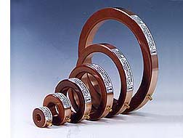
Beam Current Monitors
Beam current transformers will be used in front end plus one between main linac sections
  Except for the very front-end, will likely only be used for early commissioning.
Available off the shelf.
  Issues:
    On-line calibration system
    Position dependence

Slide 11
Beam Position
  One dual-plane BPM per quadrupole.
  Button BPMs in most of linac, striplines may be used in front end.
  Physically attached to quads.
Issues: low beta issues - the field is not solely transverse; Sensitivity not only given by geometry, but frequency dependent.

Slide 12
Beam Size/Emittance
Carbon wire tested at LEDA
Los Alamos (M Plum et al)
Beam size measurement is difficult for high intensity machines
  Interceptive devices such as wire scanners may break and need to be replaced.
  Concerns about wire fragments contaminating SC cavities lead SNS to embrace the laser wire scanner – Not an option for ESS.

Slide 13
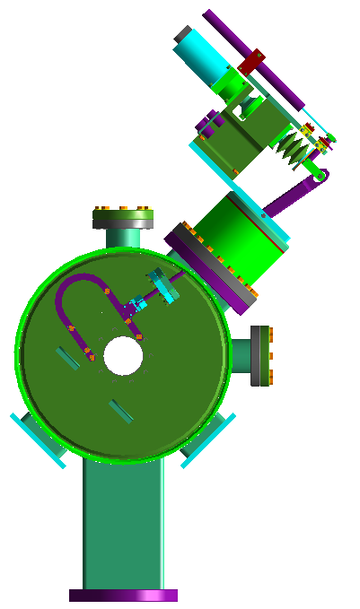
Wire Scanners
SNS studies concluded that carbon wires would work for short pulse.
GANIL wire sublimation test suggests carbon wires bad for SC cavities, tungsten and niobium OK.
Tungsten will likely have issues with thermionic emission, may need to measure downstream loss signal instead of SE current
  Potential space/geometry issue, need study.
Wire scanner baseline profile device!
SNS Wire Scanner

Slide 14
Profile Monitors
An Ionization Profile Monitor (IPM) measures beam profile by collecting rest gas molecules/electrons ionized by the beam.
Is the gas pressure (and composition) in the cold linac good enough?
Micro-channel plates age, and need to be replaced.
P. Forck et al, GSI
Gas fluorescence monitor measures light emitted by atoms/molecules excited by the beam.
Cross sections much lower than for ionization
Light emittance isotropically.
What is the rest gas pressure?
F. Becker et al, GSI

Slide 15
Profile Monitors
Except in front-end, IPM/BIF would likely need long integration time, and may require gas injection.
  Gas injection compatible with SC cavities?
Gas jet to be investigated for use in SC linac (discussion with Cockroft Institute, UK now member)
Kuehnel et al, EPAC08

Slide 16
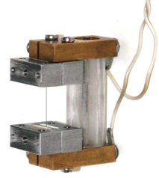
Halo Diagnostics
Options for halo measurements include instrumented scrapers, vibrating wires, and high dynamic range wire scanners.
WS Telescope, e.g. ANL
LEDA WS, LANL
Vibrating Wire, Bergoz

Slide 17
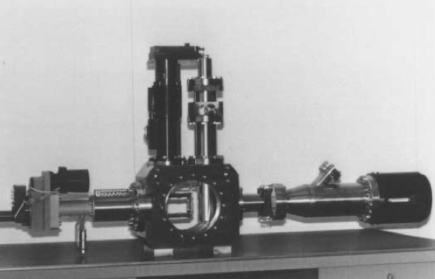
Bunch Shape Monitor
At low beta, field is not transverse, and wall current not longer reflect beam pulse.
The Feschenko monitor (first Faraday cup award) makes use of secondary electrons from a wire in the tail of the beam distribution.
  Very fast (ps) process
A high bias voltage accelerates the electrons towards a slit, and an RF deflector turns time-of-arrival into position
BSM installed in CERN Linac2
A. Feschenko, Bunch Shape Monitors using Low Energy Secondary Electrons, PAC’92

Slide 18
GSI (Forck) Variant
The GSI variant uses ionization electrons instead of secondary electrons – no wire!
Unresolved issues with background.
Space charge sensitive, since uniform electric field.
P. Forck et al, Measurement with a Novel Non-Intercepting Bunch Shape Monitor
at the High Current GSI LINAC, DIPAC’05

Slide 19
ANL (Ostroumov) Variant
The ANL variant uses x-rays, which are turned into electrons at a photocathode.
Space charge not an issue.
Wire or gas target could be used.
P. Ostroumov et al, Bunch Length Detector Based on X-Ray Produced Electrons, PAC’09

Slide 20
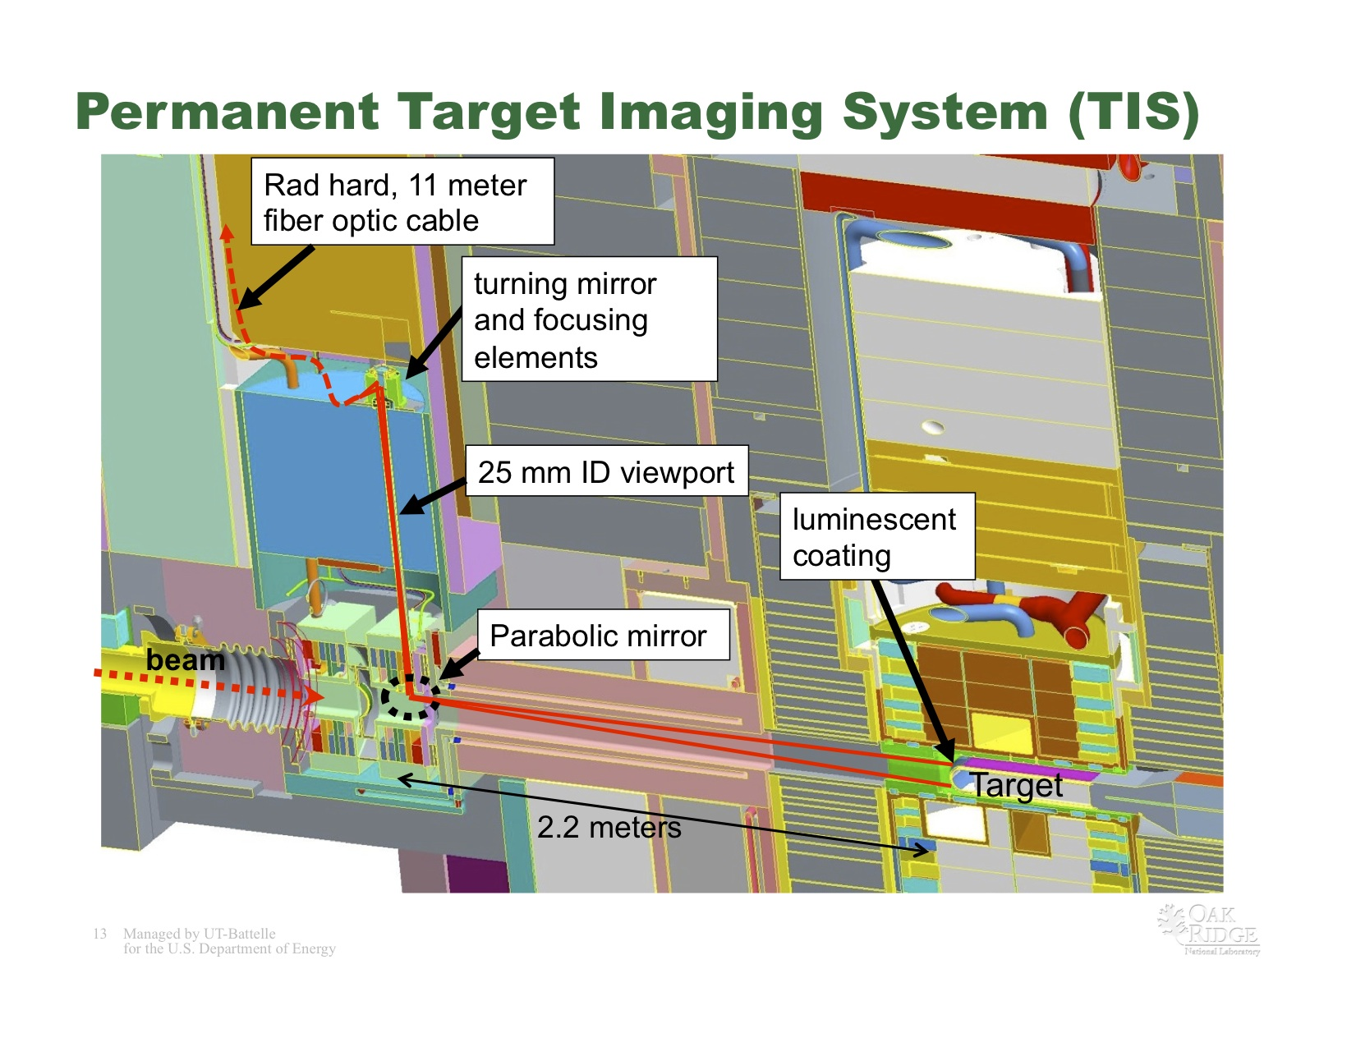
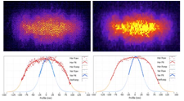

Target spot size
SNS experience with CrAl2O3 coated target is good, we would like something similar.
ESS baseline target is a rotating tungsten wheel (He cooled), need to adapt.
Will investigate measurement both on target rim and proton beam window (possibly using OTR).
T. Shea
W. Blokland, BIW10

Slide 21
ESS Preliminary System Count

Slide 22
Front end diagnostics and commissioning
Several specific systems for front end
  Slits, grids, faraday cups.
Additional diagnostics will be installed on movable diagnostics girder, to be used for commissioning.
Considering permanent diagnostic side-spurs
Linac4 diagnostics bench

Slide 23
Summary
Work to define the ESS diagnostics is progressing
Particular challenges in transverse beam size and longitudinal bunch shape diagnostics.
Beam Diagnostics group in Lund is responsible for diagnostics in the entire linac.
Thank you!

