Slide 1
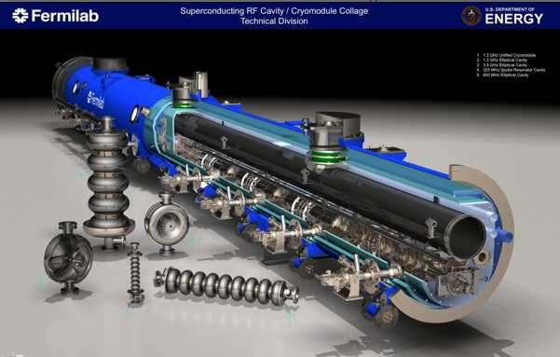
Cryogenics
Accelerator Division / Cryogenics and Vacuum
Christine Darve
12/05/2011

Slide 2

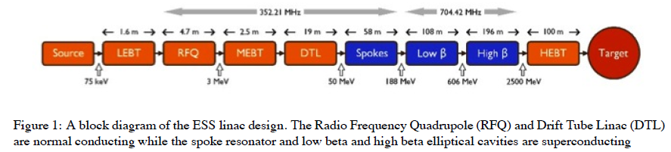
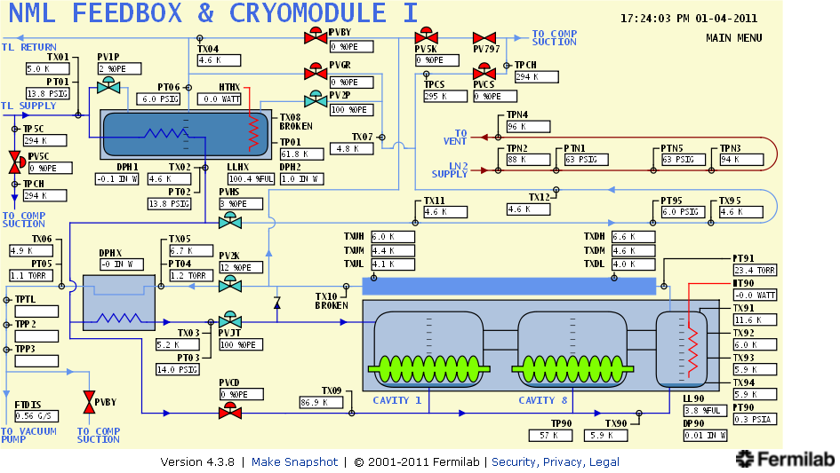
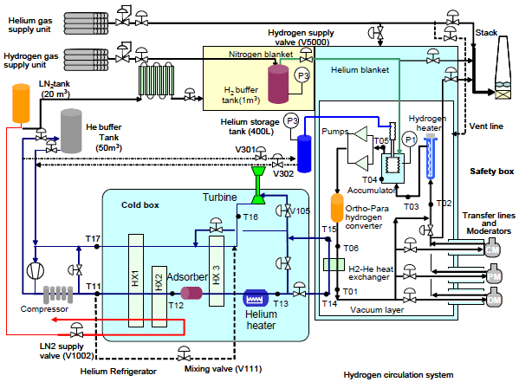
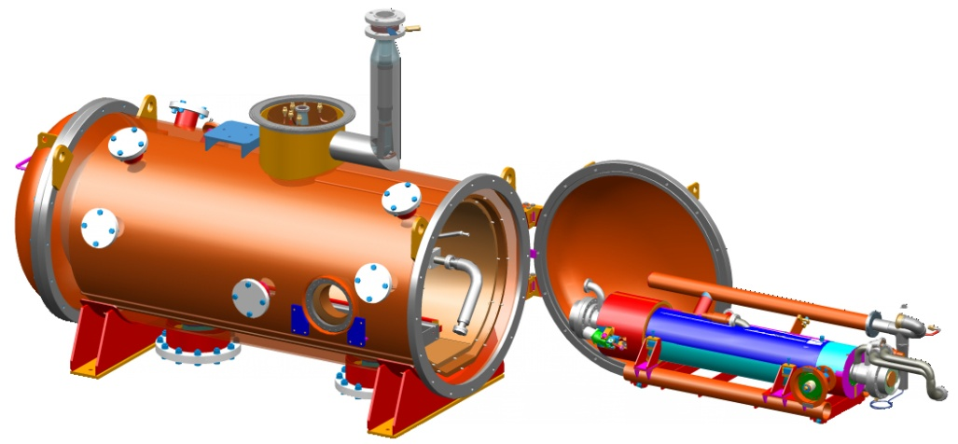
Cryogenics (Cryo-plant, He, N₂)
Linac:
Cryomodules
Distribution Lines
Storage
Target station:
Target (Helium 60 C, 3 bar)
Moderator (20 K, 15 bar)
LH₂ system
Instruments and Test Stands (TBD)

Slide 3
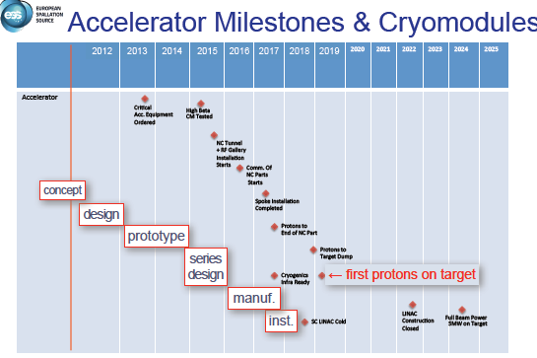
Complete a cryogenic system capable of supplying sufficient cryogenic cooling to Linac, target station, instrument and possible test stands by 2019.
Design, procure, install, commission & operate a cryo-plant, purification system, storage, cryo-distribution and Cryo-Modules. Reliability = 95 %
ESS staff (1+1+1+..)
Saclay – Elliptical SRF cavities package
IPNO – Spoke SRF cavities + CM
CERN – Possible testing of prototype?
+ SPL design experience, etc..
Lessons learned from FNAL, X-FEL, SNS, J-PARC, etc..
Cost from “design to operation” of cryo-plant, cryo-distribution and cryomodules.
e.g. 1/3 of ILC Project cost for CM, 40 % of it for cavity fabrication, processing, dressing, and qualification (but there are higher gradient one).

Slide 4
Complete a cryogenic system capable of supplying sufficient cryogenic cooling to Linac, target station, instrument and possible test stands by 2019.
Design, procure, install, commission & operate a cryo-plant, purification system, storage, cryo-distribution and Cryo-Modules.
No real cryo. technical challenge, but time constraint.
Constraint: Minimum Energy Consumption.
Danger: failure to achieve an R&D goal has a potential cost impact by mitigating the design modification.
Use existing solutions for cost-effective fabrication and operation. Possible trade-offs?
Keep it Simple !

Slide 5
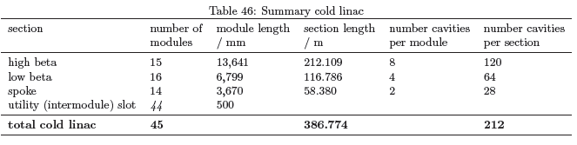
What do we have
Official basic parameters as listed in the CDR for the cryomodule …
  Components list for Linac: layout optic optimization using Hybrid version
  Demand in refrigeration: linac heat load estimate using experimental data
  (required capacity appropriate margin, overcapacity and uncertainty factor).
Elliptical cavity package (incl. coupler, tuner and helium tank)
→ Saclay/Guillaume Devanz : Conceptual Design Phase
Spoke resonator cavity package (incl. coupler, tuner and helium tank)
→ Sebastien Bousson/INPO : Conceptual Design Phase
→ Patxi Duthil/IPNO (Design Spoke CM): to be started in 2012
➔ Open issue : Design Elliptical CM → to be defined asap

Slide 6
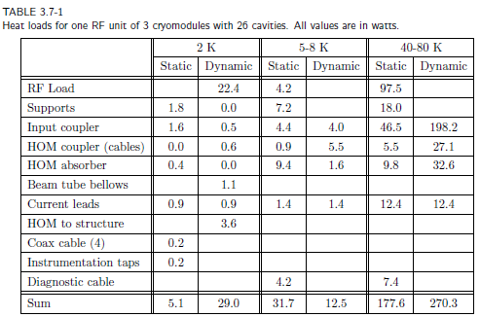
Estimate heat load to the cryomodule
Not accounted :
1 W/m beam effect
Qs_CWT
Cavity +MLI - 2 K
Qs_end
Qs_SP
Qs_MLI
Thermal Shield + MLI –5 K ?
Qs_SP
Qs_MLI
Thermal Shield +MLI – 50 K
Qdyn
Qs_Coupler
Qs_SP
Qs_MLI
Vacuum vessel – 300 K

Slide 7
What do we need (elements)
Complete ESS Cryogenic Design Baseline parameters: e.g. heat load distribution (Linac, target).
Define the conceptual of the cryomodules. Possible show stopper ? Preferred solution.
Define the technical specification for the cryo-plant, distribution lines (P,T), purification system, storage, etc..
Experimental measurement for static heat load on power couplers.
Define cryogenics – Architecture and study process to validate feasibility: e.g. # of HX.
Define flow schematics and cooling schemes: e.g. Cryomodule.
  Consider the different operation modes: and analyze types of intervention: e.g. cool-down, degraded vacuum, response time, Controls, Availability, Reliability. Redundant elements?

Slide 8
What do we need (elements)
Define standardization and design standards: e.g. bring together ESS, manufacturers: e.g. ASME, ISO.
Identify cryogenic instrumentation (diagnostic): e.g. PT, TT, RadHard.
Technical risk analysis to emphasize requested redundancy.
Define the control system, DAQ: e.g. Unicos.
Define the safety system: e.g. Interlock, safety equipment.
Define CM acceptable operational pressure stability, w/o over-constraint: e.g. 1 mbar ?
Identify tools to manage technical document: eg. CERN MTF, Equipment Management folder.
Et Tu Continues…

Slide 9
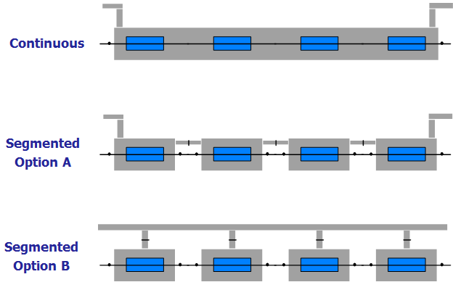
 | Segmentation-Cold Quad | Segmentation-Warm Quad | Continuous
Advantage | *Limit zones of warm-up and opening of vacuum system – cost & downtime. *Increased flexibility. *operational flexibility. *Reduce down-time. *More modular design. *Decoupling of problems. *Staged acceptance tests. *Minimize cold equipment – access, alignment, repairs, upgrades, unnecessary outgassing, leaks, etc. *Modules are complete & tested before installation. | *Limit zones of warm-up and opening of vacuum system – cost & downtime. *Increased flexibility. *operational flexibility. *Reduce down-time. *More modular design. *Decoupling of problems. *Staged acceptance tests. *Minimize cold equipment – access, alignment, repairs, upgrades, unnecessary outgassing, leaks, etc. *Modules are complete & tested before installation. *Classical “off-the shelf” warm magnets. *Easy alignment. *Maintainability/upgrade. *Cryo-module internal positioning requirements can ne relaxed. * Standard Diagnostics | * Compact longitudinal layout – fewer CWT, fewer RF contacts. * Helium transfer line can be integrated – less vac systems. *Less tasks for systematic repairs on modules – venting, repumping
Dis-advantage | *Diagnostic development in cold environment. *More cold to warm transitions, intermodules, more heat load. *More volumes to commission. *More equipment, more maintenance. *More risk of equipment failure. *More Interlocks. | *More cold to warm transitions, intermodules, more heat load. *More volumes to commission. *More equipment, more maintenance. *More risk of equipment failure. *More Interlocks. | *Cold Diagnostic Instrumentation *Cold BPM *Cavities need to be recommissioned if vented. *Equipment will see more thermal cycles. * Beam vacuum sectors long- cold sector valves don’t exist! * Some sensitive equipment is imprisoned in cryostat - needs vacuum compatibility and validation

Slide 10
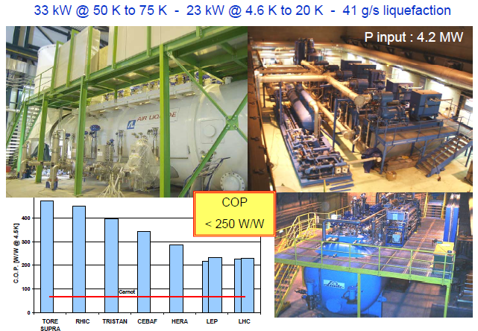
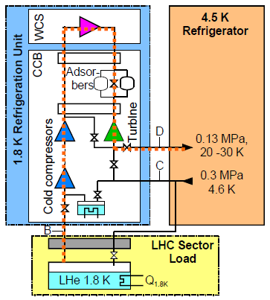
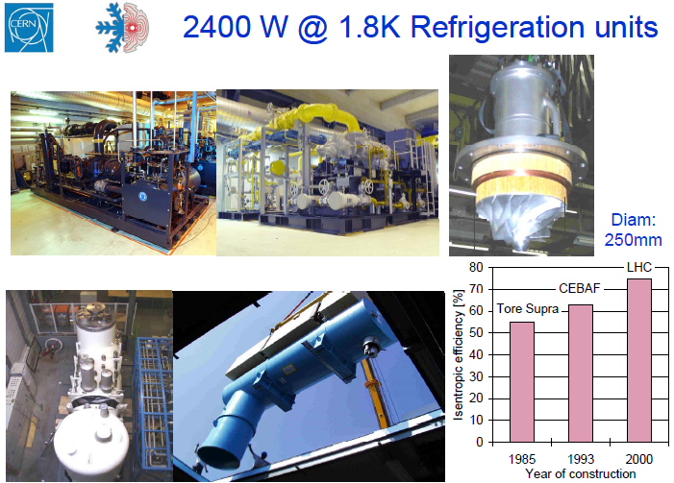
Example of CERN CryoPlant (S. Claudet)

Slide 11
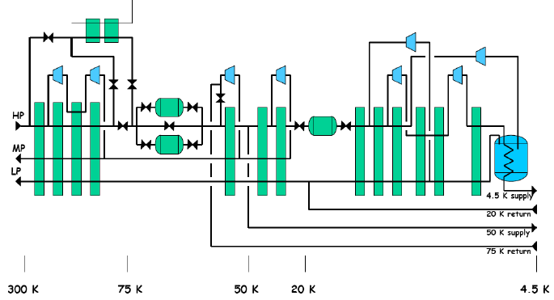
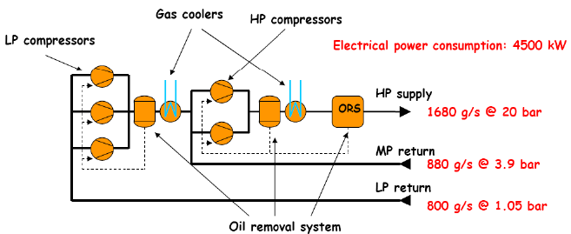
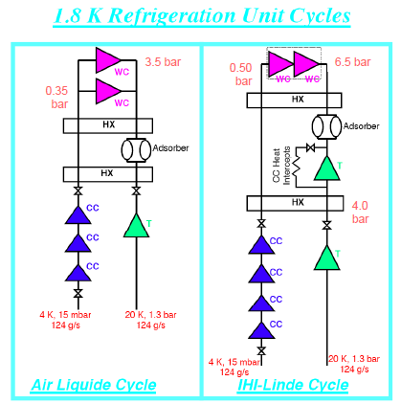
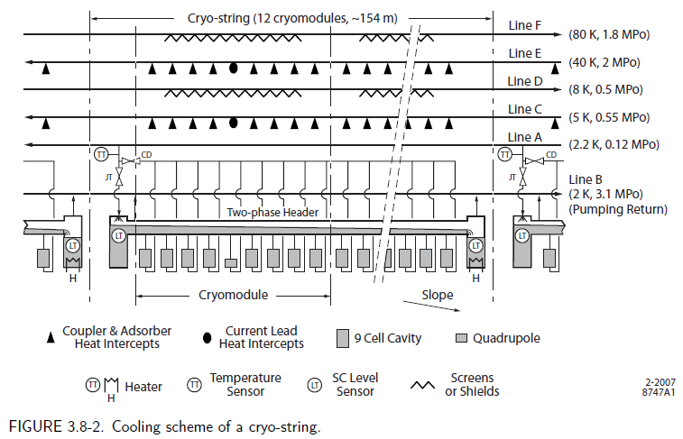
Example of cryo-plant and Flow schematic

Slide 12
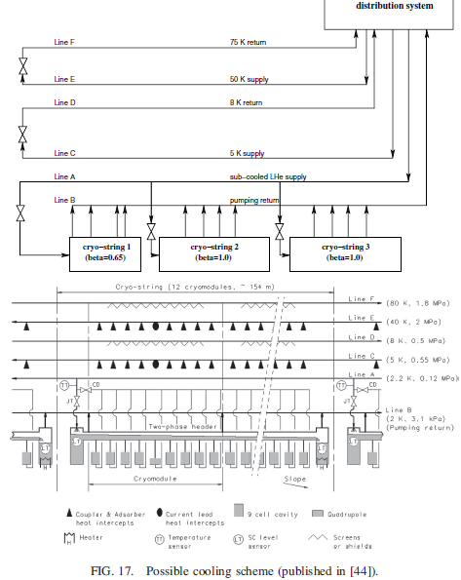
PHYSICAL REVIEW SPECIAL TOPICS - ACCELERATORS AND BEAMS
Assessment of the basic parameters of the CERN Superconducting
Proton Linac
12, 070402 (2009)

Slide 13
Cavity Supporting system
IPNO/Patxi
The concept
Intercavity supports
RF coupler double-walled tube flange fixed to vacuum vessel
The RF coupler (its double-walled tube) provides:
fixed point for each cavity (thermal contractions)
mechanical supporting of each cavity on the vacuum vessel
The intercavity support provides:
a 2nd vertical support to each cavity (limits vertical self-weight sag)
relative sliding between adjacent cavities along the beam axis
enhancement of the transverse stiffness to the string of cavity
(increases the eigenfrequencies of first modes)

Slide 14
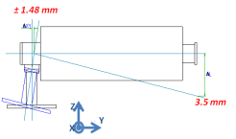
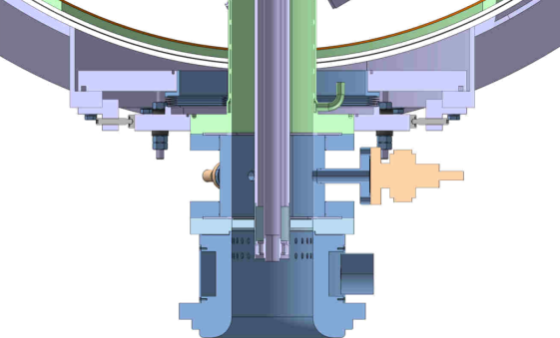
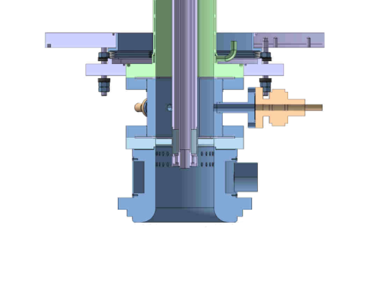
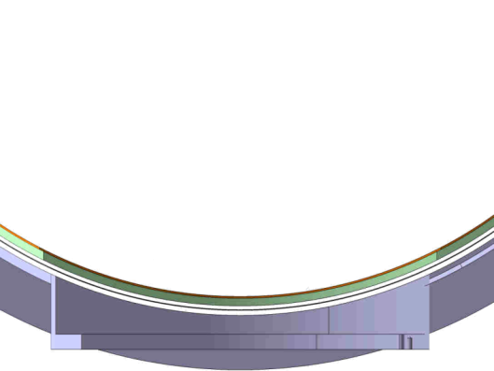
Cavity Supporting system
IPNO/Patxi
Coupler / Vacuum vessel interface
Interface → fixed point, compensation of the geometrical defaults {coupler + cavity}
Defined:
- Conceptual design
Detail designed
drawings + Technical notes
A mock-up is under construction by CERN
To be tested

Slide 15
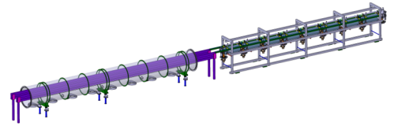
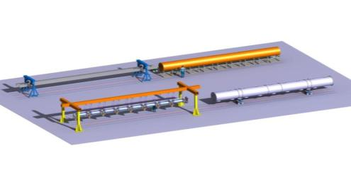
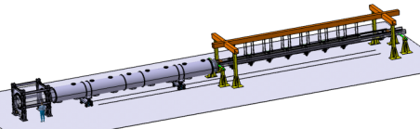
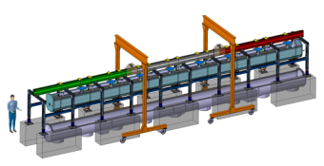
WP2.3 – Outillages de mise en cryostat
IPNO/Patxi
Reference beam path
and rolling frame
Horizontal cryostating Tooling Studies
  3 concepts were studied (8 cavities)
  Tooling design studies
  Assembly procedure studies
    dressing of the string of cavities
    alignment
    cryostating
  Tooling comparison (for long and short cryostats)
Rolling reference tool
Cantilever tooling
Vertical Cryostating Tooling Study
  1 concept was studied (8 cavities)
All tools were compared (for long and short cryomodule)

Slide 16
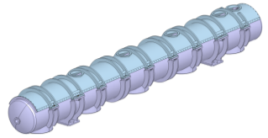
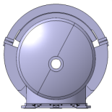
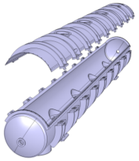
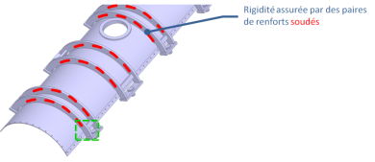
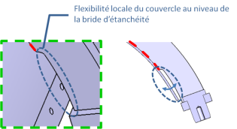
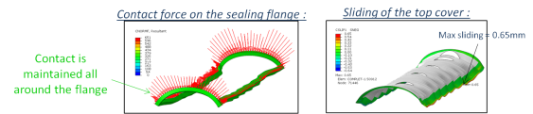
Vacuum vessel design
IPNO/Patxi
Retained concept
Main dimensions
1054
Cylindrical vacuum vessel with long top aperture
7400
1021
Aperture concept
e=6mm
e=10mm
Aperture sealing
Prototype (short cryomodule) : polymer seal placed in a groove / welding
Machine cryomodule (long) : welding

Slide 17
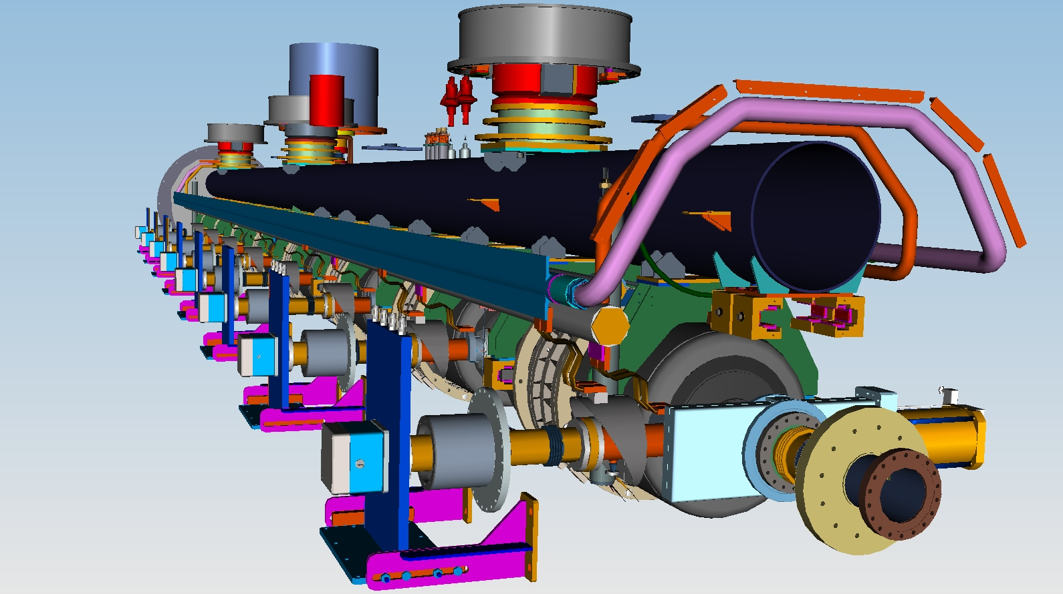
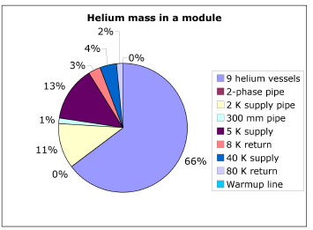
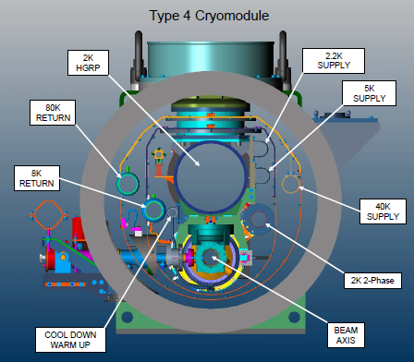
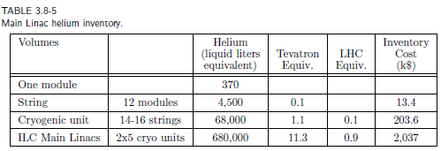
FNAL/Tom

Slide 18
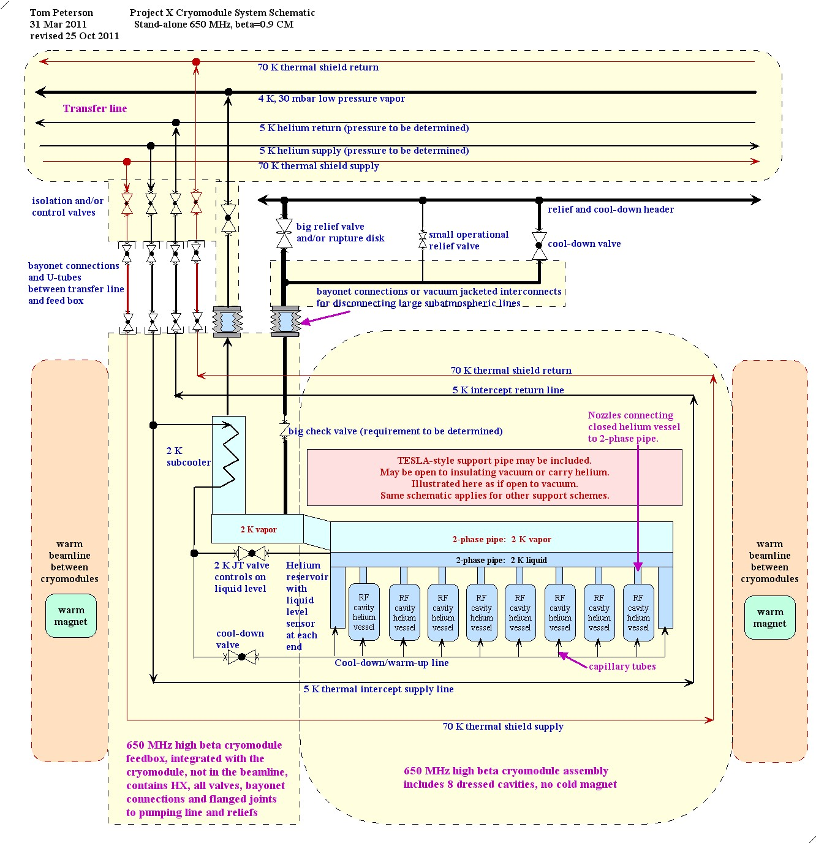
FNAL/Tom

Slide 19
Summary from cryomodule requirements document
FNAL/Tom
1.1 The baseline design concept includes cryomodules closed at each end, individual insulating vacuums, with warm beam pipe and magnets in between cryomodules such that individual cryomodules can be warmed up and removed while adjacent cryomodules are cold.
1.2 Provide the required insulating and beam vacuum reliably
1.3 Minimize cavity vibration and coupling of external sources to cavities
1.4 Provide good cavity alignment (<0.5 mm)
1.5 Allow removal of up to 250 W at 2 K per cryomodule
1.6 Protect the helium and vacuum spaces including the RF cavity from exceeding allowable pressures.
1.7 Intercept significant heat loads at intermediate temperatures above 2.0 K to the extent possible in full CW operation
1.8 Provide high reliability in all aspects of the cryomodule (vacuum, alignment stability, mechanics, instrumentation) including after thermal cycles
1.9 Provide excellent magnetic shielding for high Q0
1.10 Minimize cost (construction and operational)
Page 19

Slide 20
Summary and Road Map for the Cryogenics activities
Several milestones to consolidate over the coming year.
Define the requirements based on moving “target”.
Reliability and Flexibility are Key-Words
Finally and hopefully : YES WE CAN !!

