Slide 1
Radio Frequency Systems
Stephen Molloy
RF Group
ESS Accelerator Division
AD Retreat
05-December-2011

Slide 2
Overview
RF system outline
    What are our responsibilities?
RF system concepts
  Lumped element models
  Forward/reflected power
  Matching to cavity & beam parameters
CDR/TDR
  Task breakdown & organisation

Slide 3
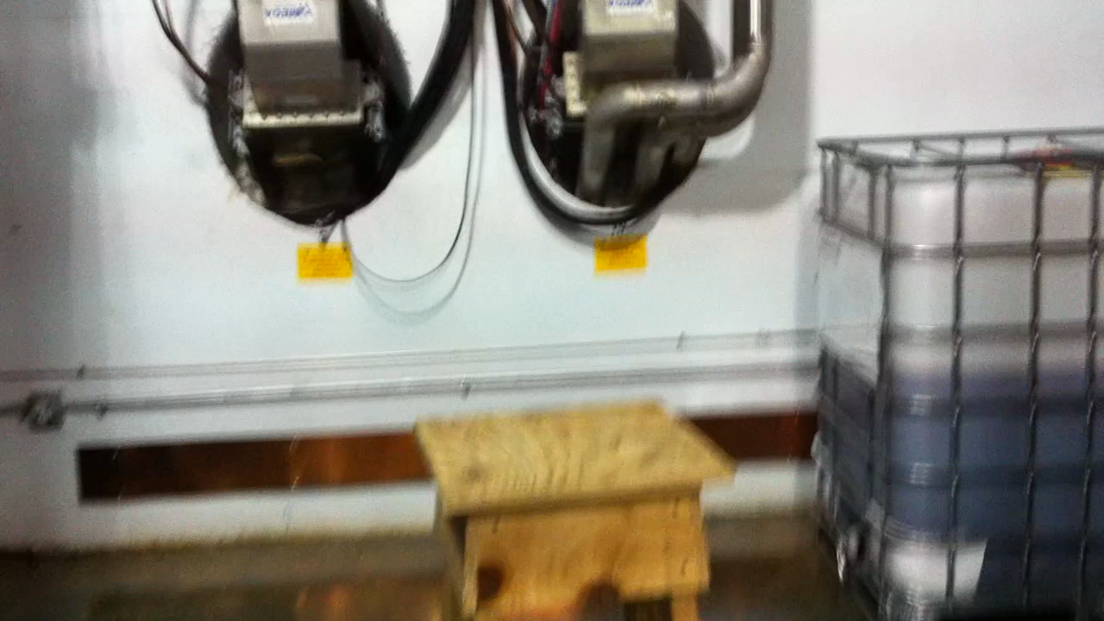
RF System Definition

Slide 4
“Wall-plug to coupler”
Generation
    HV supplies, low-level RF, & high power amplifiers
Distribution
    Amplifiers → cavities
    Waveguide, cooling, protection, monitoring, …
Control
    Amplitude & phase control of accelerating field
    Low-level RF
Stabilisation
    Long range timing/phase control

Slide 5
RF System concepts
(Much of this is borrowed from the phd thesis of Thomas Schilcher, Hamburg, 1998)

Slide 6
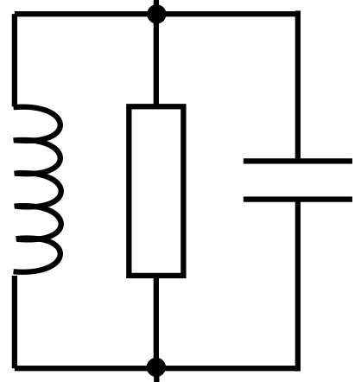
Lumped elements: RF cavity
Parallel LCR circuit. L & C depend on geometry. R depends on material.
Resonant with a certain quality factor, Q₀.

Slide 7
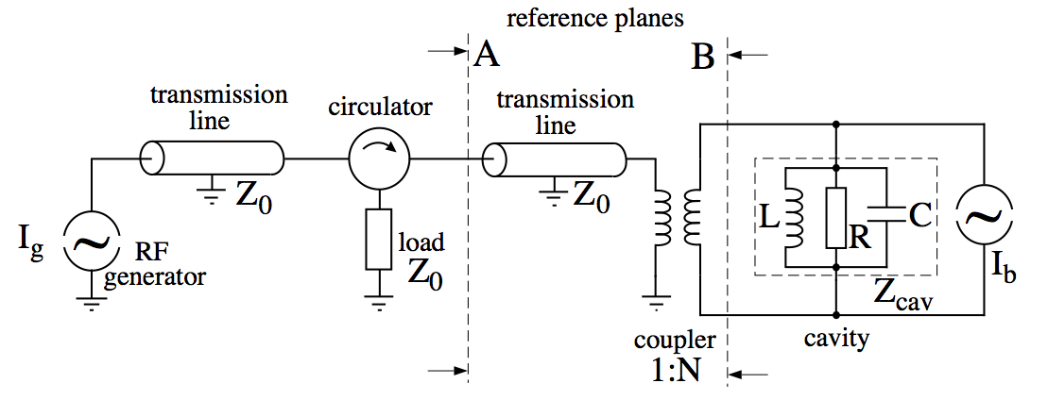
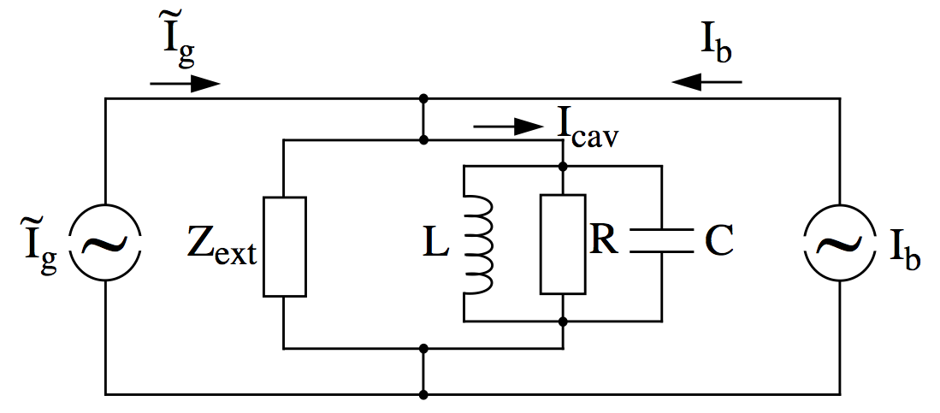
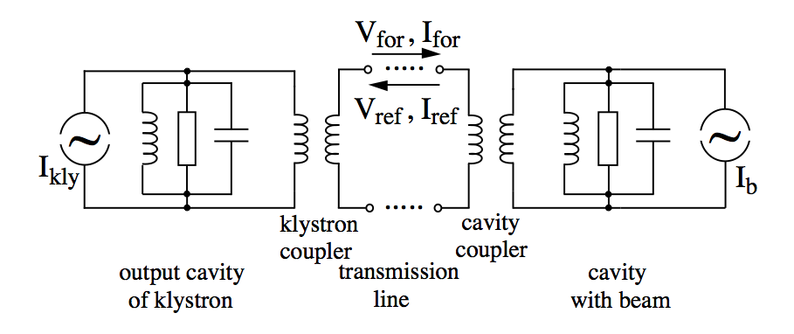
Lumped elements: RF system
Generator current after transformation by the coupler
Transmission line impedance seen from “the other side” of the transformer.
Note it is in parallel with the cavity resistance, R.

Slide 8
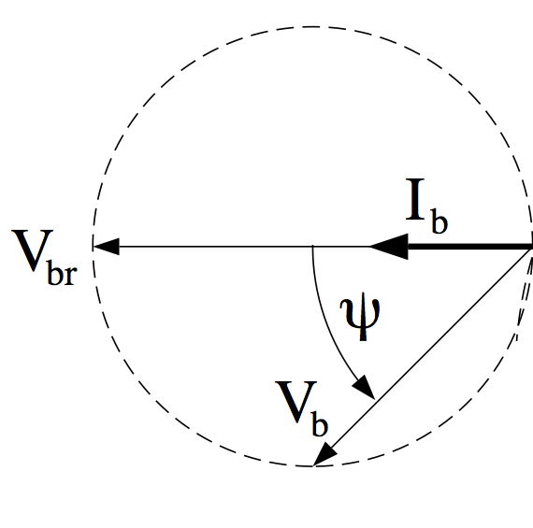
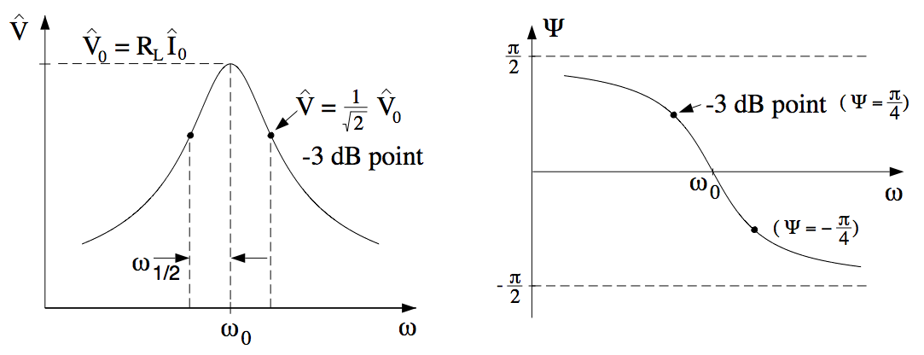
Ohm’s Law for resonant cavities

Slide 9
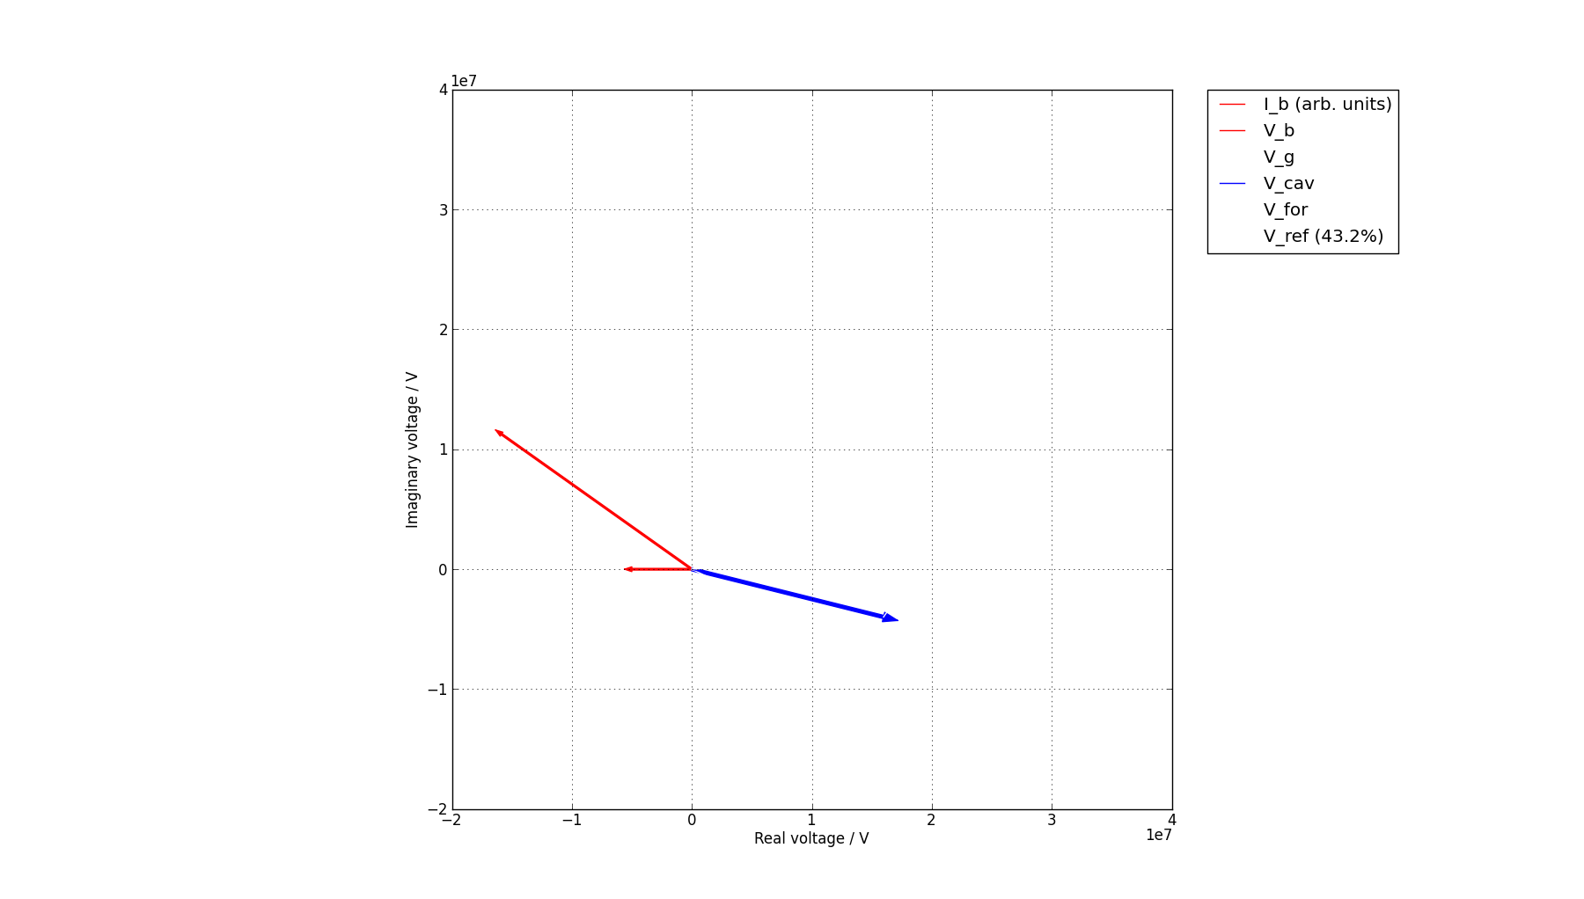
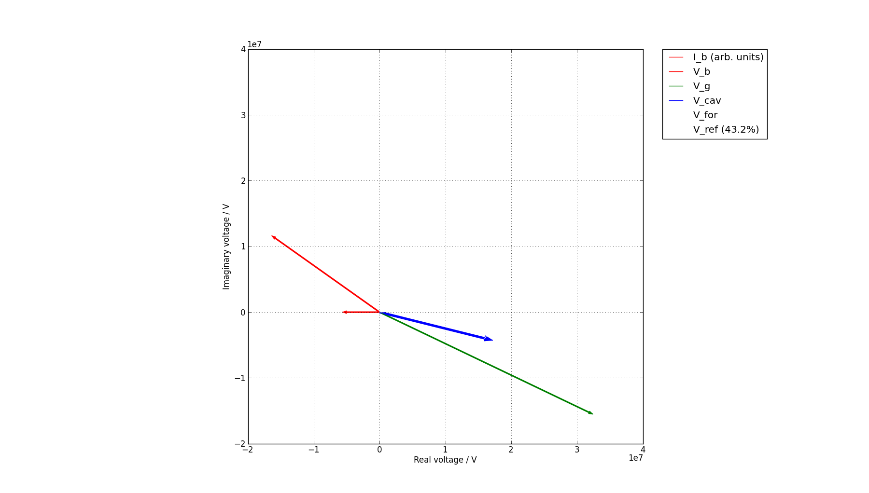
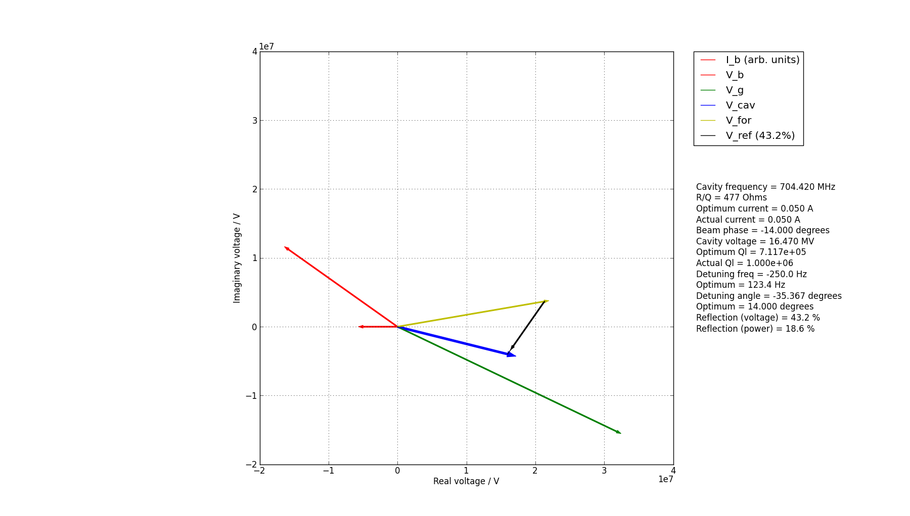
Vectors
In reality, V_{g} is excited by the forward voltage from the source, V_{for}. These differ in phase due to the cavity detuning.
The difference between V_{cav} and V_{for} is the reflected voltage, V_{ref}.
V_{b} rotated from I_{b} due to “Ohm’s Law”. (Negative rotation due to cavity settings.)
Generator excited voltage (that the cavity *would* achieve without beam), Vg. Note V_{g}+V_{b}=V_{cav}.
Desired Vcav. Rotation angle is synchronous phase, set by beam dynamics.

Slide 10
Forward & reflected SCRF: Nominal

Slide 11
Forward & reflected SCRF:
50% beam current
>10% of input power is reflected

Slide 12
Forward & reflected SCRF:
200% beam current
~5% of input power is reflected

Slide 13
CDR/tdr: organisation
(may have changed since I wrote this last night. Your mileage may vary. contains products known to the state of California to cause cancer. For external use only. May contain nuts. Not suitable for small children. Known to cause irritation to laboratory rats. May contain small parts.)

Slide 14
Requirements
8.2
RF System Design
8.10
RF Power Upgrade
Specifications
Requirements
8.4
Master Oscillator
8.3
Low Level RF
8.5
Phase Reference
Specifications
8.1
Coordination
Vendors
Vendors
Vendors
Requirements
8.7
Modulators
8.6
Power Sources
8.8
Distribution
Specifications
Vendors
Vendors
Vendors
Requirements
8.9
RF Gallery
Specifications

Slide 15
Thank you

