Slide 1
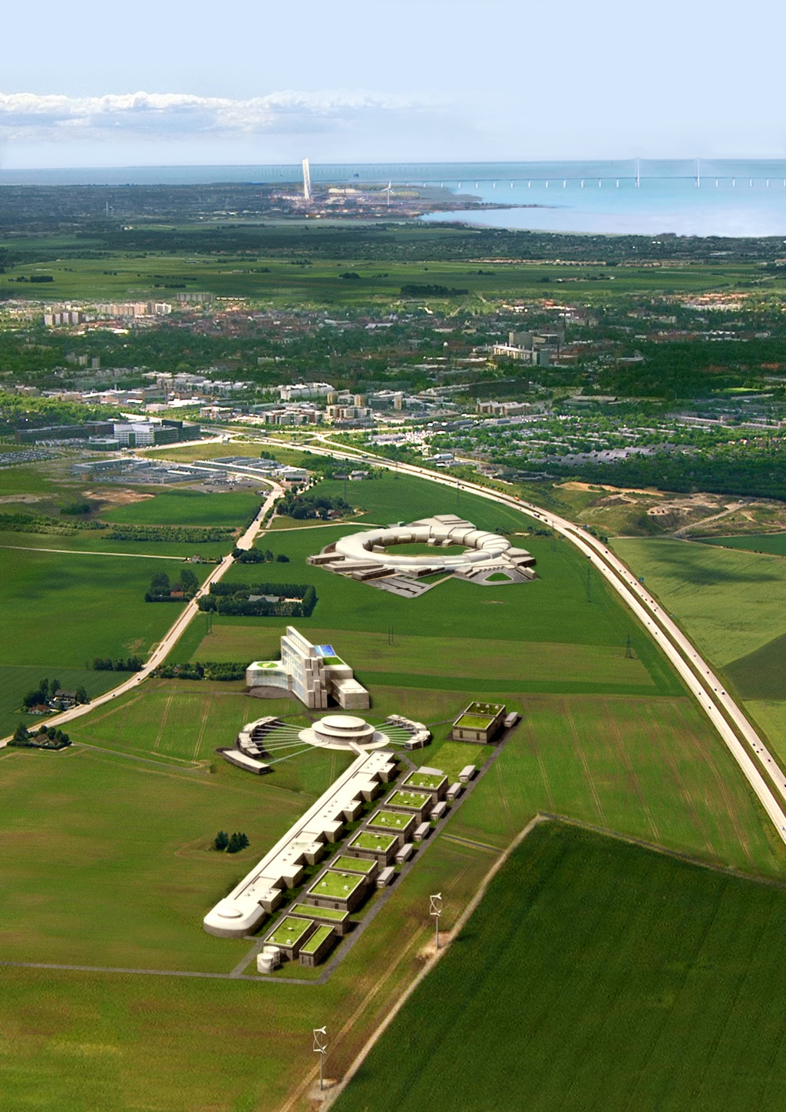
ESS
Control System
Miha Reščič, ESS / Cosylab
AD Retreat, 2011-12-05, Lund, Sweden

Slide 3
Outline
The ESS Control System
Recent developments
Summary

Slide 4
Control System
A control system is a device, or set of devices to manage, command, direct or regulate the behavior of other devices or systems.
Source: Wikipedia

Slide 5
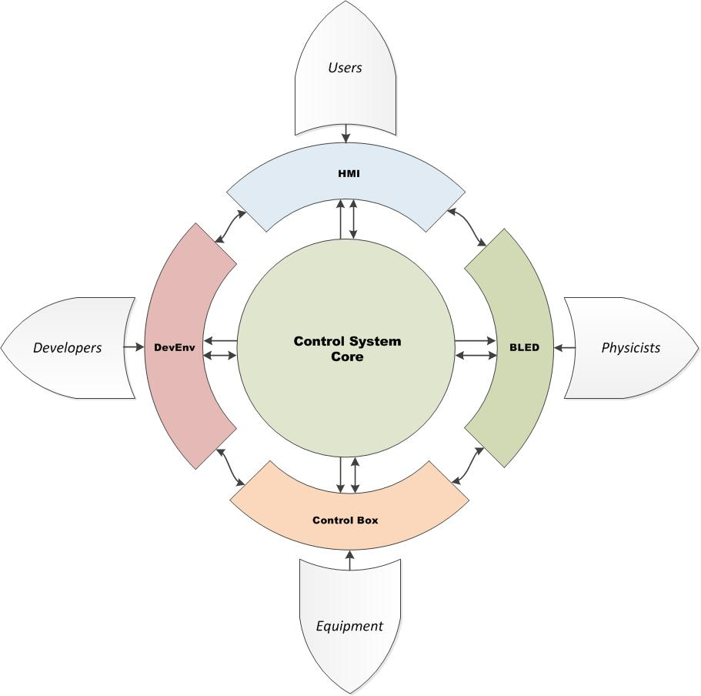
The ESS Control System

Slide 6
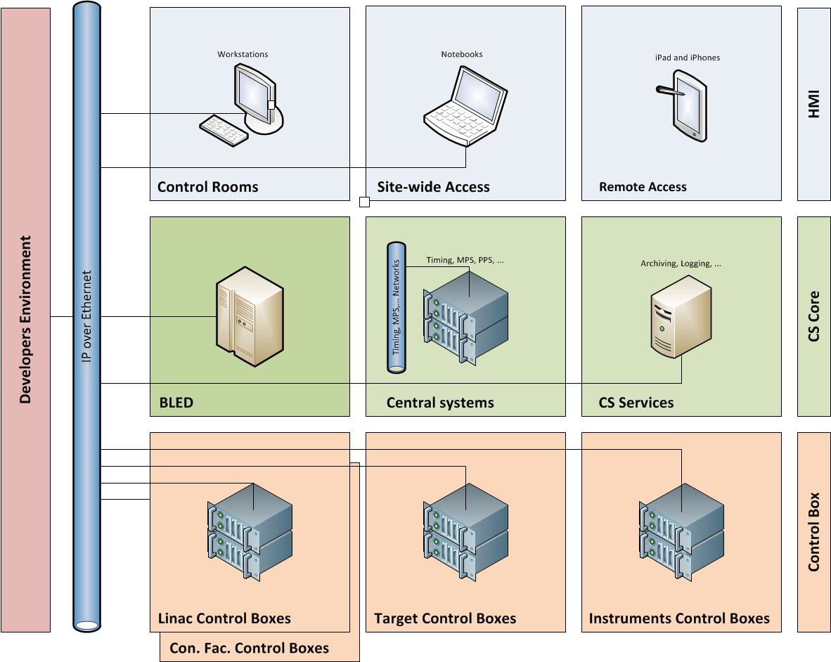
The ESS Control System

Slide 7
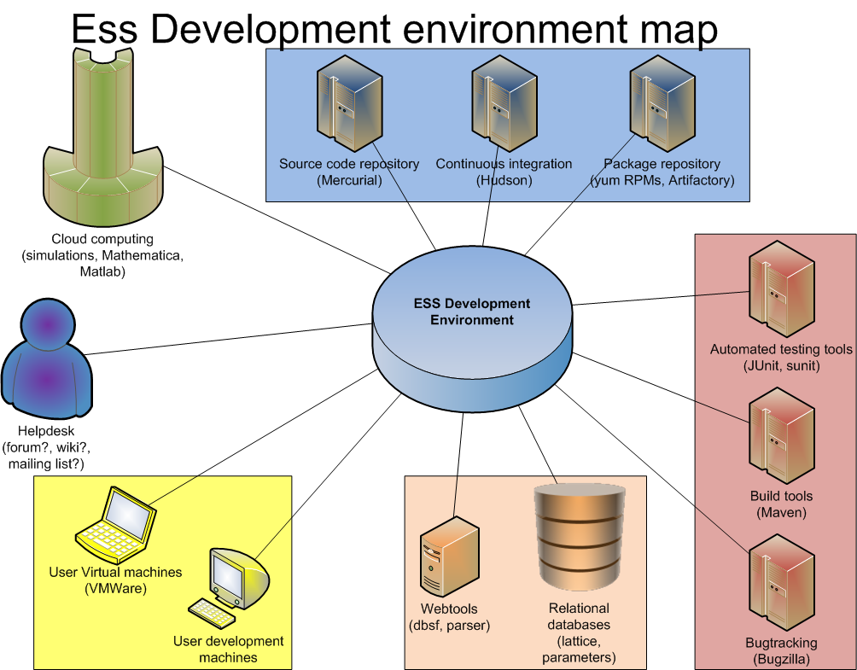
Recent developments - DevEnv

Slide 8
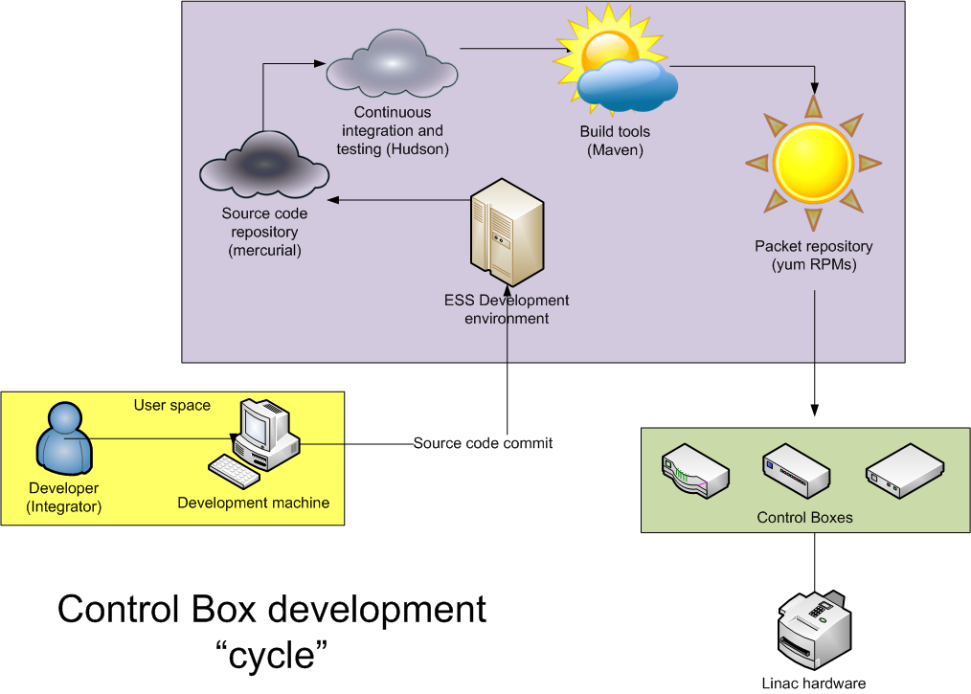
Recent developments – DevEnv

Slide 9
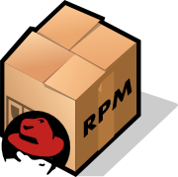
Recent developments - DevEnv

Slide 10
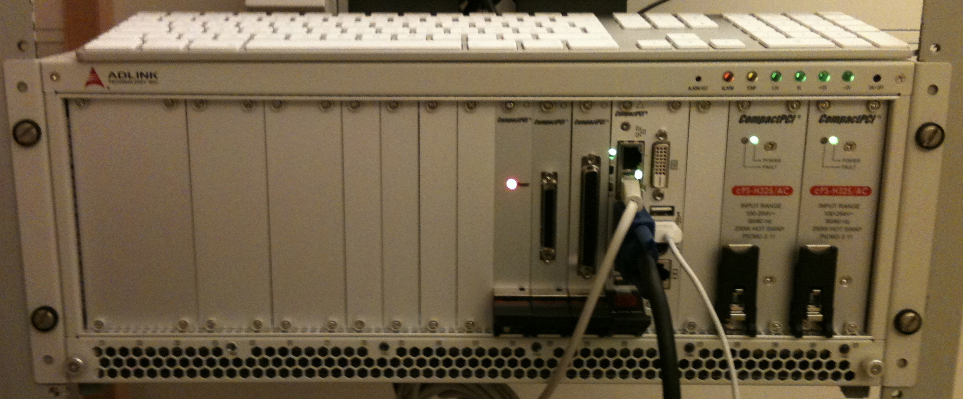
Recent Developments - Core & CB
Control, Data Access and Communication – CODAC (3.0b1)

Slide 11
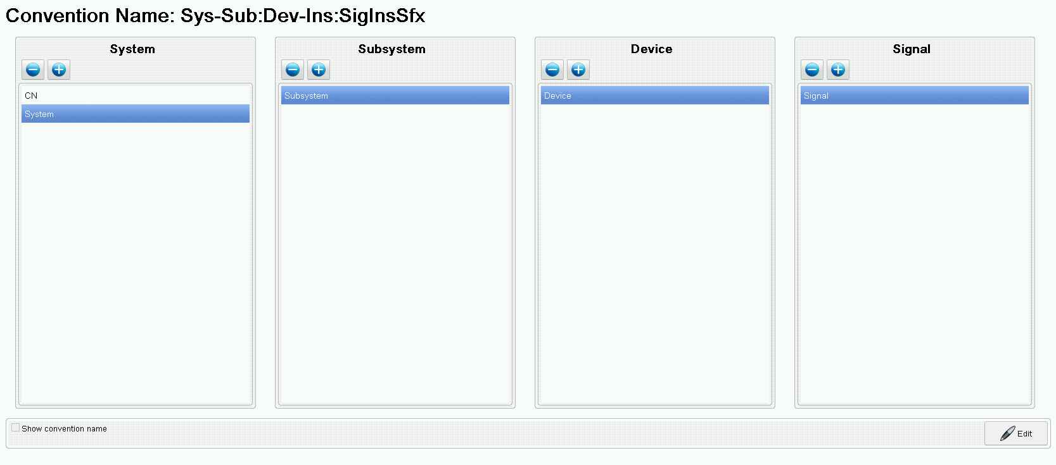
Recent Developments – BLED
Naming Convention Tool

Slide 12
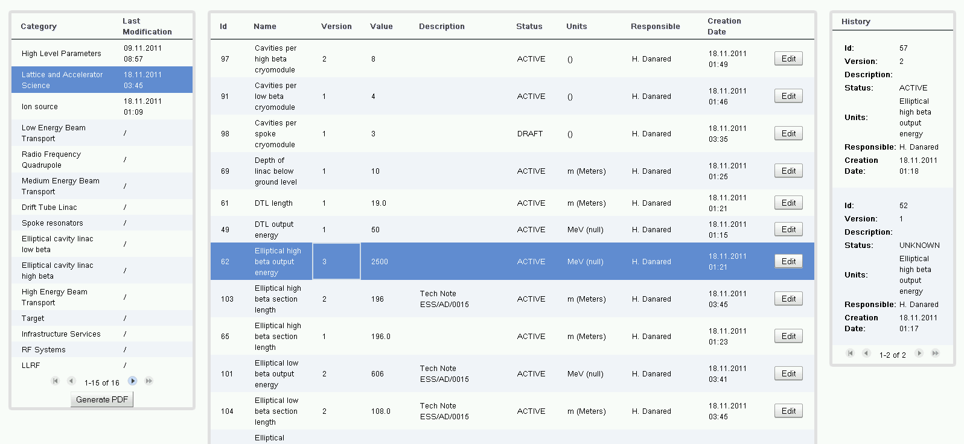
Recent Developments – BLED
Parameters Editor

Slide 13
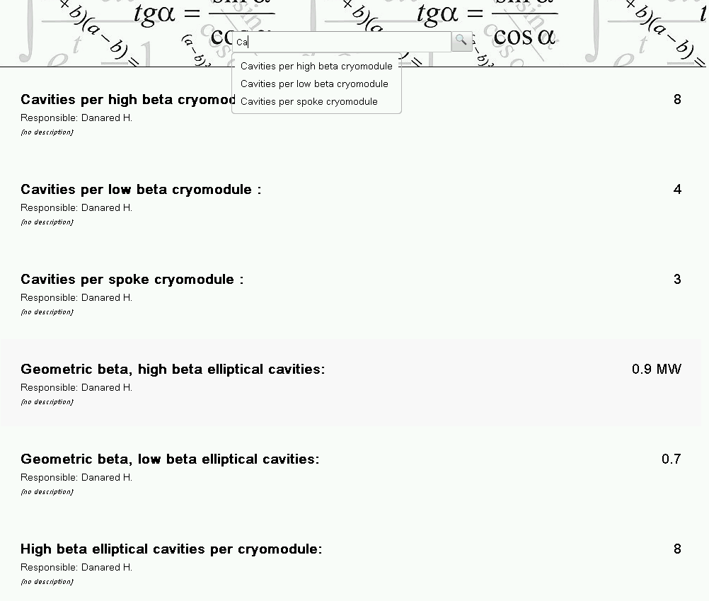
Recent Developments – BLED
Parameters Viewer

Slide 14
Summary
Fundamental tools and services put in place
Making small steps towards the best solution
Emphasizing inter-dependency
Enforcing early “integration”

Slide 15
Thank you!

