Slide 1





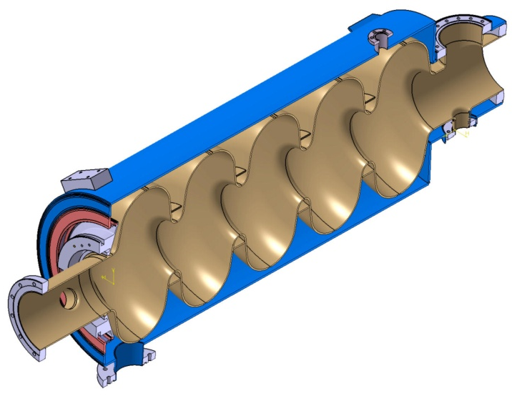
Elliptical
AD retreat Lund 12/05/2012
G.Devanz CEA-Saclay

Slide 2


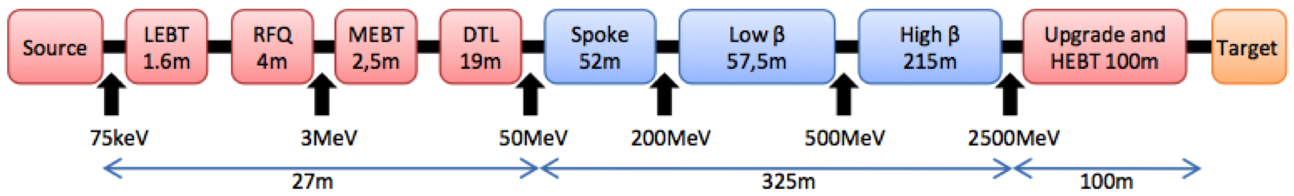

Elliptical superconducting cavities
5-cell cavities, bulk niobium
two beta families
frequency = 704.42 MHz
operating temperature 2K
gradient specifications :
Peak field specifications : Epk < 40 MV/m
beta | Eacc VT (MV/m) | Eacc Linac (MV/m)
0.65 | 17 | 15
0.86 | 20 | 18
page

Slide 3
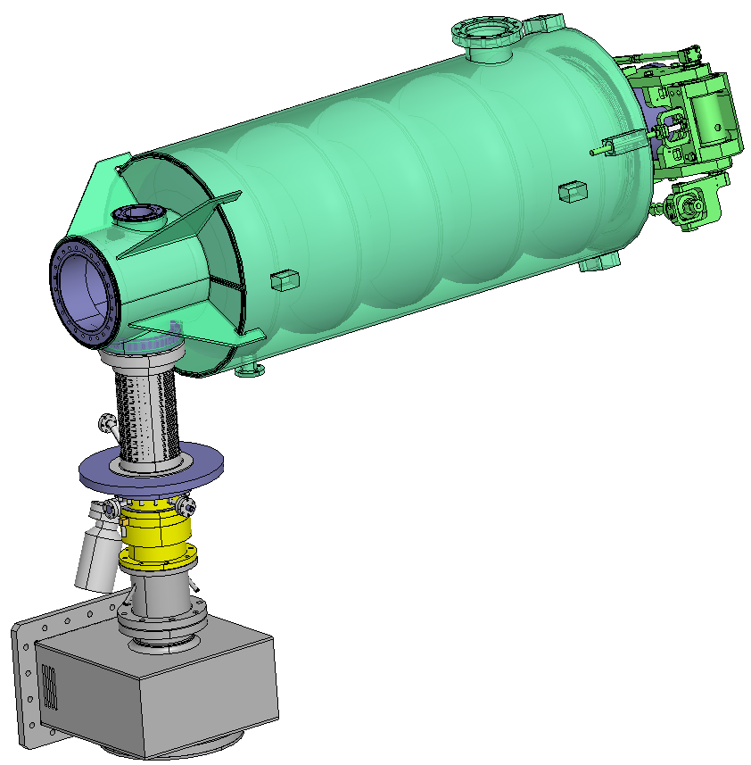
Elliptical cavities cryomodules
Cryomodule options:
Hybrid
Segmented
Comparison of static losses has started, first indications is that a segmented design could competitive on this parameter (might also be shorter!)
Cavity string building block : fully dressed cavity
page

Slide 4
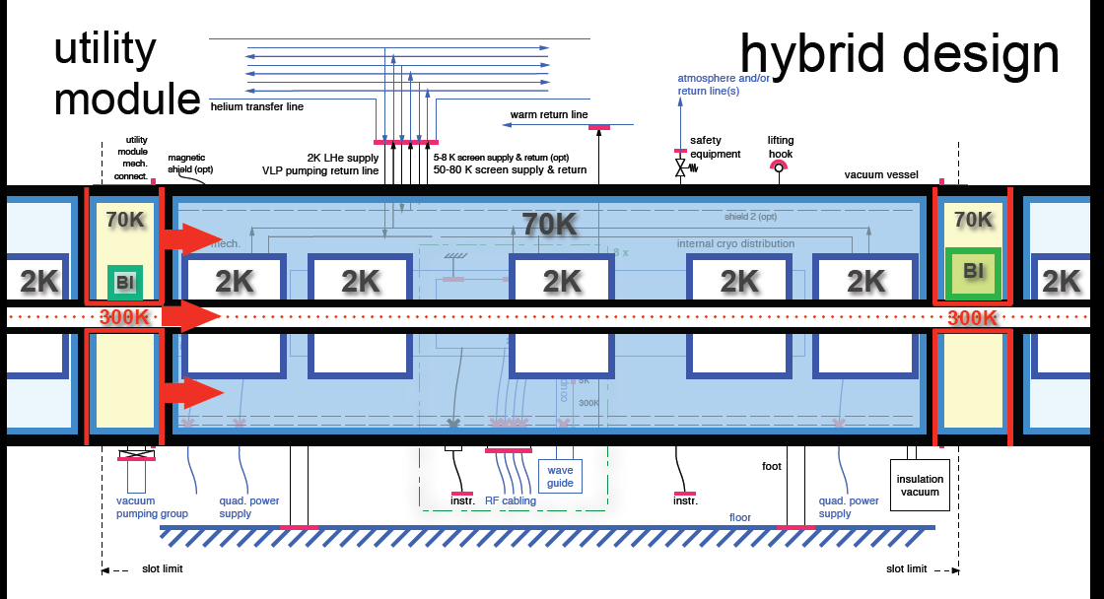
From W. Hees
page

Slide 5
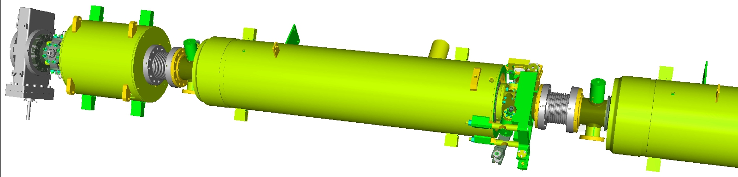
Elliptical cavities cryomodules
XFEL string layout example, With SC Quads
QUAD
Lmag 166 mm
physical length 300 mm
VALVE
CAVITY
COLD BPM
BELLOW
10 convolutions
100 long
78 mm diameter
BELLOW
page

Slide 6
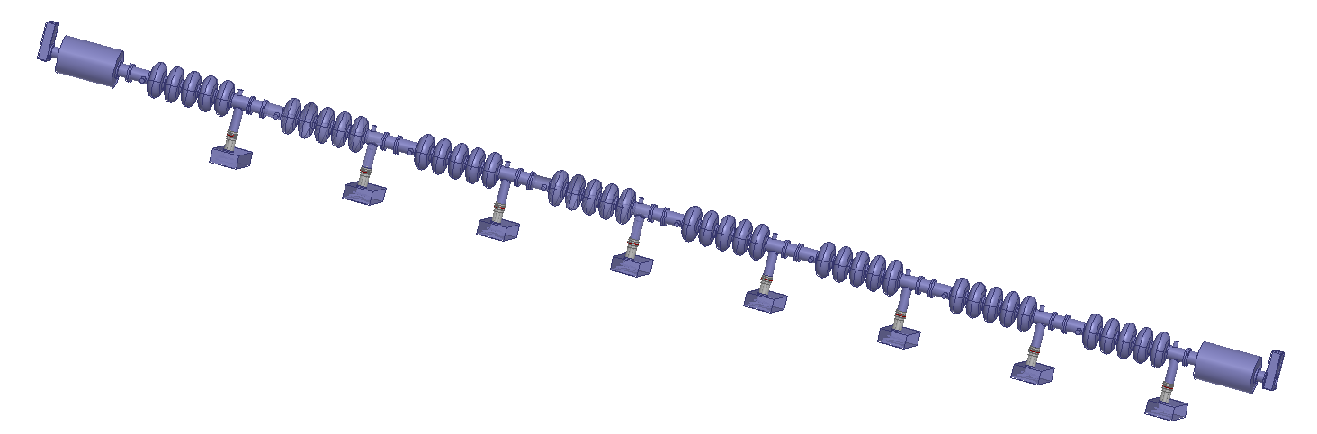
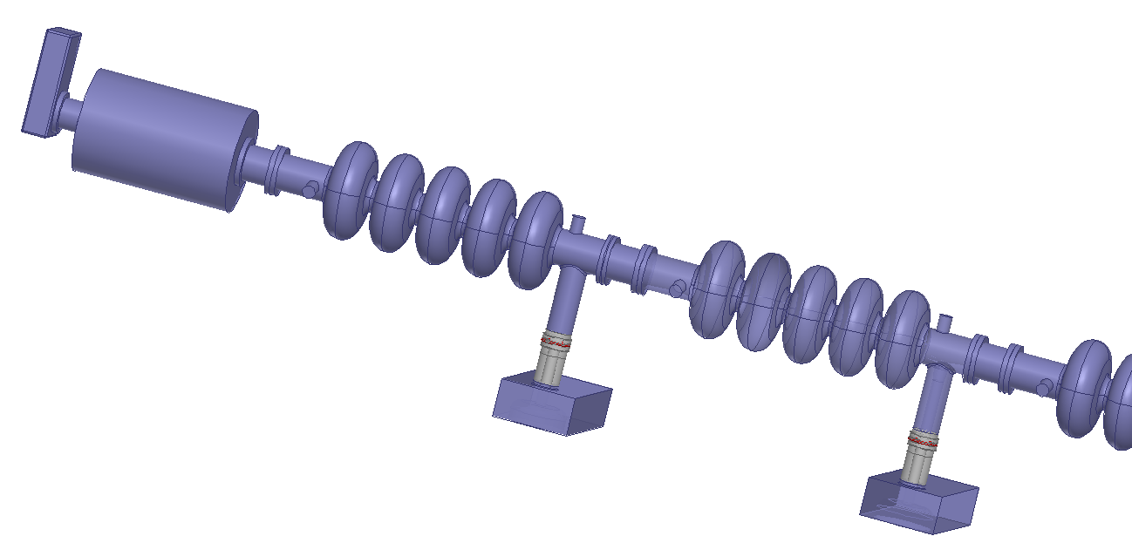
Elliptical cavities cryomodules
8 cavities with 2 sc quads
page

Slide 7
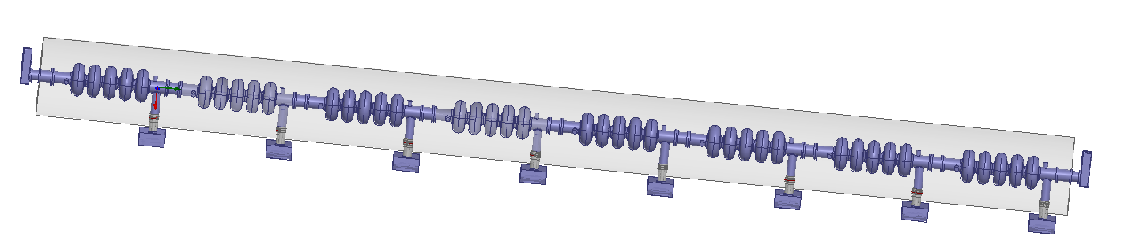
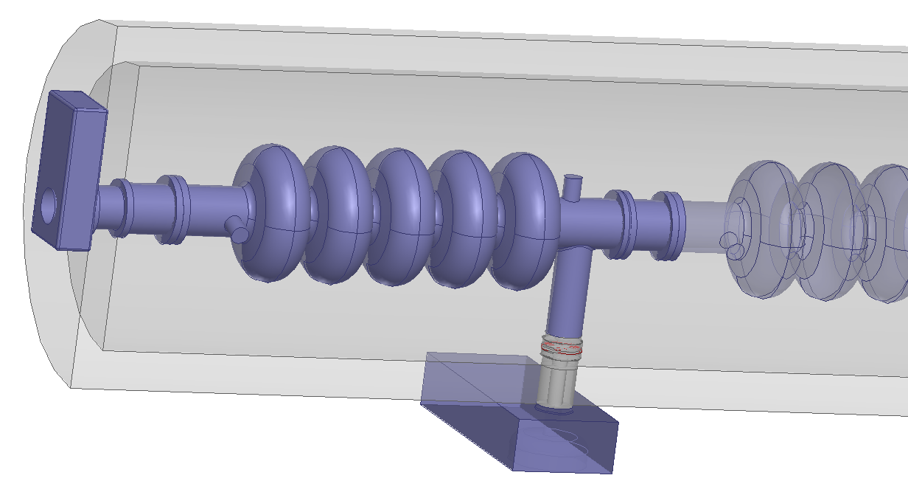
Elliptical cavities cryomodules
8 cavities segmented scheme, room temperature quads
page

Slide 8
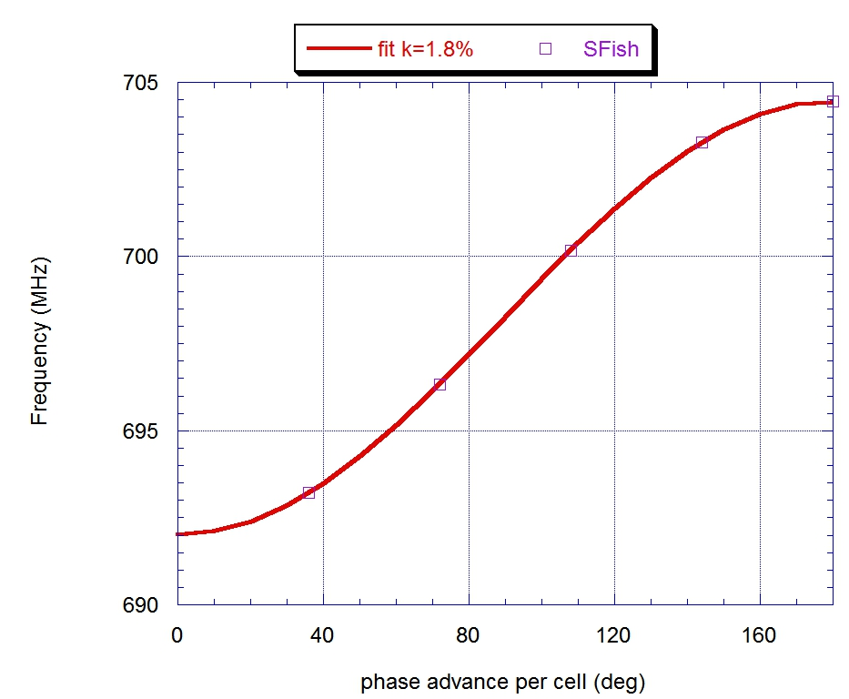
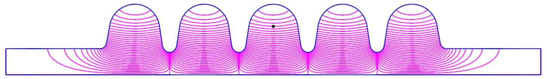
RF design
Advantages of high cell to cell coupling for TM₀₁:
easier to obtain field flatness, control over peak fields distribution among cells
more consistent Qext across cavities
enhanced mode separation between π and 4π/5 modes
HOM also better coupled to the outer cells (needed for damping)
β g=0.86 |  | unit
Frequency | 704.42 | MHz
Nr of cells | 5 (sym.)
Cell to cell coupling | 1.8 | %
π and 4π/5 mode separation | 1.2 | MHz
Epk/Eacc | 2.2
Bpk/Eacc | 4.3 | mT/(MV/m)
Max. r/Q | 477 @ β=0.92 | Ω
G | 241 | Ω
Low field Qo | 3e10
Qo at nominal Eacc | 6e9

Slide 9
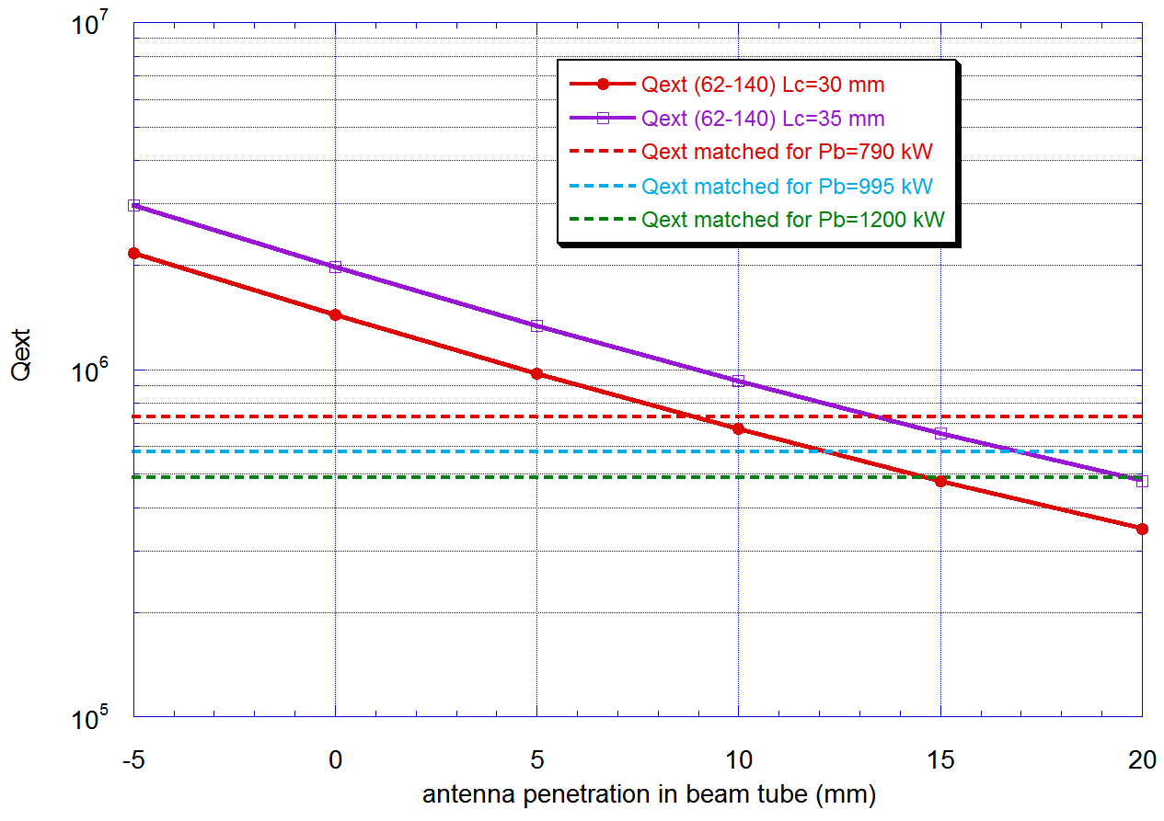
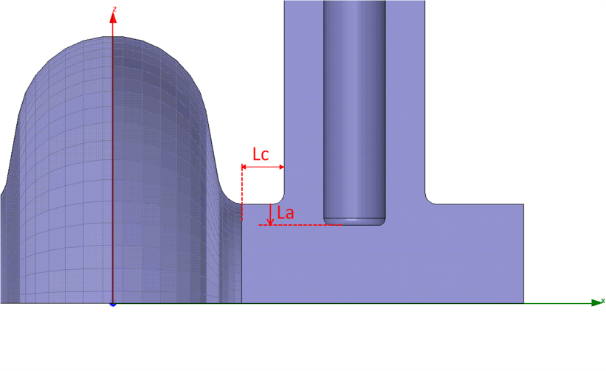

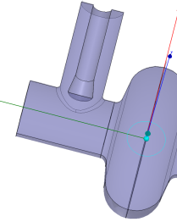
RF design – End groups and Qext
Lc could be reduced to 30 mm (Ti vessel option)
Using a conical tip decreases Qext by ̴̴15% for a given antena penetration
140 mm tube, flat antenna tip w/ fillet
 | Cut-off frequencies (GHz)
Diameter (mm) | TE11 | TM01 | TE21 | TM11 | TE01 | TE31 | TM21
130 | 1.3535 | 1.7683 | 2.2405 | 2.8143 | 2.8143 | 3.0769 | 3.7831
140 | 1.2568 | 1.6420 | 2.0804 | 2.6132 | 2.6132 | 2.8571 | 3.5129
page

Slide 10
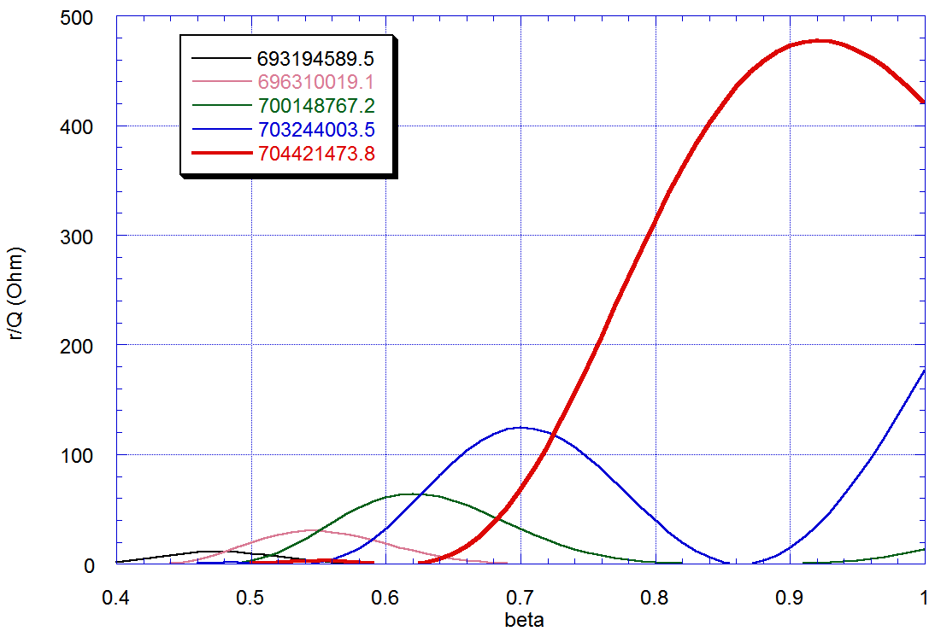
Fundamental passband modes
page

Slide 11
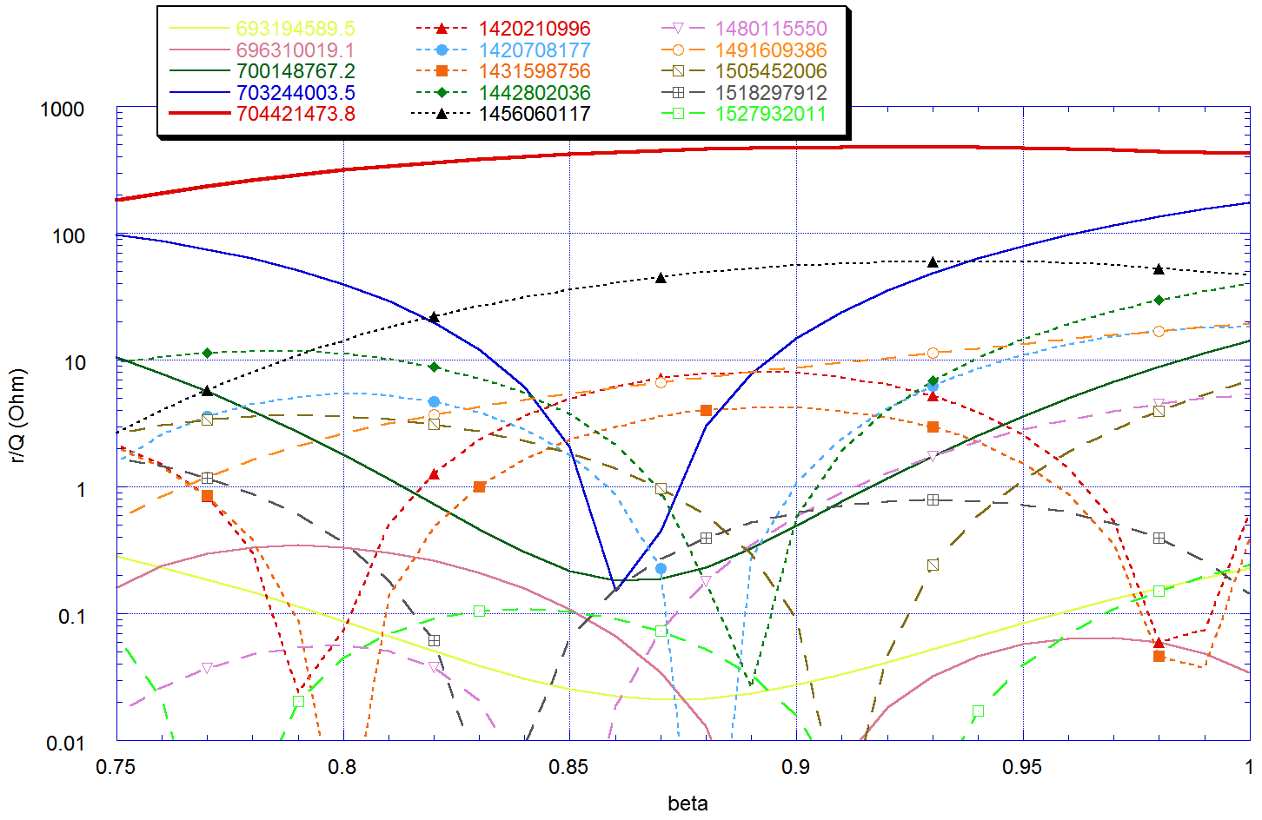
HOM - monopoles
Monopole HOM for the 5-cell below cutoff
+TE passband 1454-1476 MHz
page

Slide 12
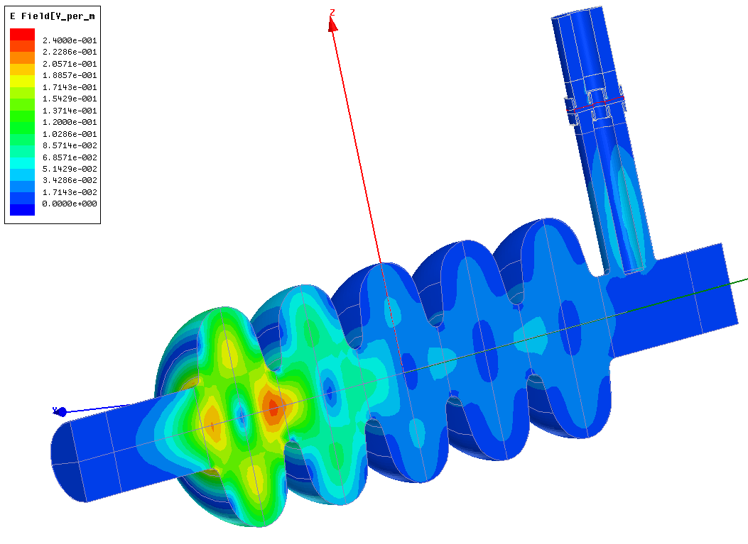
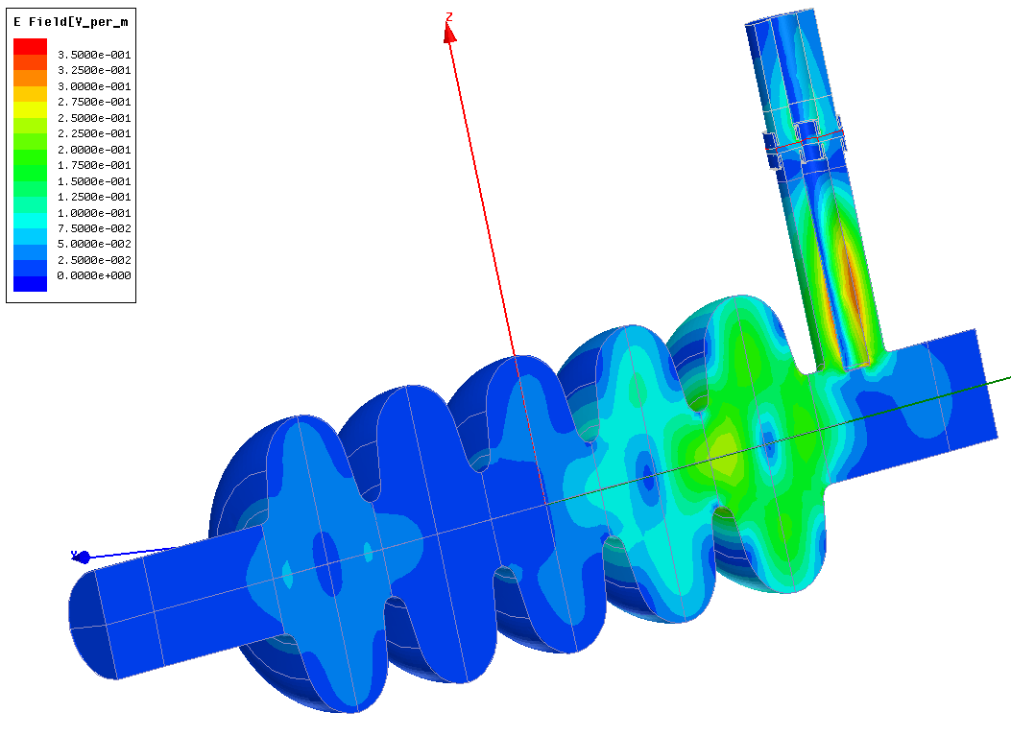
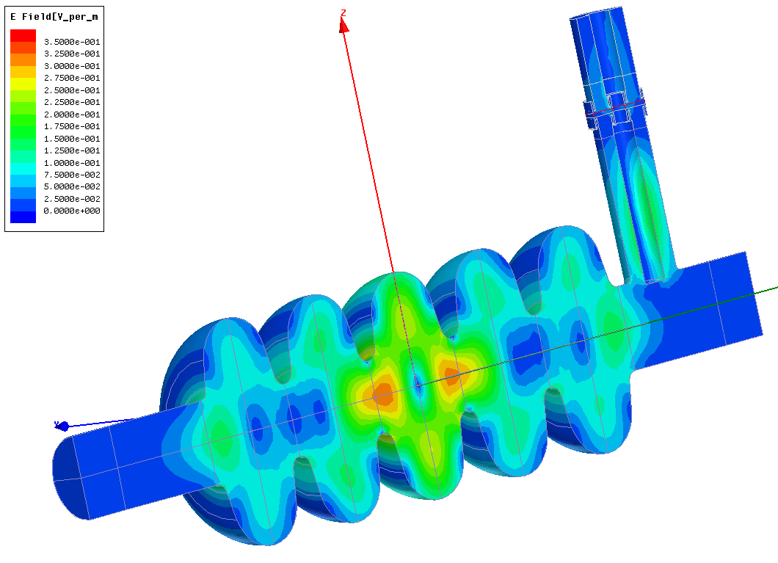
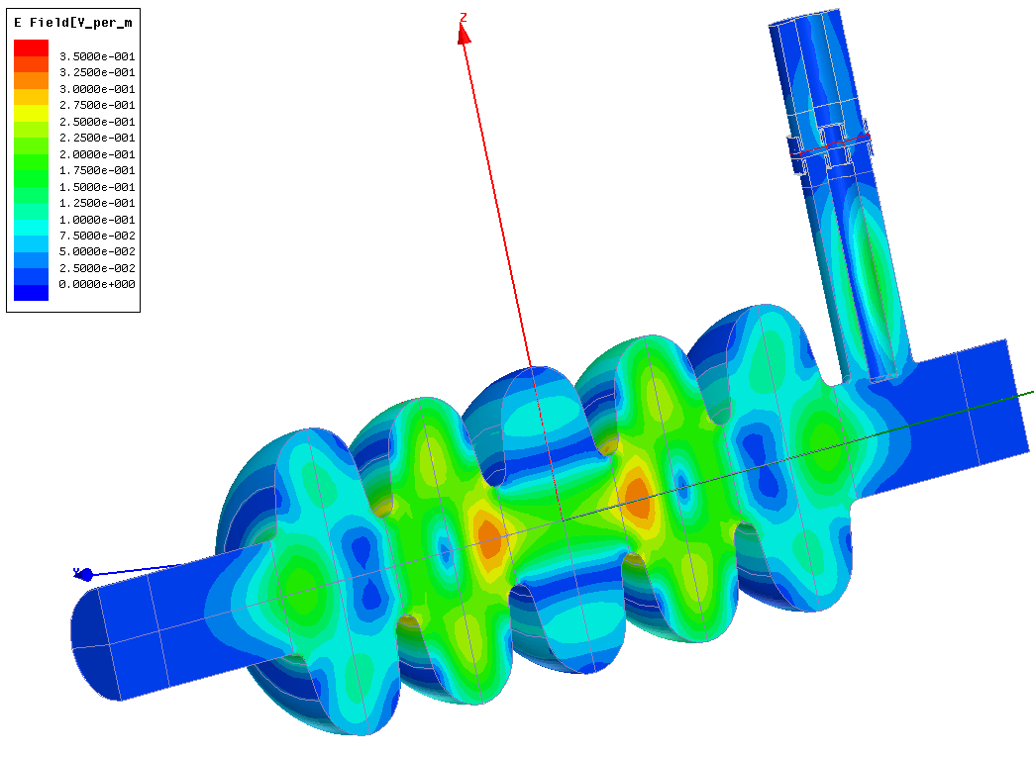
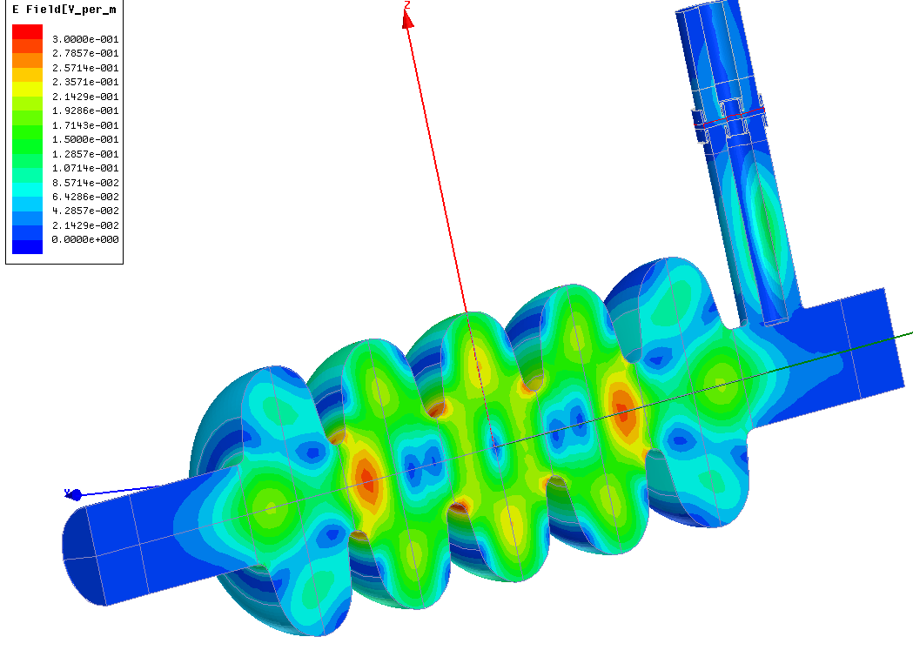
First monopolar HOM band
Freq Q Max. r/Q
1,420314E+09 1,58E+05 8
1,421856E+09 4,30E+03 17
1,431672E+09 3,22E+04 4
1,442845E+09 3,30E+04 29
1,456038E+09 4,41E+04 60
RF window included
Copper losses from
- power coupler
inter-cavity bellows
BUT OPTIMISTIC (matched termination)
Simulations including the doorknob and waveguide confirm the Qext is below 5e7 for all non-propagating non TE monopole modes
page

Slide 13
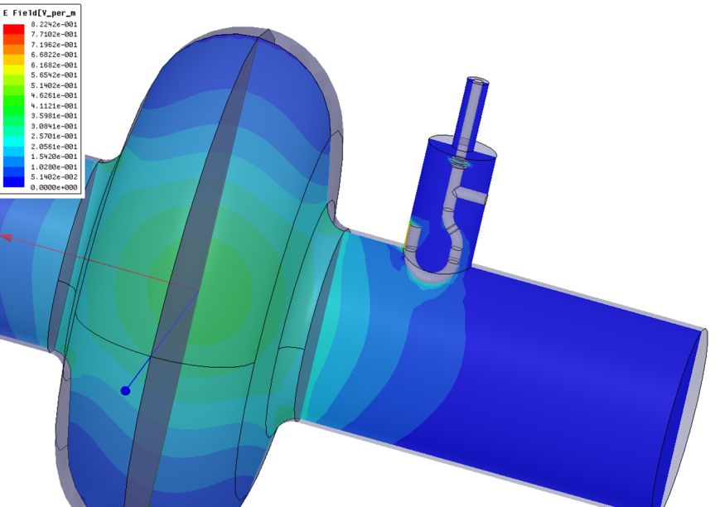
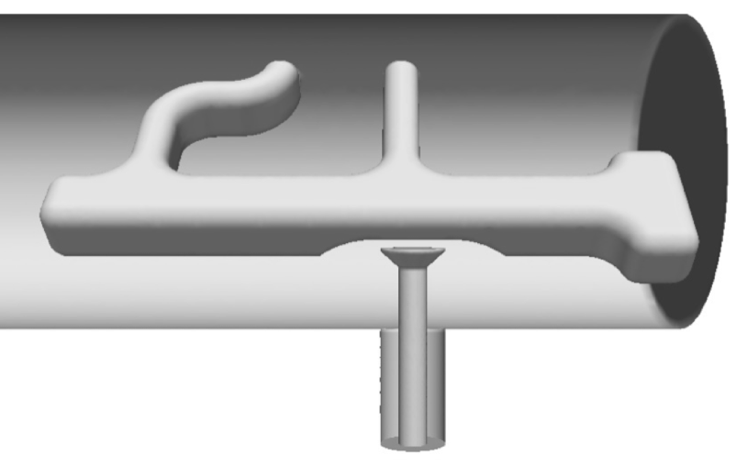
HOM damping
Freq Q Max. r/Q
1,480140E+09 1,98E+04 5
1,491491E+09 1,33E+04 17
1,505236E+09 1,40E+04 4
1,518154E+09 1,87E+04 4
1,527895E+09 4,57E+04 0,2
RF window included
Copper losses from
- power coupler
- inter-cavity bellows
page

Slide 14
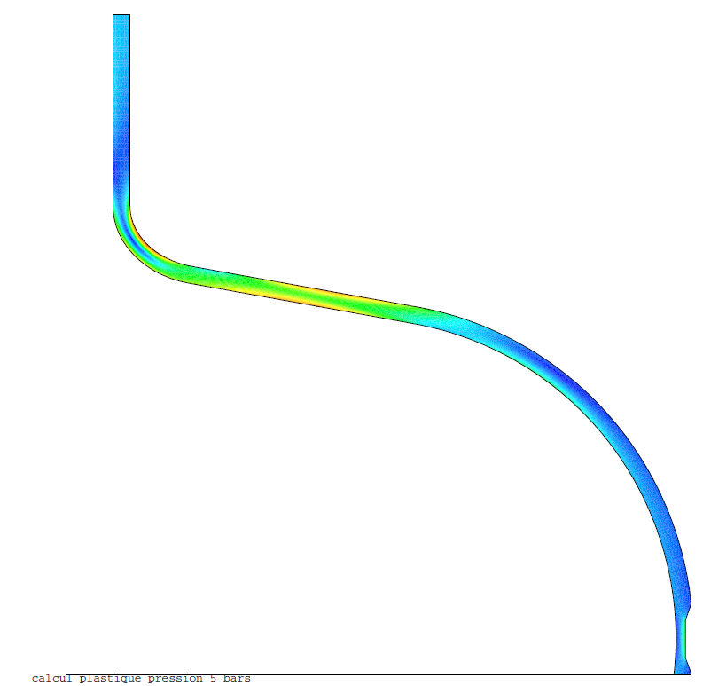
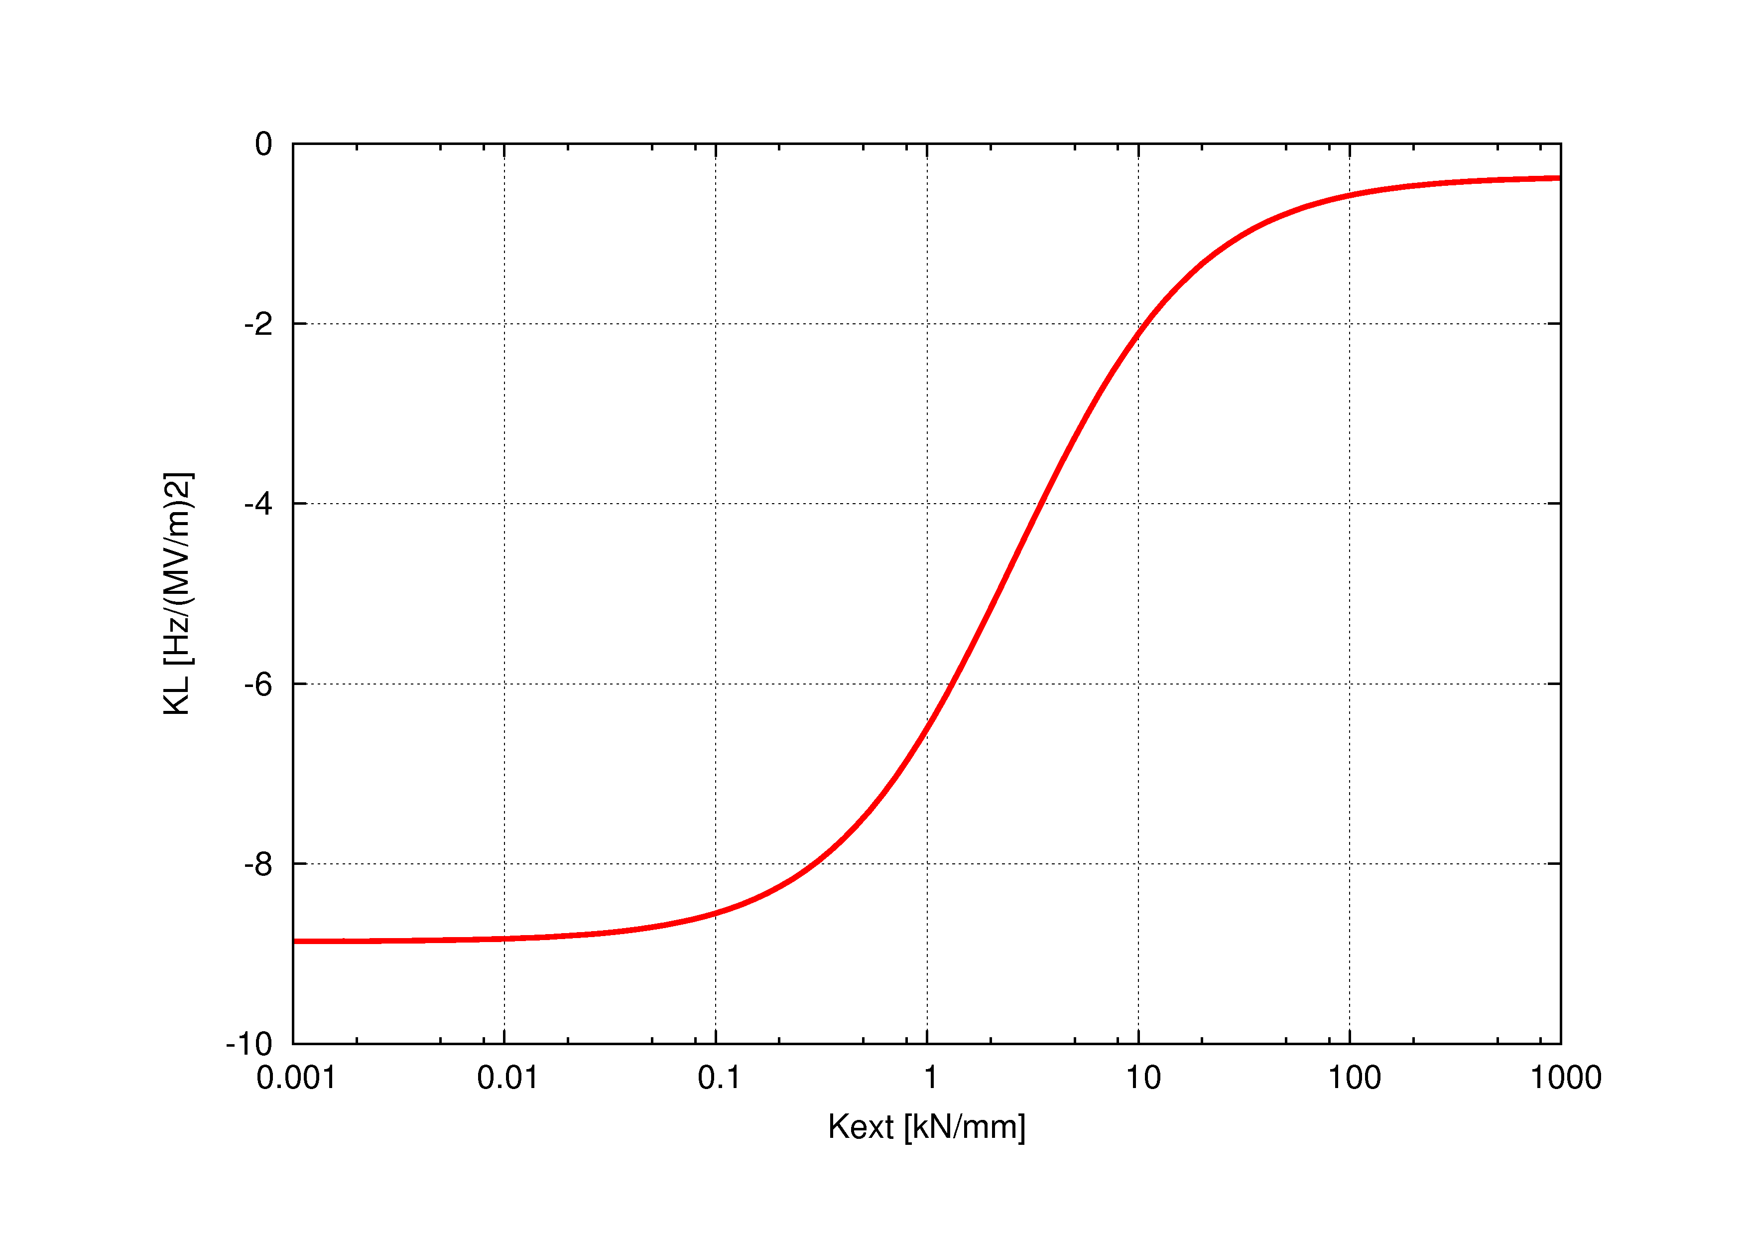
RF/Mechanical design
Optimal compensation ring radius (mm) | 84
K_{L} fixed ends (Hz/(MV/m)²) | -0,36
K_{L} free ends (Hz/(MV/m)²) | -8.9
Stiffness (kN/mm) | 2.59
Δf/Δz (kHz/mm) | 197
max VM stress /1mm (MPa) | 25
K_{P} fixed ends (Hz/mbar) | 4,85
K_{P} free ends (Hz/mbar) | -150
max VM stress /1bar fixed (MPa) | 12
max VM stress /1bar free (MPa) | 15
DP
5 bar
Simulation of cavity deformation with a plastic model, 3.6 mm thickness
The differential pressure is cycled : 0-5-0 bars at room temperature
external rig used to maintain cavity length : fixed ends
max residual deformation after 1 cycle : 7μm for 1 cycle, detuning -560 Hz
Aiming at kext=30 kN (tuner and He vessel combined stiffness) to get KL = -1 Hz/(MV/m)²
At Eacc=18 MV/m the corresponding static detuning is 324 Hz (1/3 of cavity bandwidth), need to be compensated by piezo tuner
page

Slide 15
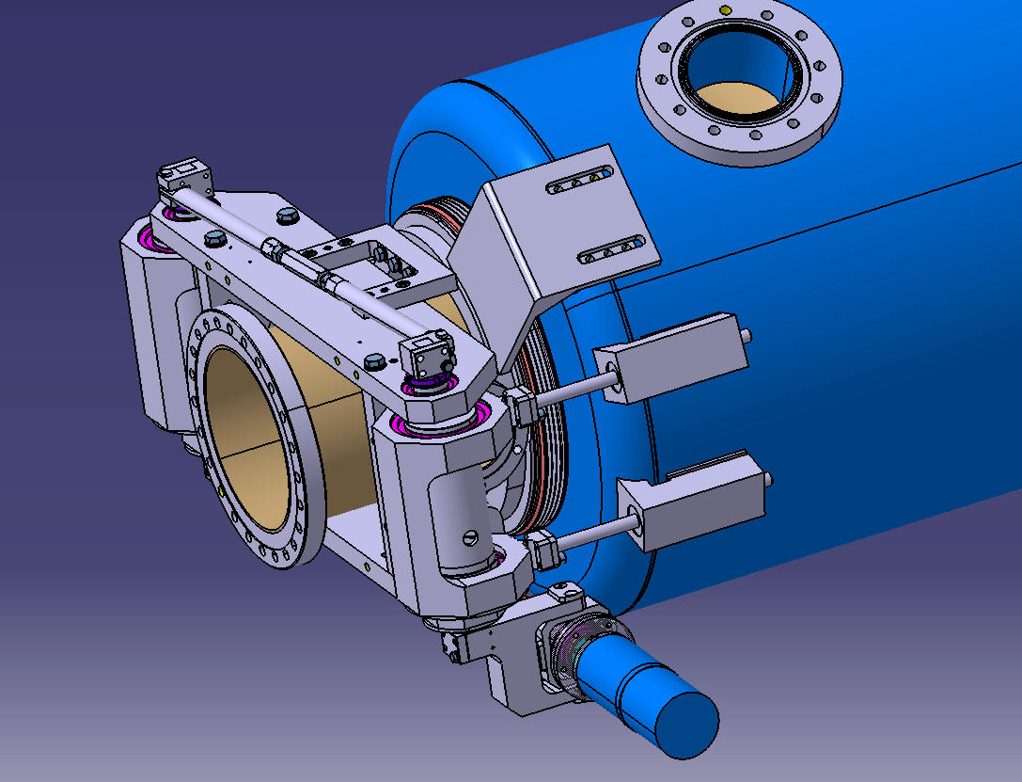
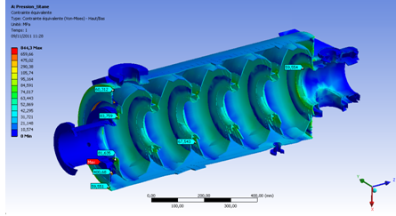
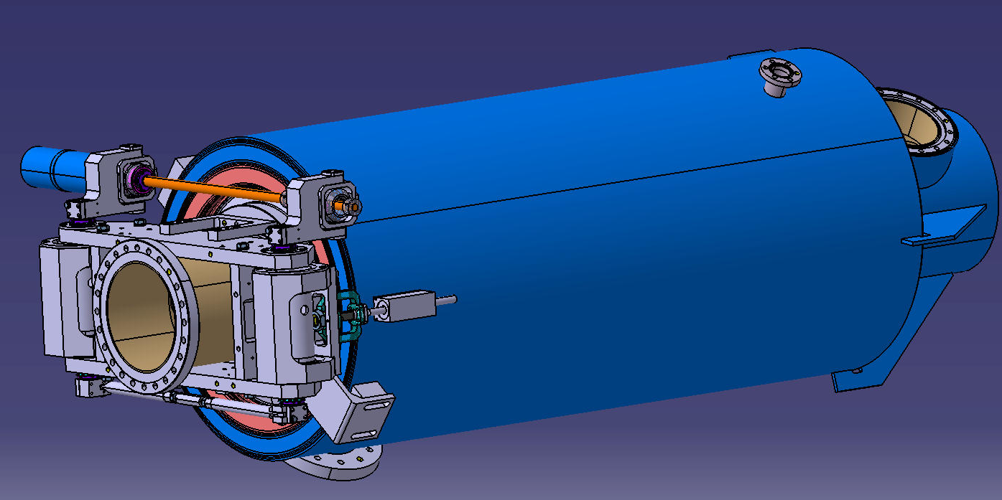
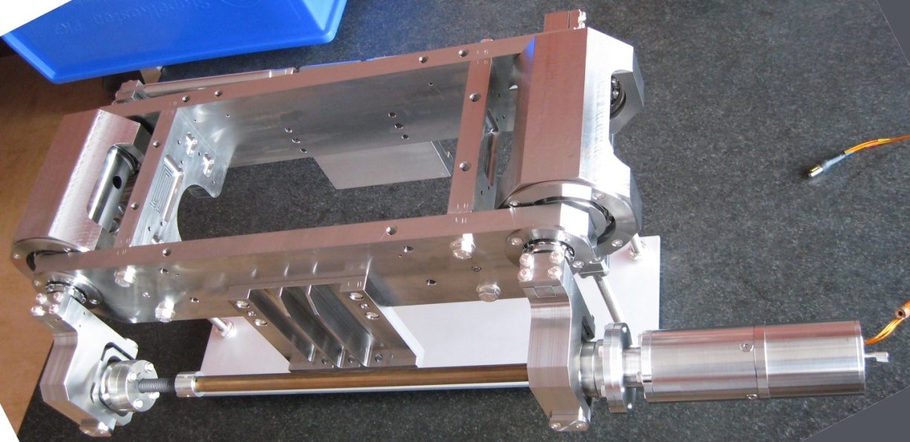
He vessel and tuner integration
Stainless steel vessel option
Titanium tank
NbTi flanges, Al Hex seals
(single bellow)
Derived from CARE-HIPPI β = 0.5 cavity
Titanium vessel option
New Saclay piezo tuner for SPL cavities
Derived from SPL Ti tank design
page

Slide 16
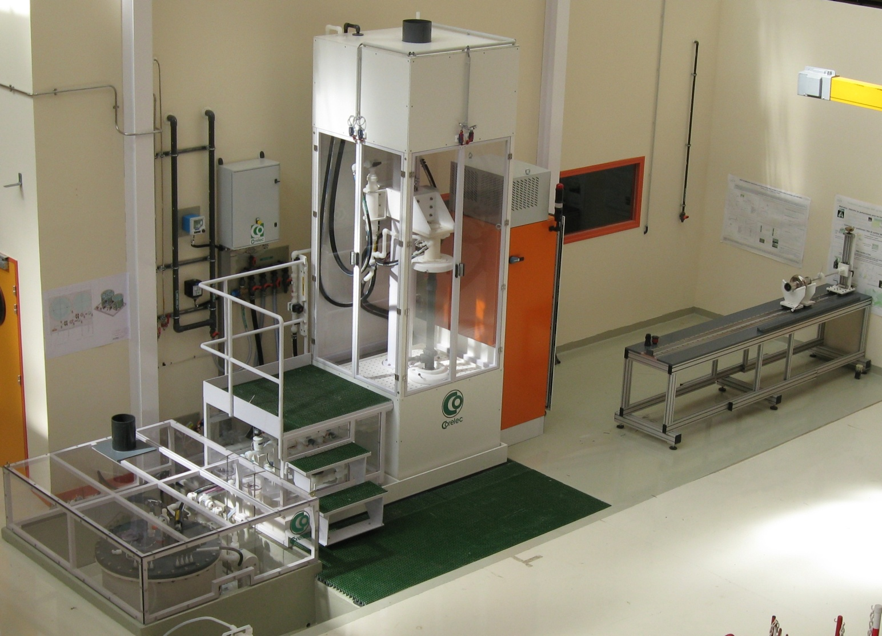
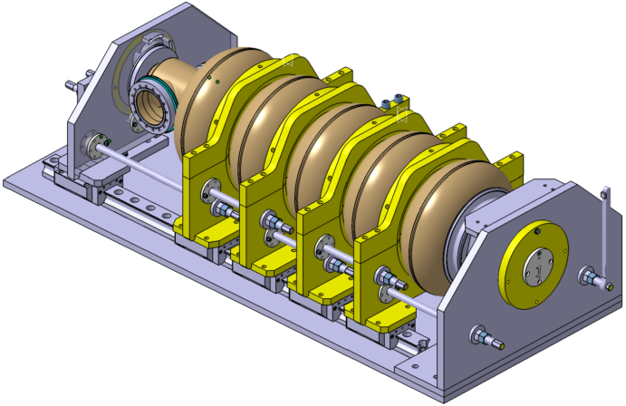
New cavity tooling at Saclay
Field flatness tool :
Designed for SPL beta=1 cavities, compatibility with ESS high beta cavity included (larger flanges, stiffening rings, shorter cells)
New Saclay vertical EP station
page

Slide 17
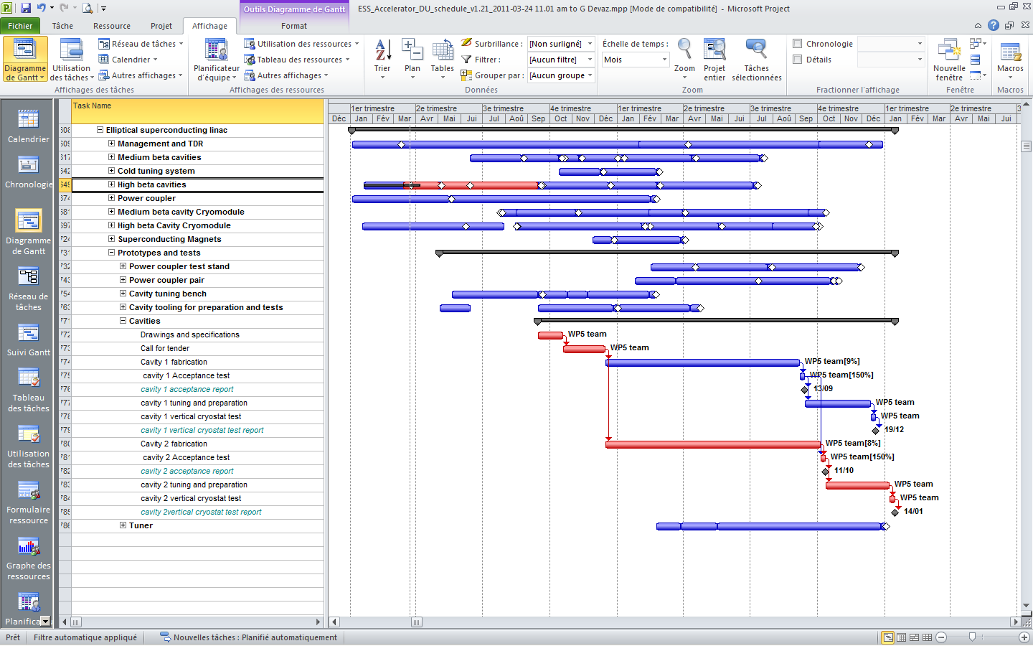
Prototype cavities planning
page

Slide 18
Summary on beta 0.86 cavity
RF design of the cavity is done
Mechanical design of cavity and helium vessel done
Order of RRR>250 Nb launched in early october
Technical specification for cavity fabrication done
Call for proposal for cavity manufacturing : 3 candidates
Launch of call for tender foreseen this week
page

Slide 19
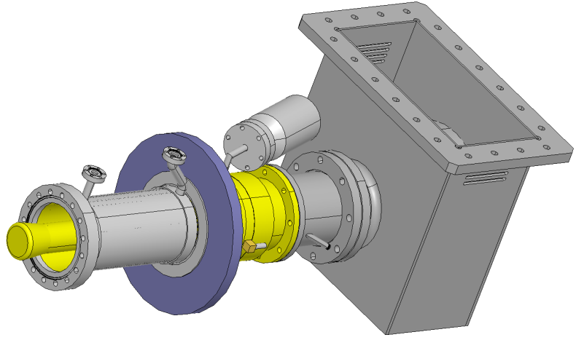
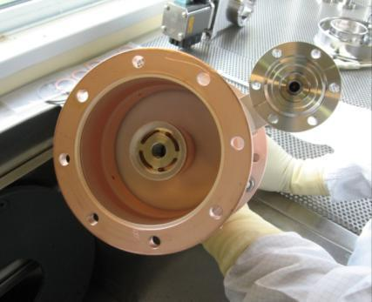
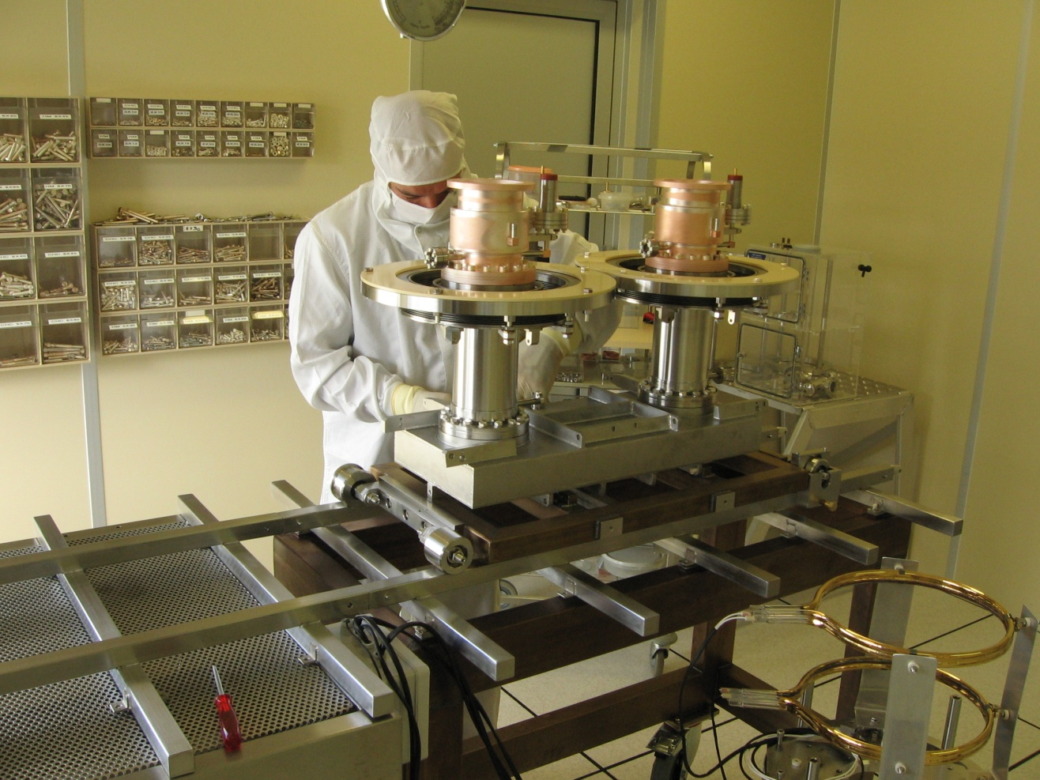
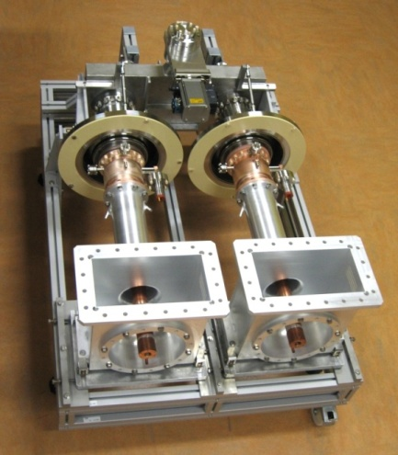
Power coupler RF design
Starting from Saclay HIPPI 1MW 10%DC coupler (KEK type window)

Slide 20
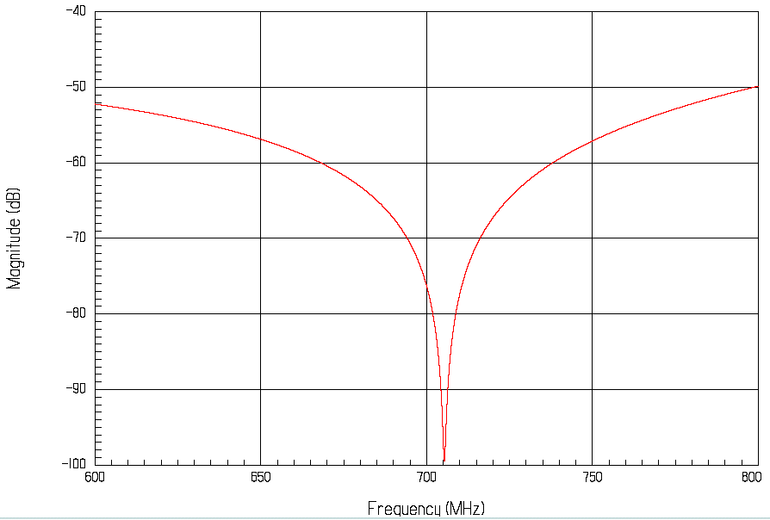
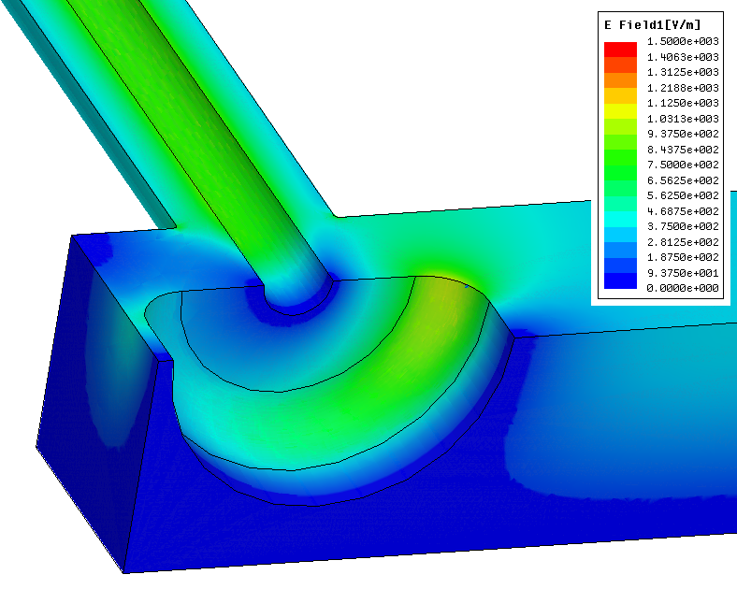
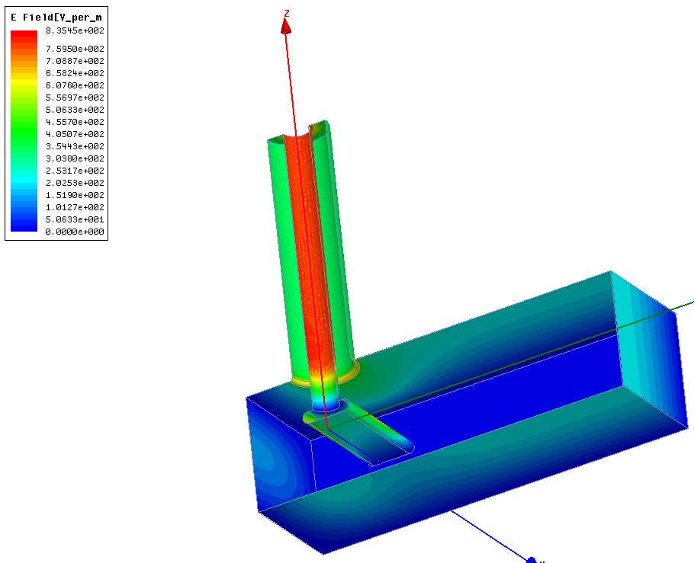
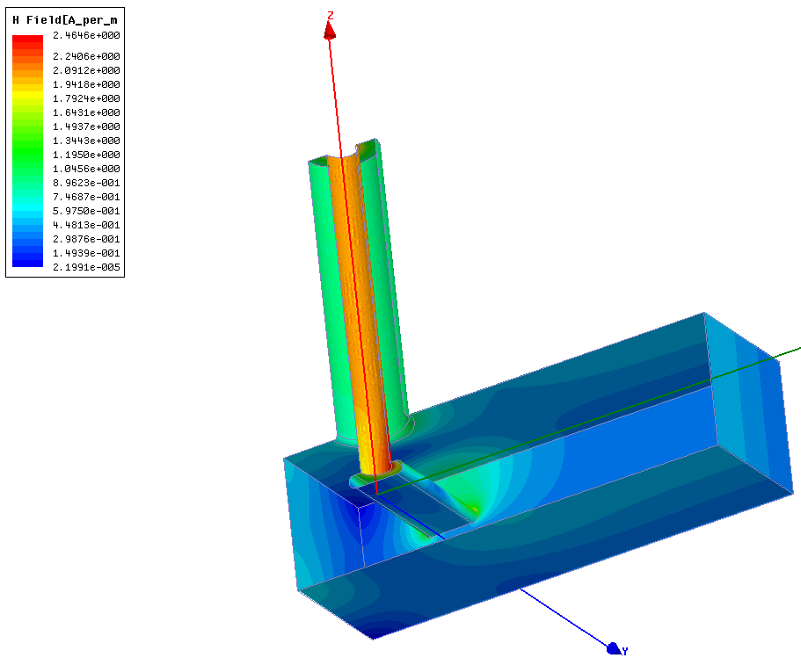
Power coupler RF design
HIPPI doorknob
T-bar transition
|E|
|H|
T-bar transition has 3 times the current doorknob bandwidth
potentially less sensitive to geometrical errors
however implementation of biasing may be difficult

