Slide 1
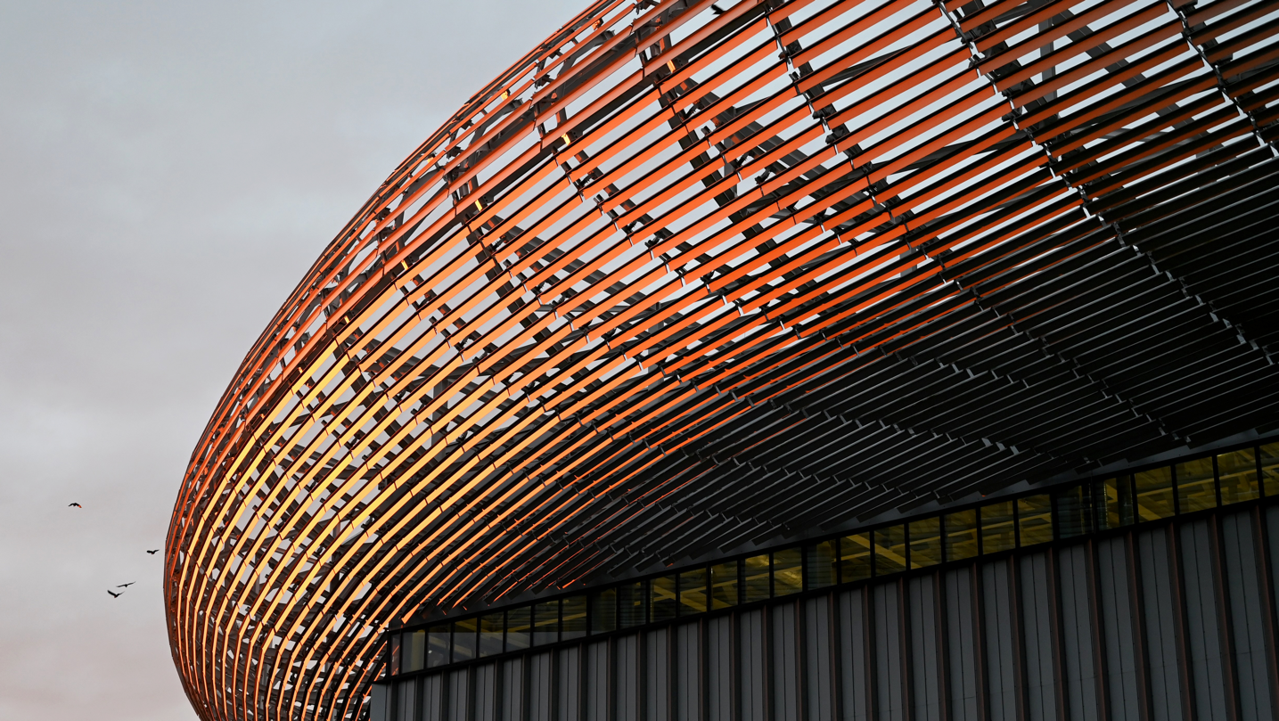
23rd ESS Industry Liaison Offices Network
ESS, Lund
14 April 2026
The European Spallation Source – ESS: Engineering status & updates
Dr. Eng. Nick Gazis
Group Leader ESS Mechanical Engineering, Technology & Analysis (META) Head of ESS Mechanical Measurements Lab (MML)
www.europeanspallationsource.se
Many thanks to Andrew Kimber, Ciprian Plostinar, Mikhail Feygenson, Antonio Bianchi & colleagues for input material

Slide 2
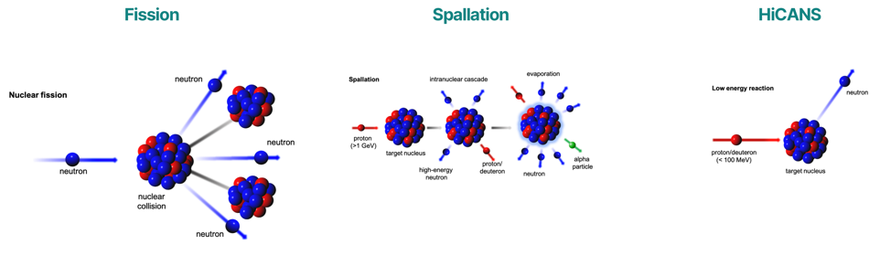
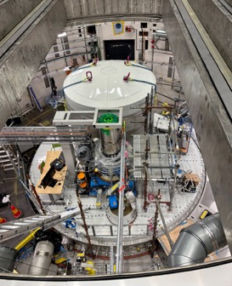
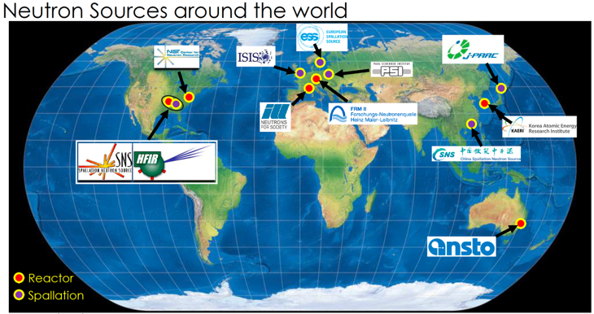
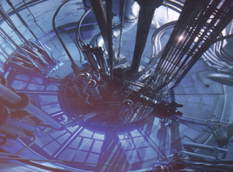
Freeing the neutrons from the nucleus
Spallation offers
highest efficiency
no criticallity
pulsed operation
It requires sophisticated
powerful accelerators
resilient targets
Notes:
Reactor based fission neutron sources produce neutrons by nuclear fission.
Europe is hosting a suite of reactor-based neutron facilities ranging from small- and middle-scale facilities up to large scale and high-flux neutron sources like the FRM II in Garching, Germany, or the ILL High flux Reactor in Grenoble, France. These facilities serve a user community of about 8,000 users with nearly 30,000 instrument beam days each year and are the main work horses for neutrons in science and industry.
Worldwide a number of reactor-based neutron sources are in operation with similar performance as the mentioned European facilities.
Only a few projects on new research reactors are planned worldwide such as the PIK reactor in Gatchina, Russia, and the RA-10 reactor in Buenos Aires, Argentina. These reactor-based sources will be used as well for the production of radioisotopes for medical use to balance the investments of several 100 MEUR for the construction.
Most of the facilities mentioned above are in operation since the 60s or 70s and they have already reached or will reach soon the end of their scientific lifetime.
In a spallation neutron source protons are accelerated by a high-powered accelerator and made collide into a heavy metal target (like mercury or tungsten) that “spall off” free neutrons in response to the impact.
Since the 70s spallation neutron sources have been developed and put into operation. In Europe the first of this kind of sources was ISIS in UK followed by SINQ in Switzerland which came into operation in 1985 and 1996, respectively. Worldwide spallation neutron sources can be found in USA, Japan and in China where recently the Chinese Spallation Neutron Source in Dongguan with a 1.6 GeV proton beam and a neutron beam intensity comparable to ISIS has been put into operation.
Three powerful megawatt spallation sources have been built in the last decade or are under construction. They operate in pulsed mode with a peak flux much superior to the average flux of research reactors. This peak flux can be used efficiently in time-of- flight applications. These sources are the SNS in Oak Ridge, USA, J-PARC in Tokai-mura, Japan and the ESS in Lund Sweden that will become the world brightest neutron source.
Neutron sources based on nuclear reactions using low energy proton beams and light elements are in operation in USA and Japan since the 90s. The LENS facility in Indiana, USA, was built in 2003 and uses a proton accelerator with 13 MeV proton beam offering a neutron yield in the range of low flux reactors. Several university-based small neutron sources are in operation in Japan. These use low energy proton accelerators in the energy range up to 7 MeV (except at HUNS, where an electron beam with 45 MeV is used). The performance of these sources for neutron scattering experiments is mostly an order of magnitude below small reactor-based sources but allows qualified experiments on structure research (diffraction, small angle scattering) and imaging.
A compact neutron source using an electron accelerator has been in operation in Bariloche, Argentina, till recently. Several projects exist in China to establish small and compact accelerator driven neutron sources.
In Europe no such kind of accelerator driven neutron source for neutron scattering applications does exist at present, but there are several projects to develop and built High Current Accelerator-based Neutron Sources (HiCANS). ELENA is just the association, where these projects are cooperating.
https://elena-neutron.iff.kfa-juelich.de/neutron-facilities/

Slide 3
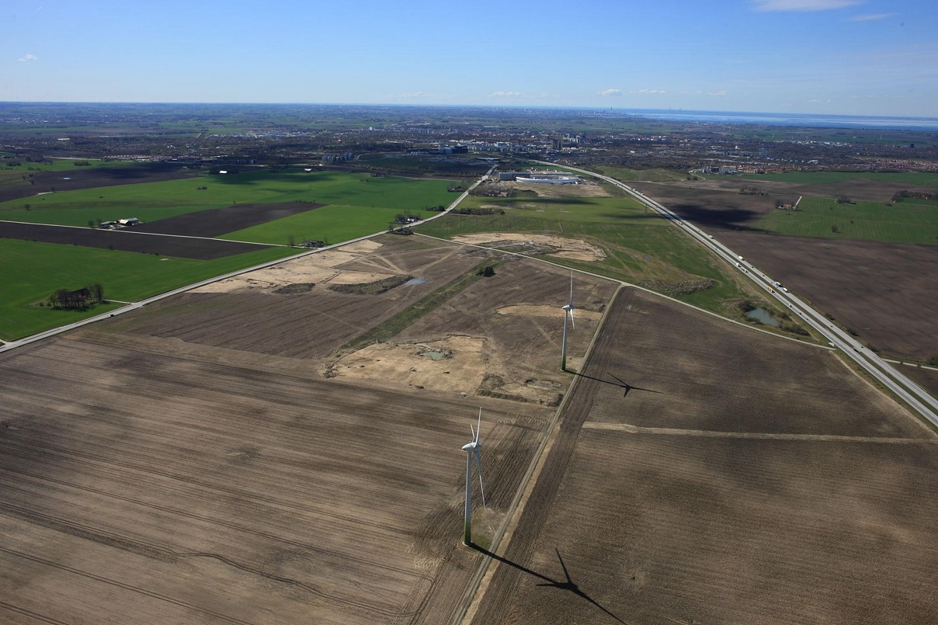
ESS – April 2014

Slide 4
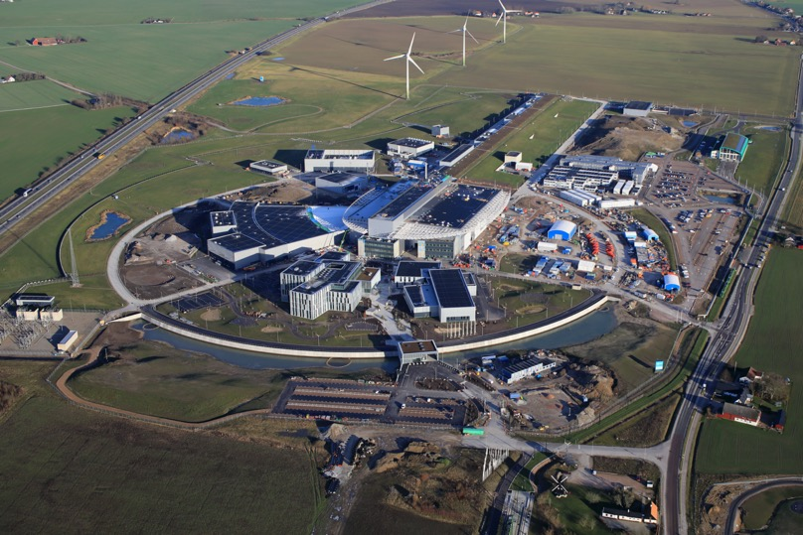
ESS buildings
Klystron Gallery
From 2022 onwards
Accelerator Tunnel
Experimental Hall
E01
Target
Monolith

Slide 5
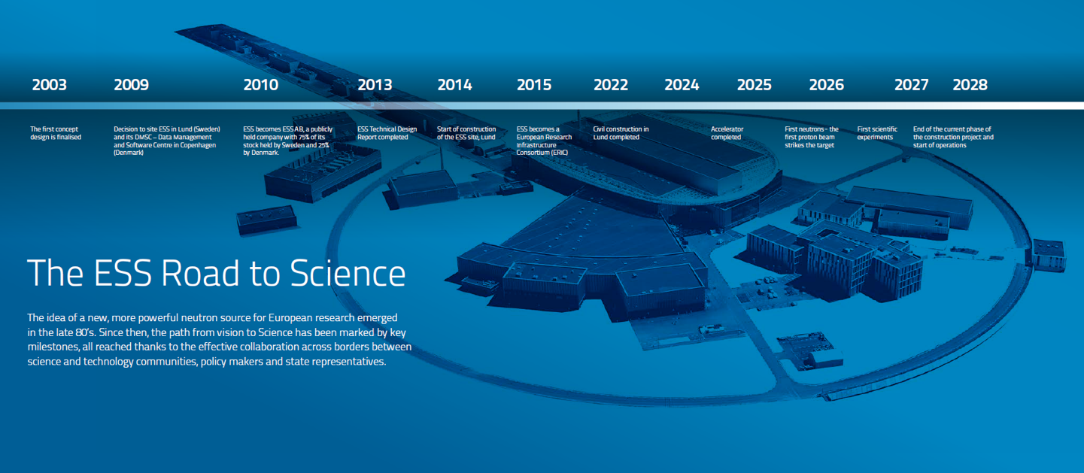

From concept design to start of operations
BoT: January 2027
The world’s current leading neutron and X-ray facilities, ILL and ESRF, Grenoble, France
Beam on Dump!
ESS Data Management and Software Centre at DTU in Lyngby, Denmark

Slide 6
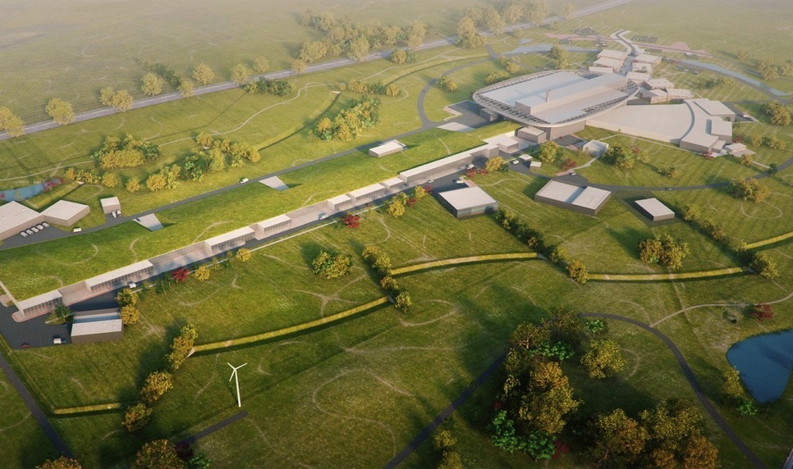
ESS design
Target Station
He-gas cooled rotating
W-target (5MW average power)
42 beam ports
16 Instruments in construction budget
Committed to deliver 22 Neutron Instruments
Ion Source
High Power
Linear Accelerator
Energy: 2 GeV
Rep. Rate: 14 Hz
Current: 62.5 mA
Notes:
Total cost: 1843 MEuros ₍₂₀₁₃₎

Slide 7
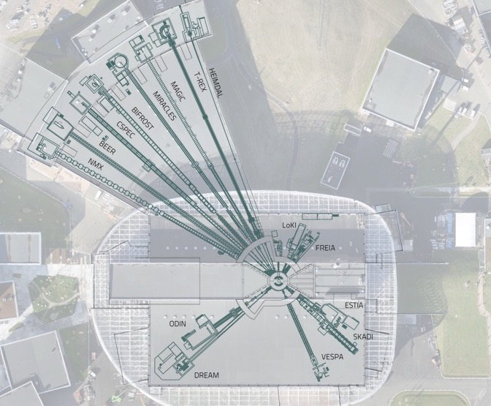

15 instruments under construction
Edit Master text styles
Each instrument designed to be world-leading at 2MW
Life sciences
Soft condensed matter
Chemistry of materials
Energy research
Magnetism & superconductivity
Engineering & Geo-sciences
Archeology & Heritage conservation
Fundamental & particle physics

Slide 8
The ESS way
ESS-0307562
At ESS, we are united by a shared purpose:
Opening up the World of Matter and Materials, through cutting-edge neutron science.
This purpose drives us to create meaningful impact by advancing scientific discovery, fostering innovation, and addressing global challenges.
To fulfil this mission, we uphold three core commitments that define how we work:
Creating Impact through Performance built on Thoughtful Collaboration
Our commitment to Impact, Performance, and Thoughtful Collaboration is reflected in every decision we make, every challenge we tackle, and every opportunity we pursue.

Slide 9
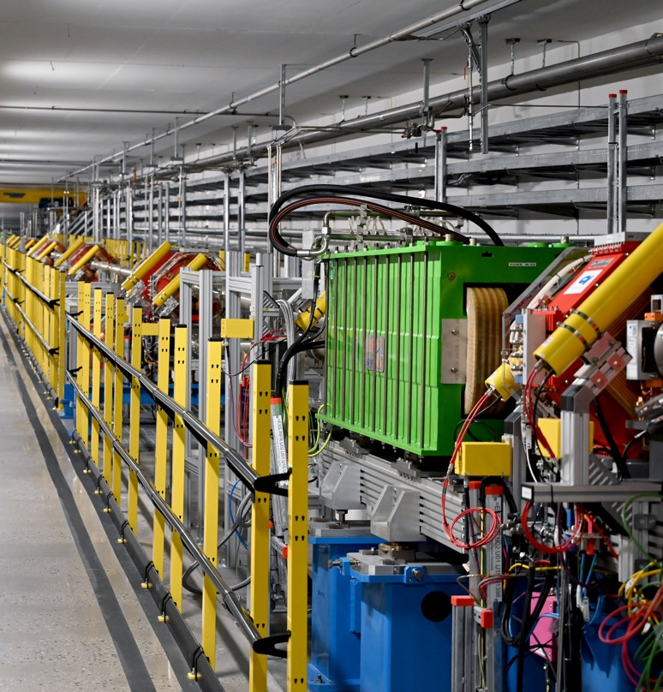
Accelerator

Slide 10
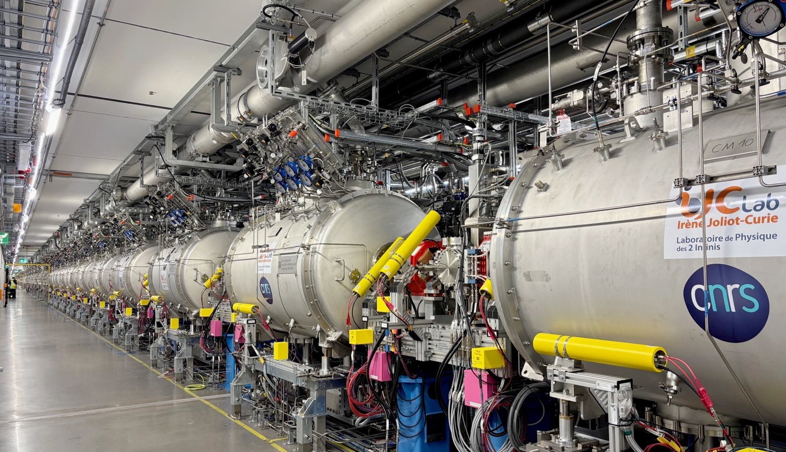
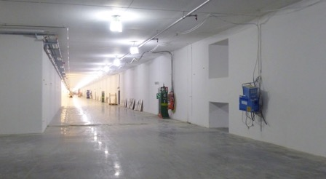
Accelerator delivering Beam on Dump (BoD)
Edit Master text styles
Installation finalized
Safety Readiness confirmed
NCL RF conditioned
BI operational
Protons accelerated in NCL
Beam on Dump (BoD) achieved!
SCL cooled down
A picture form the past..

Slide 11
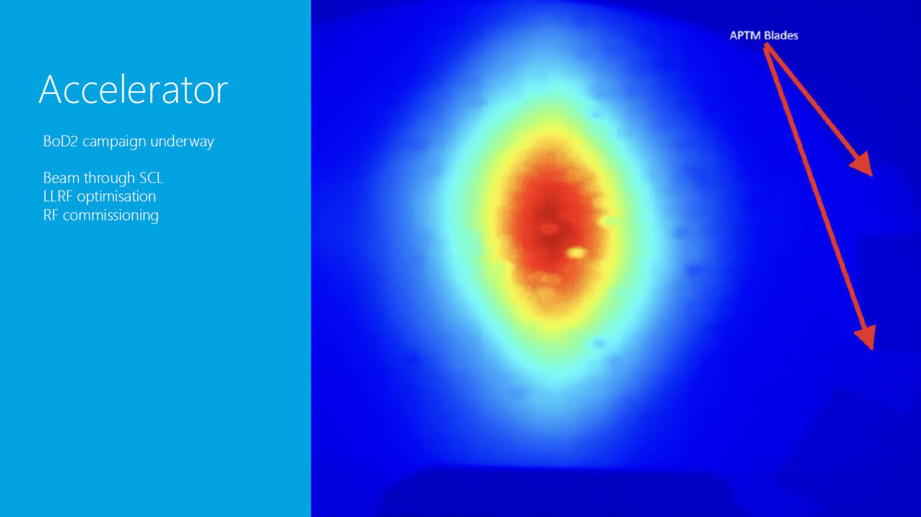
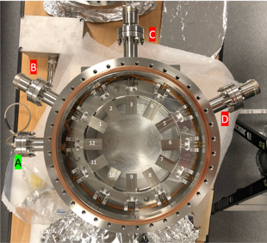
Accelerator status
BoD2
Orientation: Blade 3 top, blade 6 outboard, blade 9 bottom, blade 12 inboard

Slide 12
Accelerator status
Progress & Actions
Beam at dump SCL conditioning: Commissioning up to all SPK CMs
LLRF optimization with beam
Energy measurements
APTM dumpline confirmation with beam
Runing nBLM, icBLMs tested with rad source
Machine stop planned for week.17
TS4: PSS Fit ongoing
TS2: CM46 warm up, CM48 moved to start testing
Maintenance days move to Wednesdays (from 8 April)
From ICS for ACC:
CM controls testing and commissioning
MPS plan
Prep for 2-3MW
PSS for TS4
Status and details:
https://confluence.ess.eu/spaces/AO/pages/788704404/RF+Cavity+Operational+status

Slide 13
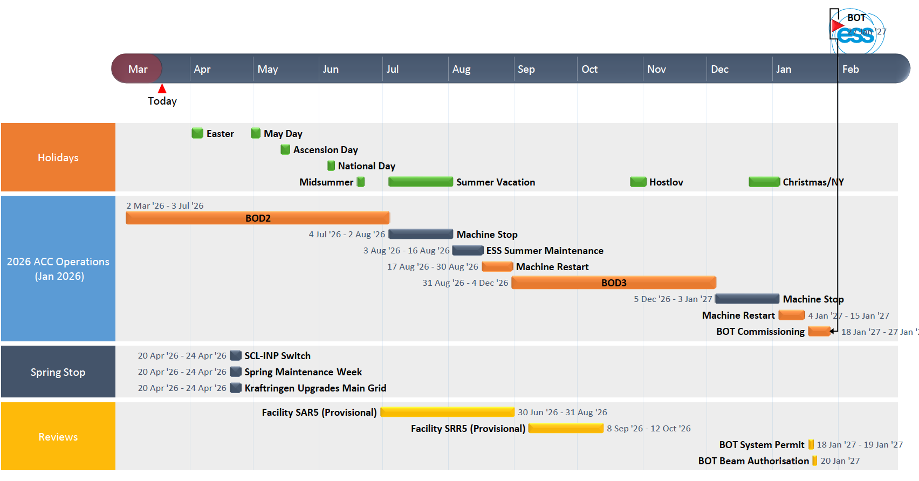
Accelerator status
Plan
Courtesy of CIPRIAN.PLOSTINAR@ess.eu
Notes:
Demonstrate stable operation with the nominal RF pulses (3ms) in closed loop at 14 Hz, using piezo compensation
Demonstrate long beam pulses of (>1ms) at low current (6mA) using adaptive feed-forward
Demonstrate longer beam pulses (50us) to dump at nominal current using adaptive feed-forward
Demonstrate 80% availability of the accelerator

Slide 14
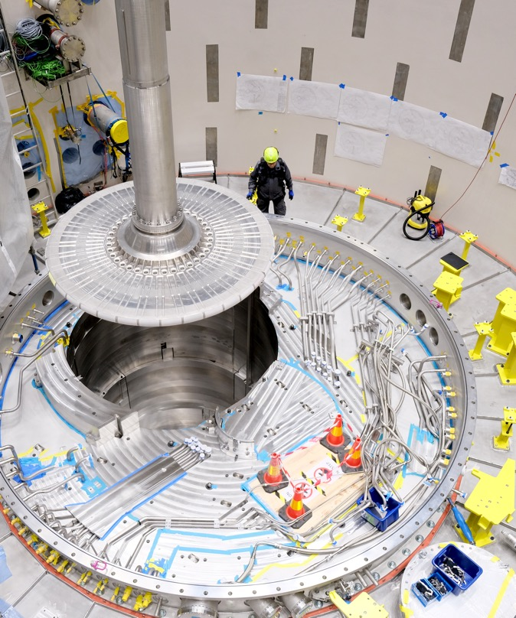
Target

Slide 15
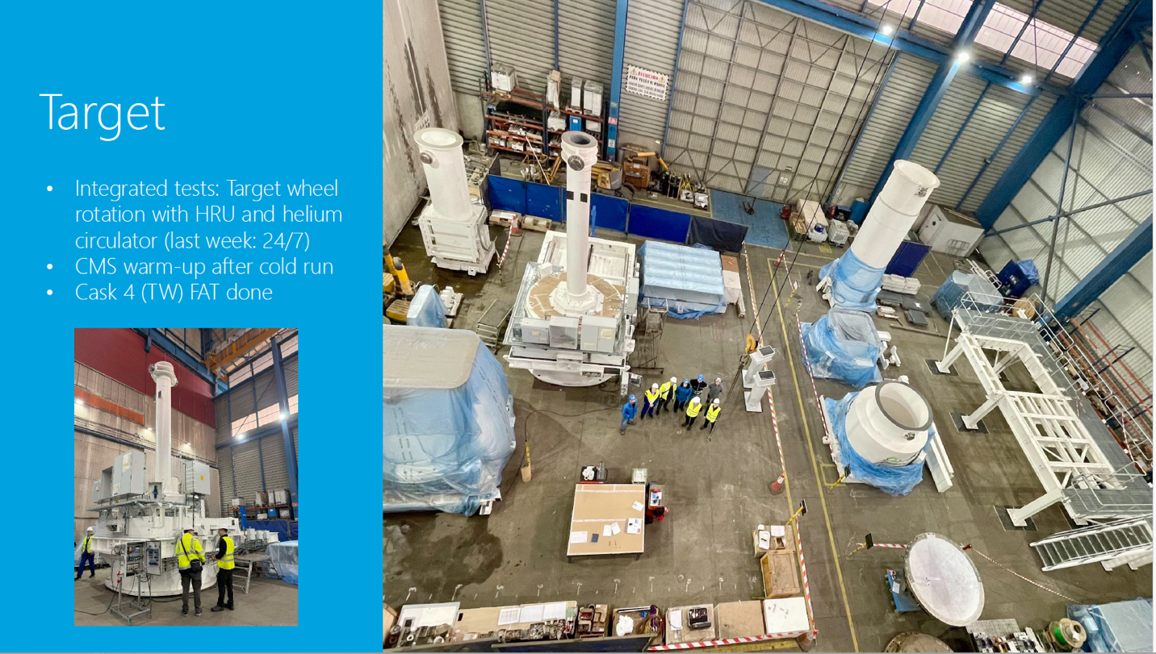
Target status
On the way to BoT

Slide 16
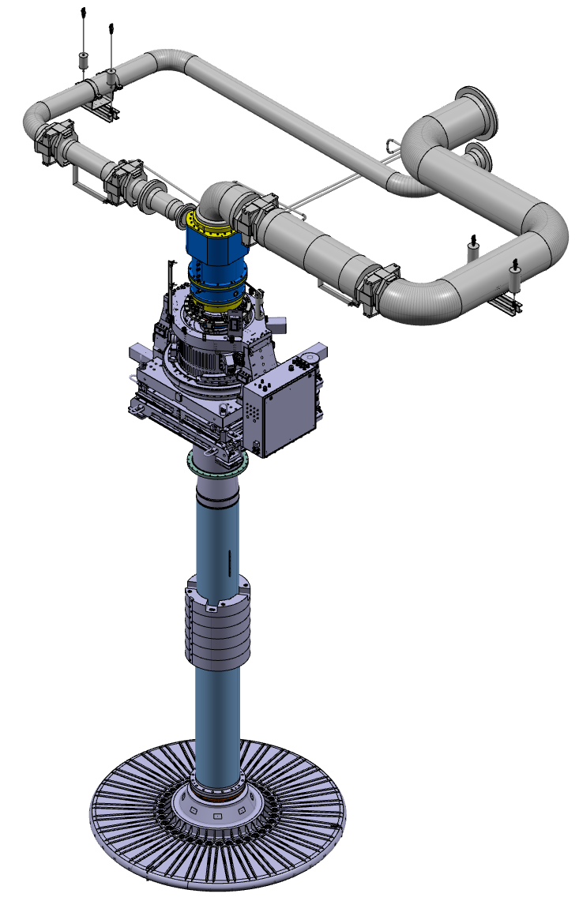
Target:
HRU v2

Slide 17
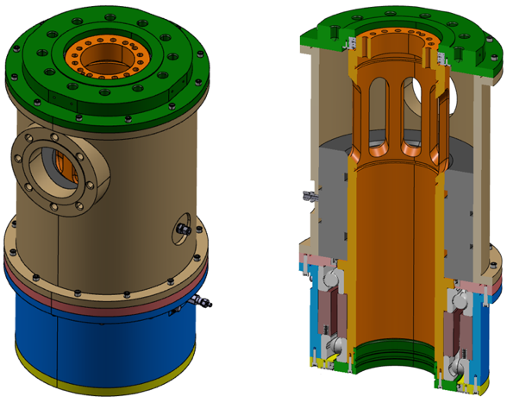
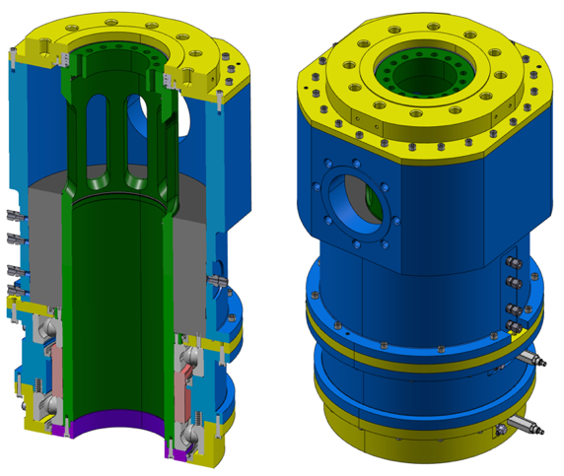
Target HRU
v2 design progress
PDR design
Final detailed design

Slide 18

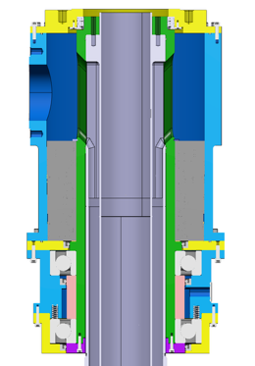
Target HRU
Rotary Seal Functions
Connection between a rotating target shaft and stationary pipe system
High performing seal to keep the He in the cooling circuit for optimal cooling of the target wheel
Withstand substantial lateral forces coming from the piping system
Hot helium
”Cool” helium
Seal

Slide 19
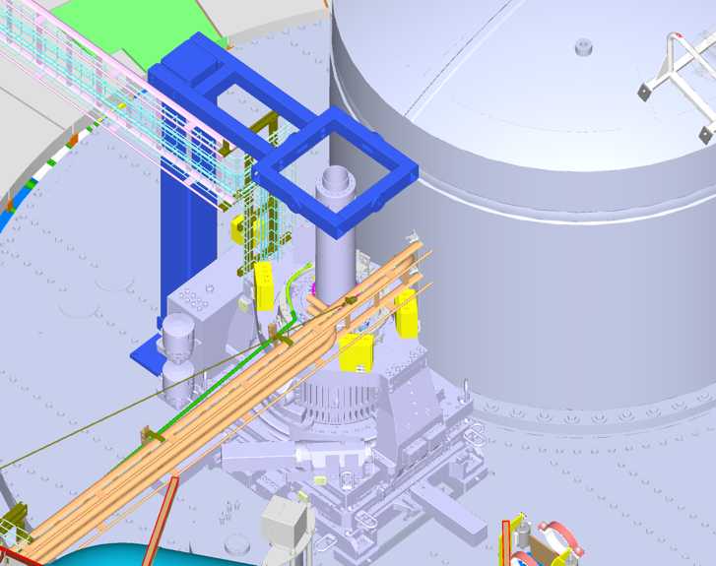
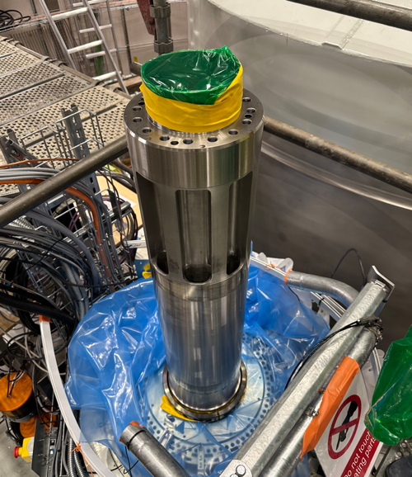
Target HRU
Installation conditions
scaffolding

Slide 20

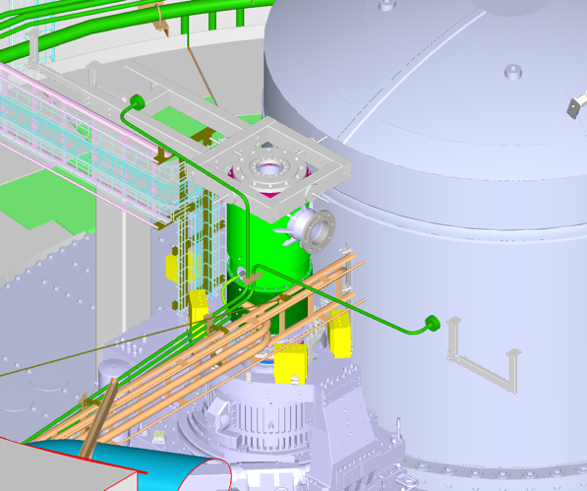
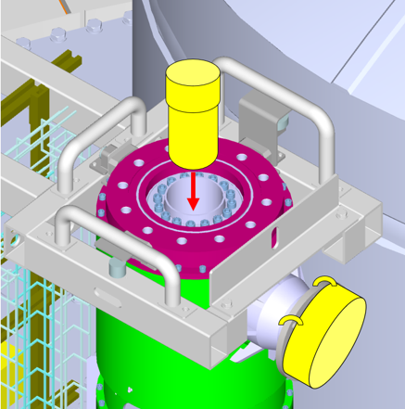
HRU maintenance & risks (ESS-5856666)
In Operations: Potentially radioactive parts and conditions involved in HRU installation
Shielding plugs (in principle shown)

Slide 21
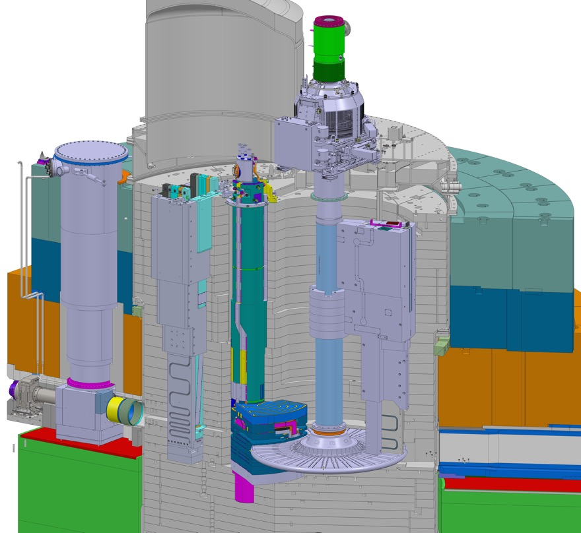
Target:
MRP
Courtesy of Rasmus Johansson

Slide 22
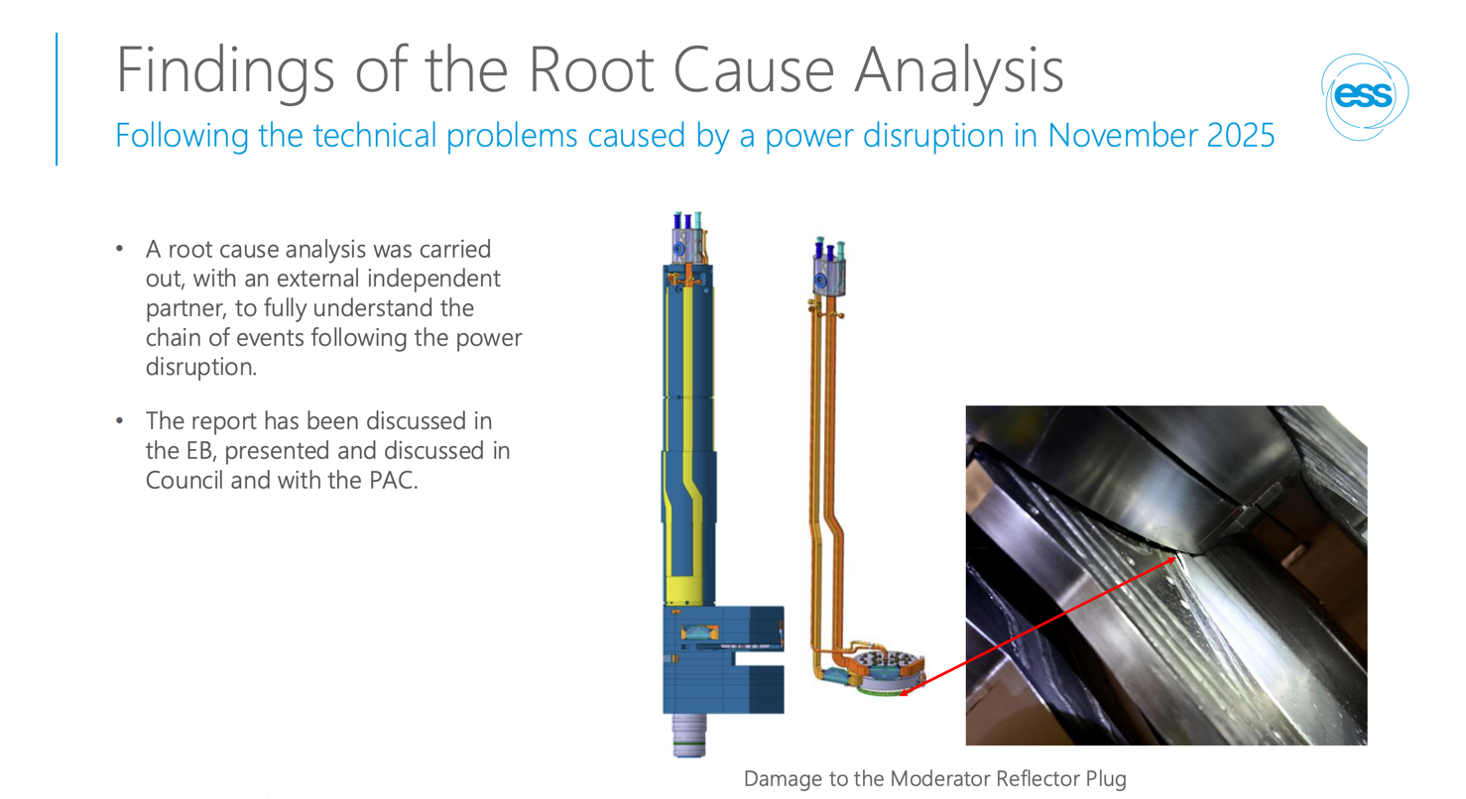
Target MRP
RCA

Slide 23
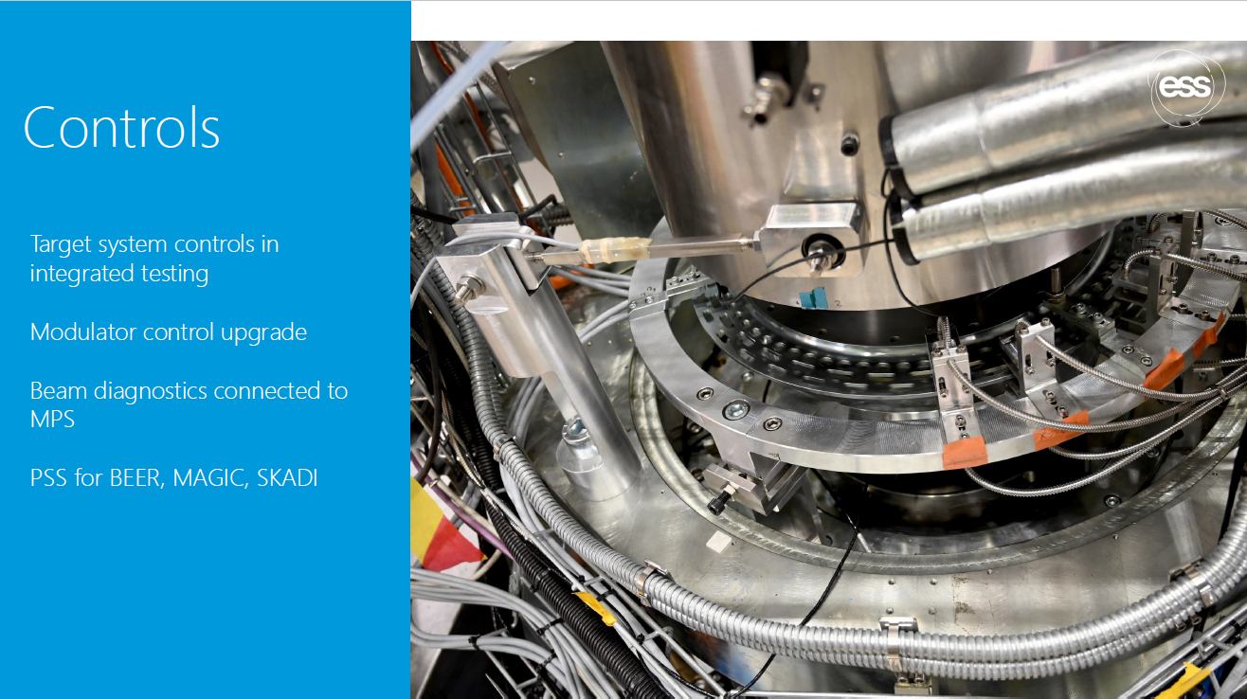
Controls
Status

Slide 24
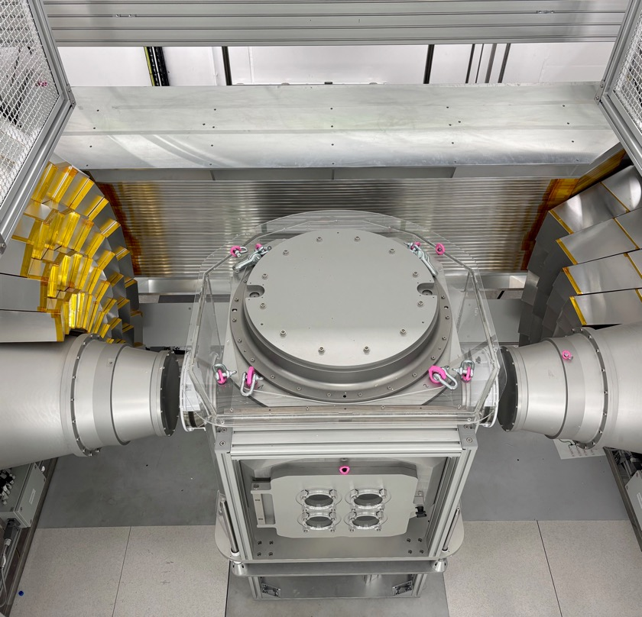
Neutron Instruments
Notes:
DREAM instrument sample stage and detectors

Slide 25
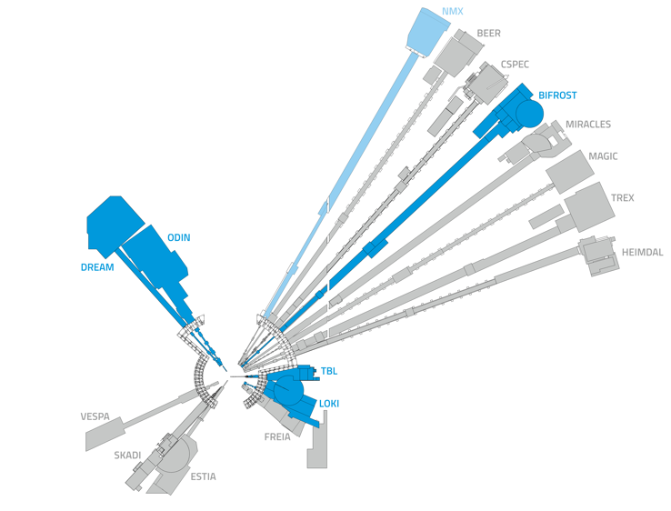
Different instruments for different science
Instruments’ delivery
Tranche 1: BIFROST DREAM LOKI NMX ODIN TBL https://confluence.ess.eu/display/SPD/Tranche+1+instruments+critical+paths
Tranche 2: ESTIA BEER SKADI FREIA MAGIC https://confluence.ess.eu/display/SPD/Tranche+2+and+3+Instruments+Critical+paths
Tranche 3: HEIMDAL MIRACLES TREX CSPEC VESPA https://confluence.ess.eu/display/SPD/Tranche+2+and+3+Instruments+Critical+paths
Small Angle Neutron Scattering (SANS) | LOKI, SKADI
Reflectometry | ESTIA, FREIA
Powder Diffraction | DREAM, HEIMDAL
Single-Crystal Diffraction | MAGIC, NMX
Imaging & Engineering | ODIN, BEER
Direct-Geometry Spectroscopy | CSPEC, T-REX
Indirect-Geometry Spectroscopy | BIFROST, MIRACLES, VESPA

Slide 26
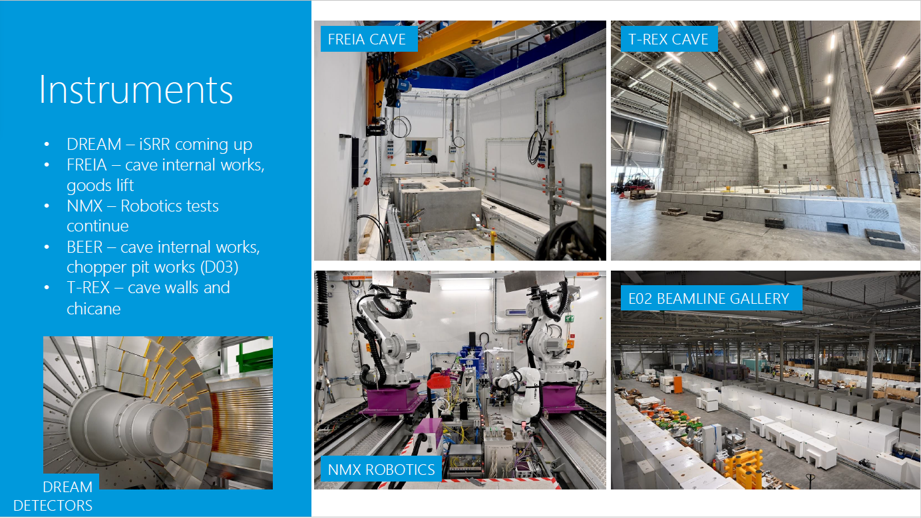
Neutron Instruments
Status

Slide 27
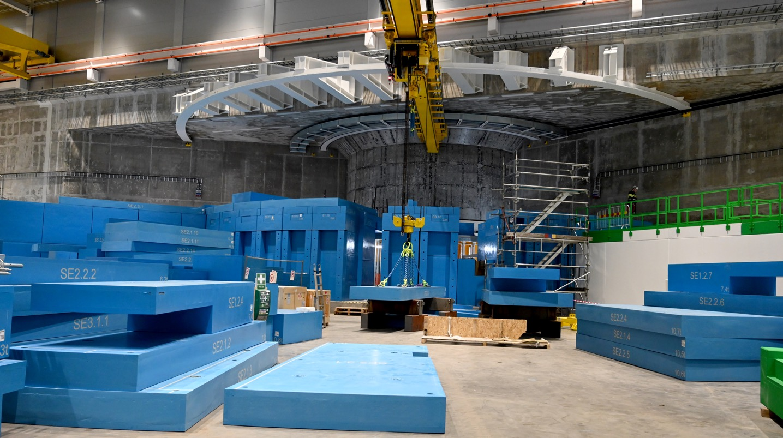
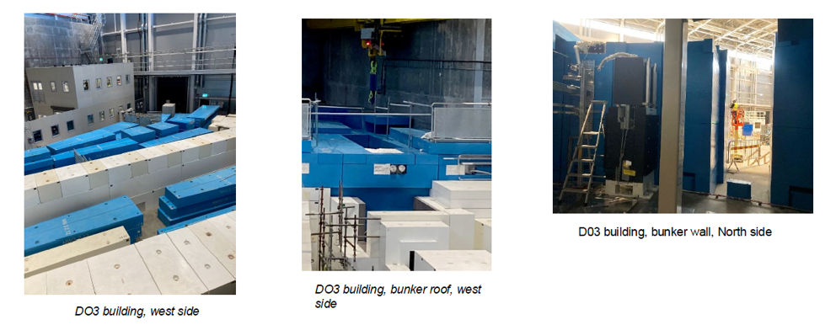
Experimental Halls
Status
From a safety perspective, installation and test activities in the Ex-Halls are progressing smoothly (no injuries, nor major incidents)
Moving BoT to 2027:
became an opportunity to reopen the Bunker for installation
presents new challenges to space availability
Aim is to complete as much in-Bunker installation as possible before BOT

Slide 28
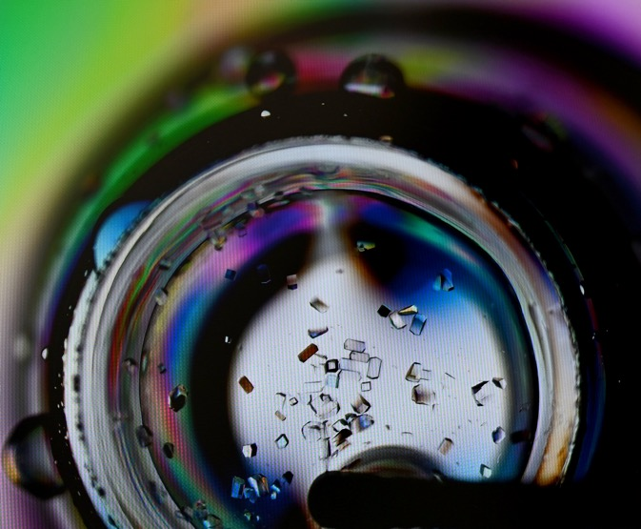
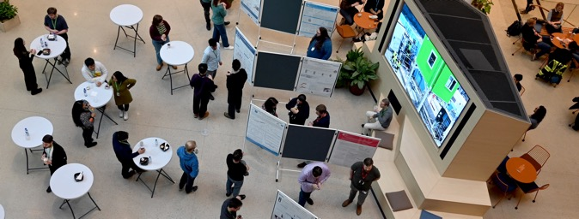

Science
Notes:
For the first time, ESS is hosting activities from the HERCULES European School together with MAX IV Laboratory and LINXS, bringing the programme to Lund as part of this year’s training activities.
20 students participating in the school will visit ESS this week. On Tuesday, March 17, they will take part in practical sessions at ESS instruments, where they will gain firsthand insight into neutron-scattering experiments and interact with instrument scientists.
The students will return to ESS on Friday, March 20, to present their experimental reports and take part in a proposal session as part of the school programme. A poster session will also take place at ESS from 12:00 to 13:00, where students will present their thesis or research projects. ESS staff who are interested are warmly invited to stop by and engage with the students.
This visit is part of the HERCULES School’s mission to train the next generation of scientists in the use of large-scale research infrastructures.
https://confluence.ess.eu/spaces/RCO/blog/2026/03/16/882216463/HERCULES+School+Students+Visit+ESS

Slide 29
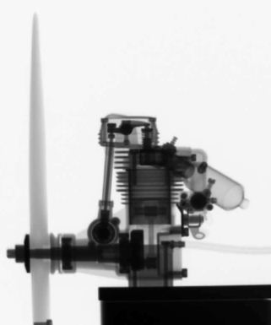
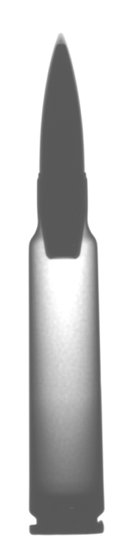
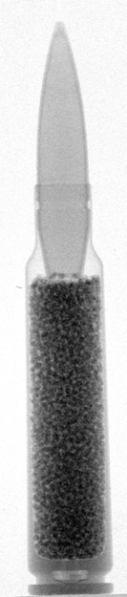
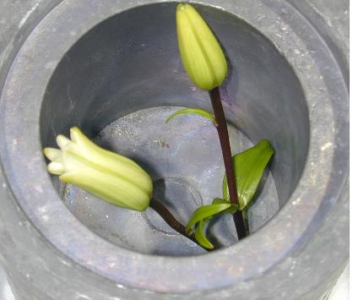
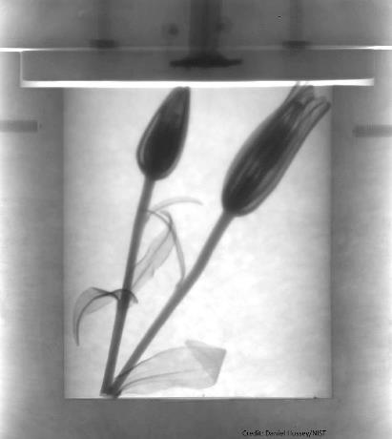
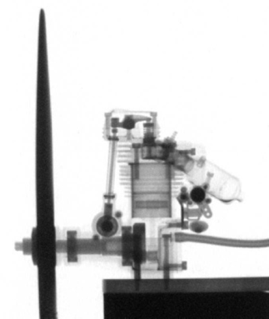
Neutron imaging
x-ray
ODIN: Neutrons & X-rays
x-ray
neutron
Courtesy of mikhail.feygenson@ess.eu
neutron
Notes:
And as a result of this, neutrons can penetrate for example this thick lead container
Click1 : And reveal the flowers inside
Click2: As you will see in several examples later on, neutrons and xrays are highly complentary, here are radiographs of a model airplane engine and a bullet.

Slide 30
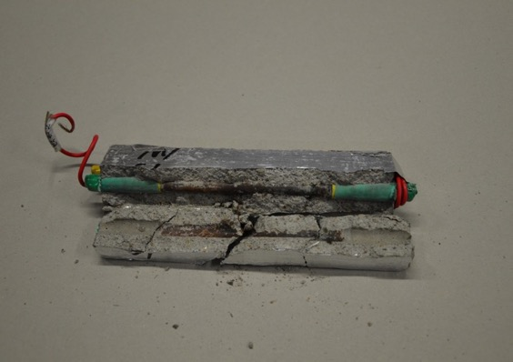
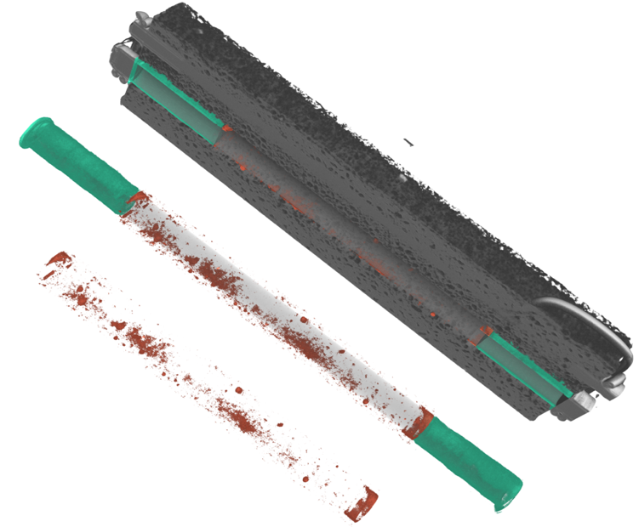
Corrosion of steel inside concrete
Concrete
Ct. E. Lehmann (PSI)
Corroded areas
Steel
ODIN
Courtesy of mikhail.feygenson@ess.eu
12

Slide 31
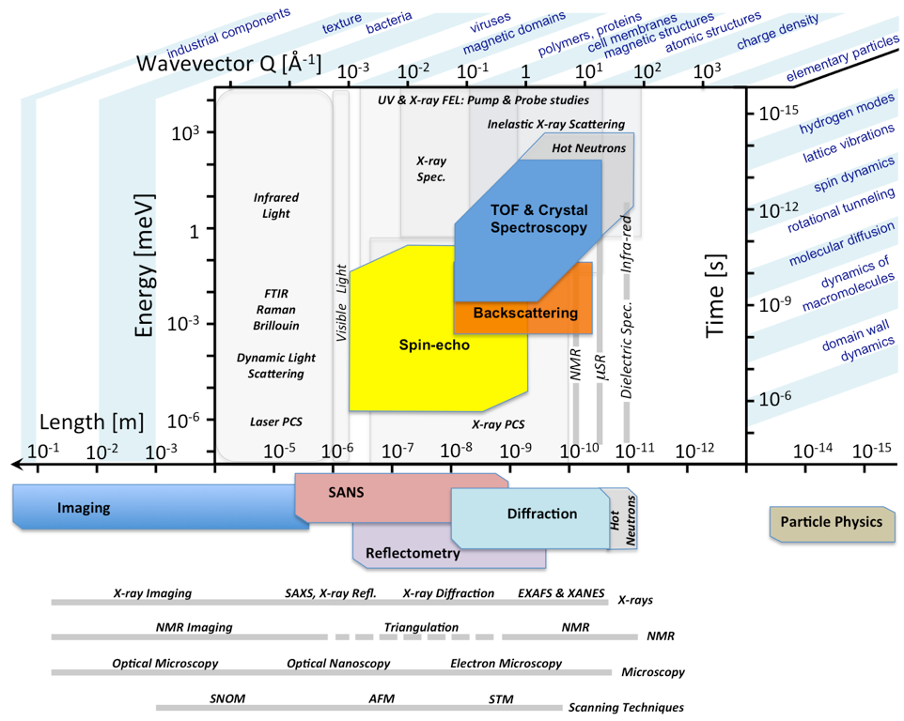
Length scales
Industrial parts
Heritage
Texture
Atomic structures
Magnetic structures
Courtesy of mikhail.feygenson@ess.eu
Notes:
All instruments, short and long, were designed to provide an access to the certain length scales from Nuclear Magnetic Resonance (Imaging) to Small-Angle Neutron Scattering etc.

Slide 32
How?
An instrument journey to users
Component Commissioning with Neutrons
Testing Sample Environment
Early Science with Expert Users
Standard Samples & Round Robin
Testing and Calibration
Instrument Enters User Programme
Activities that could meet “First Science” Milestone
Safety Readiness Review
570 kW
2026
140 kW
2028
Cold Commissioning
Hot Commissioning
Early Science
User Programme
First instruments: ODIN, LoKI, DREAM, BIFROST, NMX, TBL
Courtesy of mikhail.feygenson@ess.eu
Notes:
Ramp up. Not to 2 or 5 MW straight away. Remember we need to commission not only the instruments but accelerator, target and moderator. At some point we do expect new users

Slide 33
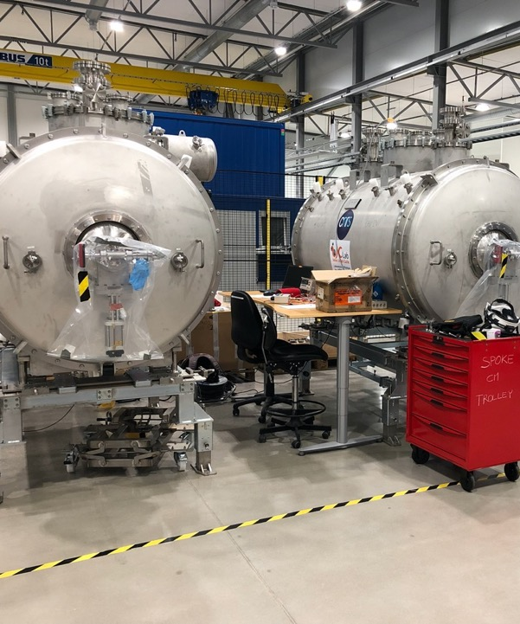
Mechanical Engineering Technology & Analysis (META) Group

Slide 34
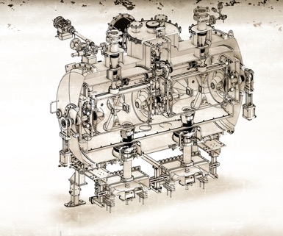
Mechanical Engineering Technology Analysis Group
‘One shop stop’ for centralized mechanical engineering services
From available FTE to Mechanical Engineering services
Centralization of Mech Engineers & Machine Design
Centralization of Mechanical Engineering Expertise & Reviewing
Centralization of Simulations, FEA & Eng Calculations
Operate Mechanical Measurements Lab (MML) & Repairs
Execute Mechanical Standardization, ISO-GPS Training, FEA codes
Organize & Host the Fora for Mechanical Users & development for ESS

Slide 35
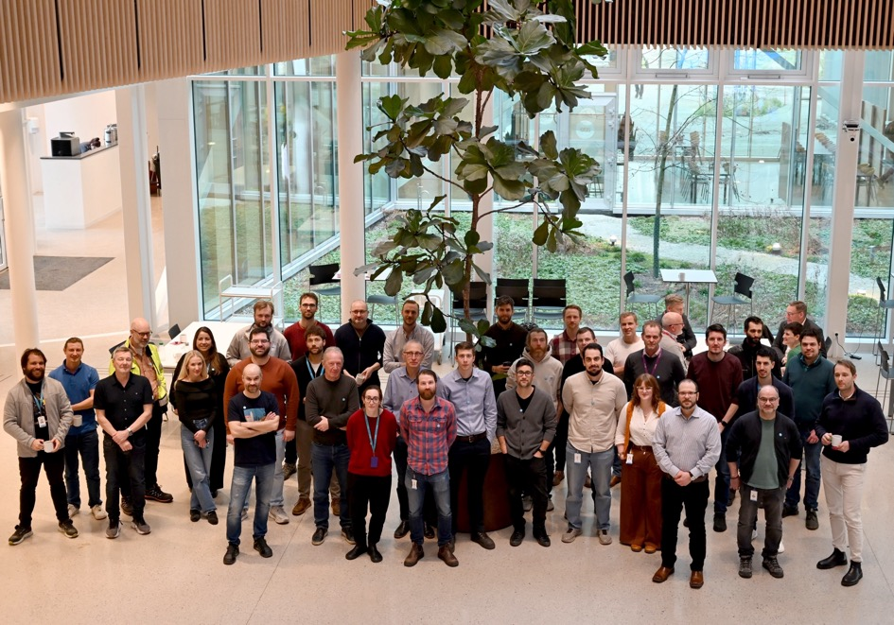
Mechanical Engineering Technology & Analysis (META) Group
Part of the Design & Engineering Division
Many but not all of META is in this photo ☺

Slide 36
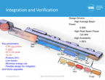
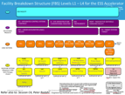







Systematic flow
Mechanical Design
from Physics Needs & Project Reqs.
to Eng. Deliverables Machines, Parts, Eng. Services, Operat.,
Integrat. Exp. Areas, etc.
via
Verification
Validation
Traceability
1. Physics Needs, Case Study etc.
2. Requirements, Systems & Disciplines, Risks
3. System spatial Integration
9. As-built DWGs, Commissioning, Maintenance
4. Preliminary Design, Simulations, Integration& CDR
8. Assembly, Installation, Red Line update DWGs
LoM ASB
5. Detailed Design & Baseline
7. “Series” Manufacturing (manuf. DWGs), QA/QC etc.
LoM C
6. Mock-up*, Prototype Fabrication Tests & QA/QC method verification
Fully Centralized: - Reviewing
- Redlining - As-Built
LoM P
Notes:
How we apply the VnV, our interpretation of it.
he Verification & Validation VnV-model, which is quite common

Slide 37

Graded Approach
Engineering implementation addressing USER needs
Major systems need to be built according to ISO-GPS design standards with precision & tolerances (or GD&T) to eliminate:
ambiguity (cause: lack of quality or engineering ways)
delays (cause: mistakes and known-unknowns)
additional costs (cause: repairs, reworks, orphan scopes)
Some systems need to be built simpler:
In specific cases, framework can be limited
The Systems’ models granularity can be coarse (depending on installation reqs)
However, there are few things engineers can’t omit:
e.g. Revision control for designs & documents
Emphasis on the design complexity & modularity

Slide 38




ESS tunnel views
Then vs now
Then vs now
View of the NCL
View of the CDS, ready for
CM installation

Slide 39




Gallery hall for klystrons & power sources
Then vs now
View of the G02 gallery with racks, klystrons, RF manifolds, modulators and cooling skids installed and commissioned

Slide 40






Parts & Prototypes
Edit Master text styles
Issues: Missing Requirements or Inspection Plan
Casks for replacing buckled bellows
Failures during welding & assembly can cause leaks in terms of vacuum

Slide 41

ESS Project
update

Slide 42

ESS Project
Update
Courtesy of ANDREW.KIMBER@ess.eu

Slide 43

ESS Project
Update
Courtesy of ANDREW.KIMBER@ess.eu

Slide 44
Summary
Achievements & Timeline
April 2025:
The proton beam was successfully delivered on the dump, reaching the Beam on Dump milestone (BoD)
May 2025:
The proton beam reached 870 MeV successfully, nominal for the upcoming Beam on Target milestone (BoT)
2026:
Getting ready for the BoT, incl. HRU v2 design, test stand, production & MRP 2 production, installation
2026-2027:
Becoming ready for the first Users to arrive at ESS, incl. hot commissioning of neutron instruments
2027-onwards:
- Finalization of the Construction Project
- Transition to Steady State Operations (SSO)
- Looking at the next upgrades

Slide 45






Edit Master text styles
ESS will be the world’s leading facility for neutron-based research
Build and operate the most powerful linear proton accelerator ever built
5 MW nominal power (currently 2MW installed capacity)
Build and operate a full suite of
Instruments with unprecedented performance
Welcome more than
one thousand
guest scientists
every year
Conduct more than one thousand
experiments every year
Assure responsible and sustainable operation as well as stewardship of entrusted resources

