Slide 1

SINE
Scientific Investigations of Nuclei at
ESS
Dr George O’Neill

Slide 2
Table of Contents
01
Introduction
04
Feasibility
02
Scientific Impact
05
Resources
03
Uniqueness
06
Summary

Slide 3
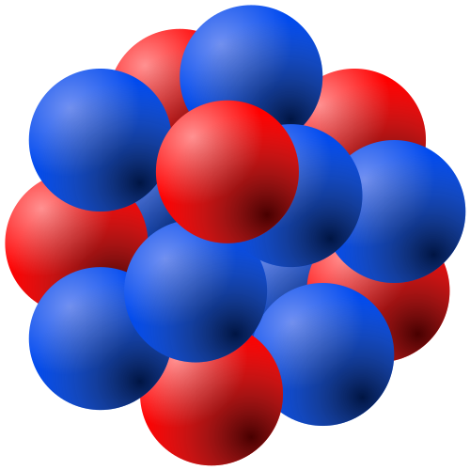
Overview of SINE
01
Probing complex many-body systems using neutrons
Understanding neutron interactions furthers science
Nuclear structure
Nuclear applications
Beyond-standard-model physics

Slide 4
Overview of SINE
01
Probing complex many-body systems using neutrons
Understanding neutron interactions furthers ESS
Nuclear structure – high scientific impact
Nuclear applications – high societal value
Beyond-standard-model physics – high risk-reward

Slide 5
Key concepts of SINE
01
Array for detection of induced nuclear reactions from pulsed neutron beams
Neutron as a probe of the strong interaction
Not detecting neutron directly
Instead, using it to induce observed reactions
Using high flux to investigate low cross-sections

Slide 6
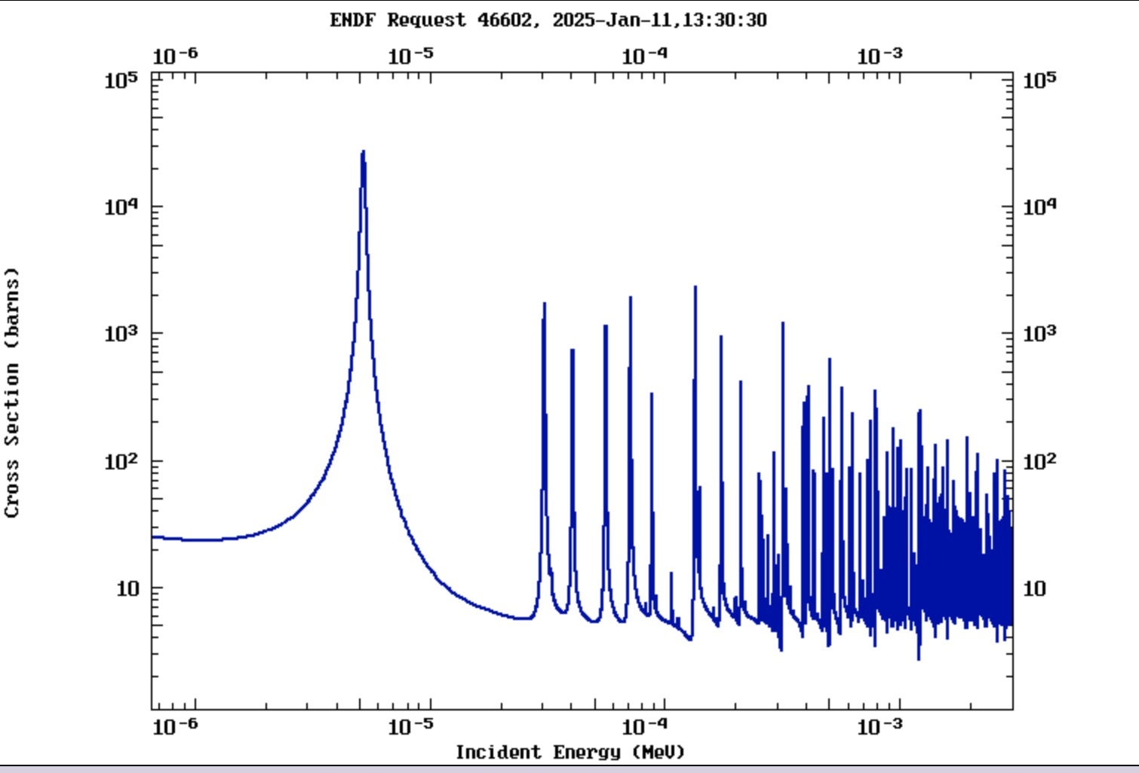
Key concepts of SINE
01
Timed pulses across a large energy range
Adaptable & expandable detector array
Proven technological basis
Utilises timing structure of beam to investigate delayed/suppressed reactions
Epithermal fluxes with fast chopper setup

Slide 7
Key concepts of SINE
01
Timed pulses across a large energy range
Adaptable & expandable detector array
Proven technological basis
Utilises timing structure of beam to investigate delayed/suppressed reactions
An example photon-silicon detection array

Slide 8
Scientific Impact
02
A
B
C
D
Structure
Nuclear astrophysics, shape, resonances…
Applications
Criticality, medical treatment, proliferation…
BSM physics
Hidden neutrons, >2 fission reactions…
NAA
Isotopic composition of irradiated samples…

Slide 9
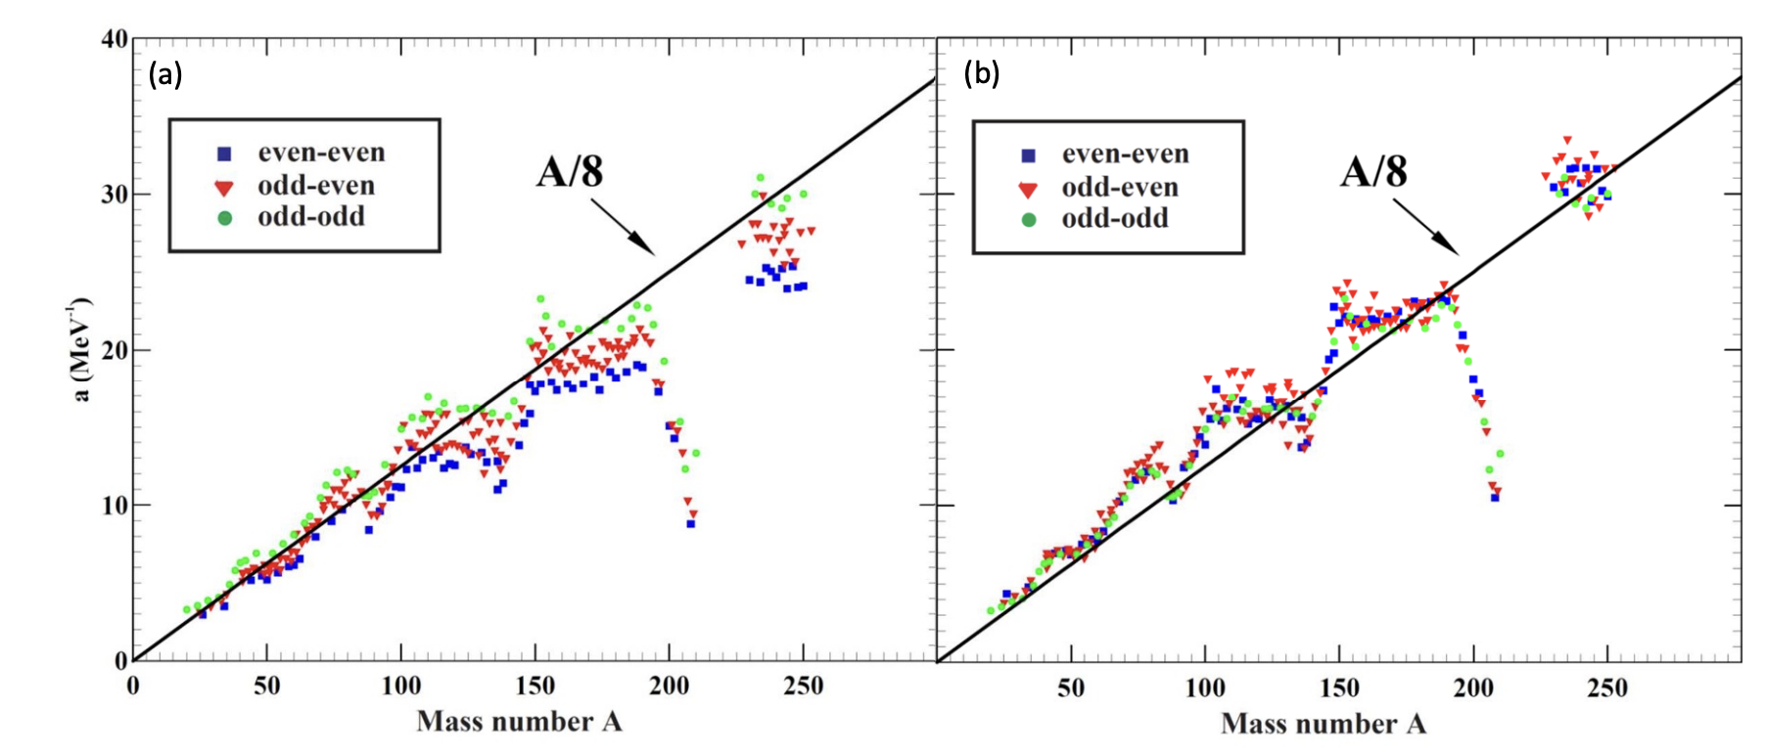
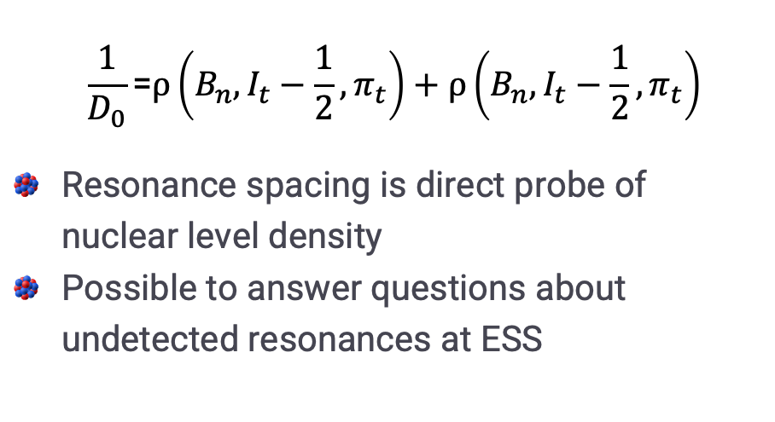
Scientific Impact - Structure
02
$$\frac{1}{D_{0}}\text{=}ρ\left(B_{n},I_{t}−\frac{1}{2},π_{t}\right)+ρ\left(B_{n},I_{t}−\frac{1}{2},π_{t}\right)$$
Resonance spacing is direct probe of nuclear level density
Possible to answer questions about undetected resonances at ESS
Effect of shell closures on s-wave mean spacing

Slide 10
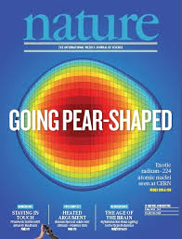
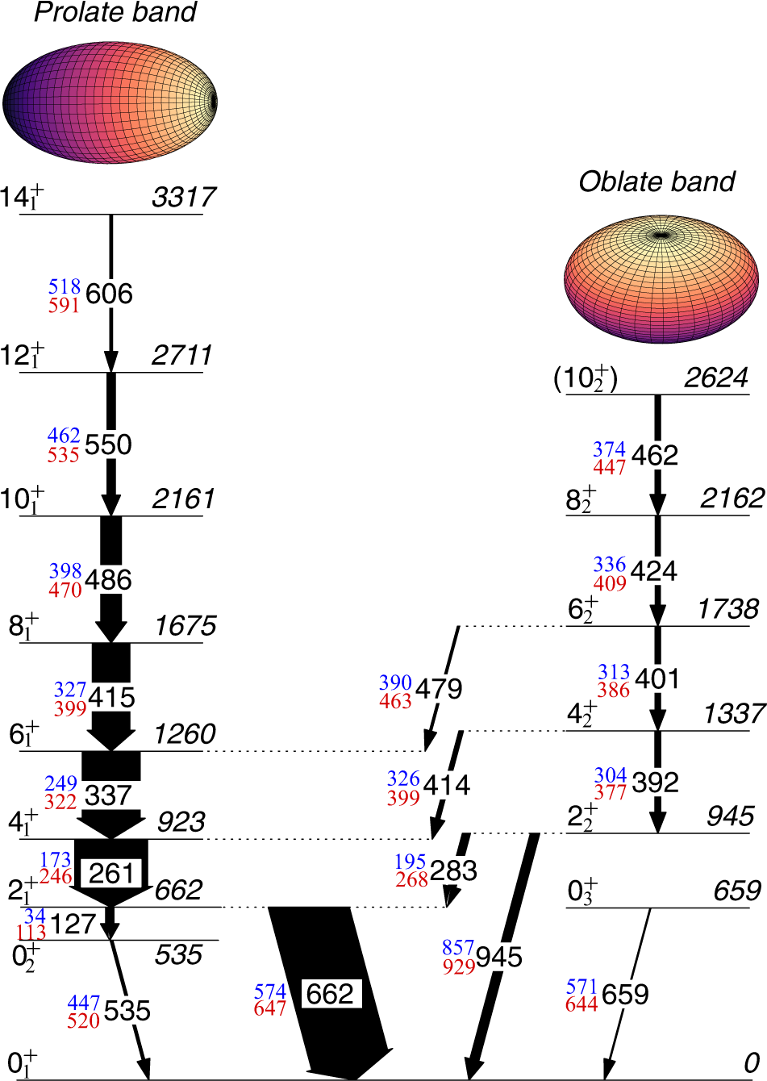
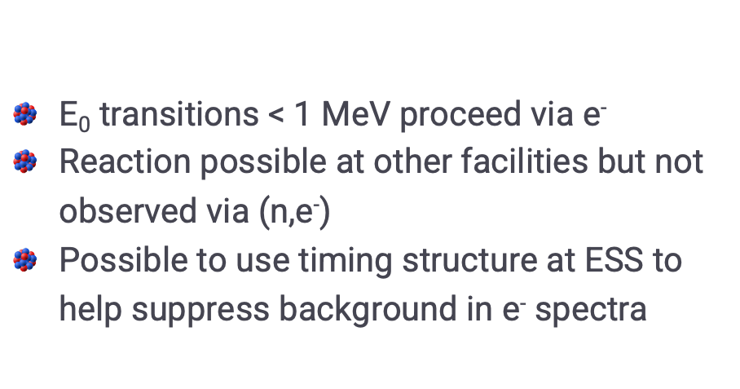
Scientific Impact - Structure
02
E₀ transitions < 1 MeV proceed via e⁻
Reaction possible at other facilities but not observed via (n,e⁻)
Possible to use timing structure at ESS to help suppress background in e⁻ spectra
Example E0 transition in ¹⁸⁶Pb

Slide 11
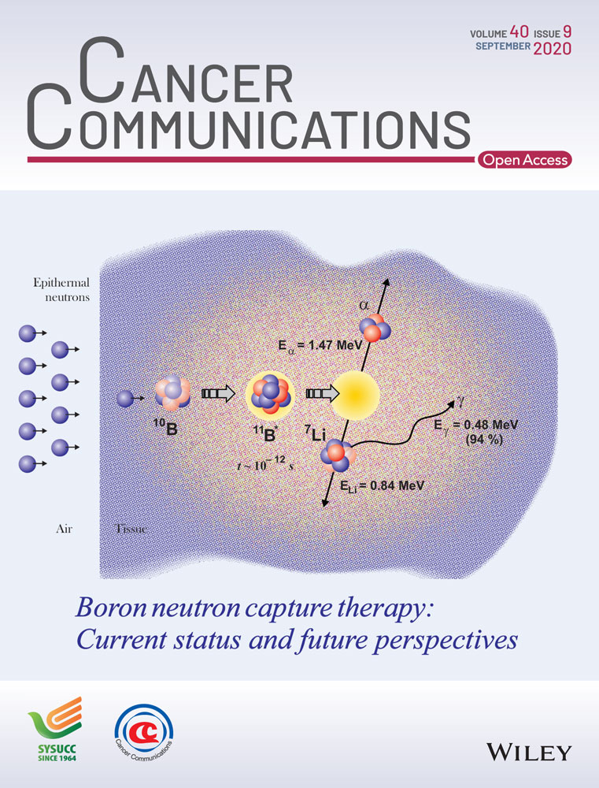
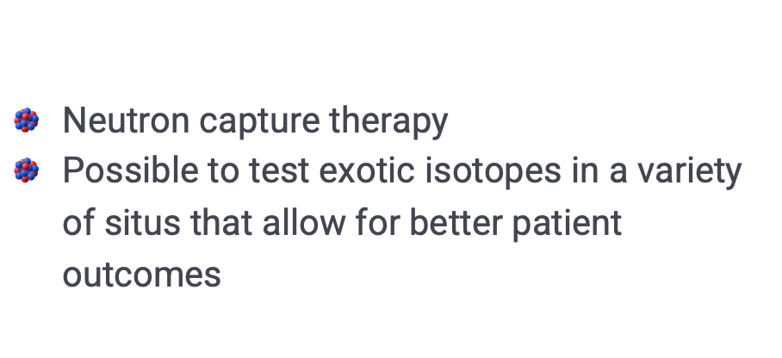
Scientific Impact - Applications
02
Neutron capture therapy
Possible to test exotic isotopes in a variety of situs that allow for better patient outcomes
Principle of capture therapy in contained volume

Slide 12
Scientific Impact - Applications
02
Security screening and proliferation detection
-----------------------------------

Slide 13

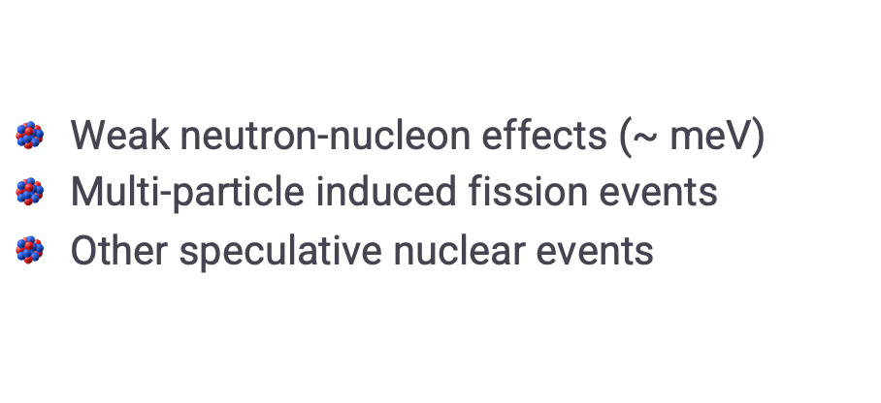
Scientific Impact – BSM
02
Weak neutron-nucleon effects (~ meV)
Multi-particle induced fission events
Other speculative nuclear events
High-risk, high-reward – needs high flux

Slide 14
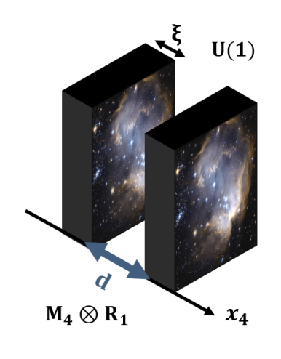
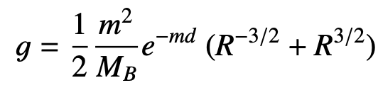

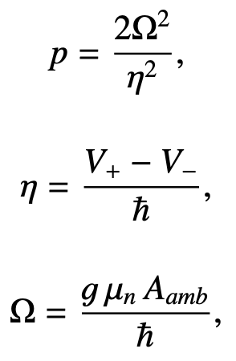
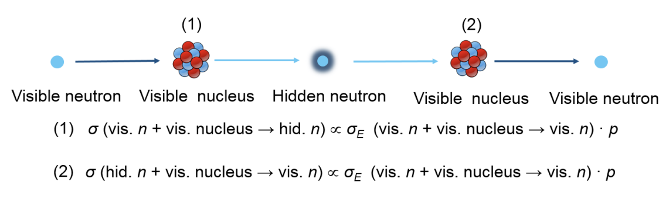

Scientific Impact – BSM
02
Concept that weakness of gravity can be explained by a ‘braneworld’
Not possible to probe to Planck scale with HEP]
Possible to measure coupling constant, g

Slide 15
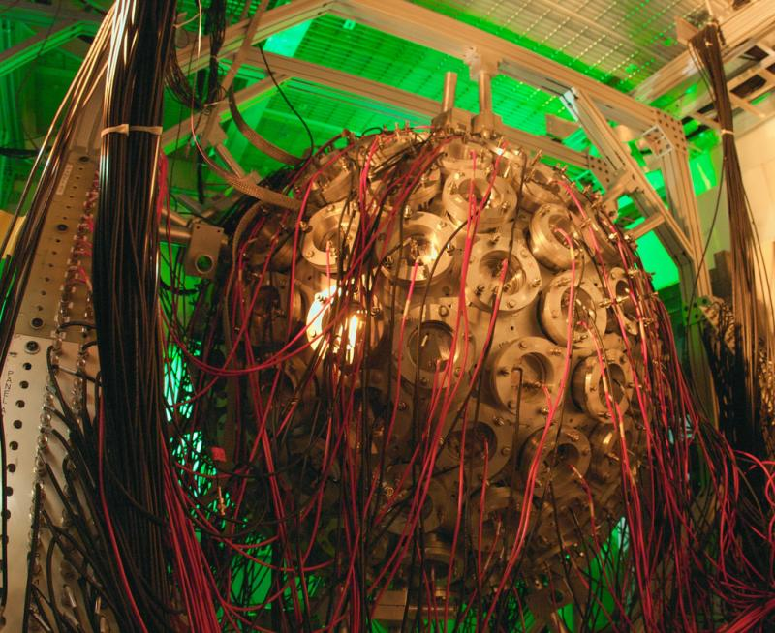
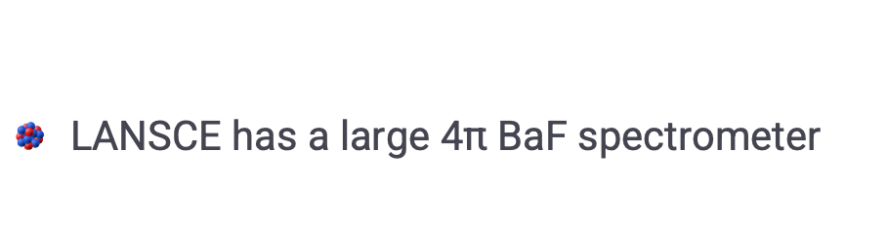
Uniqueness – Other facilities
03
LANSCE has a large 4π BaF spectrometer
DANCE

Slide 16
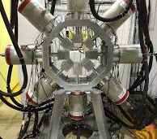
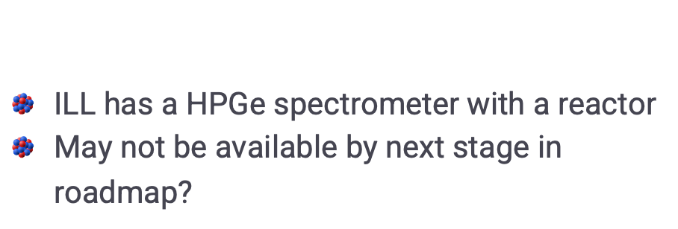
Uniqueness – Other facilities
03
ILL has a HPGe spectrometer with a reactor
May not be available by next stage in roadmap?
FIPPS

Slide 17
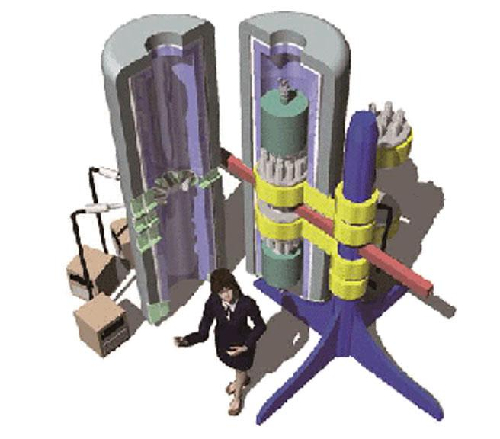
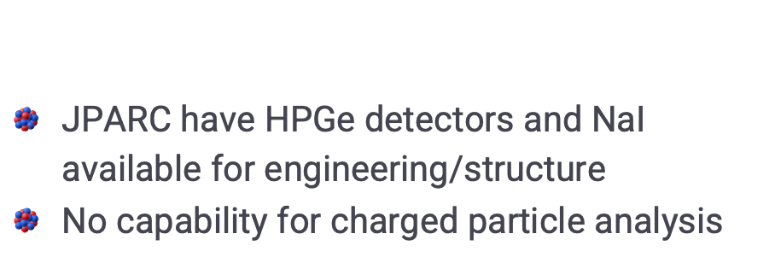
Uniqueness – Other facilities
03
JPARC have HPGe detectors and NaI available for engineering/structure
No capability for charged particle analysis
ANNRI

Slide 18
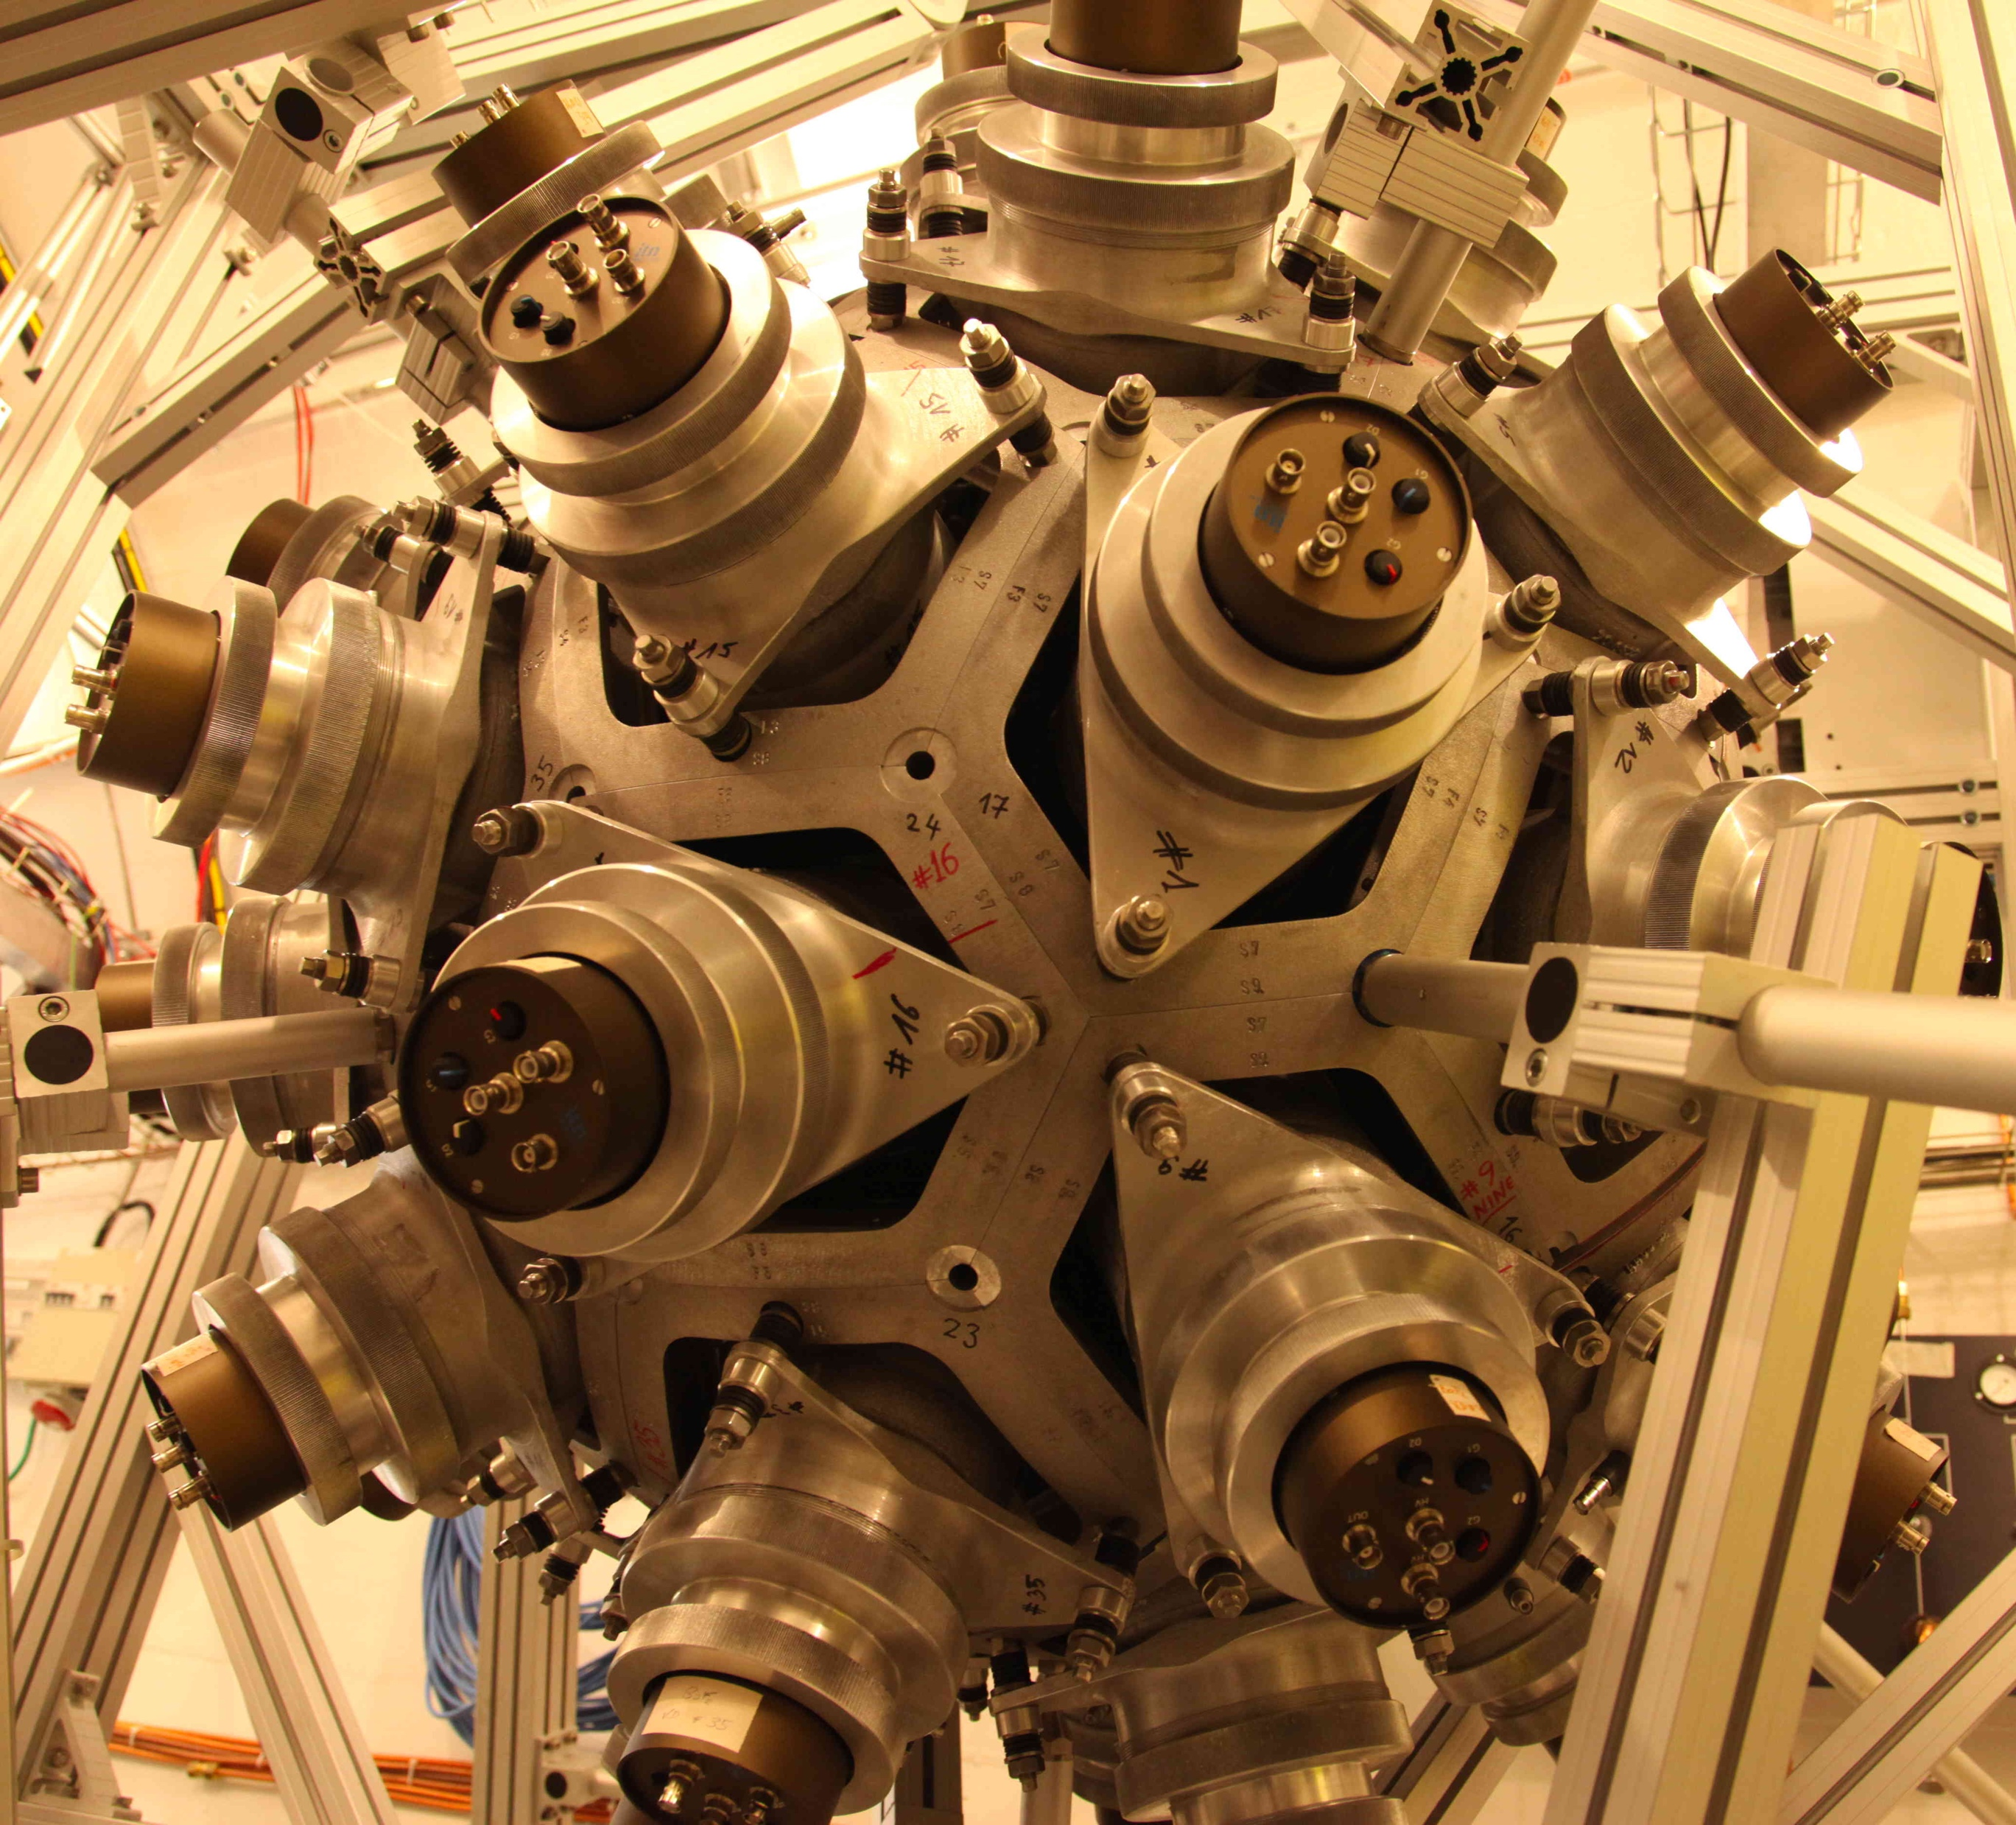
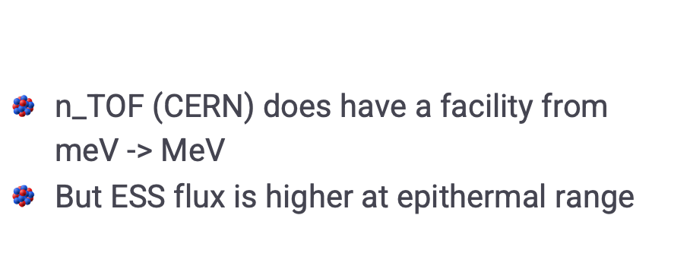
Uniqueness – Other facilities
03
n_TOF (CERN) does have a facility from meV -> MeV
But ESS flux is higher at epithermal range
4π calorimeter @ n_TOF

Slide 19
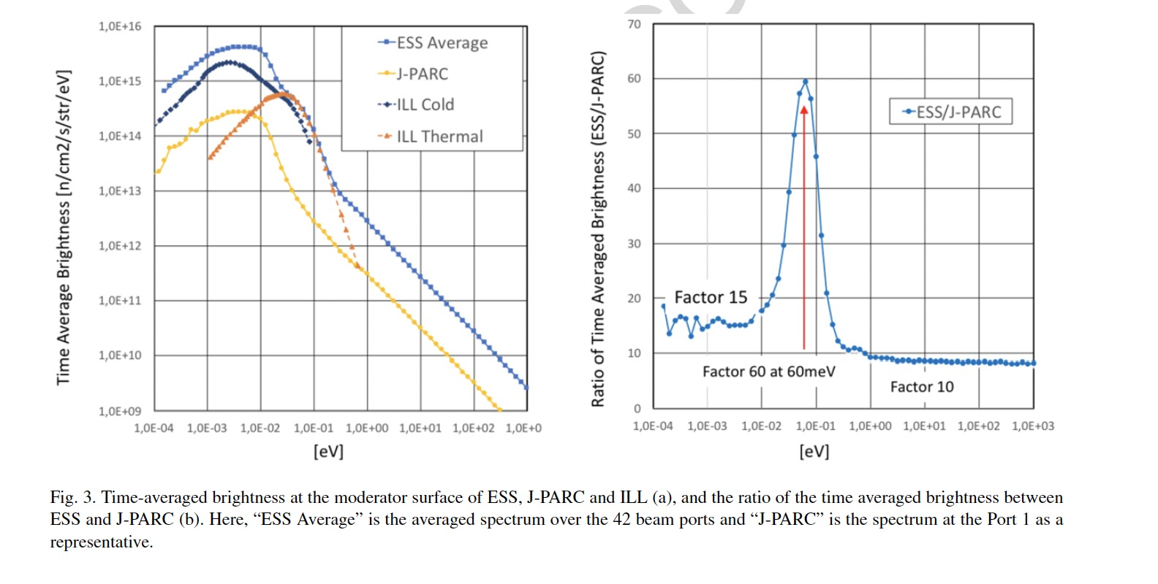
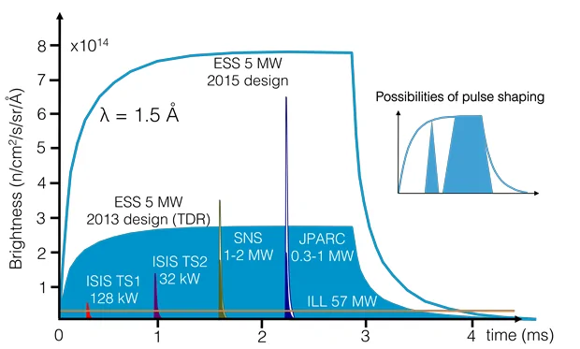
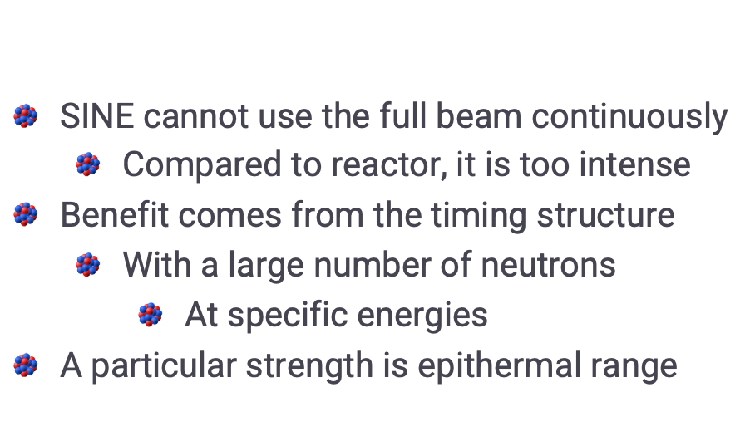
Uniqueness – Advantage of ESS
03
SINE cannot use the full beam continuously
  Compared to reactor, it is too intense
Benefit comes from the timing structure
  With a large number of neutrons
    At specific energies
A particular strength is epithermal range
High flux with high selection with timing

Slide 20

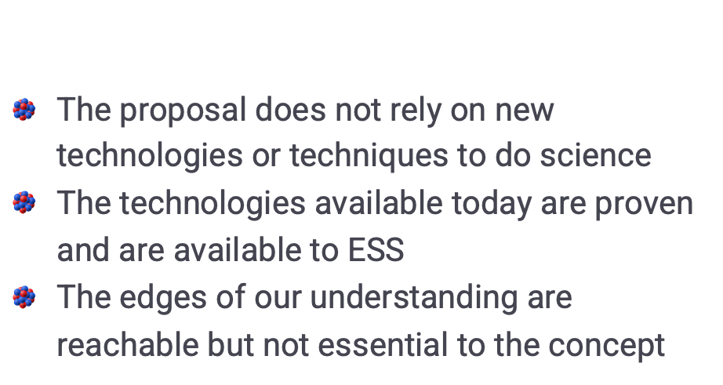
Feasibility
04
The proposal does not rely on new technologies or techniques to do science
The technologies available today are proven and are available to ESS
The edges of our understanding are reachable but not essential to the concept
It is ready to go as soon as neutrons are available

Slide 21
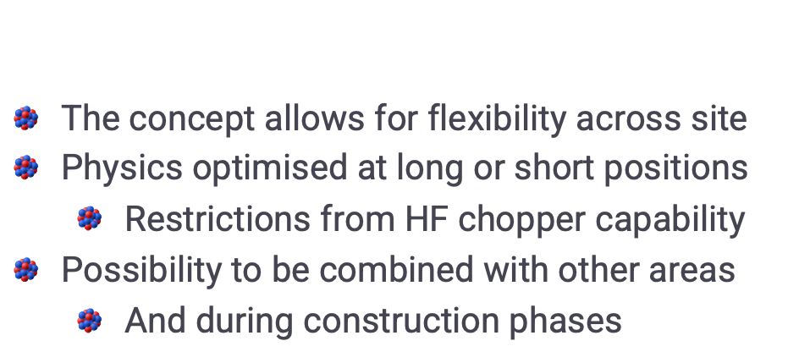
Feasibility – Beamline choice
04
The concept allows for flexibility across site
Physics optimised at long or short positions
  Restrictions from HF chopper capability
Possibility to be combined with other areas
  And during construction phases
Maximum value from ESS can be extracted

Slide 22
Resources
05
A
B
C
D
Beamline
Flexible
Detectors
Available
Team
Large
Construction
Not required

Slide 23
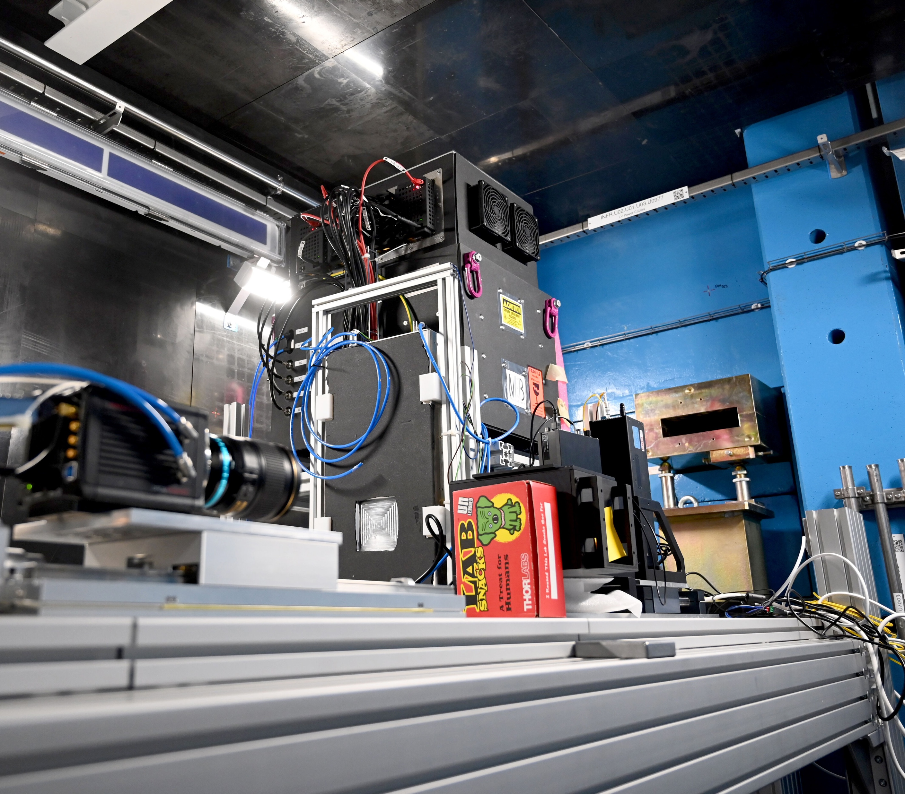
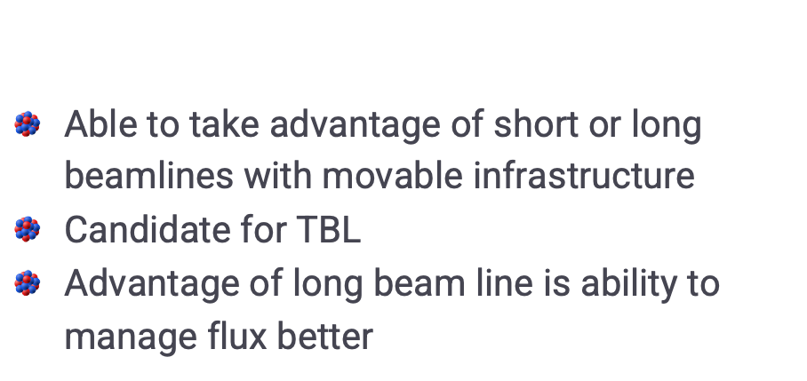
Resources – Beamline
05
Able to take advantage of short or long beamlines with movable infrastructure
Candidate for TBL
Advantage of long beam line is ability to manage flux better
Test Beam Line is a possible location

Slide 24
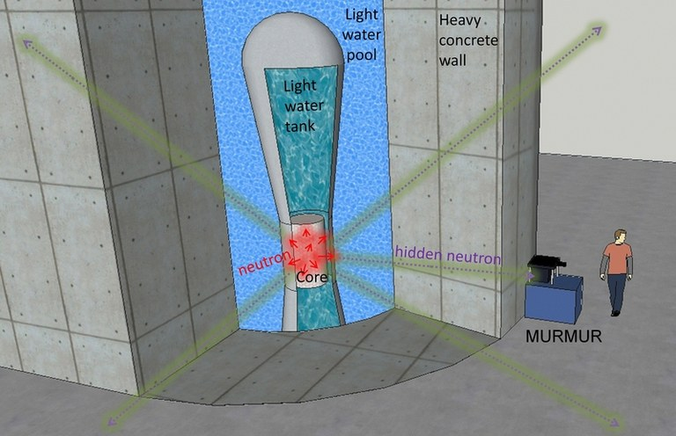
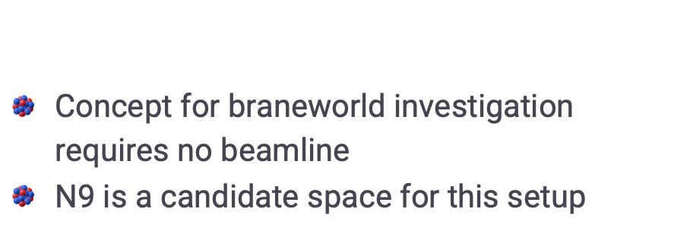
Resources – Beamline
05
Concept for braneworld investigation requires no beamline
N9 is a candidate space for this setup
MURMUR experiment

Slide 25
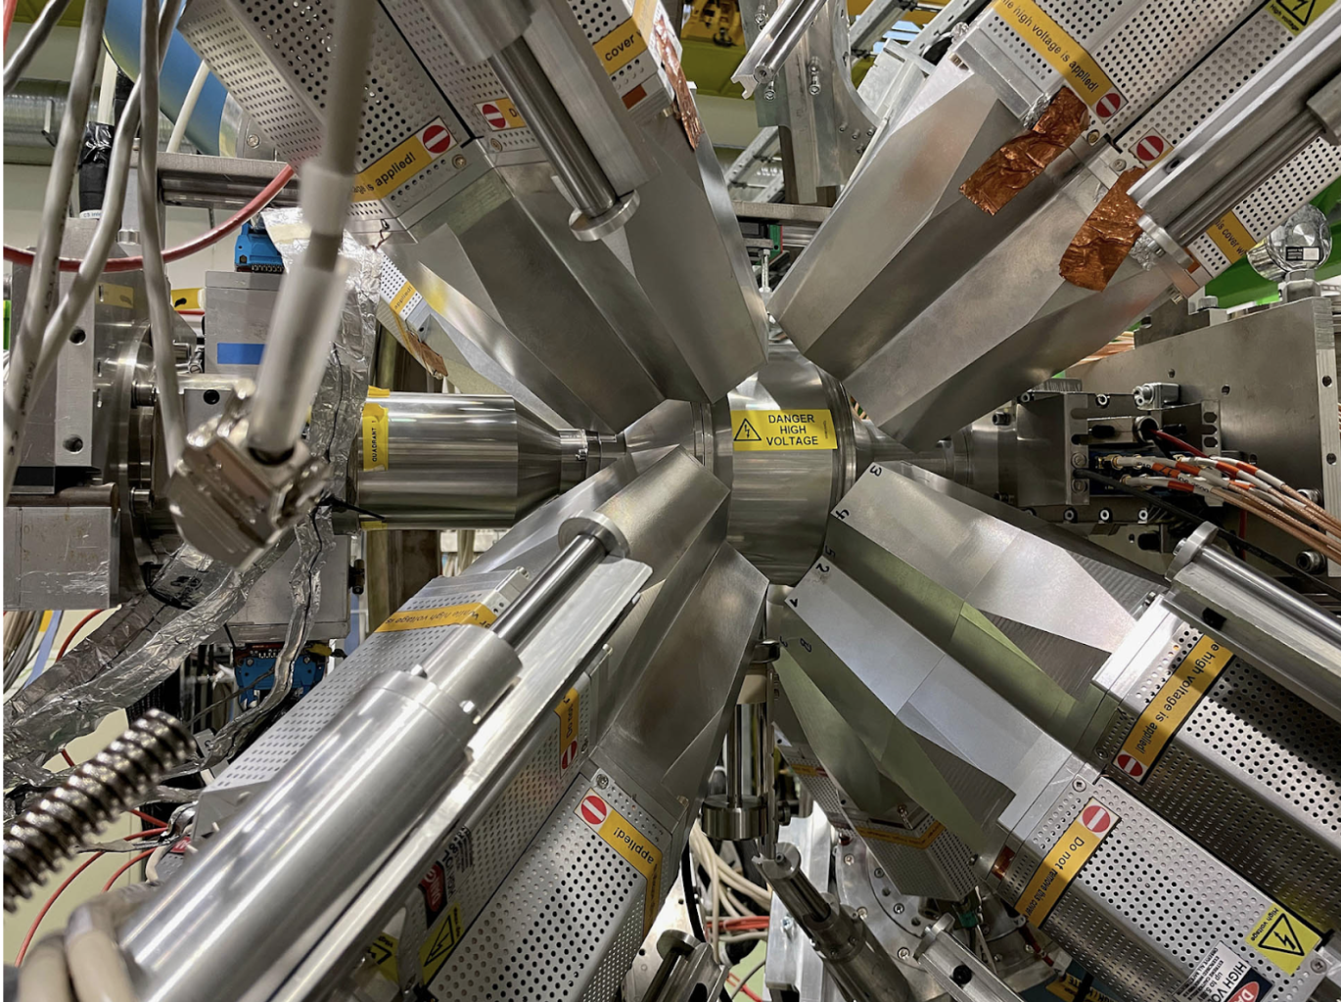
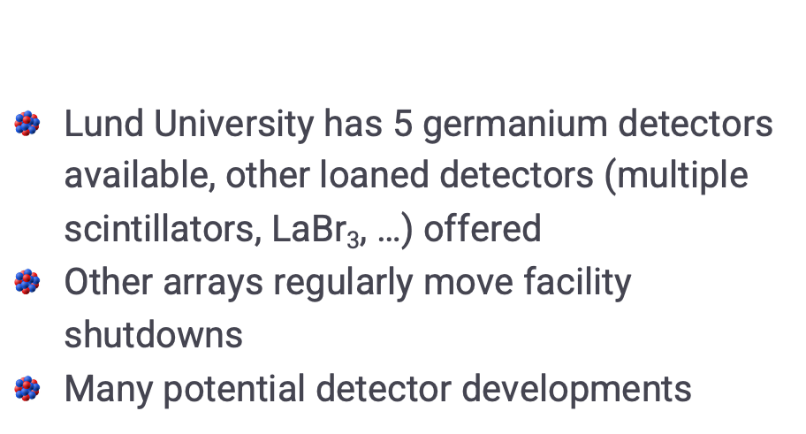
Resources – Detectors
05
Lund University has 5 germanium detectors available, other loaned detectors (multiple scintillators, LaBr₃, …) offered
Other arrays regularly move facility shutdowns
Many potential detector developments
MINIBALL experiment

Slide 26






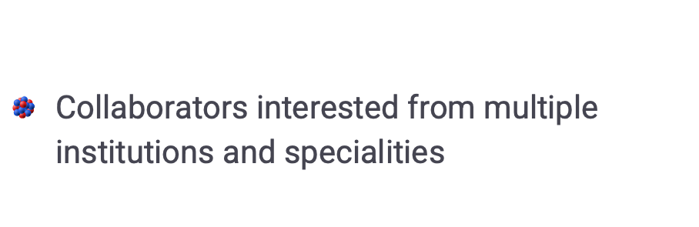
Resources – Team
05
Collaborators interested from multiple institutions and specialities
(Non-exhaustive) list of institutes

Slide 27

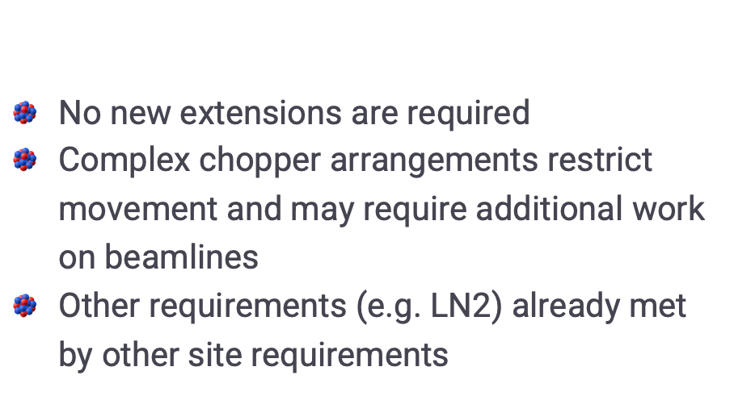
Resources – Construction
05
No new extensions are required
Complex chopper arrangements restrict movement and may require additional work on beamlines
Other requirements (e.g. LN2) already met by other site requirements

Slide 28
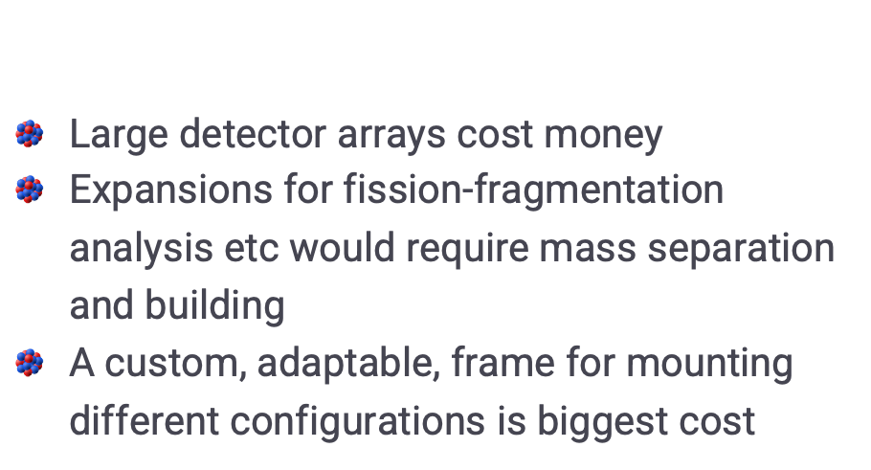
Resources – Development
05
Large detector arrays cost money
Expansions for fission-fragmentation analysis etc would require mass separation and building
A custom, adaptable, frame for mounting different configurations is biggest cost

Slide 29
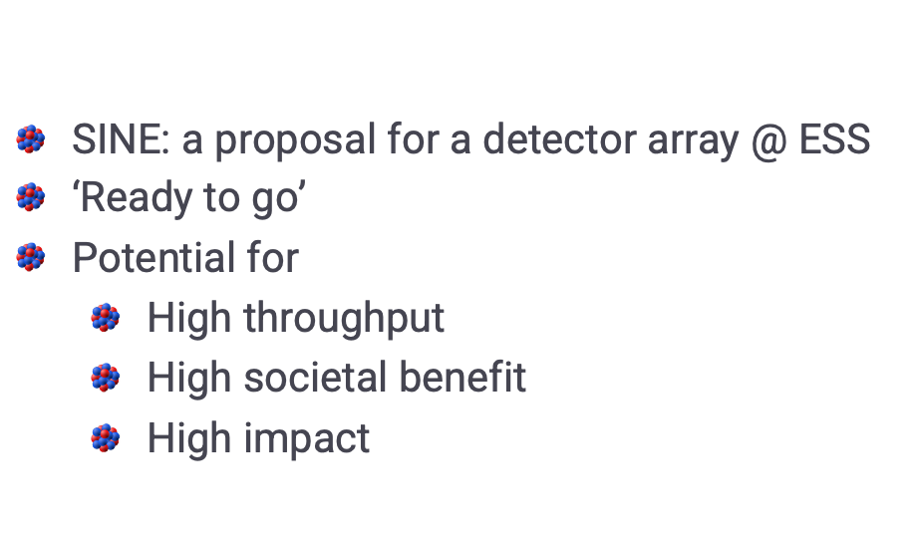
Summary
06
SINE: a proposal for a detector array @ ESS
‘Ready to go’
Potential for
  High throughput
  High societal benefit
  High impact

Slide 30
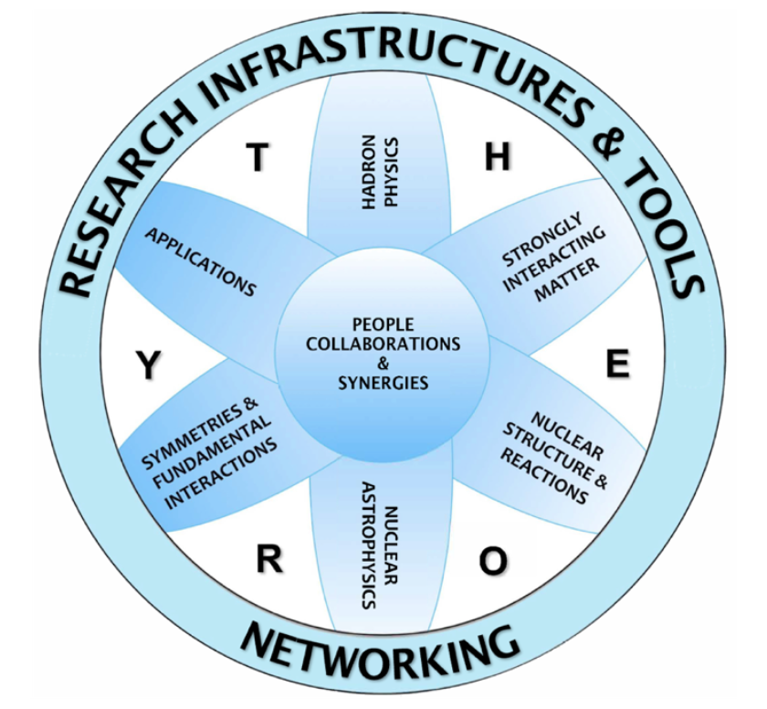
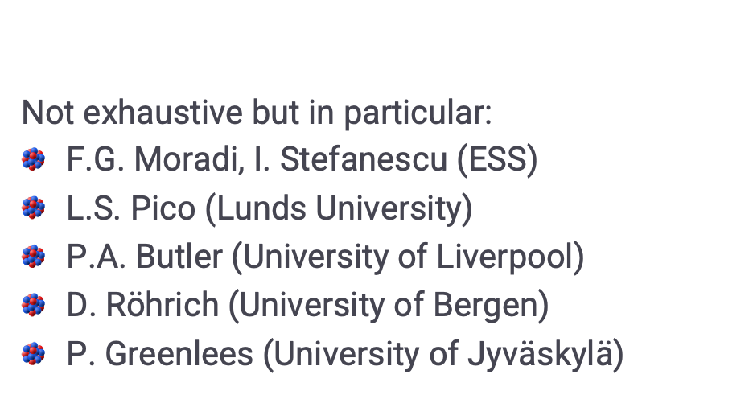
Thanks
06
Not exhaustive but in particular:
F.G. Moradi, I. Stefanescu (ESS)
L.S. Pico (Lunds University)
P.A. Butler (University of Liverpool)
D. Röhrich (University of Bergen)
P. Greenlees (University of Jyväskylä)

Slide 31
THANK YOU
george.oneill@ess.eu
SINE collaboration institutes:

