Slide 1
SKADI
Small-Angle Neutron Scattering at ESS
PRESENTED BY Sebastian Jaksch

Slide 2
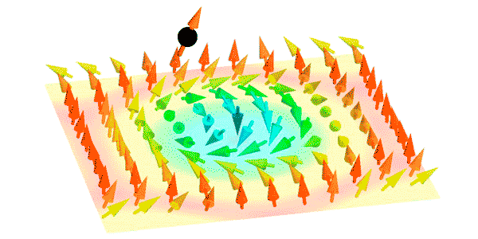
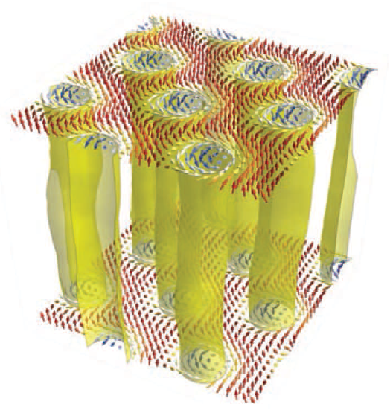
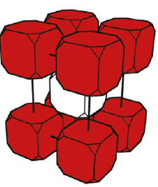
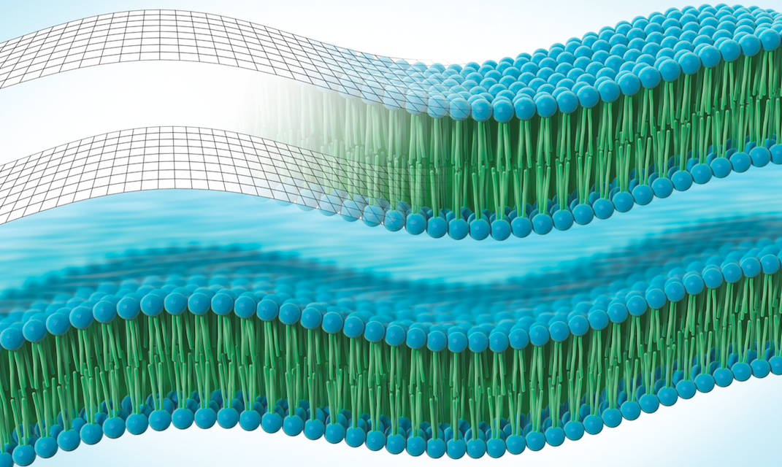
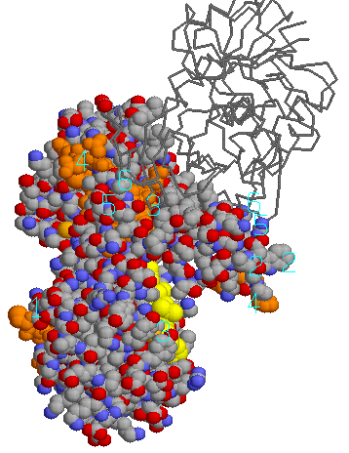
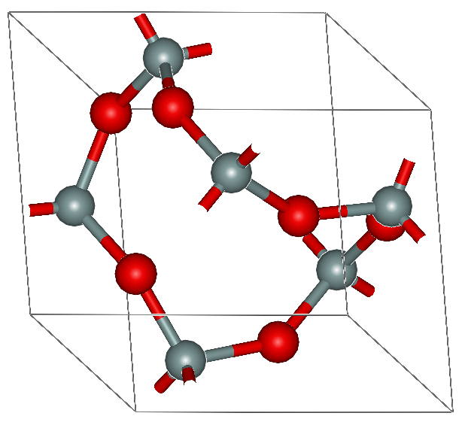
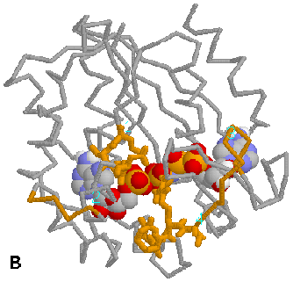
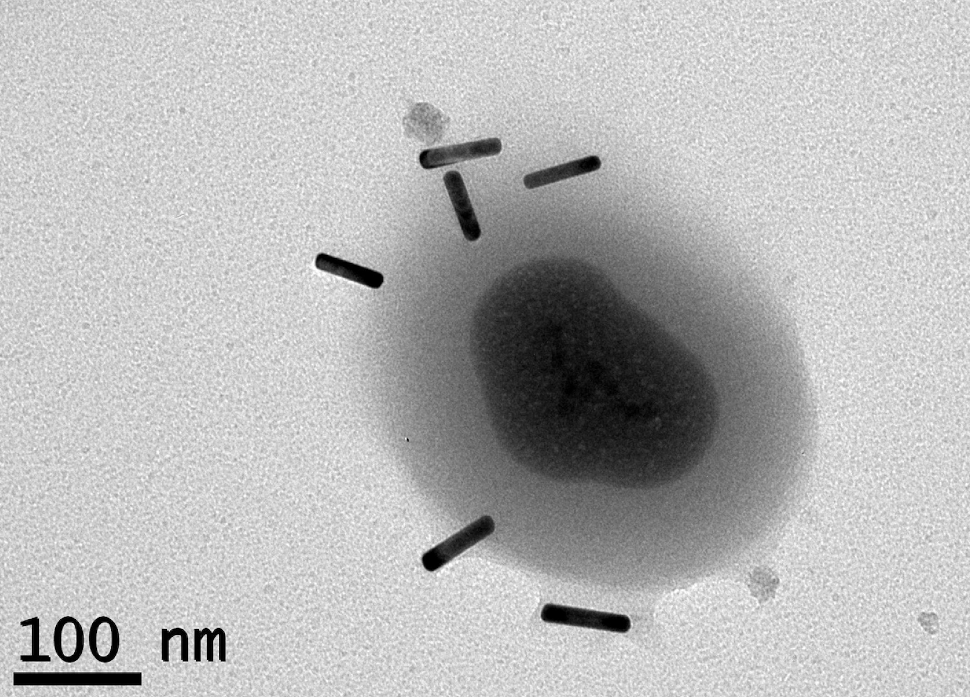
SKADI: Science Case
C
C
real space
1Å
10Å
100Å
Q-space
1Å⁻¹
0.1Å⁻¹
0.01Å⁻¹

Slide 3


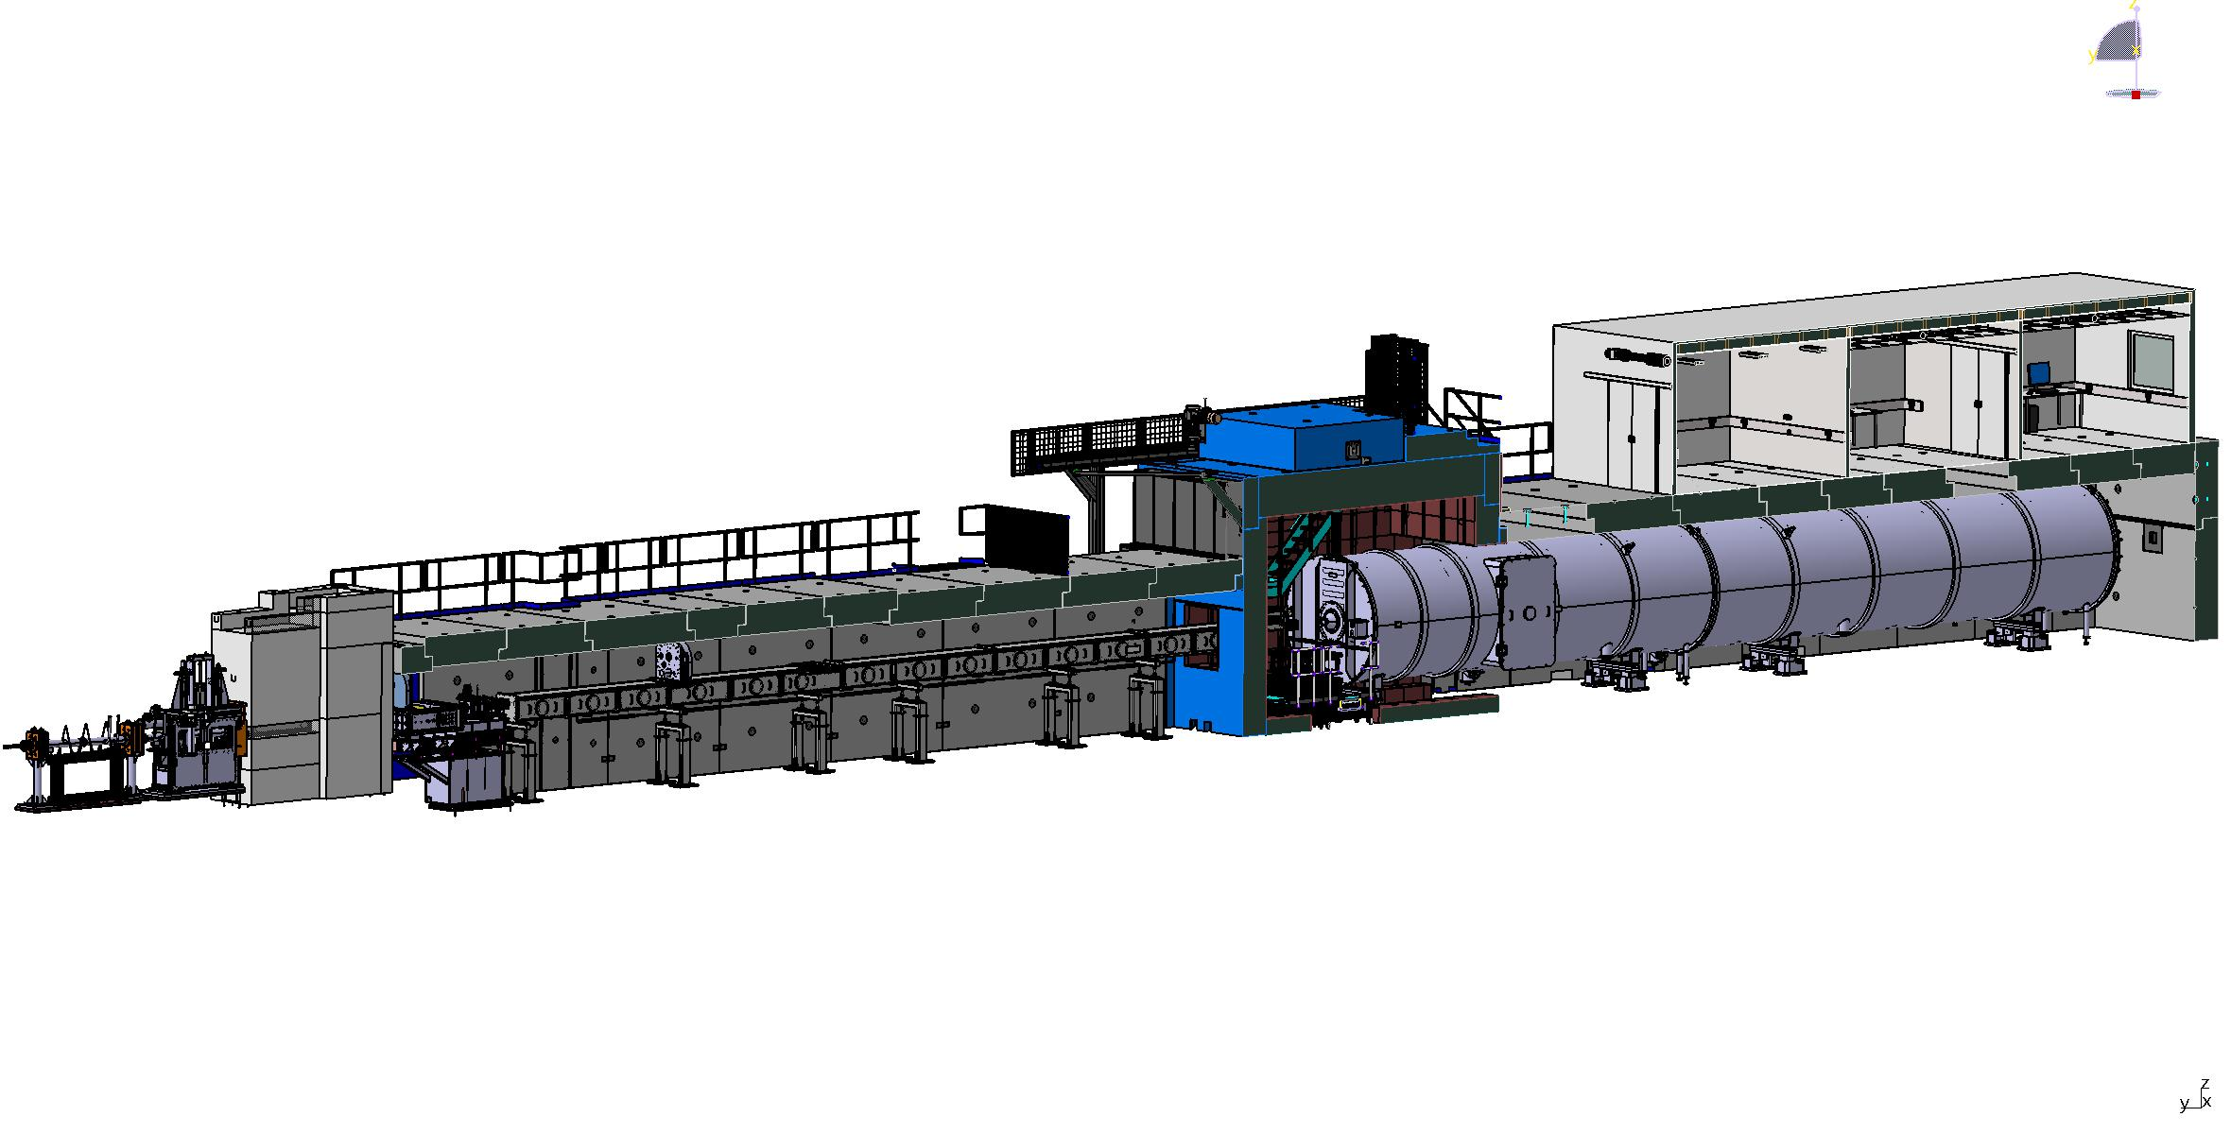
SKADI
50 / 50
CEP: installation ongoing
CUP: installation imminent
MCA: installation imminent
Installed,
In installation/storage,
In manufacturing
FZJ / LLB
Hutch
FZJ
Sample Exposure System
Sample area, shielding
FZJ
Beam extraction Sysystem
NBOA, BBG, Reflector
FZJ
Chopper System
FZJ
Neutron detector system
Detectortube, detector vessel, shielding
LLB
Beam geometry conditioning
Collimation and apertures +shielding
LLB
Heavy shutter
FZJ
Neutron Detector
FZJ
Housing ready Mid-2025
Installation of electronics into housing End-2025
Transfer to Lund until mid 2026
Cooling delivered
Beam filtering system
Polarizer, Spin Flipper
FZJ

Slide 4
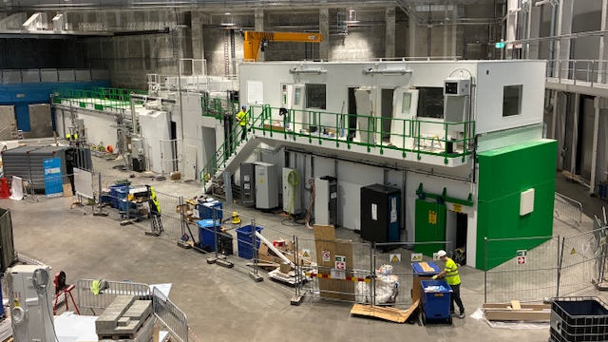

Slide 5
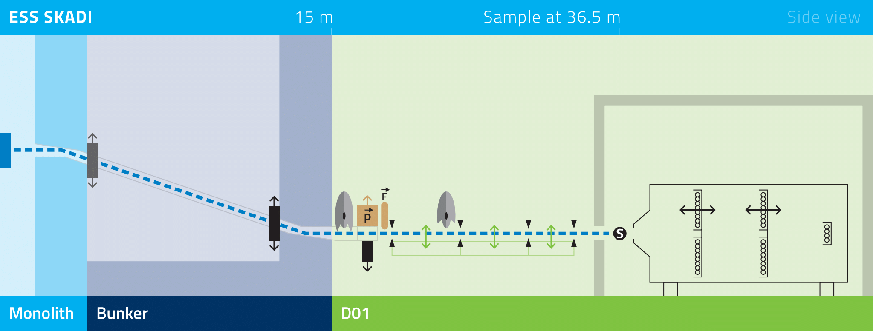
Technical Overview
Quick Facts
Class | Polarized SANS
Moderator | Cold
Length | 58 m
Q-Range | 10⁻⁴ – 1 Å⁻¹
Flux at sample position | 7.7×10⁸ n s⁻¹ cm⁻²
Standard Mode (14 Hz)
Wavelength Band |  | 5 Å
Wavelength Range |  | 3 – 21 Å
Momentum Resolution |  | ΔQ/Q= 2-7 %
Pulse Skipping Mode (7 Hz)
Wavelength Band |  | 10 Å
Wavelength Range |  | 3 – 21 Å
Momentum Resolution |  | ΔQ/Q = 1-7 %
General purpose SANS
Focus on high time and spatial resolution
Attempt to optimize S/N ration (future will tell …)
  Low concentration weak scattering samples
  High H-background samples
  Polarization with PA

Slide 6
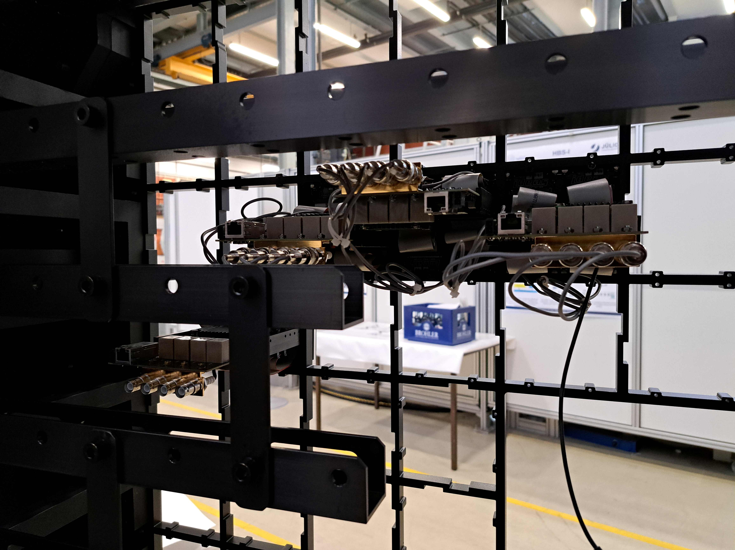
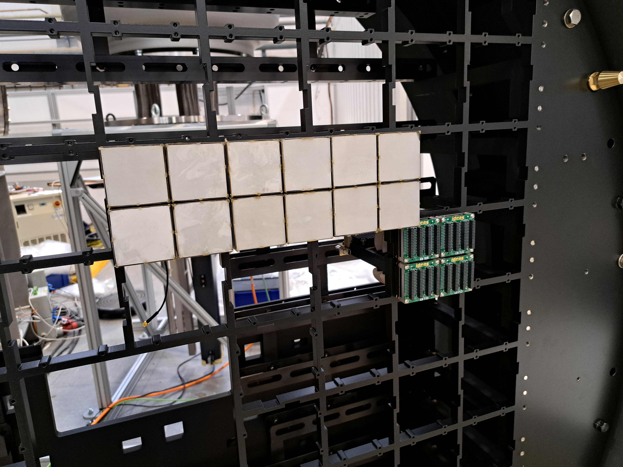
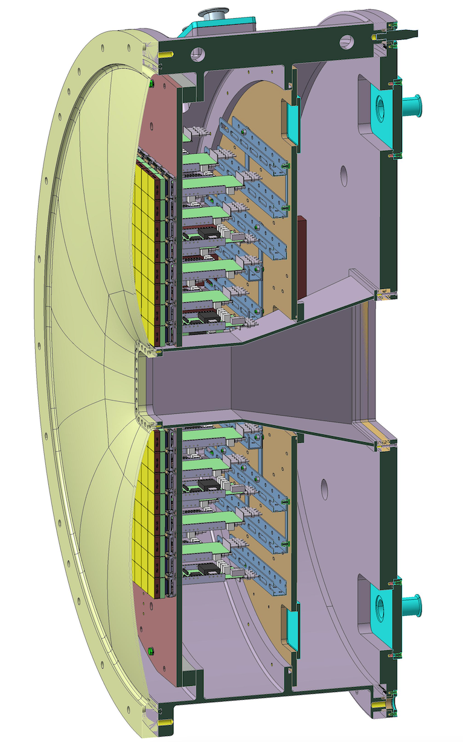
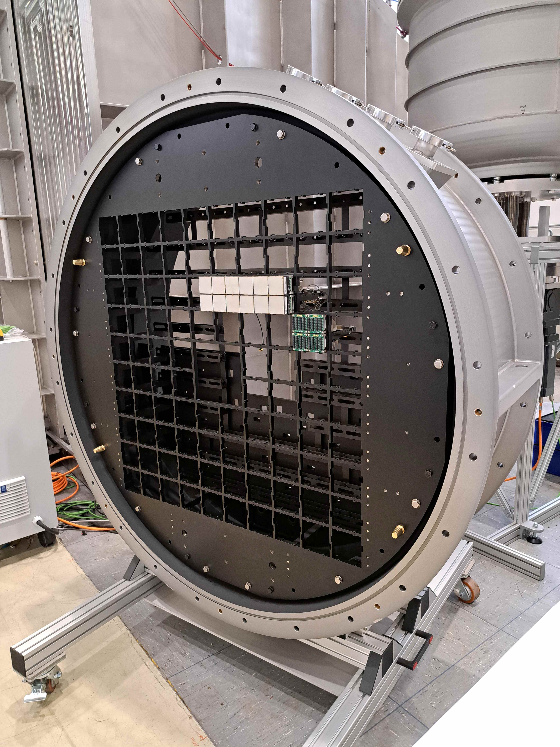
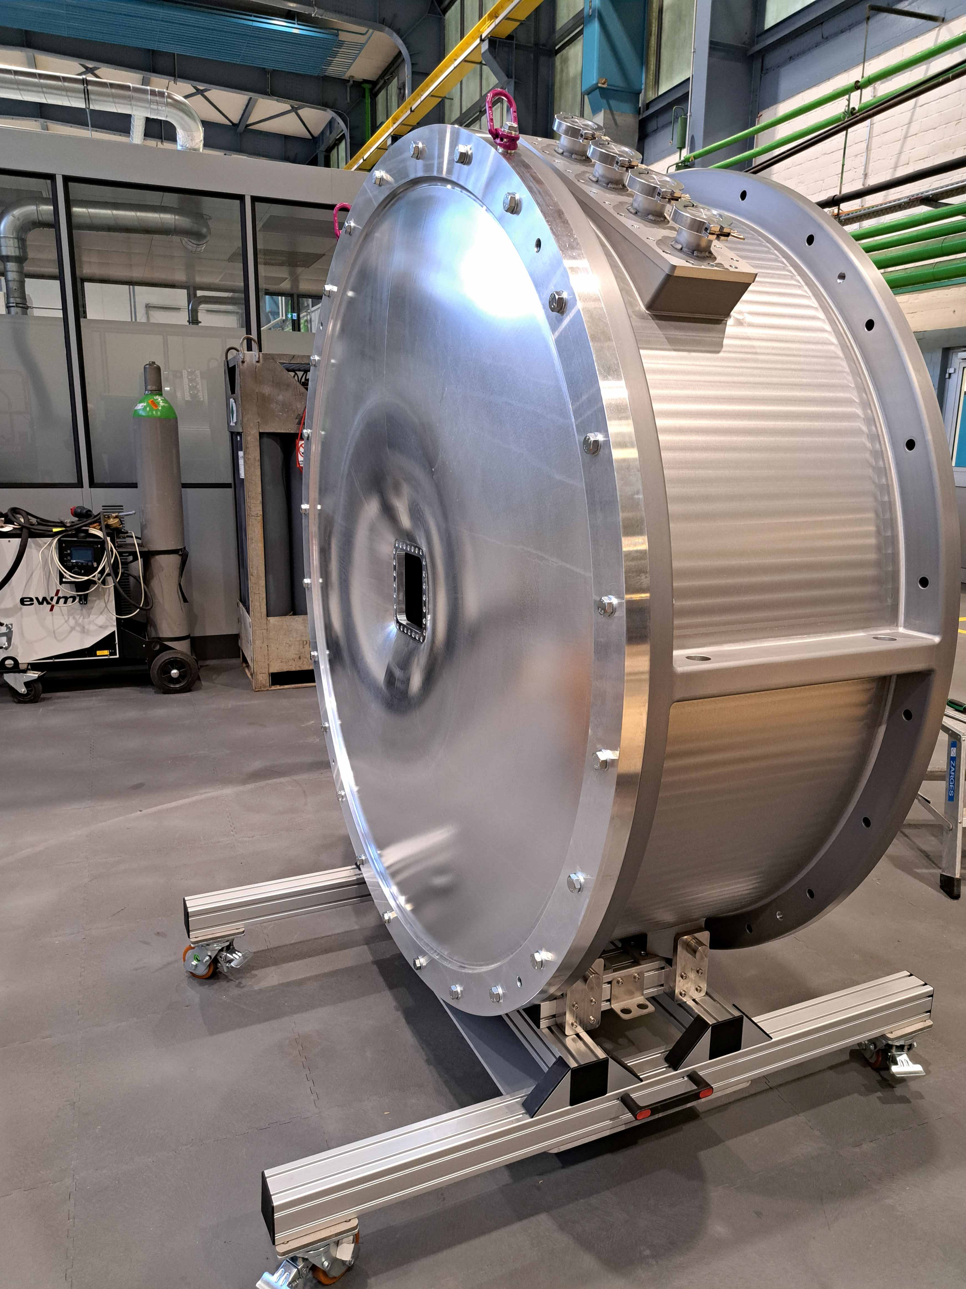
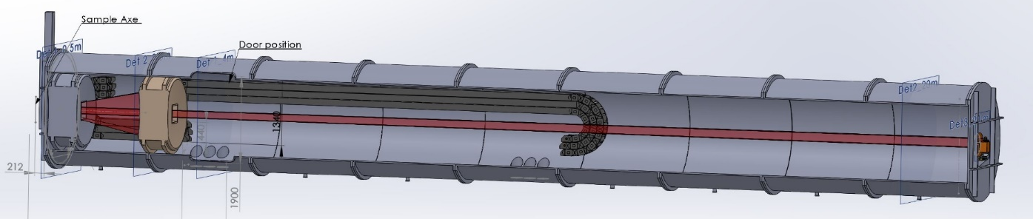
Detector
High-Flux Neutron Detector: Pixelated MaPMT Scintillation Detector

Slide 7
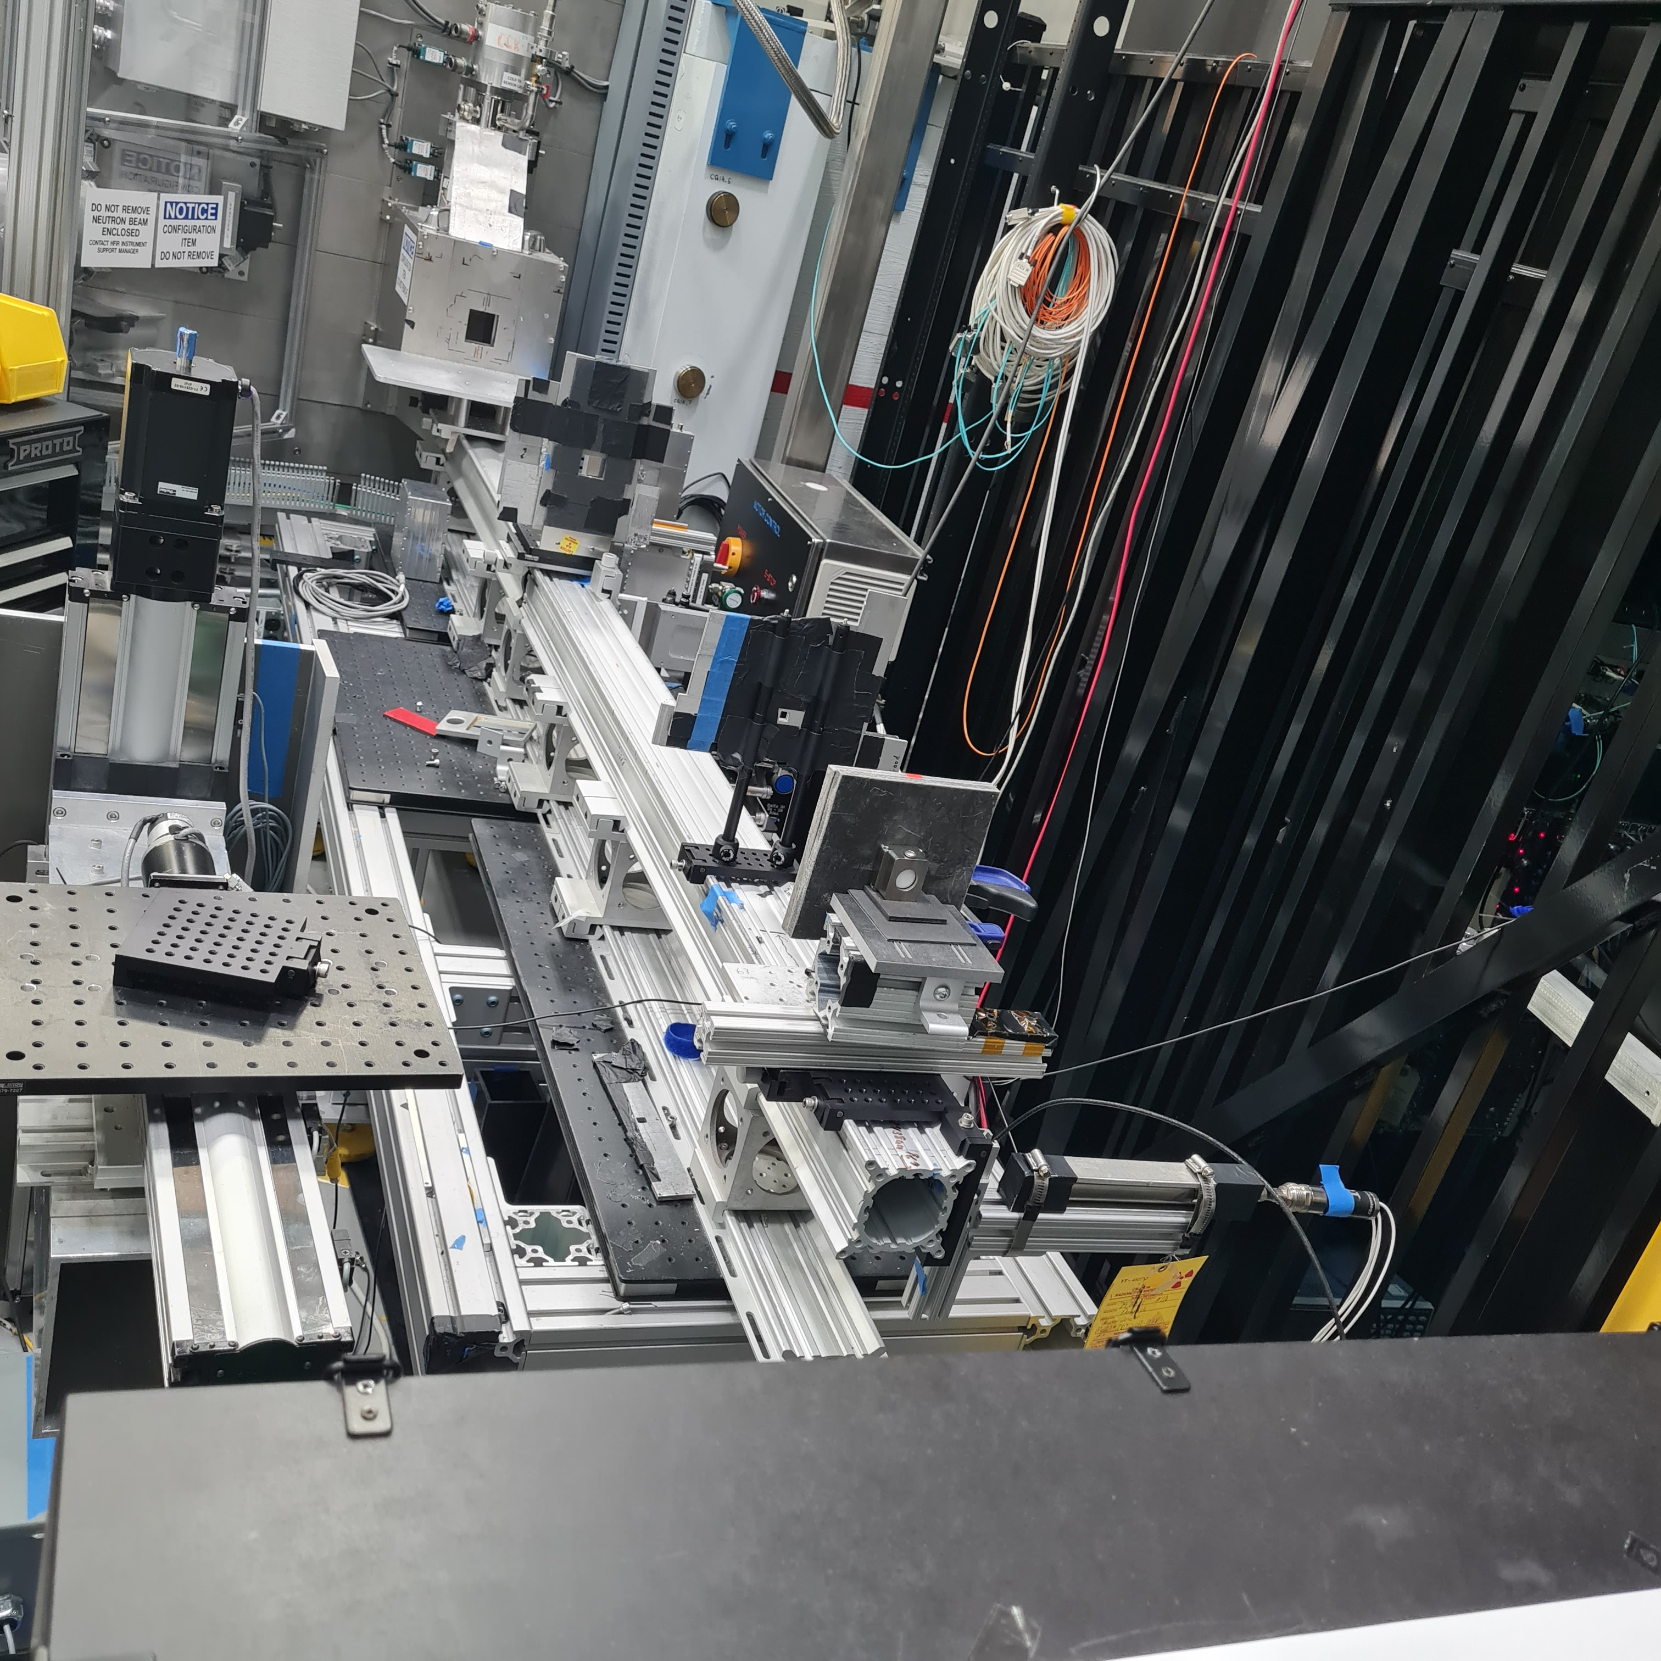
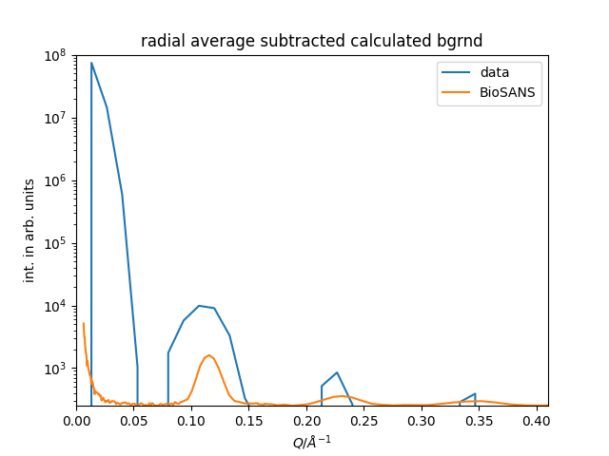
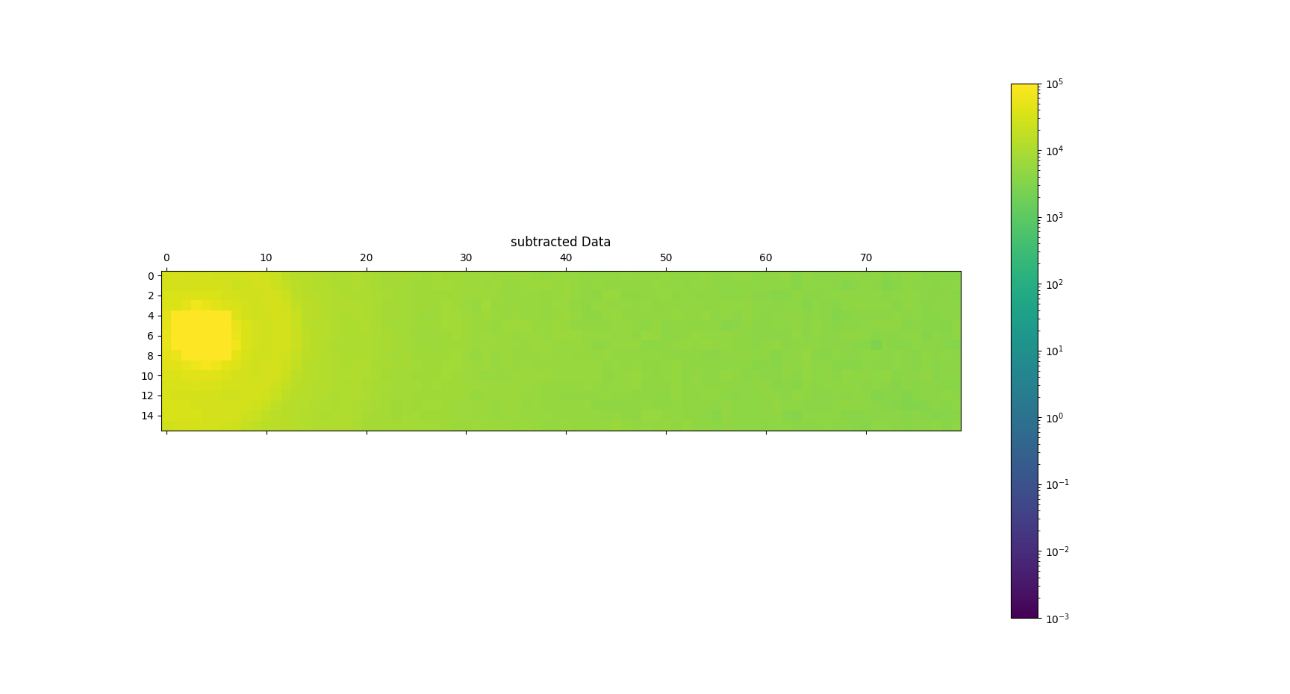
Detector
1 m² distributed over three detector boxes (final scope 2 m² + primary beam detector)
Capable of handling direct ESS beam on detector (test at SNS with primary beam were well within linear range)
6 mm xy resolution, 3 mm for primary beam
Time resolution around 1 µs
Better 1:1000 gamma suppression
90% + percent efficiency
Pure network readout with fed-in sync signal
Based
Hamamatsu MaPMT
GS20 scintillator
SoNDe EU project developed electronics

Slide 8
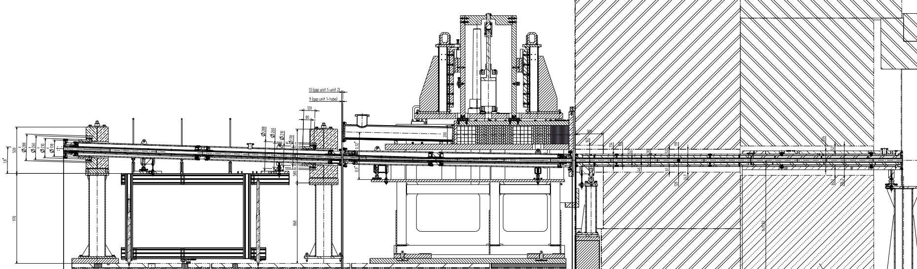
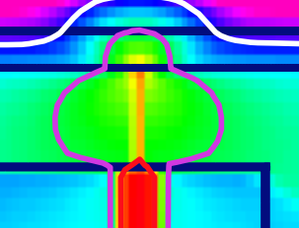
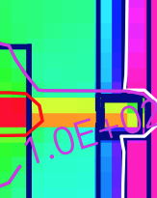
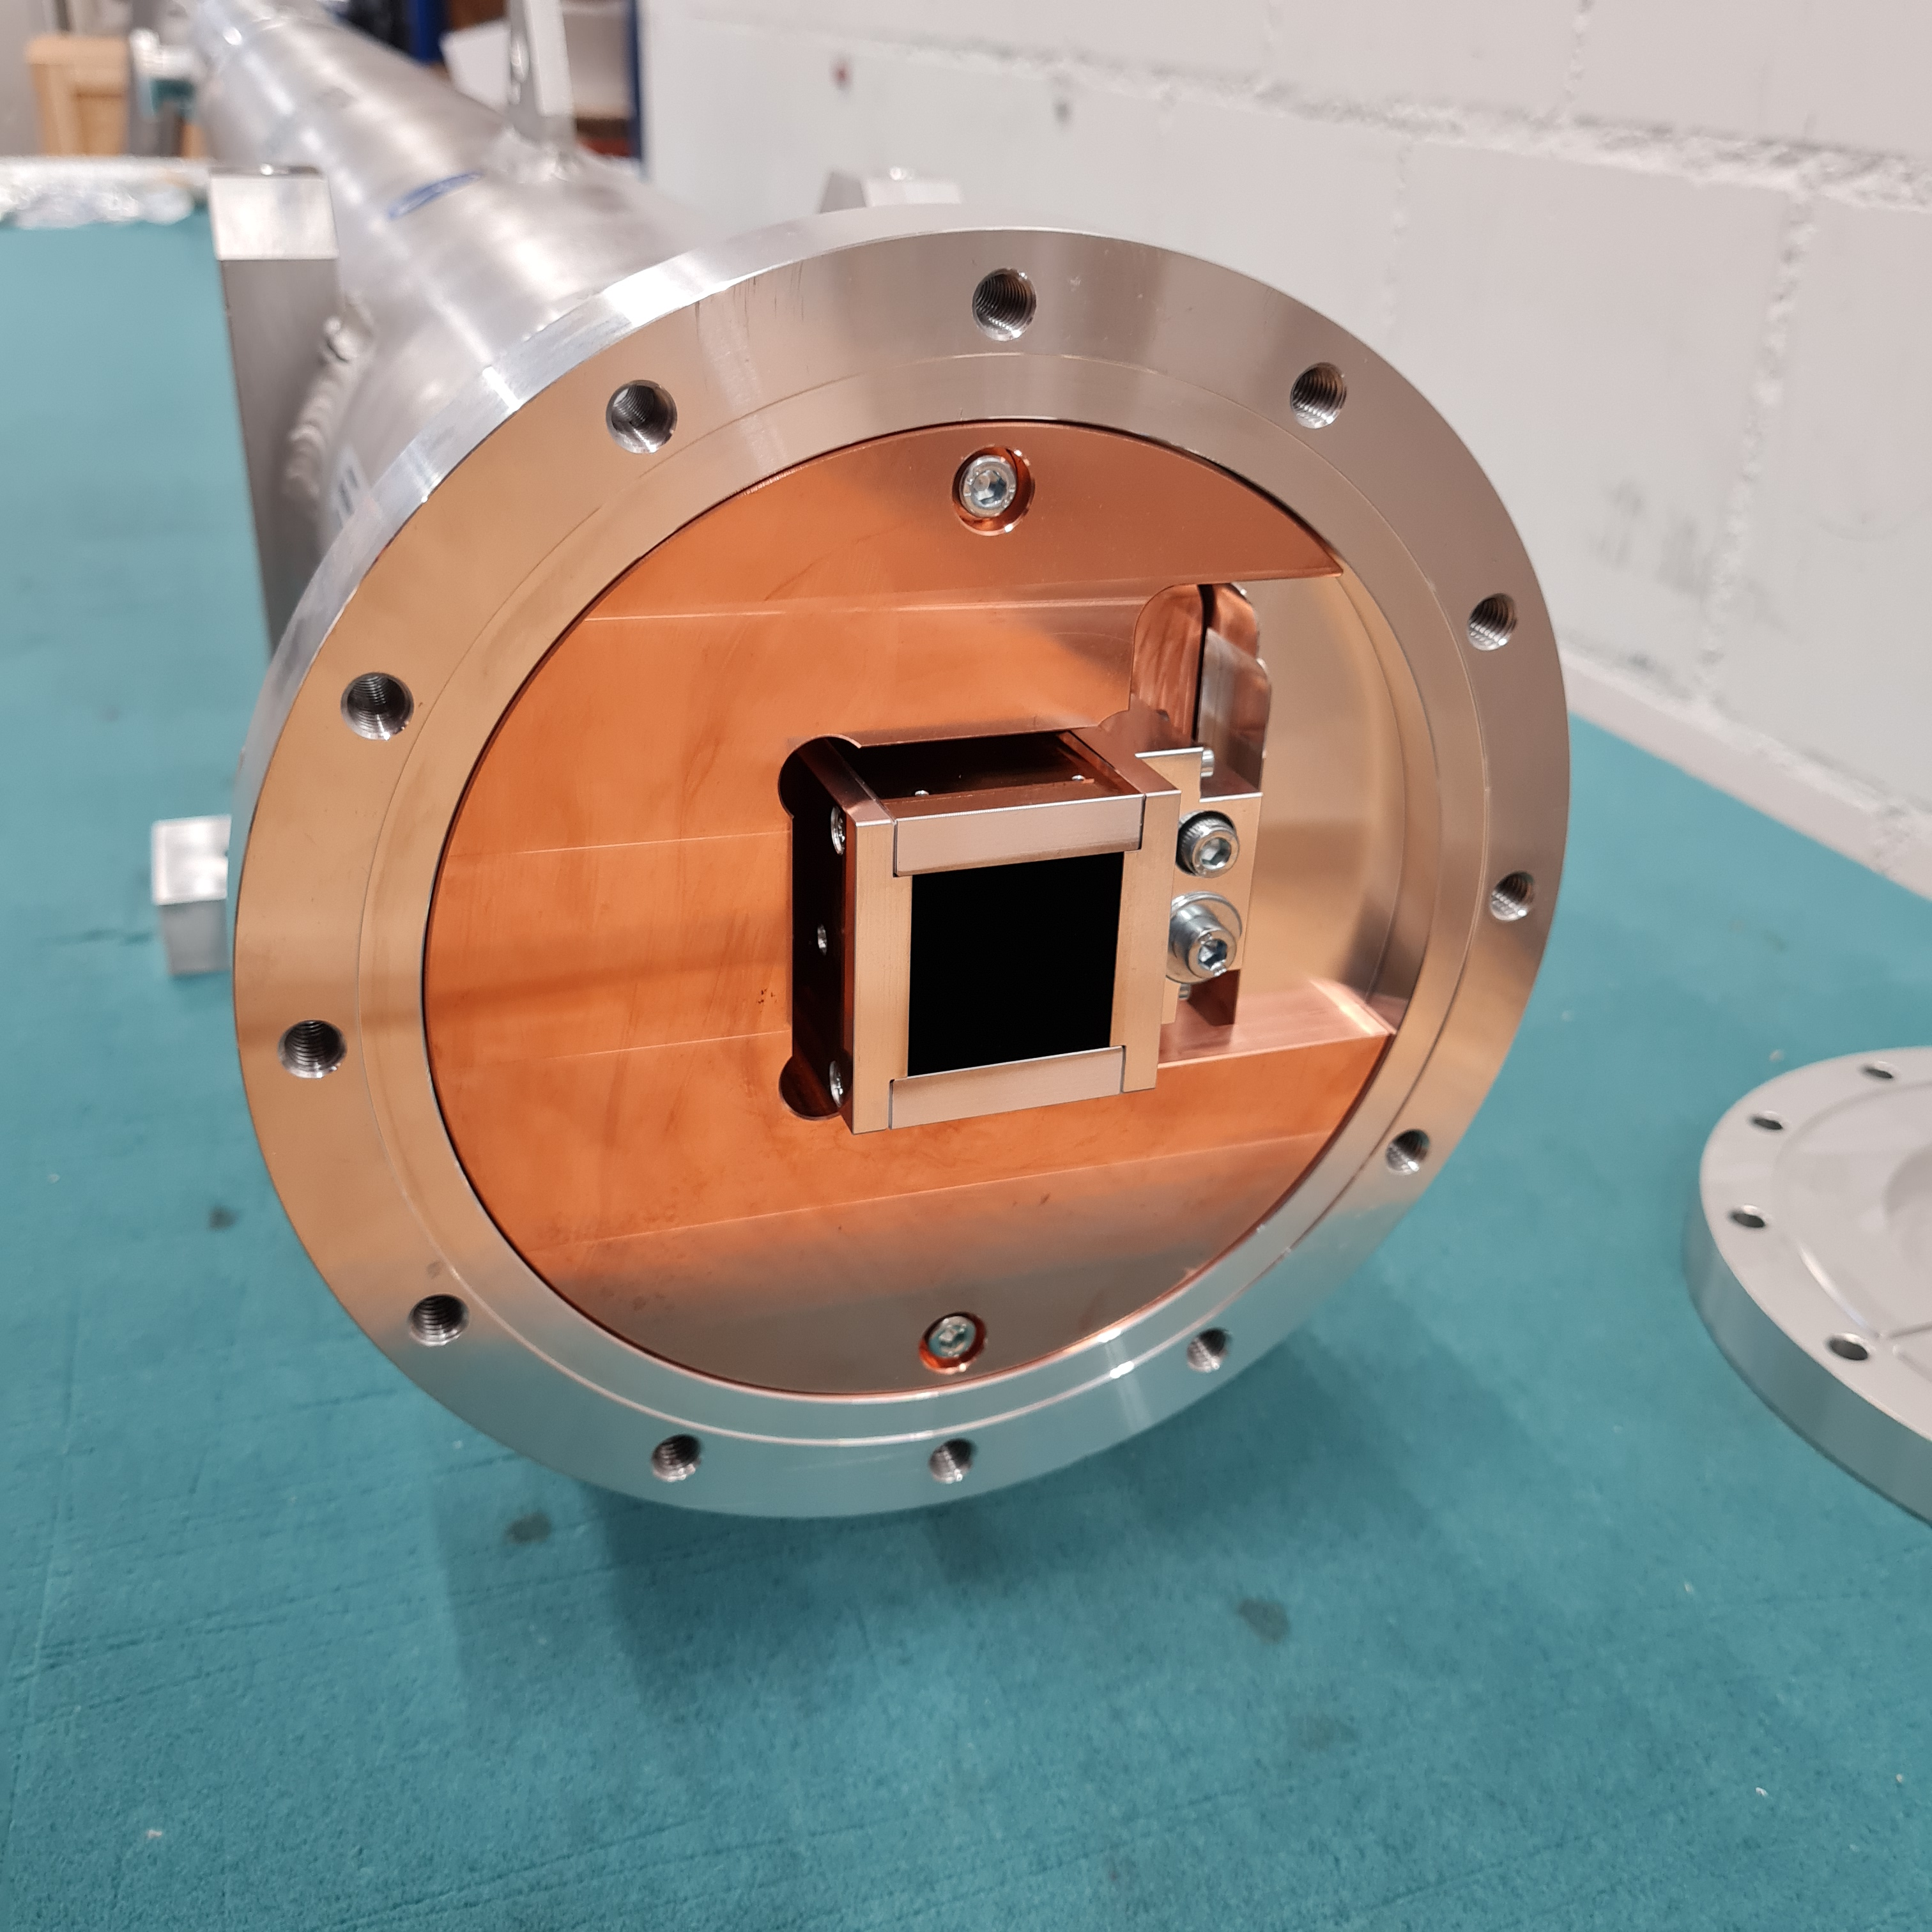
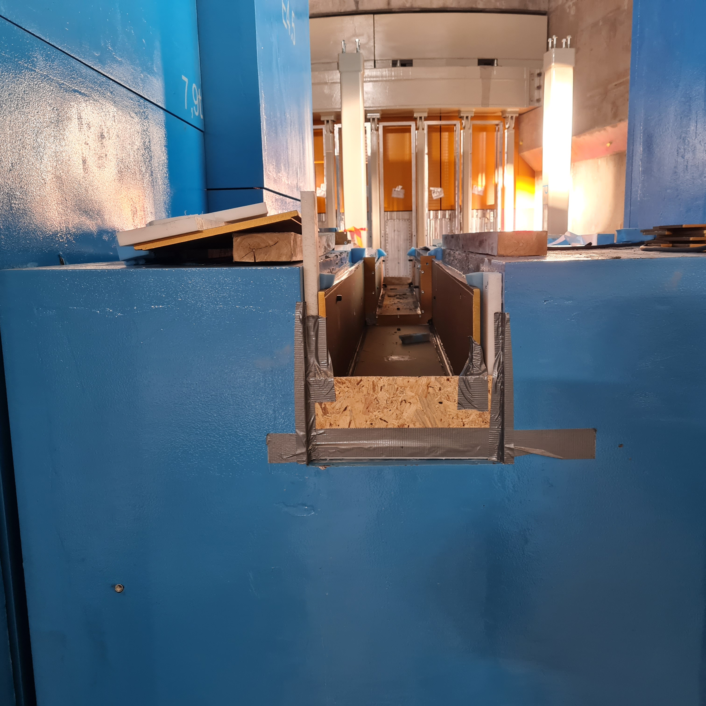
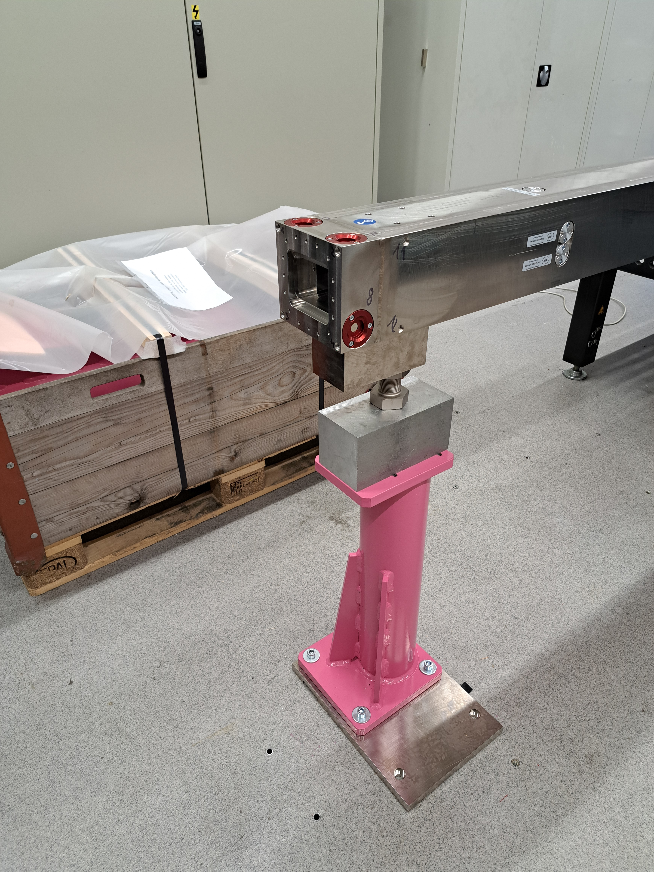
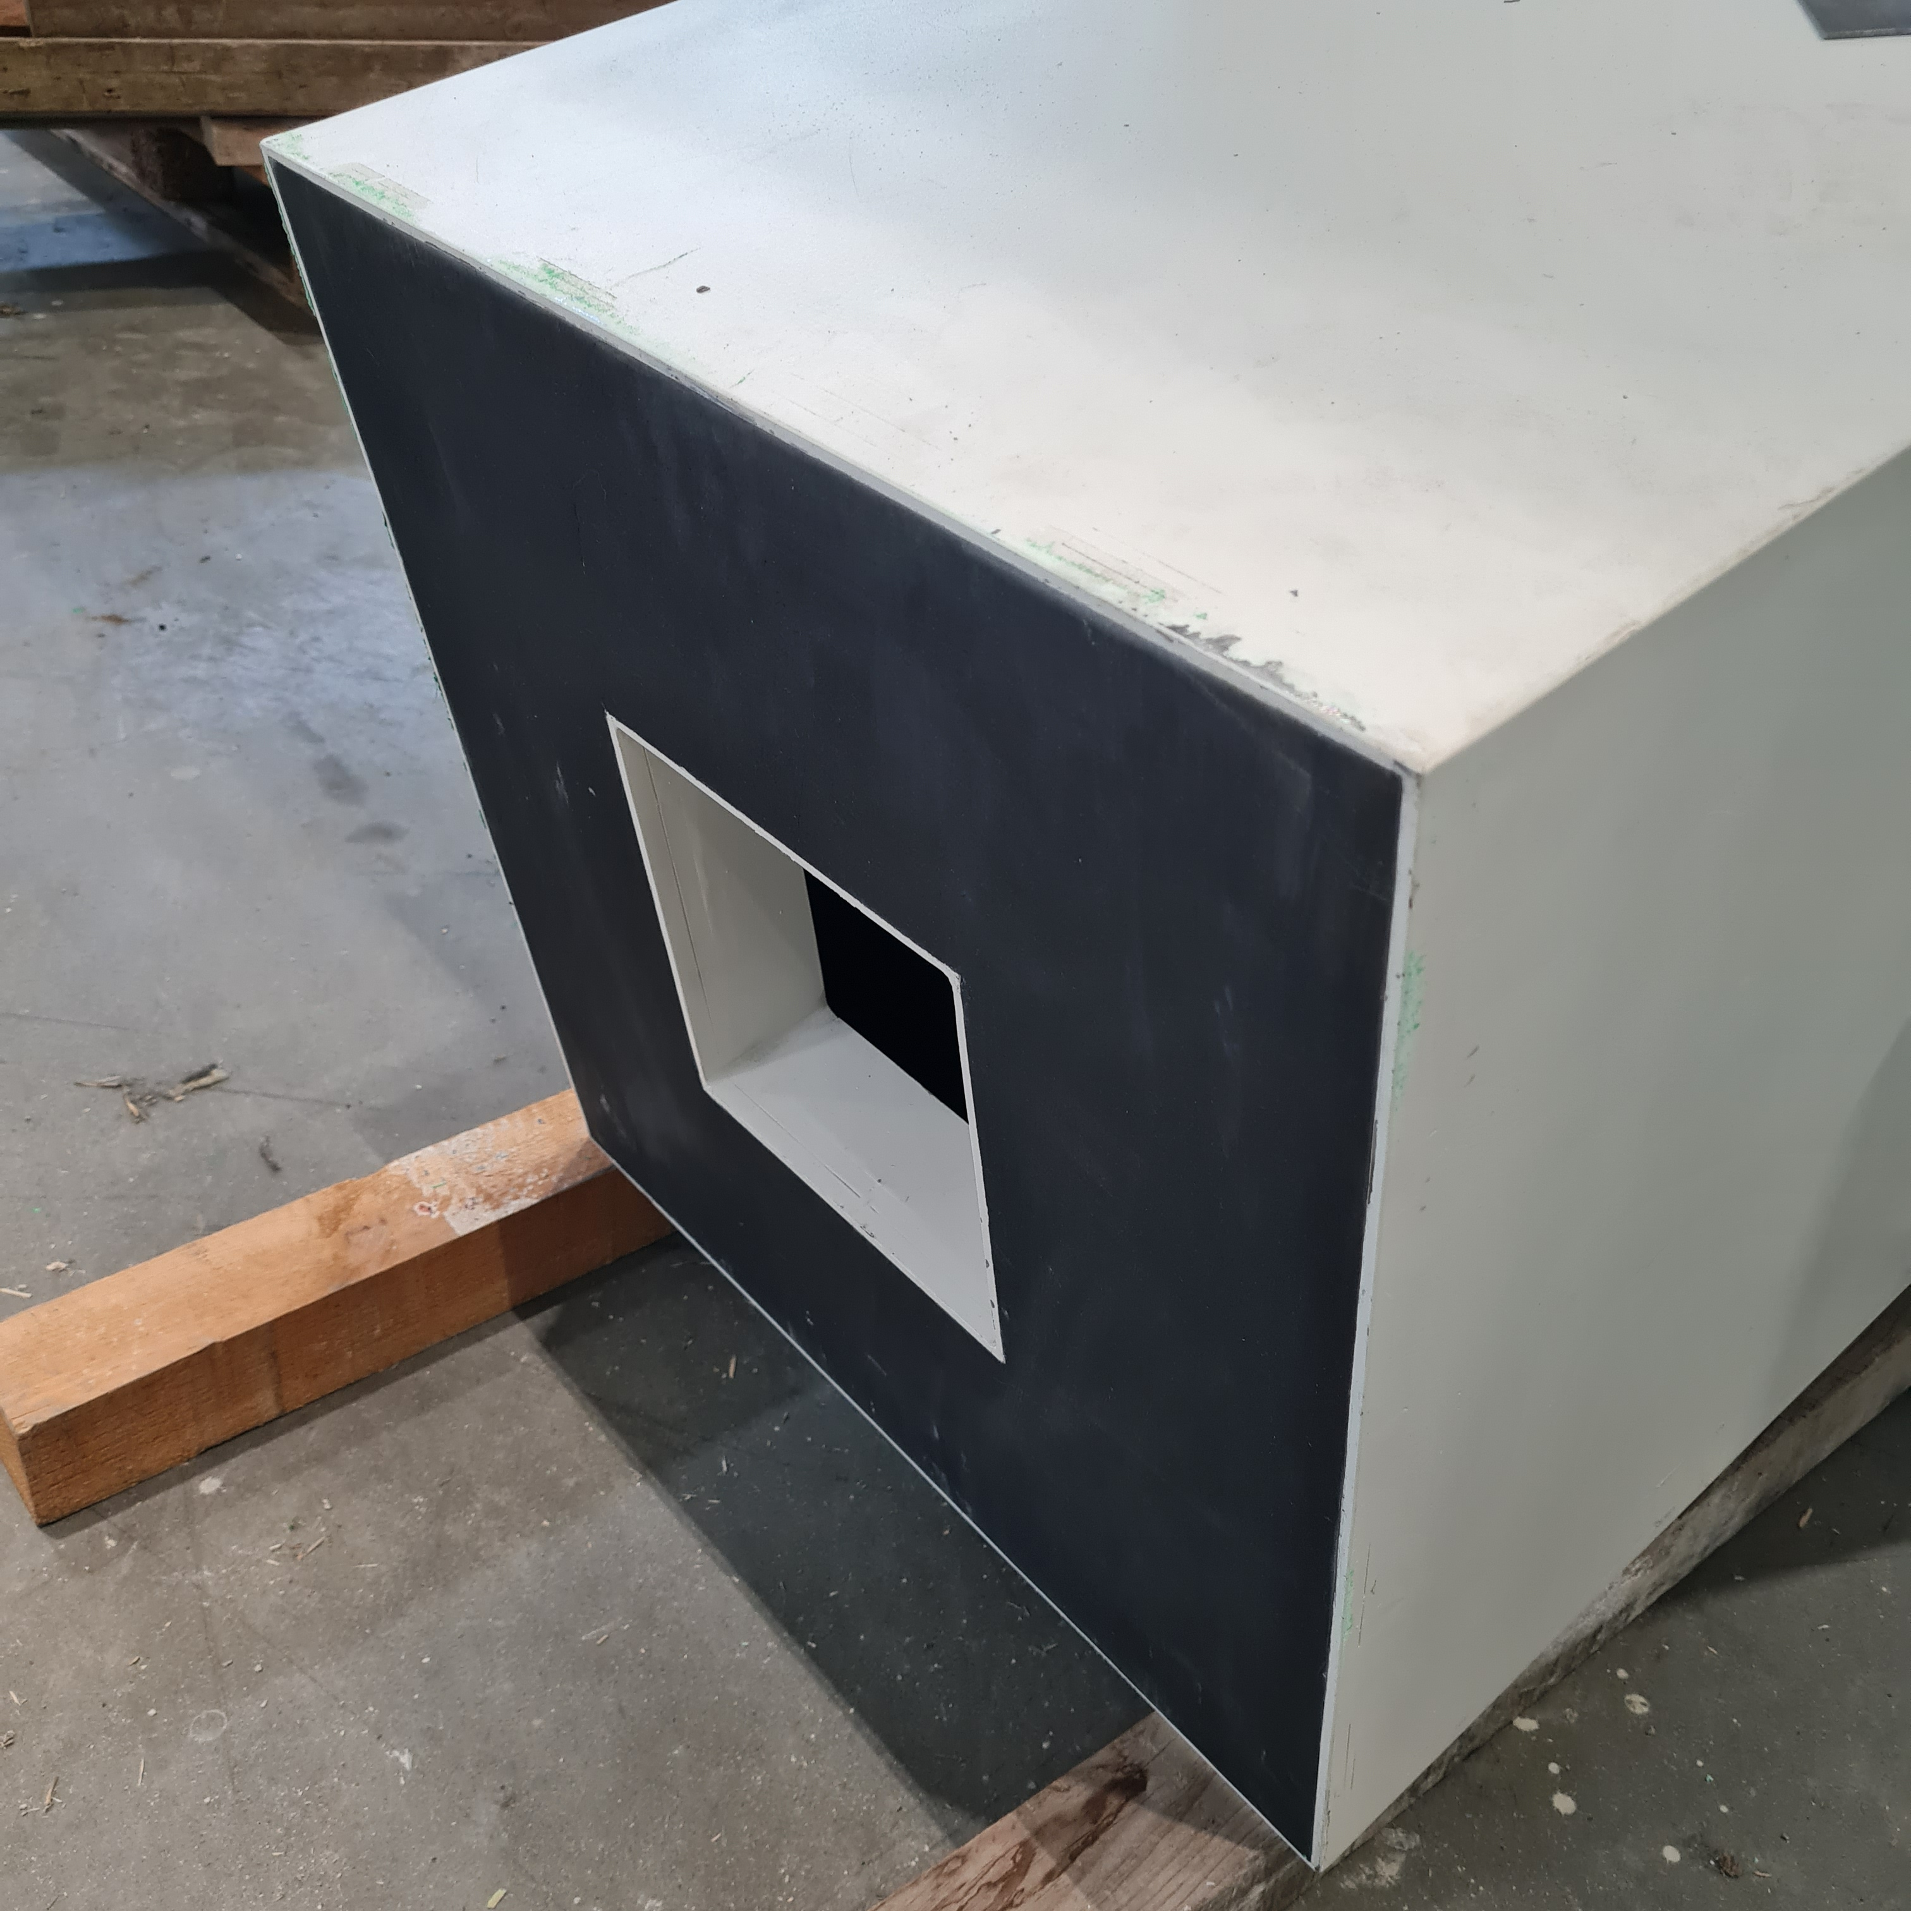
Shielding and background
Flux is nothing without a good S/N ration
Twice out of line of sight
All parallel streaming path blocked in-bunker
Fully B4C clad streaming and collimation path
Get lost beam-trap at end of detector

Slide 9
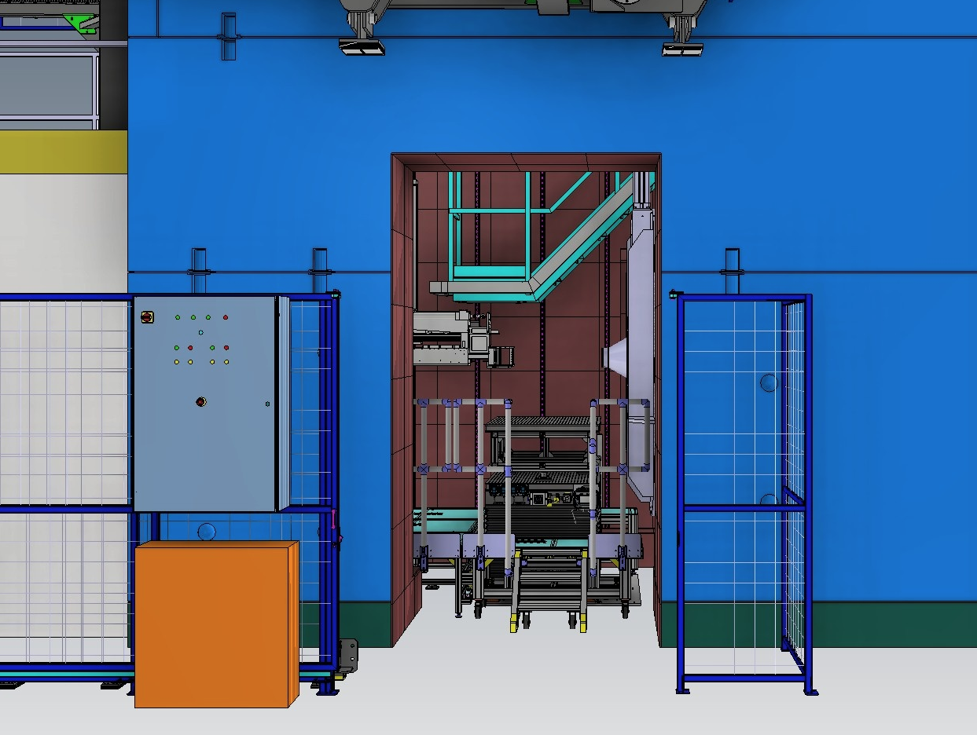
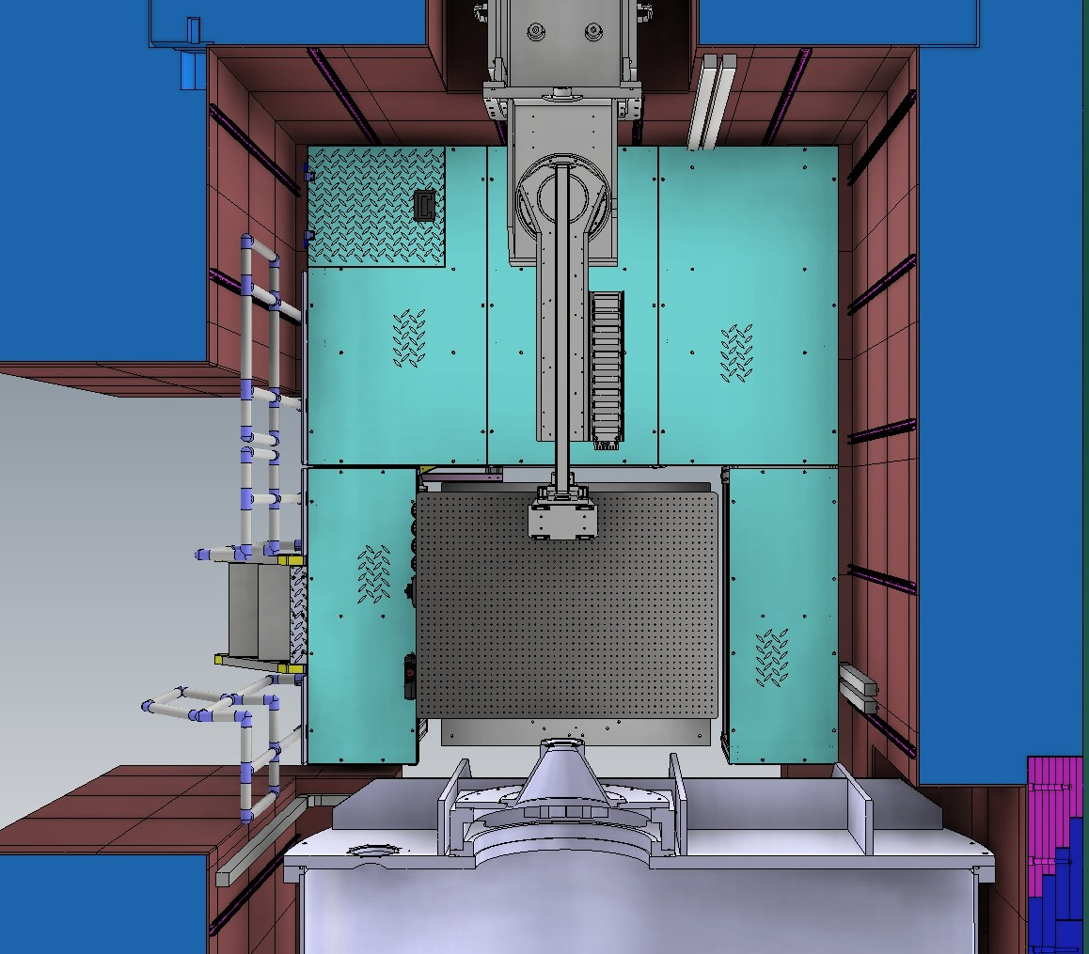
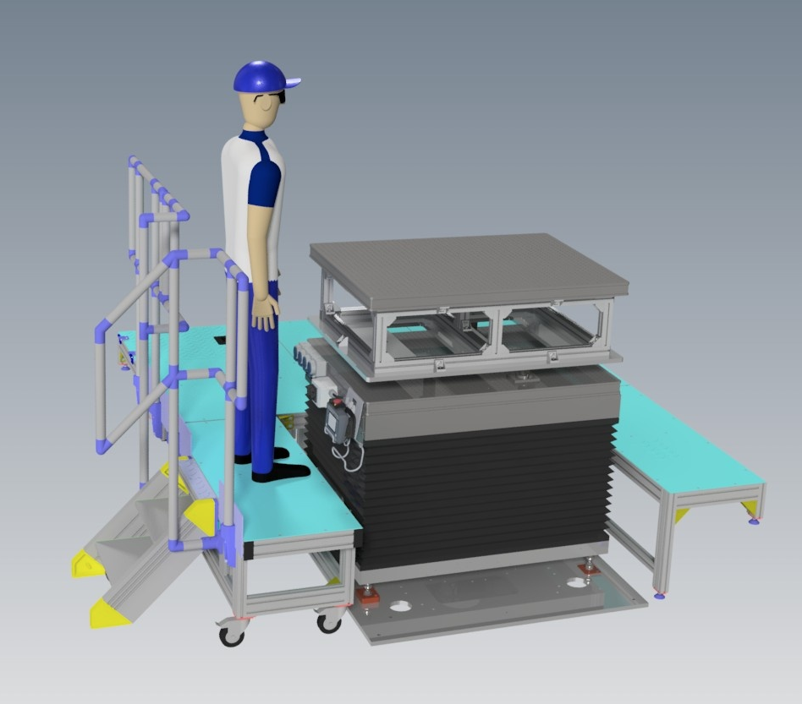
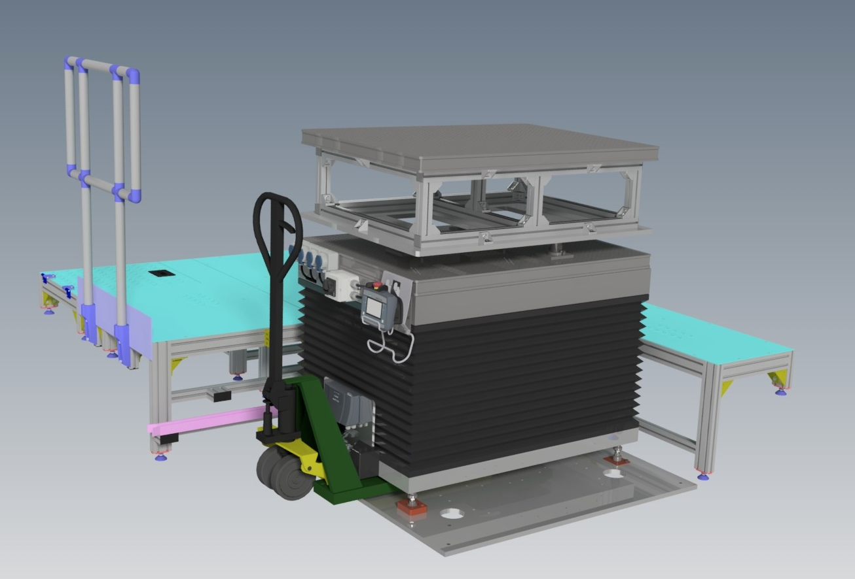
Sample Environment
3 m x 2.6 m total area
EUR pallet sample stack
Flat floor accessible with kinematic mount
Optical table
Up to 999 kg
Optical table
Huber Axes and (small) hexapods available
Optimized for custom S/E
Custom top boxes can be prepared at users’ lab and be brought to the instrument

Slide 10
Relevant instrument settings: Geometry
Collimation sets the angular resolution
Distance from the sample slit
Opening of sample and collimation slit
Detector position determines width of cone

Slide 11
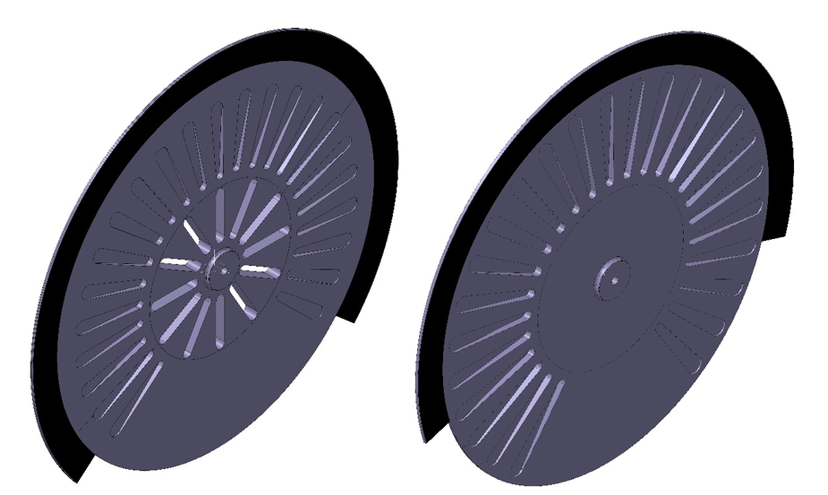
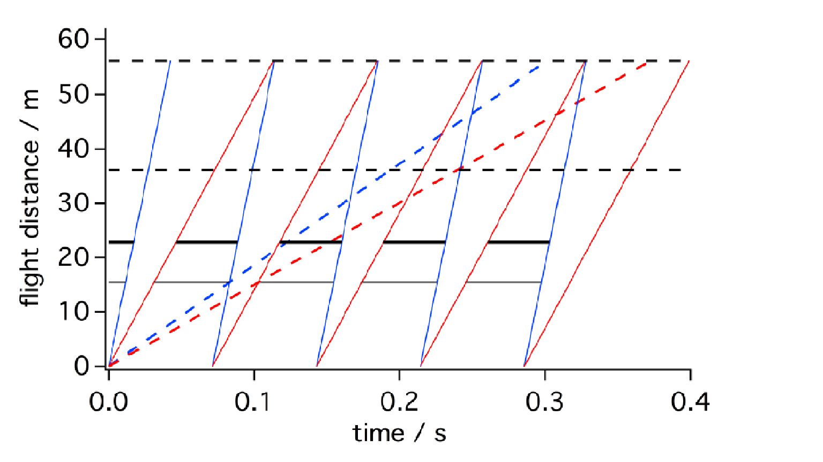
Relevant instrument settings: Wavelength
Choppers Control
Lowest and highest wavelength (phasing with respect to source)
Wavelength band (stay with 14 Hz or only rotate at 8 Hz)
Quasi monochromatic beam possible (phasing with respect to each other)
All this impact wavelength resolution
→ Calculation of respective Q-values

Slide 12
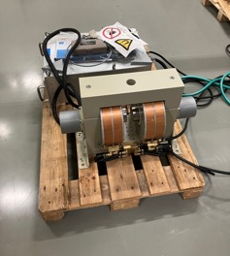
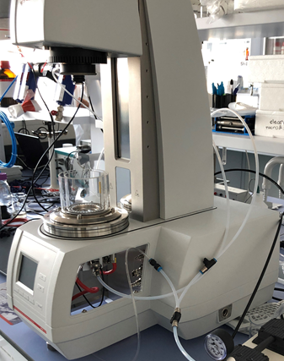
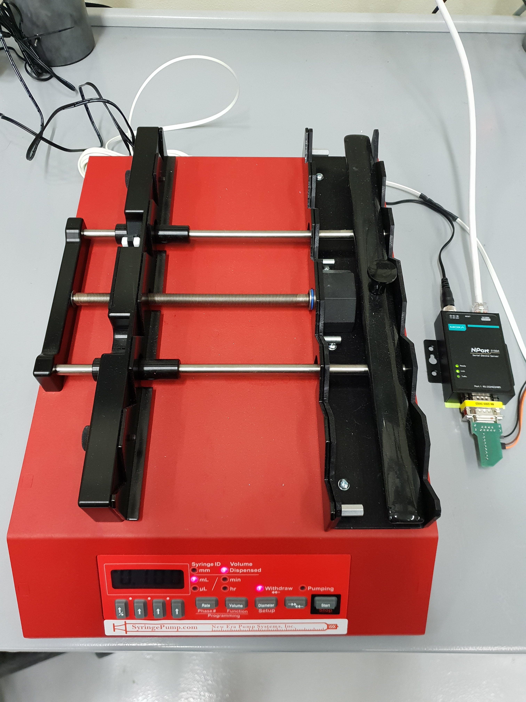
Relevant instrument settings: Sample
Field (magnetic, electctric …)
Temperature
Shear rate
Angle of incidence
Time off-set from arbitrary starting point

Slide 13
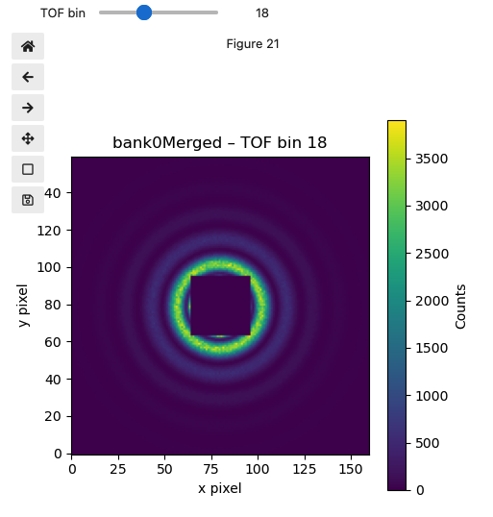
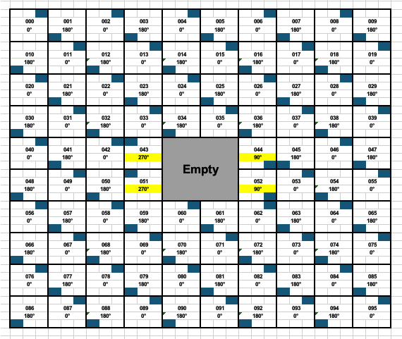
Relevant instrument settings: EFU
Geometry
Things necessary to know
Where does my beam come from?
What shape does my beam have?
What is the position of my detector?
What is the incoming intensity?
When did my beam start/end?
  Both relative and absolute w.r.t. source
Sample properties
EFU
Only with this a useful Q-map can be created.
Wavelength

Slide 14
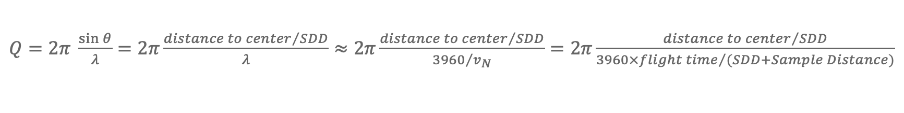
Relevant instrument settings: EFU
$Q=2π \frac{sin⁡θ}{λ}=2π\frac{{distance to center}/{SDD}}{λ}≈$ $2π\frac{{distance to center}/{SDD}}{{3960}/{v_{N}}}=2π\frac{{distance to center}/{SDD}}{{3960×flight time}/{(SDD+Sample Distance)}}$
SDD is the most ”manual” contribution
Flight time is know down to microseconds
However has a relatively large error due to pulse length (ca. 5%)
Here chopper phasing has an impact
Distance to center has 3 or 6 mm error, ca. 1%
Sample distance roughly 5 mm error, ca. 0.01%
Property | Input data
SDD | Detector position, Sample alignment
Flight time | Proton pulse+calibration, detector timing
Distance to center | Detector alignment
Sample distance | Sample alignment

Slide 15
Data Flow
Detector event
Pixel ID
Timestamp
Detector position
Ideally also post-production “filtering”
Chopper
Chopper settings
- Pulse skipping
- Direct pulse
- phasing
Sample
Position
Q-calculation

Slide 16
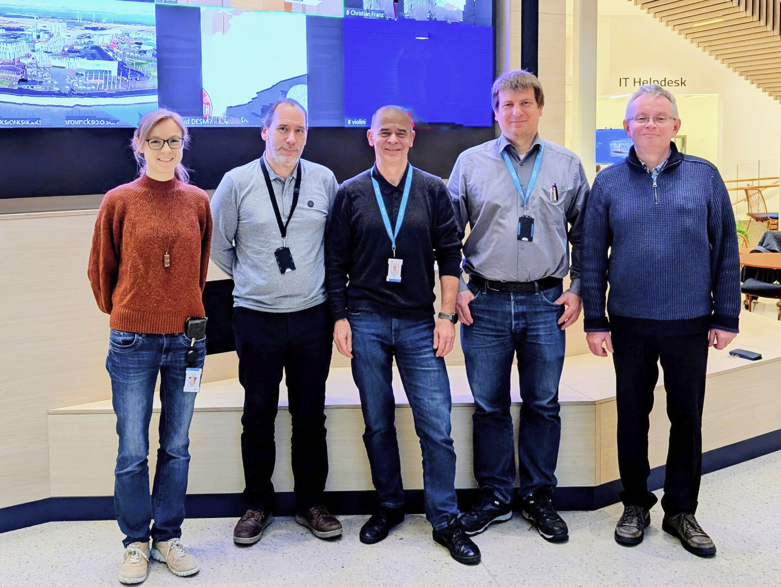
Thanks to ….
Romuald Hanslik, FZJ
Sylvain Désert, formerly LLB now ESS
Tadeusz Kozielewski, FZJ
Ralf Engels, FZJ
Tamires Gallo, ESS
Annika Stellhorn, ESS
Henrich Frielinghaus, FZJ
… And you, for your attention !

Slide 17
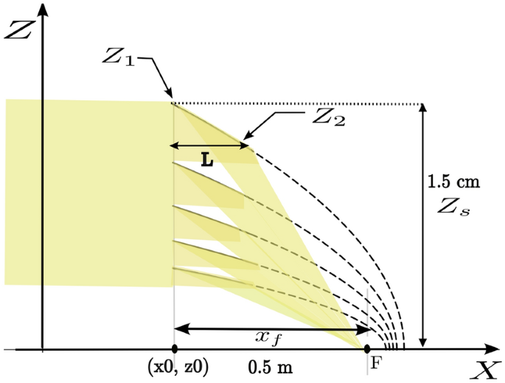
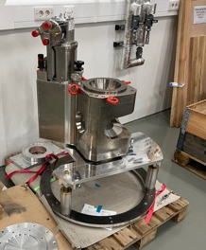
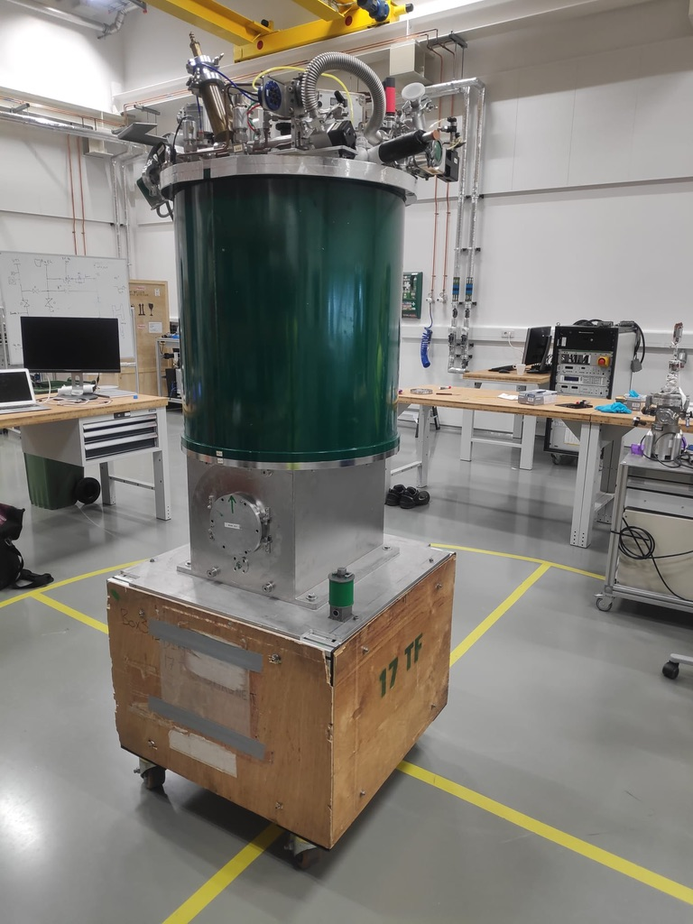
Science Cases
A selection at the start
Soft Matter and biology
Microfluidics (with and w/o stopped flow)
GISANS / Surface science
Stroboscopic measurements in rheometers
Hard Matter and magnetic systems
Magnetic nanoparticles/Janusparticles
Skyrmions in films
Hopfions/Magnetic solitons
Spin-glasses
Filip Mehler, Max Wolff, Sebastian Jaksch, et al. https://doi.org/10.1038/s41598-025-28836-3
General capability enhancements
- incoherent Background substraction
2.1T warm bore
GMW electromagnet
- just got a grant for a SEMSANS development
17T horizontal solenoid
(with E. Blackburn. LU)

Slide 18
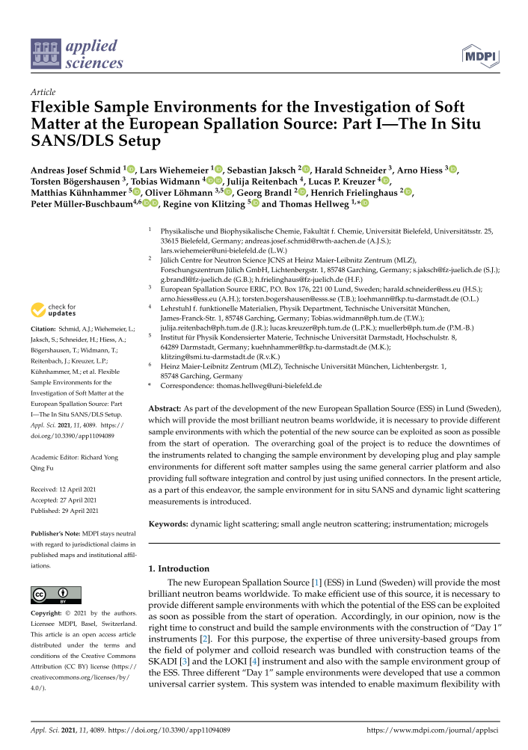
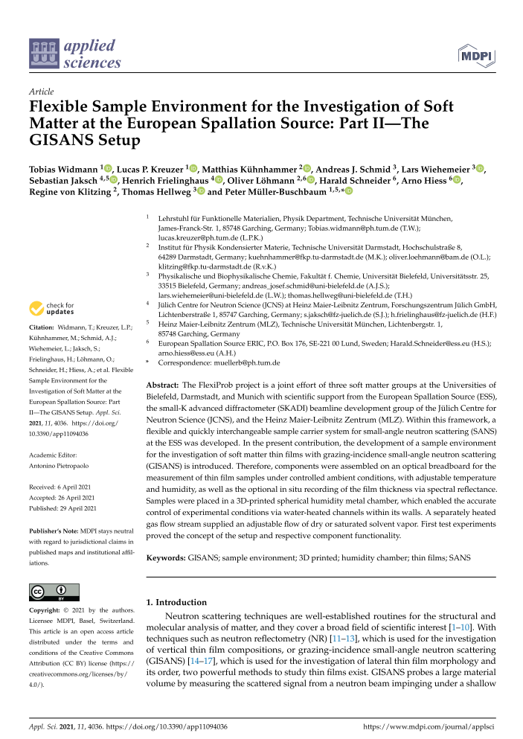
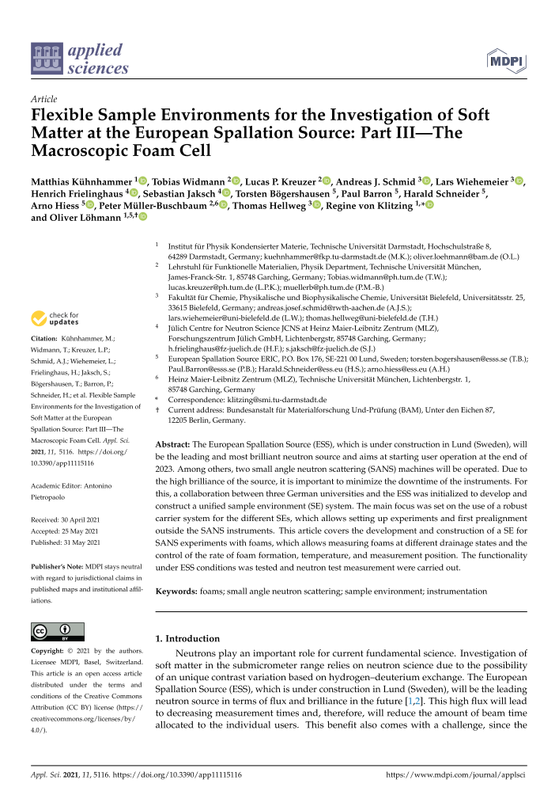
Flexiprob projects
Easily switchable set-up between:
  in situ DLS
  Foam cell
  Humidity chamber for GiSANS
Three paper have been published on flexible S/E. Next meeting will take place ASAP.
Currently improving on usability and accessibility
Coordinations with Harald Schneider.
Thanks to the groups of
  Regine v. Klitzing
  Thomas Hellweg
  Peter Müller-Buschbaum

