Slide 2
SKADI Data into Files
What NeXus is and what EC/DC needs from SKADI+
PRESENTED BY George O’Neill

Slide 3
Site Overview for Data
EFU
NeXus
Filewriting
CODA
Requirements

Slide 4


Site Overview for Data
Experimental Control & Data Collection
Aim of ECDC:
  Capture device data
    Detectors, motors, choppers…
  Produce data file for analysis
    Triggerless Total Data Capture
  Writes messages from Kafka
FOR THOSE ABOUT TO RESEARCH

Slide 5
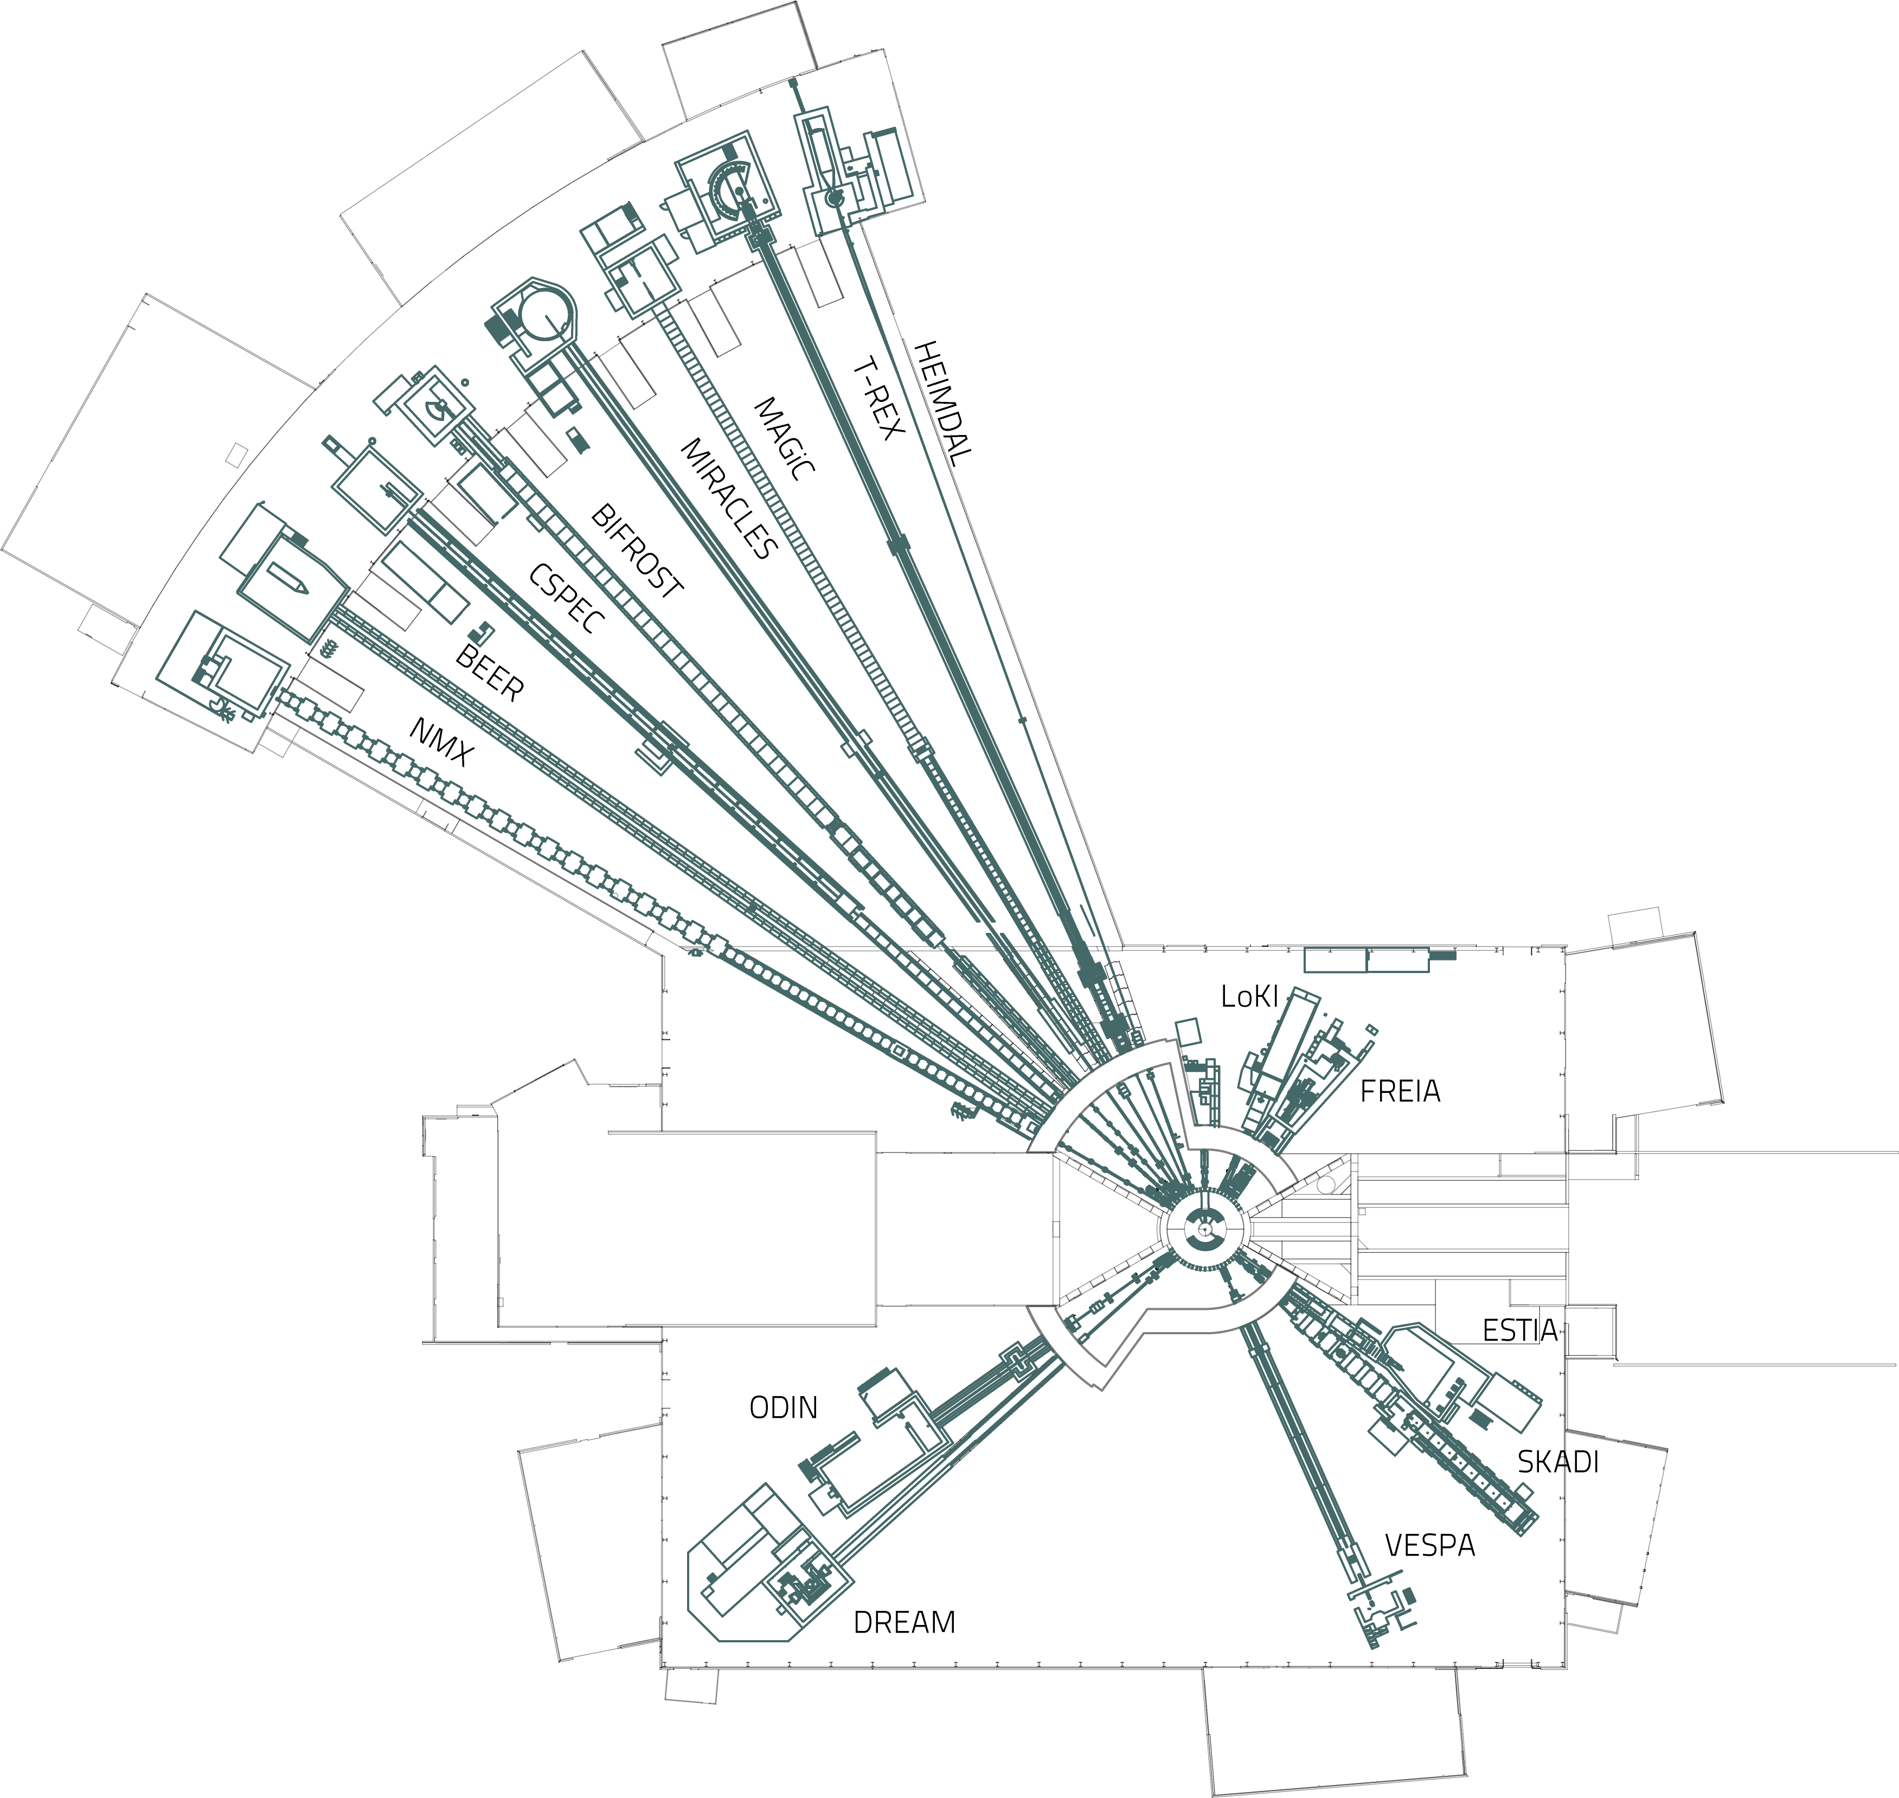
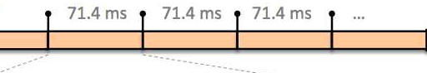
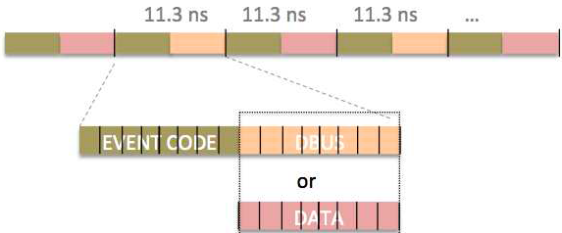
Site Overview for Data
Data Pathways @ ESS
14 Hz <-> 71.4 ms
t

Slide 6





Site Overview for Data
Data Pathways @ ESS
14 Hz <-> 71.4 ms
t

Slide 7

Site Overview for Data
Data Pathways @ ESS

Slide 8
EFU
Event Formation Unit
Aim of EFU:
  Process bespoke detector data and create neutron events ⇒ (t, p)
  Creates (logical) 1-D geometry space [1, N] (N = number of pixels)
  Binary application run as systemd service
    Configured via text files
Filtering and clustering readouts
rToA calculation
Geometry transformation
Publish data to Kafka

Slide 9
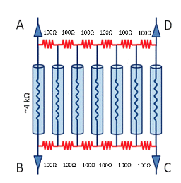
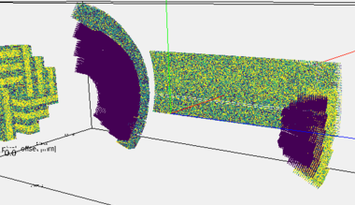
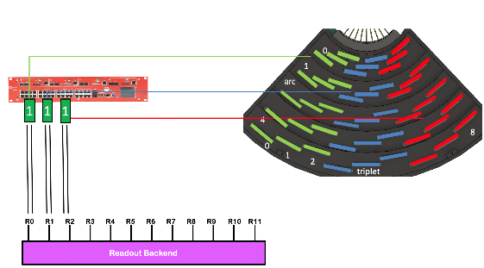
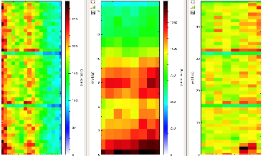
EFU
Geometries
Analog
Digital
Logical
Physical
(V(t), A(t), Ohm)
(t, FEN, RING, ch, adc)
('tof', pixel)
('tof', r, ϕ, θ)
Readout
Frontend
Readout
Backend
EFU
Scipp & friends
Conversion electronics ultimately measures charge, current or voltages.
Deals with instrument configuration identifiers such as rings and front-end nodes + other digital and digitized values: grids, wires, strips, tubes, amplitudes or ADC values.
This step abstract all information on the left away and provides a 2D (3D) detector surface which can be used for commissioning, monitoring and calibration.
Here, pixels are 'connected' with the physical instrument geometry: lengths, angles and detection volumes.

Slide 10
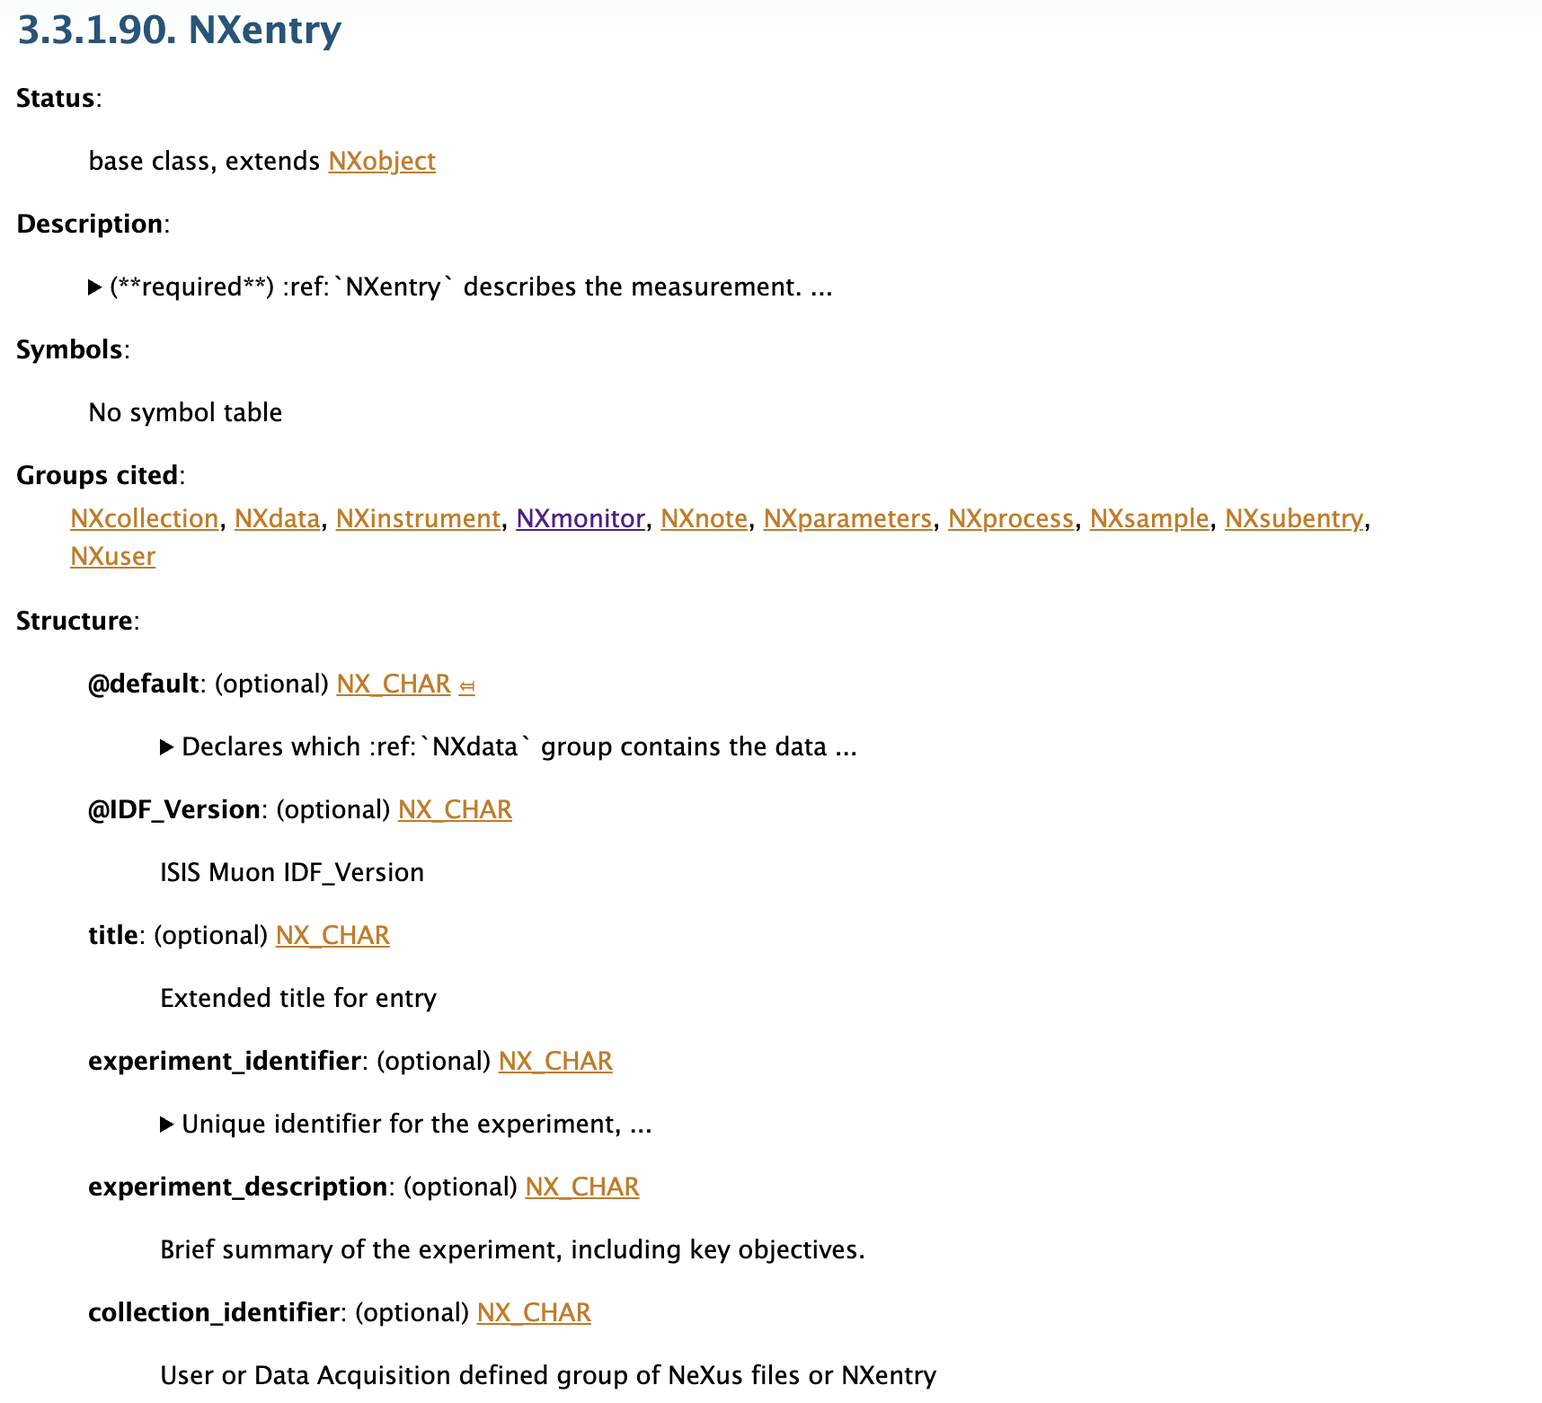
NeXus: Neutron, X-ray, and muon information
NeXus
Neutron, X-ray, and mμon Standard
https://www.nexusformat.org/
Base classes & Application classes
Not a closed standard!
Always needs NXentry
Stylised NXlike_this

Slide 11
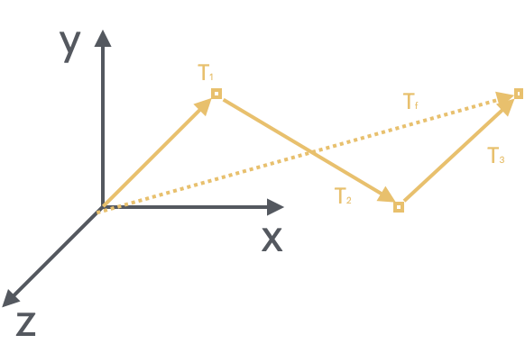
NeXus: Neutron, X-ray, and muon information
NeXus
Coordinate space is McStasish
ESS-5937831 for ESS

Slide 12
Filewriting
JSON templates store ‘truth’
Pre-computed into -dynamic part
Creates HDF file from template
Doesn’t really care about NeXus
Deployed by EC/DC

Slide 13
JSON Template Writing
Filewriting
Huge ASCII-based system
Bunch of JSON key-value stores
‘Source of truth’ for ESS
Values we write here end up in the file!
  SKADI defines names

Slide 14

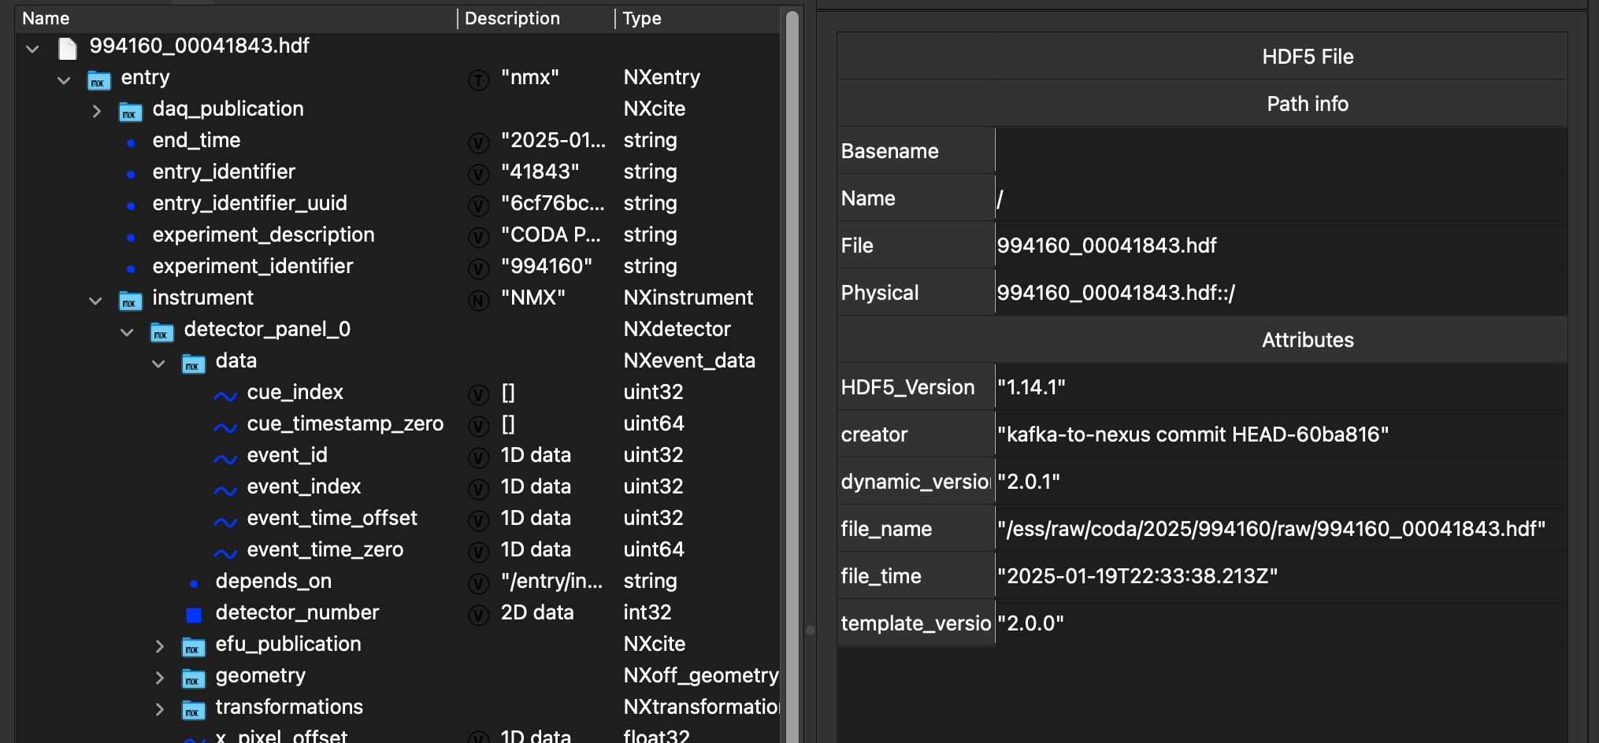
Hierarchical Data Format
Filewriting
Data storage type
B-tree base optimised for time series data
Uses ‘groups’ and ‘datasets’
  Akin to ‘folders’ and ‘files’ on a filesystem
Use h5tools, h5cpp, or h5py

Slide 15
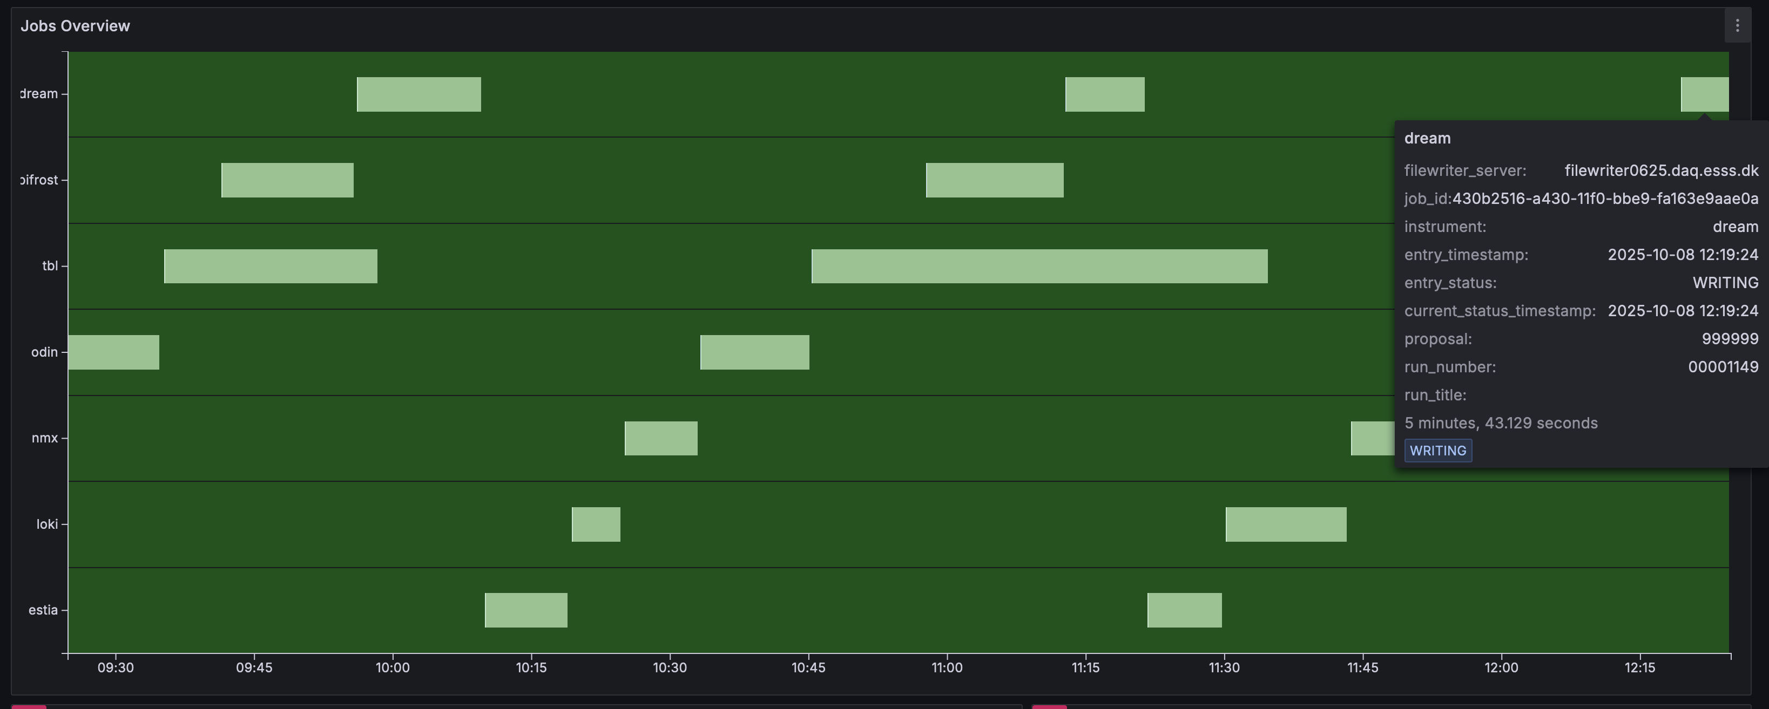
Job Monitoring
Filewriting
ECDC customers are DR (the ones who make SCIPP) + users
Product = file ⇒ continuous QA
= CODA

Slide 16
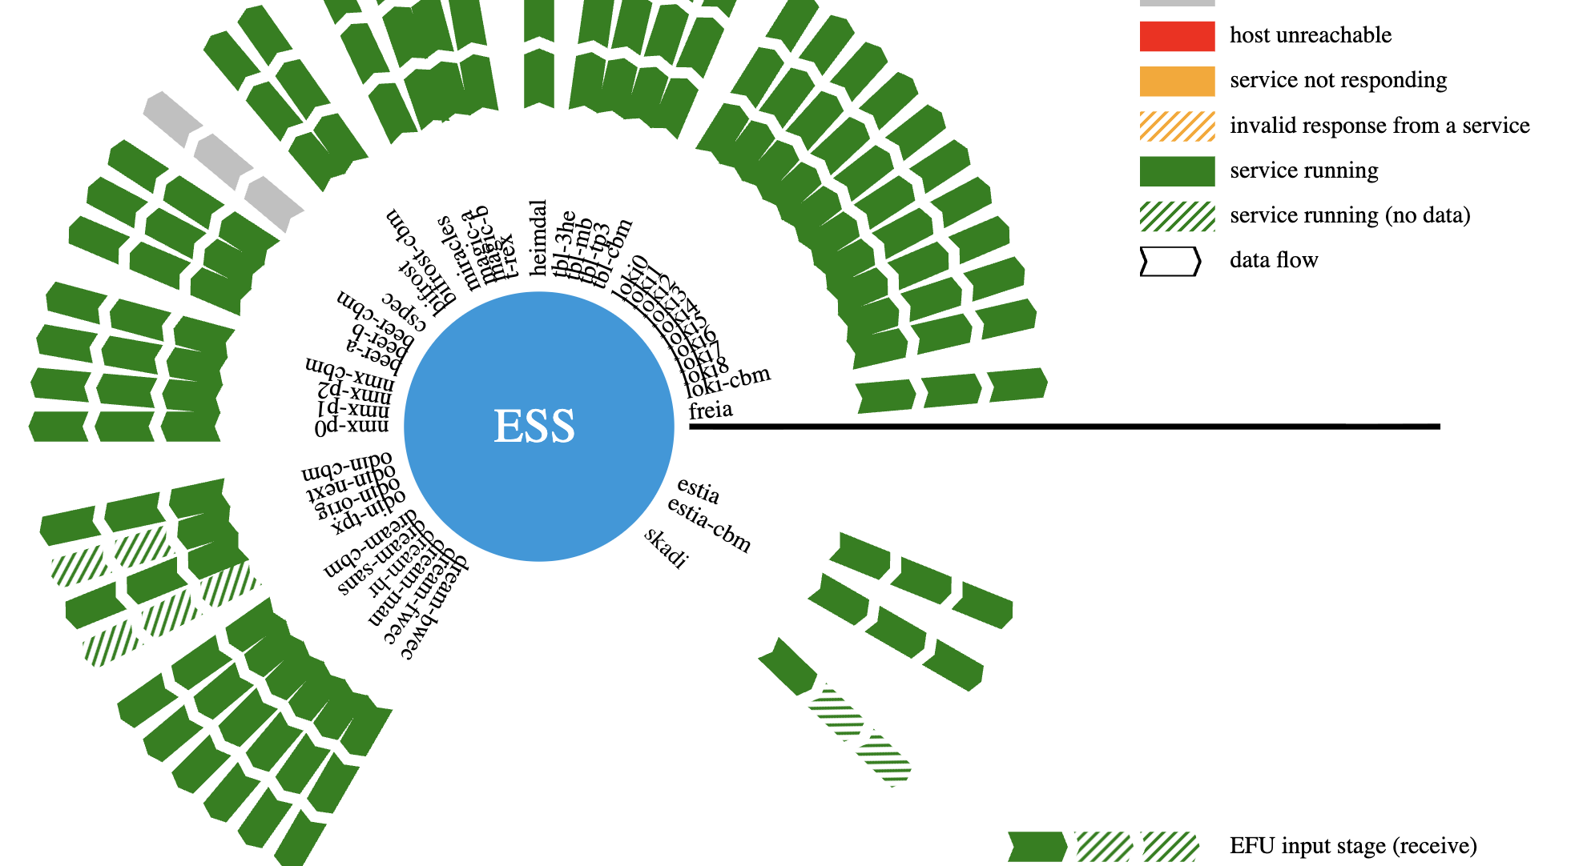
CODA
Dashboard

Slide 17
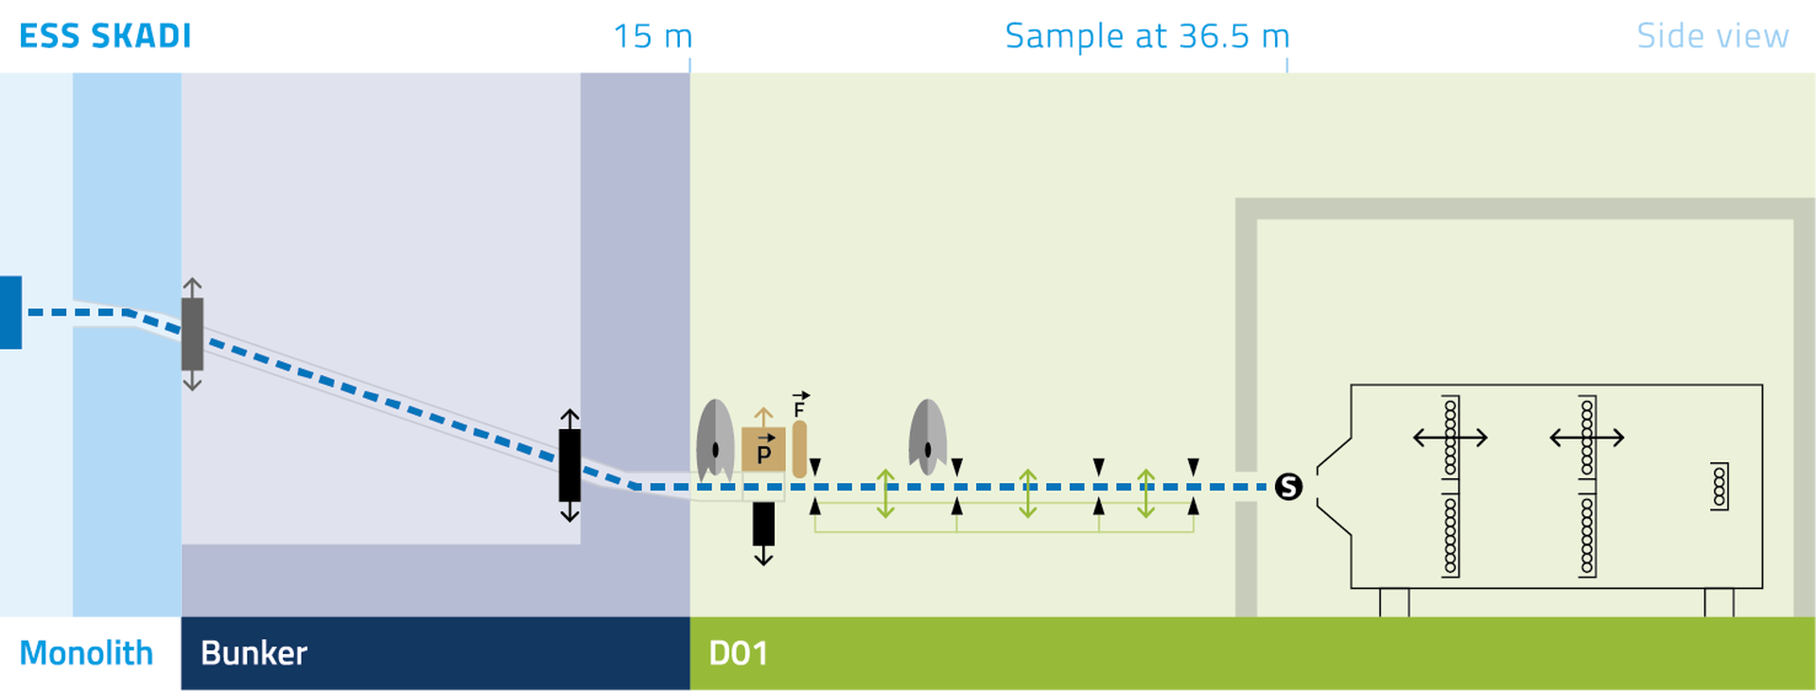
Job Monitoring
Requirements
Fixed components
  Positions
  Orientations
Dynamic components
  Motors
  Choppers
  Detectors?
Build up a tree w.r.t. sample

Slide 18
Job Monitoring
Requirements
Current understanding:
  8 * 8 * 784 = 50k
  4 shapes
  Sample position measured manually
Suggestion:
  Implement detector positions w.r.t. some virtual sample position
EFU is king!

Slide 19
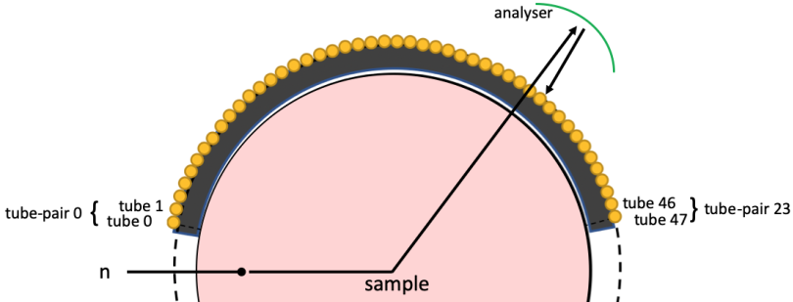
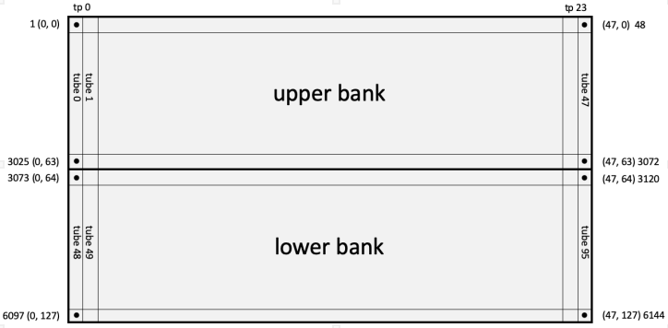
Requirements
Geometry Transformation
Digital geometry
Logical Geometry
Optical Fiber
Front End Node
Digitizer Channel
A BIG map of possible pixel ID’s
ADC values
rToA relative time of arrival
Record time

Slide 20
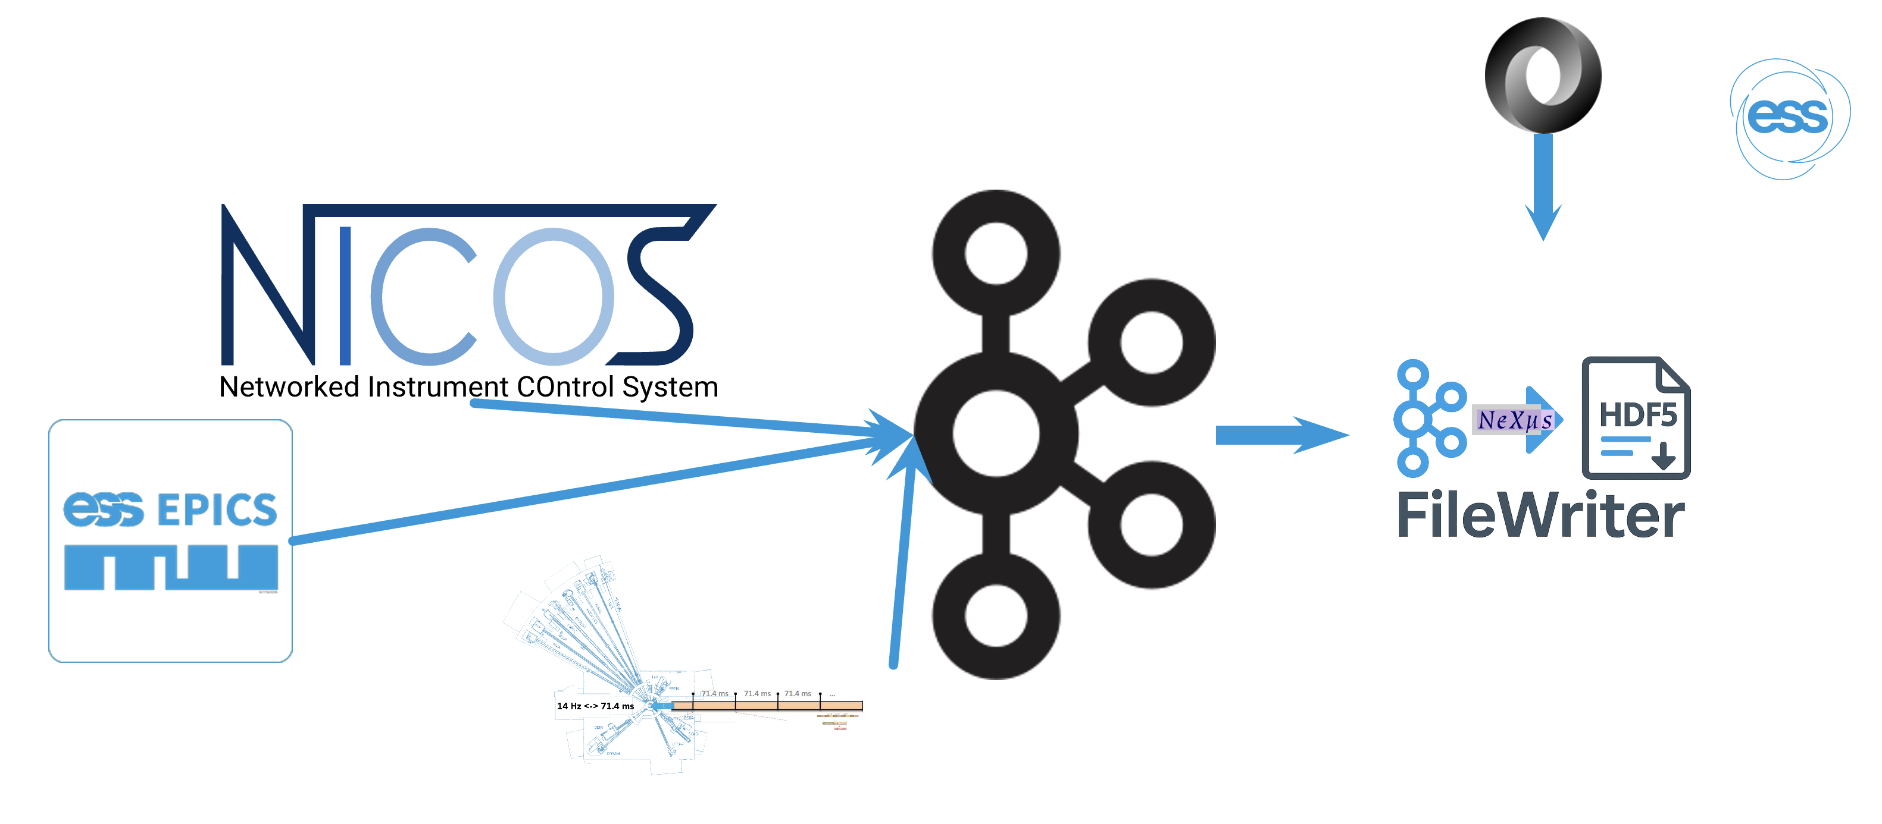
✅
Requirements
❌
EFU in place
NICOS workstation
EPICS PVs defined
Kafka topics made
SKADI JSON template created
✅

Slide 21
Summary
Components:
  What (= NXtype)
  Where (= locations, sizes, position dependency)
  How (= PVs)
Names
Detector positional agreements

