Slide 1
TAC 13
Parallel Sessions - Integrated Control System
ICS project replanning
Hector Novella
Deputy project manager
www.europeanspallationsource.se
2016-04

Slide 2
ICS project replanning TAC 13
Outline
ICS planning process
ICS planning implementation
ICS planning status

Slide 3
ICS project replanning TAC 13
Outline
ICS planning process
Boundaries
Scheduling process
System life cycle stages and milestones
Top level scope decomposition
ICS planning implementation
ICS planning status

Slide 4
ICS planning process Foundations
Based on ESS Process for Planning (ESS-0019598)
Conformant with ISO/IEC 15288 (Systems Engineering)
Approach taken:
ICS construction planning is Schedule oriented (vs Cost) and Time oriented (vs Resource).
Top-down approach for most of the plan, with some refinements bottom-up.
Rolling out detail in stages.
One plan (work packages or work units are integrated).
Automated scheduling (supported by Primavera et al.).
Deliverable or Milestone-focused (seeking robustness to uncertainties)
Notes:
Deliverable or Milestone-focused. Seeking robustness to uncertainties (scope adaptation to meet time and budget)

Slide 5
Boundaries ICS planning process
Fixed budget for ICS. 50% cash, 50% IKC.
ICS budget may be distributed among Work Packages according to ICS criteria.
ESS Integrated Master Schedule is our reference to report on the same milestones.
ESS top level requirements for reliability and availability set the quality level of ICS deliverables.

Slide 6
Scheduling process ICS planning process
Plan from the top down
Start thinking about the overall project deliverables
Break down into greater detail
Add tasks and milestones
Outlining deliverables and activities (in a measurable way)
Timescale in relation to detail
Key milestones at key decision points
Enter work against tasks
Best-guess (“duration” in exceptional cases; “work” = ManMonth)
Large-duration: rolling wave / estimated (late tasks)
Link related tasks together (logical sequence)
Benefit from L1, L1b, L2, L2b milestones
Resource load the schedule
IKC, personnel, services (consulting, travel, etc.)
Notes:
Milestone levels:
L1: ESS Project 0
L1b: Shared among divisions
L2: ICS Project 14 relevant
L2b: Shared among Work Packages

Slide 7
System life cycle stages and milestones ICS planning process
ISO/IEC-15288 Systems Engineering.
When no other external milestone applies.
Phase (system stages) | Milestone (end of phase)
…
Requirements | SRR: System Requirements Review
Design | PDR: Preliminary Design Review
 | CDR: Critical Design Review
Development (from design to complete system) | TRR: Test Readiness Review
Integration and Test (conformance to requirements) | SAR: System Acceptance Review
Production (system into operation, resolve problems from Integration and Test)
 | ORR: Operational Readiness Review
Operation & Maintenance | (yearly? maintenance review)
Disposal | …
Construction Phase
Initial Ops
Operations Phase

Slide 8
Top level scope decomposition ICS planning process
Work package 01 Management and administration
Work package 06 Equipment
Work package 07 Control system infrastructure
Work package 09 Personnel safety systems
Work package 05 Machine protection
Work package 03 Software core
Work package 02 Software Applications
Work package 08 Physics
Work package 04 Hardware core
Work package 14 Test Stands
Work package 13 Integration - Conventional facilities
Work package 10 Integration - Accelerator
Work package 11 Integration - Target
Work package 12 Integration - Instruments
Work package 20 Installation

Slide 9
ICS project replanning TAC 13
Outline
ICS planning process
ICS planning implementation
Rationale under ICS planning
Graphical example
PSS correlated overview
MP correlated overview
CS integration correlated overview
Beam on Target challenges
High level schedule – Project ICS
ICS planning status
Further ToDo:s

Slide 10
ICS planning implementation Overview
ICS Planning
ICS Requirements*
ICS Project Charter*
output
input
ICS Schedule*
output
ICS Concept
input
ICS Project Mgmt Plan**
output
* Ongoing
** Pending

Slide 11
Rationale under ICS planning ICS planning implementation
To help seeing the relation of ICS activities with the rest of ESS systems, we can categorize them according to what is needed to switch-on the Machine.
ICS critical activities are:
PSS (Personnel Safety System)
MPS (Machine Protection System) integration
CS (Control System) integration
ICS enabling activities are:
Software core systems
CS development
Hardware core systems
Infrastructure
ICS complementing activities are:
Operations oriented applications
Physics oriented applications
High Dependencies on other Division’s specifications
Minimum Viable Product to guarantee Beam on Target for ICS activities
Notes:
This will give us an idea of prioritization.

Slide 12
Beam on Target challenges ICS planning implementation
Under ICS perspective, BoT milestone implies some constraints:
PSS, MPS and control systems integration are a must.
The scope for BoT is directly related to the effort needed in ICS.
We believe that a scope of Low Power Beam on Target without instruments is still feasible and compatible with today’s ICS plans.
After that BoT, a transient period with iterative extension will be needed to:
Accommodate to a High Power Beam and Operational Modes.
Accommodate new Neutron Scattering Systems.
For the future success of ESS as a research facility, Operator Applications and Physics Oriented Applications is a must and requires continuous activity.
Notes:
Just READ

Slide 13
High Level Schedule – Project ICS ICS planning implementation
2014
2015
2016
2017
2018
2019
2020
2021
2022
2023
2024
2025
Global & Project MS
First Installations
Handover Completed
First Beam on Target
#1
#2
#3
#4
#5
#1: Isrc+LEBT
WP Integrations
Controls ready for
integrated testing
#6
#2: +RFQ+MEBT
#3: +DTL1
#4: +DTL2-4
NMX controls ready
for cold commissioning
#5: +NCFE+... to DUMP
1st Bldg integration complete
#6: to TARGET
WP Personnel Safety
Accelerator PSS-1
Accelerator PSS-2 complete
Target PSS complete
WP Machine Protection
Beam Interlock System installation started
Beam Interlock System ready
for High power beam commissioning
WP SW, HW & Infrastructure
Timing system components ready for procurement
Temporary control room operational
Notes:
In this presentation, skip this fast.

Slide 14
ICS project replanning TAC 13
Outline
ICS planning process
ICS planning implementation
ICS planning status
Project Plan Optimization
Conclusions

Slide 15
ICS planning status Overview
WP | Title | Work package manager | Status | Artefacts | In P6
01 | Administration | Henrik Carling | Done | 75 | Done
02 | Software Applications | Leandro Fernandez | Ongoing
03 | Software Core | Susanne Regnell | Ongoing
04 | Hardware core | Timo Korhonen | Ongoing
05 | Machine protection system | Annika Nordt | Done | 260 | Ongoing
06 | Equipment | Timo Korhonen | Not applicable
07 | Control system infrastructure | Remy Mudingay | Done | 160 | Ongoing
08 | Physics | Garry Trahern | Done | 150 | Done
09 | Personnel safety system | Stuart Birch | Done | 250
10 | Integration accelerator | Han Lee | Ongoing
11 | Integration target | Benedetto Gallese | Done | 275 | Done
12 | Integration NSS | David Brodrick | Ongoing
13 | Integration CF | Nick Levchenko | Done | 610 | Done
14 | Test stands | Daniel Piso | Pending
20 | Installation | Henrik Carling | Pending
Achievements:
Beginning to have a hierarchy of milestones.
Raised internal awareness of the importance of consistency in the plan
(EVM reports)
Some WP are now better oriented towards deliverable products and/or review milestones. Making them more robust to uncertainties.
Main missing element:
Traceable list of deliverables.
Notes:
Unfortunately, not everything that I would like is done. For example:
We still lack comprehensive milestones inside the WP:s.
We still lack a clear view of our scope of work, reflected in deliverables traceable in the plan.
Everything takes time and not everything is yet in the MS Projects:
I still need to synchronize some data from P6 (it is not so straightforward).
I still need to update some MS Projects with data from the Excel files we were working up until now.
Then I would like to define L2 (ICS level), L2b (between ICS WPs) and L3 (inside a WP) milestones.
I would also like to include the Deliverables for each WP.
Finally, I would like to simplify the way the activities are expressed, to make our monthly reports more consistent and predictable. (with the use of milestones and deliverable linkage).

Slide 16
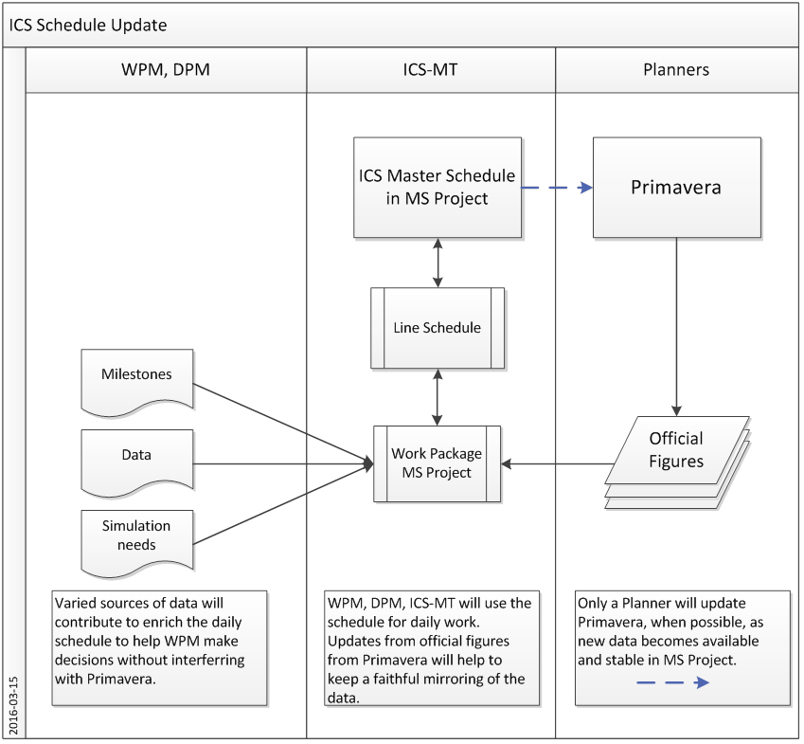
Project plan optimization ICS planning status

Slide 17
Conclusions ICS planning status
The previous slides show part of the work done during the last 4 months.
ICS construction cost estimates do not include all research and development costs from other areas/labs that are needed to support ICS.
Furthermore, since significant R&D activities to support ICS remain to be completed and technical uncertainties persist, the cost of ICS could grow and completion could take longer.
To avoid cost increases and schedule delays ICS is trying to improve on management and oversight. With emphasis on having an integrated management team.
Independent reviews are expected to be effective on examining both the construction project and its supporting external activities (R&D, IKC).
Focus on (1) planning for the complexities associated with assembling and installing the linac controls along with the target and instrument controls in stages, and (2) refining the cost estimations as soon as new data is disclosed. Supported on more systems engineering focus within ICS work package managers; in order to better identify the full scope of ICS and realistically estimate the project’s engineering complexities.
Project management decisions could be affected by unrealistic budgets (IKC) or the fast-track construction strategy imposing substantial cost pressures.

