Slide 1
ESS ICS Hardware choices
Timo Korhonen
ICS Chief Engineer
www.europeanspallationsource.se
2016-04

Slide 2
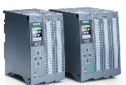
Outline
Signal speed
Control System Hardware strategy – recap
PLC
EtherCAT
MTCA
Platform issues
Digital Frontend Platform
Advantages, risks, status
Summary
10 MHz
1 MHz
Electronic front-end platform
100 kHz
10 kHz
1 kHz
100 Hz
EtherCAT
10 Hz
1 Hz
Industrial automation (PLC)
0.1 Hz

Slide 3
Hardware strategy – recap (from TAC 10)
Control systems have a lot of interfaces
Need to cater for a spectrum of I/O requirements
Fast, real-time signal processing
State-of-the-art technology, evolving fast
FPGA-based processing
MHz to GHz range of signal acquisition
Middle-range I/O
Requires synchronization, kHz range I/O
Non-real time industrial I/O
Typically PLC-based
Off-the-shelf devices
Serial, Ethernet or other fieldbus devices
No single platform can cover this cost-efficiently!

Slide 4
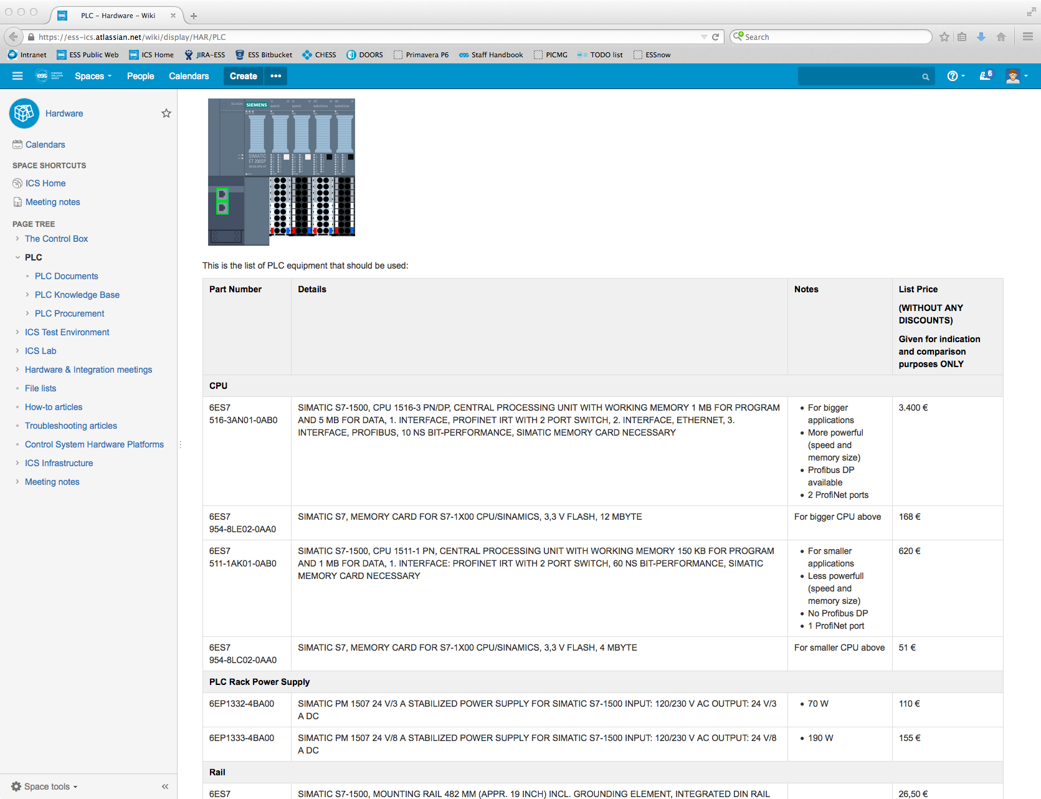
PLC
With a (tendered) framework agreement, Siemens S7-1500 has been selected as the ESS standard PLC
Documentation and a list of standard modules available in Confluence (https://ess-ics.atlassian.net/wiki/display/HAR/PLC)
EPICS integration with “soft” virtual IOCs, or if the application requires, with an industrial PC.

Slide 5
EtherCAT
For applications that “Require synchronization, kHz range I/O”
Two-prong strategy
Open source EtherCAT master for general I/O and simple (single-axis) motion control applications
Simpler system, no extra PLC
Beckhoff PLC & separate IOC for motion control with demanding requirements (e.g., multi-axis coordination) and I/O
Development of an FMC EtherCAT slave module in-kind with Estonia
Bind together EtherCAT and MTCA, or FPGA-based mini-IO
transport time stamps to EtherCAT motion control directly from timing system
Beam data to EtherCAT
EtherCAT data to MTCA system

Slide 6
MTCA – as a platform
Working on MTCA standardization for ESS
Crate, power supply, MCH
Goals: Cost, Reliability, Availability, Maintainability
MTCA.4 issues
Long-term future of the platform is a concern
e.g. SLAC decided to abandon it after several years of development
Selection of available components and solutions is too small
Market share is limited to very few players in the research market (which is small to begin with)
Interoperability continues to be an issue
If the market does not grow, it is questionable if this will ever be solved

Slide 7
MTCA – as a platform (#2)
Why, what & how of MTCA standardization
Why #1:Facilitate installation & system commissioning
Minimize interoperability issues: main headache with MTCA.4
Increase availability (fighting with troubleshooting costs time)
Why #2: Ensure maintainability
ICS has to manage the whole infrastructure in operation
What: Learn, specify & standardize
Crates, power supplies, fan units, MCH
How: Collect information and study
Learn what others have done
Buy components for testing, talk to manufacturers, request fix if not OK
Off-the-shelf is often not sufficient!

Slide 8
Status of MTCA standardization
Some information collected
https://ess-ics.atlassian.net/wiki/display/HAR/MTCA.4+COMPONENTS+EVALUATION
Hardware procured for testing
Deliveries and repairs can take a long time!
Lab testing to be started
Not yet systematically done, some initial effort spent

Slide 9
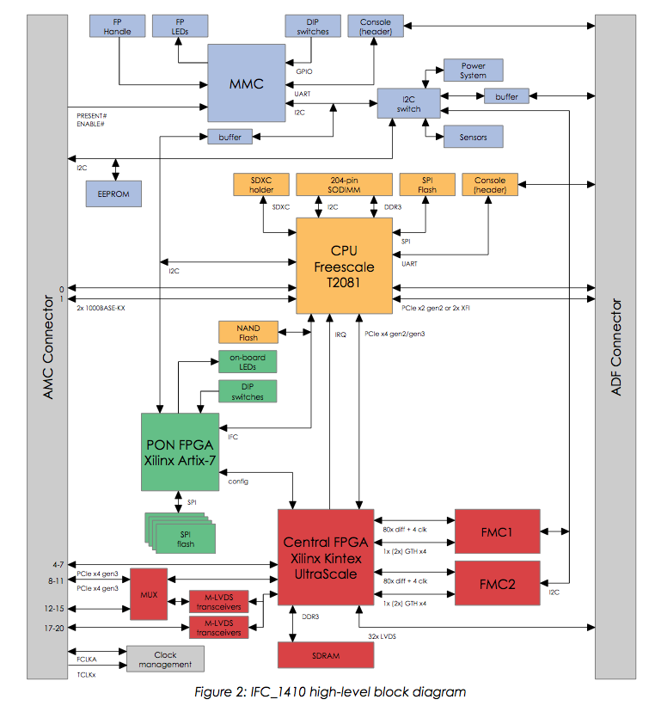
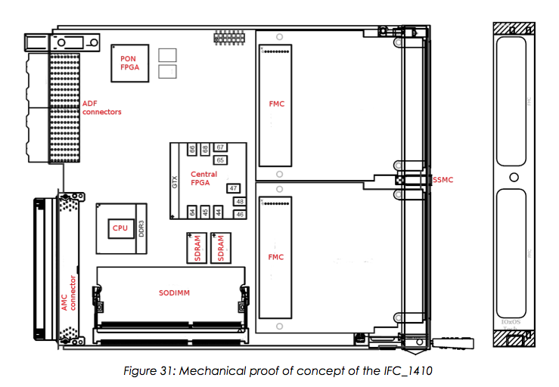
MTCA processing and I/O
Common Digital Platform
A board for MTCA.4 that can host almost all applications that need FPGAs, high throughput and/or fast real-time responses
In-kind effort with PSI & commercial partner
IOxOS SA in Gland, Switzerland
Based on an existing architecture

Slide 10
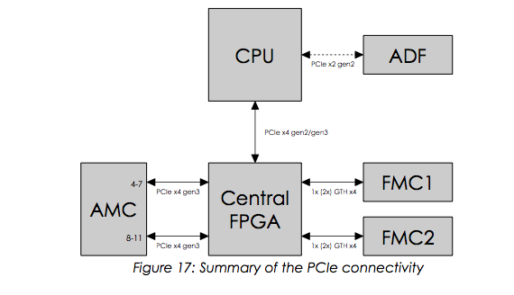
Common Digital Platform
Architecture
Combination of a FPGA with a CPU, connected with PCIe
I/O primarily via FMCs (VITA 57.1)
FMCs allow reuse of digital platform for several purposes
CPU allows for
Flexibility in programming (cf. Xilinx SDSoC concept)
Scalability: Instantiate similar simple resources instead of building a single complicated one
PCI express
Is the most common computer interfacing standard today
Also the basis of MTCA.4
More complicated than e.g. UDP but provides full feature set
DMA, SR/MR-IOV, interrupts, etc.
Requires more infrastructure handling (PCIe enumeration, NT port mapping, etc.)

Slide 11
Common Digital Platform
Common Digital Platform Variants
Pure FMC carrier
Full flexibility and reusability of FMC infrastructure
Variant for Analog I/O through Rear Transition Modules
A lot of existing designs based on uRTM
Substitute one FMC slot with ADCs on-board
Full firmware compatibility
Fixed ADCs follow FMC interfacing pattern
Application-specific
Limits the use of this variant to the specific cases that follow DESY Zone 3 A.1 standard (to be proposed for standardization in PICMG)

Slide 12
Common Digital Platform
Advantages
A lot of proven infrastructure available
Full documentation and source code available for ESS, including in-kind contributors
Can be tailored to ESS requirements
that are only now becoming clear (e.g., MPS interfaces)
Modular architecture allows for evolution
FMCs can be introduced and replaced as needed
Digital platform can be reused as well
Infrastructure code can be ported to new generations
Firm- and software plus integration represent the biggest value (or cost), reusability is very important
An addition to the MTCA.4 infrastructure
New I/O and processing solutions
Aims to add to the attractiveness of the platform

Slide 13
Common Digital Platform
Risks
Start of the project has been slow
In-kind process start takes time
MTCA.4 issues may appear
Although the partners (IOxOS SA and PSI) have a lot of experience, this is the first real experience with MTCA.4
Substantial in-house knowledge will be required
Working on that…but this needs to be taken seriously
MTCA.4 as a platform has its risks
Need to find the right partners in order not to get stuck
IPMI solutions, licensing, incompatible size variants,…
Single source?
Largely mitigated by availability of full documentation and data needed for production.

Slide 14
Common Digital Platform
Status
Start of the project has been slow
In-kind process in general, priorities of the laboratories
Technically in agreement of scope and deliverables
Technical annex close to completion
Preparatory work has been going on in the background
Conceptual study done, with already a lot of detail
a lot of experience with similar designs
Variants add complexity to the project
Technical risks limited but schedule and cost risks grow
Special-purpose variant has a bigger obsolescence risk
Preliminary target date for production-ready design
End of 2016
Time-critical, any further delays add to (multiple) project risks

Slide 15
Summary
Three-layer strategy for controls hardware
Was already presented in TAC #10
Has been communicated to stakeholders
In use at in-kind contributors, e.g. CEA Saclay
MTCA.4 developments ongoing
Platform has its risks – yes, we know.
Work to be done to develop robust standards
Common platform
To maximize re-usability of firm- and software
To provide a roadmap for future development
To be an open (as far as possible) platform for all ESS stakeholders
Is time-critical

