Slide 1
TAC 13
Progress in Integration
Daniel Piso Fernández
Hardware & Integration Support Group Leader
www.europeanspallationsource.se
2016-04

Slide 2
1 ½ year ago…
The last time that hardware integration was brought up was in TAC 10 (November 2014).
The topics were Conventional Facilities Integration and the freezing of the Hardware Platforms.
An approach for the planning and the integration for conventional facilities was presented.
There was no Hardware and Integration Team and the integration work was fully done by external resources.
There was no consistency in the approach between different work packages in the integration area.
TAC 10 Observations/Recommendations:
  “While there has been progress on hiring, the ICS appears to be short of resources for system integration”
  “Issue ICS standards for hardware, software, processes and documentation”
  “Develop Interface Control Documents for the technical systems”
  “A good working relationship has been established between ICS and CF for controls integration. This work is progressing well with lessons learned from initial attempts now incorporated in a defined process.”

Slide 3
Since then….
A lot of effort has been put in forming a team. Hiring of new people, and making adjustments on the existing resources.
Expanding the base for competition in the commercial suppliers.
Develop a common approach for all the integration work packages.
Improve or change existing workflows and creating new ones
Identify the basic elements we need to start deploying systems with certain efficiency and level of quality
Focus on the most critical systems for the machine

Slide 4
What do we bring today?
Short status of the team
Working in a common Systems Integration Approach
Some building blocks (Timing, Data Acquisition, Motion Control, Software)
WP 10 (Accelerator Integration)
WP 11 (Target Integration)
WP 12 (NSS Integration)
WP 13 (Conventional Facilities Integration)
Summary/Conclusion

Slide 5
Short status of the team
Organization – ICS team 2016-03-01
Henrik Carling
Division head
Anna Gillberg
Team assistant
?
IT/Infrastructure ?
(Vacant?)
Annika Nordt
Safety and protection
Daniel Piso
Hardware and integration
Hector Novella
Deputy project manager
Susanne Regnell
Control Software
Timo Korhonen
Chief engineer
Angel Monera
FPGA Engineer
Benedetto Gallese
Integrator
Ben Folsom
PhD student
?
Deputy chief engineer
(Vacant)
Denis Paulic
PLC Engineer
David Brodrick
Integrator
Emanuele Laface
Accelerator physicist
Manuel Zaera-Sanz
PLC Engineer
François Bellorini
Integrator
Karin Rathsman
Senior scientist
Morteza Mansouri
Safety Engineer
Javier Cerejo
PhD Student
Leandro Fernandez
Senior software engineer
Riccard Andersson
PhD student
Jeong Han Lee
Integrator
Ricardo Fernandes
Senior software engineer
Stuart Birch
Senior safety engineer
Nick Levchenko
Integrator
Remy Mudingay
Infrastructure engineer
Yong Kian Sin
IEC61508 engineer
Julen Etxebarria
Intern
Thilo Friedrich
PhD Student
Vacant
Alexander Söderqvist
Integrator
Consultants
Vacant
Engineer?
Niklas Claesson
Integrator
Vacant
Software engineer
Recruitment ongoing!
Vacant
Embedded syst. engineer
Open
now
Vacant
Employee
Consultant
Vacant
Engineer?
Vacant
Position under consideration
Vacant
Engineer?
Temporary employee
Consultant
off-site

Slide 6
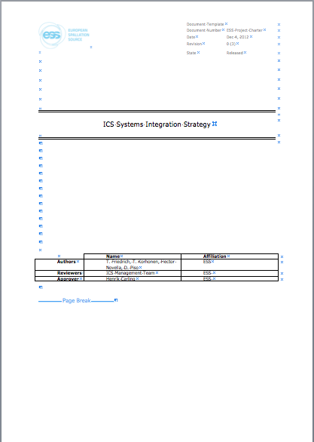
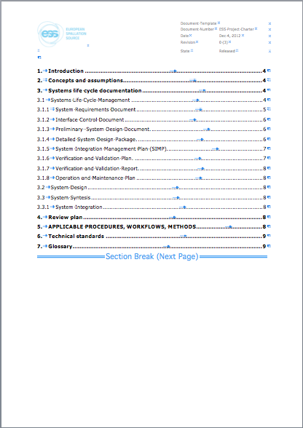
Working in a common Systems Integration Approach
ICS Systems Integration Strategy
ESS-0054678 1

Slide 7
Working in a common Systems Integration Approach (II)
ICS Systems Integration Strategy
The content of this document will be also part of the ICS Handbook.
Defines:
  Systems life cycle documentation.
  Systems review plan
  Applicable procedures, workflows and methods
  Technical Standards
Issues
  ESS Baseline Tool. Not decided yet if it is in CHESS or the Requirements Management Tool (problem here…we do not know how to handle requirements).
  There is no official template for a System Requirements Document.
  With this document we intend to be proactive. There is a good window of opportunity in the next few months to propose a set of templates for different purposes/systems and get them accepted on the SE/QA Division

Slide 8
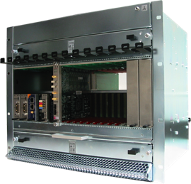
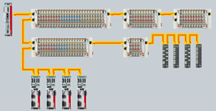
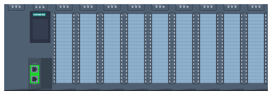

Some building blocks (I)
Hardware Strategy. Threefold structure for generic I/O
  Fast real-time processing, FPGAs
    MTCA.4
    Use only where needed (high cost, specialization)
    Extensively use FMC (Vita-57) mezzanine cards
  Real-time industrial-type I/O
    EtherCAT, on IOC
    Low cost, distributed, good real-time performance
    Moderate speed (e.g. up to 100 kSPS A/D conversion)
  Process I/O with no tight synchronization requirements
    PLCs (Siemens)
  In addition, prepare integration of off-the-shelf devices
    Serial and LAN interfaces
ESS-0037909 1

Slide 9
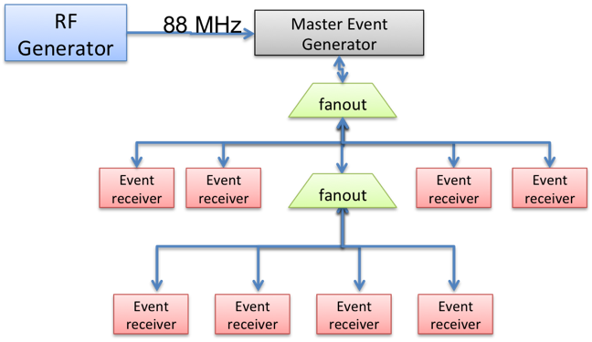
Some building blocks (II)
Timing System
Almost all the components are ready
We’re currently debugging the MTCA EVR
The previous strategy was based in a driver developed by Cosylab.
This strategy was changed by our Chief Engineer and all our timing development will be based on mrfioc2.
We are now in the process of porting back some of the systems (e. g. LLRF).

Slide 10
Some building blocks (II)
Data Acquisition
Drivers Development and support for:
  Struck SIS8300(L)
  D-tAcq ACQ420FMC (Analog Input)
  D-tAcq AO420FMC (Analog Output)
  FM-S14 Quad SFP/SFP+transceiver FMC
  IOxOS ADC_3110 FMC
  IOxOS ADC_3111 FMC
  IOxOS ADC_3117 FMC

Slide 11
Some building blocks (III)
Motion Control
Until now Geobrick has been the motion control solution supported by ICS.
In collaboration with the Motion Control and Automation Group (MCAG) we are developing a technology based on an Open Source EtherCAT master. This will be the standard solution for the accelerator.
MCAG group also evaluates an industrial control based on TwinCAT with EtherCAT hardware and the same hardware can be used with this open source approach. This will be the standard solution in order to support complex motion requirements.

Slide 12




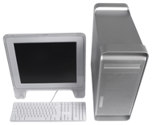

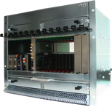
Some building blocks (V)
EPICS Integration Workflow using our Development Environment
EPICS Base
EPICS modules (community)
EPICS modules (ESS)
Continuous integration, tests, etc.
CCDB
Compilation, maintenance
EPICS core
EPICS modules
(RT)OS image
File system (NFS)
IOC Factory
File system (NFS)
rsync
st.cmd
Replication
System integration
Boot
Boot
12

Slide 13
Some building blocks (V)
Software
The basic blocks regarding CSS, Archiving and Alarms are available. We need to do some work with the Software Group.
We are addressing the creation of workflows for starting populating data in the Databases.
We are doing a code review of the EEE (ESS EPICS Environment). The quality of the software and its generation needs to be improved.
EEE will be tested using the testing infrastructure provided by the Software Group
Creating release cycle for the EEE and collaborate with the software group to include it in the Development Envinroment
Quality needs to be improved overall

Slide 14
WP 10 - Accelerator Integration (I)
Status
A full replaning of the work package has been started. It is specially difficult because there were a high number of activities already going on in the plan.
We are changing the way we relate with our stakeholders. This is generating some resistances.
We are putting a great deal of focus on RF and BI. Time has passed, a lot needs to be done, and we have to change many things.
We start to see improvements in the collaboration with AD.
This work package is the biggest one and it is consuming a lot of our resources
The system breakdown chosen complicates the management of the interfaces.
The requirements gathering process is cumbersome
We start to see a ’silo effect’ in the design on the different accelerator sections, and we still did not manage to work on a global accelerator controls architecture.
The introduction of a new FMC front end platform progressed slowly. Now we have different platforms support with ’divergent’ workflows. The stakeholders do not yet agree with this new approach and have concerns about schedule.
 |  | NOT STARTED | UNDER DISCUSSION | DOCUMENT CREATED IN CHESS | UNDER REVIEW | 1st VERSION APPROVED
ACCELERATOR SYSTEMS | Global Accelerator -ICS
 | Vacuum System - ICS
 | Beam Instrumentation - ICS
 | Rastering Magnets Systems -ICS
 | ACCP-ICS
 | RF Cell - ICS
 | RF Phase Distribution System
 | Power Supplies – ICS
 | Water Cooling Systems
 | Main Power Supply
 | PS & LEBT
 | RFQ
 | MEBT
 | DTL
 | Cryogenics Systems-ICS

Slide 15
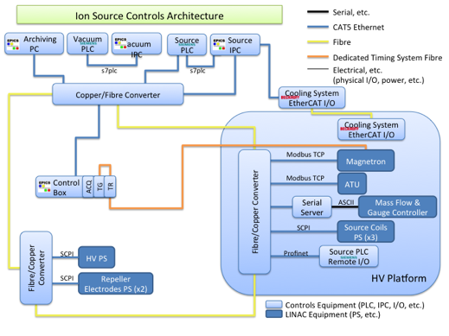
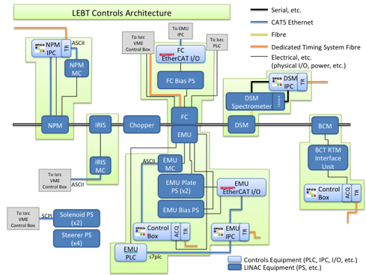
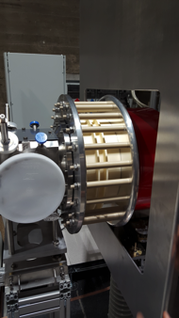
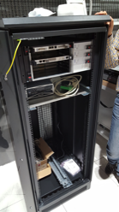
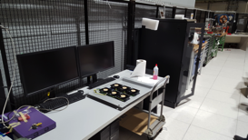
WP 10 - Accelerator Integration (II)
PS & LEBT

Slide 16
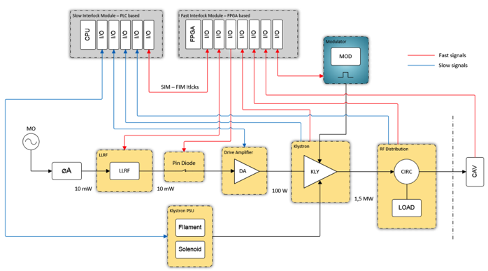
WP 10 - Accelerator Integration (III)
RF Local Protection System
Slow part based in Siemens PLC
Fast Interlock Module
  NI based prototype
  IFC 1210 prototype
Lack of resources on RF group
Limited trust in ICS being able to support their standards.
Trying to change the way of working towards a ‘sustainable’ support.
Design proposal:
22 Channel FMC ADC
Digital IO FMC
IFC 1210 board
Firmware portable to final platform
FMCs to be developed (needed by other projects)
First stage:
Use existing ADCs and digital I/O interfaces
ADC, DIO firmware blocks exist
Not ideal setup but demonstrates the principles and performance

Slide 17
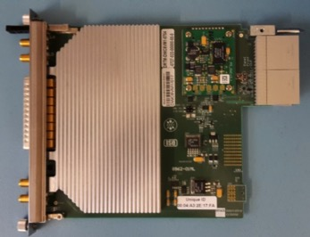
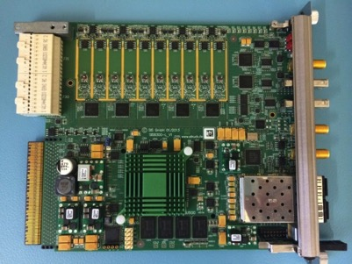
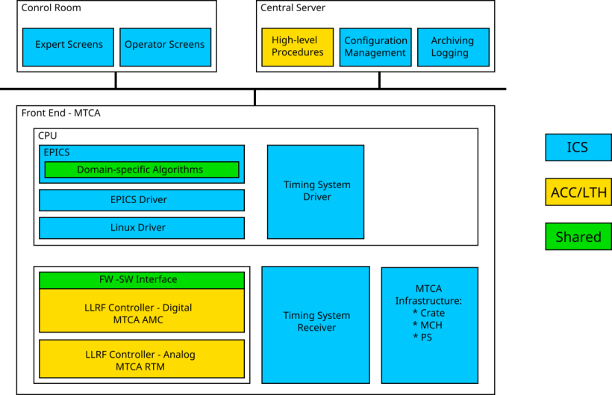
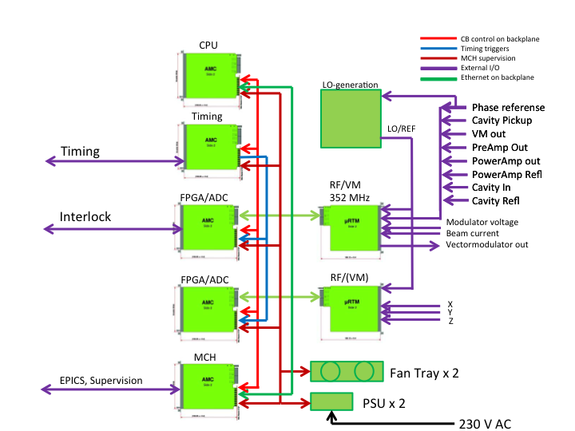
WP 10 - Accelerator Integration (IV)
LLRF
Current solution based on Struck SIS8300
ICS is proposing to migrate to a solution based on IFC_1410 variant
Fall back to mrfioc2
Trying to change the workflow with the LLRF team
ICS default software services installation need to be fixed.

Slide 18
WP 10 - Accelerator Integration (V)
RF
Other activities
  Try to start a collaboration with the RF group to develop standard controls for modulators
  High Power RF Circulator
  Phase Reference Distribution System

Slide 19
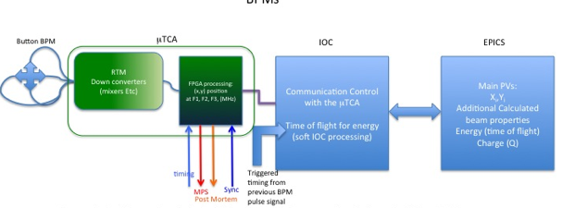
WP 10 - Accelerator Integration (VI)
Beam Diagnostics
INTERCEPTIVE DEVICES PROTOTYPE
The final goal is to build the one - working well- template system for interceptive devices in terms of EPICS Integration (CSS, IOC, and so on) and Machine Protection.
BPM Prototype
  Currently based on Struck SIS8300
  Fall back to mrfioc2
  ICS is proposing to migrate to IFC_1410 variant
  Trying to change the workflows with the BI Team

Slide 20
WP 11 – Target Integration
Status
The old staffing plan and activities were stopped and reevaluated around mid 2015.
The way of working together with Target had to be changed. Some adjustment period was needed.
A new planning has been developed.
In order to perform this planning a system breakdown for target control systems had to be done
There is still some indefinitions on the scope

Slide 21
WP 11 – Target Integration
ICDs
 |  | NOT STARTED | UNDER DISCUSSION | DOCUMENT CREATED IN CHESS | UNDER REVIEW | 1st VERSION APPROVED
TARGET SYSTEMS | Target Safety System - ICS
 | Tartet Moderator Cryoplant-ICS
 | Shielding & Plugs Cooling System-ICS
 | Target intermediate cooling system-ICS
 | Intermediate water Cooling System 30C-ICS
 | Intermediate water Cooling System 15C-ICS
 | Reflector Primary Cooling System-ICS
 | Drainage System – ICS

Slide 22
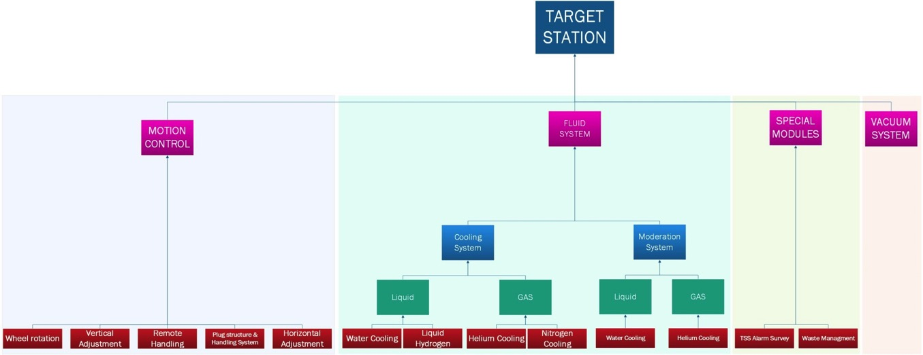
WP 11 – Target Integration
System Breakdown
Unmanageable breakdown
  The Target functional breakdown is a mechanical breakdown, not useful for ICS purpose.
  Is also difficult to identify interfaces, in terms of function and people.
  The ICDs documents reflects the Target breakdown structure; for these reasons, the ICDs include NOT USEFUL information from a control point of view.

Slide 23
WP 11 – Target Integration
Overall Progress
Most of the scope discussions have been cleared up.
In some cases, lack of competences were identified to cover some scope.
One of the last discussions of scope
  Active Cell is a rather autonomous system, with a own control room and with many specifics and “self consistent ” control systems. These control systems already have SCADA functionality (HMI, Alarm management and Historical records). The Active Cells system will work when the beam is off.
  Many signal are safety related.
  Given that ICS handles relevant information that impacts the machine operation, there is no purpose in the integration with the ICS archiving and alarm systems.
  The identification of the interfaces that involve PSS system need to be carefully clarified.

Slide 24
WP 12 – NSS Integration
Status
The collaboration is proceeding normally
Science Directory is a big organization, sometimes it is not easy to reach everyone and create ‘controls awareness’
Work on planning soon to be ready
Reach the different in-kind partners is sometimes difficult.
Collaboration with DMSC is crucial

Slide 25
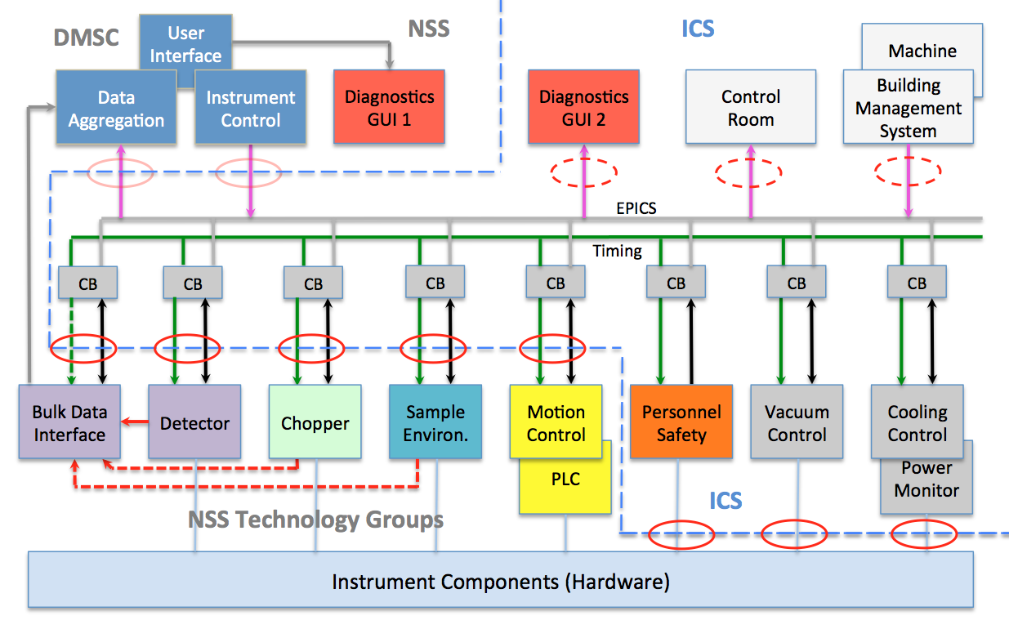
WP 12 – NSS Integration
Interfaces
 |  | NOT STARTED | UNDER DISCUSSION | DOCUMENT CREATED IN CHESS | UNDER REVIEW | 1st VERSION APPROVED
NEUTRON SCATTERING SYSTEMS | Motion Controls - ICS
 | Chopper Controls -ICS
 | NMX-ICS
 | Loki-ICS
 | Others

Slide 26
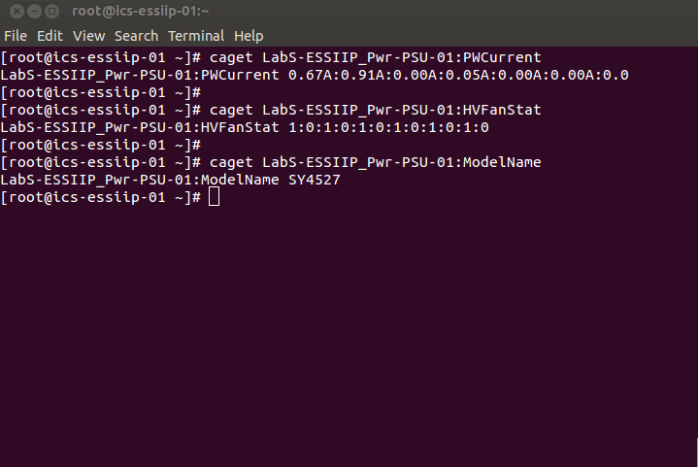
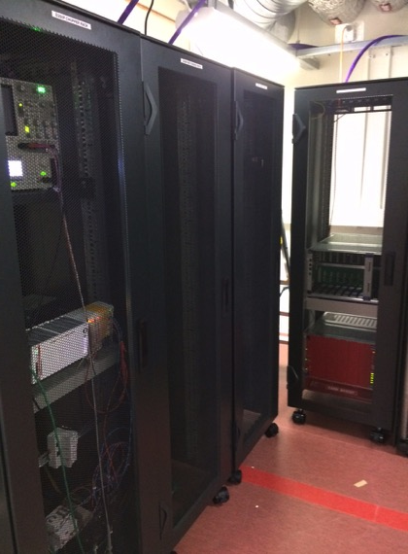
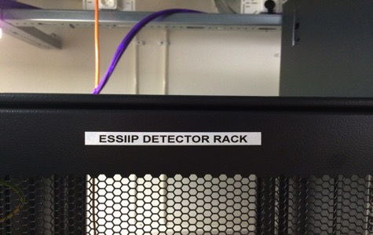
WP 12 – NSS Integration
ESSIIP
ESSIIP is a lab project to integrate real equipment from NSS technology groups (Detectors, Motion, Sample Environment, Choppers) into ICS control system.
Full vertical integration from PLCs through DMSC Experiment Control Software.
Provides an environment to facilitate integrated development for all groups.
26

Slide 27
WP 12 – NSS Integration
Main Issues
Project planning needs to be improved.
  Challenging while the instrument construction schedule is not clearly defined.
  Working on establishing improved direct interface to instrument teams.
  Need to identify instrument-specific effort required.
  Lack of shared milestones with NSS Technology Groups.
Project resourcing needs to increase sharply.
  At least sixteen neutron instruments to be integrated.
  Commissioning of first instruments starting in 2-3 years.
  Significant integration effort required for each and every instrument.
  Extensive development and integration of modular instrument technologies required beforehand.
Overall ESS instrument commissioning strategy not yet well developed.

Slide 28
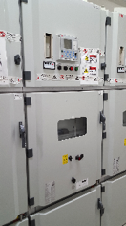
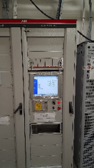
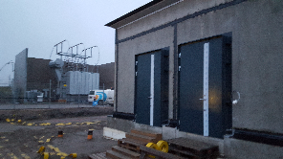
WP 13 – CF Integration
Status
Planning delivered
Collaboration with CF has relatively improved.
H05 CF-ICS interface preliminary design is done and under review, and system will be deployed soon.
Once approved, H05 design will be used for other buildings
Information is being collected from various stakeholders for detailed interface design (power monitoring, water, etc.)
 |  | NOT STARTED | UNDER DISCUSSION | DOCUMENT CREATED IN CHESS | UNDER REVIEW | 1st VERSION APPROVED
CF SYSTEMS | Global SI -ICS
 | Interface description formats
 | Technology and standard platform interfaces
 | Interfaces of ESS site deliverables
 | Interfaces of ESS Site Deliverables - Building H05
 | Interfaces of ESS Site Deliverables - Building H06
 | Interfaces of ESS Site Deliverables - Building H01
 | Interfaces of ESS Site Deliverables - Building G01
 | Interfaces of ESS Site Deliverables - Building G02
 | Interfaces of ESS Site Deliverables - Building D02
 | Interfaces of ESS Site Deliverables - Building D01,D03-D08
 | Interfaces of ESS Site Deliverables - Building E01-E05

Slide 29
Summary/Conclusion
The Integration team is being put in-place
Planning is progressing in different work packages
A new overall strategy for all the integration work packages is being developed.
It is difficult to evolve the team at the speed needed.
The challenges in terms of schedule are noticeable
Some stakeholders still need to adjust to another way of working
Some of the existing work needs to be reviewed and there are reasonable concerns about its validity

