Slide 1
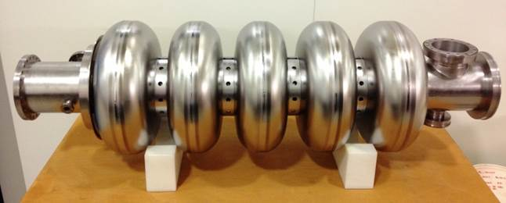
High-Beta Cavity Delivery
P McIntosh ASTeC, STFC Daresbury Laboratory
ESS Technical Advisory Committee
Lund
6 – 8 April 2016

Slide 2
Outline
Cavity Delivery Objectives
Project Delivery Schedule
Key Milestones
Excluded Activities
Nb Sheet Non-Conformance
QA Processes
Project Governance
Project Staffing
Test Facility Preparations
Progress to Date
Risks and Mitigation
Conclusions

Slide 3
Deliverables I
Niobium procurement: STFC to procure the high RRR Niobium for the high-β elliptical dressed cavities in agreement with the SRF collaboration for the ESS linac.
Cavity fabrication of the 84 (+ 4 spares) high-β elliptical dressed cavity in industry including:
Cavity fabrication.
Chemical processing.
Heat treatment.
Vacuum processing.
High pressure rinsing.
Field flatness and frequency tuning.
Assembly of RF antenna and isolation valve in cleanroom.
Shipment of dressed cavities to STFC.
Procedure Qualification and Training:
A qualified test procedure to be developed and implemented.
A QA/QC system for individual tests in accordance with ESS policies.
Trial tests to be performed and performance targets verified.
Staff training in procedures and processes.

Slide 4
Deliverables II
Vertical Test (VT) of SRF cavities:
VT stand to be qualified to meet ESS cavity requirements including new cryogenic and RF system, along with a suitable controls system.
A QA/QC system for individual tests in accordance with ESS policies.
Testing of the high-β dressed cavities to 22.9 MV/m at 704 MHz, with a Q_{o} better than 5 x 10⁹.
Documented test results provided to ESS.
Preparation and shipping of cavities to cryomodule integration site:
STFC to design and procure shipping fixtures for SRF dressed cavities for transport from industry.
STFC to transport SRF cavities from STFC to the cryomodule integration site at CEA Saclay.
UK-IKC Technical Annex used to agree project scope and delivery.

Slide 5
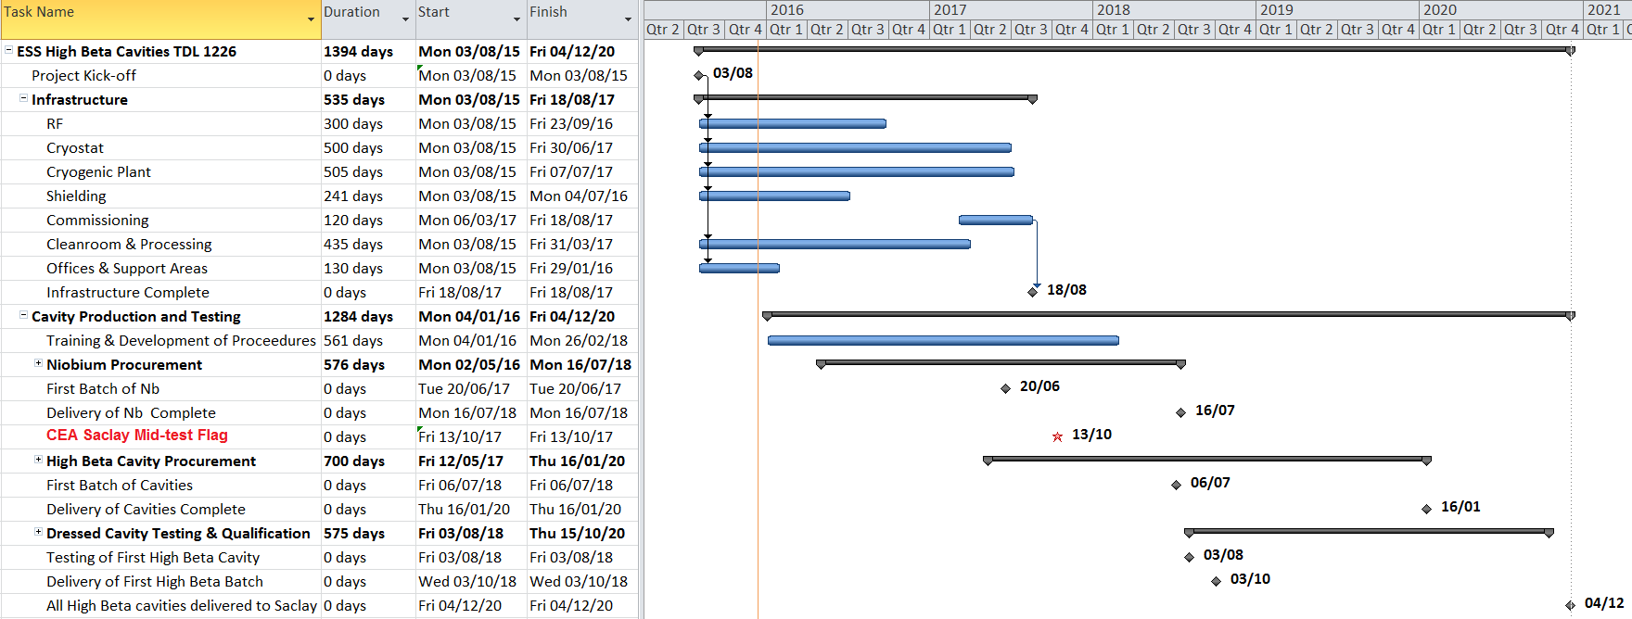
Revised Project Delivery
Cavity Test Facility
Staff Training
Cavity fabrication and testing
ESS Primavera

Slide 6
Project Schedule & Key Milestones
Milestone | Description | Date | CAS
Stage 1 4 | Design and procurement of the VTF including RF system, control system, cryogenic system, cryostat, cavity handling tooling. | 9/9/2016 | 5%
5 | Installation and commissioning of the full VTF system with suitable prototype/pre-production cavities. | 7/7/2017 | 5%
8 | Critical Design Review, reporting, stage 2 starts after approved CDR | Q4 2017 | 10%
Stage 2 9 | Receiving and arrival inspection reporting of first batch of niobium material at STFC | 20/6/2017 | 5%
12 | FAT at STFC and shipping of high-β cavities for CM 1 to CEA | 25/10/2018 | 5%
18 | FAT at STFC and shipping of high-β cavities for CM 2-3 to CEA | 3/2/2019 | 5%
19 | FAT at STFC and shipping of high-β cavities for CM 4-6 to CEA | 6/6/2019 | 5%
20 | FAT at STFC and shipping of high-β cavities for CM 7-9 to CEA | 3/10/2019 | 5%
21 | FAT at STFC and shipping of high-β cavities for CM 10-12 to CEA | 3/3/2020 | 5%
22 | FAT at STFC and shipping of high-β cavities for CM 13-15 to CEA | 3/6/2020 | 5%
23 | FAT at STFC and shipping of high-β cavities for CM 16-18 to CEA | 3/9/2020 | 5%
24 | FAT at STFC and shipping of high-β cavities for CM 19-21 to CEA* | 4/12/2020 | 5%
28 | Preparation of the data package for SAR 2 regarding cavities to CM 2-21 after assembly and SAT at ESS in Lund | Q1 2021 | 10%
*Note for 84 cavities only (excl spares)
Factory Acceptance Tests (FAT)
Site Acceptance Tests (SAT)
System Acceptance Review (SAR)

Slide 7
Excluded Activities
No Eddy current scanning is to be performed for Nb sheets:
Gradient level perceived to be low enough not to be required by ESS.
If required, timescales and costs will need to be factored into the STFC SoW.
DESY have the capability currently, Hereaus exploring possible partnership.
Major risk to STFC’s delivery programme.
Cavities failing to achieve gradient requiring BCP rework:
BCP will not be performed by STFC.
Any requirements for BCP re-processing will require cavities to be returned to the manufacturer for rework – outside of STFC scope.
No cavity or tooling design work is included:
Finalised engineering drawings are required from ESS.
Cavity processing requirements to be defined by ESS.

Slide 8
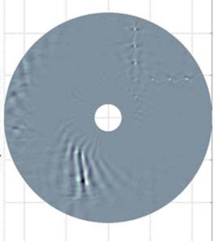
Nb Sheet Non-Conformance
Wah Chang, Tokyo Denkai and Ningxia don’t have eddy current scanning capability.
Heraeus can perform small scale scanning and are exploring partnering with DESY to provide larger scale scanning capability.
ESS proposed performance mitigation to use ultrasonic microscopy (surface only), increase number of spare cavities to 8 and relax gradient performance target for ~20% of affected cavities.
Eddy current scan for 1.3GHz Nb sheet
Total number of high beta cavities (excl spares) | 84 | Cavities
Number of sheets per cavity (excl beampipes) | 10 | Sheets
Total number of sheets | 840 | Sheets
Total expected cavity failure (assuming 2 % non-conformance)* | 17 | Cavities
Cavity failures with relaxed gradient specification 20% total (excl spares) | 14 | Cavities
Cavity failures with relaxed gradient specification 20% total (incl 8 spares) | 15 | Cavities
Total % failure rate (worst case probability) | 16 | %
Note TAC Charge specifically on mitigation strategy:
Expected failure rate
Should eddy current scanning be performed
Number of spares
*Statistic to Eddy Current Scanning of Niobium Sheets for the Eu-XFEL, A Brinkman et al, SRF2013
Minimum number of cavities without Nb sheet limitations (excl spares) | 70/84
Estimated energy reduction (excl spares) | 238 | MeV
Minimum number of cavities without Nb sheet limitations (incl spares) | 77/84
Estimated energy reduction (incl spares) | 119 | MeV

Slide 9
Nb Material Validation
Note: Many UK-IKC contributions currently identified and approved, funding restrictions are now in place in terms of increasing IKC project scope.
Option 1 (Preferred):
Eddy current scanning of sheets performed by another IKC partner.
STFC then retains its original scope for delivering 84 cavities (+4 spares).
Option 2:
STFC procures eddy current scanning system and performs scanning ourselves.
The hardware and resourcing cost of including this activity, therefore reduces the associated number of cavities delivered (TBD).
Option 3:
STFC sub-contracts the eddy current scanning to another organisation.
Costs for this activity would also reduce the associated number of cavities delivered (TBD).
Note that capability for eddy current scanning is comprehensively limited in Europe – DESY only group with available infrastructure & expertise.
Fundamentally we believe eddy current scanning is required to ensure STFC’s delivery can be maximised.

Slide 10
Quality Assurance
STFC Technology Department at Daresbury Laboratory operates a quality system that meets the requirements of ISO 9001:2008.
The quality system defines how a project will be coordinated and documented.
The management of a project is based on an agreed Project Specification and a series of reviews at key stages in the work.
The detailed implementation of the Quality Management system is described in standardised group procedures, processes and local instructions.
These provide the core of the Quality Management System and provides the detail required to operate the system.
The processes and procedures are followed by STFC staff undertaking specified activities.
The work undertaken will be defined under an agreed series of bespoke processes and procedures based on existing Daresbury Laboratory vacuum and cleanroom procedures, in association with procedures developed by ESS/CEA-Saclay.
These procedures and processes would then be followed and tracked by the technicians assembling the equipment to ensure a repeatable, auditable standard is achieved.

Slide 11
QA Data Management
Industrial:
Nb material
Company – Provision documentation – certifications, procedures, measurement data
STFC – Monitoring of documentation – Inspection, Approval
Industrial:
Cavity fabrication
Company – Provision documentation – certifications, procedures, measurement data
STFC:
Cavity Testing
STFC − Provision of cavity documentation and test data
ESS − Monitoring of documentation (with site visits) - Inspection, Approval
CEA Saclay − Monitoring of documentation (with site visits) - Inspection, Approval
STFC – Monitoring of documentation (with factory visits) - Inspection, Approval,
Need a better understanding of parameters to be recorded.
Understand data collected on prototype cavities tested to date.
Need to understand/agree how the data is to be presented – compliance with ESS PLM system.
Need to define the architecture – Being progressed.

Slide 12
Project Governance
STFC ESS-IKC Project Board
Project Manager (Technology)
Material/Cavity Procurement (Technology)
Vendor Monitoring
(Technology)
SRF Cavity Testing (ASTeC)
Cleanroom Assembly (Technology)
Quality Assurance (Technology)
SRF Infrastructure (Technology)
Project Sponsor (ASTeC)
Vertical Testing (ASTeC)
Cleanroom/HPR/VTF Preparation (Technology)
Production Preparation/Training
(Technology/ASTeC)
Preparation/Shipment (Technology)
QA Documentation Preparation
(Technology)
Project Management Committee (PMC)
(Technology & ASTeC)
Project Management Board
(ASTeC, Technology & Independent)
TMVE/T@DL Programme Management (Technology)
ESS/CEA Elliptical Cavity Collaboration Board
Stakeholder planning
Financial reporting
Project planning (& current R,A,G status)
Change Management
Risk Register
Started
Imminent
Not yet Started

Slide 13
High-Beta Cavity Delivery Team
Management
Project Sponsor – P McIntosh (ASTeC)
RF Group Leader – A Wheelhouse (ASTeC)
Interim Project Manager – P Atkinson (Technology)
New Project Manager – M Ellis (ASTeC) (started 1st April)
QA Manager – M Pendleton (Technology)
RF
Senior RF Engineer – P Smith (ASTeC) (starts 18th Apr)
RF Engineer – K Dumbell (ASTeC)
RF Engineer – P Goudket (ASTeC)
Cryogenics
Senior Cryogenic Engineer – S Pattalwar (ASTeC)
Senior Cryogenic Engineer – A Goulden (ASTeC)
Senior Cryogenic Engineer – R Buckley (ASTeC)
Cryogenic Engineer – L Bizel-Bizzellot (ASTeC)
Mechanical
Senior Mechanical Technician – P Davies (Technology)
Senior Mechanical Technician – W Roberts (Technology)
Mechanical Technician – R Corcoran (Technology)

Slide 14
Procurement Priorities
Formal UK-IKC funding starts 1/4/16:
Niobium material
Provisional Nb quotes received from Wah Chang, Tokyo Denkai & Ningxia:
Based upon drawings supplied by CEA Saclay
Inflation costs of Nb uncertain
Nb specification needs to be clarified by ESS to allow procurement to commence urgently!
Prefer single supplier for Nb:
Ensure timescales can be achieved
Need to minimise delivery timescales
Minimise risk against other known external procurements for Nb over this period (e.g. SLAC – LCLS-II)
Cavity Fabrication
Refined quotes to be obtained from industry:
Processing requirements to be agreed
Finalised engineering drawings required from ESS
Cavity processing requirements to be defined by ESS
ESS to provide tolerance requirements to aid HOM management
Cavity suppliers need to be qualified
ESS/CEA/STFC/INFN collaboration process is critical to ensure specifications/drawings/procedures are collectively agreed and utilised.
Jun 2015 – CEA Saclay (https://indico.esss.lu.se/event/354/)
Dec 2015 – Daresbury (https://ess-ics.atlassian.net/wiki/display/CRYOM/2015-12-15+%3A+2nd+SRF+Collaboration+Meeting+@+STFC)
Next meeting to be arranged at INFN Milano

Slide 15
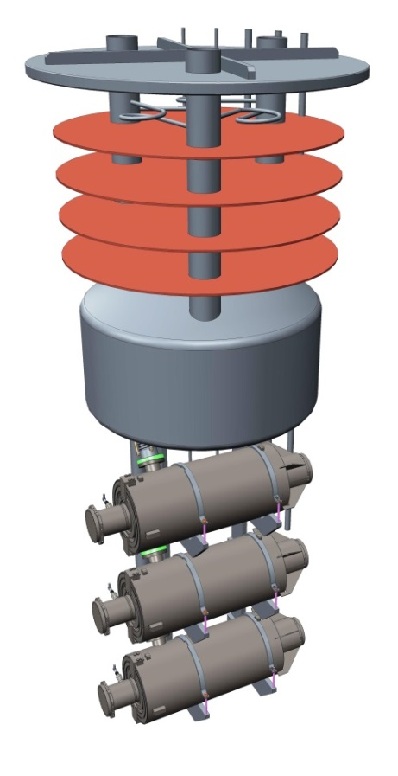
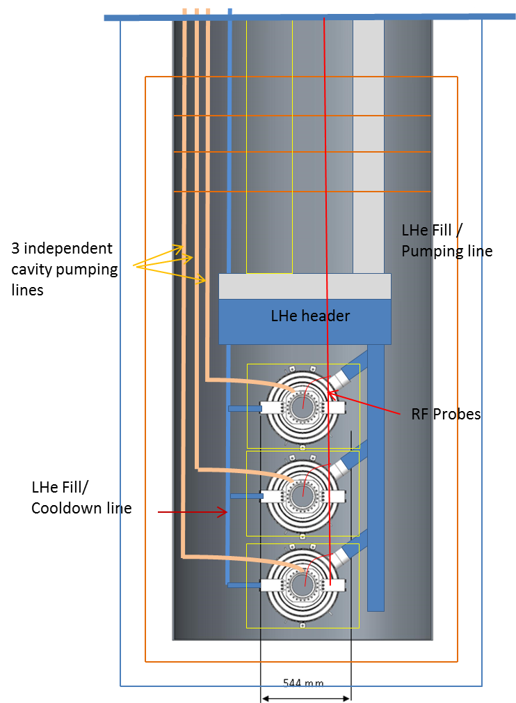
Horizontal Tests in a Cryostat
Aim to test 3 cavities horizontal in the cryostat - Typically done vertically:
Diameter sufficient to test 3 vertically if required
Helium vessel will be used to cool the cavities:
Reduced LHe requirements
75% saving on LHe and gas storage
Automatic leak checks on He vessel
Higher confidence in performance
Quicker cool-down/warm up periods
Lower operational hazards (due to lower gas flow/less quantity of LHe)
Risks/Issues
Additional assembly steps
Additional leak checks during assembly
Need to understand the cryo load during F/E or multipactor
Need careful QA steps
Cryostat tender in progress.
Proposed Cryostat Design

Slide 16
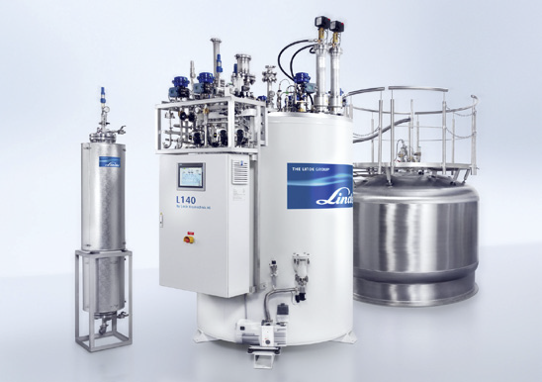
Cryogenic Liquifier Plant
Cryogenics plant consists of:
He Liquefier (100 l/h)
5000 l LHe Dewar
Helium Recovery System (10 g/s)
Gas Storage
3 company tenders received:
Linde Kryotechnik
Air Liquide Advance Technologies
Vorbuchner Cryogenics & Applications
17/3 contract agreed with Air Liquide:
expected delivery by Jan 2017.
Linde
Kryotechnik
Air Liquide
Advance
Technologies

Slide 17
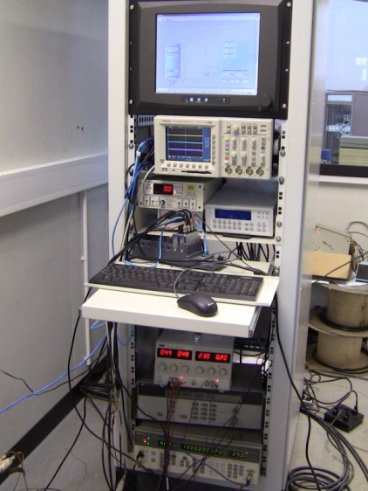
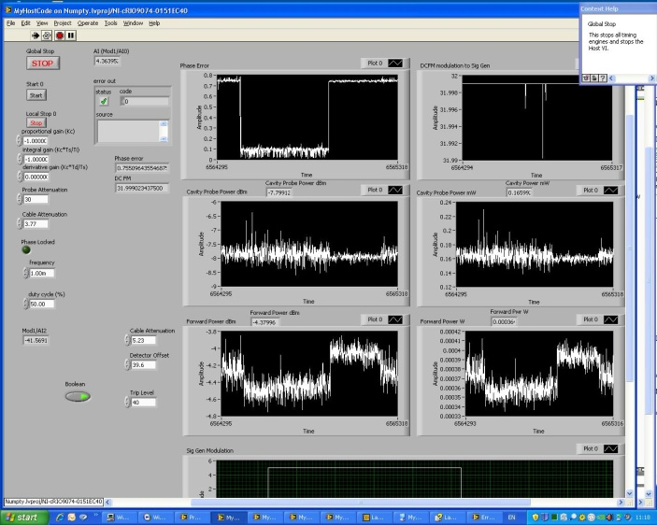
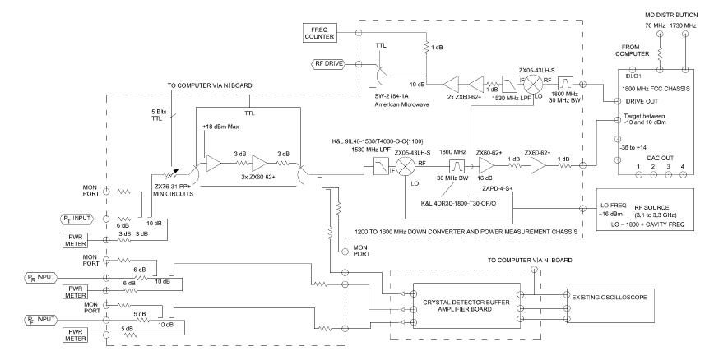
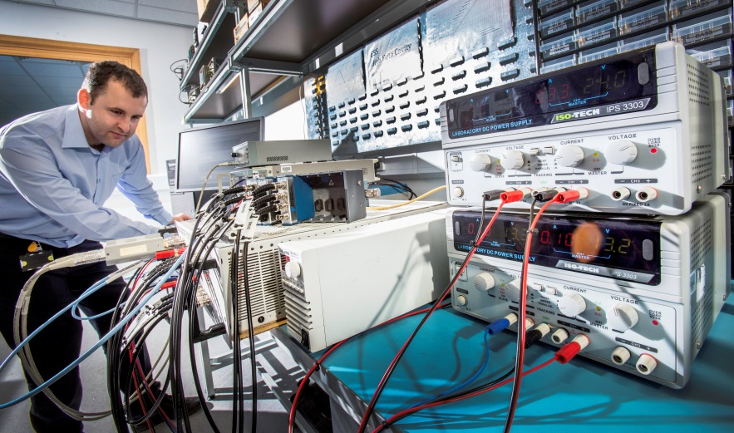
RF Cavity Test System
Existing VTF test facility configured for an operational frequency of 1.3 GHz.
Modifications required to enable testing at 704 MHz.
System has been defined.
Robust and versatile system.
Low risk as it is an already operational system at JLab.
RF amplifier is being sourced:
Need RF power to accommodate F/E and/or m/p limitations.
500W amplifier ordered.
Existing VTF test facility
Low level block diagram
Courtesy of Tom Powers (Jlab)

Slide 18
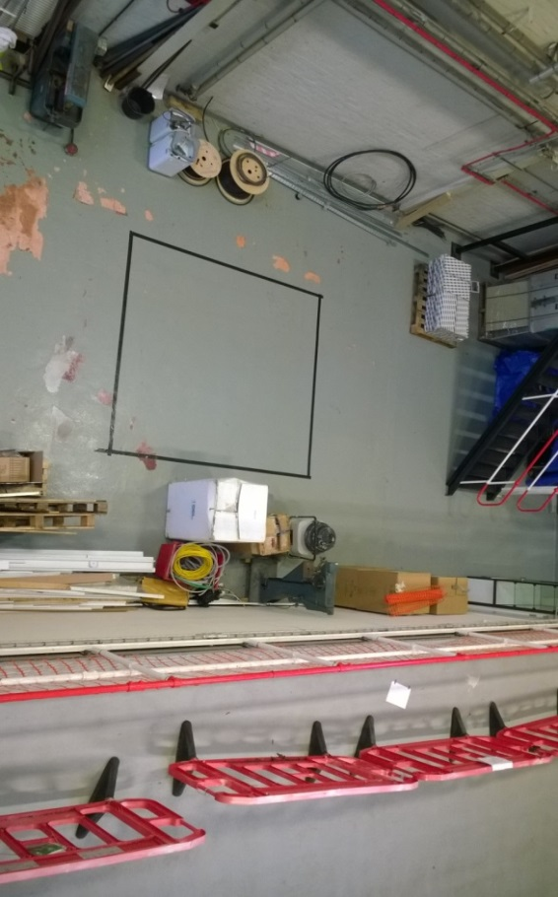
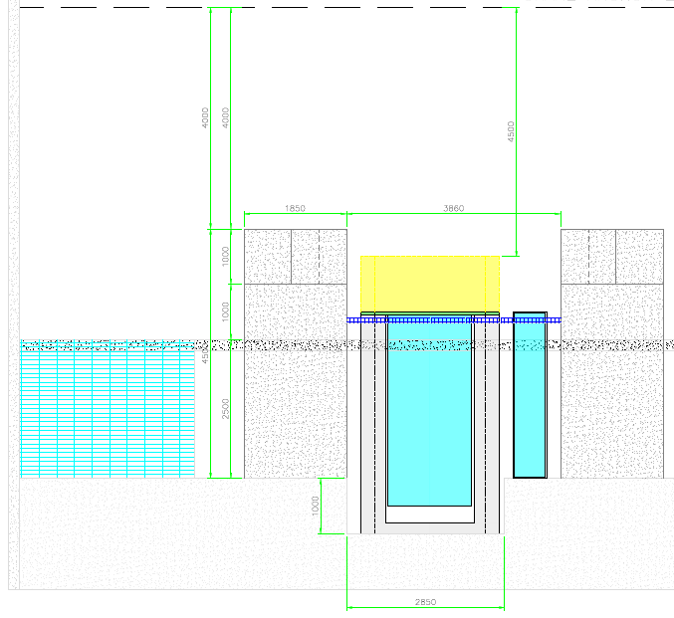
Cryostat Shielding
Outlined radiation assessment has been performed.
More detailed assessment is being undertaken at present.
To date the concrete thickness is defined – 1.8 m.
Shielding design and ancillary system integration still being finalised.

Slide 19
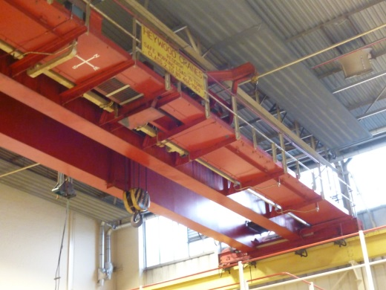
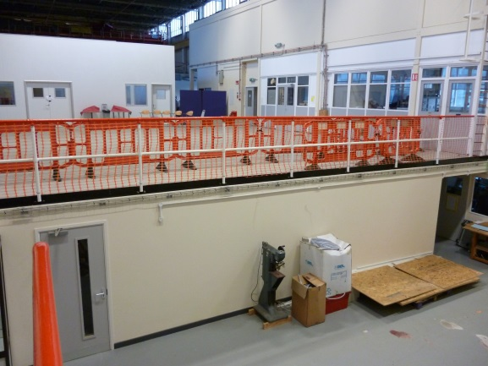
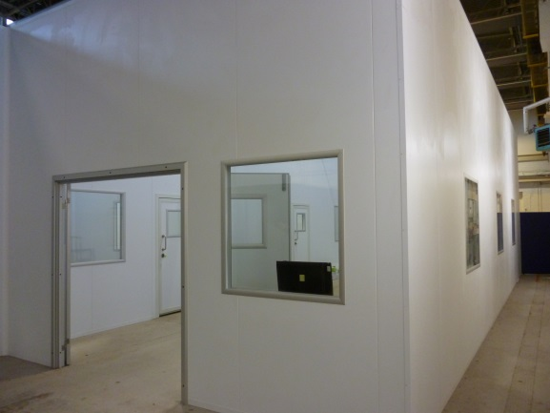
SRF Test Hall
He Compressor House
Full crane coverage
Offices upstairs
Cavity Goods-In & Out downstairs
Thin Film Lab
Crab
Lab
20m
VTF
Cleanroom
Cryo-plant
55m

Slide 20
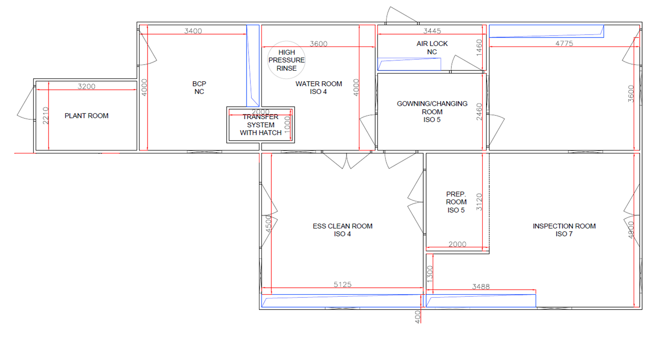
Reconfigured Cleanroom
8m
18.9m

Slide 21
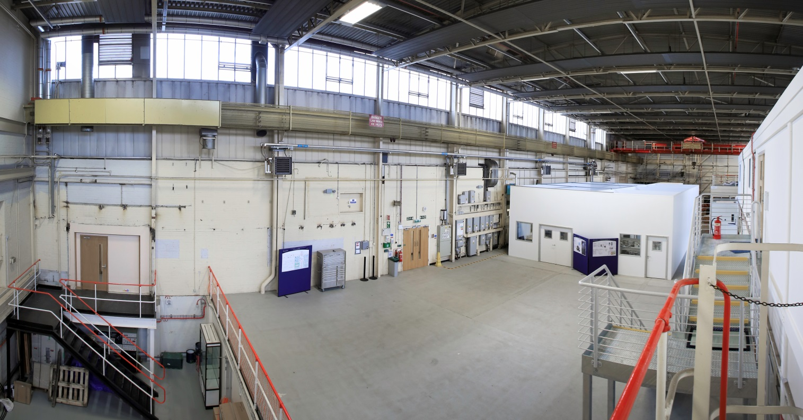
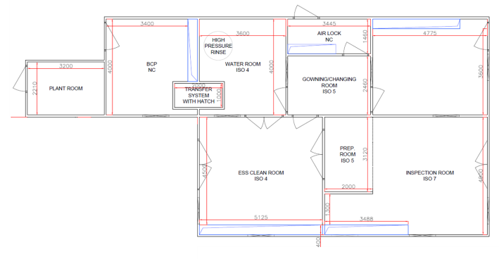
SRF Hall – Cleanroom Layout
BCP not included in ESS scope
He Compressor House
Offices upstairs
Cavity Goods-In & Out downstairs
Thin Film Lab
Crab
Lab
VTF
Cleanroom
Cryo-plant

Slide 22
Cavity Testing & Delivery
Project Management:-
Project Team Management
Resource Planning & Management
Scheduling
Risk Planning & Management
Monitoring progress of timescales, budgets, and quality
Stakeholder Management - Key point of contact with ESS
Project reporting
Procurement:-
Tender documentation
Procurement of material for 84 (+spares) high-β cavities.
Procurement of dressed 84 (+spares) high-β cavities from industry.
Quality assurance to be managed
Vendor qualification
Processes and Procedures:-
Documentation for all the processes and procedures to be defined and agreed
Training on the processes to be performed and monitored
Process trials to be performed
Cavity preparation and final test QC documentation prepared.
Cavity Qualification:-
Installation of cavities onto vertical insert
Installation into VTF cryostat
Qualification in a vertical test facility of cavities at 2 K to the required gradients of 22.9 MV/m for the high-β cavities.
Assessment and provision of test data
Test data to be reviewed and approved
Removal of cavities from VTF Cryostat and vertical insert.
Complete final sealing, leak checks and QC processes.
Sealing and packing of cavities
Arrangement for delivery of cavities to cryomodule integration team (CEA Saclay).
Maintenance of the equipment
Cavity Rework:-
HPR of cavities
Repeat qualification
Started
Imminent
Not yet Started

Slide 23
Project Delivery Risks
Niobium material defects severely restrict ability to prepare cavities to ESS specifications:
Investigate whether vendors are able to perform sheet scanning.
Assess with ESS effective mitigation for sheet non-conformance.
Difficulty in achieving effective HOM management for high-beta cavities:
Rigorous validation of fabrication procedure to be performed by CEA Saclay prior to STFC purchase of fabricated cavities.
Tuning procedures to be defined and provided by CEA Saclay and adhered to with chosen cavity fabricator.
Conflict of resources with other ASTeC/TD projects:
Dedicated resourcing assigned to SRF high-beta cavity project, including new recruitments in specialist areas.
Regular monitoring/reporting of project delivery to ASTeC/TD senior management.
Procurement delays with STFC’s internal procurement processes:
Working closely with procurement agents to identify problems early and resolve issues rapidly.
Dedicated STFC ESS procurement officer appointed to support procurement processes.
Regular meetings with ESS procurement team.

Slide 24
Conclusions I
STFC project delivery and milestones agreed – Technical Annex however not yet approved based upon potential scope change as result of eddy current scanning mitigation.
STFC project governance processes now in place, full delivery team almost complete.
Test facility implementation underway:
Test area secured and being prepared,
Cryostat and liquifier procurements underway,
Cavity test electronics and hardware being evaluated,
Cryostat shielding preparations ongoing,
Cleanroom reconfiguration developed in readiness for implementation.
Project delivery risks identified and mitigation strategies being prepared.
Nb material validation is currently STFC’s prominent risk.

Slide 25
Conclusions II
TAC Charge:
During manufacturing and testing, the yield and the risk of not reaching specified gradients for the superconducting cavities have to be considered. Does TAC have recommendations on
What failure rate we should expect, i.e. what fraction of the cavities will not reach full gradient during tests, allowing additional HPR if needed but not rework (incl. BCP) at the factory?
Whether eddy-current scanning of the niobium sheets should be performed, taking into account cost, schedule and the possibility to mitigate by ordering spare cavities?
What number of spare cavities should be ordered?
Does the TAC have specific recommendations regarding the 84 high-beta cavities for which the TAC had a more extensive presentation?
STFC has a plan for the provision of the high-β elliptical cavities which still meets the timescales for the ESS schedule – excl Nb material validation.
STFC needs to have strong coordination with ESS/CEA & INFN to ensure requirements and timescales are fully integrated:
Specifications, drawings, procedures, QA processes and project management integration is critical for successful delivery.

Slide 26
Many Thanks

