Slide 1
Integrated Control System Infrastructure and Main Control Room TAC 13
Remy Mudingay
ESS/ICS
2016-04

Slide 2
Content
Introduction
Control System Infrastructure Scope
Control Room Work Unit
Control Room Project
Standard
Working Group
Standard
MCR location
Documentation

Slide 3
Control System Infrastructure WP 7 Scope
The scope of this work package is to design, develop and procure the IT infrastructure required for the Control System to operate.
It has the following work units:
Control Room 7.1
Design and implementation of the centralized ESS Control Room, which allows the Accelerator, Target, Neutron Instruments and Conventional Facilities to be monitored and controlled from the same room.
Data Centre 7.2
Provide servers and file storage infrastructure required for normal operation during development, commissioning and operations phase.
Control System Networks 7.3
Design and implementation of the networks between IO Controllers, Control Room(s) and Data Centre.
Covers the efforts and material required for connecting devices to the ICS through to the IO Controllers.
Notes:
Is the scope for the infrastructure work package appropriate and precise enough?

Slide 4
Main Control Room

Slide 5
Control Room Work Unit
In-Kind agreement with Norway
IFE (Institute for Energy Technology)
Three Stages (Technical Annexes)
Stage 1 – (2015 Q4/2016 Q2)
Preliminary/Conceptual Design
Semi-monthly meetings
Accomplishments
Activities for the next period
Comments/Changes/Concerns/Risks
Action items
Stage 2 TBD (2016 Q3/2017 Q3)
Detailed Design
Stage 3 TBD (2018 Q1/2019 Q2)
V&V
Main Control Room (MCR) realisation

Slide 6
Control Room Stage 1 ISO 11064 Ergonomic design of Control Centres
Phased approach
Participatory process
Best practice
High level functions
Task analysis
Task synthesis + link analysis
Diagrams/functional arrangements
Workstation layouts
Room layout
CAD model
User group
Visit and documentation
- other facilities.
Done: (CERN, PSI, Diamond)
Preliminary Design 2016-06-17
Review
Phase C: Conceptual Design 2016-05-09
Design Process
Phase B: Analysis & Definition 2016-03-16
Objectives
Phase A: Clarification 2016-01-29
✔
Operations & Management
Machine
(Hardware & Software)
Environment
Human

Slide 7
Clarification Phase – Completed Stage 1, Phase A
Safety and Security
Requirements
Interviews
Operation and Control
Constraints
Work organization
Deliverable
Work environment
Summary report
ESS-0052323

Slide 8
Clarification Phase Participants Stage 1, Phase A
Interview Type | Stakeholders
Division | AD | CF | EIS | ESH | ICS | NSS | Operations | Target | Technical Coordinator
Operator Experience | 2 |  |  |  | 2
Requirements & Constraints | 3 | 1 | 2 | 2 | 3 | 1 | 1 | 1 | 1
Target control, Cooling, Target Safety System (TSS)
Beam Physics, Diagnostics, Instrumentation, Cryogenics
Conventional Facilities, Building Management System (BMS)
Commissioning, Operations
Personnel Safety System (PSS), Machine Protection System (MPS), Beam Permit System(BPS)
Electronics and I&C
OpenXAL, Control System Infrastructure, Alarm Design
Fire protection, Security
Neutron Instruments
Technical coordination.

Slide 9
Clarification Phase - MCR Functions Stage 1, ISO 11064 Phase A
Division | System/Sub-system
CF | BMS Electrical SCADA Security access Fire alarms Mobile and Radio ELV systems
ICS | Control System Infrastructure Alarm Personal Safety System Key Exchange Machine Protection System Beam Permit System
NSS | Neutron Instruments CCTV Shutter status
Target | Target Safety System Key Exchange Motion of the Target Wheel Helium flow
Division | System/Sub-system
Accelerator | Beam RF Systems Diagnostics Instrumentation Physics Source Vacuum … Cryogenics Accelerator Cryo Plant (ACCP) Target Moderator Cryo Plant (TMCP) Test and Instrument Cryo Plant (TICP) Flow Temperature Vibration
ESH | Fire protection Alarm signals Safety Ionizing radiation monitors Security Communication

Slide 10
Analysis & Definition Phase Stage 1, ISO 11064 Phase B
User Reference Group ESS (URGE)
Staff | Division | Previous experience
Linda Coney | Target | FNAL, RAL, MICE
Emanual Laface | ICS | CERN
Marc Munoz | Accelerator | Daresbury, SLS, Alba
Annika Nordt | ICS | CERN
Thomas Shea | Accelerator | SNS, BNL, LANL
Workshop – scenario analysis (Functional & Task based)
Scenario Analyses
ESS-0052323

Slide 11
Control Room Project summary
14.7.1 ICS Control Room work unit
ISO 11064 Ergonomic design of Control Centres
In-kind Stage 1:
Phase A - Control room requirements (Done)
Safety & Security
Operation & Control
Work organization
Phase B - Functional & Task analysis (In Review)
Phase C - Preliminary Design (Next)
In-kind Stage 2: Detailed Design & Temporary Control Hardware
In-Kind Stage 3: Main Control Room Hardware
The Norwegian Institute for Energy Technology (IFE) in Halden (In-kind contribution)
Summary report
ESS-0052323
Interviews
Requirements
Constraints
output
output

Slide 12
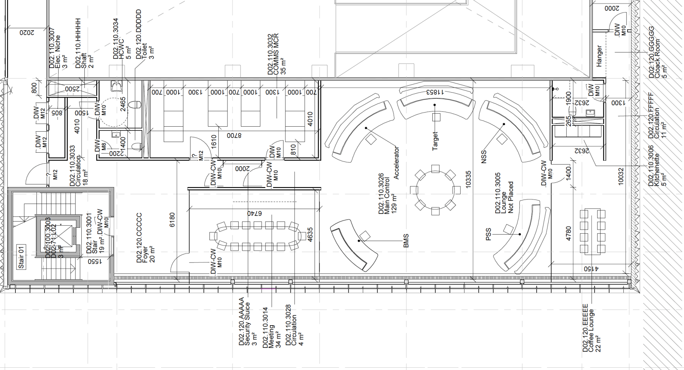
Control Room project
MCR proper
129m²
Coffee/Lounge & Kitchenette Area
27m² (22+5)
Shared
Meeting room
34m²
Glass wall
Total space: 206m² + 29m² Server room/COMMS room*

Slide 13
Control System Data Centre
and Network

Slide 14
Control System Data Centre
Data Centre 7.2
Provide servers and file storage infrastructure required for normal operation during development, commissioning and operations phase.
Servers
Virtualisation infrastructure
IO Controller
PV Access gateway (pva2pva)
Server Applications
Monitoring
Control System Services
RDBMS/Database
DHCP
CSentry
NTP
Channel Archiver
Logs
Post-mortem
Storage
NFS
Distributed
Backup
Online
Offline

Slide 15
Control System Network
Control System Networks 7.3
Design and implementation of the networks between IO Controllers, Control Room(s) and Data Centre.
Covers the efforts and material required for connecting devices to the ICS through to the IO Controllers.
Fibre backbone
Network
Timing system
Structured cabling
COMMS room to µTCA/iPC/IO device
Network devices
Cyber security implementations & policy

Slide 16
Control System Infrastructure Needs & Timeline
When
2016
2017
2018
2019
Security Assessment
In-kind
Proto-typing:
Controls network
Virtualization platform (VP)
Performance/Stress & evaluation tests
Storage & VP
Applications
Proxy
DPI
IDS
EPICS gateway
Procurement
Use of RATS facility for acceptance testing
Network
Desktop computers
Storage and compute Servers
Performance/Stress & evaluation tests
Accelerator installation
Wifi in the tunnel
Remote connectivity
Procurement
Use of RATS facility acceptance testing
Installation and
Network
Storage and compute Servers
Procurement
Network
Desktop computers
Storage and compute Servers
Performance/Stress & evaluation tests
What
ICS Lab
Remote connectivity
Collaboration ICS/IT /DMSC conducive
ESS Lund
Site
Accelerator installation & integration
Temp. Server room
Temp Control room
connectivity
Site
Neutron Instruments
Target
Target integration
Site
Neutron Instruments
Commissioning of all systems
Main Control room
Connectivity
2nd Controls Server room
Where
Notes:
2016 – Working primarily in the ICS lab – Tunavägen – to proto-type both accelerator and neutron instruments control system network. Some procurement of network switches is planned Q1-Q2 2016. Other baseline metrics also needs to be identified for storage and computer needs for the EPICS control system.
2017 – Design for the controls infrastructure is completed and we move towards procuring hardware. Remote connectivity will be needed for the acceptance testing and verification at the RATS facility. Installation of the accelerator begins in earnest Q4 2017 for networks. Storage and computing for the controls network will commence Q2/Q3 2017. Site internet connectivity would be “nice to have” by the end of Q4 2017.
2018 – Accelerator installation and testing spills over throughout 2018 but work on the preparation of Target and neutron instruments begins in Q3 2018 but via the RATS facility.
2019 – Installation of Target and neutron instruments begins in Q2-Q3 2019. Some work will occur on the main control room (network) and a second sever room for controls which will mirror the CUB server room, at least for the control system.

Slide 17
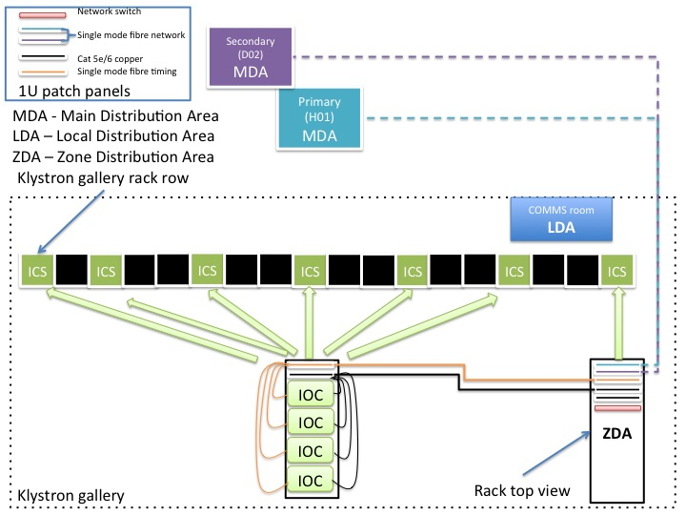
Accelerator Commissioning
Standardisation ESS-0052535
Naming convention
Standard Rack
Standard Rack dimensions
Rack layout – COMMS room
ISO/IEC 11801 for generic cabling …

Slide 18
Regulatory requirements ICS Plan for Cyber Security
Integrated Control System
IEC 62443 Network and System security for industrial-process measurement and control
Security assurance levels
System security requirements and security assurance levels
Threat/Risk Assessment (TRA)
Security Assurance (SA)
ESS Cyber Security workshop: Feb 2016
SA
TRA
Threats
Assurance Techniques
Evaluation
Vulnerabilities
identify
produce
Gives evidence
Assurance
require
create
Counter measures
Owners
Confidence
Risk
require
minimizes
Assets
to

Slide 19
Control System Network fibre termination
2016: Available now
Substation
Substation
2017: COMMS room
Temporary Server room
Central utility
Server hall
Beam lines
Cryo
building
Klystron gallery
Control room
Target building
Dedicated COMMS room
Shared COMMS (NSS &| IT)
Cabinet
50 rack rows
2019: Server/computer room &
COMMS room

Slide 20
ICS Network Architecture
D04
Lab/Exp. Hall 2
COMMS room
B01
Campus
COMMS room
D07
Lab 1B /Exp. Hall 1
COMMS room
Route A
Route B
G04
Cryogenic Plant
COMMS room
D08
Lab 1A /Exp. Hall 1
COMMS room
G02
Gallery Building
COMMS room
E02
Beam line gallery
COMMS room
H05
Primary Substation
COMMS room
E04
Lab 3B /Exp. Hall 3
COMMS room
H01
Server Hall
Central Utility Building
D02
MCR ICS Computer Room
D02
MCR

Slide 21
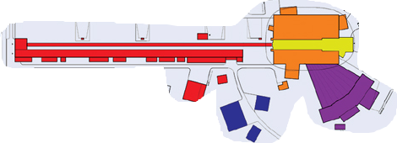
Conceptual ESS Control System Network
PVGW: EPICS PV Gateway (pva2pva)
Red: Accelerator
Yellow: Target & Cryogenics
Orange & Violet: Experimental halls
Blue: Conventional facilities
ESS Network
DMZ
PVGW
PVGW
PVGW
PVGW
PVGW
PVGW
PVGW
PVGW
PVGW
PVGW
Core Network
CA network
CA network
CA network
CA network
CA network
CA network
CA network
CA network
CA network
Main Control Room

