Slide 1
Introduction and Charge
for the 13th TAC meeting
6-8 April 2016, Lund
Roland Garoby
https://indico.esss.lu.se/event/406/overview

Slide 2
Progress since TAC#12
Since October 2015:
For all project within the Machine Directorate (Accelerator, Target and ICS), many reviews (PDR as well as CDR) and kick-off meetings (with partners and industry) have taken place, and orders for large equipment have been made (e.g. Target He Cryoplant),
Similar situation at partners, where prototyping has progressed mostly as planned and large orders have been made (generally before signature of agreement and before VAT-exemption is solved…),
Work is very advanced for the “Installation Permit” to be submitted early May 2016 to the SSM (2nd step of licensing),
Construction on site has remarkably progressed: Civil Engineering of the Accelerator Tunnel is completed ! (Special ceremony on Friday afternoon),
Presently intense activity preparing for the 3rd Annual Review (19-22 April).

Slide 3
Progress in Earned Value…
Scheduled: 380.472 M€
Earned: 369.440 M€
Actuals: 364.943 M€
Total project completion : ~20 %

Slide 4
Questions to the TAC for its 13th meeting
Accelerator (1/2)
a1) The AD staff plan (In short, AD is responsible for ion source, accelerator, RF systems, local cooling circuits, Cryogenics for all of ESS and vacuum for all of ESS):
The “green field” nature of ESS means that all AD staff is newly recruited starting from 2010. The pace of recruitment has been set by several parameters such as internal AD project needs, available candidates, budget availability at ESS, ESS HR capability to support recruitment etc. Does the TAC have general recommendations on this process and the priorities set?
There are limited possibilities for short term contracts in Swedish labor law. To avoid “hire and fire” AD is using contracted staff and IK staff contributions. Does the TAC have recommendations on this?
The ambition is to have recruited staff for both the project and operation phase (excluding operators) by 2018, does the TAC have recommendations regarding the competences and numbers of different staff categories in the present staff plan.
a2) The TAC proposed at the last meeting to review the linac accelerating structures. Does the TAC have recommendations on the systems presented regarding the design and early prototyping? Regarding the proposed procurements and assembly, which mostly is done at IK partners? For the proposed testing?

Slide 5
Questions to the TAC for its 13th meeting
Accelerator (2/2)
a3) The risk of not reaching the specified gradients in a fraction of the superconducting cavities is non negligible. Does TAC have recommendations on:
What failure rate we should expect, i.e. what fraction of the cavities will not reach full gradient during tests, allowing additional HPR if needed but not rework (incl. BCP) at the factory?
Whether eddy-current scanning of the niobium sheets should be performed, taking into account cost, schedule and the possibility to mitigate by ordering spare cavities?
What number of spare cavities should be ordered?
Does the TAC have specific recommendations regarding the 84 high-beta cavities for which the TAC had a more extensive presentation?
a4) The plan is to at next TAC return to RF systems and services as well as integration and installation issues. We would be happy to have your comments on that, in particular on what we should focus on.

Slide 6
Questions to the TAC for its 13th meeting
Target
t1) Are the hazard analyses and accident analyses being evaluated using a sound approach and are reasonable and appropriate safety-classified mitigation measures being properly identified?
t2) Is the design approach for the Primary Water Systems sensible and likely to meet system requirements, and does it represent a reasonable balance between performance, manufacturability, operability, maintainability, cost, and schedule?
t3) Is the approach to developing a plan to integrate the civil construction of the Target Station Building with the installation of Target Station systems sound? Do you see opportunities for compressing the schedule further?
t4) Does the concept of maintaining an evacuated atmosphere in the monolith vessel during operation seem sound, and is the proposed design approach reasonable? Is it reasonable to preserve the design option of operating with 1 bar of helium?

Slide 7
Questions to the TAC for its 13th meeting
ICS
c1) Is the software scope correctly timed/prioritized for the ICS/ESS context?
c2) Have the risks of the hardware choices been properly estimated? Have any viable alternatives been left out?
c3) Are the management strategies and plans for Accelerator integration appropriate? Are there major issues that need to be addressed/prioritized in order to ramp up with the integration work?
c4) Is the planning method appropriate? Is the connection to the ESS schedule strong enough?
c5) Are the design choice conclusions for infrastructure appropriate? Is the action plan for the MCR appropriate?

Slide 8
Additional considerations
General questions
Have the recommendations and concerns of the previous TAC meeting been properly addressed?
Additional suggestions/comments and recommendations?
Planning
A preliminary version of the Committee report is expected on Friday 8, April.
The final report is expected two weeks later.
The Chairman will orally present the TAC#13 report to the Council on June 9-10.

Slide 9
Agenda TAC#13: Wednesday 6 April 2016
Meeting on the construction site
Dinner in Flyinge
(Gastro Gaspari)

Slide 10
Agenda TAC#13: Thursday 7 April 2016
Combination of common and separate sessions
Visit of ESS test place at Lund University
5 – 2.5 hours TAC session
Buffet dinner at hotel

Slide 11
Agenda TAC#12: Friday 8 April 2016
3.5 hours TAC session: additional Q&As and presentations are possible
Optional private close out to the ESS management
“Tunnel topping out Ceremony” on construction site

Slide 12
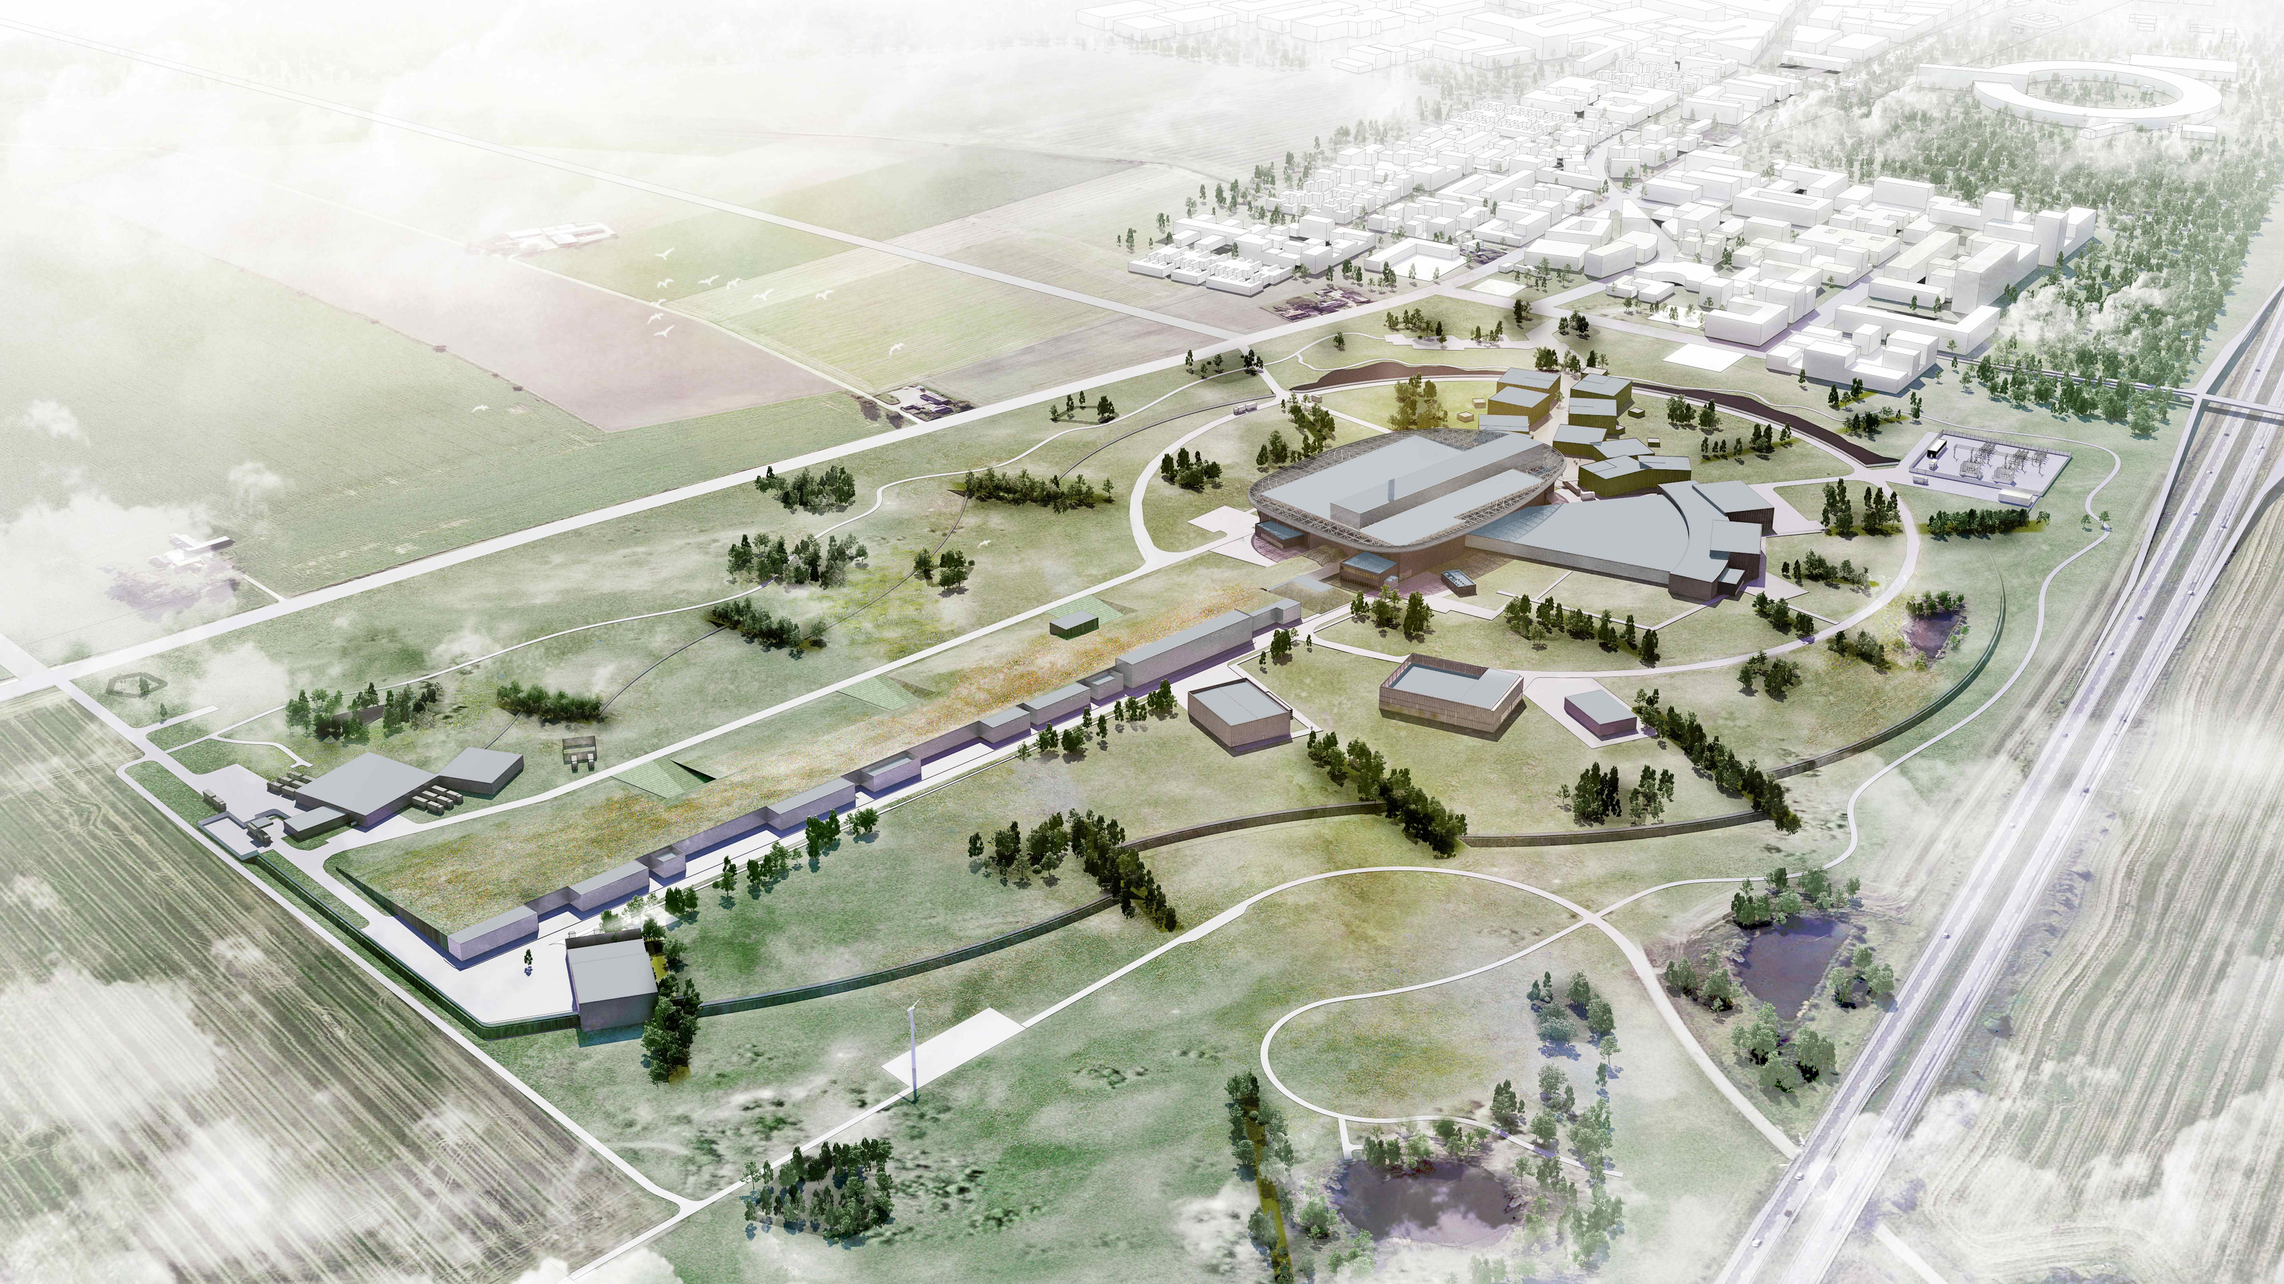
Thank you for being here.
We look forward to your advice!

