Slide 1
Conventional Facilities
Kent Hedin
Head of Conventional Facilities
www.europeanspallationsource.se
16-03-30

Slide 2
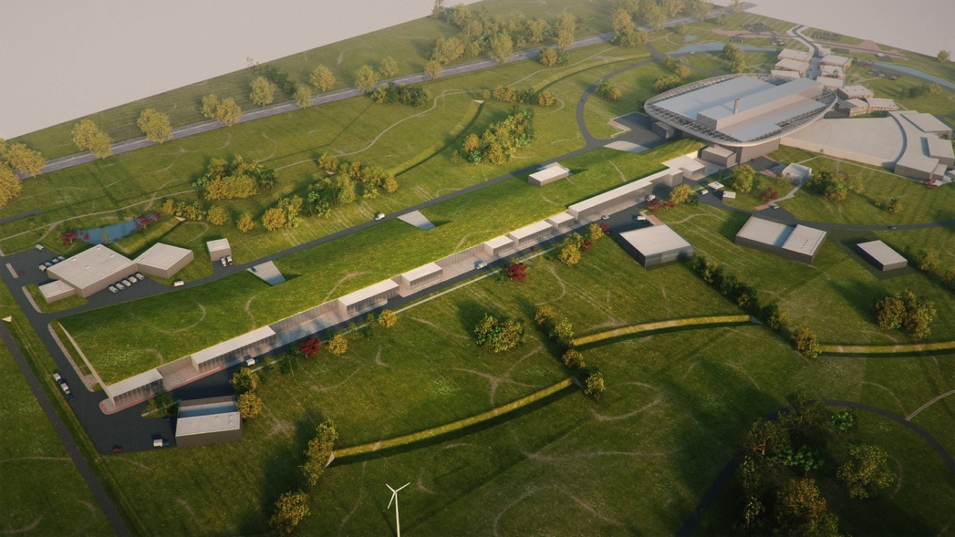
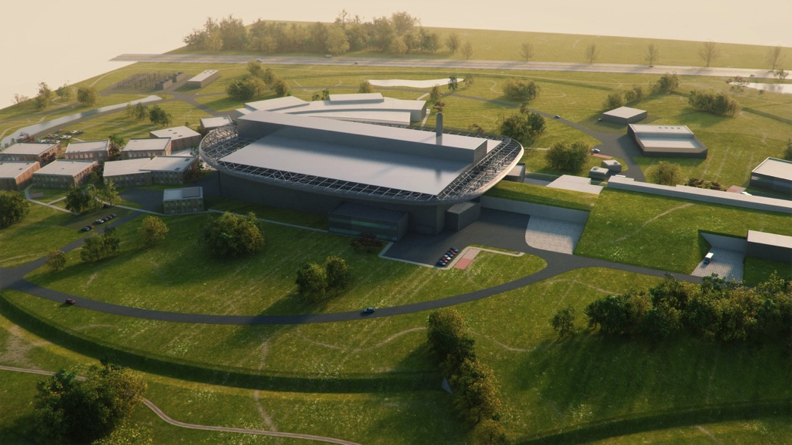
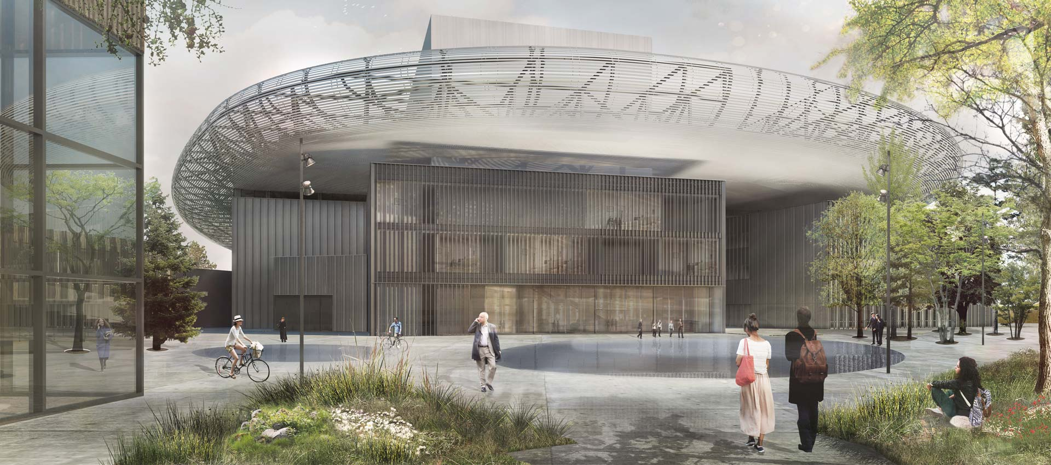
ESS vision

Slide 3
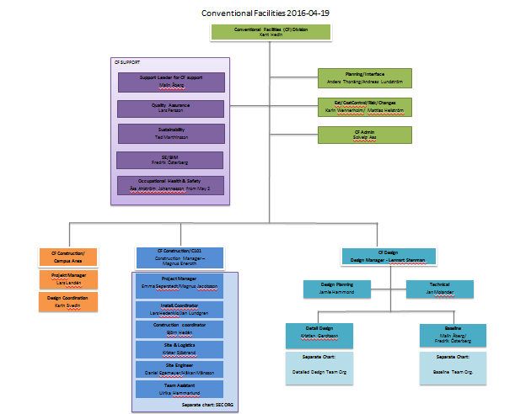
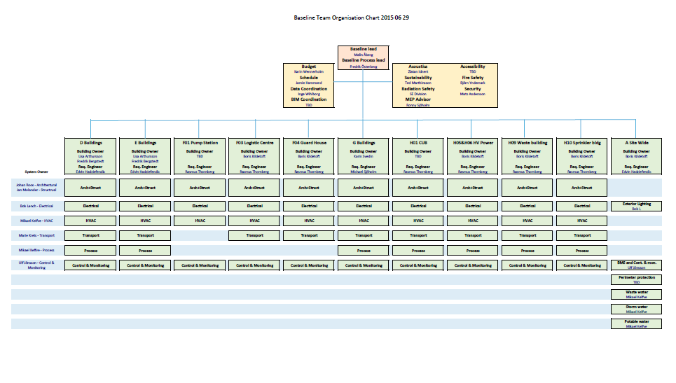
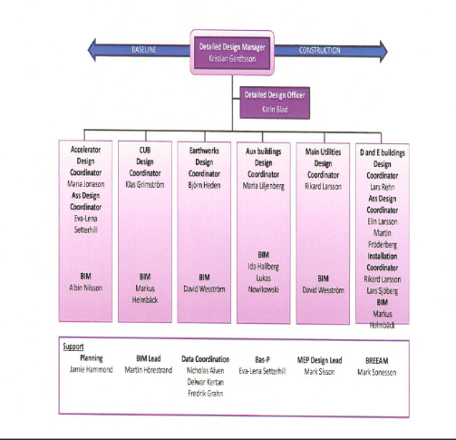
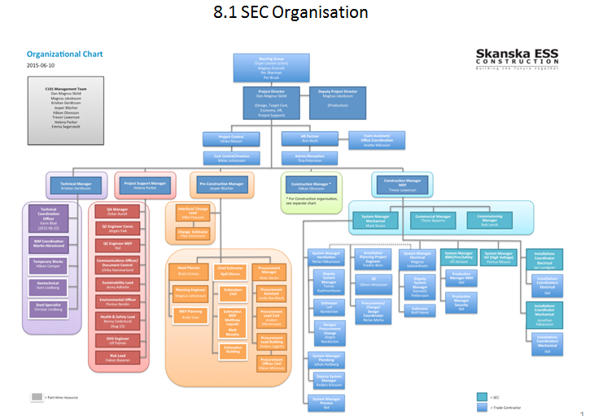
CF organization
Notes:
Energy
Climate
Health
Agriculture
Digital society

Slide 4
Overall construction status – March 2016
First building completion May 2016 (H05)
Sept 2016 (H06)
First client access (Acc Div) Sept 2016 (G04)
Followed by G02 in November 2016.
Target Division commence parallel works on site in May/June 2016.

Slide 5
Staff on site
400
339
324,5
250
249
186,5
181
127
106,5
83
143,5
152,5
151
123
93,5
5

Slide 6
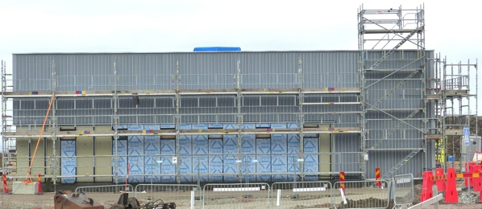
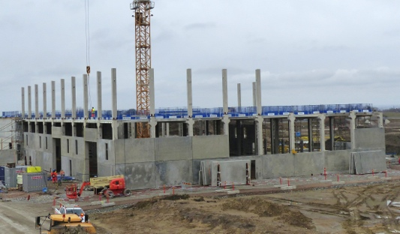
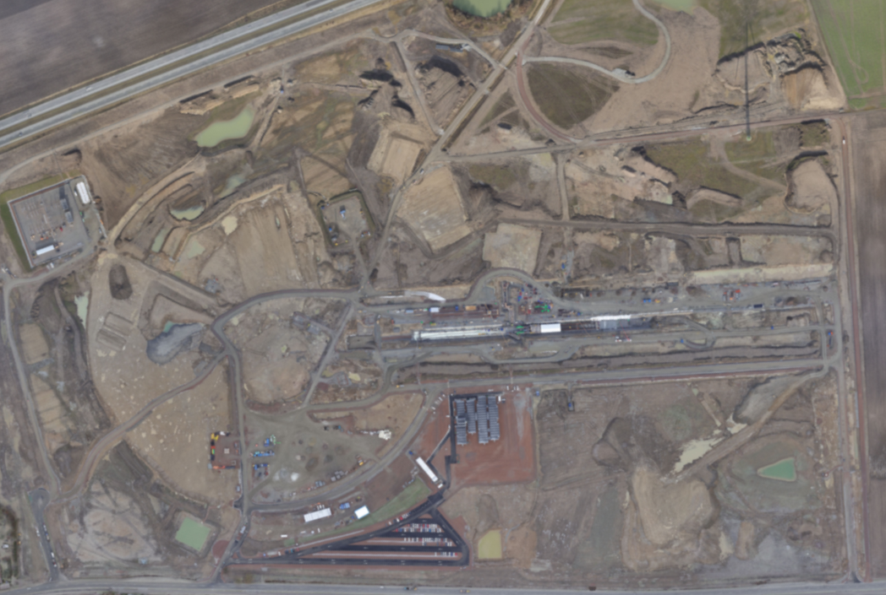
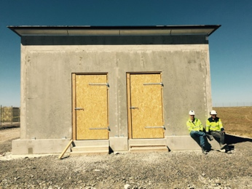
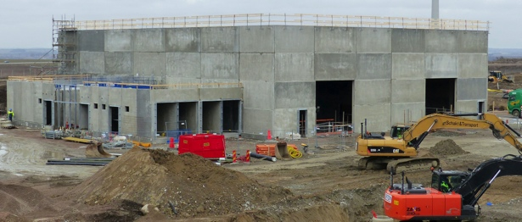
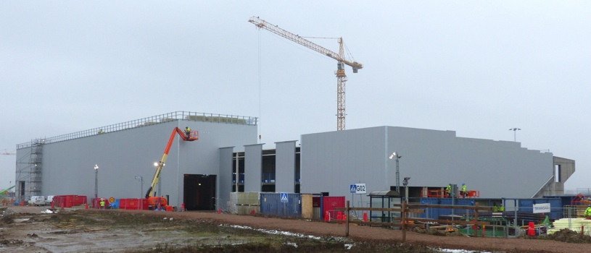
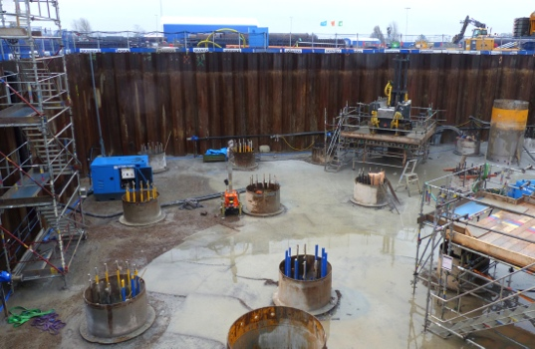
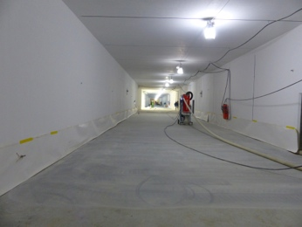
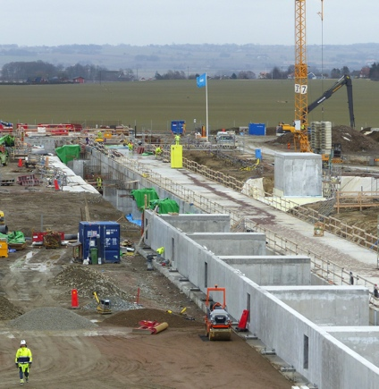
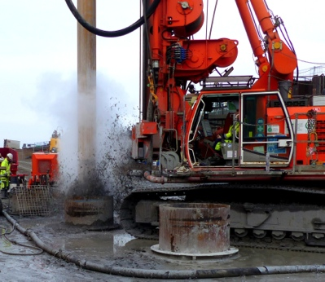
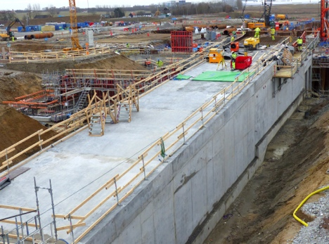
Ongoing works
H06
E01
H05
H01
G04
G02
D02
G01
Site Offices
Notes:
Compulsory

Slide 7
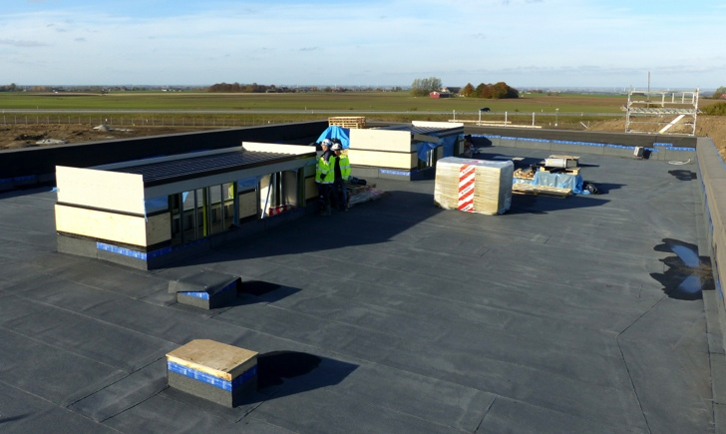
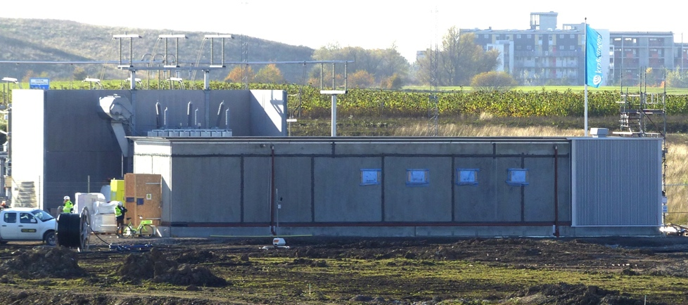
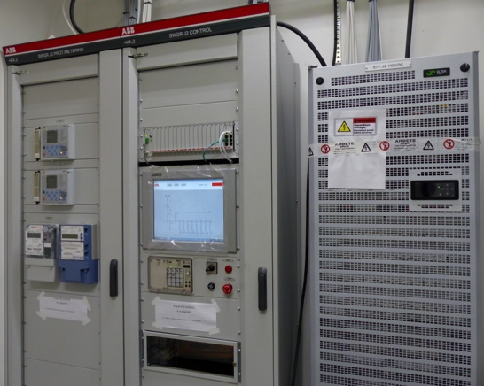
Buildings
H01 - CUB
H06 – Distribution Substation
H05 – Primary Substation

Slide 8
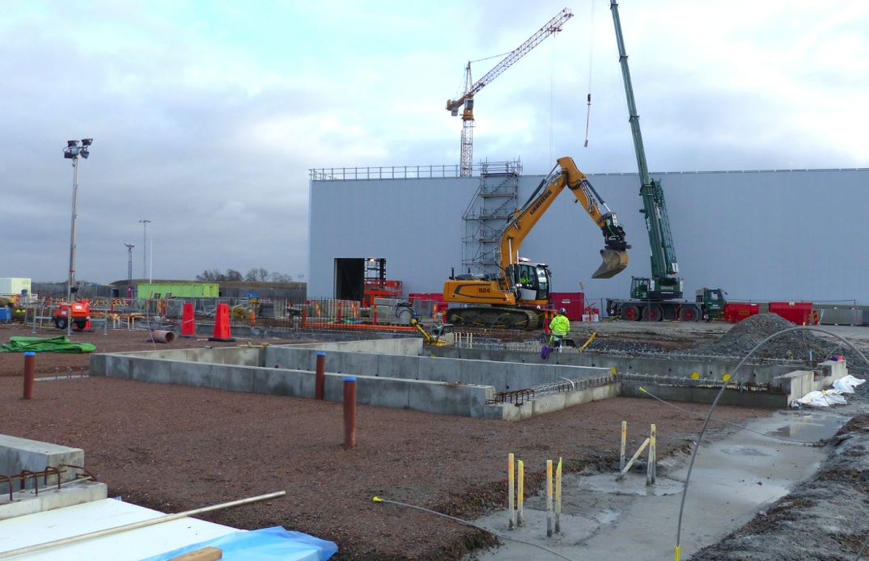
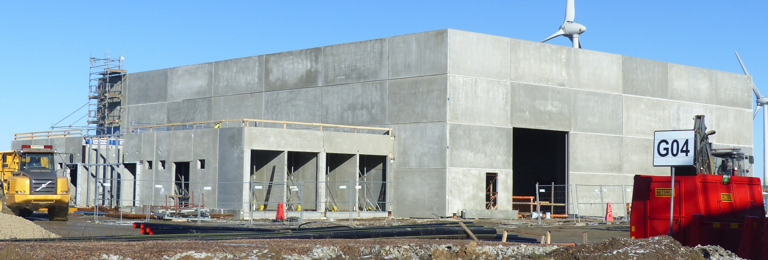
G04 – Cryo Compressor Building

Slide 9
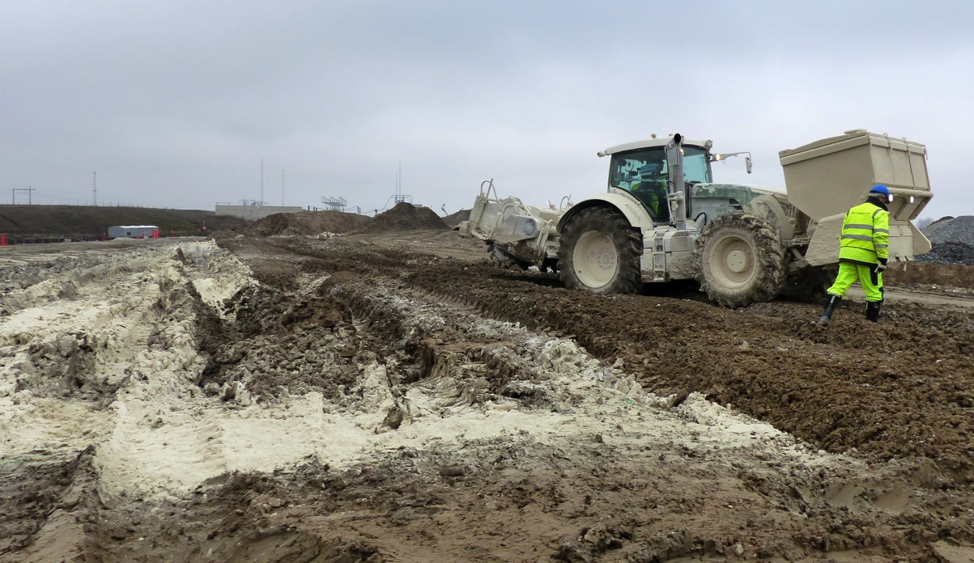
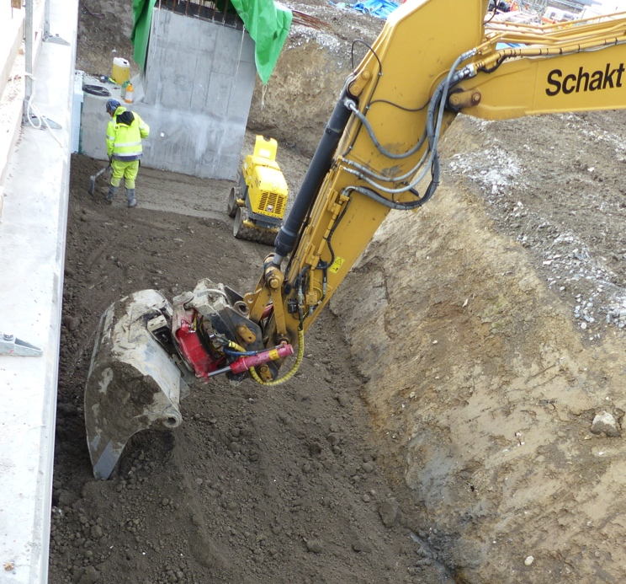
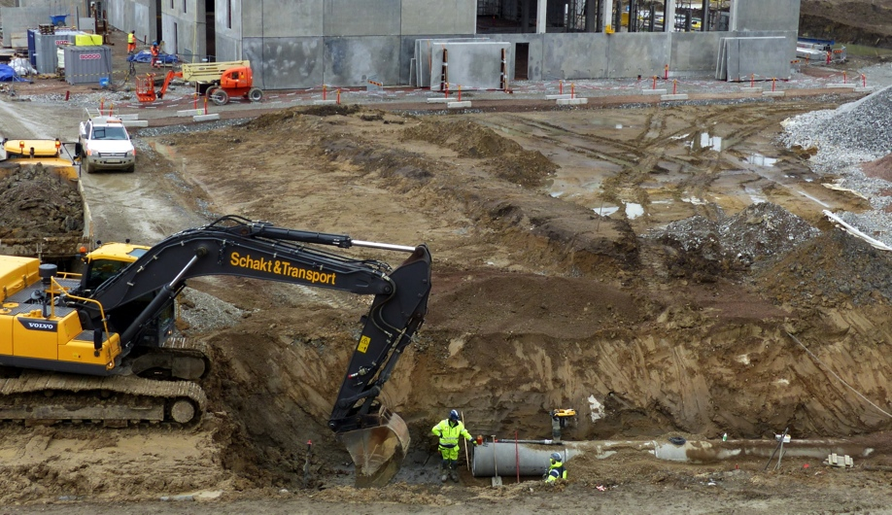
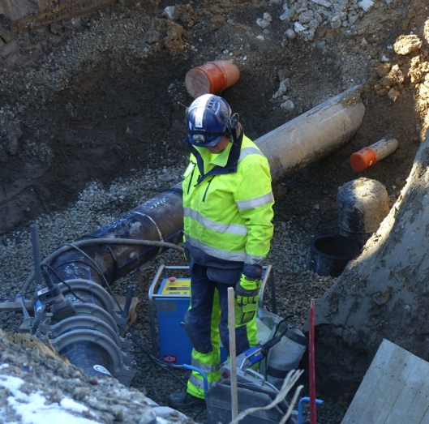
Civil Works
Soil modification
Refill around stubs, tunnel, emergency exits, HEBT
Excavation for pipes & cables

Slide 10
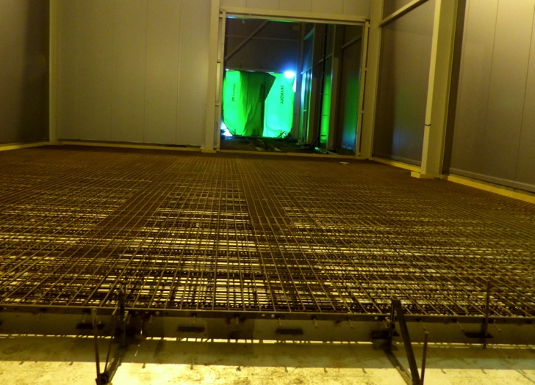
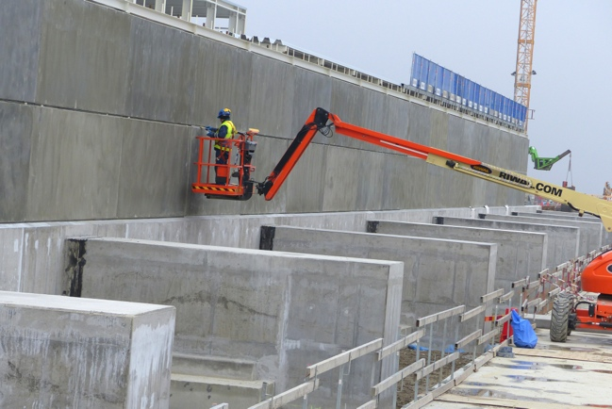
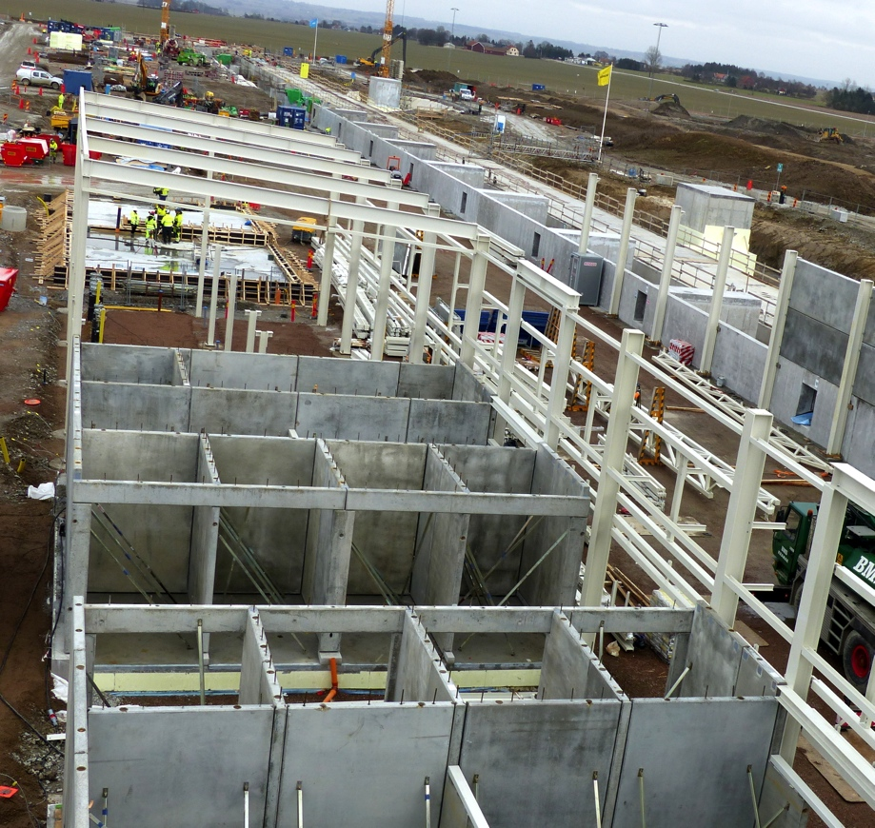
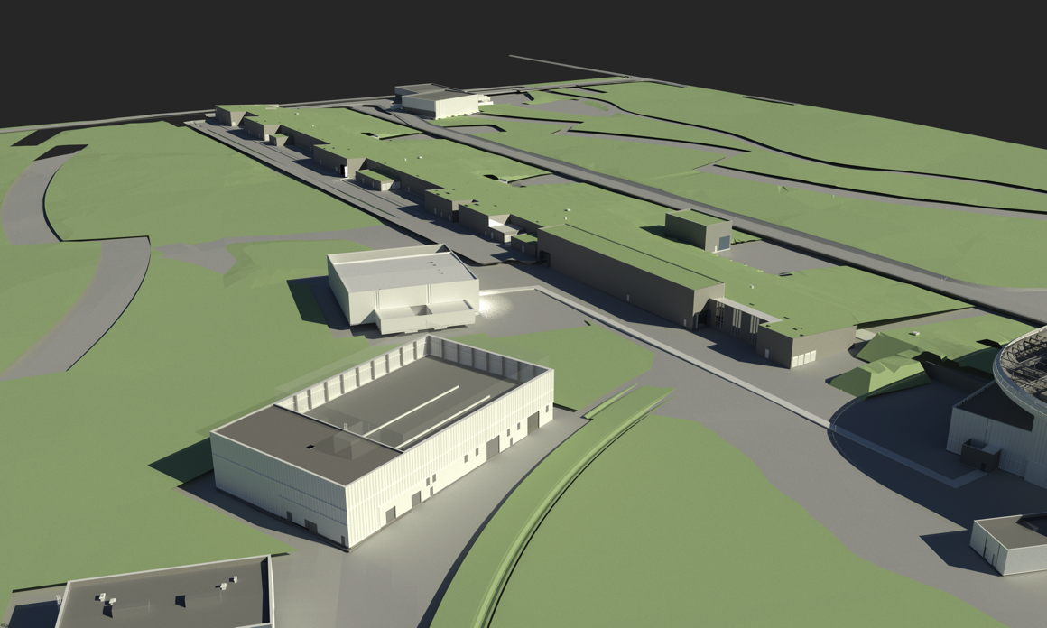
Gallery G02
Gallery, section 1-3
Gallery, cold box floor
Gallery, section 4 prefab

Slide 11
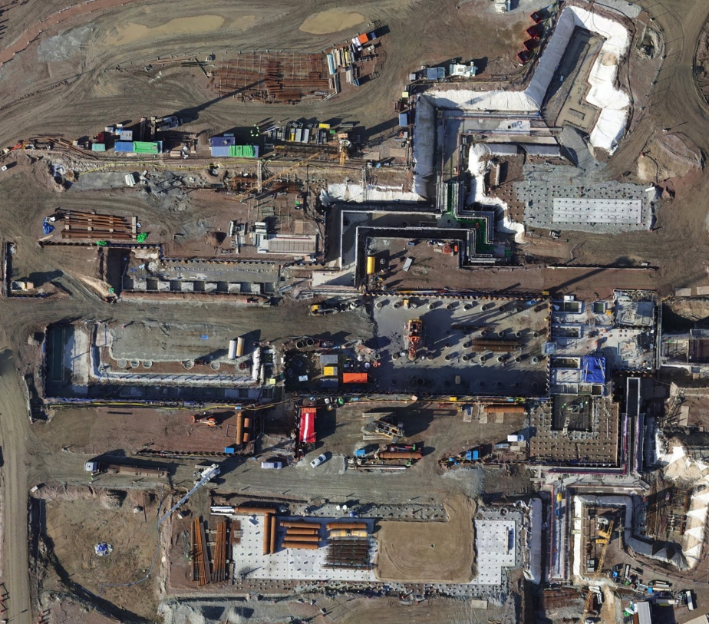
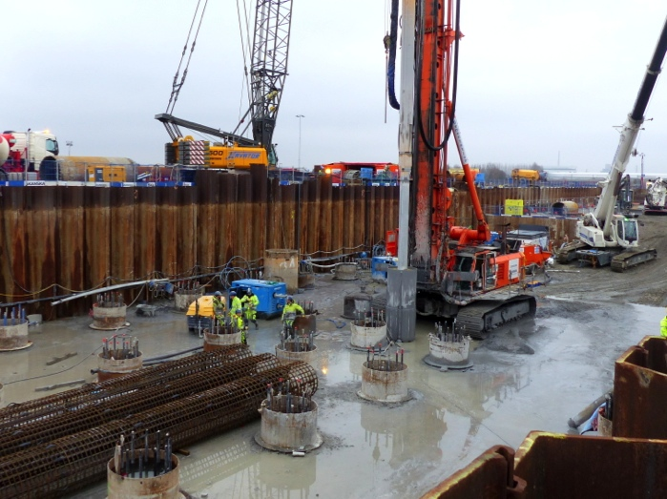
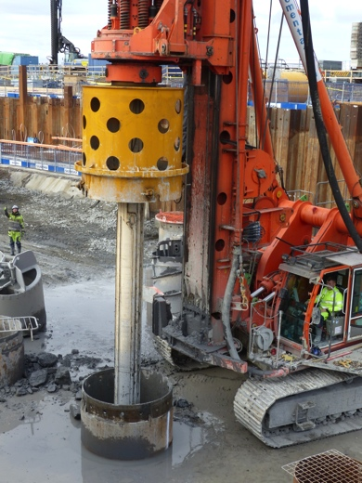
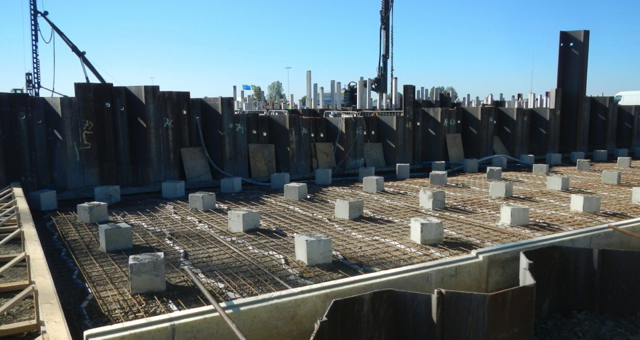
Target
Bored piling, Monolith
D01/D02/D03/E01/E02
Sheet Piles
Steel core Piles
Concrete Piles
Large diameter Bored Piles (Monolith)
Progress, Target, 29th of February 2016
^{3891 /6010 concrete piles 65%)}
193 /356 steel core piles (54%)
^{38/63 bored piles (60%)*} ^{*11 March 2016}
Concrete piling & sheet piles

Slide 12
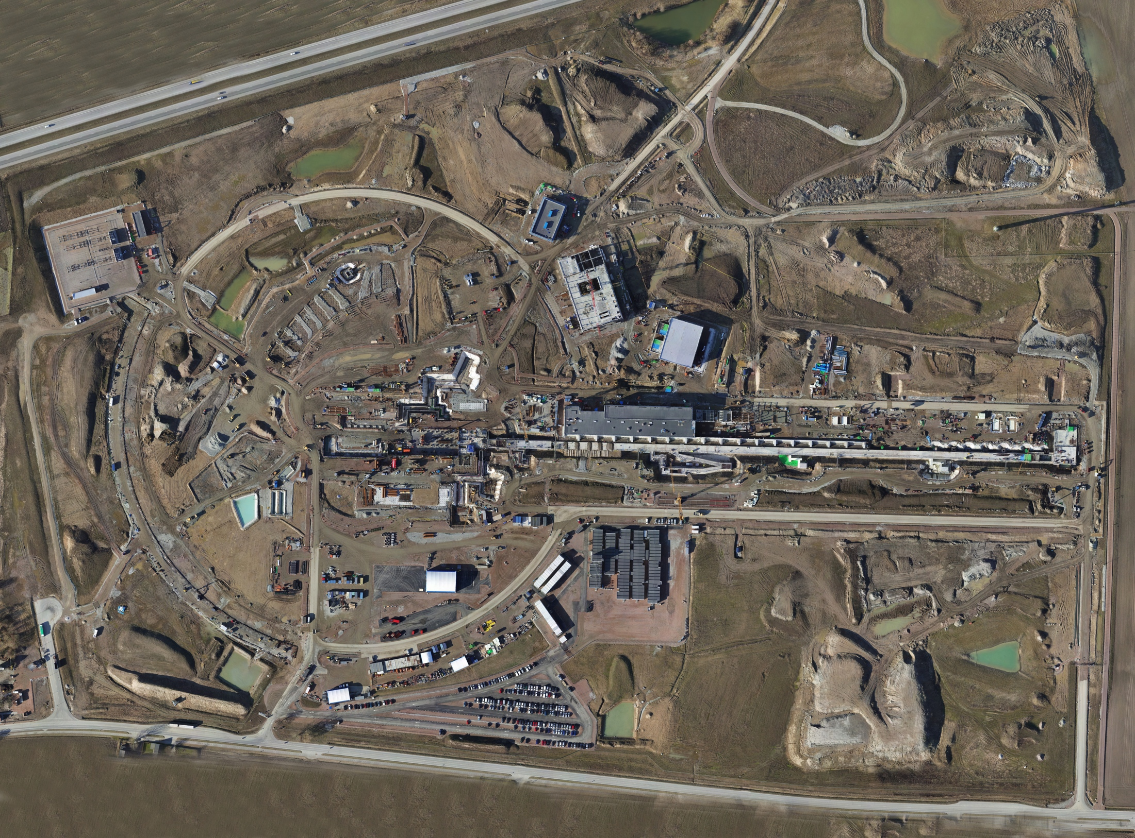
February 2016

