Slide 1
Plans for instruments
Andreas Schreyer
European Spallation Source ERIC
TAC
Lund
April 6 – 8, 2016

Slide 2
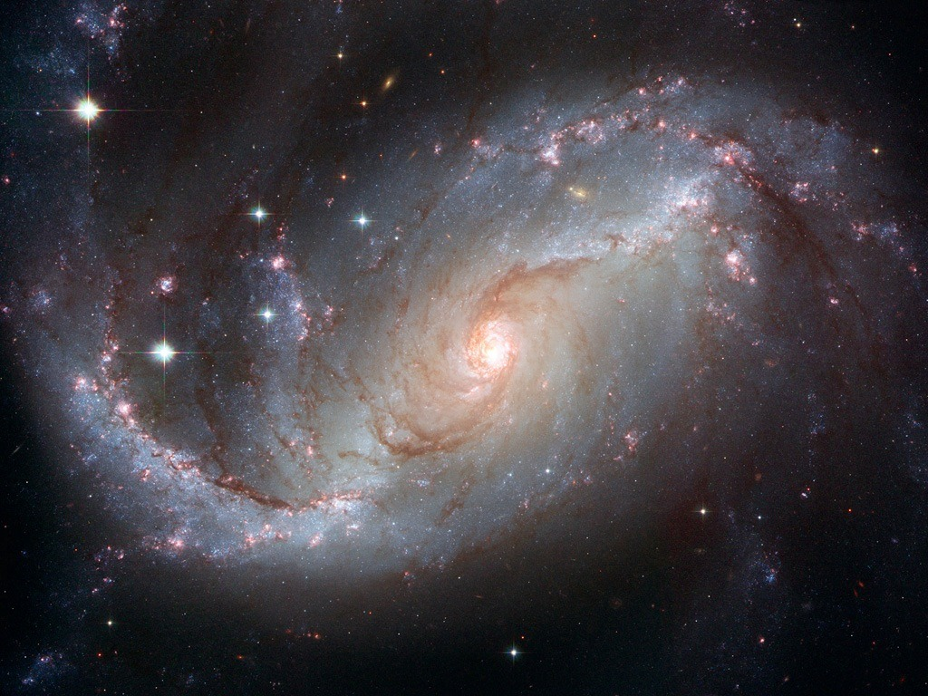
Neutrons are special
Charge neutral
Deeply penetrating
S=1/2 spin
probe directly magnetism
Nuclear scattering
Sensitive to light elements and isotopes
Test AdS/CFT correspondence
Solve the puzzle of High-Tc
superconductivity
Actives sites in proteins
Li motion in fuel cells
Help build electric cars
Efficient high speed trains
Better drugs

Slide 3
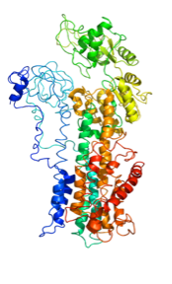
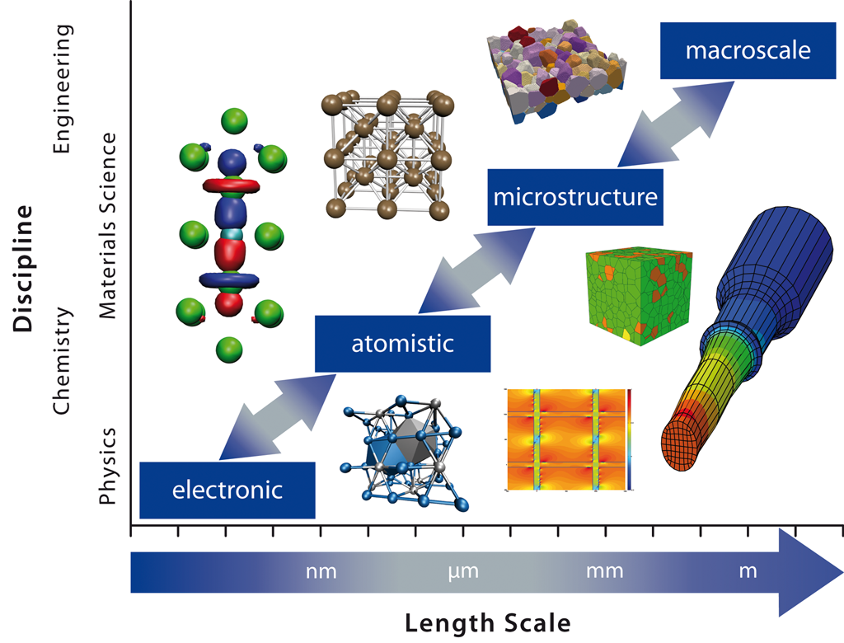
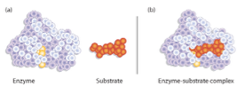
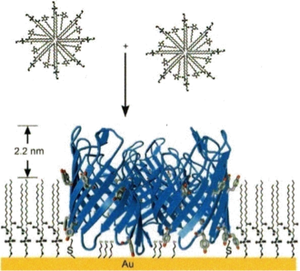
Grand challenges in Materials
Multi-scale Modelling
and advance computing
ESS

Slide 4
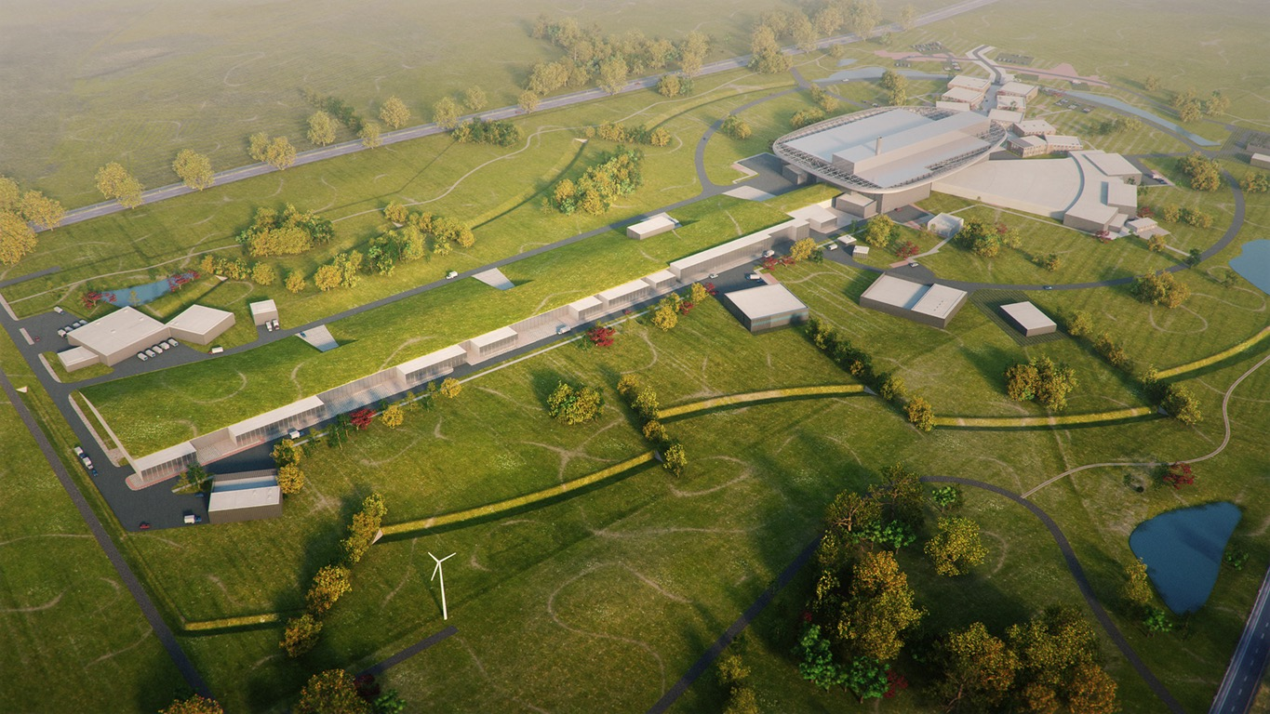
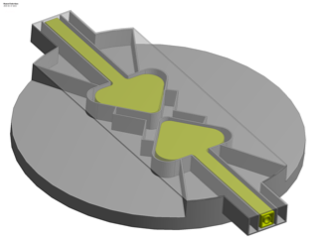
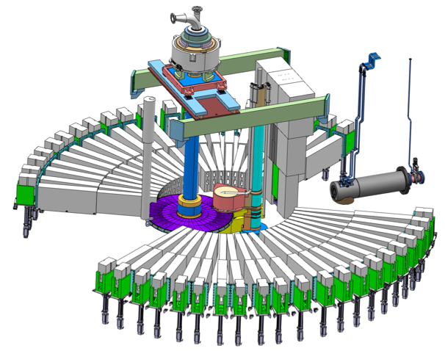
The European Spallation Source
Flat moderator delivering smaller and brighter neutron beams
High Power Accelerator means more neutrons
High brightness and tuneable resolution makes new measurements possible
An Innovative Target Station that can host >30 instruments

Slide 5
Two strategies for neutron instrumentation at ESS
Intensity
Use as much as possible of the whole pulse:
Good for low wavelength resolution instruments.
SANS, Reflectometry, single crystal diffraction.
Estimated gains 10-100 times than currently available.
0
1
2
3
4
time (ms)
Cut the long pulse into smaller pulses:
Good for higher wavelength resolution instruments
Diffraction, cold/thermal spectrometers.
Long Instruments (80-100 m)
Estimated gains 10-30 times than currently available.
Thermal gains lower.
0
1
2
3
4
time (ms)

Slide 6
ESS Opens New Capabilities to Science
Fast Measurements
long-wavelength advantage
Detection of weak signals
Flexible instruments
Low background
wide dynamic range
polarized neutron contrast
tuneable resolution
advanced neutron technologies
high
neutron
brightness
UNiQUE
LONG PULSE
STRUCTURE
high reliability
small sample volumes
advanced
computations
& software
(dmsc)
REAL world
SAMPLES, real world
CONDITIONS
real time
data visualisation
dilute sample
extreme environments (p.h.t)
efficient data reduction
real world sample environment
computational support
intuitive data analysis
In-situ processing
Dedicated support labs
Notes:
We have encoded this into requirements and …

Slide 7
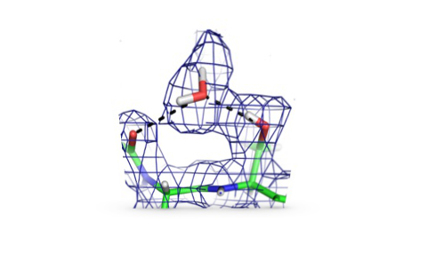
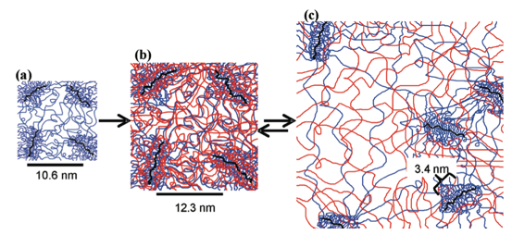
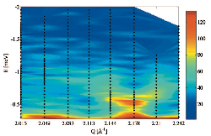
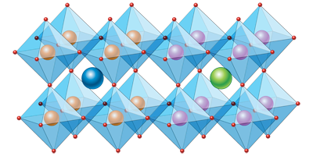
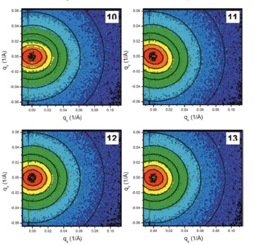
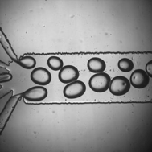
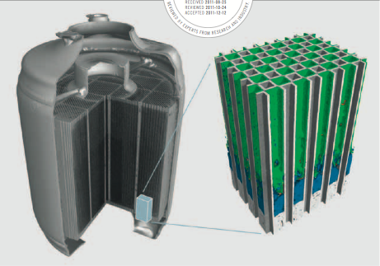
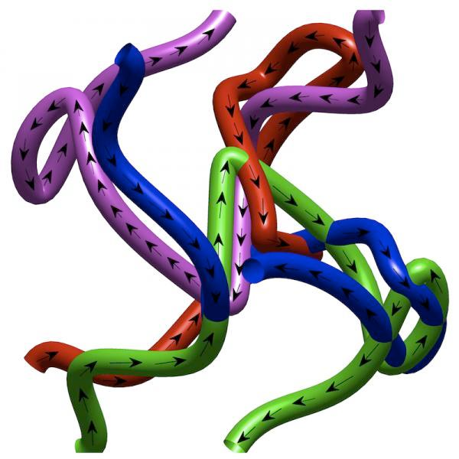
ESS Opens New Capabilities to Science
Quantum Enzymology
Complex Interfaces
Protein Dynamics
Multi-scale structure and dynamics
Charge and spin
Transport in Novel Materials
Kinetics of Complex
micro-fluids
In Operandi Advanced
Energy Devices
New States of Matter

Slide 8
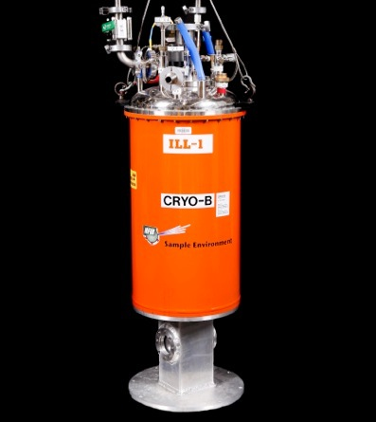
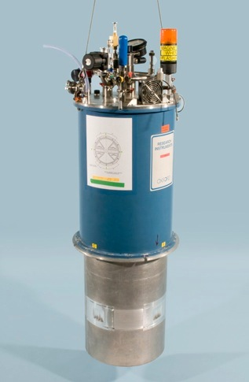
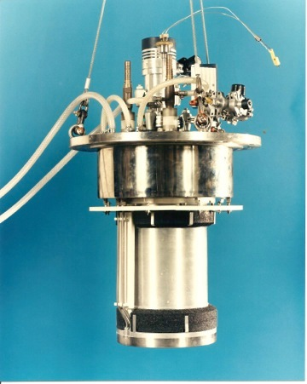
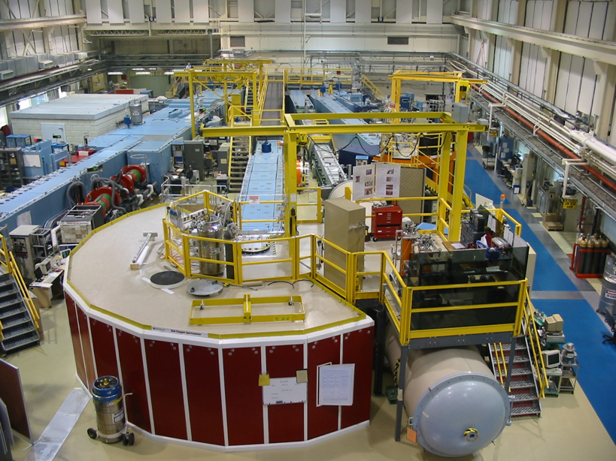
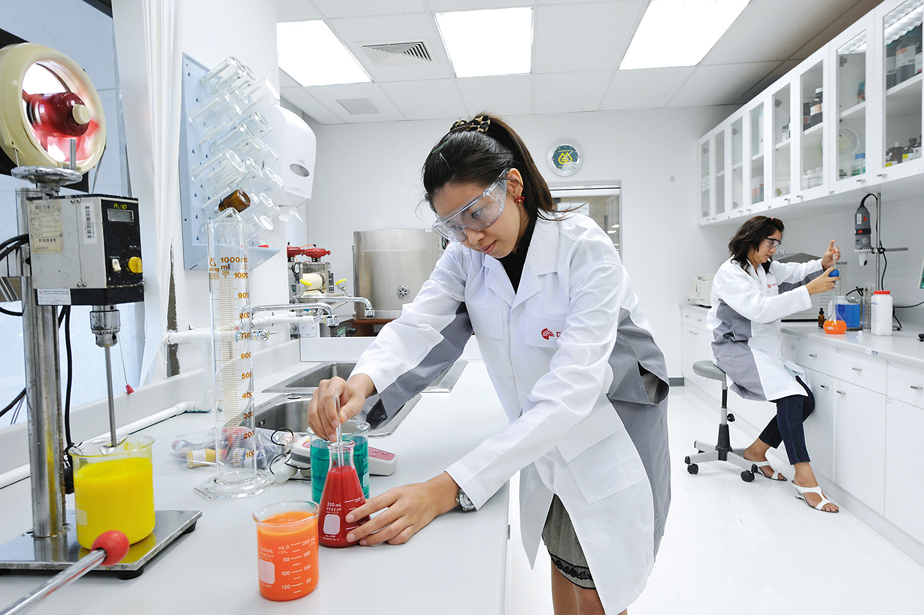
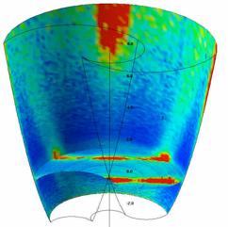
ESS Project Scope on Instruments (NSS)
NSS Scope: 22 “public” instrument suite of ESS together with a technical and scientific support infrastructure that enables scientific excellence and high quality scientific user service.
Science
(Publications)
Sample Environment
Ideas
(Proposals)
Science Support
Laboratories
22 Instruments
Analysis and Visualisation Software

Slide 9
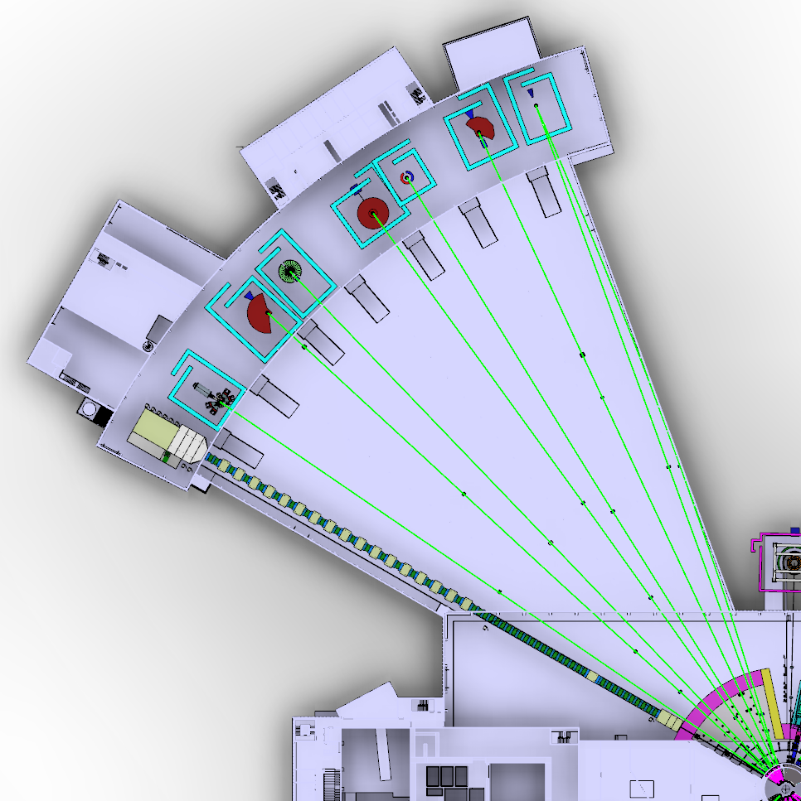
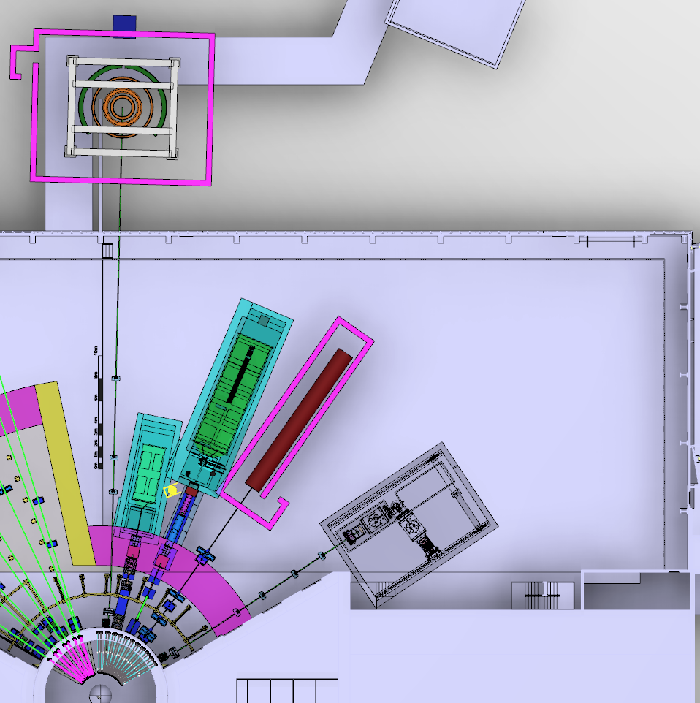
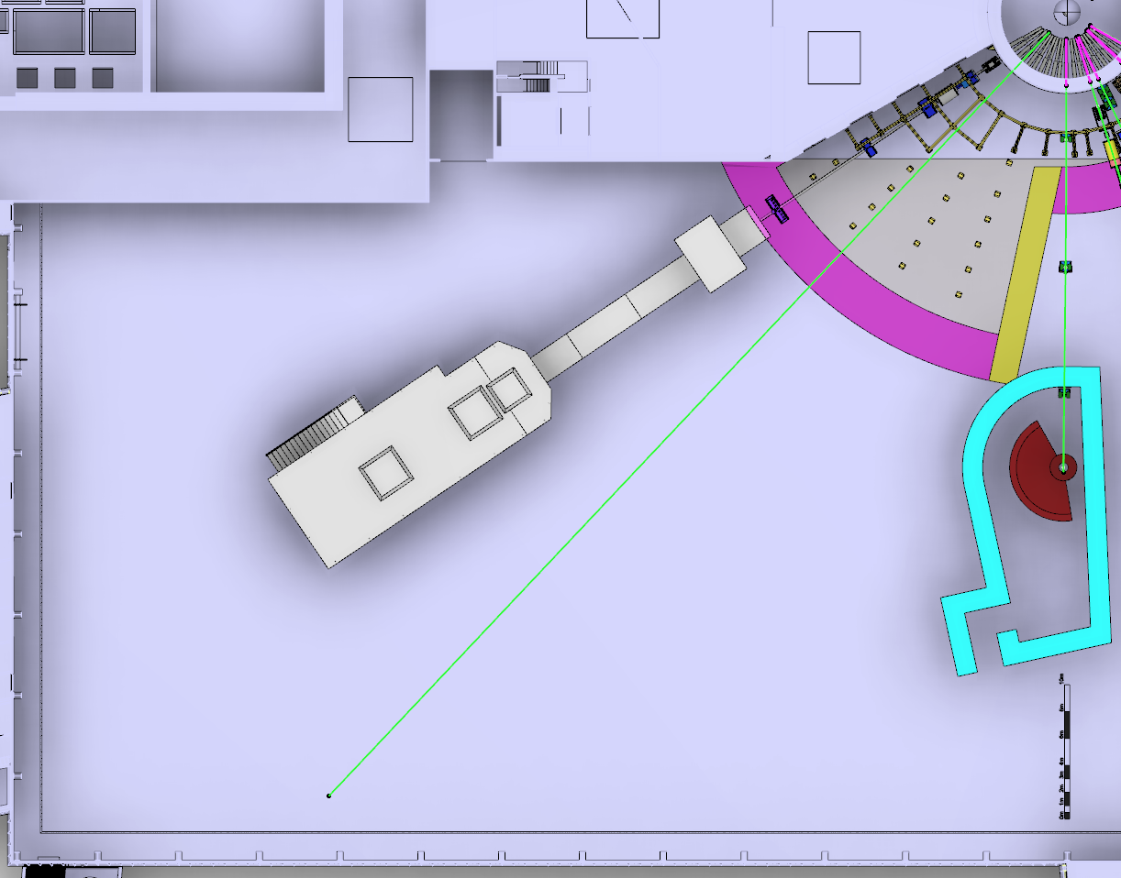
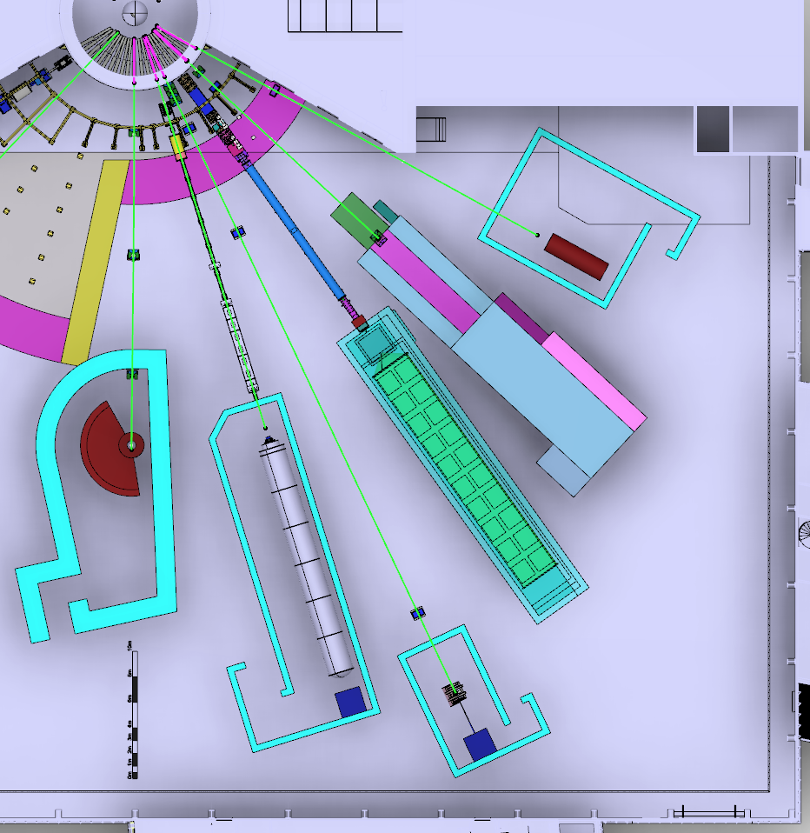
NSS: Where we stand today
TREX
HEIMDAL
MAGIC
MIRACLES
Decisions on the first 16 instruments
Baseline where to place 15 instruments
- minimize mechanical interfaces
- maximize number of usable beam
ports in the future
- 16th instrument (HR-NSE, VOR)
BIFROST
CSPEC
BEER
NMX
Bunker design advancing fast
Funding delays for some
in-kind partners (65% in kind)
Working on entering several
new instruments into phase1
(prel. engineering design)
LOKI
FREIA
HR-NSE
Baseline Layout of the NSS Neutron Beam Instruments
(January 2016)
ESTIA
ODIN
DREAM
VOR
SKADI
VESPA

Slide 10
NSS: Priorities for 2016
TREX
HEIMDAL
MAGIC
MIRACLES
Align the instrument budgets with the
NSS budget
Develop a realistic schedule for all
instruments ensuring early science
success in line with available in-kind
resources and partner capabilities
BIFROST
CSPEC
BEER
NMX
Propose which instruments
are to be operational first
Proposal to Council in
December 2016
LOKI
FREIA
HR-NSE
Baseline Layout of the NSS Neutron Beam Instruments
(January 2016)
ESTIA
ODIN
DREAM
VOR
SKADI
VESPA

Slide 11
NSS Budget overview -with current IK estimates for Instruments and bunker
NSS total budget (ring-fenced) = 350 M€
NSS In-Kind Target (65%) = 227,5 M€
NSS Cash Target (35%) = 122,5 M€
In-kind commitment so far = 190.6 M €
In-Kind uncommitted = 36.9 M €
We are at 84% of our In-kind target
Cash budget = 122.5 M €
Cash spent (Dec 2015) = 32.3 M €
We have spent 26 % of our cash
Cash contingency is 5.5 % of cost to complete
SJK, 8 Feb 2016

Slide 12
The In-Kind Delivery Model Roles and Responsibilities for NSS
In-Kind Collaborators – deliver most of the suite of instruments, most of bunker, large portion of sample environments, DMSC and competency development
ESS-Lund –Coordinate NSS Project, collaborate on instruments AND deliver everything else; neutron sources, safety systems, standards, IK framework packages, buildings, services, labs, support for installation, commissioning, operations & maintenance

Slide 13
The NSS Instruments Collaboration
Science Advisory Committee
ERIC Council
In-kind Review Committee
ESS Director General
Director for Science
NSS Project Leader
Instruments Collaboration Board
Chair: Director for Science
STAP / TAPs
NSS Project
Management and Project Reporting
Collaboration Management and Reporting
In-kind contract workflow
Advisory
Key
Science Support (SS)
Instrument
Technologies (IT)
DMSC
Instrument
Projects
Instrument Consortium 1
Instrument Consortium 2
Instrument Consortium n
In-Kind SS
In-Kind IT
In-Kind DMSC
Notes:
Collaboration model in place. Neutron instrument building community not used to working in the fashion but is taking ICB seriously.

Slide 14
NSS Project; Neutron Instrument project phases
Proposal and Planning
Design and Construction
Installation and Commissioning
Instrument Proposal
Phase 0
Preparation for Design
Phase 1
Preliminary Design
Phase 2
Detailed Design
Phase 3
Manufacturing and Procurement
Phase 4
Installation and Integration
Phase 5
Hot Commissioning
Deliverables
Science case covering scientific relevance, impact and usage
Conceptual design with credible estimates of performance
Preliminary costing.
Deliverables
Conceptual design updates
Prototyping
Definition of facility requirements and interfaces
Clarification of institutional responsibilities
Resource planning
Deliverables
Scientific and technical requirements
Technical design concept
Delivery plan for all phases (including hot commissioning)
Delivery Schedule covering all phases
Resource plan
Staging plan for later enhancements
Budget with contingency at 10% of cost to complete
Deliverables
Complete definition of all major technical components
Completion of detailed plan for Phase 3
Refined plan for phase 4
Refined Resource plan
Refined delivery schedule, with critical path items and dependencies
Refined budget with contingency at 10% of cost to complete
Deliverables
Procurement and manufacture of all major technical components
Completion of detailed plan for phase 4
Site preparation
Refined plans for phase 5 and for staging
Refined Resource plan
Refine instrument delivery schedule
Maintain budget with contingency at 10% of cost to complete
Deliverables
Construction of physical infrastructure on site.
Assembly and installation of technical components
Integration and testing of technical components
Installation, integration and testing of Personnel Safety System
Submission of application for approval to hot commission
Formal project completion
Deliverables
Verification of performance of Personnel Safety System
Proof of compliance with radiation dose limits
Critical performance demonstration of basic functionality
Scientific performance demonstration
Friendly user experiments
Completion of technical and user manuals
Tollgate 1
STAP review
SAC recommendation
NSS recommendation
STC approval
Tollgate 2 (PDR)
Preliminary Design Review
STAP review
NSS
scope review
assign cost book value
approval
Tollgate 3 (CDR)
Critical Design Review
STAP review
ICB review
NSS approval
Tollgate 4 (IRR)
Installation Readiness Review
ICB review
NSS approval
Tollgate 5 (SAR)
Safety systems acceptance review
NSS approval
Tollgate 6 (ORR)
Operations readiness review
NSS approval

Slide 15
2016 | Jan | Feb | Mar | Apr | May | Jun | Jul | Aug | Sep | Oct | Nov | Dec
LOKI
SKADI
ESTIA
FREIA
NMX
MAGIC
HEIMDAL
DREAM
BEER
ODIN
C-SPEC
BIFROST
MIRACLES
T-REX
VESPA
Agreed schedule
ICB, 7.3.2016
Annual Review
IKON 11
ICB
SAC
COUNCIL
STAP
scope-setting
TG2

Slide 16
Candidate Neutron Instruments for early delivery to address recommendations of 2nd Annual Review
Review the schedule for initial operation from Dec 2019 through 2022, with the goal of optimising scientific success from the start of user operation in 2023.
Prioritisation of instruments within budget must ensure that the first tranche of instruments (8±2) is ready to deliver world-class science at the start of user operations (2023)
Instrument Class | Sub-class | Candidates
Large Scale Structures | Small Angle Scattering | LOKI or SKADI
 | Reflectometry | ESTIA or FREIA
Diffraction | Powder Diffraction | DREAM or HEIMDAL
 | Single crystal diffraction | MAGIC or NMX
Engineering | Strain scanning | BEER
 | Imaging and tomography | ODIN
Spectroscopy | Direct geometry | C-SPEC or T-REX
 | Indirect geometry | BIFROST, MIRACLES or VESPA

Slide 17
Potential order of commencement of operation of first 8 instruments (August 2023)
Matching early success in delivery of scientific outputs with the capacity of Lead In-Kind partners to deliver on schedule.
Instrument Class | Sub-class | Candidates
Large Scale Structures | Small Angle Scattering | LOKI (ISIS) or SKADI (FZJ)
 | Reflectometry | ESTIA (PSI) or FREIA (ISIS)
Diffraction | Powder Diffraction | DREAM (FZJ) or HEIMDAL (ÅU)
 | Single crystal diffraction | MAGIC (LLB) or NMX (ESS)
Engineering | Strain scanning | BEER (HZG/NPI)
 | Imaging and tomography | ODIN (TUM/PSI)
Spectroscopy | Direct Geometry | C-SPEC (TUM) or T-REX (FZJ)
 | Indirect Geometry | BIFROST (DTU), MIRACLES (Bilbao), VESPA (CNR)
Select 1 of each of these pairs
Should 1 of these be early ?
Both of these should be early
Select 2 or 3 of these
To be finalized by the end of 2016

Slide 18
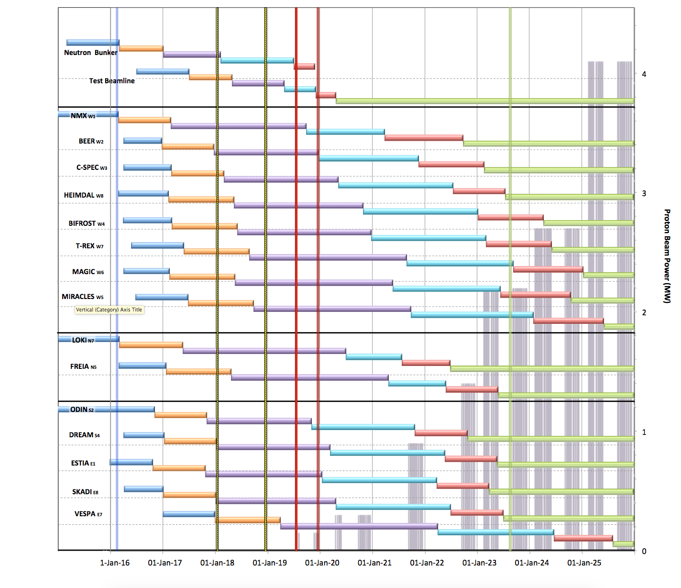
Neutron Beam Instrument Schedule; V1.4, 10th Feb 2016
Notes;
The order of completion 1- 8 chosen for science and deliverability
Shift 9-16 to focus in early science success
The order of completion here is still notional
Actual schedule critically depends on in-kind partners
Agreements with in-kind partners pending
Beam on Target
Start User Program
Current date
Early Access D01/D03
Full Access D01/D03
1st Spectrum
West sector
ESS would like to start Hot Commissioning of the first Neutron Instrument here.
test beam line?
North sector
Preliminary Design
Detailed Design
Manufacturing & Procurement
Installation & Integration
Hot Commissioning
Operation
East and South sectors

Slide 19
NSS Project Instruments
MOU Status
MOU Current Status (April-2016)
MOU Signed
MOU Can be Signed
Partners waiting for funding
class | Instrument | In-kind Partners (% contribution) | Cost Book (M€) | Cost Target (M€) |  | % IK | Cash (M€)
Large scale structures | LOKI broadband SANS | UK (ISIS) | 12.2 |  |  | 90% | 3.66
 | SKADI general-purpose SANS (note 1) | DE(FZJ 50%) + FR(LLB 50%) |  | 12 |  | 100%
 | ESTIA focusing reflectometer | CH(PSI) |  | 9 |  | 95% | 0.45
 | FREIA liquids reflectometer | UK (ISIS) |  | 9 |  | 95% | 0.45
Diffraction | NMX macromolecular crystallography | ESS (<30%) + HU (Wigner and Centre for Energy Research) + FR (LLB) + NO (Bergen Uni) | 11.7 |  |  | 70% | 3.50
 | DREAM powder diffractometer (bispectral) | DE(FZJ 75%) + FR(LLB 25%) |  | 12 |  | 95% | 0.60
 | HEIMDAL hybrid diffractometer | DK(AU 30%) +CH(PSI) +NO (IFE) |  | 12 |  | 70%
 | MAGIC magnetism single-crystal diffractometer | FR (LLB 65%) + DE (FZJ 20%) + CH (PSI 15%) |  | 12 |  | 100%
Engineering | BEER engineering diffractometer | DE (HZG 50%), CZ (NPI 50%) |  | 12 |  | 100%
 | ODIN multi-purpose imaging | ESS -> DE(TUM 50%) +CH (PSI 50%) |  | 9 |  | 95% | 0.45
Spectroscopy | C-SPEC cold chopper spectrometer | DE(TUM 50%) + FR(LLB 50%) |  | 15 |  | 100%
 | BIFROST extreme-environments spectrometer | DK(DTU/KU 30%) +CH(PSI) + HU(Wigner) +NO (IFE) + FR(LLB) |  | 12 |  | 70%
 | T-REX bispectral chopper spectrometer | DE (FZJ 75%) + IT (CNR 25%) |  | 15 |  | 95% | 0.75
 | VESPA vibrational spectroscopy | IT (CNR) + UK (ISIS) |  | 12 |  | 100%
 | MIRACLES backscattering spectrometer | ES(Bilbao) +FR(LLB) +HU (Wigner) + ESS |  | 12 |  | 95%
 | 16th Spectrometer (VOR or Spin-Echo, Decide 2018) | Wigner Institute (HU) for VOR or Juelich and TUM for Spin-Echo |  | 12 |  | 95% | 0.60
 | 16 instruments | cost | 188.9 |  |  | 90.3% | 18.3
 | neutron guide bunker | CZ, IT, D, F,… |  |  | 14.6 | 80.0% | 2.92
 |  | total cost (with bunker) |  |  | 203.5 | 89.6% | 21.2

Slide 20
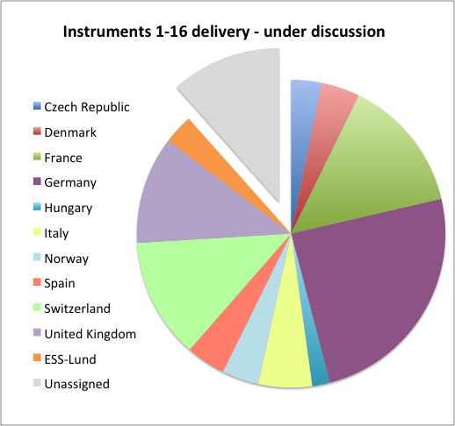
NSS Project Instruments
MOU Status
MOU Current Status (April-2016)
MOU Signed
MOU Can be Signed
Partners waiting for funding
class | Instrument | In-kind Partners (% contribution) | Cost Book (M€) | Cost Target (M€) |  | % IK | Cash (M€)
Large scale structures | LOKI broadband SANS | UK (ISIS) | 12.2 |  |  | 90% | 3.66
 | SKADI general-purpose SANS (note 1) | DE(FZJ 50%) + FR(LLB 50%) |  | 12 |  | 100%
 | ESTIA focusing reflectometer | CH(PSI) |  | 9 |  | 95% | 0.45
 | FREIA liquids reflectometer | UK (ISIS) |  | 9 |  | 95% | 0.45
Diffraction | NMX macromolecular crystallography | ESS (<30%) + HU (Wigner and Centre for Energy Research) + FR (LLB) + NO (Bergen Uni) | 11.7 |  |  | 70% | 3.50
 | DREAM powder diffractometer (bispectral) | DE(FZJ 75%) + FR(LLB 25%) |  | 12 |  | 95% | 0.60
 | HEIMDAL hybrid diffractometer | DK(AU 30%) +CH(PSI) +NO (IFE) |  | 12 |  | 70%
 | MAGIC magnetism single-crystal diffractometer | FR (LLB 65%) + DE (FZJ 20%) + CH (PSI 15%) |  | 12 |  | 100%
Engineering | BEER engineering diffractometer | DE (HZG 50%), CZ (NPI 50%) |  | 12 |  | 100%
 | ODIN multi-purpose imaging | ESS -> DE(TUM 50%) +CH (PSI 50%) |  | 9 |  | 95% | 0.45
Spectroscopy | C-SPEC cold chopper spectrometer | DE(TUM 50%) + FR(LLB 50%) |  | 15 |  | 100%
 | BIFROST extreme-environments spectrometer | DK(DTU/KU 30%) +CH(PSI) + HU(Wigner) +NO (IFE) + FR(LLB) |  | 12 |  | 70%
 | T-REX bispectral chopper spectrometer | DE (FZJ 75%) + IT (CNR 25%) |  | 15 |  | 95% | 0.75
 | VESPA vibrational spectroscopy | IT (CNR) + UK (ISIS) |  | 12 |  | 100%
 | MIRACLES backscattering spectrometer | ES(Bilbao) +FR(LLB) +HU (Wigner) + ESS |  | 12 |  | 95%
 | 16th Spectrometer (VOR or Spin-Echo, Decide 2018) | Wigner Institute (HU) for VOR or Juelich and TUM for Spin-Echo |  | 12 |  | 95% | 0.60
 | 16 instruments | cost | 188.9 |  |  | 90.3% | 18.3
 | neutron guide bunker | CZ, IT, D, F,… |  |  | 14.6 | 80.0% | 2.92
 |  | total cost (with bunker) |  |  | 203.5 | 89.6% | 21.2
Main unassigned scope
6th Spectrometer (16th NBI), 25% VESPA, 25% MIRACLES, 6% NMX
+ Neutron Guide Bunker ( ~12-14 M€)

Slide 21
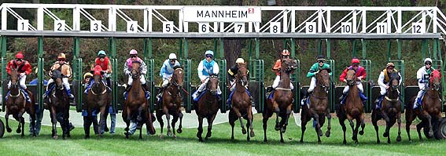
Conclusions
Phase 1 (preliminary engineering design) for as many instruments as possible => 12 scope setting meetings before November 2016 agreed with ICB
Critically revise NSS budget
Requires hard work by NSS and in-kind partners to meet the deadlines
After involvement of ICB and SAC
Proposal to council on
- updated overall instrument budget
- sequencing of instruments
- how to insure early science success
Strategic decision by council on instrumentation at ESS in December 2016

