Slide 1
TAC 13 – Accelerator presentation
2016-04-06
Mats Lindroos,
Head of accelerator
www.europeanspallationsource.se
6 April 2016

Slide 2
Accelerator overview
The accelerator project is progressing according to plan towards first beam in June 2019 at 572 MeV
The project has entered into the construction phase with Preliminary Design Reviews (PDR) for all major systems completed and Critical Design Reviews (CDR) for these systems to follow in 2016
The CDRs for most of the low energy part have been done and the construction has been launched at the IK contributors
Prototypes are being completed and testing will start in 2016.
  Superconducting cavity prototypes haven been tested with results above expectations
  The ESS design for the modulators are presently under testing in Lund
  The first 704 MHz ESS klystron has just been received after a succesful Factory Acceptance Test
Major progress has been made on the Technical annexes for the IK contracts with the objective of completing all in 2016
The installation plan, which respects the June 2019 milestone for first beam has been completed. The aim is to freeze it after this years Annual Review
  First accelerator equipment to be installed on site in September 2016

Slide 3
Accelerator Division – Scope
Accelerator Technical performances
Key parameters:
    -2.86 ms pulses
    -2 GeV
    -62.5 mA peak
    -14 Hz
    -Protons (H+)
    -Low losses
    -Minimize energy use
    -Flexible design for mitigation and future upgrades
Design Drivers:
High Average Beam Power
5 MW
High Peak Beam Power
125 MW
High Availability
95%
352.21 MHz
704.42 MHz
2.4 m
4.6 m
3.8 m
39 m
56 m
77 m
179 m
Target
Source
LEBT
RFQ
MEBT
DTL
Spokes
Medium β
High β
HEBT & Contingency
75 keV
3.6 MeV
90 MeV
216 MeV
571 MeV
2000 MeV
First beam at 572 MeV in June 2019
5 MW capacity for 2023
RF sources for HB part is the scope contingency for accelerator

Slide 4
High Level Master Schedule (Level 1)

Slide 5



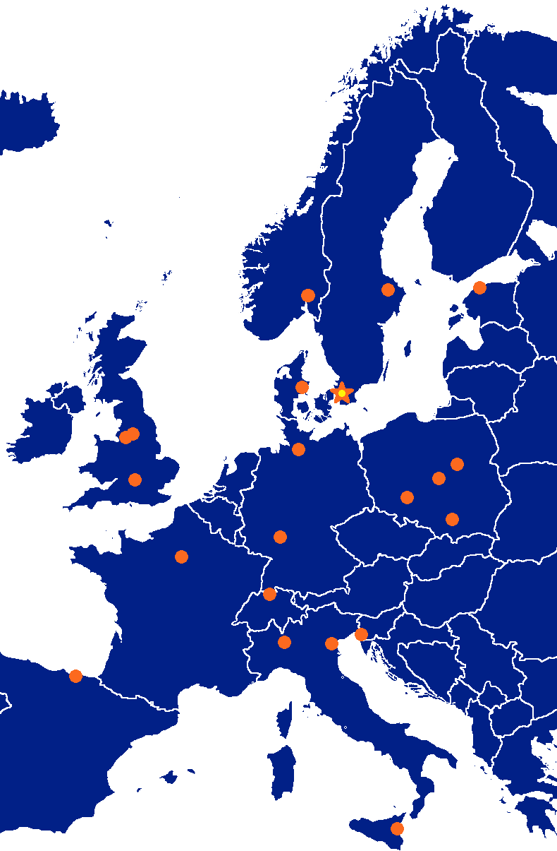



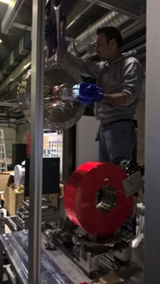




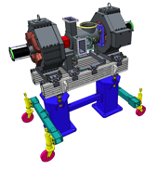


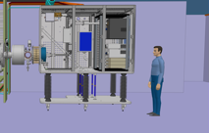



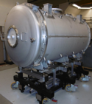
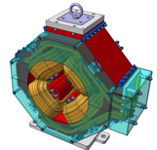

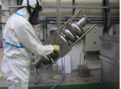

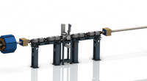




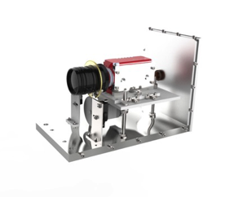
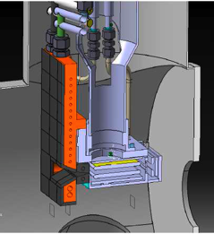
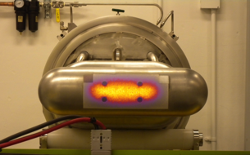

Accelerator Collaboration - Accelerator
352.21 MHz
704.42 MHz
2.4 m
4.6 m
3.8 m
39 m
56 m
77 m
179 m
Target
Source
LEBT
RFQ
MEBT
DTL
Spokes
Medium β
High β
HEBT & Contingency
75 keV
3.6 MeV
90 MeV
216 MeV
571 MeV
2000 MeV

Slide 6


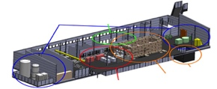



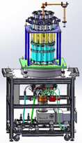
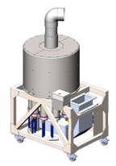



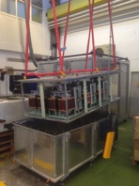
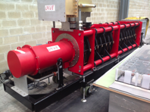
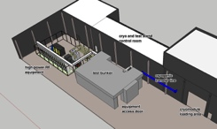
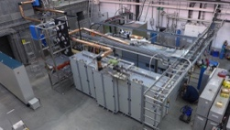
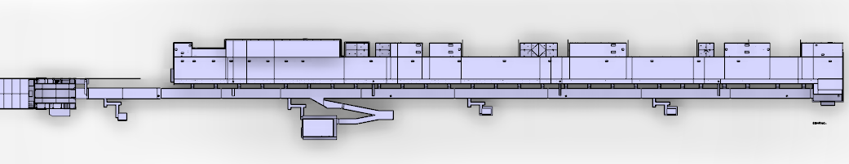







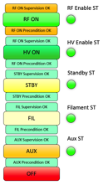


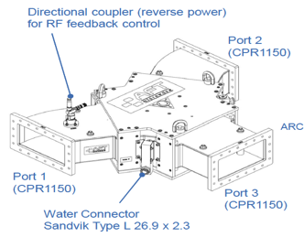
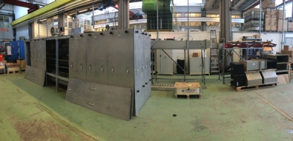
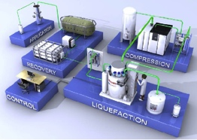
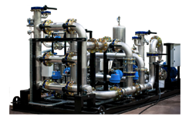

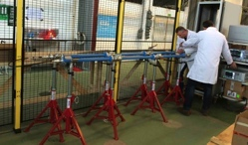
Accelerator Collaboration – RF and STS
Concept, courtesy of GRE (UK)

Slide 7
Where do we expect to be in December 2016 for design maturity?

Slide 8
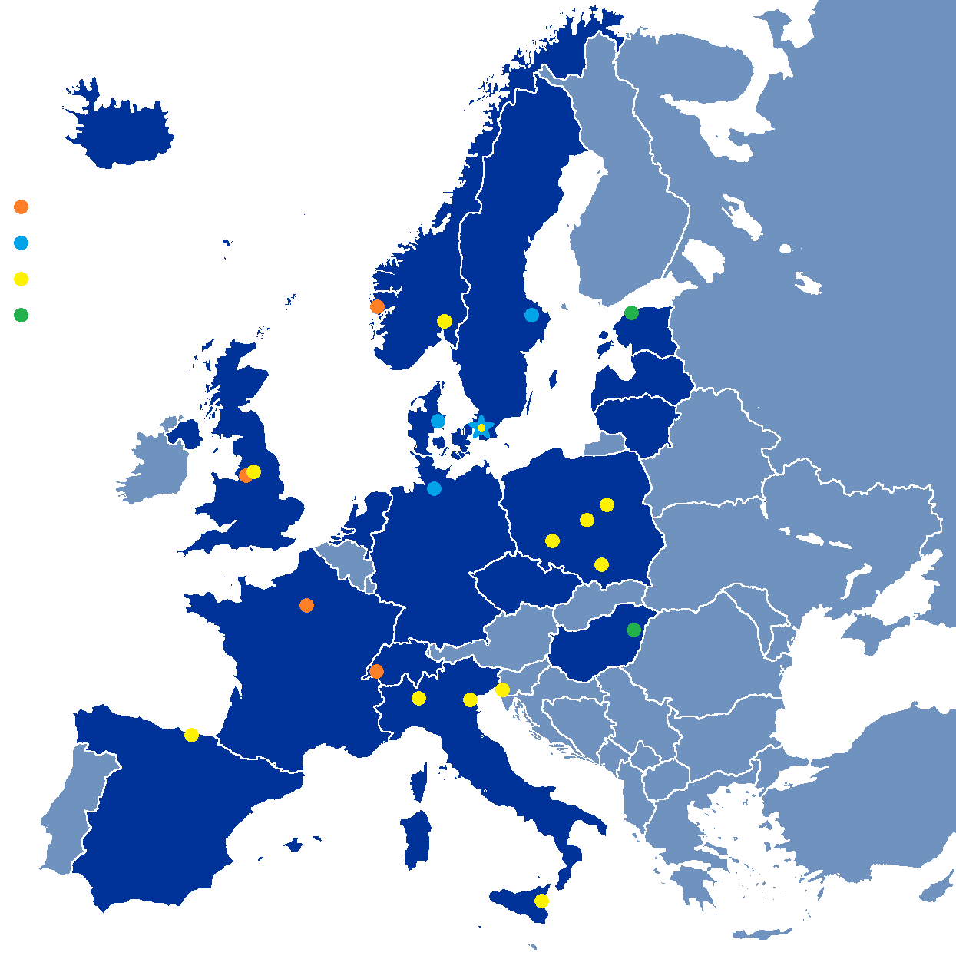

Partner Institutions
In-kind (main contributions)
ATOMKI (RF-LPS)
CEA (RFQ, SRF, Diagn)
CNRS (SRF, Cryo)
Daresbury Lab (SRF, Vacuum)
Elettra (RF, Magn, PS, Diagn)
EPFL (Modulators)
ESS-Bilbao (MEBT, RF)
Huddersfield Univ (RF distrib)
IFJ PAN (Installations)
INFN Catania (Source, LEBT)
INFN Legnaro (DTL)
INFN Milan (SRF)
Lodz UT (LLRF)
NCBJ (LLRF, gamma blockers)
Tallinn UT (RF)
Univ Bergen (Seconded staff)
Univ Oslo (Diagn)
Warsaw UT (LLRF)
Wroclaw UT (Cryo)
Not yet signed
Contract
HoA/Cover page
IKC
Not IKC, 32%
Planned IKC, 52%
Possible IKC, 13%
Paid contracts
Aarhus Univ (Beam delivery)
DESY (Diagn)
Lund Univ (LLRF, RF)
Uppsala Univ (Tests)
SE,DK, 3%

Slide 9
In Kind Status
In-Kind Agreements
Agreements signed: 2 Annexes: 2
Expected remaining: 14 Annexes: 40
Heads of Agreement
Signed: 11 (with 8 partners) Annexes: 16
Cover Letters, etc.
Annexes: 5
Contracts (construction phase)
SE, DK, PL, DE, etc.: 10
Issues
VAT still delaying
Partners need help with manpower and requires risk sharing (against “IK principle”)

Slide 10
Objectives of re-org
The annual review recommended a re-org to:
Further align line and project
Strengthen the safety organization
Strengthen the role of all WPs in the line organization
Furthermore, I also think it is essential:
To bring together lead engineers, liaison person and deputy WP leaders
Establish clear line authority for the accelerator systems and the Work Packages
  No split responsibility for WP between groups
Clarity regarding the responsibility for the development of interface requirements

Slide 11
New AD – Groups, sections and WP
ACCELERATOR DIVISION
WP 1
Mats Lindroos
Beam Physics, Operation & Beam Diagnostics
WP 2,7
Andreas Jansson
Engineering Resources
WP 99
David McGinnis
LINAC
WP 3,4,5,6,14
Håkan Danared
Radio Frequency
WP 8,17
Anders Sunesson
Admin & QA
Safety
WP 13
Lali Tchelidze
Specialized Technical Services
WP 10,11,12,15,16
John Weisend
Beam Physics
WP 2
M. Eshraqi
Beam Diagnostics
WP 7
T.Shea
Linac hardware
WP 3, 4 and 5
H. Danared
Integration
WP 6
S. Molloy
Power Converters
WP 17
C. Martins
RF Sources
WP 8
M. Jensen
Cryogenics
WP 11
P. Arnold
Vacuum
WP 12
M. Ferreira
Planning

Slide 12
Accelerator Division
ACCELERATOR DIVISION
Mats Lindroos
Beam Physics, Operation & Beam Diagnostics
Andreas Jansson – GL
Engineering Resources
David McGinnis – GL
Eugene Tanke
Nick Gazis
Carl-Johan Hårdh (C)
Daniel Lundgren (C)
Mats Pålsson (C)
LINAC
Håkan Danared – GL
Radio Frequency
Anders Sunesson - GL
Admin & QA
Caroline Prabert
Inga Tejedor
Matthew Conlon
Safety
Lali Tchelidze – GL
Duy Phan
Enric Bargalló
Eder García Etxearte (I)
Frank Kornegay (C 15%)
Mikael Motyka (S)
Spec. Technical Services
John Weisend II – GL
Wolfgang Hees
Anton Lundmark
Evangelia Vaena
Frithiof Jensen
Gunilla Jacobsson
Beam Physics
Mamad Eshraqi - SL
Marc Munoz
Renato de Prisco
Ryoichi Miyamoto
Yngve Levinsen
Saeid Pirani (S) (at INFN)
Beam Diagnostics
Tom Shea – SL
Benjamin Cheymol
Cyrille Thomas
Hooman Hassanzadegan
Hinko Kocevar
Irena Dolenc Kittelmann
Maurizio Donna
Slava Grishin (at CERN)
Rafael Baron
Charlotte Roose
Ebbe Malmstedt (C)
Thomas Grandsaert (C)
Johan Norin (C)
Linac Hardware
Vacant - SL
Christine Darve
Georg Hulla
Walter Wittmer
Felix Schlander
Nuno Elias (EIS)
Peo Gustafsson (C)
Frank Hellström (C)
Fredrik Håkansson (C)
Accelerator Integration
Stephen Molloy – SL
Aurélien Ponton
Edgar Sargsyan
Iñigo Alonso
Power Converters
Carlos Martins – SL
Göran Göransson
Marko Kalafatic
Paulo Jose Torri (2 May)
Anders Andersson (C)
RF Sources
Morten Jensen – SL
Rihua Zeng
Rafael Montano
Bruno Lagoguez
Chiara Marrelli
Rutambhara Yogi
Staffan Ekström
Stevo Calic
Iñigo de la Fuente
Krisztian Löki (S)
Miklós Boros (S)
Cryogenics
Philipp Arnold – SL
Jaroslaw Fydrych
John Jurns
Xilong Wang
Xiaotao Su
Piotr Tereszkowski (C)
Vacuum
Marcelo Juni Ferreira – SL
Hilko Spoelstra
Simone Scolari
Christophe Jarrige
Fabio Ravelli (1 June)
Kristell Barthélemy (20 June)
Peter Ladd (C 50%)
Planning
Luisella Lari
Lena Gunnarsson
Håkan Danared – Deputy Head of Division
John Weisend II – Deputy Head of the Project
63 employees (2016-04-01)
Consultants, Students, Interns and empl from
Eng Integr Sup Div, in Yellow + Planners = 21 people
Caroline Prabert 2016-04-01
Notes:
§

Slide 13
Linac Group
LINAC
Håkan Danared – GL
Linac Hardware
Vacant - SL
Christine Darve
Georg Hulla
Walter Wittmer
Felix Schlander
Nuno Elias (EIS)
Peo Gustafsson (C)
Frank Hellström (C)
Fredrik Håkansson (C)
“External section” with Deputy WP Leaders for work packages WP3-6
Contract management
Contract follow-up
Documentation
Interfaces, Interface requirements
“Internal section” for integration at ESS in Lund
Top-down requirements
Integration in gallery and stubs
Interfaces to ICS and Target
Interfaces to MPS, PSS and TSS
Installation planning
Accelerator Integration
Stephen Molloy – SL
Aurélien Ponton
Edgar Sargsyan
Iñigo Alonso

Slide 14
Accelerator Staff Plan
I
n
i
t
i
a
l
O
p
e
r
a
t
I
o
n
From June, 28th, 2019 (i.e. first beam on target) the staff profile on the Construction Budget goes down from 112 to 21 FTE until June 2022 (i.e. at the end of the HB installation)

Slide 15
Accelerator Staff Plan with IKC
The number of IKC FTEs has to be considered just indicative, since this number is derived by the budget allocated for manpower in the IK contracts to cover manpower costs.

Slide 16
Accelerator Project organization
WP# | WP TITLE | WP LEADER | EXT. WP? | DEPUTY WP LEADERs FOR EXTERNAL WPs
WP01 | MANAGEMENT | J.G. WEISEND II | NO
WP02 | ACCELERATOR PHYSICS | M. ESHRAQI | NO
WP03 | NORMAL CONDUCTING FRONT END | S. GAMMINO | YES | W.WINTER
WP04 | SPOKE CRYOMODULES | S. BOUSSON | YES | C. DARVE
WP05 | ELLIPTICAL CRYOMODULES | P. BOSLAND | YES | C. DARVE
WP06 | BEAM DELIVERY SYSTEMS | S. MØLLER | YES | I. ALONSO
WP07 | BEAM DIAGNOSTICS | A. JANSSON | MIX
WP08 | RF SYSTEMS | A. SUNESSON | MIX
WP99 | ACCEL INFRASTRUCTURE & INSTALLATION | D. MCGINNIS | NO
WP10 | TEST STANDS | W. HEES | MIX
WP11 | CRYOGENICS | P. ARNOLD | NO
WP12 | VACUUM | M. JUNI FERREIRA | MIX
WP13 | SAFETY | L. TCHELIDZE | NO
WP14 | ACCELERATOR INTEGRATION | H. DANARED | NO
WP15 | ELECTRICAL SUPPORT | F. JENSEN | NO
WP16 | COOLING SUPPORT | A. LUNDMARK | NO
WP17 | POWER CONVERTERS | C. MARTINS | MIX
Collaboration Board (1-2 times a year):
ESS Technical Director
Project leader
Representatives of all contracted institutes (one elected as chair)
Technical Board (5 times a year):
Weekly ESS management team
All WP leaders and deputies
Representatives of all contracted institutes if not already a WP leader
Weekly ESS project management team:
Mats Lindroos, Project leader
John Weisend, Deputy project leader
Håkan Danared, In-kind manager
Lali Tchelidze, Safety including radiation safety
Anders Sunesson, RF systems
Luisella Lari, Head planner
Andreas Jansson, Beam instrumentation
Matthew Conlon, QA/QC
Section leaders when required

Slide 17
Control Change Boards (CCB) & control flow for ACCSYS
ESS ERIC governance
ESS ERIC Council
CCB-A
1-2/year
Collaboration board
CEO / ETB/ ESS CCB
CCB-B
Quarterly
ACCSYS TB
reports
ACCSYS Mngt Team
delegates, approves
CCB-C’
weekly
minutes, actions & ACCSYS Control Log

Slide 18
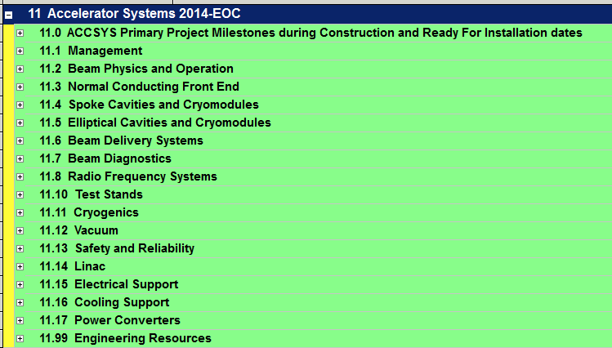
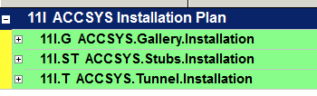
WBS P6 11 and 11I
(L.Lari and E. Sargsyan)
11→ WBS (Level 1) is the Technical/Specialized Competences
11 I→ WBS (Level 1) is the Areas where installation works are foreseen

Slide 19
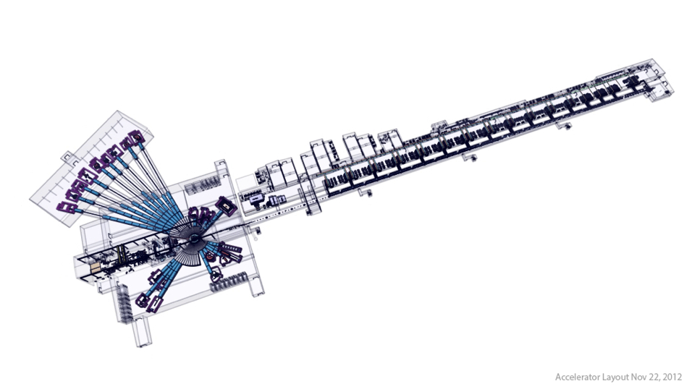
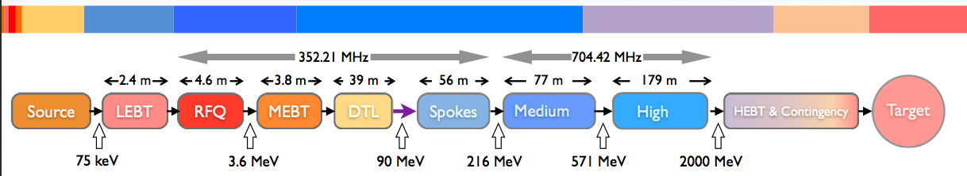
Graphical visualization of 11I
Data extracted from Primavera !!
ACCELERATOR/GALLERY LEGTH
Time (2 year)
1 Graphical visualization for each macro areas
Commissioning
Working in progress
L. Lari & E. Sargsyan

Slide 20
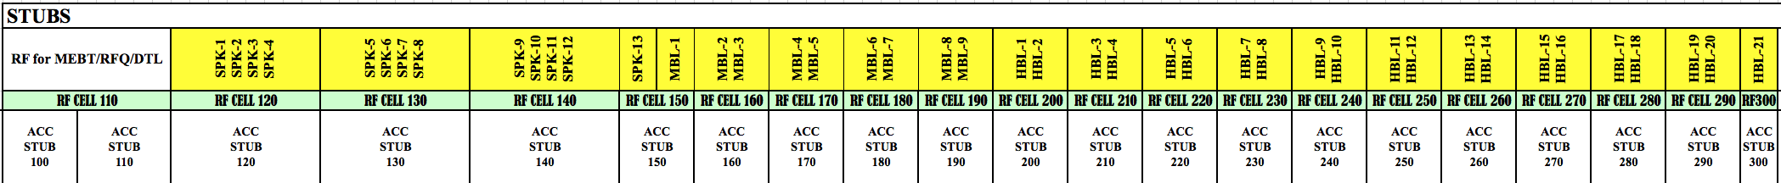
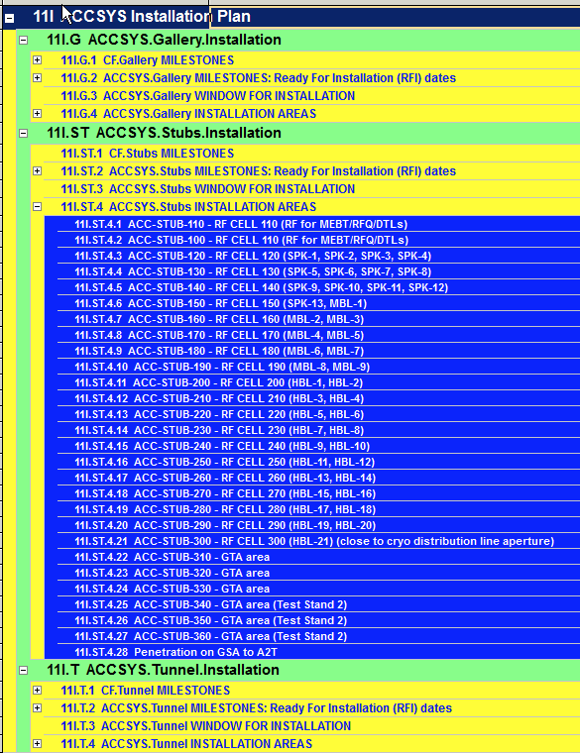
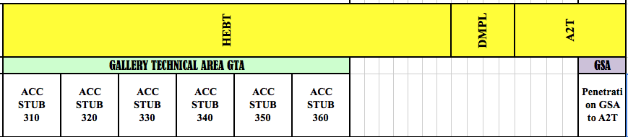
Stubs installation plan (1/2) (L.Lari and E. Sargsyan)

Slide 21
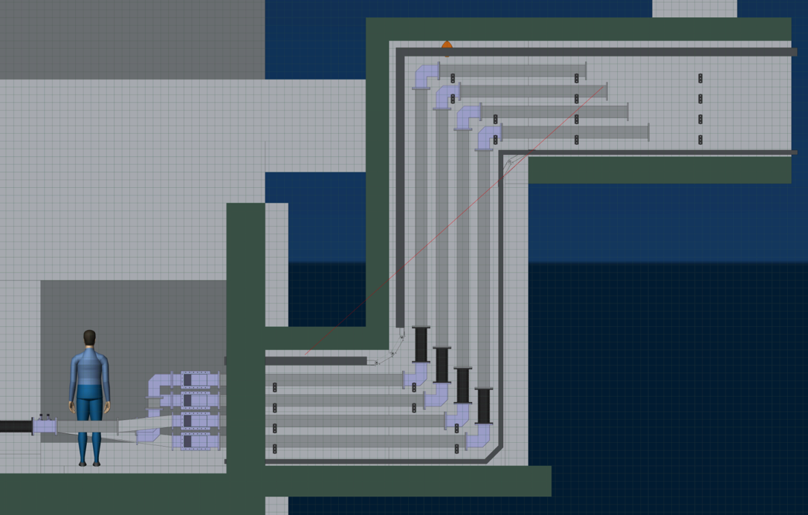
Stubs installation plan (2/2) (L.Lari and E. Sargsyan)
3 electrical teams working in parallel in 3 different stubs.

Slide 22
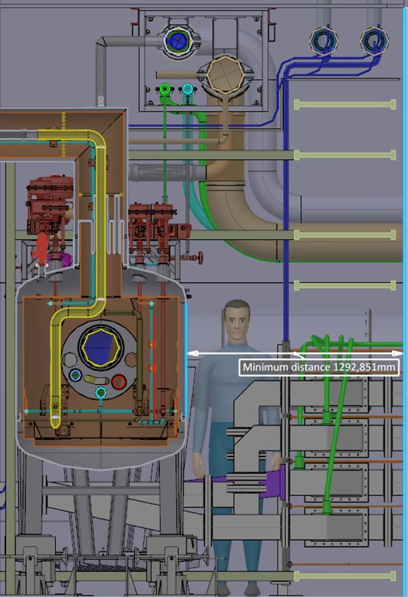
Tunnel installation plan (1/4) (L.Lari and E. Sargsyan)

Slide 23
Tunnel installation plan (2/4) (L.Lari and E. Sargsyan)
Variation from E. Tanke sequence [Ref. ESS-0037305] in the Spoke CM installation → to maximize the distance from the NCFE

Slide 24
Tunnel installation plan (1/2) (L.Lari and E. Sargsyan)
Vacuum 3 teams needed for LWU installation

Slide 25
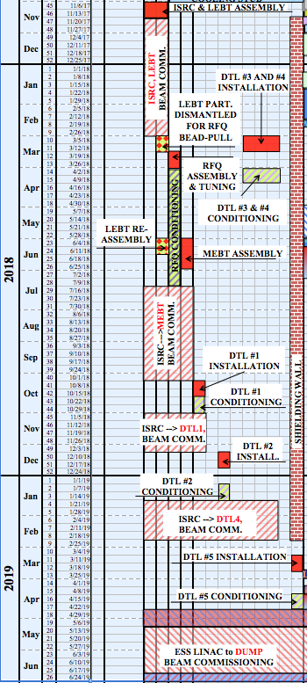
Tunnel installation plan (1/2) (L.Lari and E. Sargsyan)
---- Zoom on NCFE ----
Variation from E. Tanke sequence [Ref. ESS-0037305]
Installation & beam commissioning windows optimized taking into account:
The delivery dates (RFI) of the NCFE components
The constraints of the assembly activities in the tunnel
→ 1 shielding wall used.

Slide 26
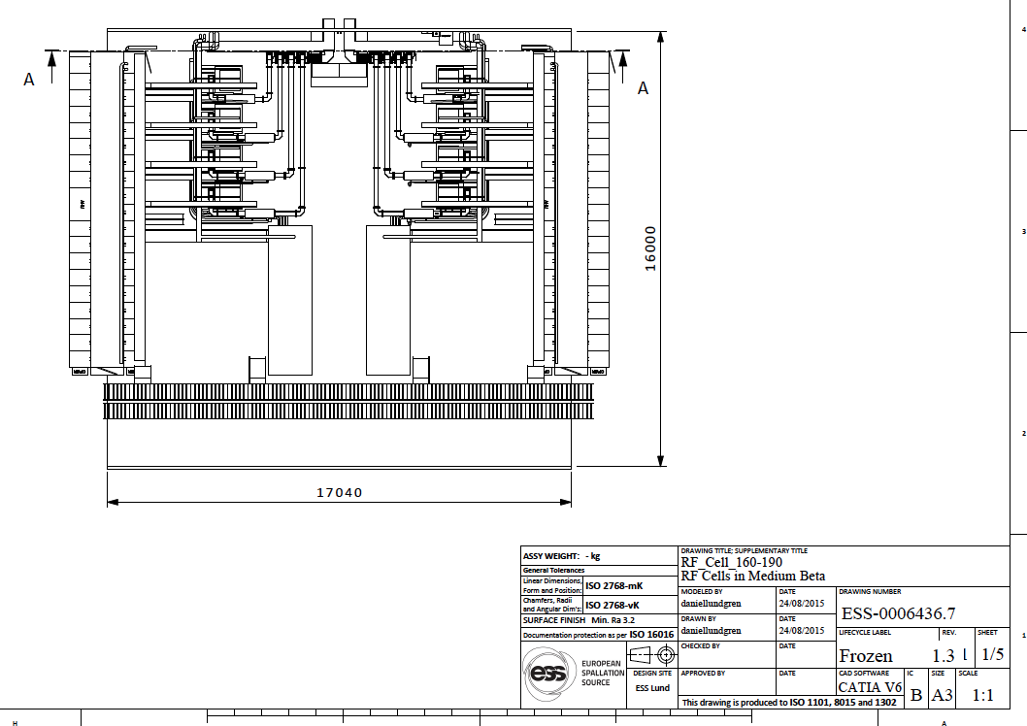
Gallery installation plan (1/2) (L.Lari and E. Sargsyan)
Example MB cell
Really draft version

Slide 27
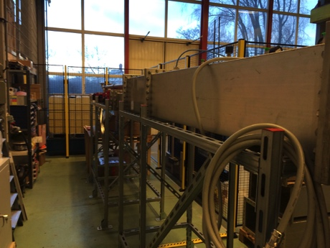
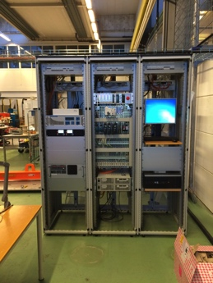
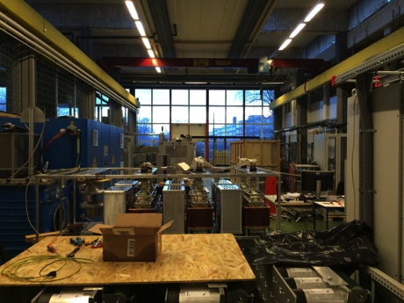
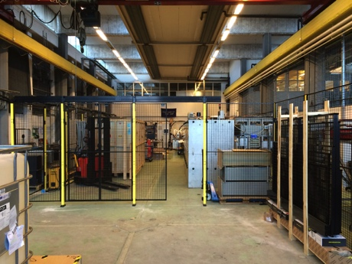
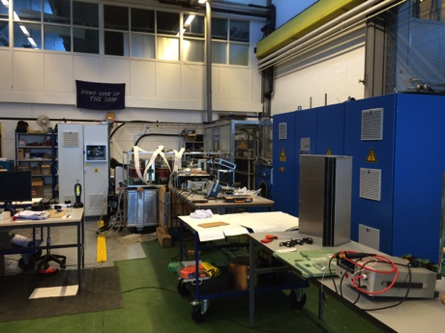
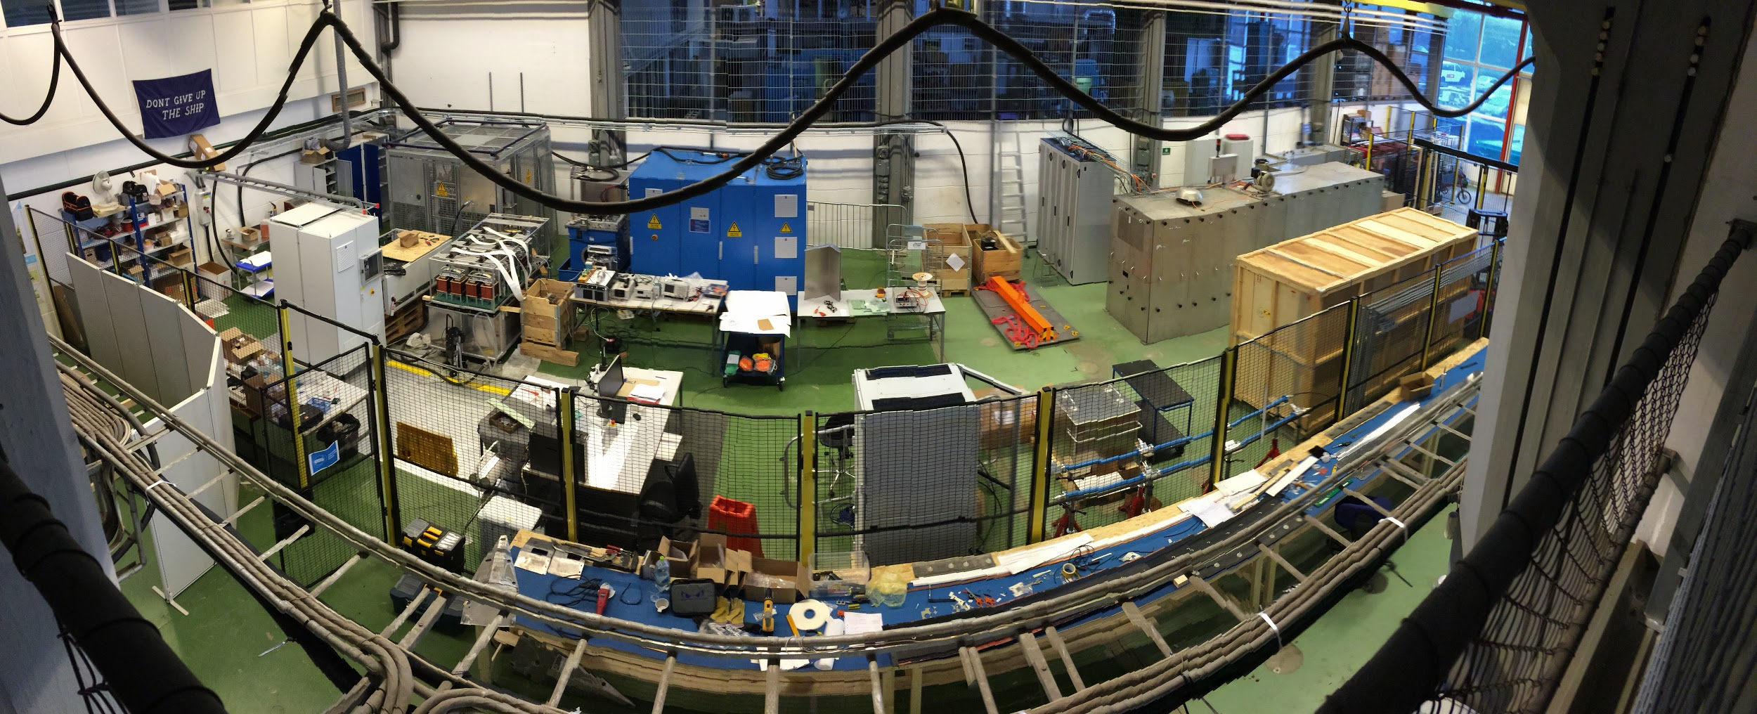
Integration Test Stand

Slide 28
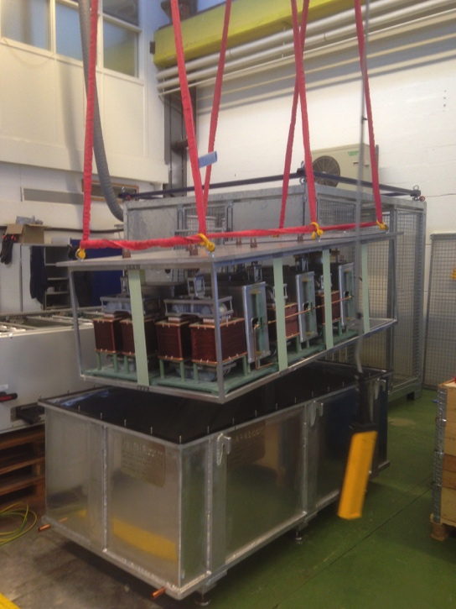
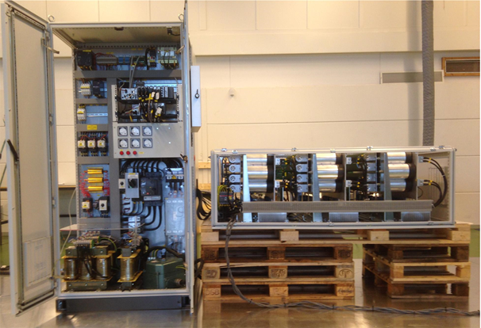
Reduced Scale modulator prototype
( SML topology status on March 2015 )
Electrical schematic
Part I
Part II
Part I – Low Voltage driver:
→ successfully tested in Feb. 2015 on resistive loads (@1kV);
Part II – HV oil tank assembly:
→ Delivered at LTH test stand on March 4th
→ Tests undergoing. Should be completed shortly

Slide 29
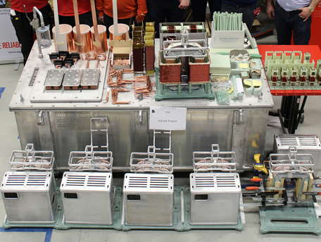
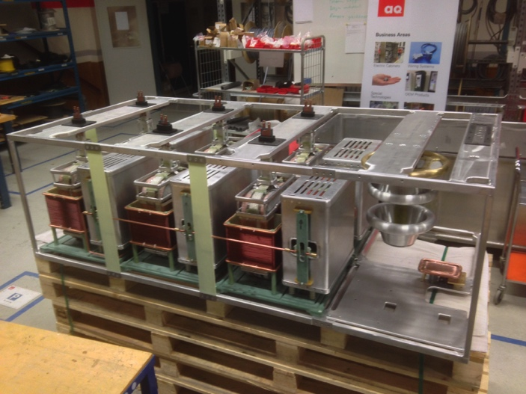
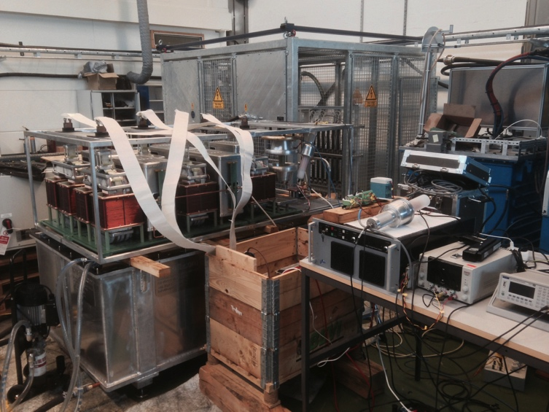
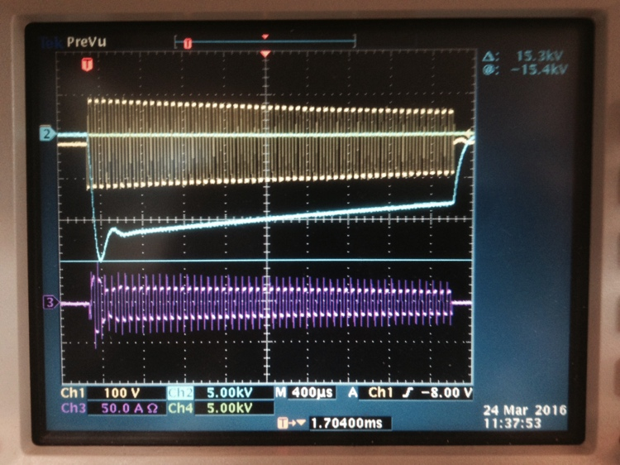
Reduced Scale modulator prototype
( Progress in construction and testing of HV oil tank assembly)
1)- Contract signed on Oct 14th 2015
3)- March 2nd at manufacturer premises (Lund):
HV module #1 to #6 assembled and placed in the frame;
Yellow: primary voltage of HV module #1
Magenta: primary current of HV module #1
Blue: output voltage pulse (in open loop, no regulation);
2)- Feb 12th at manufacturer premises (Lund):
- All parts / components delivered;
- HV module #1 assembled;
4)- March 23rd at LTH test stand:
- Preliminary testing of the full HV oil tank assembly at low voltage;

Slide 30
Initial Operations
Startup Working Group ended in December 2015:
  Contribution to the ESS startup strategy (ESS-0037295)
  Defined Accelerator and Beam modes (ESS-0038258)
  Support for the integrated simulation of the ESS facility modes and startup (state machine simulation of ESS)
Updated the Accelerator WBS for Initial Operations
  In process of updating the proposed budget to the WBS
In process of updating the staff plan to the WBS, including the overlap between Initial Operations and Installation until 2022
Issues:
  Aligning the budget with the existing plan for transition to operation.
  Only 15 operators in the steady state in the accelerator plan.
  No budget for operators in 2018 during commissioning.

Slide 31
Beam Commissioning planning
Recent Achievements:
  Commissioning sequence align with staged installation (NC Linac described in ESS-0043907) and implemented in P6 planning.
  For NC beam commissioning up to DTL4:
    Temporary PSS (PSS1) agreed to support staged commissioning
    Single temporary shield was approved as baseline, does not change sequence given expected delivery dates
    Agreed to limit the rep rate for commissioning to 1Hz, hardware limited.
    Discussions started with CERN on linac4 dump copy
  Draft documentation for SSM produced
Important issues identified during the SSM documentation:
  Temporary dump and shield wall design and build, including budgets, need to be understood
  Need to understand better the access hatch shielding, including procedures to open and close.
  Rate limiter box (for 1 Hz safe operation) needs to be built
  Expected radiation levels for tank4 commissioning too high for intermediate shield wall, plan to time share this part (100h over one month)
  Need search and secure procedures for administrative closure of tunnel for this (not expecting PSS available at that point).
  Air activation unknown, if an issue will limit power to mitigate
  No temporary diagnostics foreseen at this point (at the end of each section to commission). Would need to be defined very soon if needed to be possible in time.

Slide 32
Accelerator Project Risk Status
ACCSYS is currently tracking 192 risks
Costs have been assigned to almost all these risks (2015 Annual Review recomendation)
A way to indicate positive cost risks (i.e. opportunities) has been found (2015 Annual Review recomendation)
  No such opportunities have been identified so far.
Total likely cost risk calculated by Exonaut as 6.9 MEuros (Max @ 13 MEuros)
Calculated cost risk may seem low but consider:
  Assumes IK partners meet cost book numbers and thus IK Partners assume cost risks
  We have placed orders for all 3 cryoplants (all were under budgeted amount) and thus we have retired that cost risk.
  Staff costs are roughly 18% of budget and has low cost risk
ACCSYS has held risk workshops with CEA and University of Huddersfield. These have been valuable in identifying common risks and some risks have been transferred to ESS. We will continue to hold risk workshops with other IK partners.

Slide 33
Accelerator Project Top risks
Risk: In Kind Contributors do not meet scope or schedule requirements (# 2)
Mitigation:
1) An ESS staff member has been assigned as a single point of contact with the IKC WP. This person communicates regularly with the IKC and keeps the project appraised of the status of the work
2) The IKC provides a monthly report on progress and issues
3) Yearly formal audits of WP progress are conducted
4) Relevant IKC WP Milestones are tracked as part of the P6 schedule
Risk: Unidentified design faults are not prototyped and fail in production (# 5)
Mitigation:
1) Policy on Design Reviews has been written and implemented. It is consistent with the broader ESS policy
2) All major components will undergo a PDR and at least 1 CDR prior to start of manufacturing
Risk: Suppliers do not deliver on time with the correct quanity or quality (# 3)
Mitigation:
1) All major components undergo a PDR and 1 or more CDRs prior to series production
2) A ESS staff member is given project responsibility for QA/QC allowing for project wide focus on this topic. This person participates in both writing the TAs and in design reviews

Slide 34
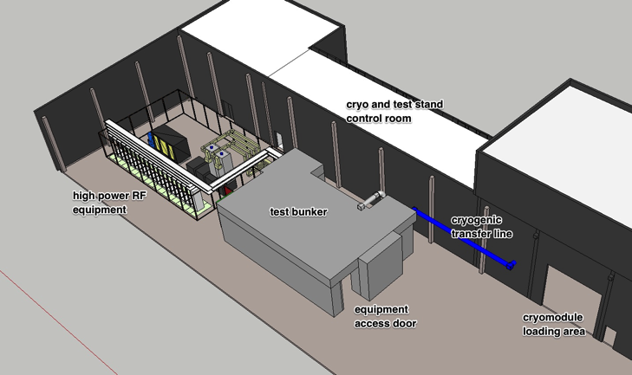
TAC reply CM test on site (H. Danared)
"As the cryomodule test bench will offer the opportunity for integrated system tests, all relevant experts from groups such as RF (power and LLRF), vacuum, installation, cryogenics, and controls should contribute.”
The cryomodule test stand, TS2, will integrate and test a number of systems:
HP RF: The RF group will install, commission and operate one modulator, two klystrons and the corresponding RF distribution equipment (waveguides, circulators, dummy loads) on TS2.
LLRF: The RF group will install, commission and operate a full LLRF control system on TS2. This is not necessary for the cryomodule tests per se, but it is indeed a way to take the opportunity as suggested by TAC.
Vacuum: The vacuum section will use a portable cleanroom in TS2 in order to install vacuum equipment on the beam port of the cryomodules. This operation is very similar to the installation work performed by the same group on the cryomodules in the tunnel.
Installation: TS2 allows installation of cryomodules according to the same procedure as in the tunnel. Installation staff can be trained on TS2 and procedures can be fine tuned.
Cryogenics: TS2 will have a valve box and transfer line similar to the equipment in the tunnel. Installation an operation of TS2 cryo equipment will help to train cryo staff.
Controls: TS2 will be fitted with a PSS (double-door sluice, radiation monitoring, LOTO) similar to the system to be installed in the tunnel.
Commissioning of the test stand including all the above items will use the M-ECCTD cryomodule prototype. A timely delivery of this prototype is thus essential for setting up the tests.

Slide 35

TAC reply beam instrumentation
The PBI task force assigned priorities to some diagnostics systems, and the conclusions of the task force have now been documented in a report (ESS-0037620). During the 6 months since the last TAC, Beam Physics have carried out a review of instrumentation performance requirements. This review is now almost finished. In parallel to this, the commissioning plan has been refined.
NPM goes here

Slide 36
TAC reply Staff resources
Staff resources for installation are being put into the installation plan with P6. Further refinement of the resources will take place as 2016 progresses.
STFC activities will be used as a training ground for staff. As an example, it has been agreed that all the vacuum technicians will spend 3 weeks at STFC Daresbury learning proper clean room assembly techniques prior to assembling beam line components at ESS using portable clean rooms.

Slide 37


TAC reply Target diagnostics
ESS wholeheartedly accepts these recommendations, as they are entirely consistent with our current plans and the PBI task force recommendations. Specifically, the baselined suite of beam instrumentation in the target station includes thermocouples as components of the aperture monitor system and a multiwire grid to complement the imaging system. The beam instrumentation section, target division and their in-kind partners are developing simple and robust components appropriate for the harsh environment of the target station.

Slide 38
TAC reply on FREIA in Uppsala
The possibility of training engineers and technicians is an important opportunity. Since October/November 2015 many in the RF group are heavily involved in setting up the integration test stand at the University in Lund, all in goal of "getting our hands dirty", as one of the Annual Review recommendations 2015 stated. Due to the emphasis on the Lund integration test stand we have not sent people to the FREIA facility yet. Once the Ampegon Modulator prototype and 704 Klystron prototype arrive at FREIA, then additional ESS staff will travel to Uppsala to participate in testing activities.
We will invite FREIA people to the integration test stand work, and for a RF review during the Spring 2016 we use one of the FREIA engineers as committee member.

Slide 39
Accelerator summary
The accelerator project is progressing according to plan towards first beam at 572 MeV in June 2019
The project has entered into the construction with prototypes being assembled and tested according and the low energy part under construction
Major progress has been made on the Technical annexes for the IK contracts with the objective of completing all in 2016
The Accelerator Division is recruiting according to plan and will be ready to: take ownership of the accelerator, install it, commission it and enter it into operation for the 2019 milestone

Slide 40
Where are we now in terms of Design Maturity?

