Slide 1
Target Overview
Eric Pitcher
Target Project Leader
www.europeanspallationsource.se
6 April 2016

Slide 2
Outline
Organization
Update on all work packages
Project schedule
Progress on securing in-kind partners
Issues
Concluding remarks

Slide 3
Target division organizational structure has remained stable for the past 2 years
TARGET DIVISION
Eric Pitcher
Head of Division
Vacant
Deputy Head of Division
Carina Blixt
Administrative Assistant
Target Controls Group
Linda Coney (GL)
Atefeh Adeghzadeh
Mikael Olsson (C)
Jan Espen Presteng (C)
Monolith & Handling Group
Rikard Linander (GL)
Magnus Göhran
Daniel Lyngh
Ulf Odén
Naja de la Cour
Marc Kickulies
Kristoffer Sjögreen
John Jurns (M)
Markus Andersson (C)
Lennart Åström (C)
Reinhard Blum (C)
Paul Erterius (C)
Jens Harborn (C)
Rickard Holmberg (C)
Bengt Jönsson (C)
Jarich Koning (C)
Mikael Möller (C)
Eldin Mukovic (C)
Anders Olsson (C)
Jesper Ringnér (C)
Aleksander Stankovic (C)
Srdjan Vareskic (C)
Mattias Wilborgsson (C)
Federico Masi (IKS)
Materials Group
Yongjoong Lee (GL)
Monika Hartl
Srinivasan Iyengar
Jemilia Habainy (S)
Neutronics Group
Luca Zanini (GL)
Konstantin Batkov
Alan Takibayev
Esben Klinkby (C)
Nicolò Borgo (S)
Zsofia Kokai (S)
Target Physics Group
Günter Muhrer (GL)
Riccardo Bevilacqua
Fluid Systems Group
Håkan Carlsson (GL)
Per Nilsson
Andrea Polato
Klaudiusz Dybowski (C)
Leif Emås (C)
Björn Eriksson (C)
Allan Lundgren (C)
Anna Bieliaieva
Coordination & Planning
Tobias Lexholm
Installation Coordinator
Vacant
Interface Coordinator
Anders Ingels (M)
Project Planner
12.1 Management and Administration
12.7 Controls
Linda Coney (WPM)
12.8 Physics
Günter Muhrer (WPM)
12.5 Fluid Systems
Håkan Carlsson (WPM)
12.2 Target System
Ulf Odén (WPM)
(GL) Group Leader
(C) Contractor or Consultant
(M) Matrixed
(S) Student
(IKS) In-Kind Secondment
12.3 Moderator & Reflector Systems
Daniel Lyngh (WPM)
12.4 Monolith Systems
Rikard Linander (WPM)
12.6 Remote Handling Systems
Magnus Göhran (WPM)

Slide 4
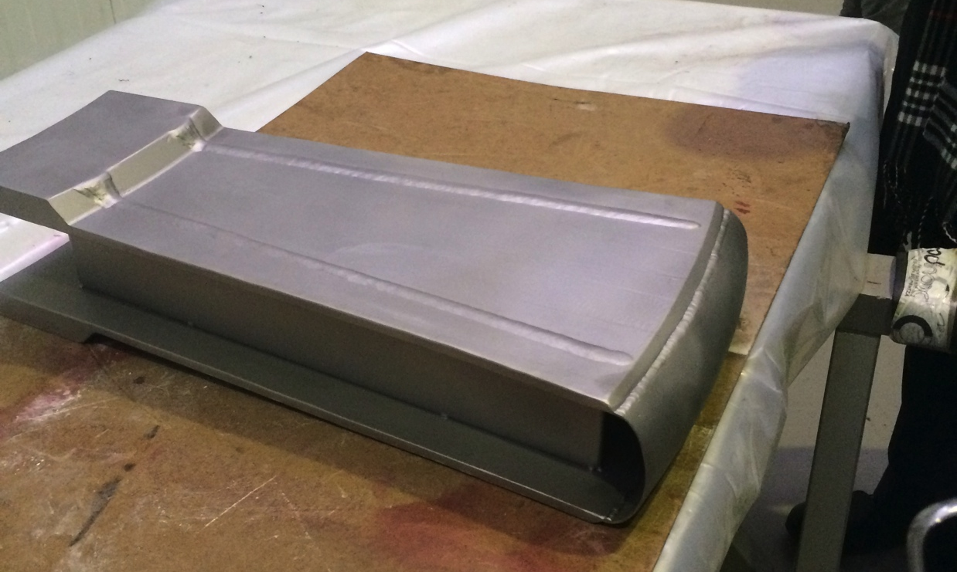
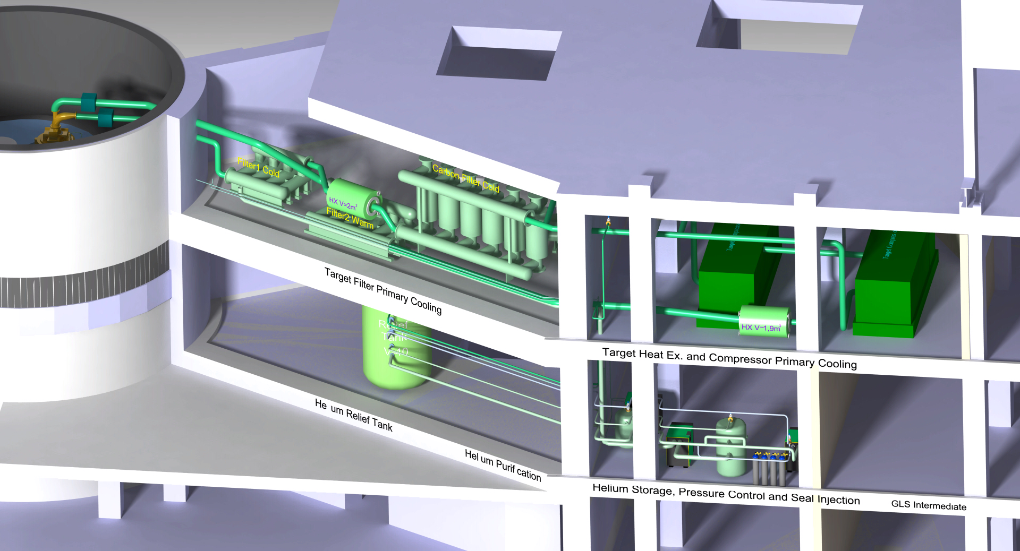
WP2: Target Systems
Target Wheel, Drive & Shaft
  ESS-Bilbao team performing detailed design and prototyping
  CDR for spallation material and cassettes scheduled for July
Target Helium Cooling System
  UJF contractor Rež exploring options for oil-free blowers
Accident analyses supporting the PSAR
  Nuclide inventories in helium, filters and getters calculated
Target Wheel Sector Prototype
Target Helium Cooling System

Slide 5
ESS-Bilbao has contributed to quantitative accident analyses
Calculated tungsten and target shroud temperatures for
  stopped wheel
  rotating wheel with loss of helium flow

Slide 6
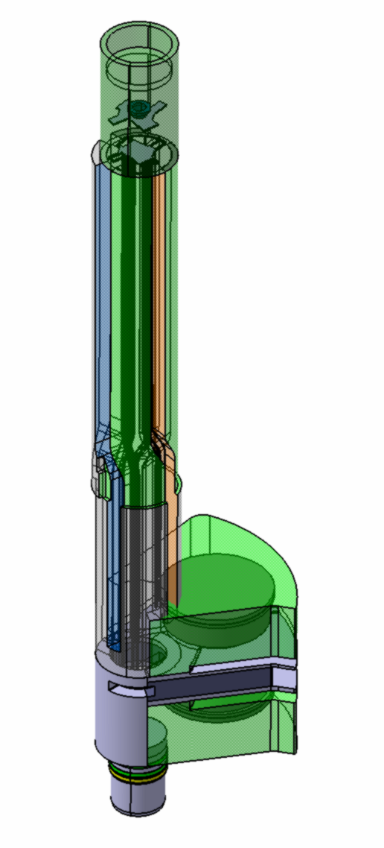
WP3: Moderator and Reflector Systems
Design and prototyping work for the MR plug structures underway by FZJ
Helium cryoplant contract awarded on schedule
  Linde selected as the supplier
Upcoming CDRs:
  Hydrogen pumps: 27 April
  MR Handling System: 21 May
  Reflectors: 10 July
  Thermal Moderator: 24 August
  Cold Moderator: 28 September
MR Plug

Slide 7
FZJ and Dresden Univ. are progressing on the design of the liquid hydrogen system

Slide 8
WP4: Monolith Systems
Conducted 3 PDRs
  Monolith Vessel
  ECHIR Embedment
  Proton Beam Instrumentation Plug
Design progress on:
  steel shielding (internal and external)
  integrated neutron beam extraction system, neutron beam window, and light shutter
ESS-Bilbao is evaluating the viability and cost of performing monolith vessel welds that are compliant with RCC-MRx and concurrently to vacuum standards

Slide 9
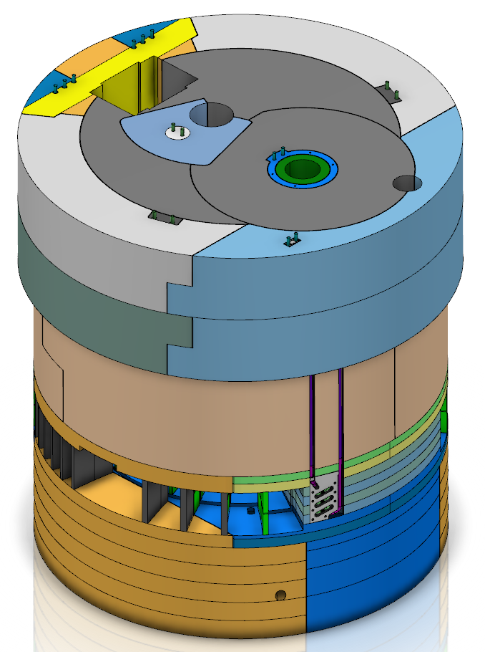
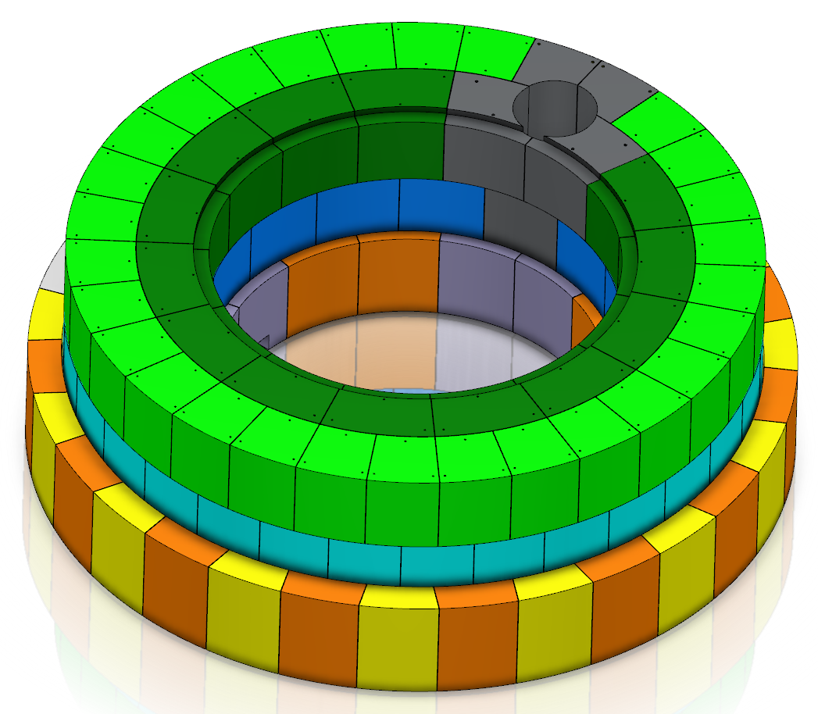
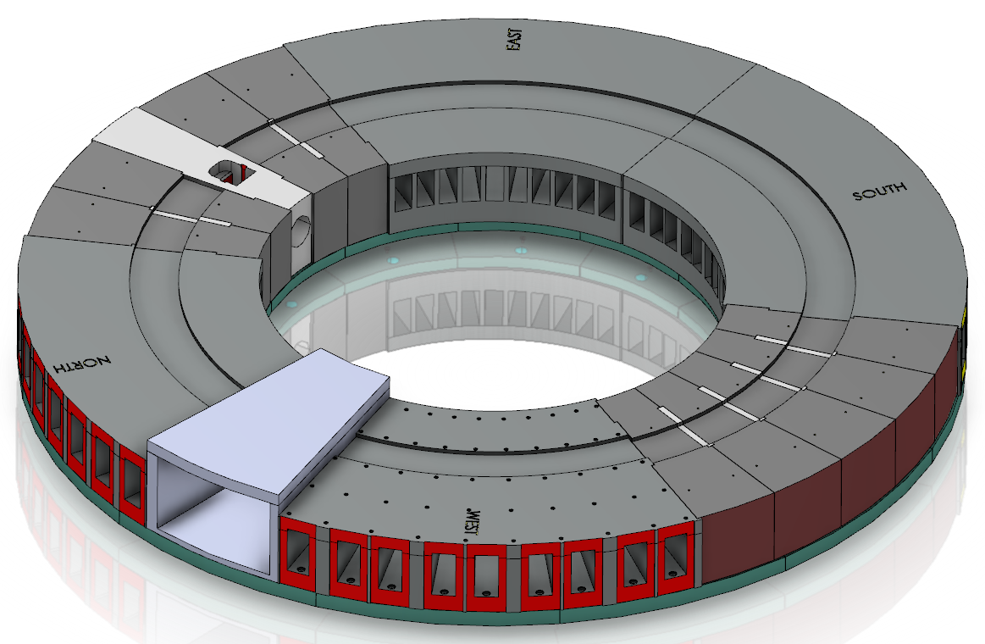
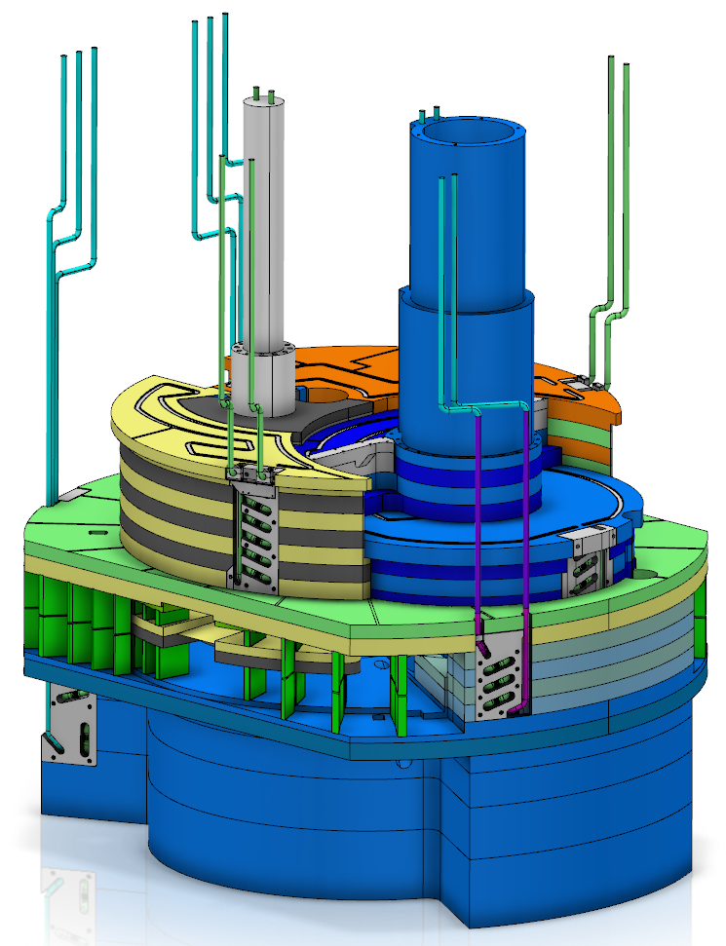
Significant progress on monolith shield design
Monolith outer shielding
  Stacked steel blocks (installation and decommissioning)
  Staggered and stepped (neutron streaming)
  Interlocked (earthquake)
  Modular (minimum number of shapes)
  About 1600 tons of material
Baseplate
  12 segments anchored to concrete foundation
  High manufacturing and installation precision
  Distributes upper mass loads to concrete foundation
Port blocks
  Neutron beam port blocks (4 normal + nnbar)
  Proton beam port block
  Filling blocks
Monolith inner shielding
  Stacked steel blocks (access to internals)
    Water-cooled blocks
    Upper removable blocks
    Peripheral blocks
  Staggered and stepped (neutron streaming)
  Interlocked (earthquake)
  Unique blocks (adapting to internals and beam extraction needs)
  About 1000 tons of material

Slide 10
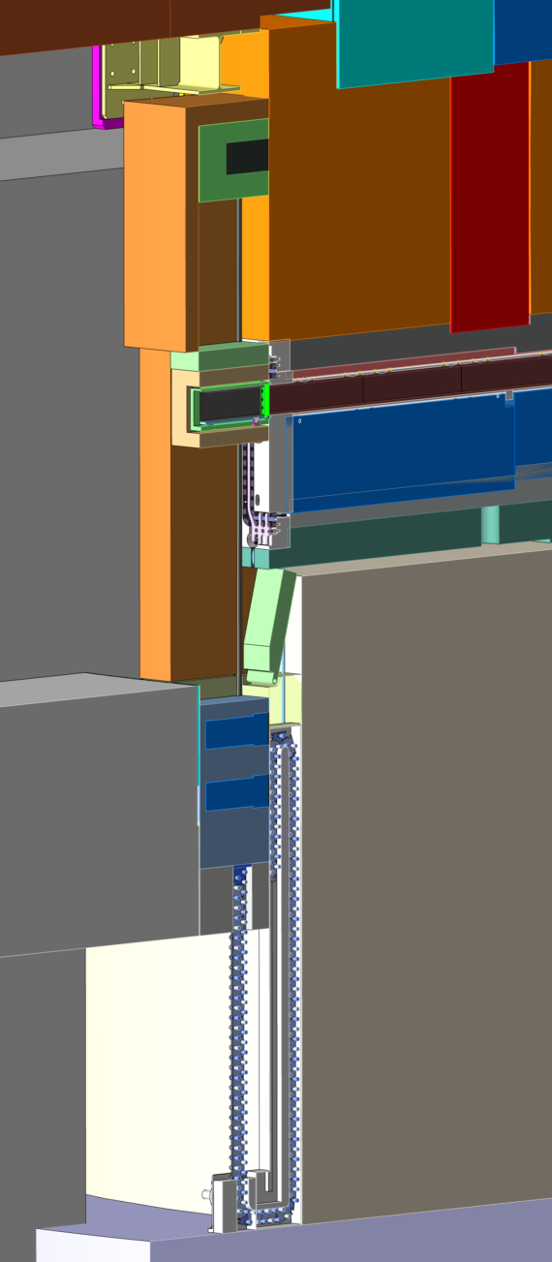
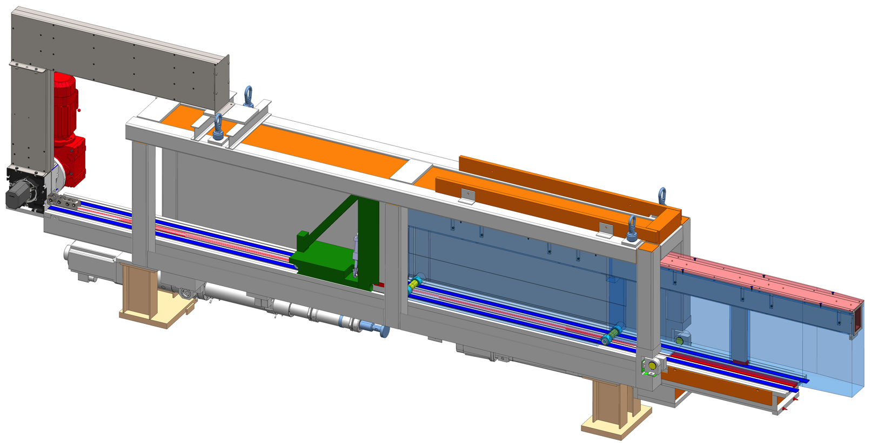
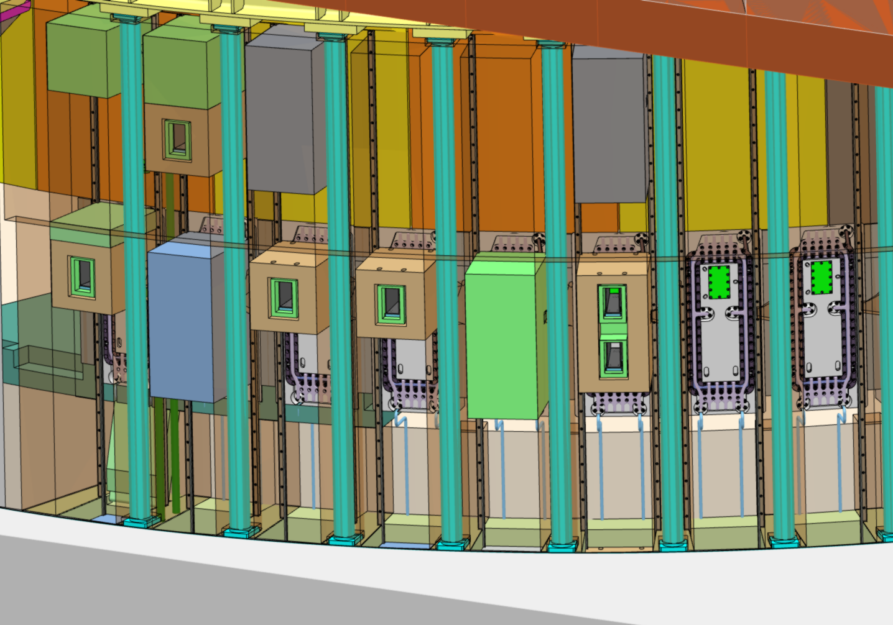
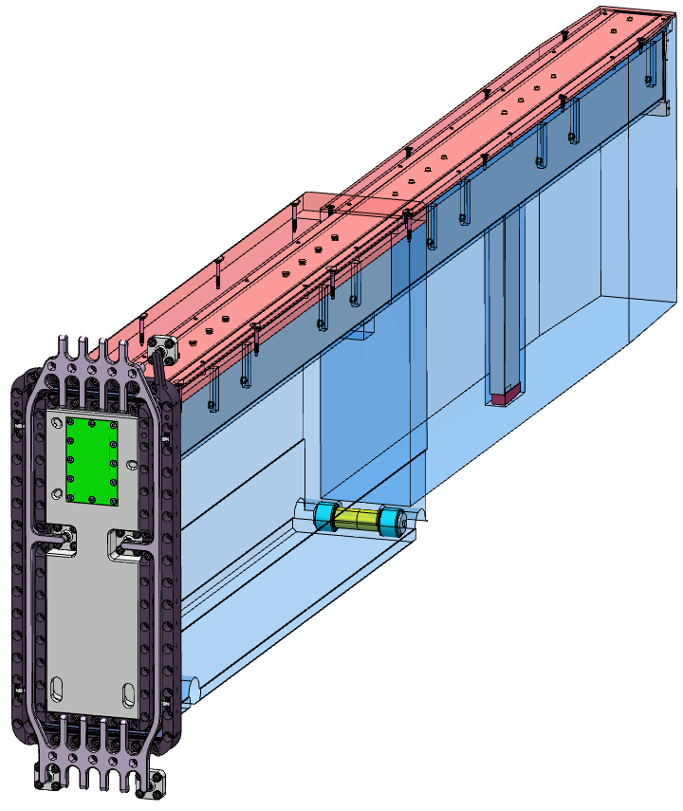
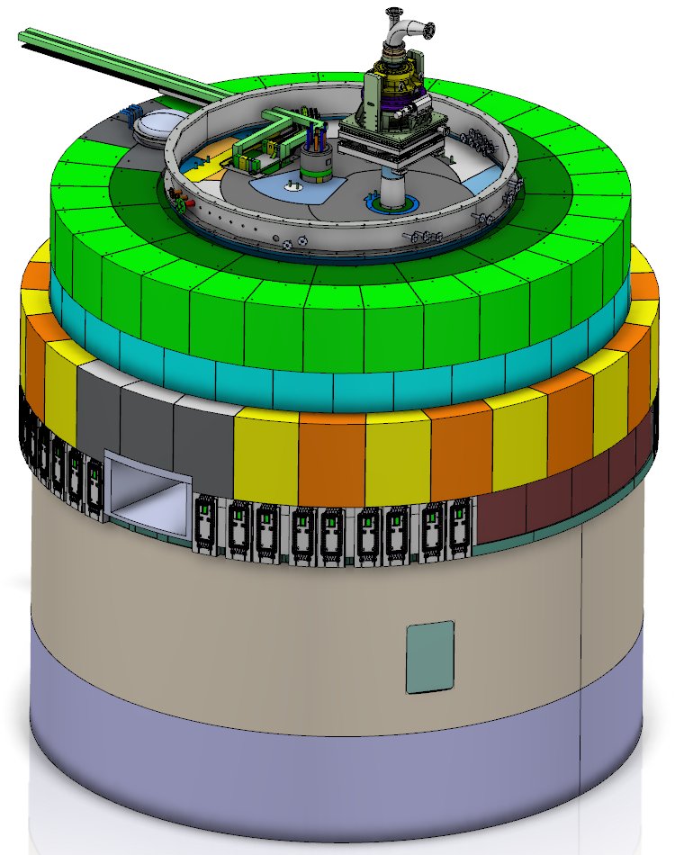
Significant progress on neutron beam extraction
Examples of possible configurations of light shutters
Handling tool
Shutter drive in basement
Neutron beam extraction system
  42 neutron beam ports, whereof
    39 normal modular beam ports
    3 beam ports within the superstructure of the nnbar port
  One fast neutron beam port for ESS chip irradiation (ECHIR) station
  Double decker neutron beam port inserts with capability to view either the upper or the lower moderators
  Light shutters with drive and handling mechanisms in the basement rooms
  Handling tool for neutron beam port inserts replacement
Neutron beam port insert
nnbar port
Neutron beam ports
ECHIR port

Slide 11
Stress analyses of the monolith vessel by ESS-Bilbao finds stresses well within allowables
Monolith vessel
under vacuum

Slide 12
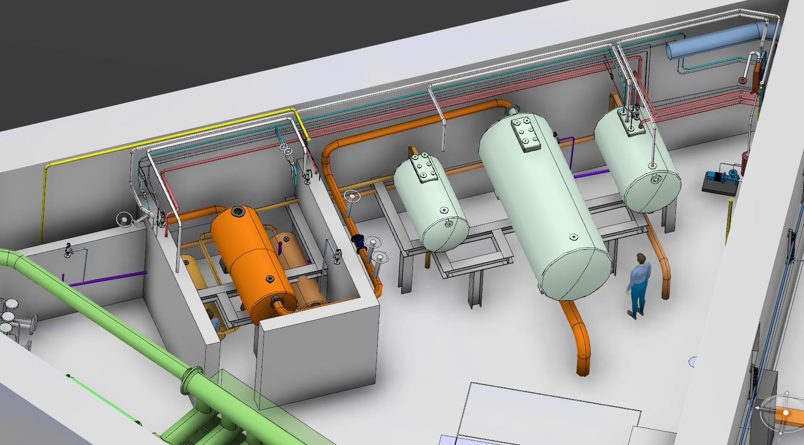
WP5: Fluid Systems
Updated the layout so that all primary water loop components are confined to the triangular utility rooms
Conducted 3 PDRs
  Water Purification System
  Water Drainage System
  Radiolysis Gas Treatment System
Working with IK partner’s (UJF)
contractor, Nuvia, to clarify the
scope of work and schedule for
the primary and intermediate
water systems, and Target HVAC
  Goal is to sign the Technical Annexes by the end of the month
Performed accident analyses for the Target HVAC and water systems in support of the design and PSAR
Utility Room Layout Level 110 Triangular Room
Delay tanks
Control Valves
GLS tanks

Slide 13
Updated Target HVAC P&IDs

Slide 14
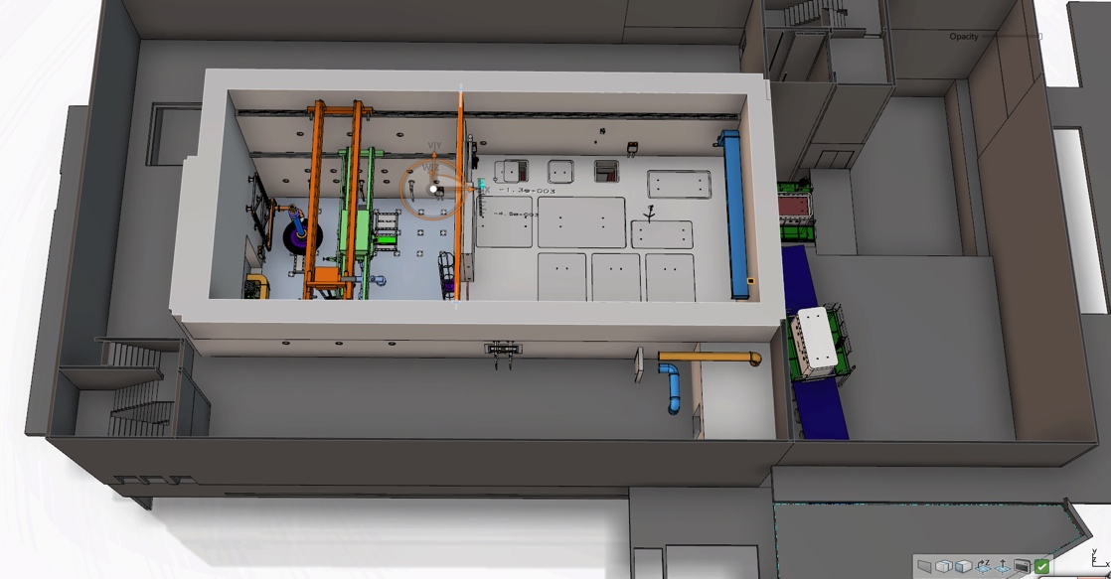
WP6: Remote Handling Systems
First Target Project procurements (concrete embedments) will be factory acceptance tested this month
Active Cells in-kind partner STFC/UKAEA held Kick-off meeting last month
  UKAEA staff participating in PDRs of components to be remotely handled
  UKAEA developing a Remote Handling Handbook
Accident scenarios analyzed to support the the design and PSAR
Conducted PDR on Active Cells Equipment & Handling
Storage Pits
Transfer Area
Shipment
Technical Galleries
Process Cell
Maintenance Cell

Slide 15
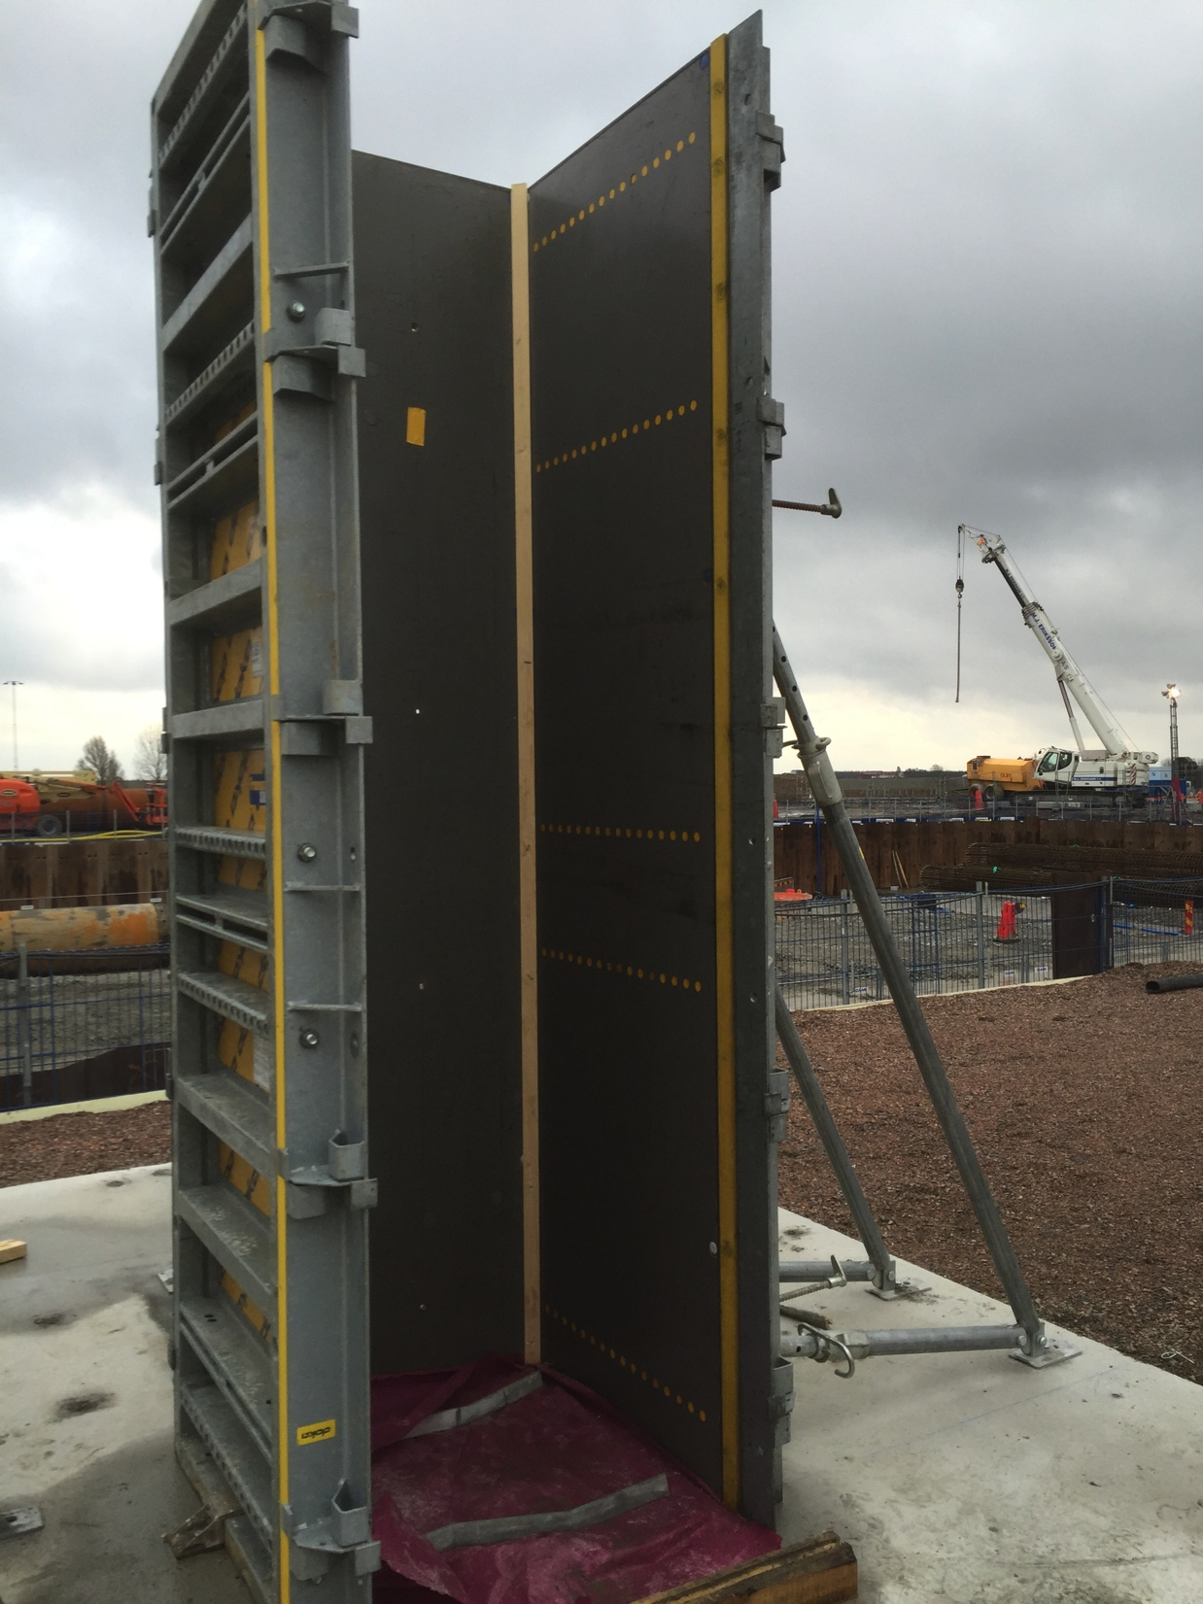
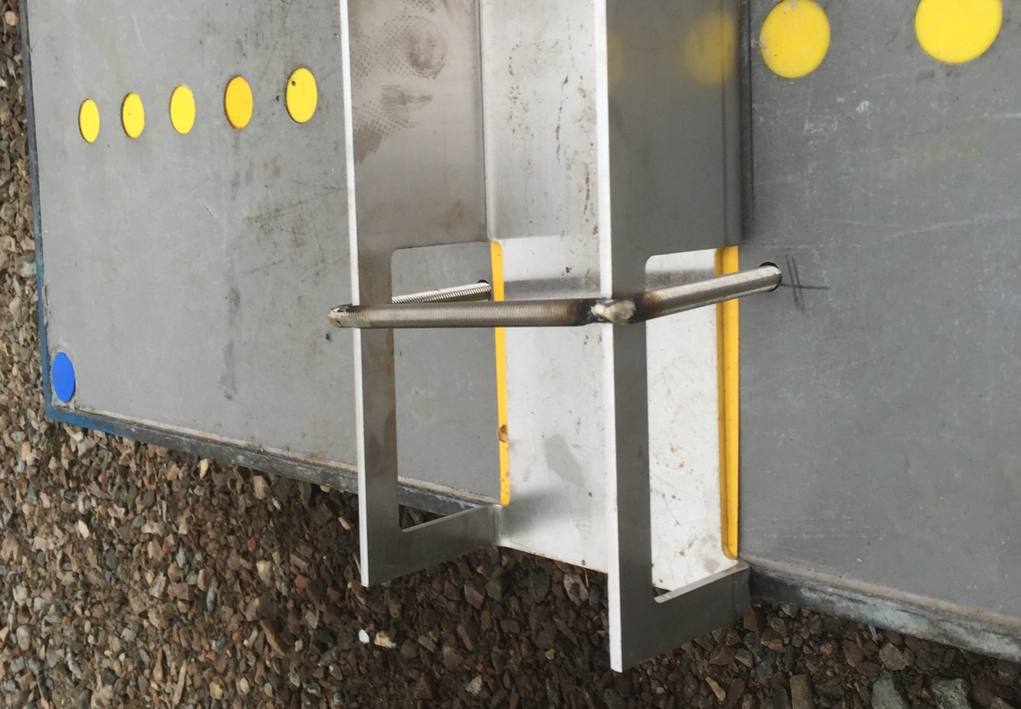
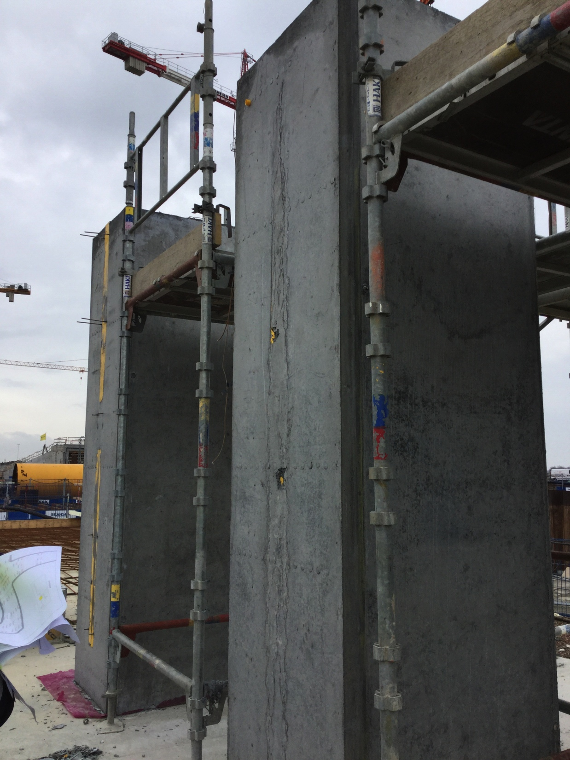
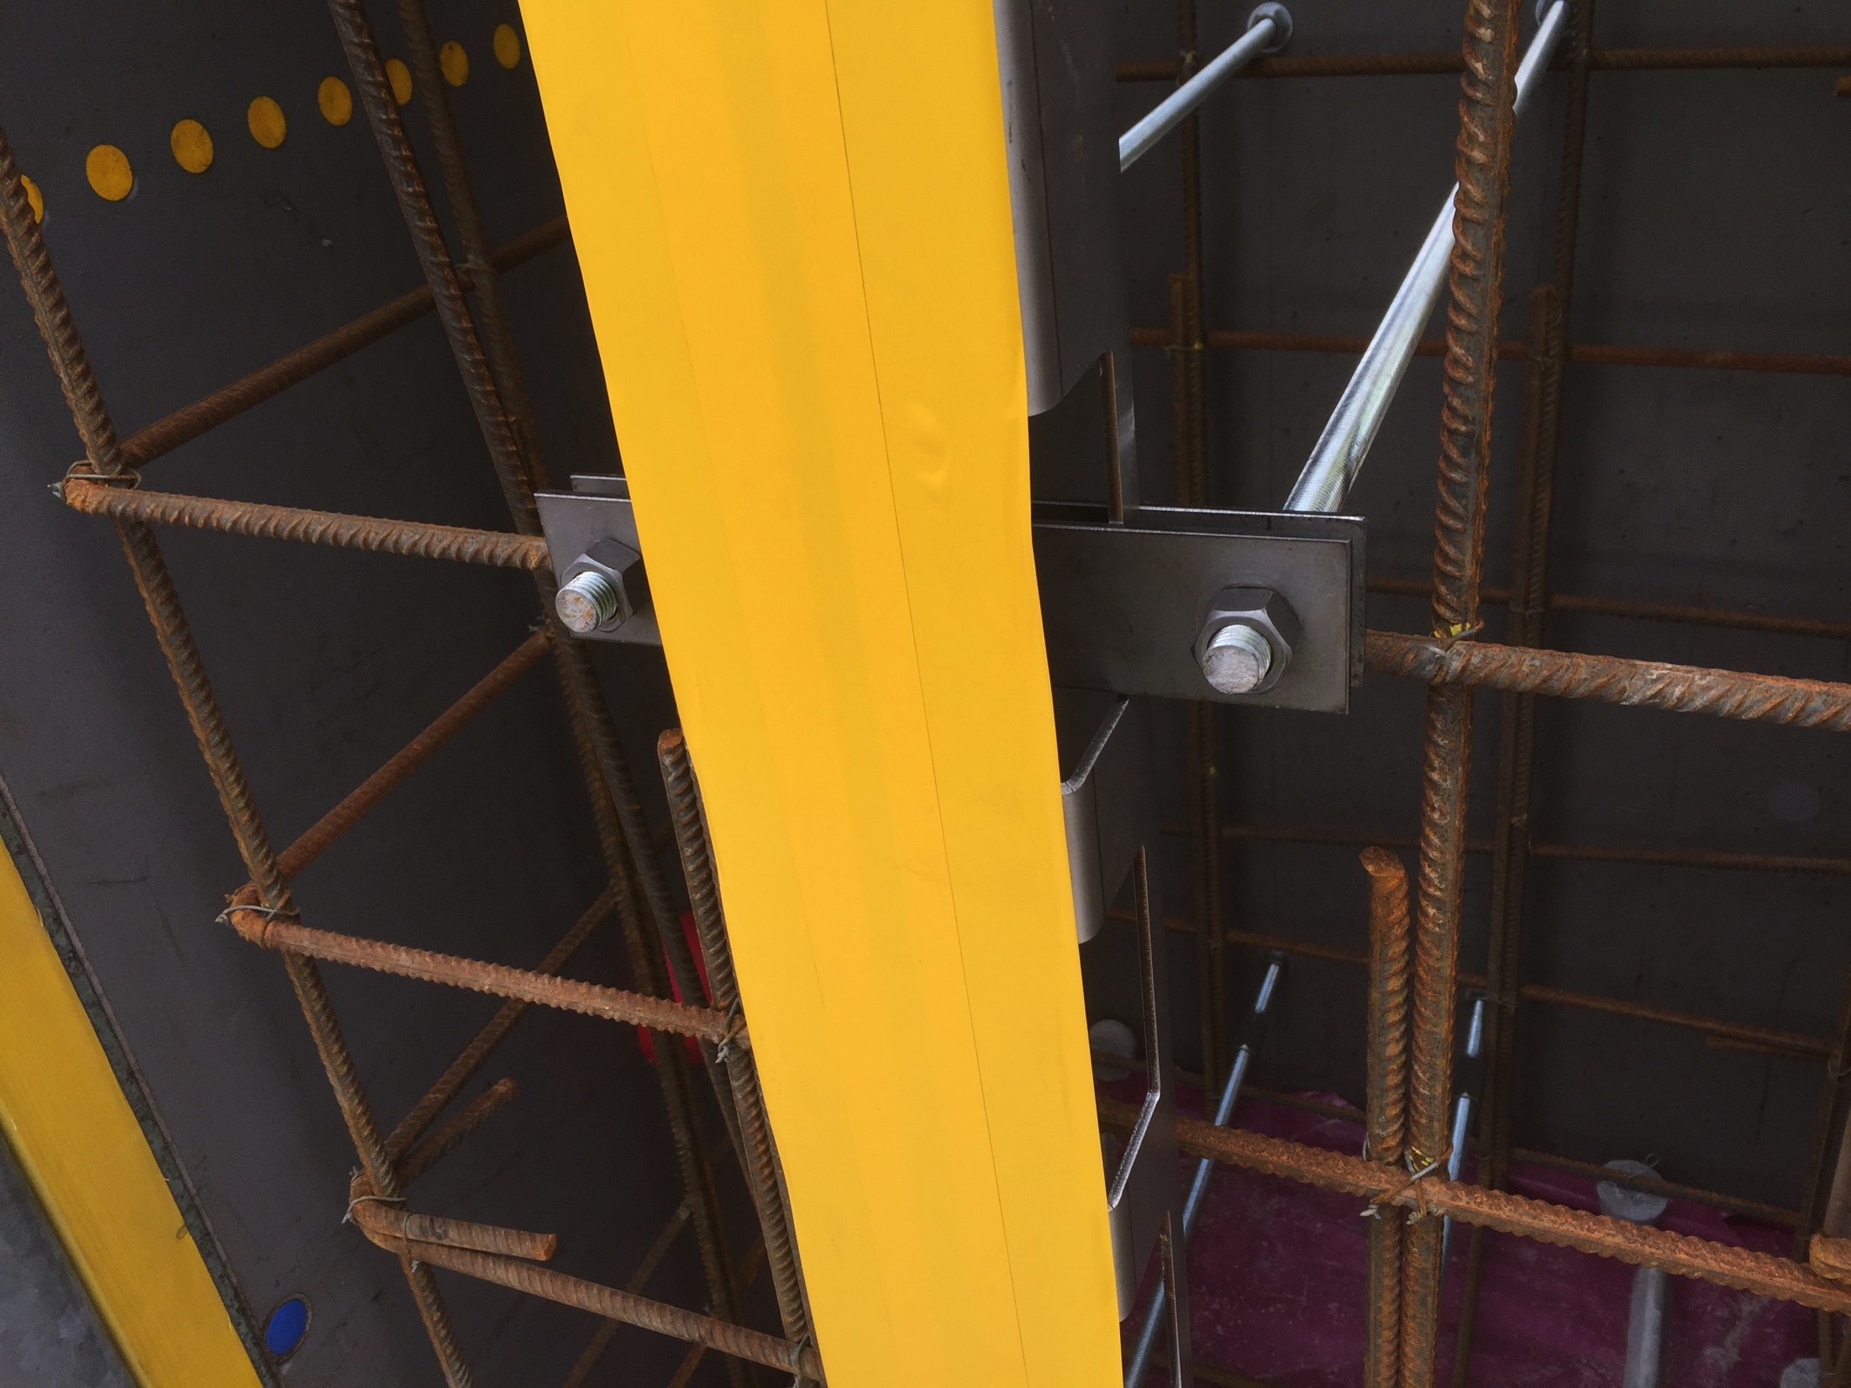
Testing options for fixing the Active Cells liner beams in concrete forms
U-bolt
yellow tape protects
surface from concrete
Good
Tension
Rods
Bad
Test Form
Options for Fixing Liner Beams
Test Pours
U-bolts work best so far, other options still to be tested.

Slide 16
WP7: Controls
Completed hazards analyses for all Target systems
Coordinated and guided the accident analyses included in the PSAR
Conducted PDR for Pilot Target Safety System in February
Constructed a test stand for Target Safety System component testing

Slide 17
Radiation Hazards Analysis and Safety Functions
Hazards analyses identified 350 events from which 21 were deemed “bounding”
Bounding events:
  8 events with abnormal heating of tungsten due to beam excursions or loss of cooling
  6 events associated with the Active Cells
  5 events associated with water leaks, hydrogen explosion or fire, chopper malfunction, and errant beam on tuning beam dump
  2 events associated with earthquake
Safety functions identified:
  Safety related SSCs
    Helium loop components
    Helium purification
    Utility room ventilation system
    Target drive unit and associated control system
    ...
  Safety SSCs
    Target Safety System: safety-class beam permit
    Personnel Safety System: personnel access control
    ...

Slide 18
WP8: Target Physics
Calculated radionuclide inventories in:
  Tungsten bricks and target shroud
  Beryllium reflector
  Helium coolant
  Moderator-reflector cooling water
Supported all work packages with shielding calculations
Measured rate of back conversion of para-to-ortho due to neutron irradiation at SNS
Applied for beam time at CERN ISOLDE to support measurement of tungsten release factors
Materials Handbook updated regularly
  Currently 140 pages covering 27 chapters

Slide 19
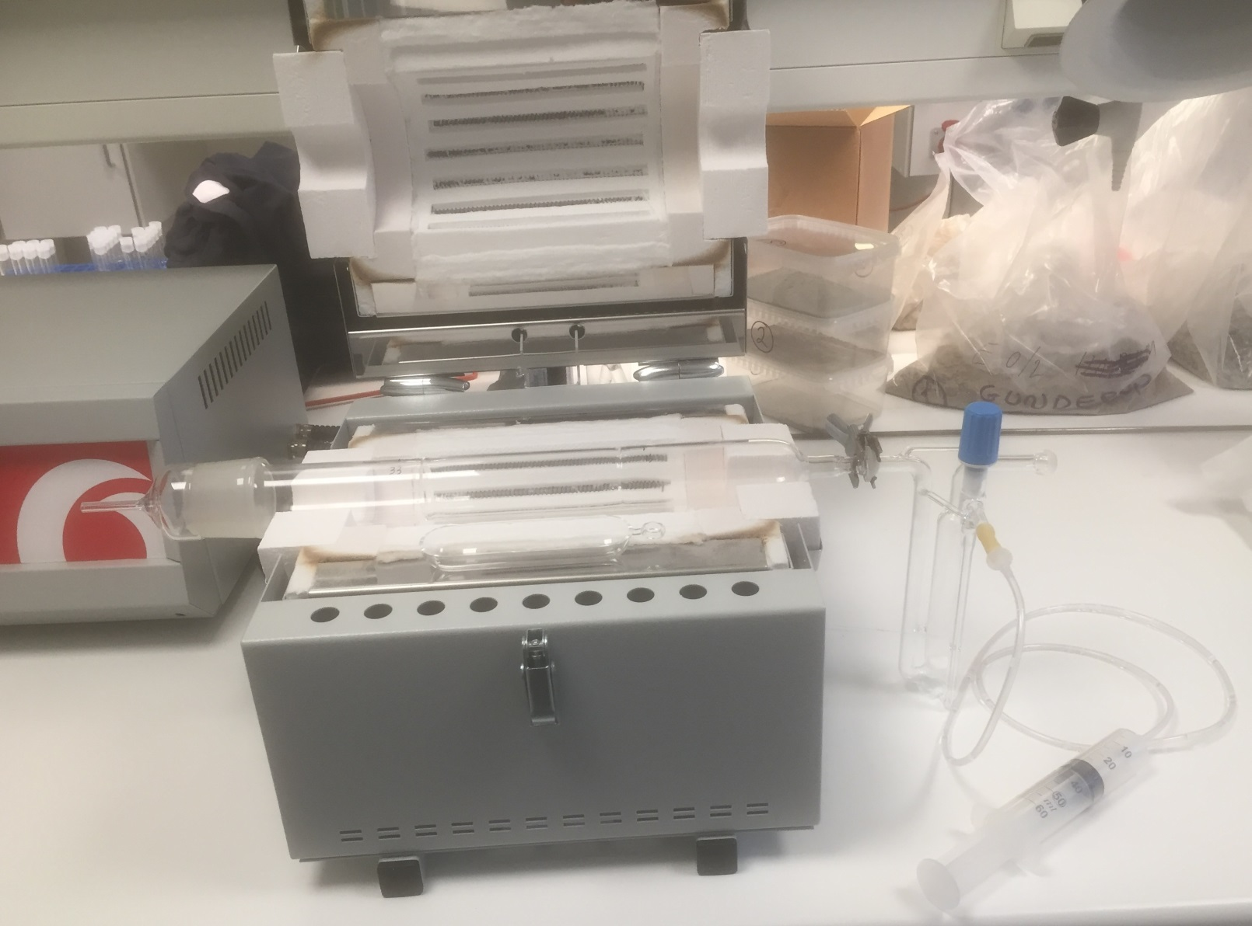
DTU’s setup for measuring release fraction of iodine and bromine at different temperatures
Apparatus capable of taking tungsten sample to 1000°C
Minimum detectable release fraction expected to be 2E-8
irradiated
tungsten

Slide 20
Target Schedule: Level 1 Milestones
2015
2016
2017
2018
2019
2020
Project Milestones
Target Project End
First Beam on Target
Design
PDR Monolith Shielding System
CDR Target Safety System
CDR Neutron Beam Extraction System
Procurement
Contract Awarded – Helium Cryoplant
Delivery on Site – Floor Embedments
Contract Awarded – Target Spallation Material
Ready for Installation – Bulk Shielding Below Base Plate
Delivery on Site – Cold Moderator Assembly
Delivery on site – Target Wheel
Delivery on site – Monolith Vessel
Installation
Installation Complete – Helium Cryoplant
Complete SAT – Monolith Vessel
Installation Complete – Liquid Hydrogen System
Commissioning
Integrated System Test (without proton beam) completed
Integrated System Test (with proton beam) completed

Slide 21
Summary of Target’s contribution to the 2nd ESS license application to SSM
General description of the target station systems
Hazards analysis summary
Summary of 7 bounding event analyses
Summary of all safety functions identified to date
Shielding and activation calculation procedures

Slide 22
Target Project Major In-kind
Target Project has 22
in-kind work elements
  TA or CA signed for 3 IKC packages
  Partner selected for 13 IKC packages
  2 IKC packages released but no partner interest
  Four IKC packages remain to be released
  “Last Call” dates set for all remaining packages

Slide 23
80% of Target’s 100M€ identified in-kind scope has been allocated to partners

Slide 24
Strategy for the six remaining Target Project IKC Packages
TIK.4.1: Target Monitoring Plug - 0.5 M€
  Serious interest expressed, partnering likely
  Will release for partnering in September 2016
TIK.4.7: Monolith Atmosphere System – 1.2 M€
  Released Mar 2015 but no interest from partners
  Undergoing revision due to evolution in the design
  Will be re-released in September 2016
TIK.4.8: Monolith Shielding Systems – 14.2 M€
  Released June 2015 but no interest from partners
  Breaking into several pieces and working to combine some with existing packages
  Remainder will be re-released for partnering in March 2016
TIK.5.4: Proton Beam Window Primary Cooling System – 0.6 M€
  Scope of work under revision due to evolution in the design of the PBW
  To be released in May 2016
TIK.6.2 & 6.7: Internal Casks and Handling Devices & Remote Handling Support – 4.6 M€
  Serious interest expressed, partnering likely
  Will release in July and October 2016 for partnering and expect positive outcome

Slide 25
Issues
Coordinating early access to the Target Building with Conventional Facilities is making it difficult to meet our high-level “Ready for Beam on Target” milestone
  Working with CF to achieve earlier “early access” dates
Mobilization of some of our in-kind partners has been slower than hoped
  Have self-performed or planning to self-perform some work originally slated for partners
Interfacing is proving challenging throughout ESS
  Hiring an Interface Coordinator dedicated to address this

Slide 26
Parallel Sessions - Target
Hazards and Accident Analyses
  L.Coney: Hazard Analysis and Safety Classification Process
  P.Nilsson: Bounding Event: Loss of dynamic confinement in
  Active Cells
  P.Nilsson: Bounding Event: Stopped Wheel
Target systems installation concurrent with completion
of civil construction is complex planning
  T.Lexholm: Installation Plan
Progress on Primary Water Systems design
  H.Carlsson: Design of Primary Water Systems
Proposal to operate the target in vacuum in lieu of helium
  R.Linander: Operating the Monolith Vessel in Vacuum

Slide 27
Summary
Significant progress in the technical design performed by in-kind partners and ESS Lund
Substantial effort devoted to performing nuclear safety assessments of target systems to support both the design and the 2nd license application to SSM

