Slide 1
Responses to Recommendations
from tTAC-12
Eric Pitcher
Head of Target Division
www.europeanspallationsource.se
7 April 2016

Slide 2
tTAC-12 Charge Item 1
Are the design approaches for the
  Target Wheel
  Moderator and Reflector Systems
  Remote Handling Systems
sensible and likely to meet system requirements?
Do they represent a reasonable balance between performance and other parameters, e.g. manufacturability, operability, maintainability, cost, and schedule?
Are plans for executing the work sound?

Slide 3
Recommendation: Consider interim storage of used targets prior to cutting to allow for cooldown and reduced radiation levels in the hot cell.
Response:
The design now has a bolted connection of the shaft to the wheel, which allows the shaft to be separated from the wheel without cutting, except for a small circumferential seal weld.
Once the shaft and wheel are separated, the wheel can then be stored for some years of cooldown prior to cutting it up.
The storage pits have the capacity to store up to six wheels.

Slide 4
Recommendation: The distance between moderator and target should be increased by ~ 10 mm. The reduction in neutron brightness of ~ 5% is not seen as critical, and reduction of high-energy background may be a benefit.
Response:
An increase of the gap by 8 mm has been approved by the Target Change Control Board and incorporated into the design.
This increase
is estimated
to reduce
the source
brightness
by 4%.
Old Baseline
New Baseline

Slide 5
Recommendation: Plan to design local shielding around the He filter system of the target and adapt handling procedures for remote operation.
Response:
The layout of the utility rooms will accommodate local shielding around He filters and components of the He purification system, and provisions for remotely maintaining filters will be incorporated into the design.

Slide 6
Recommendation: Seek an oil-free solution for the He blowers of the target cooling system.
Response:
A solution involving an oil-free blower is under consideration.
Vendor quotes for both oil-free and oil-based blowers have been received by our in-kind partner (UJF) that will be used to decide the best solution, considering cost and operational risk.

Slide 7
Recommendation: Advance the alignment philosophy to all parts of ESS, i.e. Conventional Facilities, Accelerator, Target and Neutron Instruments.
Response:
There is a central team within ESS Engineering, Integration and Support (EIS) Division that coordinates all survey and alignment of all parts of the facility.
That team will be increasingly involved as more systems enter the final design phase and as the installation procedures are defined.

Slide 8
Recommendation: Consider a backup target with alternative target material, e.g. tantalum or even Zircalloy.
Response:
There is no plan, and therefore no budget allocated, for a backup target as part of construction.
A backup target is planned as part of initial operations, with budget identified in 2019. Within the plan for a backup target we will investigate the cost associated with fabricating a full complement of cassettes containing alternative target material, and make an informed decision based on assessed risk, cost, and available budget.

Slide 9
Recommendation: Proceed with the reflector option which rotates as a single block.
Response:
The reflector now rotates as a single block.

Slide 10
Recommendation: Reconsider placing the cold-box close to the cryogenic moderator cryostat.
Response:
A change in the location of the helium cryoplant at this stage will cause significant schedule delay and have re-design costs that exceed any savings from shorter cryogenic transfer lines.

Slide 11
Recommendation: Consider high-power beam halo and beam impingement on target system structures (Twister).
Response:
Structures and components surrounding or next to the beam path within the monolith will be actively cooled.
Preliminary analyses show the power deposited in these components is manageable.

Slide 12
Recommendation: The margin between the design and operating pressure of the hydrogen moderator system is close. Consider increasing the margin to reduce operation excursions.
Response:
Changed operational pressure has been considered and will potentially be implemented. A proposal for operating at lower pressure is now being evaluated.

Slide 13
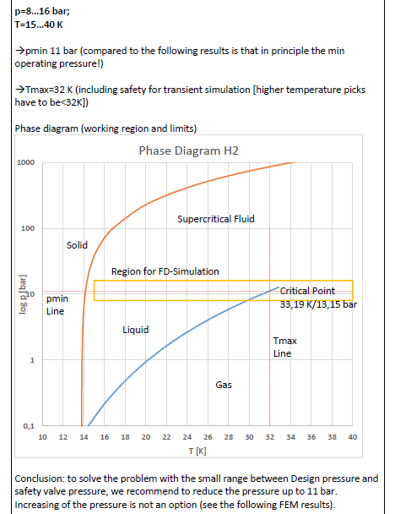
Study of changed operating pressure in the Cryogenic Moderator System
Requirements for the PDR design
P_{min}: 13bar
P_{max}: 17bar
P_{op}: 15bar
Aim is to be above supercritcal pressure at all time
The margin between design and operating pressure in the CMS is narrow and will potentially be very hard to maintain
Lower operational pressure has been analyzed.
The moderator design do not allow a higher operational pressure: the only way to increase the range is to lower P_{op}.
New proposed requirements
P_{min}: 7*bar
P_{max}: 17bar
P_{op}: 10bar
*When the beam trips, the pressure drops for a couple of seconds until the expansion vessel responds and regain pressure.
Ref: Interim report ESS cold moderators design, Y.Bessler 2015-12

Slide 14
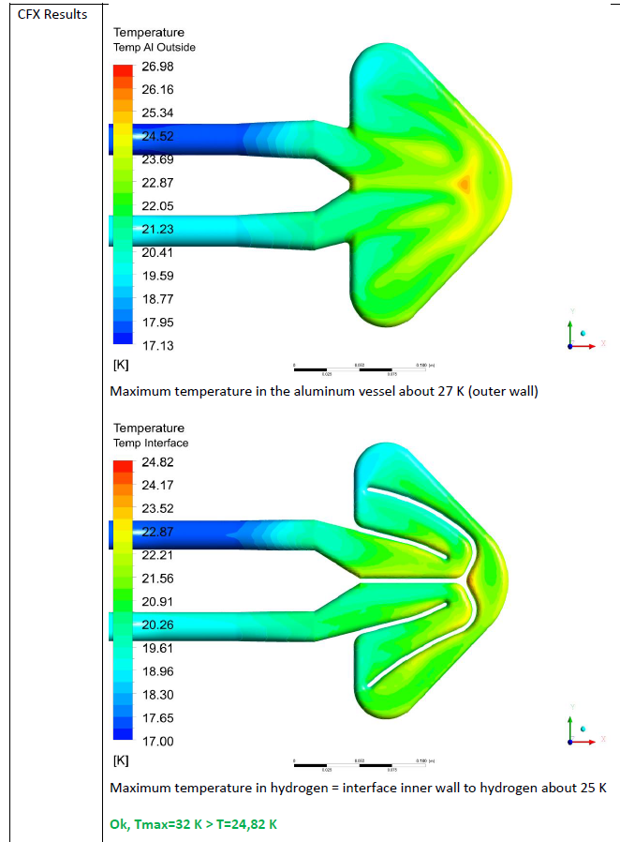
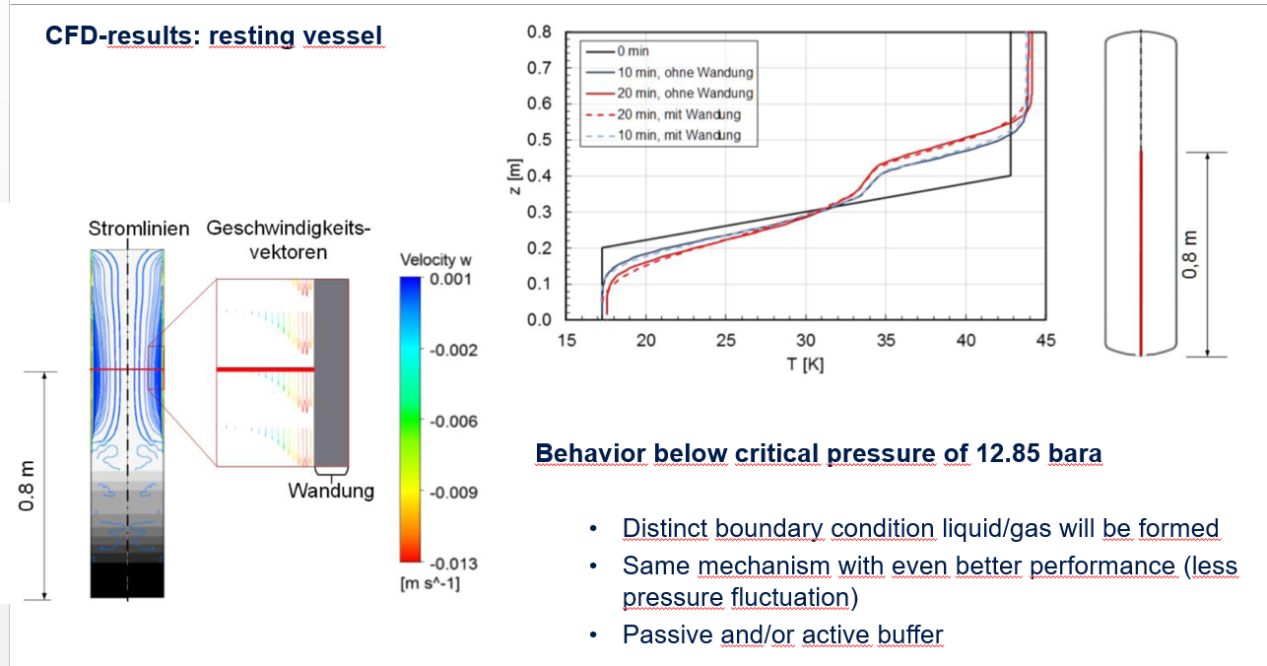
Study of changed operating pressure in the Cryogenic Moderator System
The hydrogen will always be in a liquid phase. @7bar the boiling temperature is 29.154K
Calculations made to verify that the temperature stays within boundary, below 25K at all time.
Simulation of the expansion buffer shows better performance below supercritical pressure
Pressure drop and heat capacity will not be significantly affected
During cool down the pressure will be kept at >13bar to avoid phase changes
The proposed pressure reduction is feasible according to our studies.
Ref: Interim report ESS cold moderators design, Y.Bessler 2015-12

Slide 15
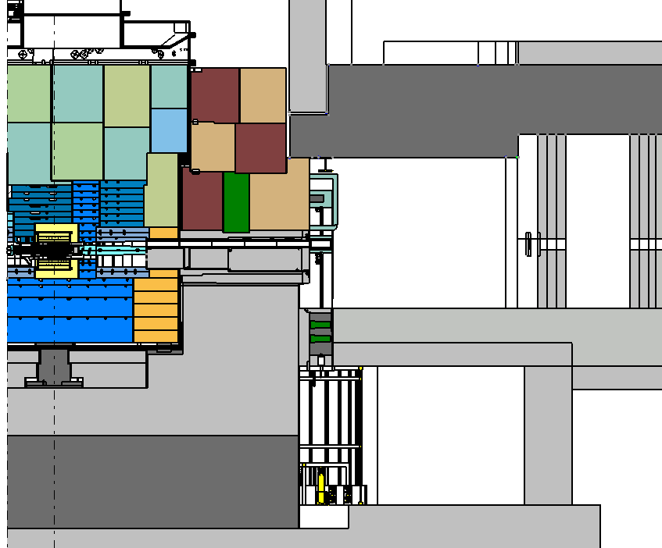
Recommendation: Responsibility for the design of the shielding interface between the monolith and bunker (the "CF" block ) needs to be defined.
Response:
The ESS Technical Coordinators have been leading a Bunker Task Force that has addressed this interface and proposed a solution.
Concrete curtain
stops farther up
and bunker roof
steel now extends
to monolith steel.
Previous Design
Only concrete is
leakage path for
high-E neutrons.
New Design

Slide 16
Recommendation: Maintenance and installation operations in the bunker need to be defined in detail to assess the issues of the high dose rates and possible contamination.
Response:
Target Division is cooperating with the Instrument Technologies Division from the Science Directorate to define the requirements and proposed design solutions associated with the installation and replacement of in-monolith equipment that need to be accessed from the bunker areas.
The plan is to present a detailed integrated installation and maintenance scheme for the bunker and basement areas, jointly between Target Division and the relevant divisions within the Science Directorate, by mid 2016.

Slide 17
tTAC-12 Charge Item 2
Are the initial accident analyses cases presented at the meeting being evaluated using a sound approach and are reasonable and appropriate safety mitigation measures being properly identified?

Slide 18
Recommendation: The date for evaluation of the 21 bounding events is May 2016. It is recommended to contact the Regulatory Authorities at an early stage to validate the proposed procedures for accident analysis.
Response:
ESS met with the Regulatory Authority (SSM) to present our interpretation of the safety assessment process described in the conditions associated with the SSM construction permit. SSM did not object to our interpretation.

Slide 19
Recommendation: Preparation of the risk analysis for handling, transporting and disposal of radioactive equipment needs to be started. Radionuclide inventories and expected dose rates are required.
Response:
A number of workshops have been held with the aim of describing the maintenance of the monolith components. The outcome will be used for a risk analysis for the handling around the monolith. A consultant with lifting/hoisting expertise will be engaged to help out with this risk analysis.
In terms of disposal, off site shipment is the responsibility of the waste management within the ES&H division.
Expected end-of-life radionuclide inventories and dose rates for several components (target wheel, MR plug, neutron beamline plugs, etc.) have been calculated and are being used to develop procedures for handling spent components.

Slide 20
Recommendation: Other working groups (accelerators, instruments, etc.) should define additional accident scenarios to be considered. Safety coordination across the different groups is critical.
Response:
Staff from interfacing systems participate in our hazards analyses.
One example is off-normal proton beam, which can be an initiator for overheating the target. For this event, Accelerator staff identify what off-normal beams might exist and estimate their associated probabilities.

Slide 21
Recommendation: Output of the safety study could impact system & component design and dimensioning. At the next TAC a credible set of source terms, release fractions & dose monitoring plans should be presented.
Response:
We will present outcomes of our bounding event analyses, including the list of safety functions that are credited with reducing event probability or mitigating event consequences.

Slide 22
tTAC-11 Charge Item 3
Is progress in identifying design requirements and development of the design approach for the safety-credited active control system (TSS) likely to lead to a highly reliable system for protecting workers and the public during the postulated reference events (stopped wheel and loss of cooling)?

Slide 23
Recommendation: Safety-credited software is difficult to realize. Consider hard-wiring Target Safety System without a PLC in the line.
Response:
In the Pilot TSS design we now have one train with a PLC in the line and another with a relay system.

Slide 24
Recommendation: Consider another shut-down measure in addition to the ion source.
Response:
We are considering the RFQ as an alternative shutdown mechanism for the proton beam. Specifics of the TSS interface with this system have not yet been defined.
We may also consider some type of physical beam stop which would be a much longer time scale method.

Slide 25
Recommendation: Consider the requirements for the security of the Target Safety System.
Response:
The TSS group is participating in an internal ESS workshop to work toward a common ESS computer security awareness and strategy.
Additionally, Target staff are participating in the assessment of the Target Station’s vulnerability to the Design Basis Threat, which may impose security requirements on the TSS.

