Slide 1
Bounding Event: Stopped Wheel
Per Nilsson, CFD Specialist
and
Kristoffer Sjögreen, Mechanical Engineer
www.europeanspallationsource.se
April, 2016

Slide 2
Outline
Background and systems
Unmitigated Scenarios
Mitigations –> Safety Functions

Slide 3
Previous tTAC:
AA1. Wheel Stop With Beam
Physical case investigated up to event, i.e. mitigated
Result: Maximum 4 pulses ( ~ 0.28 s)
New results
7 pulses (0.5s) to failure
- Further investigations

Slide 4
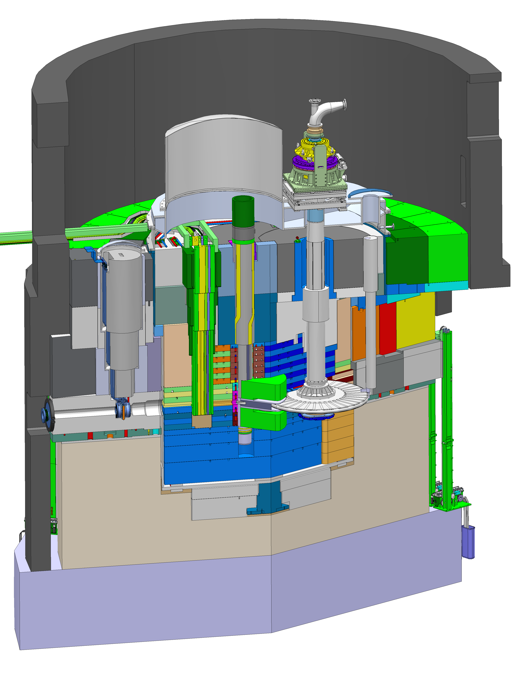

Slide 5
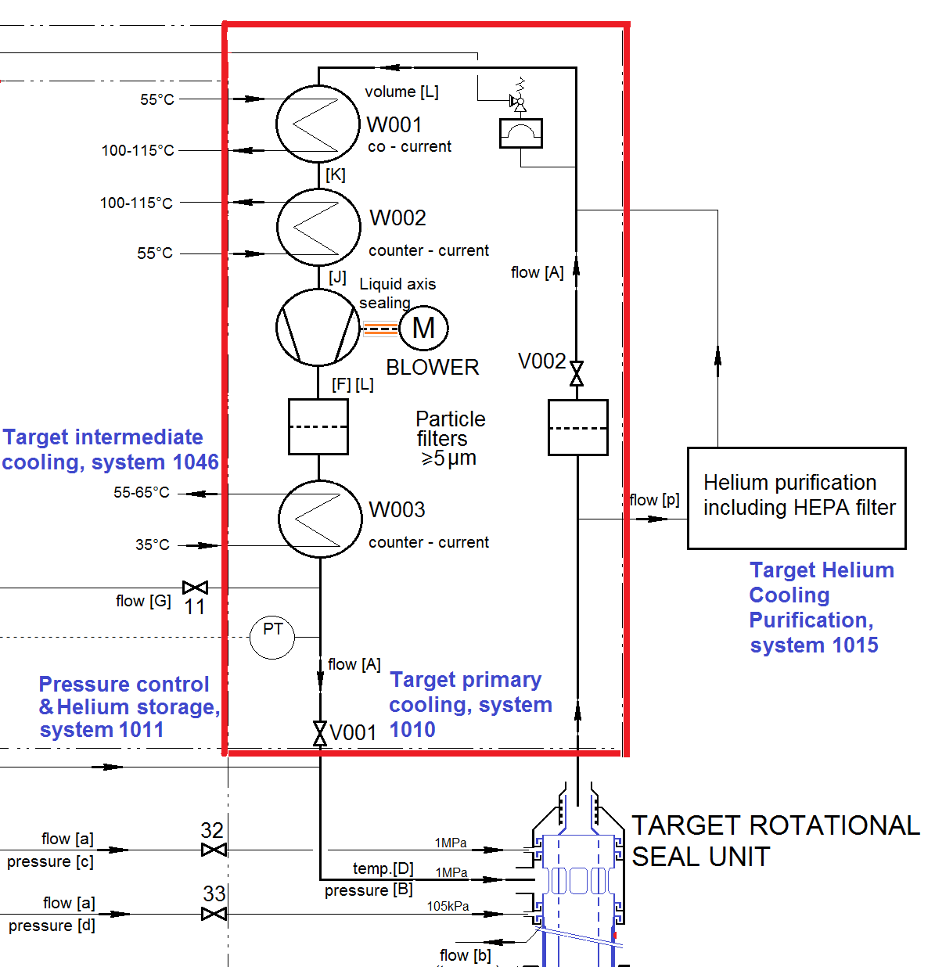
Cooling system

Slide 6
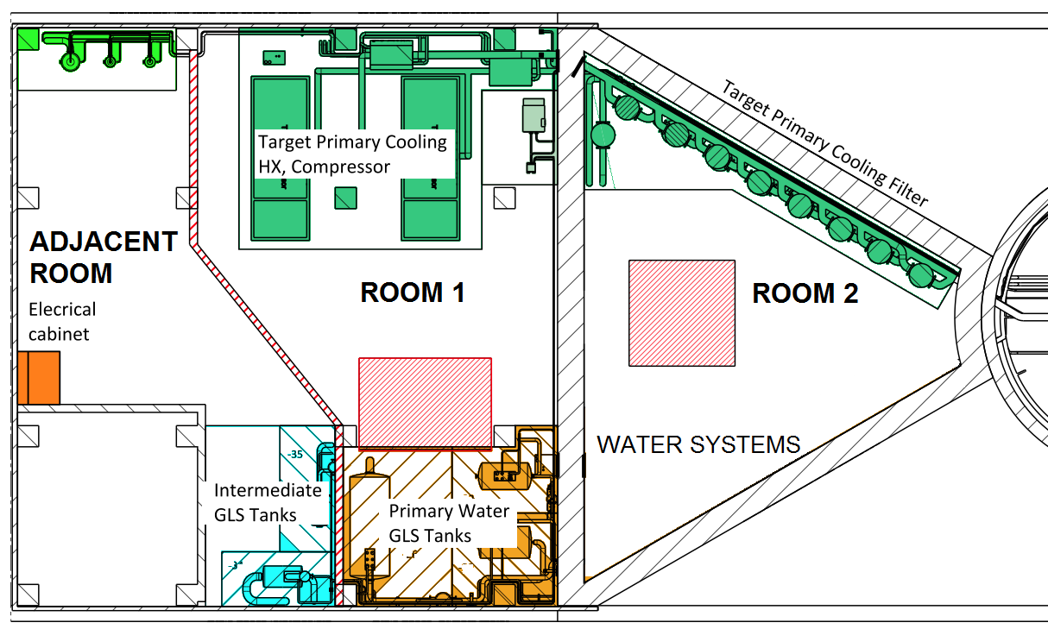
Filters and location

Slide 7
Unmitigated scenarios

Slide 8
Unmitigated Scenarios
Normal
Operation
Leakage Paths
Flow to
Accelerator
Wheel
Stops
Flow to
Workers
Monolith
Pressurized
Proton BW
Break
Flow to Bunker
and Instr. Halls
Unbearable
Thermal Load
Flow to
Public
Neutron BW
Break
Flow to Bunker
and Conn. Cell
Shroud
Opens
Material At Risk,
Damage Ratio
Air Enters
Hot Wheel
Moderator
Breaks
Water
Vaporization
Steam Enters
Hot Wheel
Tungsten
Oxid. / Vapor
Helium + Filter Dust Released
8

Slide 9
Doses
Worker dose in 4h:
Gas + He-filter inv. 7 Sv
(Gas w/o filter inv.) (0.14 Sv)
Tungsten 1352 Sv
Public:
Gas + He-filter inv. 0.3 mSv
Stack w/o HVAC filters
H2 limits:
Rad. Worker 20 mSv Public 0.1 mSv
Unacceptable!

Slide 10
Mitigations – Safety functions

Slide 11
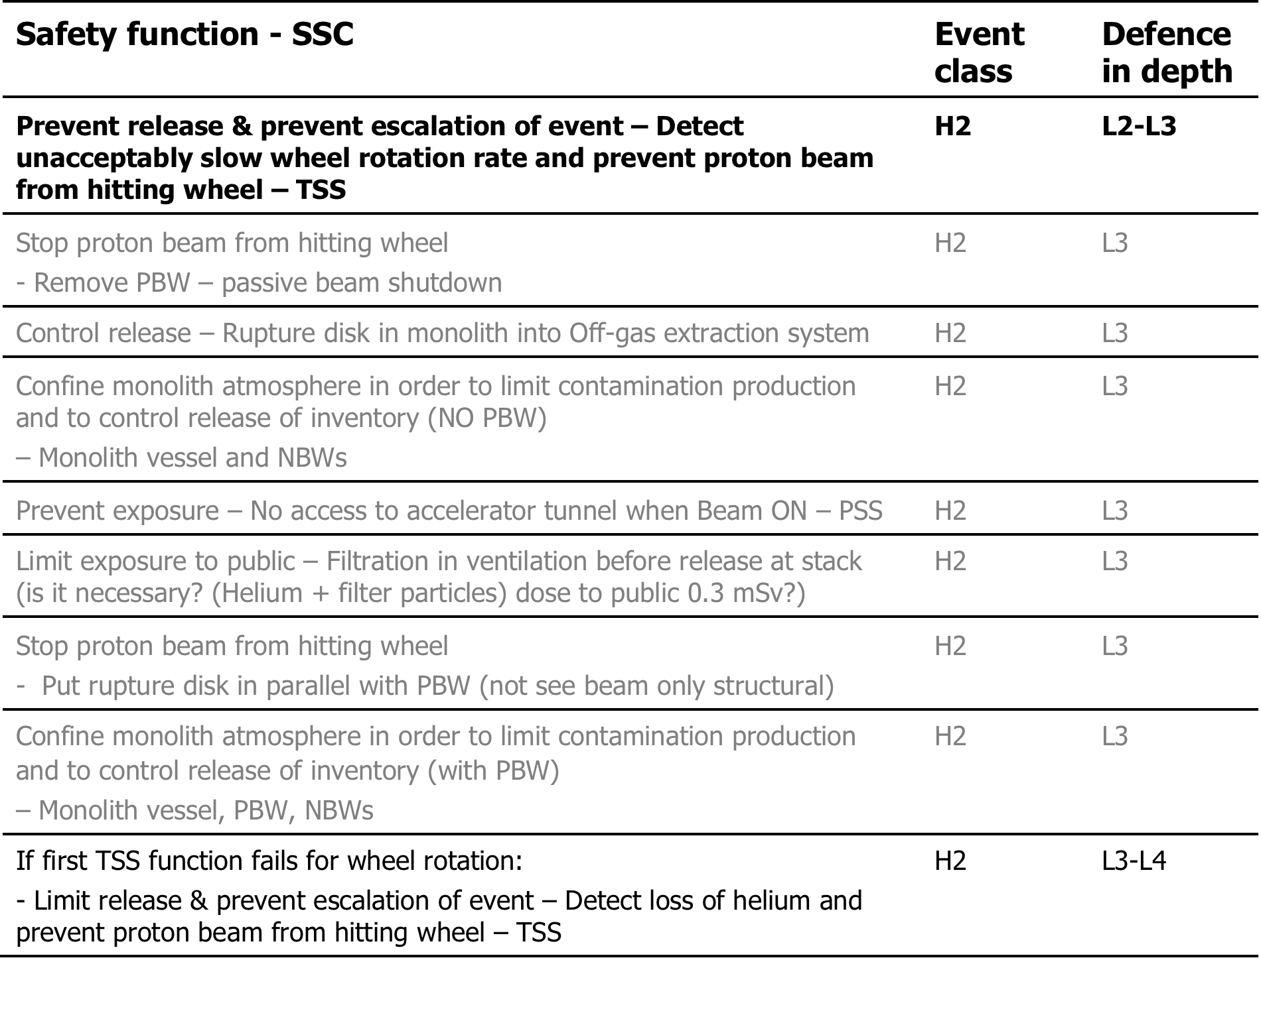
Safety functions, one chosen,many options

Slide 12
Mitigated Scenarios
Normal
Operation
Leakage Paths
Flow to
Accelerator
Wheel
Stops
Flow to
Public
Monolith
Pressurized
Proton BW
Break
Flow to Bunker
and Instr. Halls
Unbearable
Thermal Load
Flow to
Workers
Neutron BW
Break
Flow to Bunker
and Conn. Cell
Shroud
Opens
Material At Risk,
Damage Ratio
Air Enters
Hot Wheel
Moderator
Breaks
Water
Vaporization
Steam Enters
Hot Wheel
Tungsten
Oxid. / Vapor
Helium + Filter Dust Released
12

Slide 13
Additional mitigations
Normal
Operation
Controlled
Filtered Relief
Leakage Paths
Flow to
Accelerator
Wheel
Stops
Flow to
Public
Monolith
Pressurized
Proton BW
Break
Flow to Bunker
and Instr. Halls
Unbearable
Thermal Load
Flow to
Workers
Neutron BW
Break
Flow to Bunker
and Conn. Cell
Shroud
Opens
Material At Risk,
Damage Ratio
Air Enters
Hot Wheel
Moderator
Breaks
Water
Vaporization
Steam Enters
Hot Wheel
Tungsten
Oxid. / Vapor
Helium + Filter Dust Released
13

Slide 14
Safety Functions
Stop beam (TSS, based on rotation)
-> Sufficient on one level (2) of defence in depth
Monolith confinement + Controlled filtered monolith pressure relief
Limited personnel access (PSS)
-> Safety functions, used for other events too
Prevent filter backflow
Passive beam stop (removed PBW – vacuum)
-> Considered, not required yet
Stop beam (TSS, based on monolith pressure)
-> Considered, likely required for level 3 in defence in depth

