Slide 1
Target Station Heating Ventilation Air Conditioning System Bounding Event: Loss of Dynamic Confinement in the Active Cell
Per Nilsson, CFD specialist
Andrea Polato, WU Leader, TS HVAC
www.europeanspallationsource.se
6 april 2016

Slide 2
Introduction

Slide 3
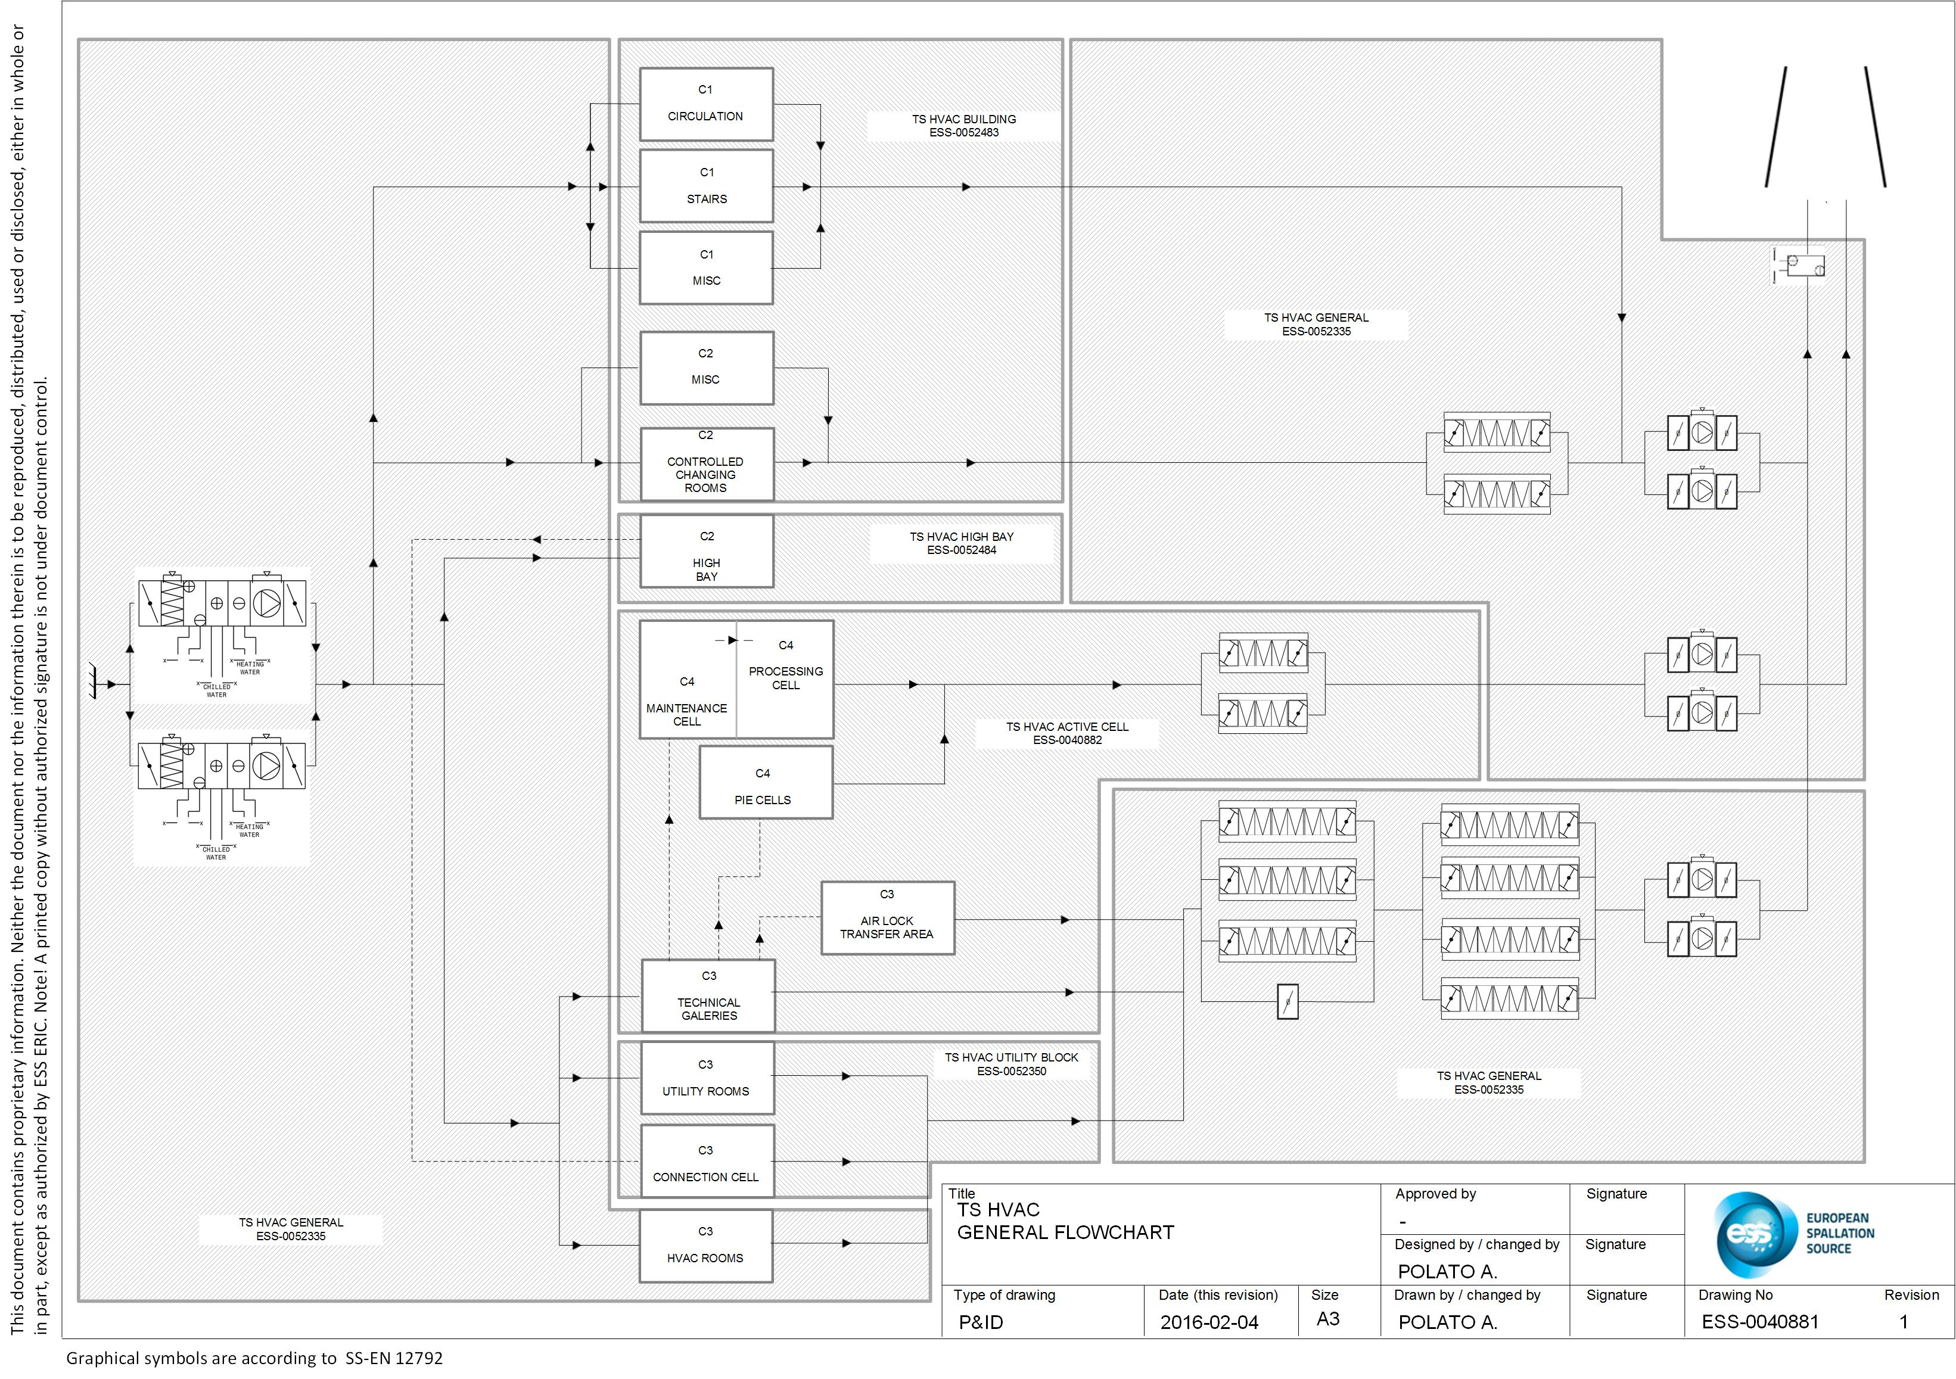
Introduction
3
3

Slide 4
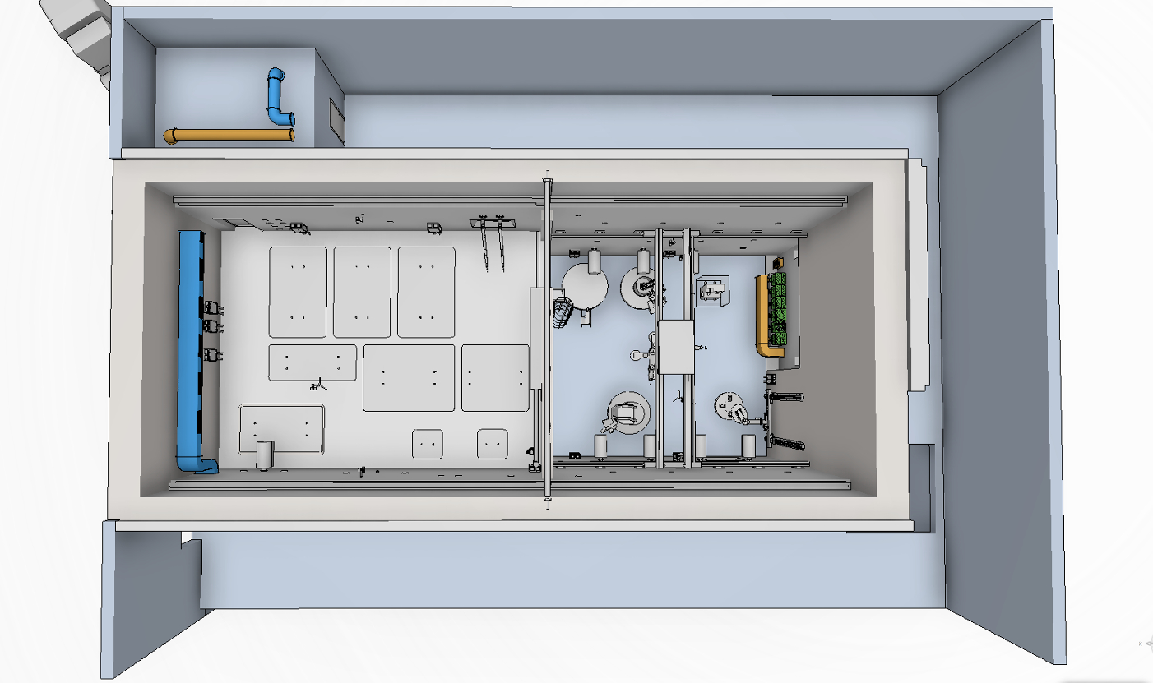
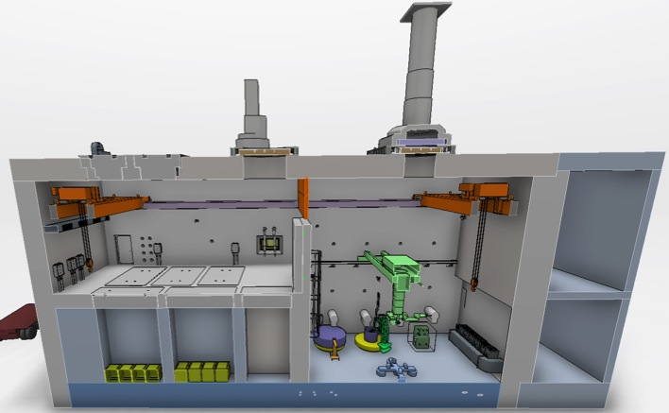
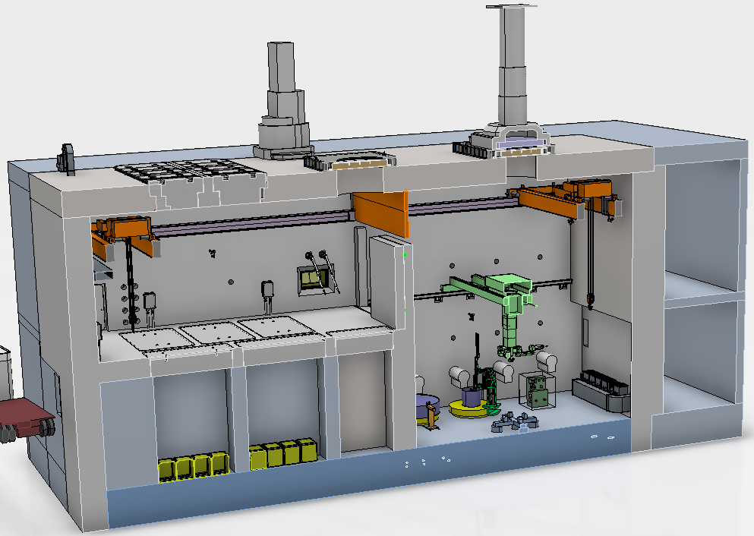
Active Cell
Maintenance Cell
Process
Cell
OPERATIONAL GROUP
SAFETY FUNCTION
From target dismantling operations:
Dusts + gases
⬇
AIRBORNE CONTAMINATION
Active Cell structure
Confinement of the contamination
Active Cell HVAC
4
4

Slide 5
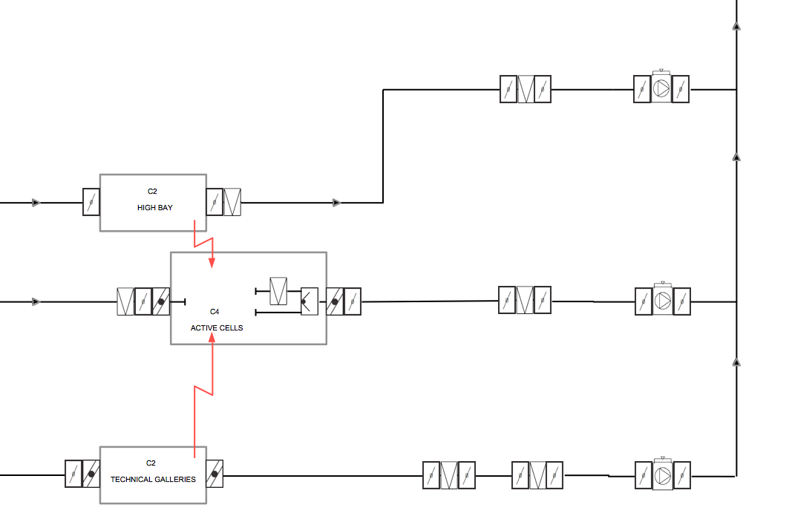
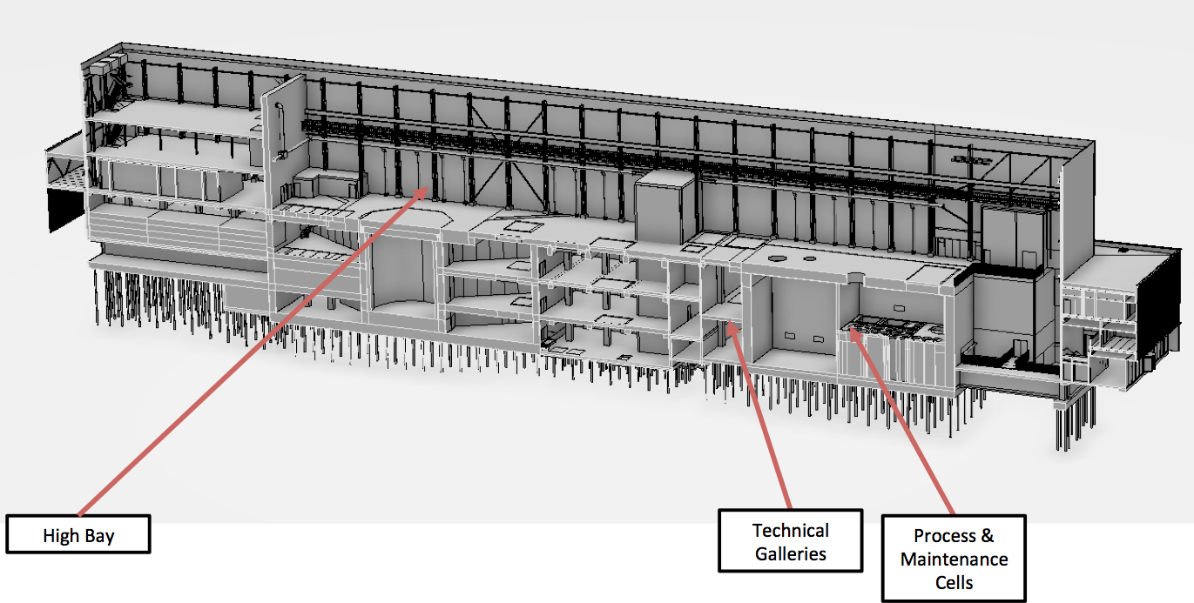
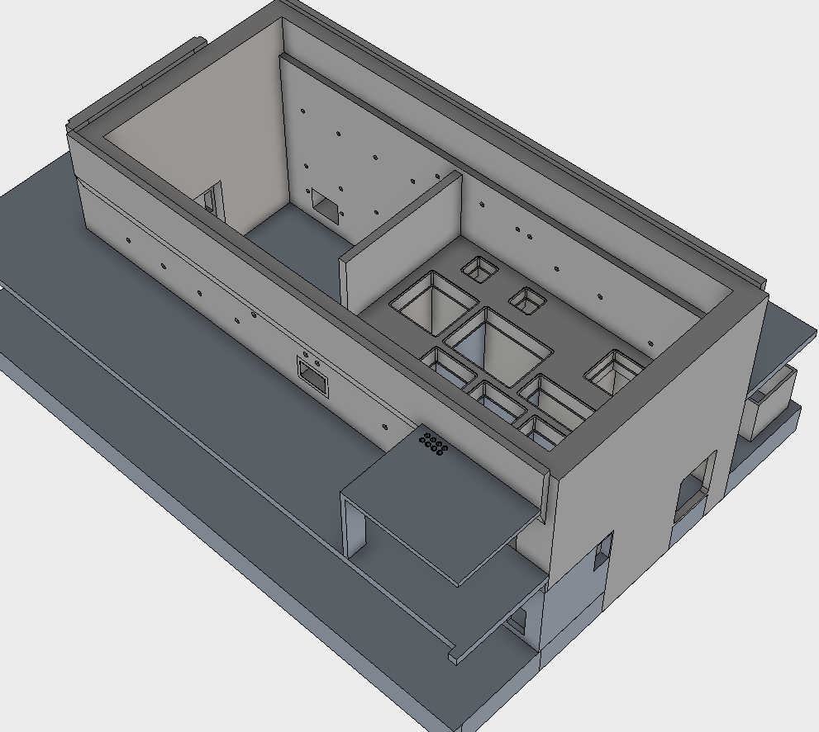
Active Cell and Adjacent Rooms

Slide 6
Accident Description

Slide 7
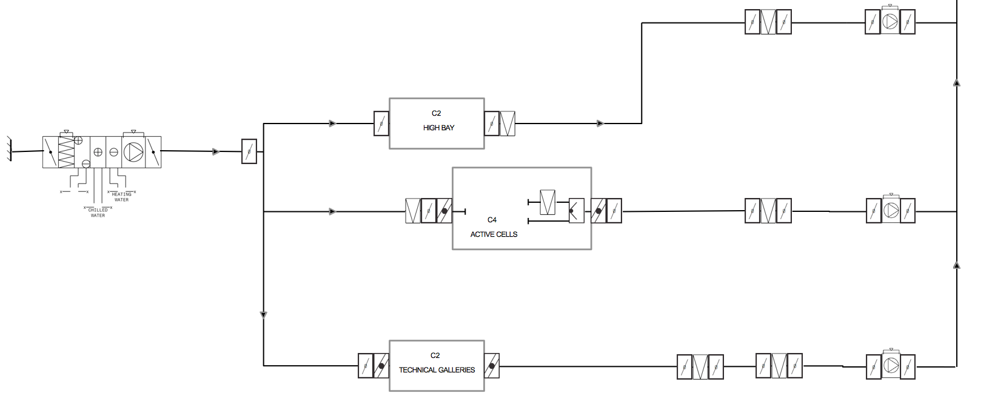
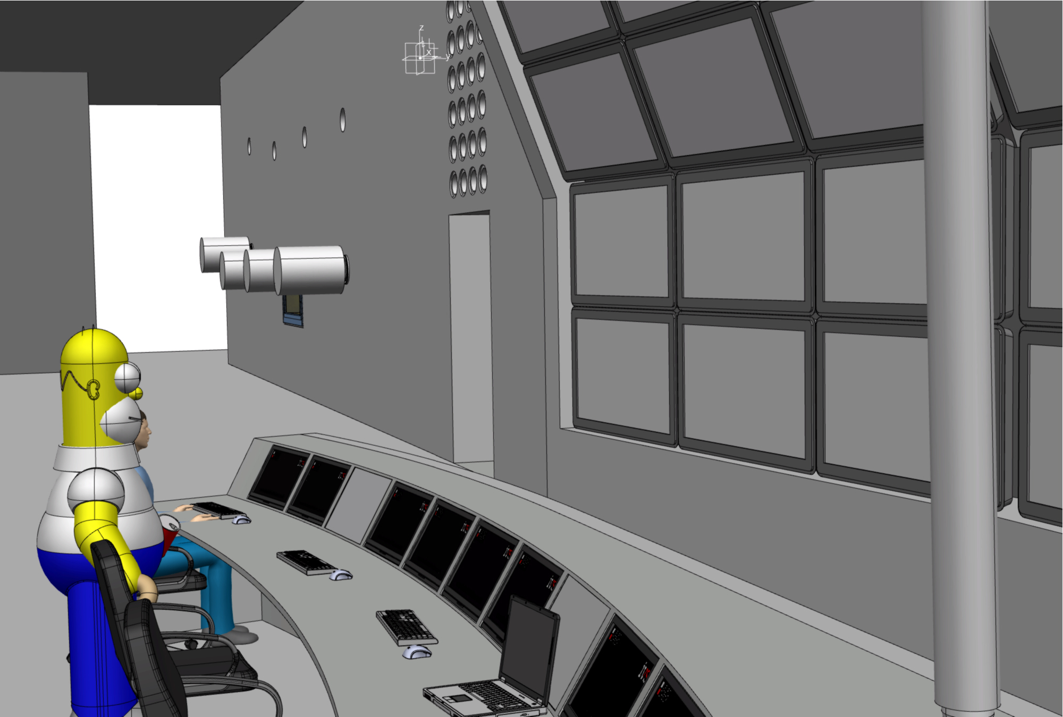
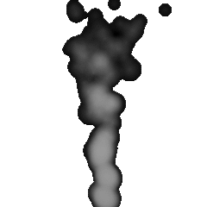
Accident Description
Target dismantling ongoing
Active Cell HVAC OFF
Pressure inversion
Dose to operators
7

Slide 8
Accident Probability

Slide 9
Accident Probability
Postulated initiating events occurrence
Target wheel Dismantling operations occurrence
Every 5 years
For a total duration of 3 months
total
9

Slide 10
Radiological inventory & Release fraction from the source

Slide 11
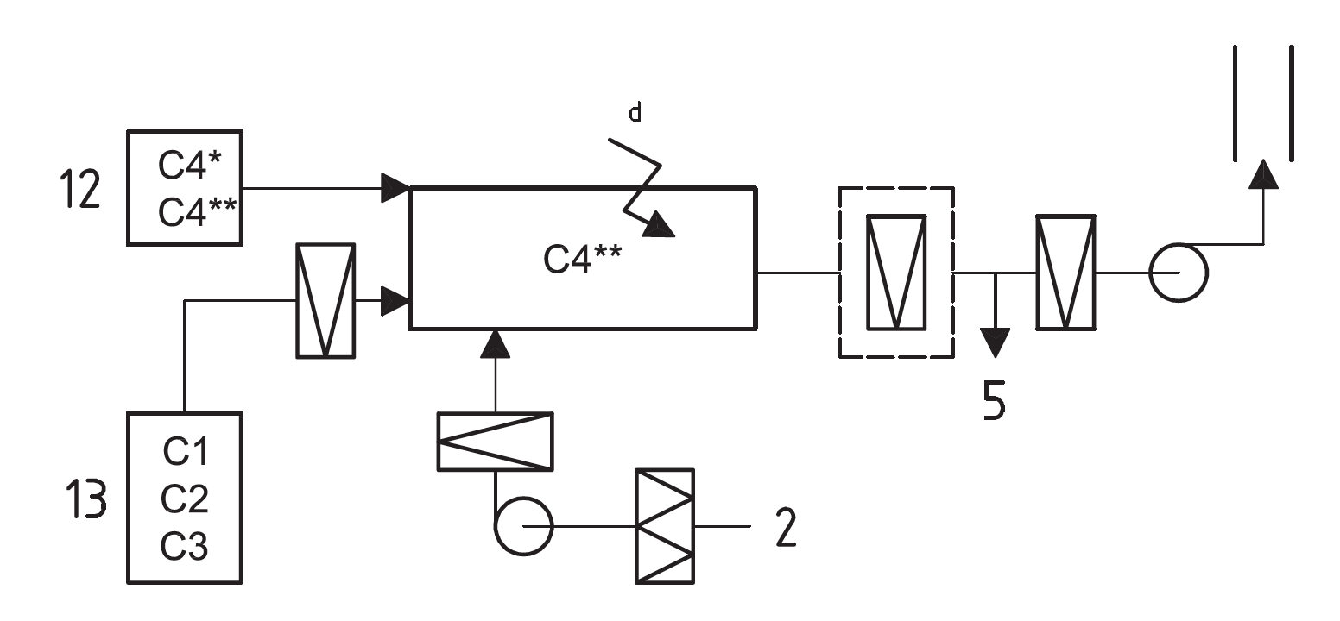
Radiological Inventory
Airborne contamination
inside the Active Cell
Release fraction from the source
Preliminary classification according to ISO 17873:
8000 DAC
Design value for the Active Cell’s Leak rate:
9 m³/h
=
2.55x10⁻³ vol/h
11

Slide 12
Radiological Inventory
Airborne contamination
inside the Active Cell
DETAILED EVALUATIONS ONGOING
DETAILED EVALUATIONS OGOING
12

Slide 13
Unmitigated accident

Slide 14
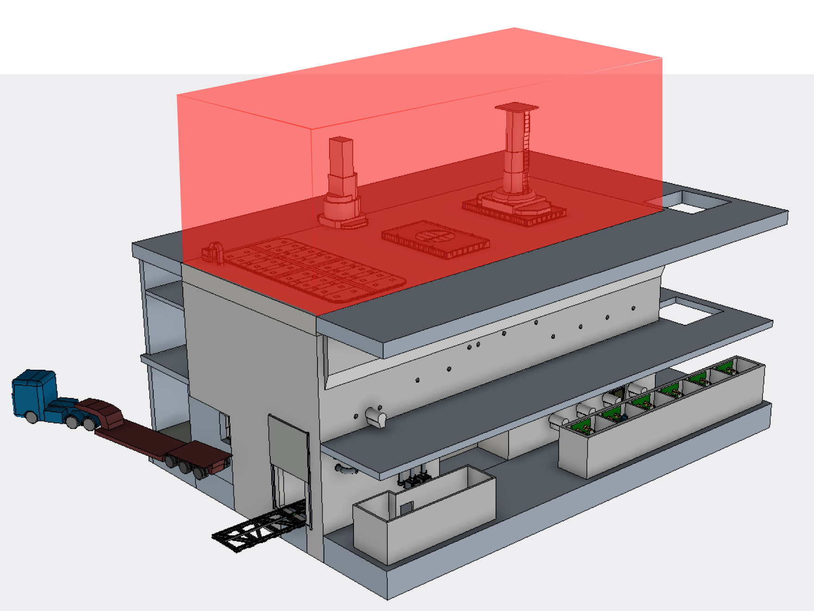
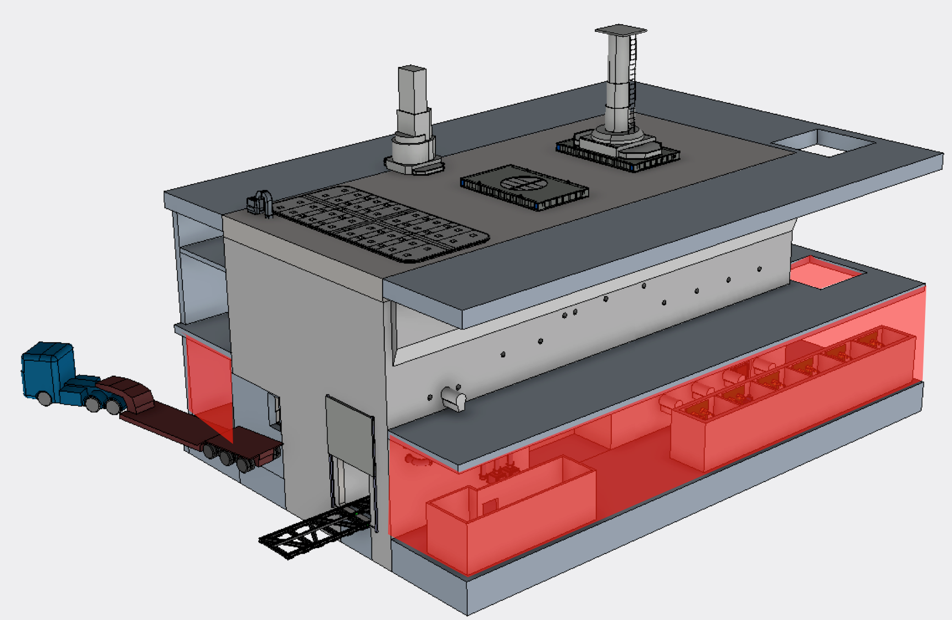
Unmitigated scenario
No detection of the HVAC stop
Worker stays in the control volume for half a shift
9000 m³
3300 m³

Slide 15
Unmitigated scenario
Severity (mSv) Probability | 0-1 | 1-10 | 10-20 | 20 to ≤ 50 | 50-100 | >100
H1
H2
H3
H4
H5
MITIGATION MEASURES NECESSARY

Slide 16
Mitigated Accident

Slide 17
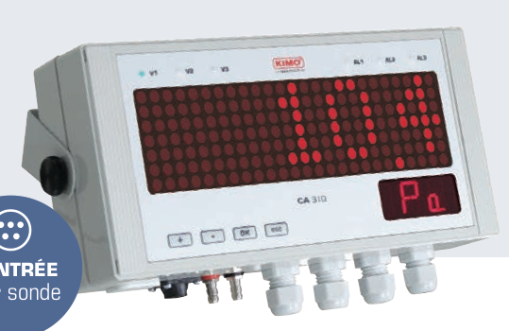
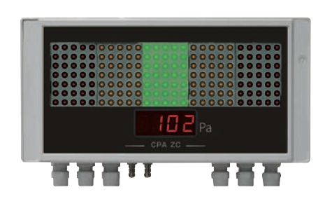
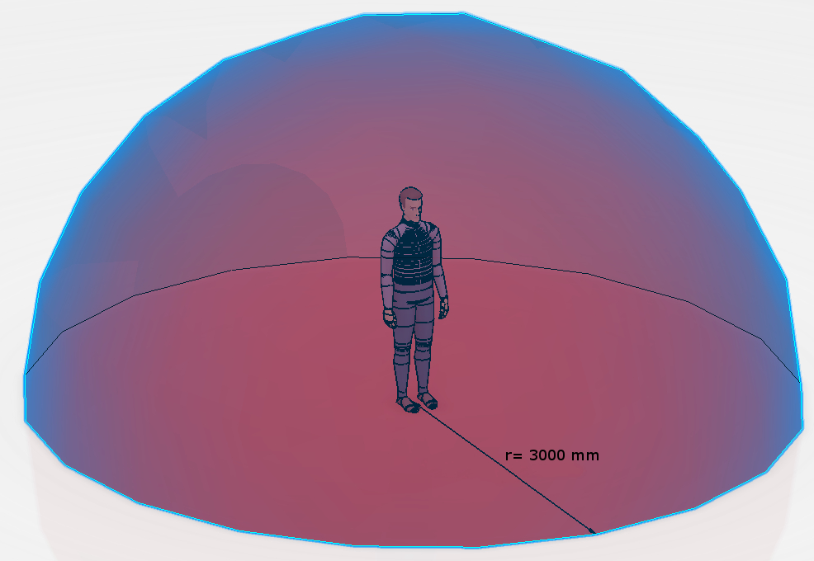
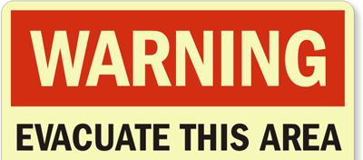
Unmitigated scenario
Mitigation measure
Dynamic confinement monitor
At the alarm reception worker leaves the space
Limited permanence of the operator in the areas
Alarm signal
Evacuation procedures
Reduced control volume:
Control volume located next to the active cell wall;
Operator remaining in the control volume for the given time;

Slide 18
Unmitigated scenario
Severity (mSv) Probability | 0-1 | 1-10 | 10-20 | 20 to ≤ 50 | 50-100 | >100
H1
H2
H3
H4
H5
RISK MITIGATED

Slide 19
Conclusions

Slide 20
Conclusions
During normal operations the confinement of the contamination is ensured by:
Active Cell Structure
Active Cell HVAC
In case of HVAC stop (off normal operations) the and no mitigation are foreseen:
Consequences for operators are NOT ACCEPTABLE
Mitigation:
Monitoring ( example: differential pressure monitor)
alarm
evacuation procedures
Limit to the exposure time ➔ limit to the dose received
Consequences for operators are ACCEPTABLE
Operational Group
Safety Group

