Slide 1
INSTALLATION Target Division
Tobias Lexholm
Installation Coordinator, Target Division
www.europeanspallationsource.se
March 2016

Slide 2
Installation Work Package 2 - 7
WP 2 – Target Systems (XXXX hours)
Target Wheel
Target Drive Unit
Target Cooling system (Helium)
Etc.
WP 3 – Moderator and Reflector Systems (XXXX hours)
Moderator and Reflector
Cryogenic system
Etc.
WP 4 – Monolith Systems (XXXX hours)
Monolith Vessel
Proton Beam Window
Inner/outer shielding
Neutron Extraction System
Etc.
WP 5 – Fluid Systems (38 000 hours on site)
Primary water cooling
Intermediate water cooling
HVAC
Radiolysis system
Off-Gas System
Proton Beam Window cooling
Active Drainage System
Water Purification System
Etc.
WP 6 – Remote Handling System (20 000 hours on site)
Active Cells
Remote Handling
Mock-up
WP 7 – Target safety Systems (6 000 hours on site)
TSS
Etc.
Notes:
WP2, Target wheel and Drive + Cooling
WP3,

Slide 3
WP 5 - Fluid Systems, Overview
HVAC
Primary Cooling
Intermediate Cooling

Slide 4
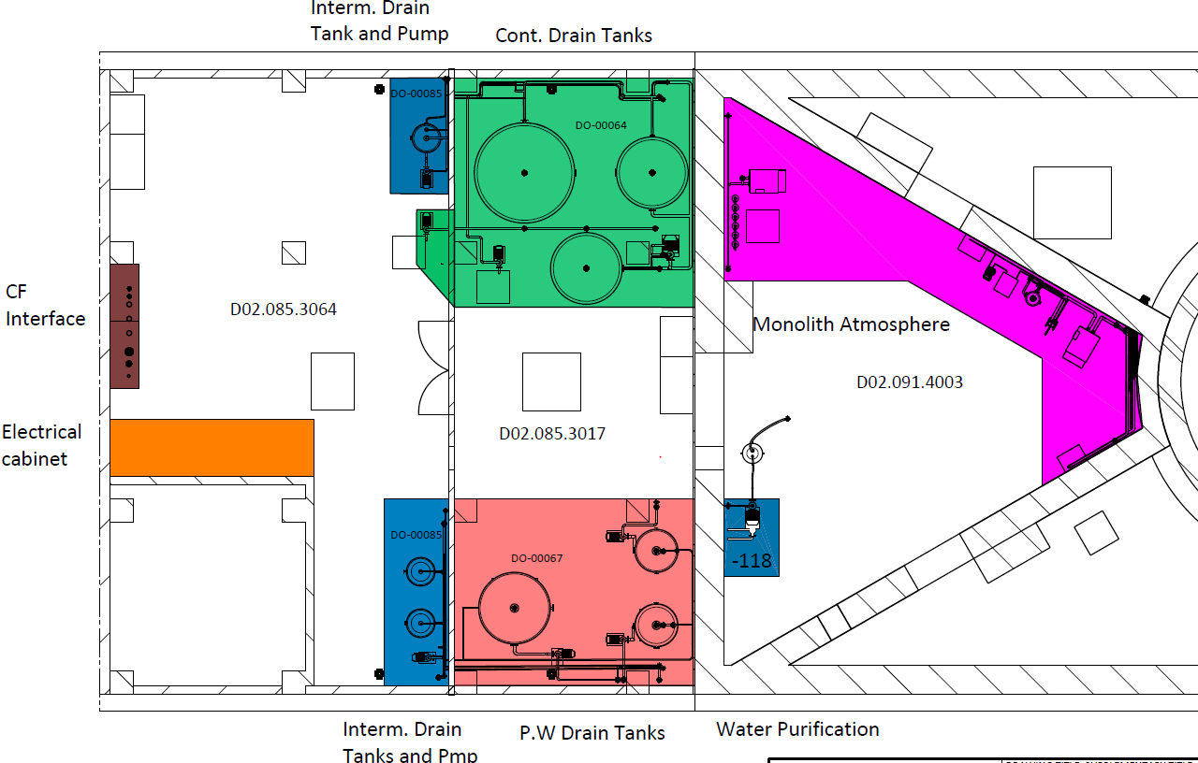
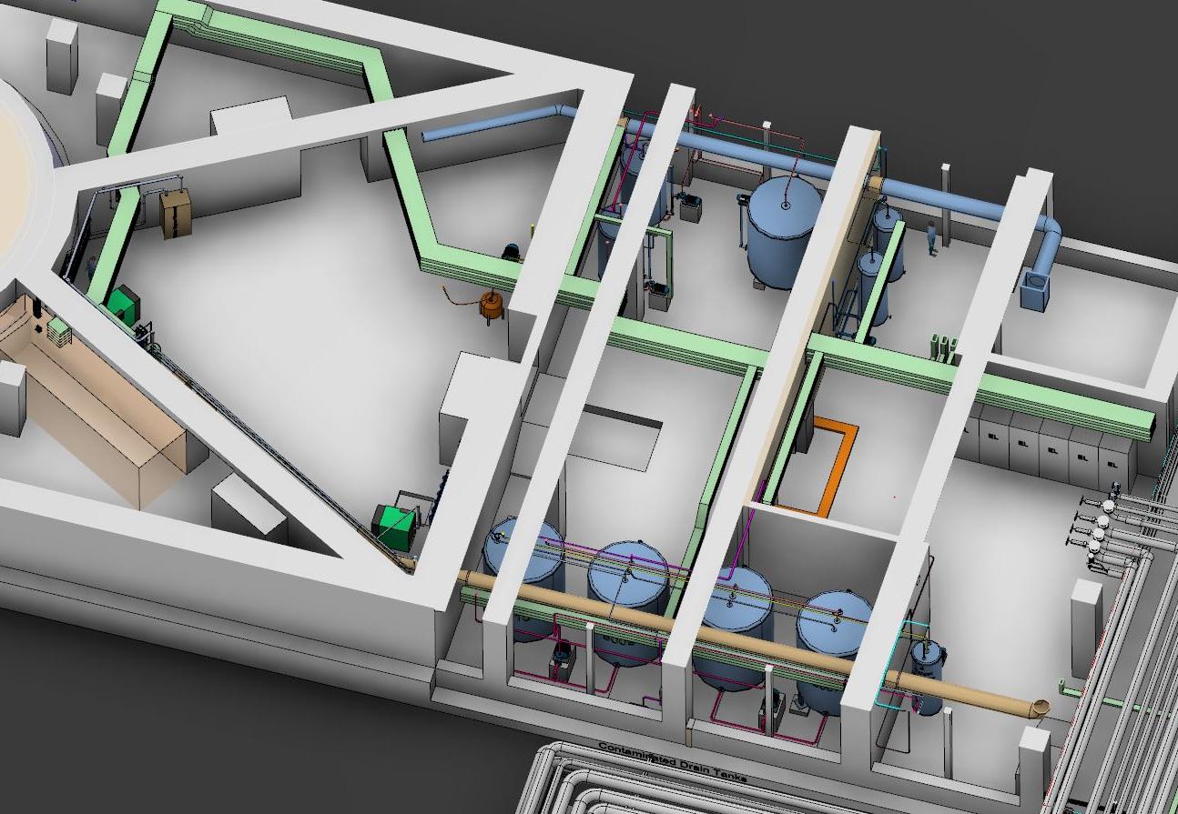
Utility – Level 90

Slide 5
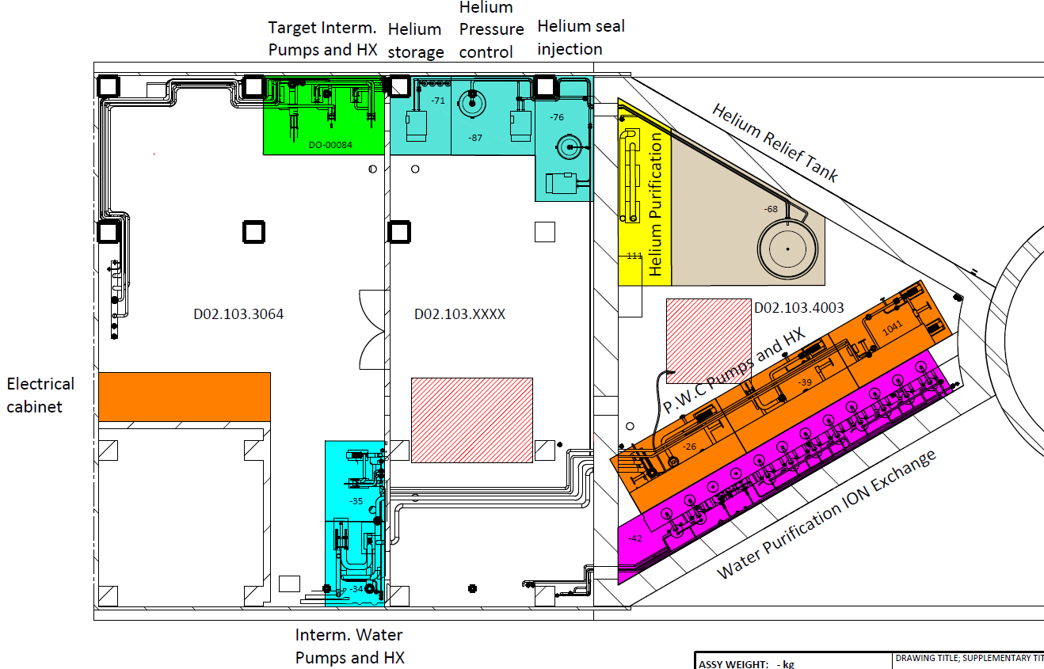
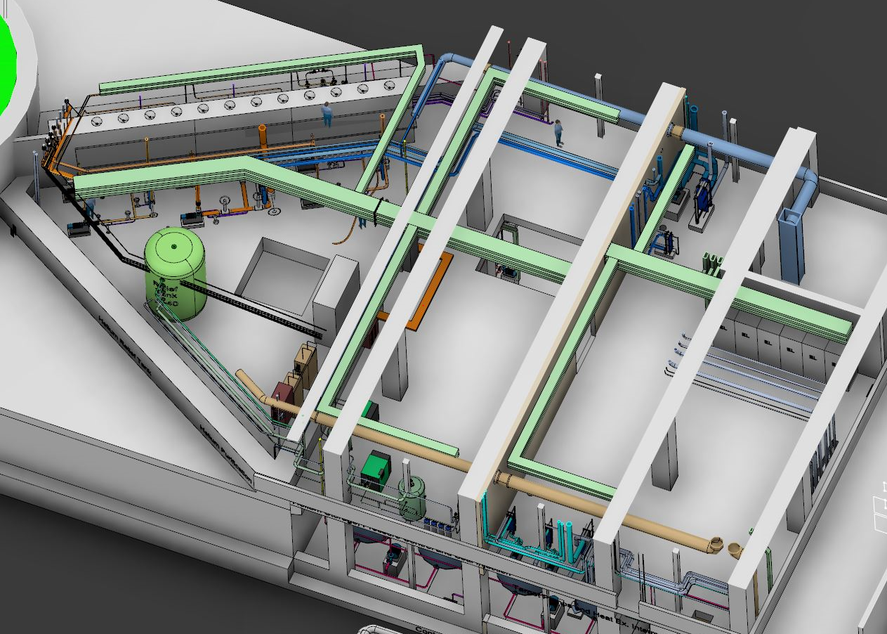
Utility – Level 100

Slide 6
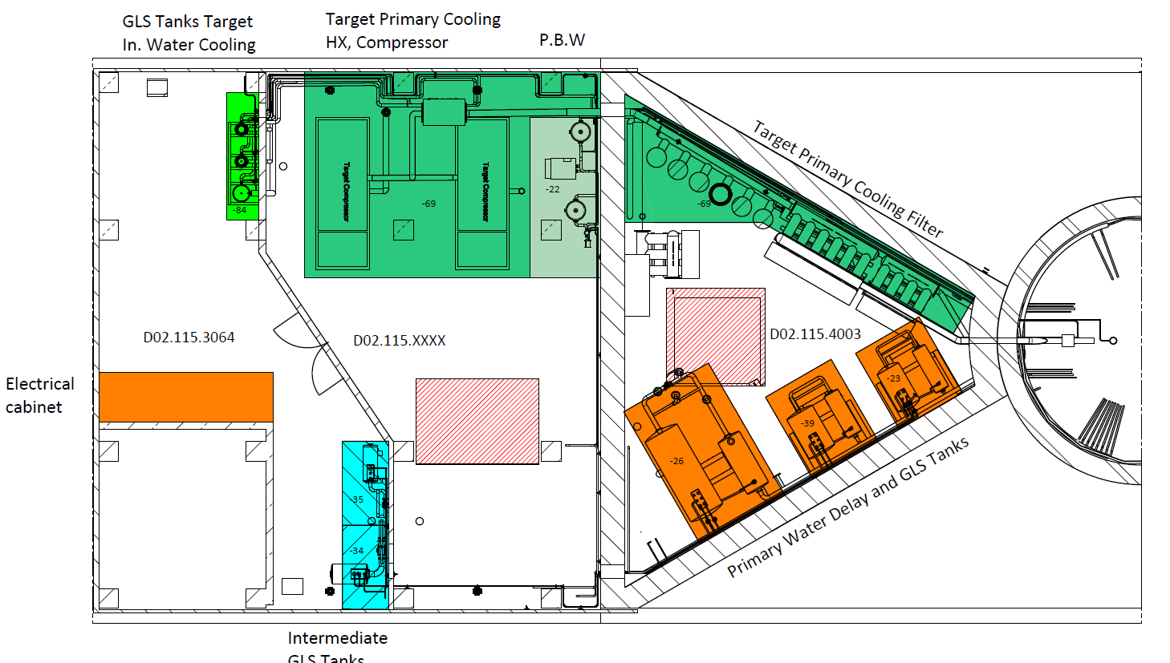
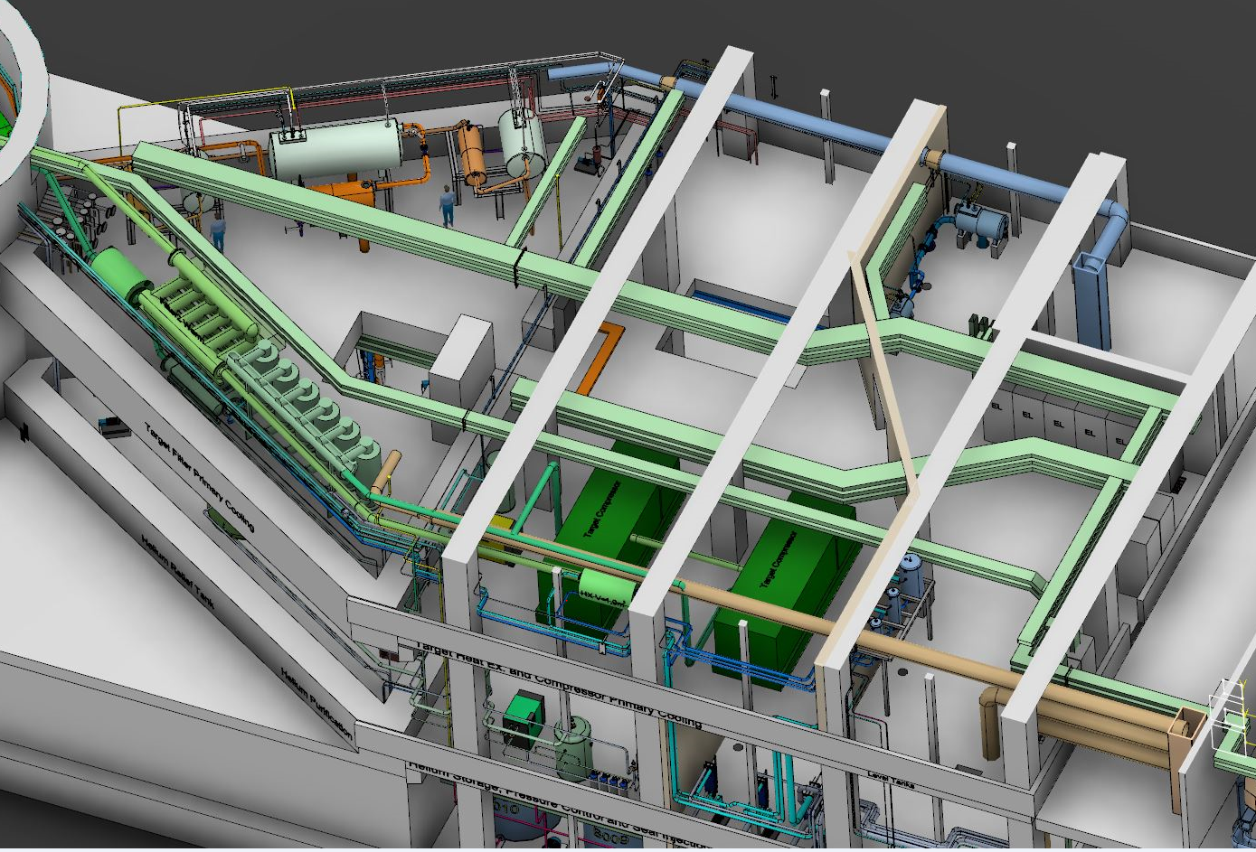
Installation Utility – Level 110

Slide 7
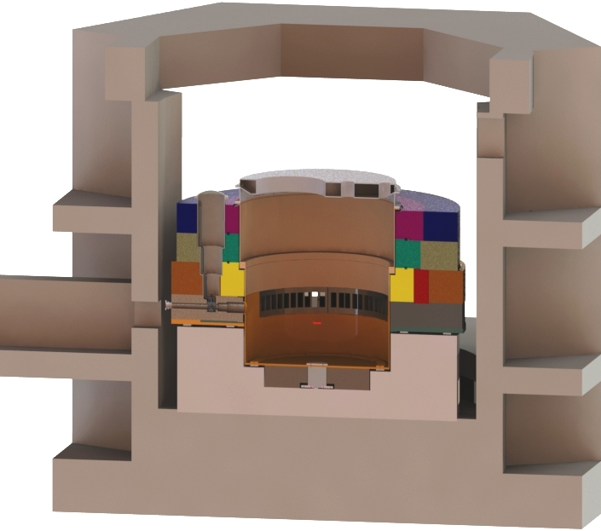
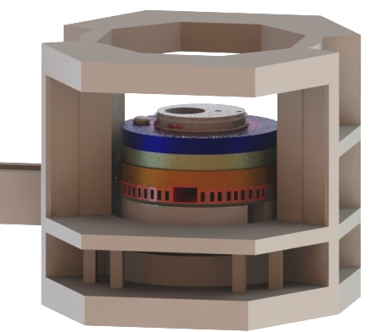
WP 4 - Monolith

Slide 8
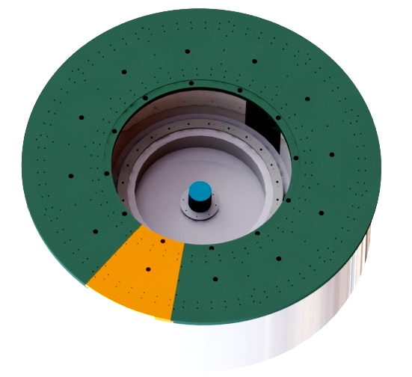
Base plates
Holes for under-grouting
Total weight approx 95 tons
Center Pillar
Rail for Vessel support
12 unique pieces
Carbon steel possible.
Finished dimension thickness 195 mm
8 Tons/Piece

Slide 9
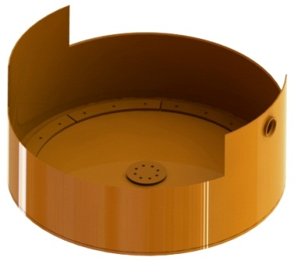
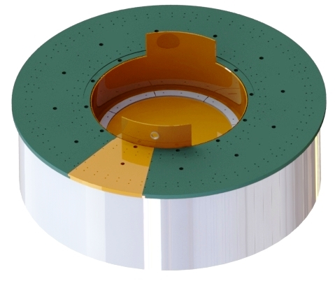
Lower vessel installation
Machined contact surfaces for cooling “puck”
Edge prepared for welding on site
Sleeve for proton beam block connection

Slide 10
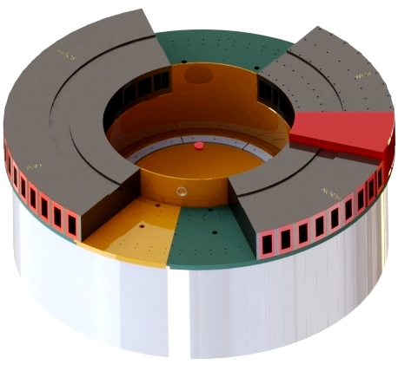
Port block lifted in place
The blocks are all bolted together and seal welded together before lifted in place.
Edges on vessel prepared for
seal welding on site
NNBAR port block
Seal welded before installation.

Slide 11
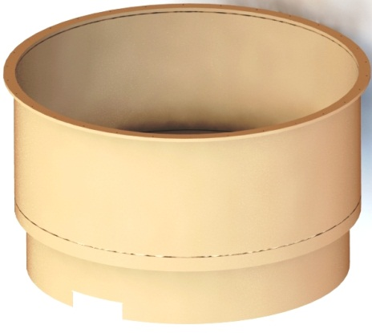
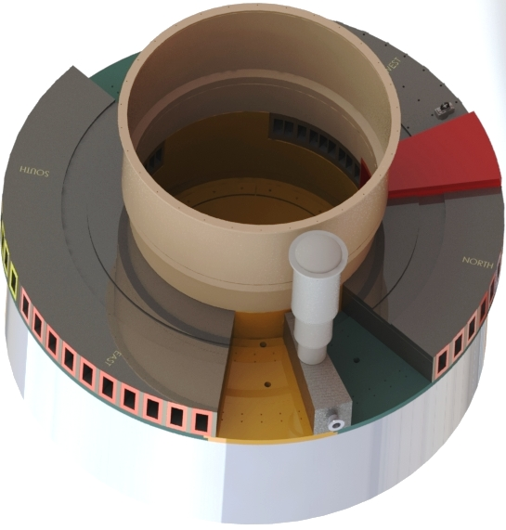
Upper vessel installation
Lower and upper vessel welded together.
Butt weld on site.
Seal weld port-blocks toVessel.
On site.
PBW block welded to vessel sleeve and plug shaft installed on top

Slide 12
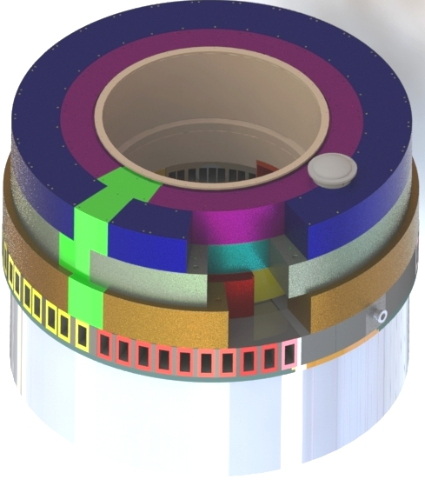
Upper outer shielding installation
Cast iron shielding blocks installed. Aligned and fixed radially using two guide pins for each block.

Slide 13
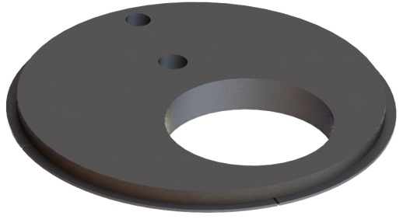
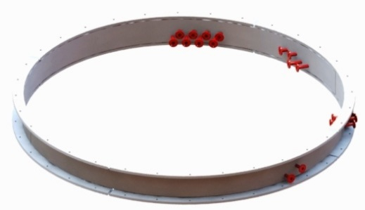
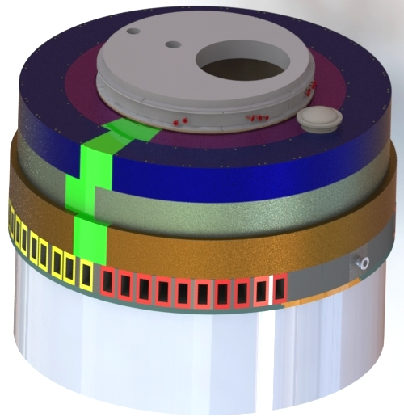
Vessel completed
Connection ring for cooling media, power and signal cables on top flange.
Top cover is bolted on top of connection ring.
Penetration holes for
Moderator & Reflector
Target wheel shaft
Instrumentation plug

Slide 14
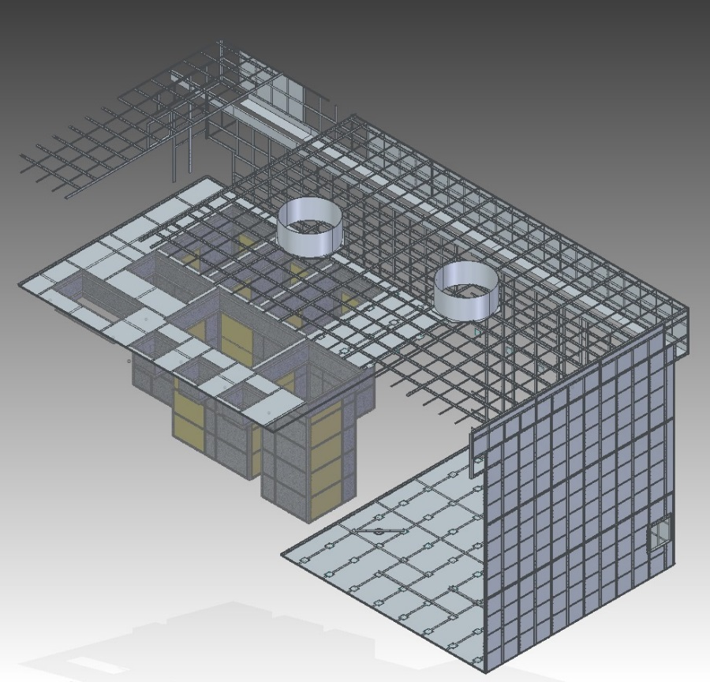
Installation Active Cell Parallel works
Liner Beams 120x70
Plates 4 mm on floor 2 mm on wall and roof
Anchor plates combined with liner beams to ensure alignment
Storage pits – prefabricated
Maintenance Cell Floor
Liner Beams
Storage Pits
Process Cell Floor
Anchor Plates in Floor

Slide 15
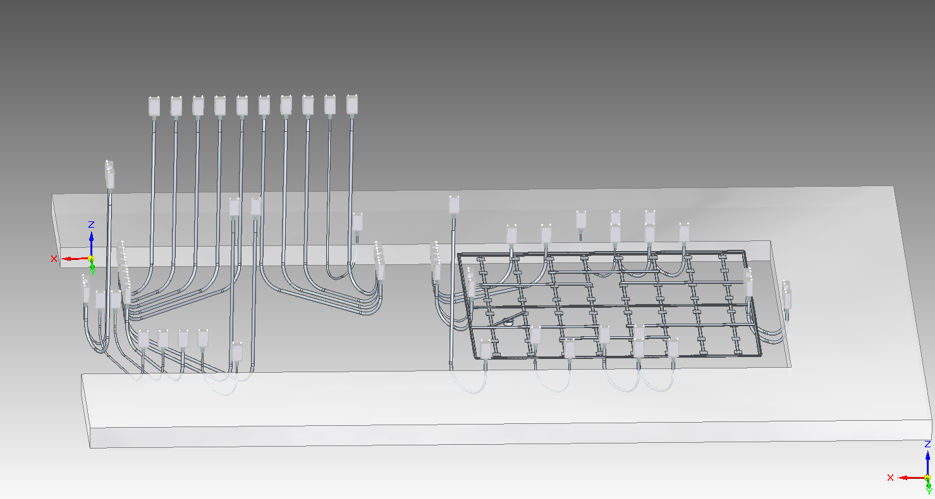
Electrical Conduits
Maintenance Cell
Cold side connection
Process Cell
Cold side connection
Transfer Area
Technical Galleries
Diameter 114 mm
Pipe routing from cold to hot side to avoid weak spots in the walls
1 meter bend radius

Slide 16
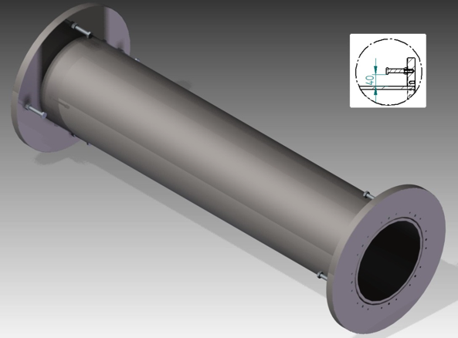
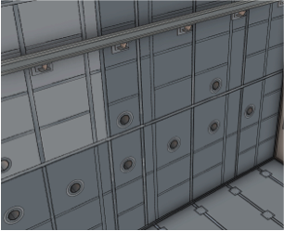
Confinement Penetrations
Stainless Steel
Straight pipe, without step
Oversized flanges
254 mm diameter
In total 40-50
Evenly distributed
One size – increase flexibility
Min. 2,7 meters from floor
Tight tolerances between tube and plug

Slide 17
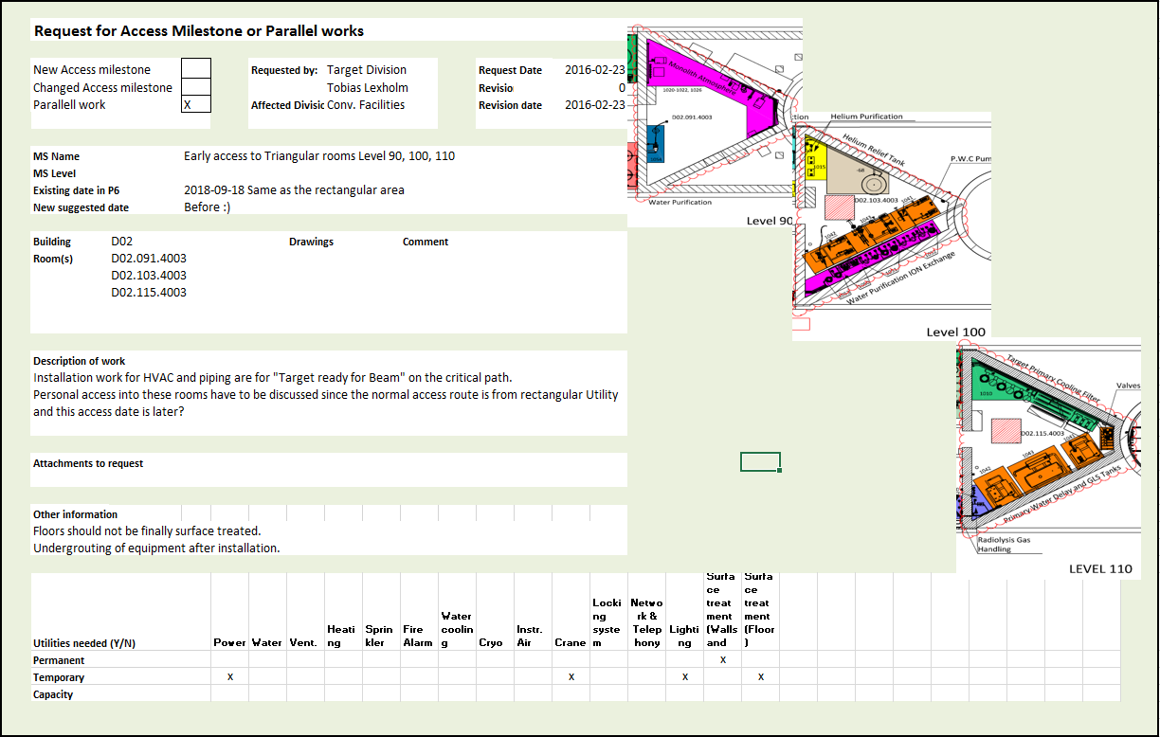
Time Schedule Description of Early Access Dates

Slide 18
Early Access Dates
Previously only one Early access date Oct -17
New Key Milestone dates proposed by Conv. Facilities:
Early Access Monolith Puck June -17
Early Access Active Cell (inside) Nov -17
Early Access Triangular Rooms Utility April-18
Early Access HVAC Room A2T Aug -18
Early Access Utility Sept -18
Early Access High Bay Crane Oct -18
Utility - Sept -18
Triangular Rooms Utility - April-18
HVAC Room A2T - Aug -18
High Bay Crane - Oct -18
Active Cell (inside) - Nov -17
Monolith Puck - June -17

Slide 19
Conclusion Critical Activities for “Target ready for beam”
Baseline date for Beam on Target: June -2019
Current ”working” date Target ready for beam: January -2020
7 month delay compared with Baseline
Reason is delayed ”Early Access” dates
Target Division Critical Path: Piping, HVAC and Monolith Vessel Installation
Mitigation Strategy:
Trying to find the critical path for ”beam on Target” and together with CF optimize the Building construction schedule for Target Division ”Early Access Dates”
This work is ongoing
Rough estimate of schedule reduction after further work is 1-2 months

Slide 20
Installation Installation Time Schedule (After integration between CF & Target Schedule)

Slide 21
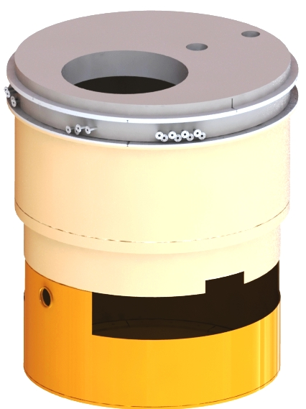
Installation Vessel completed
Top cover
mass ≈ 20 tons
Connection ring
mass ≈ 5 tons
Upper vessel
mass ≈ 25 tons
Lower vessel
mass ≈ 25 tons

Slide 22
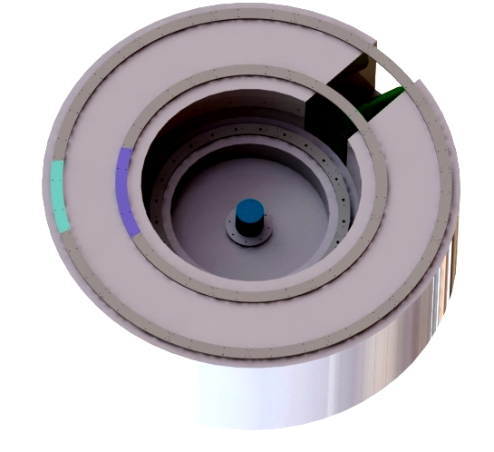
Rail and center pillar installation
Center pillar for vessel center location
Echir
3 rail rings to support and fix the base plate and vessel.

Slide 23
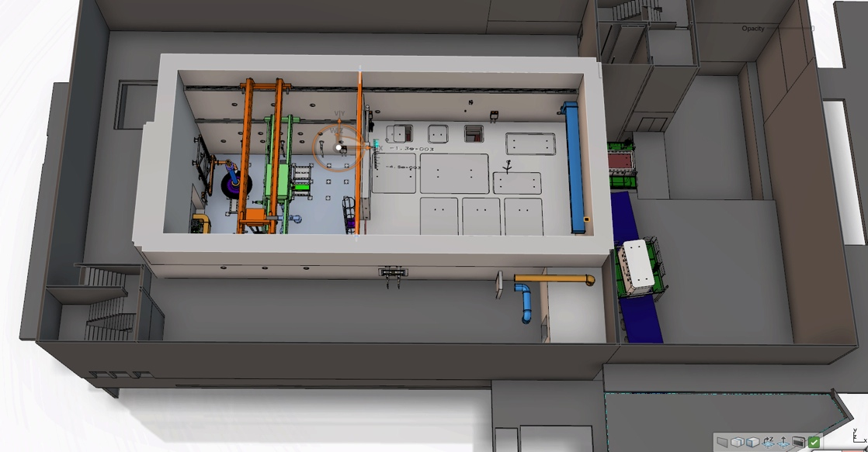
Installation The Active Cells Layout
Process cell – Introduction of radiated components from the high bay, processing of components and preparation for interim storage and shipment as well as refurbishment in specific cases.
Maintenance cell – Maintenance of equipment and logistical hub for transfer inside the active cells.
Storage pits – Intermediate storage of vessels awaiting off-site shipment.
Technical galleries – Contains the remote handling interfaces for active cell operations, component storage, PIE activities, human logistics around the cells and air locks for entrance into the maintenance cells.
Transfer area – For off-site shipment of casks, control and decontamination of shipment cask surfaces.
Storage Pits
Transfer Area
Shipment
Technical Galleries
Process Cell
Maintenance Cell
Size:
Height 15 m
Length 30 m
Width 12 m

Slide 24
Installation HVAC – Supply Level 125 – Extraction Level 150
HVAC Extraction LEVEL 125
HVAC Supply LEVEL 150

