Slide 1
Target Monolith – Instrument Bunker Installation, handling, and more
Rikard Linander
Manager WP 12.4 Monolith Systems
www.europeanspallationsource.se
7 April 2016

Slide 2
Vertical section through a beam port /beam line within monolith and instrument bunker
Lead
R = 5.5 m
Boronated-PE-Concrete
Cast Iron
R = 15 or 28 m
0.20 m
0.45 m
2.0 m
0.45 m
0.60 m
0.30 m
+2.0 m
Beam center upper moderator
TCS = 0.0
Beam center lower moderator
-2.5 m (North)
≈ -1.2 m

Slide 3
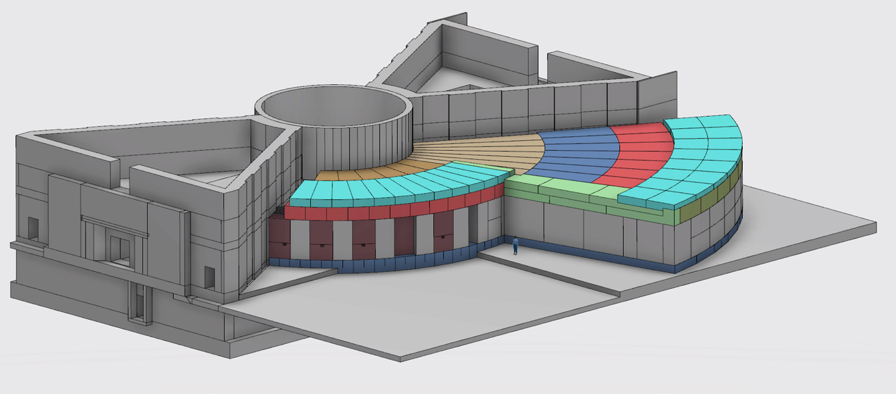
Developing a baseline for the Neutron Guide Bunker
Neutronics simulations have taken into account: Started Aug
Dose levels outside the Bunker must be < 3 μSv/h -> simulate < 1.5 μSv/h.
Floor loading in the Bunker: 30 tonnes/m²
Floor loading in the experimental halls: 20 tonnes/m².
Engineering design is ongoing to optimize on safety, performance & cost
Monolith shield wall
Bunker roof, 2 m thick
R = 15 m
R = 28 m
6 m
Bunker end wall, 3.5 m thick.

Slide 4
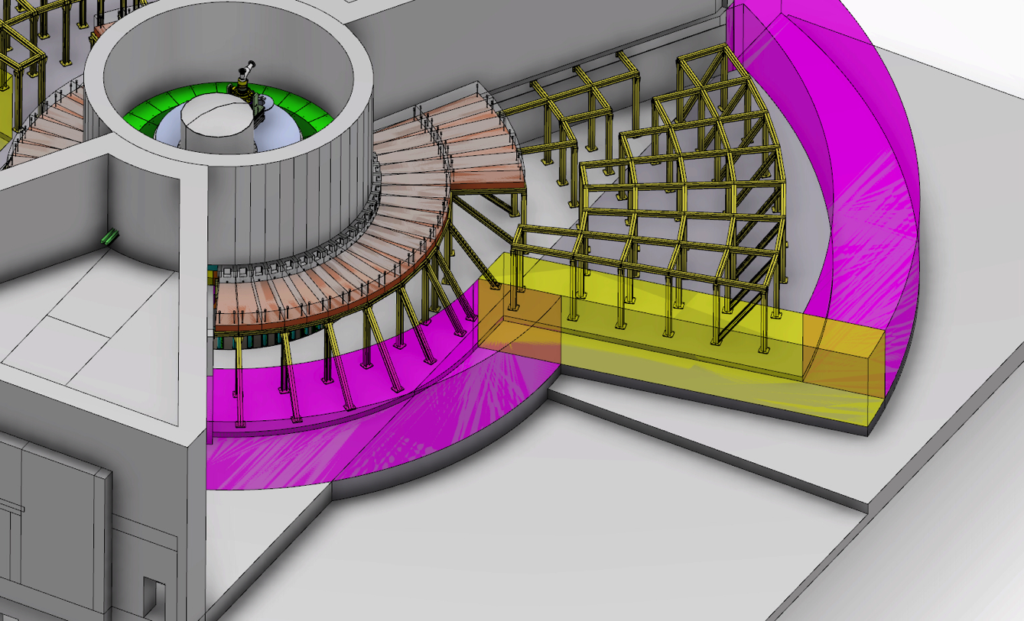
The Neutron Bunker mechanical design

Slide 5
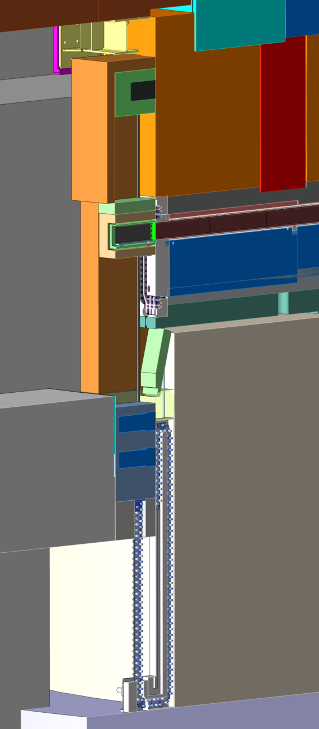
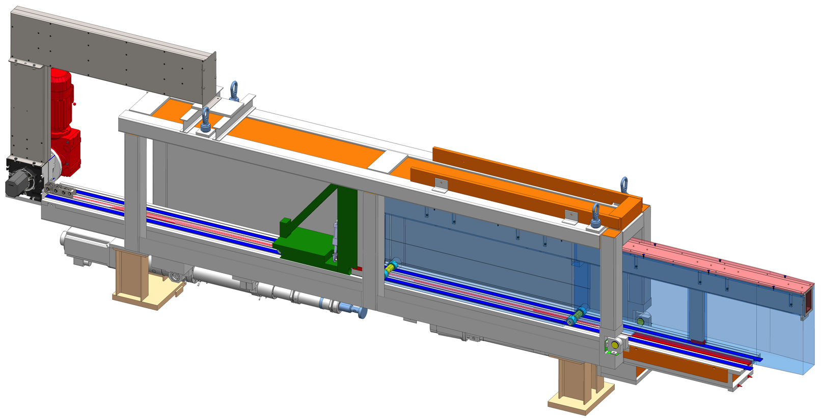
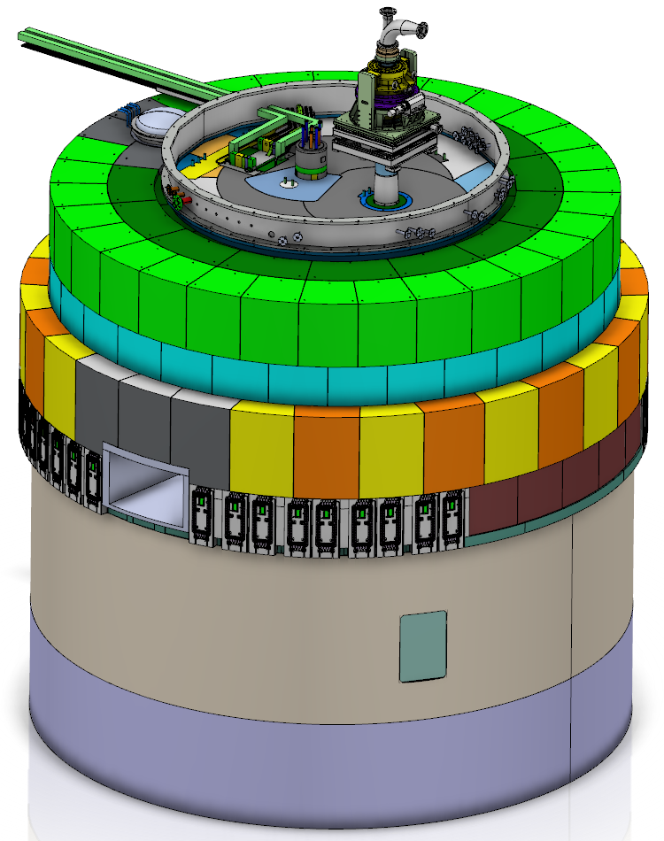
Neutron beam extraction system
Examples of possible configurations of light shutters
Handling tool
Shutter drive in basement
Neutron beam extraction system (12.4.2.4)
42 neutron beam ports, whereof
39 normal modular beam ports
3 beam ports within the superstructure of the nnbar port
One fast neutron beam port for ESS chip irradiation (ECHIR) station
Double decker neutron beam port inserts with capability to view either the upper or the lower moderators
Light shutters with drive and handling mechanisms in the basement rooms
Handling tool for neutron beam port inserts replacement
Neutron beam port insert
nnbar port
Neutron beam ports
ECHIR port

Slide 6
Dismantling of bunker roof

Slide 7
Instrument line dismantling sequence
Removal of instrument line components, either as
Individual components, or
Assembly of components sitting on a common strong-back
See also examples of technical solutions for LOKI in presentation by David Turner

Slide 8
Instrument line dismantling sequence
Gamma shutters in place in front of beam ports
Bunker area cleared and ready for monolith opening and port operations

Slide 9
Beam port seal handling

Slide 10
Beam port seal removal sequence Unbolting compression spider from port block

Slide 11
Beam port seal removal sequence Unbolting outer flange from port block

Slide 12
Beam port seal removal sequence Unbolting inner flange from insert

Slide 13
Beam port seal removal sequence Close gamma shutter, remove handling tool

Slide 14
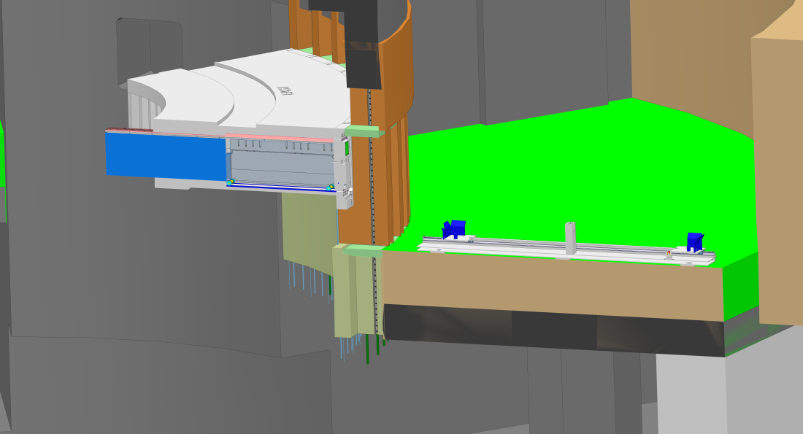
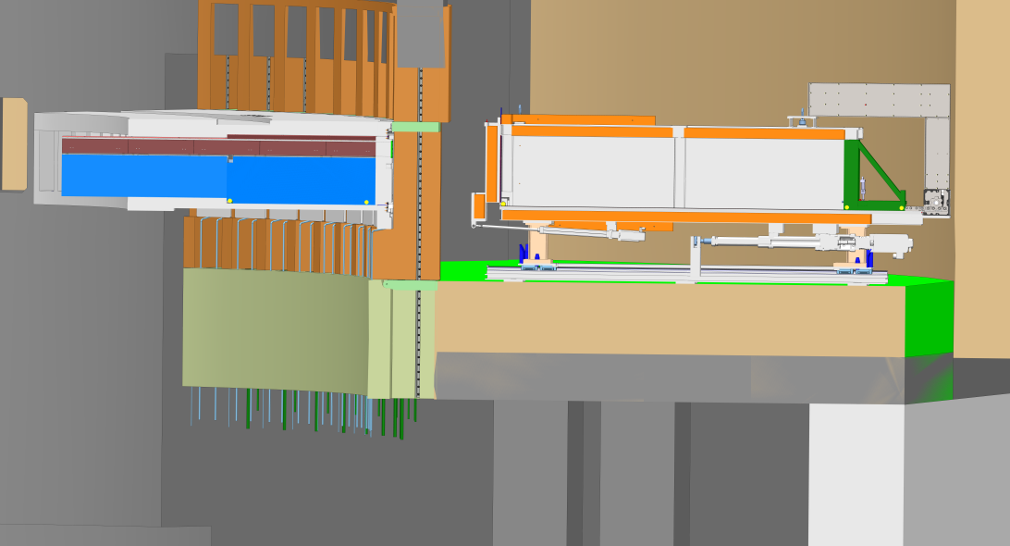
Beam port insert removal sequence
Placement of floor unit
Positioning on the same mounts as the beam line components
N.B. gamma shutter should be closed, not visible in picture
Placement of NBEX tool onto the floor unit

Slide 15
Beam port insert removal sequence
Lowering draw bridge into position
Pushing NBEX tool 300 mm towards monolith

Slide 16
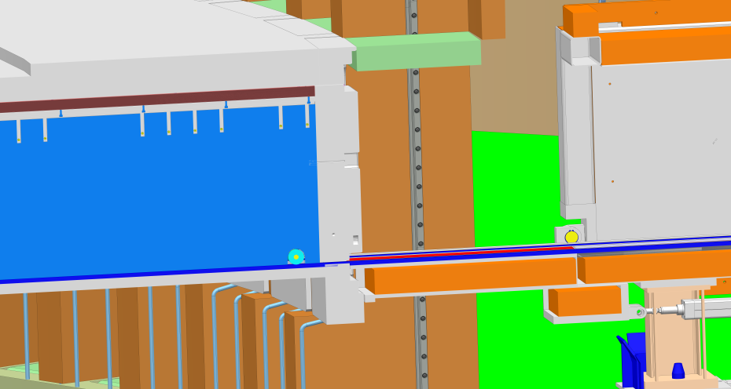
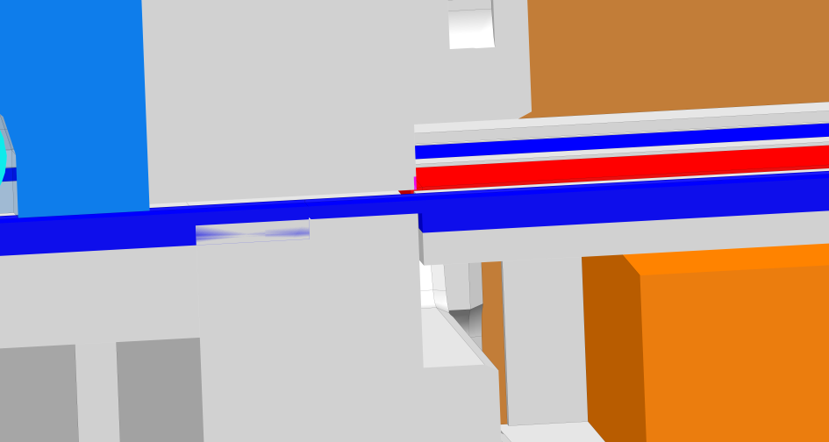
Beam port insert removal sequence
Docking NBEX tool to port block
Simultaneously docking rails on the draw bridge with rails internal to the port hole

Slide 17
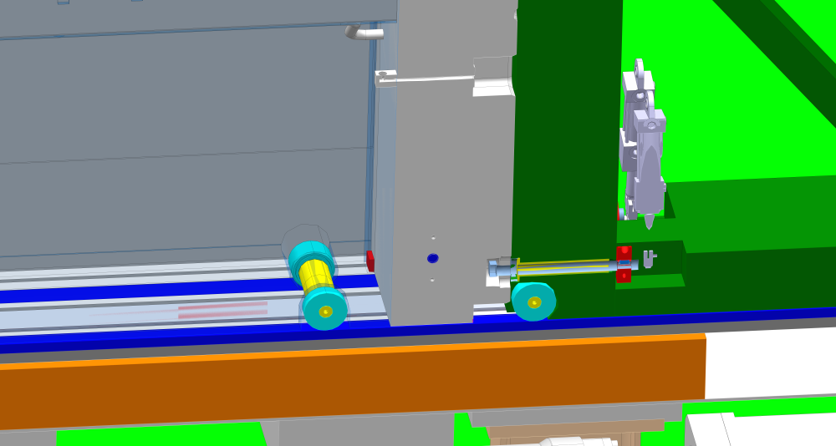
Beam port insert removal sequence
Pushing carrier (green) up to insert
Docking carrier and engaging connection to insert

Slide 18
Beam port insert removal sequence
Pulling insert on the rails into the NBEX tool cask
Closing draw bridge
Pushing NBEX tool out 300 mm from the monolith
Lifting NBEX tool including insert with bunker crane
Further transfer and handling of used insert for waste treatment

Slide 19
2 in 1 Insert
Insert Guide [1]
Insert Shielding (incl. lid) [2]
Neutron Beam Window (Al)
[2] works as a carrier for [1] when being pushed into monolith. Decouples from each other in operational position.
Guides have monolith atmosphere
2.
1.
3.
Notes:
Insert Guide: Bolted lid
Feets, rear & front
Insert Shielding rolls on wheels
No contact between Insert Guide & Insert shielding in operational position

Slide 20
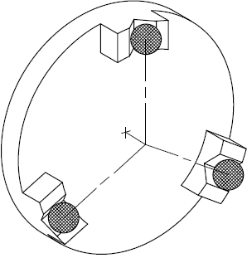
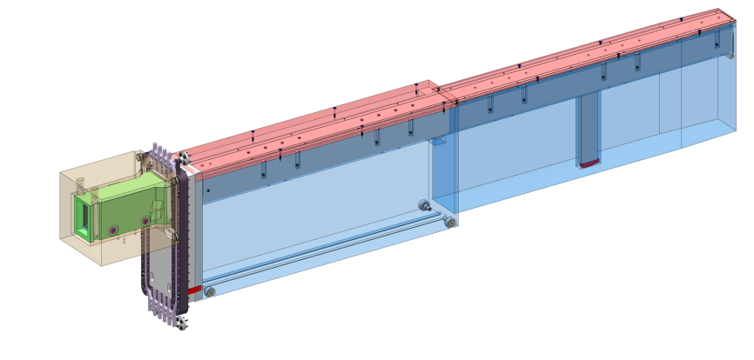
Light Shutter [Jarich Koning]
Functional principle of mount
Docked onto the Insert
Aligned with kinematic mounts
Guide internal atmosphere not supported by light shutter
Three-balls-in-3-V-grooves concept
Guide mounted in Cradle
V-grooves define central axis which should be the thermal center of the guide
1.

Slide 21
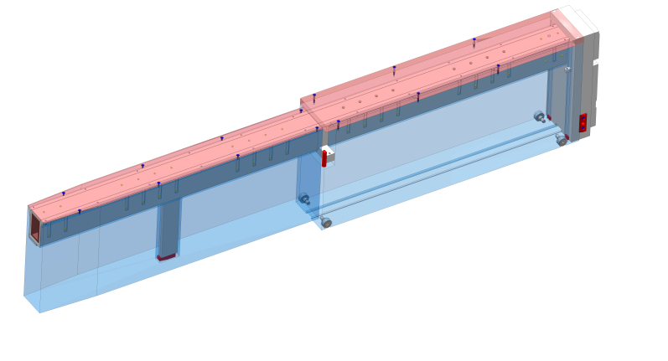
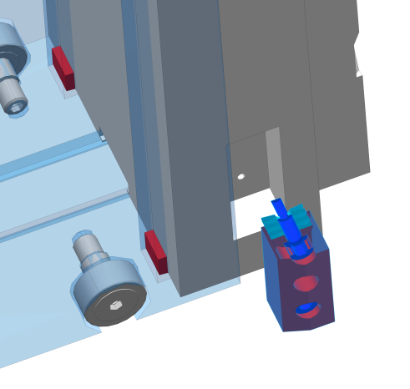
Insert alignment in Port Block
Alignment features on Insert Guide (Red)
Feet, 2 rear & 1 front
Side push
Passive
Active, spring loaded
Pivot shaft
Alignment feature Insert Shielding
T-guide opening
2.a
1.
4.
3.
2.b

Slide 22
Insert alignment in Port Block
40kN of pre-tension to be delivered by the ’spider’ integrated with the sealing assy
Side contact pad
Stack of disc springs for local pre-tension
One foot at the front
Cylindrical contact to port midways, on the left
Two feet at the back

Slide 23
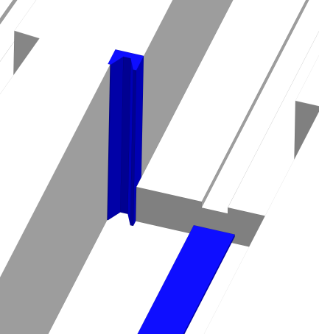
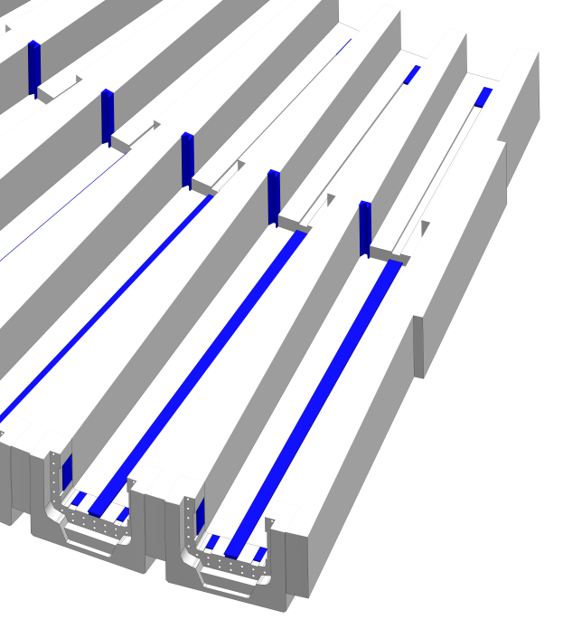
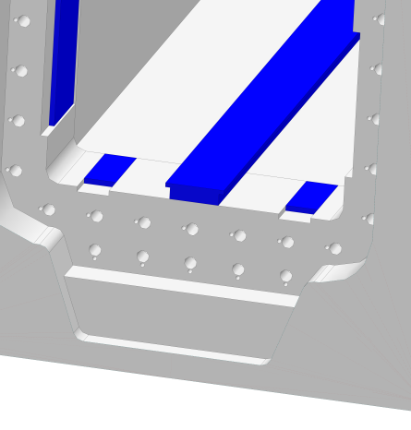
Insert alignment in Port Block
Port block alignment features (blue)
Feet
Side push (passive)
Pivot point
T-guide
Corresponds to the Insert Guide features (red, previous slide)
2.
1.
3.
2.
1.
4.

Slide 24
Kinematic support of Insert in port block
A total of 6 Degrees-of-Freedom to be constrained:
Three feet -> 3DoFs
Theoretical point contacts are 50x50mm pads
At insertion, these pads engage only the last 50mm
These are engaged by gravity
One cylindrical forward end stop -> 2DoFs
The cylindrical surface on the port block sits at half of the port depth, at its width recession, on the left side
It is full height, to accommodate later design changes
Engaged by the forward pushing force delivered by the ‘Spider’ which is integrated with the port flange
One landing pad at the right side -> 1DoF
Pad is close to the outside of the vessel.
Somewhat engaged by the central pushing force
To ascertain positive contact, on the left a stack of disc springs yields a direct pushing force

Slide 25
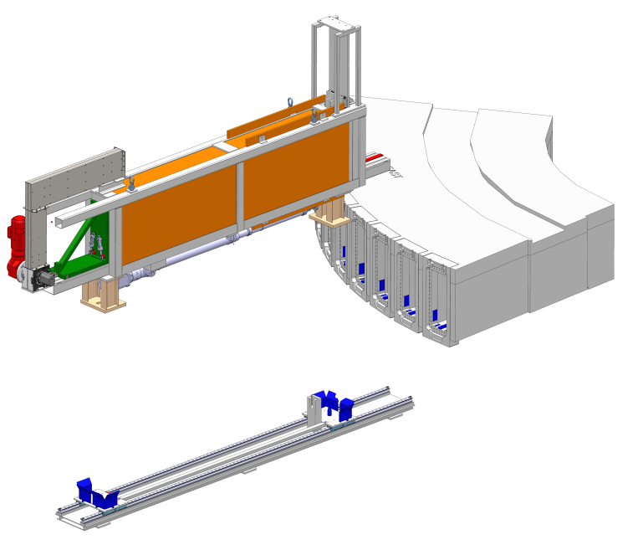
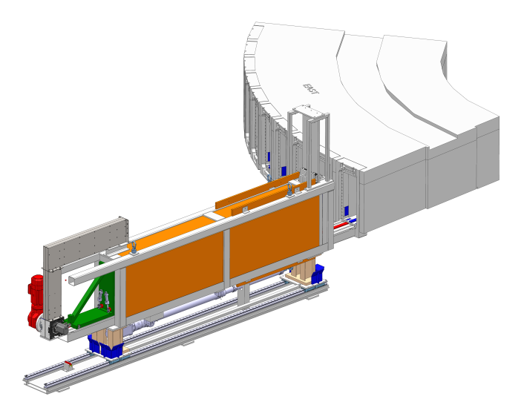
Monolith insert installation
[2] aligned on Bunker Floor
Outer position
[1] being lifted onto [2] by Crane
1.
3.
Insert Exchange 8.1, ESS-0049491 [1]
Floor Unit, ESS-0048727 [2]
Port Block, East
2.
[1] pulled itself into position, carried by wagon unit in [2]

Slide 26
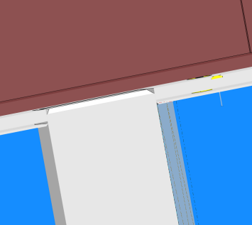
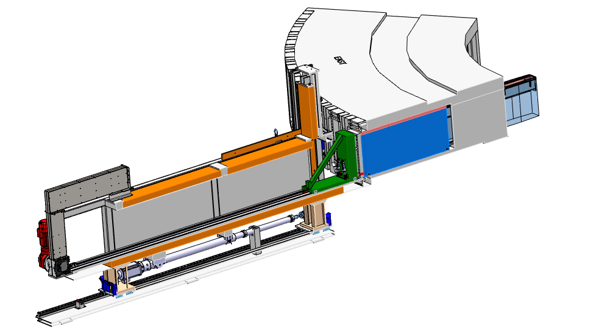
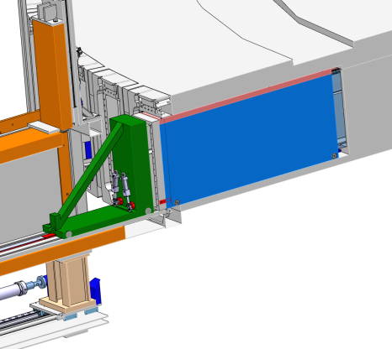
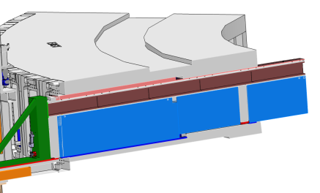
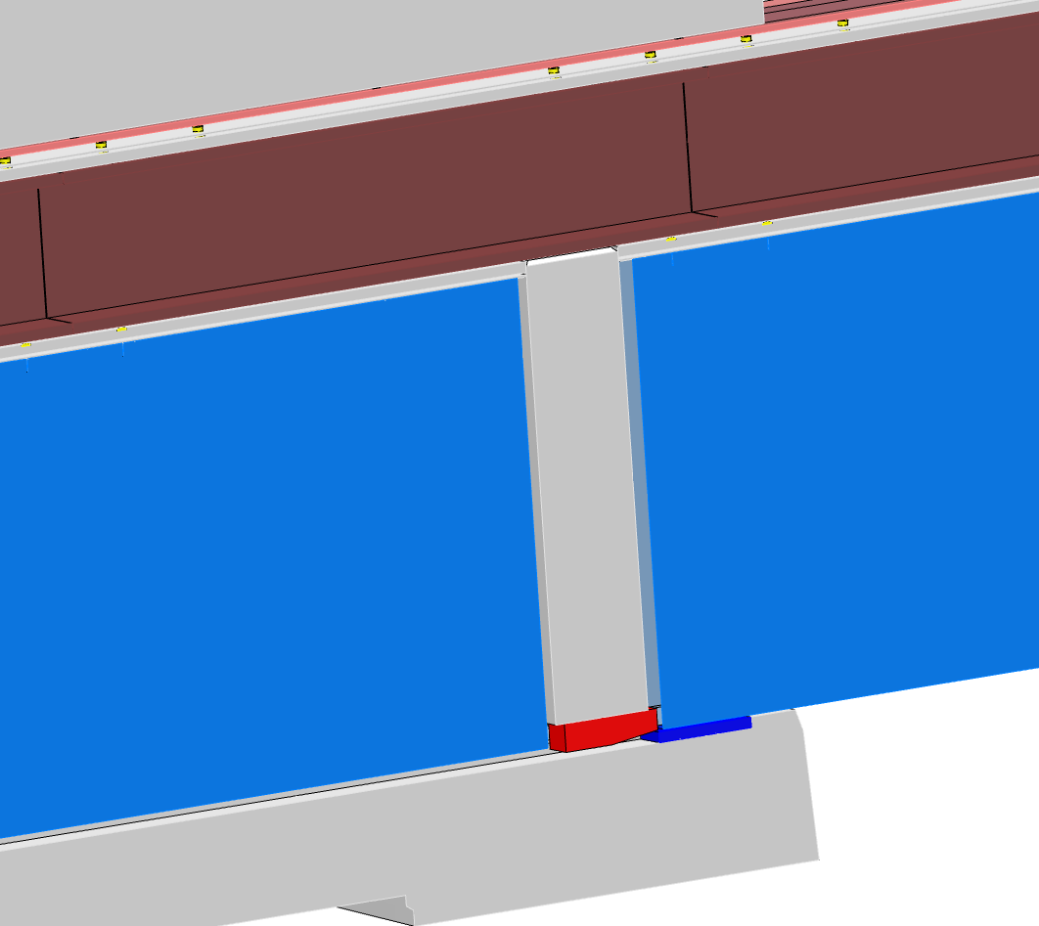
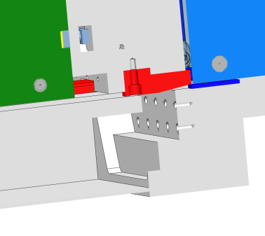
Monolith insert installation
Insert pushed 4400 mm into monolith, 100mm from final position
Insert Beam Guide holder resting in Insert Shielding
Feets about to get into contact with their corresponding port block surfaces

Slide 27
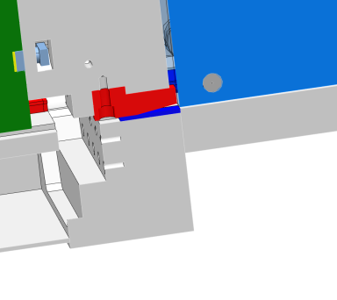
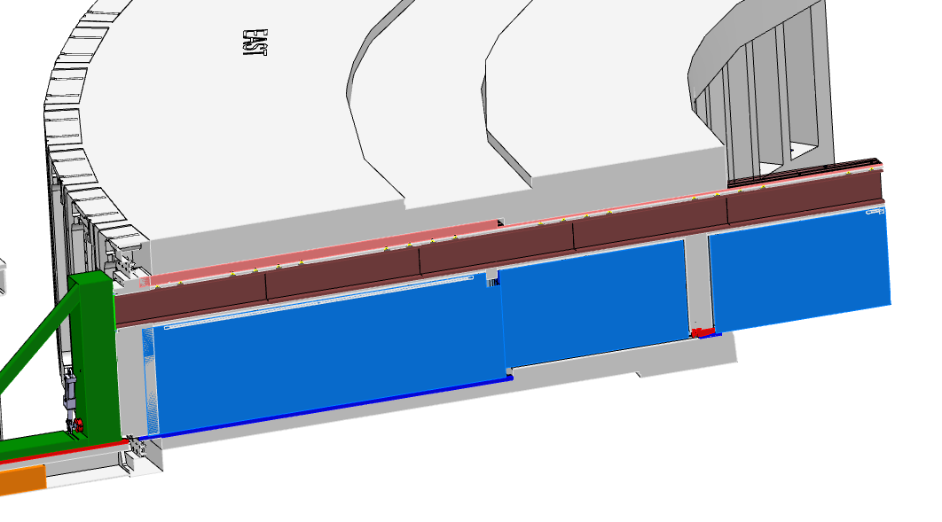
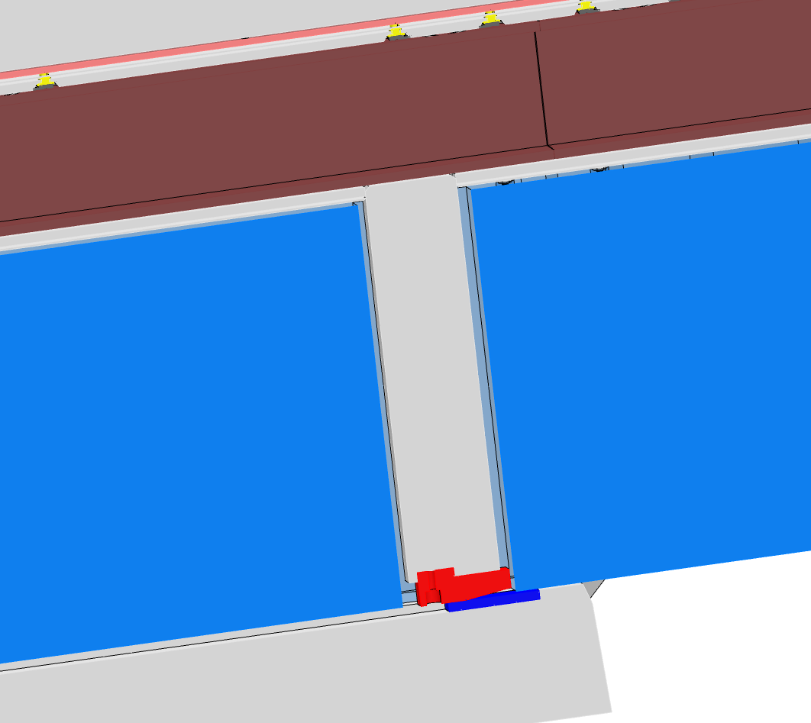
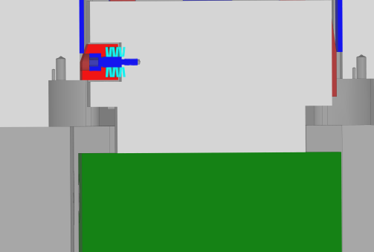
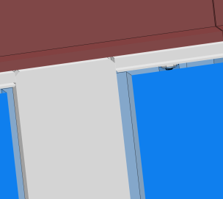
Monolith insert installation
Insert pushed 4470 mm into monolith, 30 mm from final position
Pivot point
Push direction
Active side push (Spring pretension 4.2mm =>6kN)
Feets slided up on their corresponding port block surfaces
Insert Beam Guide holder lifted 5mm versus Insert shielding
Passive side push
4.2mm

Slide 28
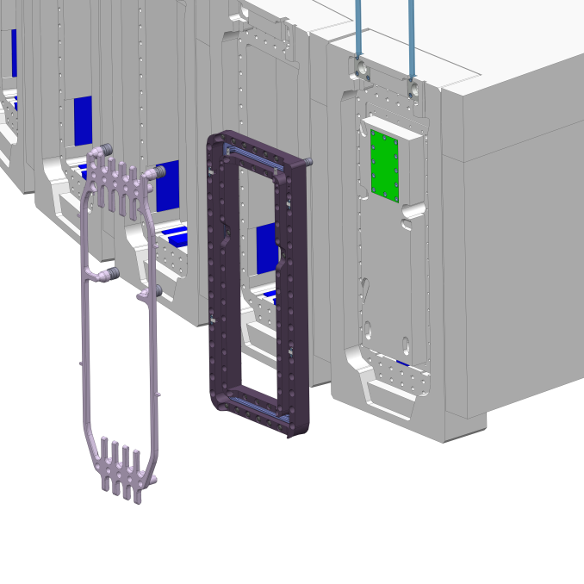
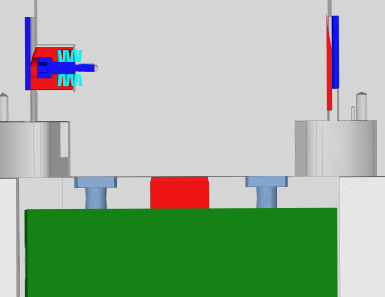
Monolith insert installation
Insert pushed 4500 mm into monolith, final position
Mounting of Double Seal Flange to [1]
Mounting of Spring compression unit [2]
Pivot point
Push direction
Active side push (Spring pretension 6.2mm =>7.5kN)
Passive side push
[1]
[2]
6.2

