Slide 1
Linac Design Overview
Håkan Danared
Deputy Head Accelerator Division
www.europeanspallationsource.se
7 April 2016

Slide 2
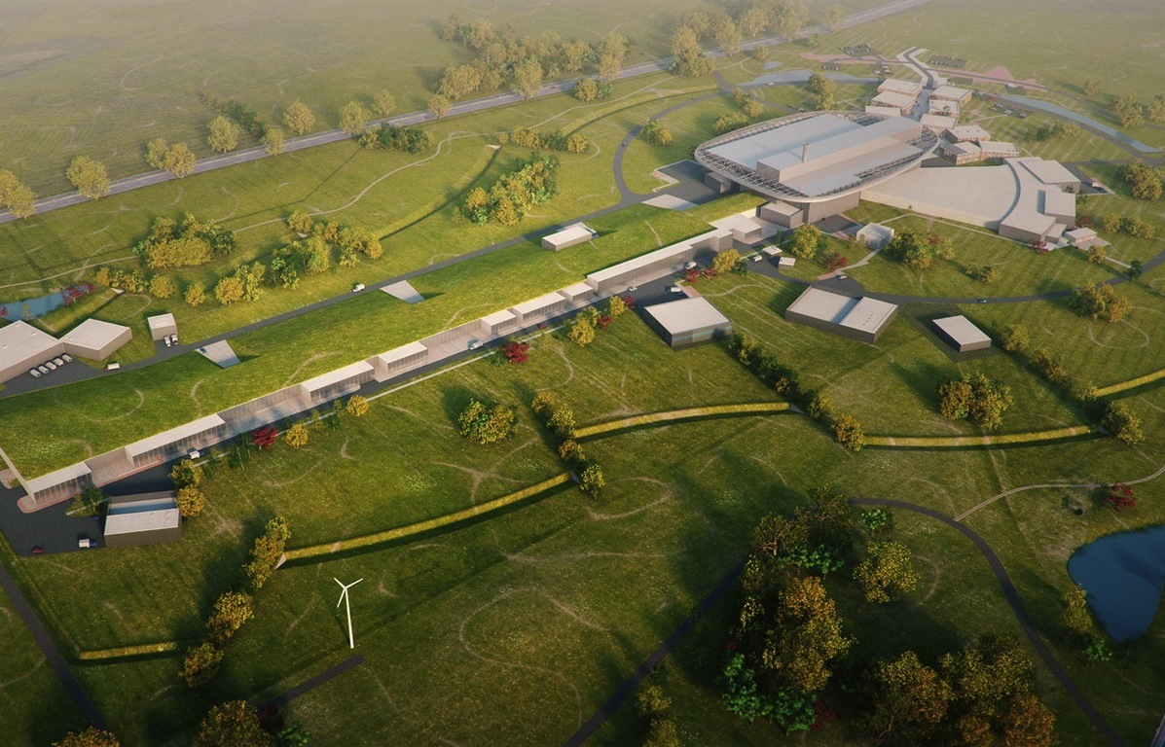
Top-Level Parameters
Target Station
Rotating W target
He-gas cooled
5 MW average power
42 beam ports
Proton Accelerator
Energy: 2 GeV
Rep. rate: 14 Hz
Current: 62.5 mA
Neutron Instruments
Construction budget
contains 16 instruments
Committed to deliver 22
instruments by 2028
Total cost: 1,843 M€ ₂₀₁₃

Slide 3
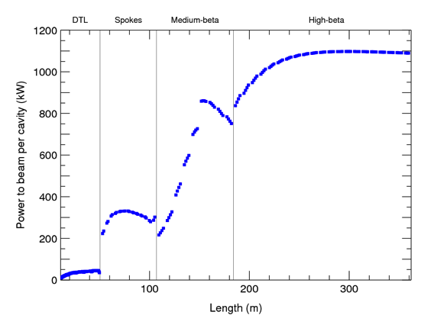
Linac Design Principles
Design goals:
Deliver as much power as possible to the beam as cheaply as possible
Ensure small losses and high reliability
Beam physics rules-of-thumb:
Phase advance in each plane < 90°
Smooth average phase advance
Tune depression > 0.4
Limits to gradients and power couplers:
Spoke cavities max gradient: 9 MV/m
Elliptical max surface field: 45 MV/m
Coupler max power: 1.1 MW

Slide 4
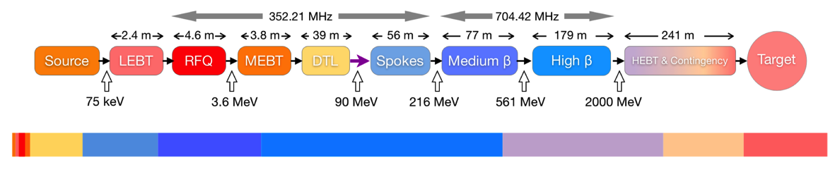
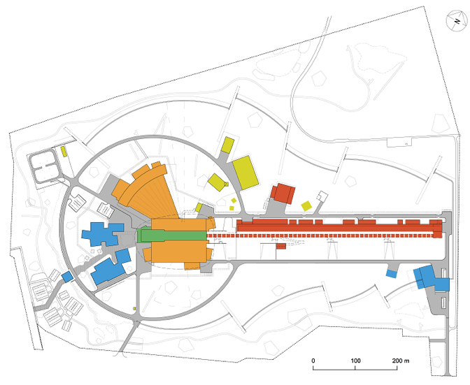
Linear Accelerator
Particle species p
Energy 2.0 GeV
Current 62.5 mA
Average power 5 MW
Peak power 125 MW
Pulse length 2.86 ms
Repetition rate 14 Hz
Operating time 5200 h/year
Reliability (all facility) 95%

Slide 5
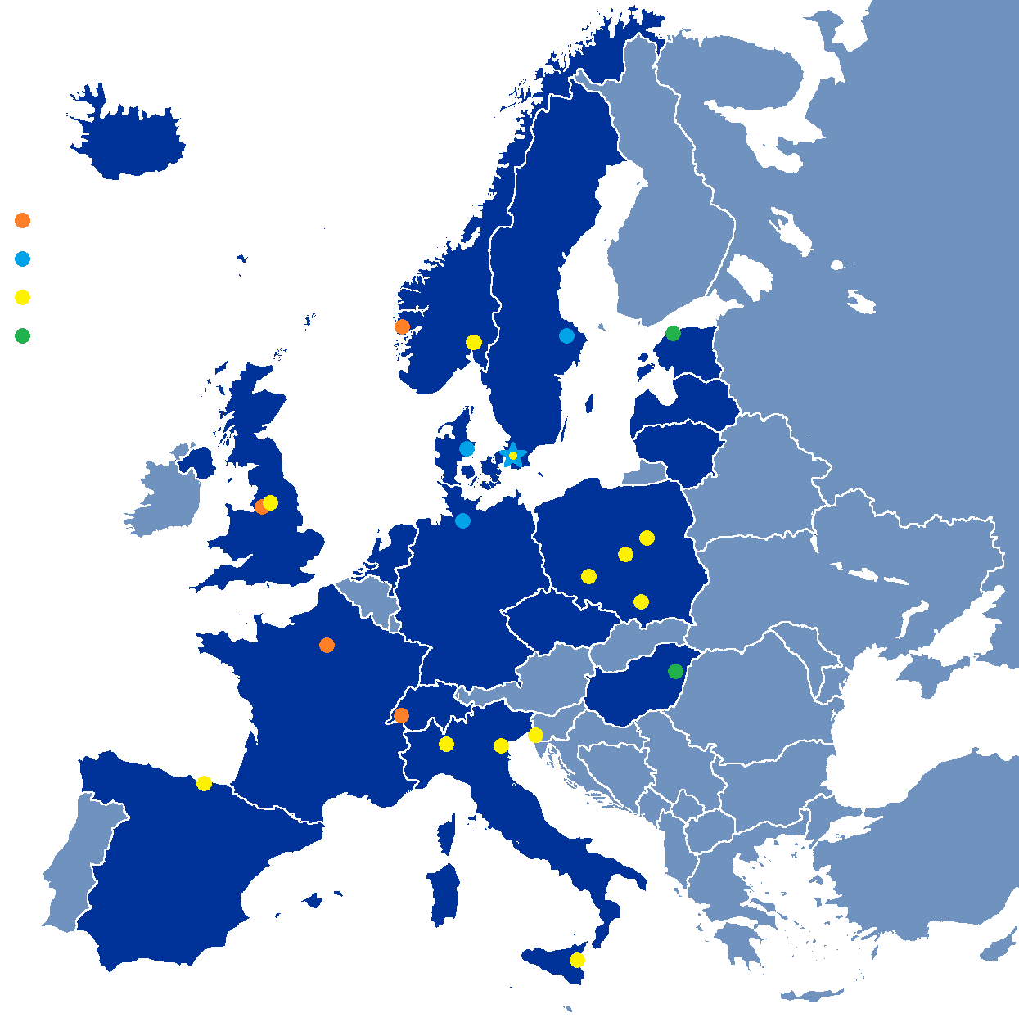
Partner Institutions for In-Kind
In-kind (main contributions)
ATOMKI (RF-LPS)
CEA (RFQ, SRF, Diagn)
CNRS (SRF, Cryo distrib)
Daresbury Lab (SRF, Vacuum)
Elettra (RF, Magn, PS, Diagn)
EPFL (Modulators)
ESS-Bilbao (MEBT, RF)
Huddersfield Univ (RF distrib)
IFJ PAN (Installations)
INFN Catania (Source, LEBT)
INFN Legnaro (DTL)
INFN Milan (SRF)
Lodz UT (LLRF)
NCBJ (LLRF, gamma blockers)
Tallinn UT (RF)
Univ Bergen (Seconded staff)
Univ Oslo (Diagn)
Warsaw UT (LLRF)
Wroclaw UT (Cryo distrib)
Not yet signed
Contract
HoA/Cover page
IKC
Paid contracts
Aarhus Univ (Beam delivery)
DESY (Diagn)
Lund Univ (LLRF, RF)
Uppsala Univ (Tests)

Slide 6
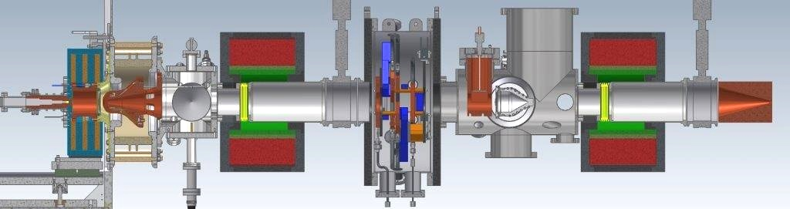

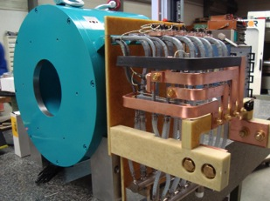
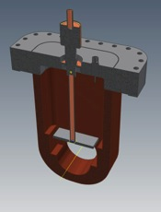
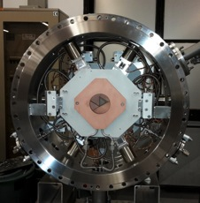
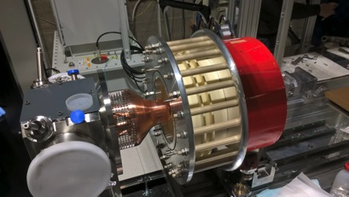
Ion Source and LEBT (INFN Catania)
Output energy 75 keV
Solenoid
Chopper
Iris
Microwave Discharge Ion Source

Slide 7
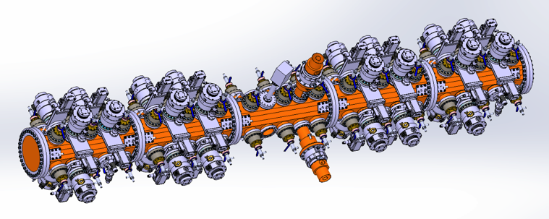
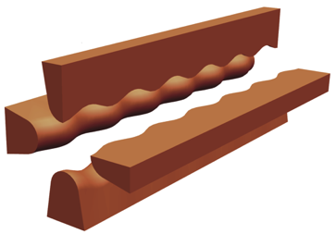
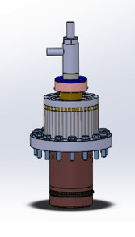
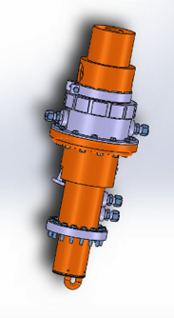
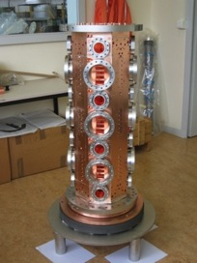
RFQ (CEA Saclay)
Complete assembly
4-vane RFQ
Output energy 3.6 MeV
IPHI RFQ section
Tuner
Power coupler

Slide 8
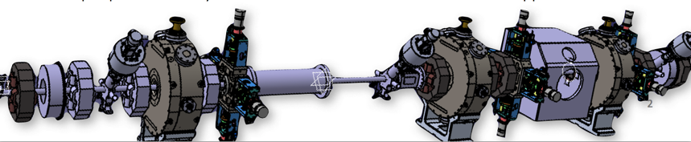
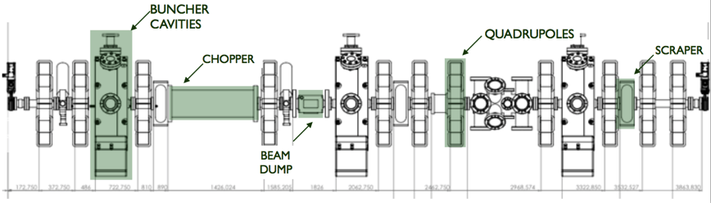
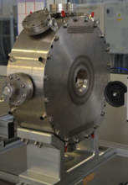
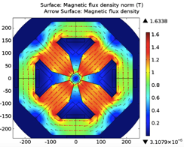
MEBT (ESS-Bilbao)
Many functions in 3.9 m:
Beam shaping
Chopping
Collimation
Instrumentation
Quadrupole model
Prototype cavity

Slide 9
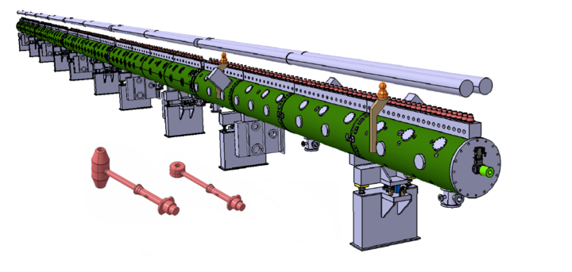
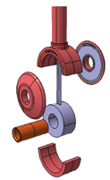
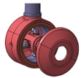
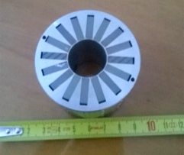
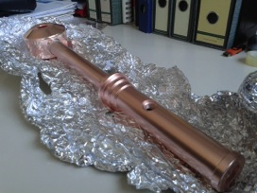
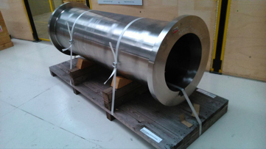
DTL (INFN Legnaro)
Tanks: 5
Sections/tank: 4
Length: 39 m
Weight: 34 tons
Output energy 90 MeV
PMQ prototype
Stem & drift tube prototype
Section prototype

Slide 10
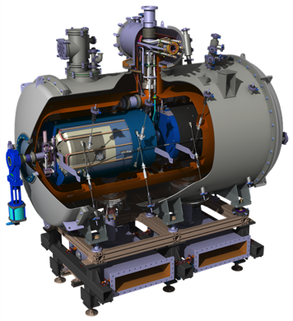
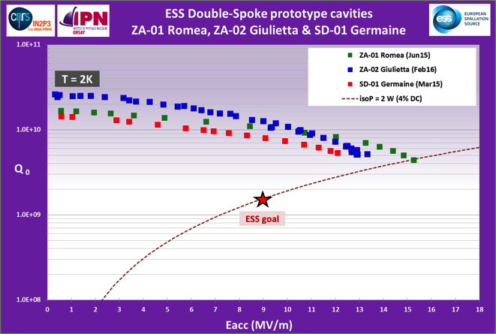
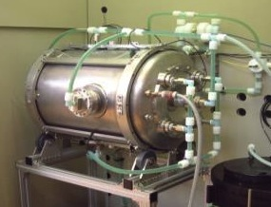
Spoke Cavities and Cryomodules (IPNO)
Output energy 216 MeV
Length 2.9 m
Cryomodule with two double-spoke cavities
Tests of the three prototype cavities, exceeding ESS requirements in accelerating gradient and Q₀
Prototype cavity at IPNO set up for surface treatment

Slide 11
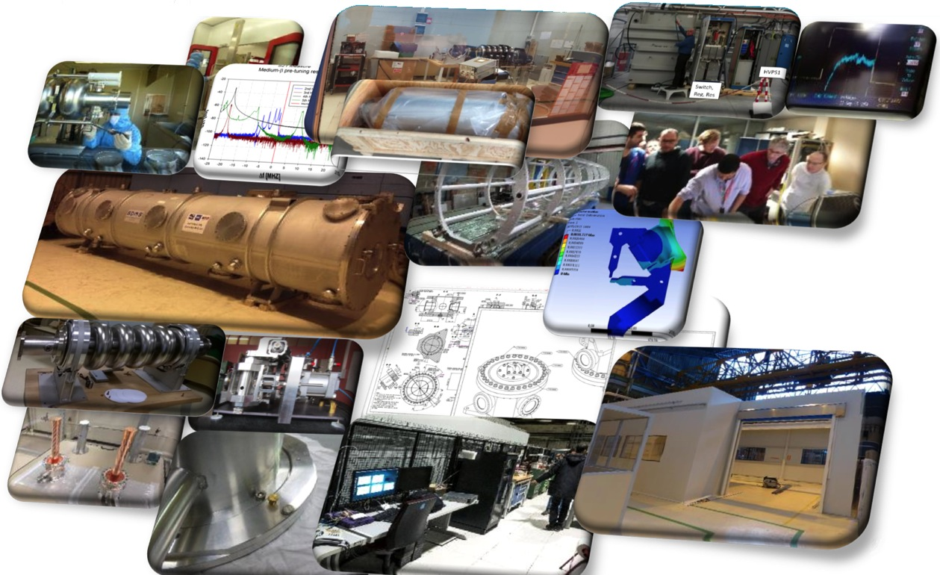
Elliptical Cavities and Cryomodules (Saclay)

Slide 12
Elliptical Cavities (Milan, Daresbury)
Elliptical cavities are delivered from LASA, Milan (medium beta) and from STFC Daresbury Laboratory (high beta) to Saclay for assembly into cryomodules.
Medium beta: 36 cavities plus spares, 45 MV/m surface field, 16.7 MV/m
High beta 84 cavities plus spares, 45 MV/m surface field, 19.9 MV/m
The delivery includes procurement, manufacturing and testing in vertical test stand. Although tested cavities will be shipped directly to Saclay, these are in-kind contracts between the Milan/Daresbury and ESS.
An SRF collaboration within the collaboration has been established, and a Collaboration Agreement is signed by all partners of the Accelerator Project to regulate IP, publications and other issues between partners.

Slide 13
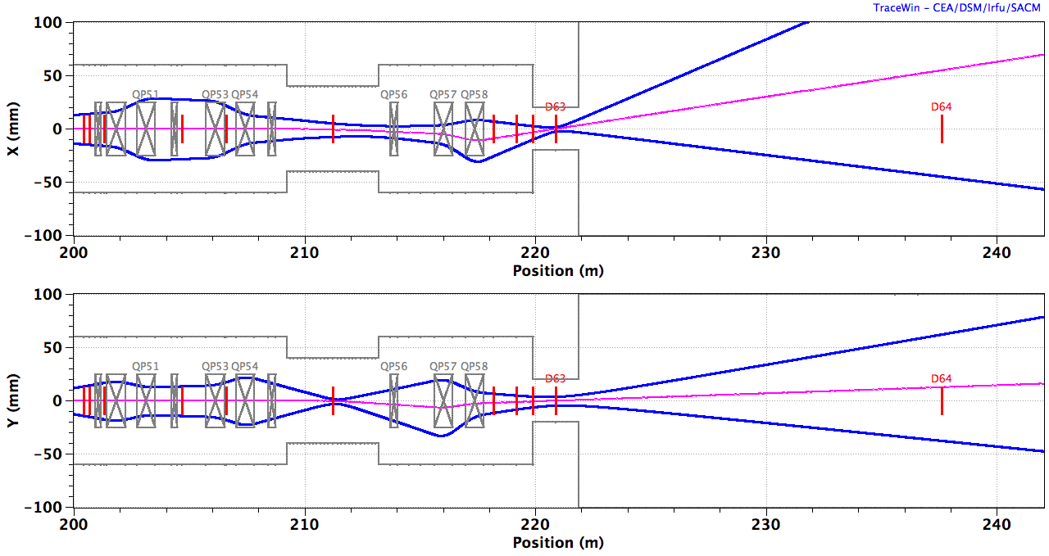
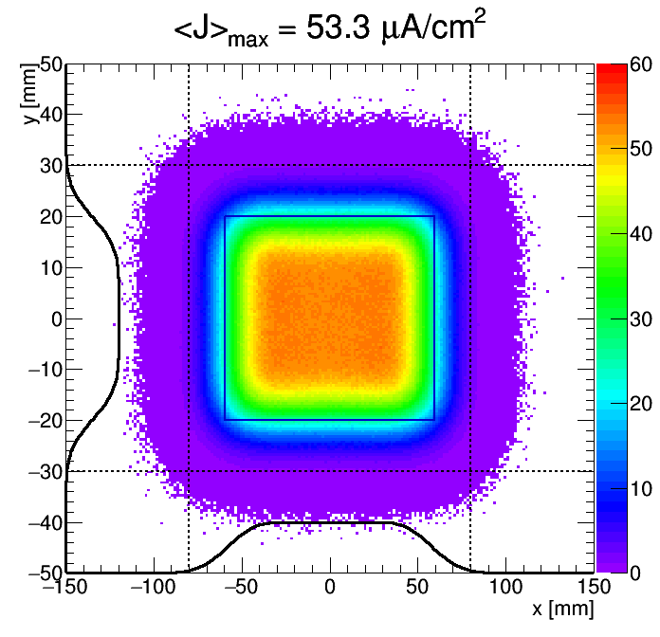
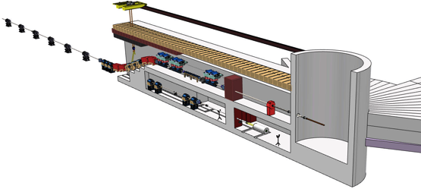
Beam Delivery System (Aarhus)
Fast rastering magnets expands the beam onto the proton beam window and the beam entrance window of the target wheel
The HEBT design and beam-delivery system are contributions from ISA, Århus.

