Slide 1
Medium Beta
Elliptical Cavities

Slide 2
Layout
EM and structural design of INFN LASA cavity completed
Prototypes
  Status and plan
Series production
  Status and plan

Slide 3
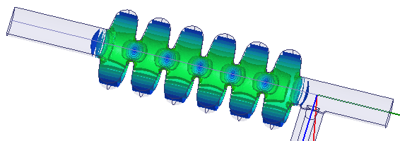
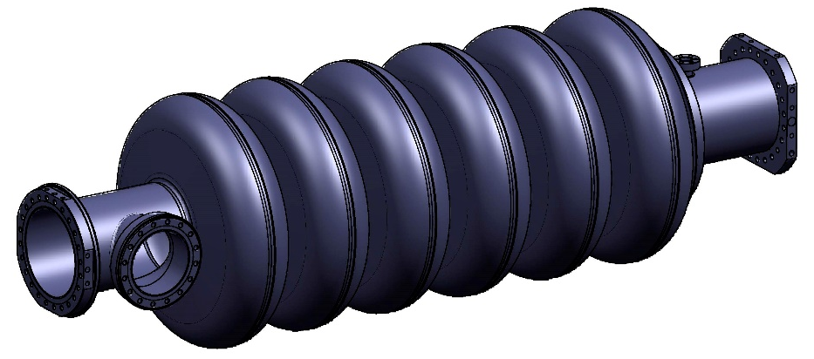
Cavity Electromagnetic Design
BuildCavity
Output
Optimum beta = 0.705 (peak of read line in TTF curve)

Slide 4
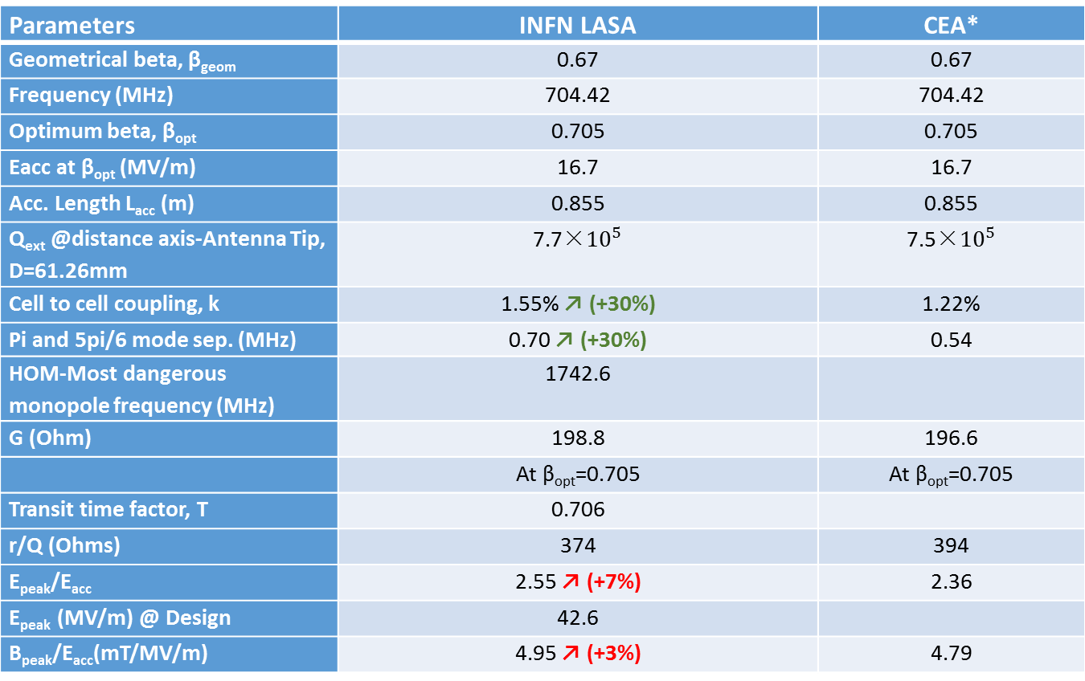
Cavity RF parameters
GOAL: Increased ~30% k & mode sep, with modest increase of peak fields (<<10%)
Parameters | INFN LASA | CEA*
Geometrical beta, β_{geom} | 0.67 | 0.67
Frequency (MHz) | 704.42 | 704.42
Optimum beta, β_{opt} | 0.705 | 0.705
Eacc at β_{opt} (MV/m) | 16.7 | 16.7
Acc. Length L_{acc} (m) | 0.855 | 0.855
Q_{ext} @distance axis-Antenna Tip, D=61.26mm | 7.7×${10}^{5}$ | 7.5×${10}^{5}$
Cell to cell coupling, k | 1.55% ↗ (+30%) | 1.22%
Pi and 5pi/6 mode sep. (MHz) | 0.70 ↗ (+30%) | 0.54
HOM-Most dangerous monopole frequency (MHz) | 1742.6
G (Ohm) | 198.8 | 196.6
 | At β_{opt}=0.705 | At β_{opt}=0.705
Transit time factor, T | 0.706
r/Q (Ohms) | 374 | 394
E_{peak}/E_{acc} | 2.55 ↗ (+7%) | 2.36
E_{peak} (MV/m) @ Design | 42.6
B_{peak}/E_{acc}(mT/MV/m) | 4.95 ↗ (+3%) | 4.79
*Enrico Cenni, Production of the medium beta cavities at Zanon, 23/06/2015

Slide 5
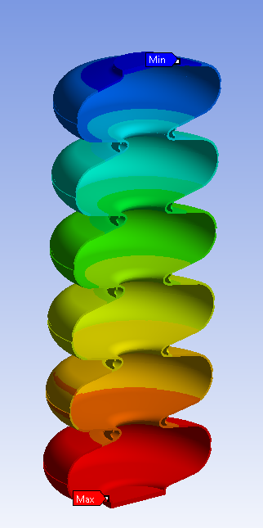
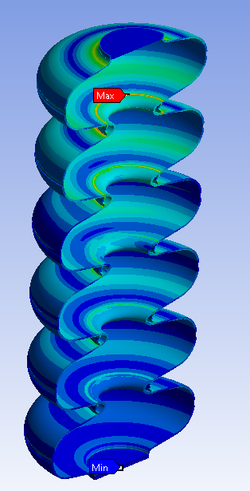
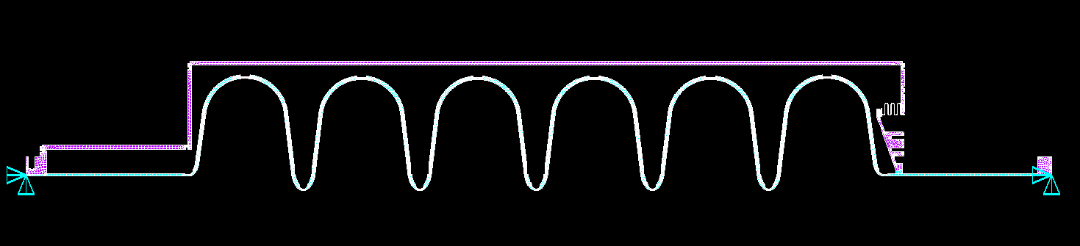
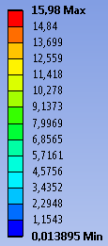
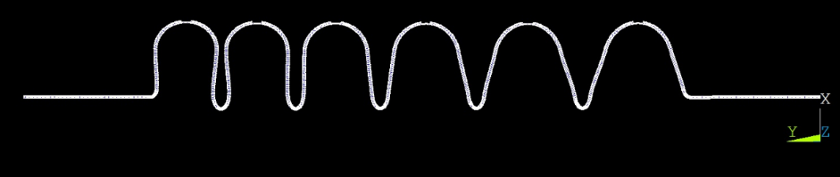
Cavity Mechanical Design
Mechanical parameter | INFN Design
Cavity wall thickness (mm) | 4.5
Stiffening ring radius (mm) | 70
Internal volume (l) | 69
Cavity internal surface (m²) | 1.81
Stiffness (kN/mm) | 1.69
Tuning sensitivity K_{T} (kHz/mm) | -171
Vacuum sensitivity K_{V} for K_{ext} ~ 20 KN/mm (Hz/mbar) | 30
LFD coefficient K_{L} for K_{ext} ~ 20 KN/mm (Hz/(MV/m)²) | -2.5
2D Model Cavity + He Tank
First Natural Mode – Fixed Cavity = 86 Hz
Water filled - Displacement
Water filled – von-Mises Stress (Mpa)

Slide 6
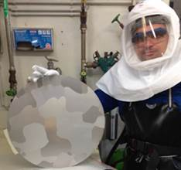
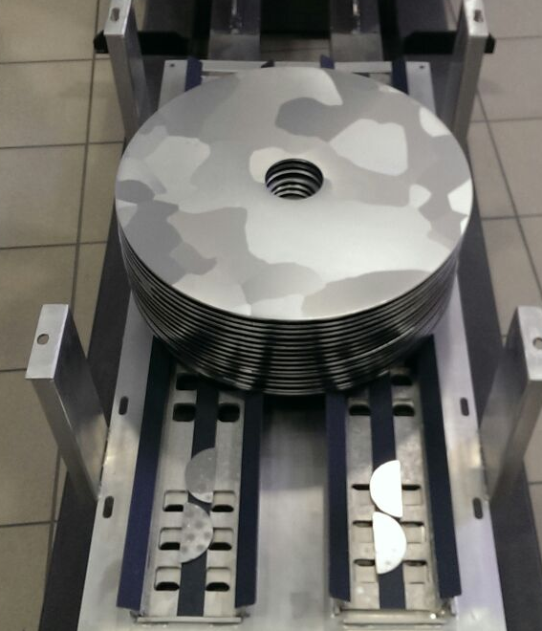
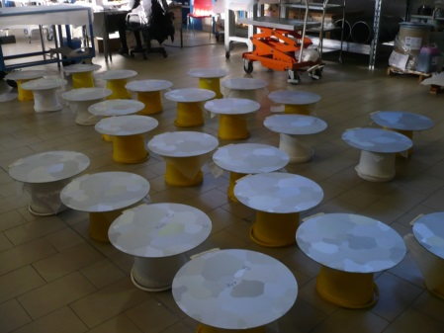
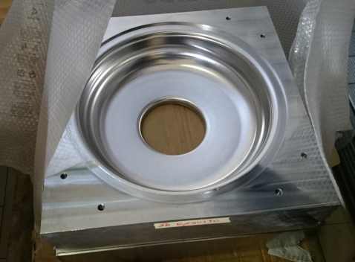
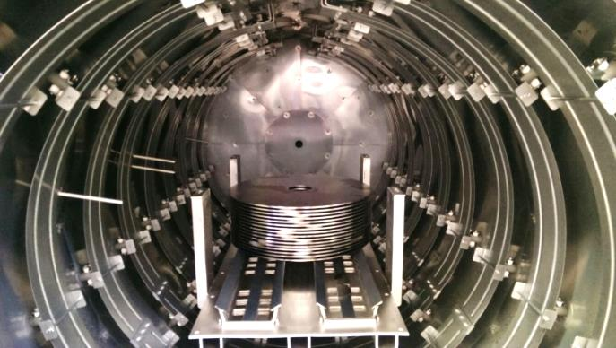
Medium beta cavities prototypes
2 medium beta prototypes cavities are under construction with the INFN design, fully plug compatible with CEA design.
  All treatments at the vendor
Material:
  Nb Large Grain: already in house, chemistry on disks done,
  heat treatment under way
  Nb FG: in house, now at Zanon.
Deep drawing tool: 2 are ready, the third one
in completion.
  Deep drawing test on copper in progress

Slide 7
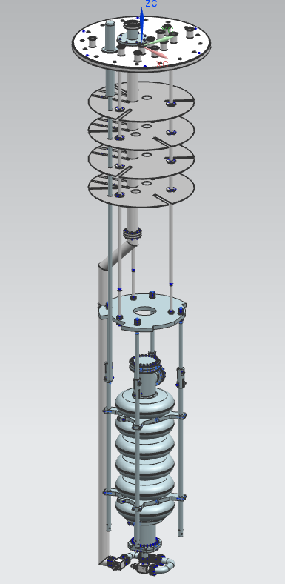
Medium beta cavities prototypes
Cavities delivery
  first prototype by the end of August,
  second one begin of September.
Upgrade of E. Zanon infrastructure in progress
  Cavity handling in the clean room
  BCP and acid plant cooling power
  UPW system
  HPR mechanical and hydraulic
  Cleaning and rinsing
Cold test at LASA scheduled beginning of September
  Cold insert at LASA: delivery foreseen in June.
  Main accessories already in house

Slide 8
Medium Beta series
Cavity Status
INFN on the basis of its experience and what has been done so far
is ready to start the procurement process for Niobium and Cavities.
Cold test for series under definition with DESY. It will be finalized once the schedule is fixed.
  2 cavities will be tested in one cooldown.
  Insert design in progress
But
Interface document is still missing.
In our opinion documentation is still far to be sufficient for a safe cavity procurement.
Up to now no data on assembly and debugging of the cryomodule package (cold mass + cavities + ancillaries) are available.

Slide 9
Medium Beta Series
Procurement
Procurement procedures require binding technical documentation with the proper finalization for the call for tender.
If changes on the interface specs are needed after the cryomodule demonstrator assembly and test, it will be a source of delays, addendum to contracts, legal implications and extra costs.
INFN will not pay for these and strongly discourages Call for Tender issued with «provisional» documentation, subject to change!!
We can start the process for cavity procurement now and fully respect the original time schedule, but we strongly suggest to postpone this action after the demonstration of the cryomodule.

