Slide 1
Workshop for reaching BoT and first commissioning
Global view (+ ESH)

Slide 2
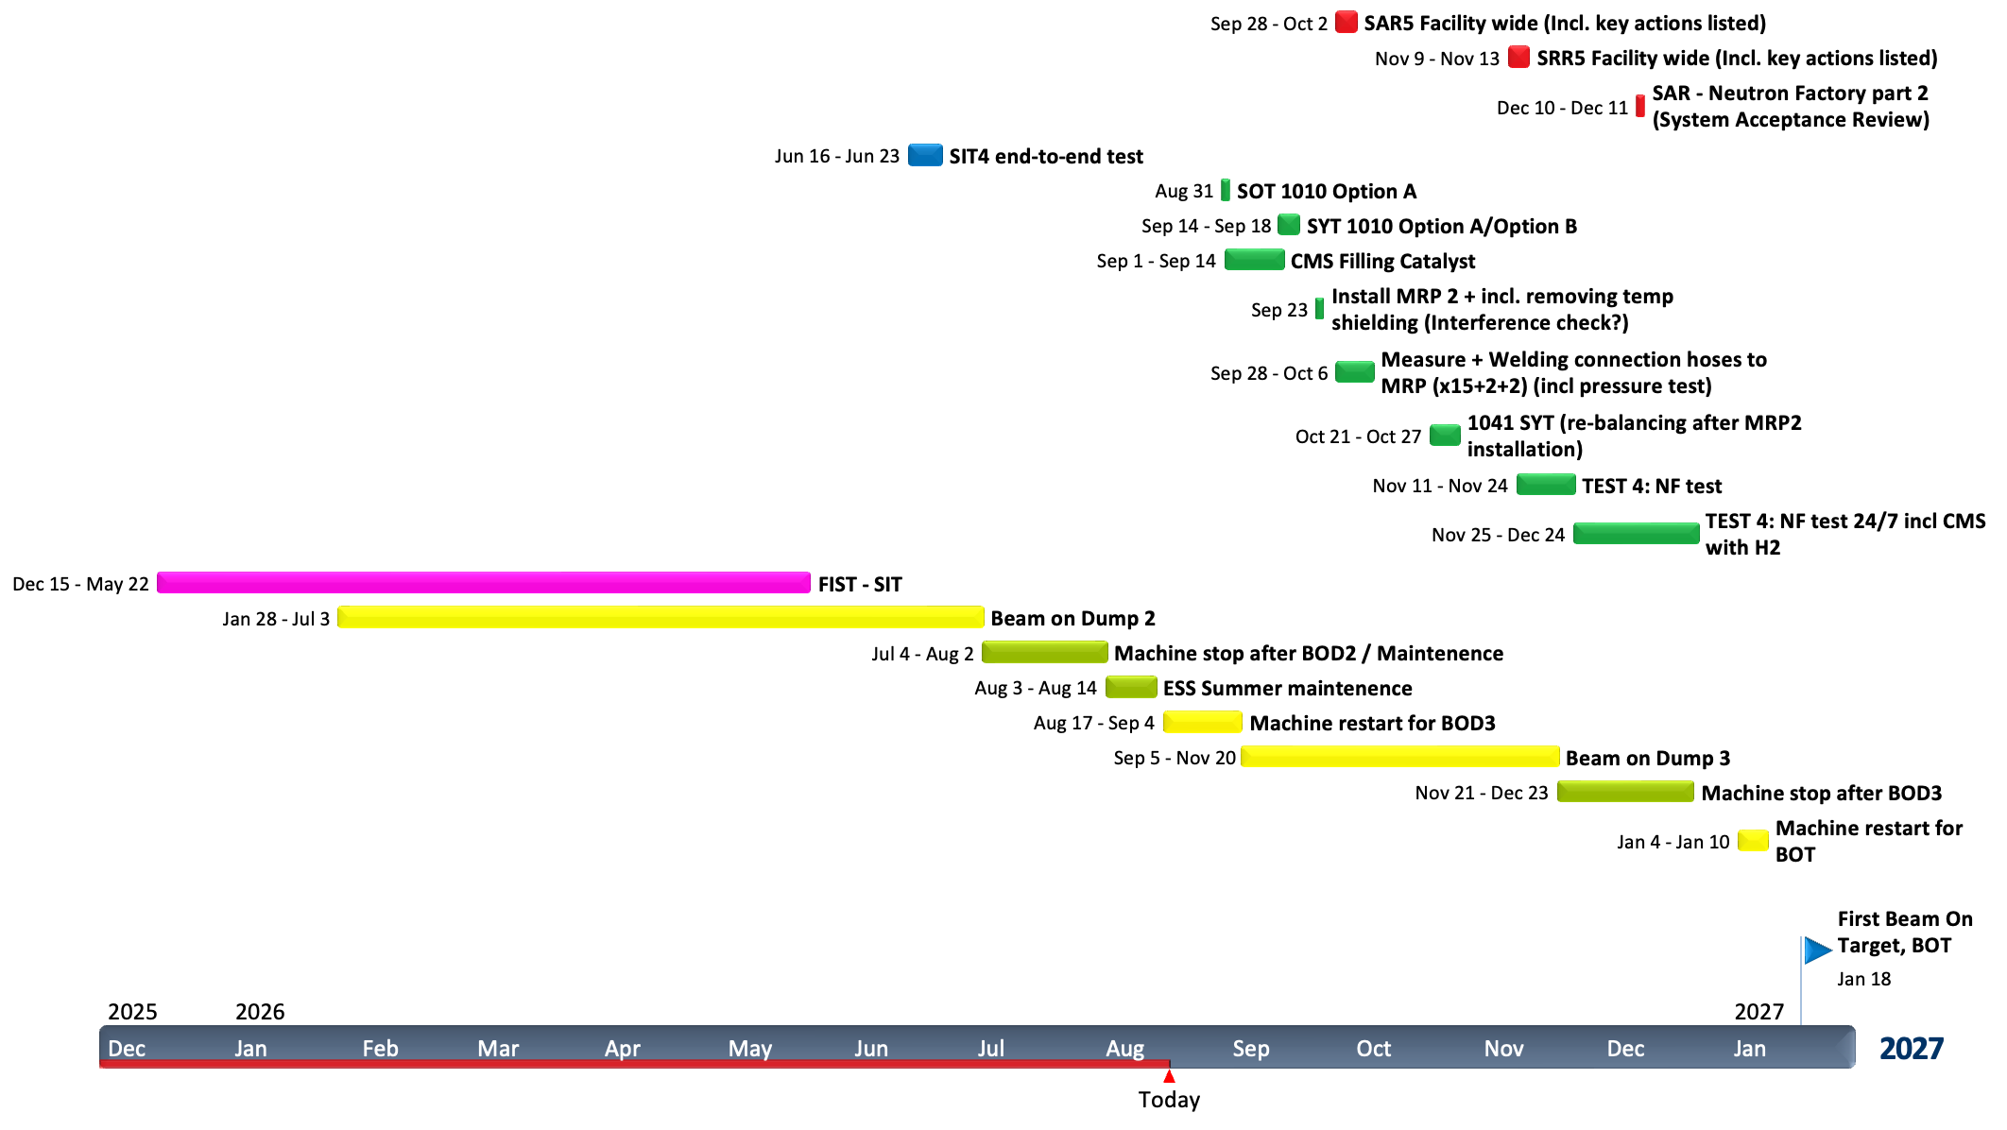
High-Level Plan
Dates from P6

Slide 3
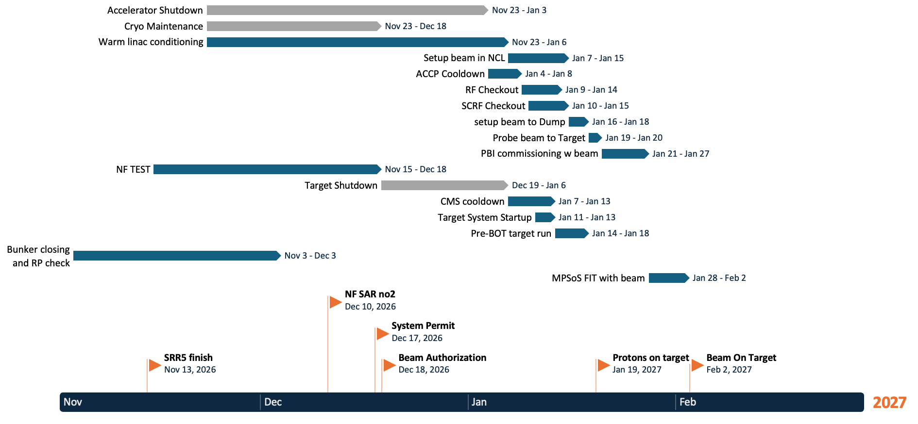
High-Level Plan
More details, based on mix of inputs + my own thought .
Possibility to acheive
BOT here, if imaging is
able to measure probe.

Slide 4
POT before Christmas?
More details, based on mix of inputs, not all in P6.
Would need to cancel the
Cryo maintenance or start
it earlier (with risk to BOT3
goals, and impact on future shutdown planning)
Accelerator would be ready directly from BOT3 if shutdown cancelled and no 4K warmup
Focus NF test on MRP/Safety only
Stability test after POT?
NF test would need to be shortened (test only Option B and focus on MRP?). POT would be a direct continuation of NF test
Bunker closing probably OK, but float gone
System permit will be VERY tight for target and Science!!!
BOT would likely later

Slide 5
Main Schedule Risks / Concerns
Describe the issue and its schedule consequence. Consider resources, technical uncertainty, duration estimates, readiness, and important dependencies.
 | Risk / Concern (Resources, Technical, Duration, Readiness, Dependencies) | Schedule impact | Proposed action / decision
1 | Resulting technical actions from SAR or SRR pushes schedule | Delay to system permit, pushing BOT | Review and Prioritize, Close as many as possible, Defer to DEBT if possible
2 | TSS and CAT plan delay | Delay to system permit, pushing BOT | Management oversight. Add resources?
3 | Documentation not complete when expected | Actions from reviews, delay in system permit | Accept some gaps in documentation?
4 | System permit process for the entire facility may take longer that expected | Day to Day push on BoT | Start early. Have draft at SAR 5.
5 | The parallel process of adding an instrument have not been tested before | Delay in later instrument start of HC | Be ready to not include in BoT if issues
6 | Both grid and imaging fails, underperforms with beam or takes a long time to commission | Delay to BOT, or impossible to achieve BoT goals as defined. Day to Day push on BoT | Management oversight. Possible mini-review of status and plans. Be ready to redefine BoT goal.
7 | Bottlenecks in central functions or resources (e.g. RP) | Delay in system permit and slow commissioning | More detailed planning
8 | Undefined initial thresholds for protection functions, or missing/unavailable parts of MPSoS | Stuck at probe | BDT to work proactively. Focus on MPSoS subsystem readiness
Notes:
CONCERN → SCHEDULE IMPACT → ACTION / DECISION NEEDED

Slide 6
BoT Scope Not covered by SAR5
Identify BoT activities or deliverables not ready for or not in scope of SAR5
 | Activity / deliverable | Status | Owner | Action or decision needed
1 | H09 full scope (Spent ion resin) | Deferred to later |  | Ongoing (expected by SRR5)
2 | Full body counting (both temporary and permanent solution) |  |  | Ongoing (expected by SRR5)
3

