Slide 1
Workshop for reaching BoT and first commissioning
NSS
Keep it high-level and make actions / decisions easy to identify.
15 min total presentation and discussion (10+5).
Rob, SOFIE

Slide 2
High-Level Plan
Key milestones / activities leading to BoT and during commissioning
Close out GRTs for SAR5 & SRR5 – ongoing. No major issues (but still a lot to do in short time)
  Building access and zones; GRT/etc.
  Several actions noted in GRTs for SAR5 are not high or critical, we are aiming for completion by December.
2. SaSS: Finalise the additional work, including;
A) Finalise the SaSS installations that we have started (5 CCRs on this topic.) – P6 details on next slides
B) Close the bunker, and do all safety checks etc (closing starts mid November)
C) Update relevant documents (work starting in parallell to A&B above)
3. Get DREAM, ESTIA and NMX ready (ESS goal to have ready for BOT, but wouldn’t push out BOT)
A) Approval of TG5/SAR & iSRR -> Dream and Estia reviews held, approval in September. NMX review November
B) Get Beam authorisation -> Initiate process first time after SRR5 approval
Show only the milestones and activities needed to understand your path to BoT. Avoid detailed task lists.

Slide 3
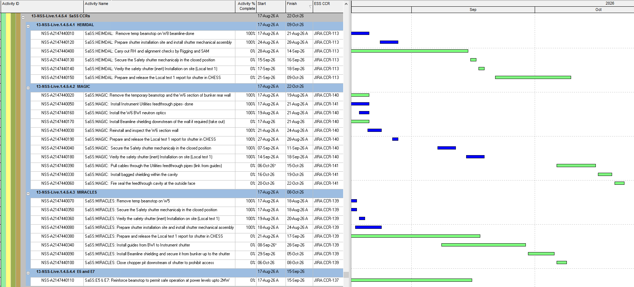
High-Level Plan
NSS S&SS CCRs – needed for BOT
Show only the milestones and activities needed to understand your path to BoT. Avoid detailed task lists.

Slide 4
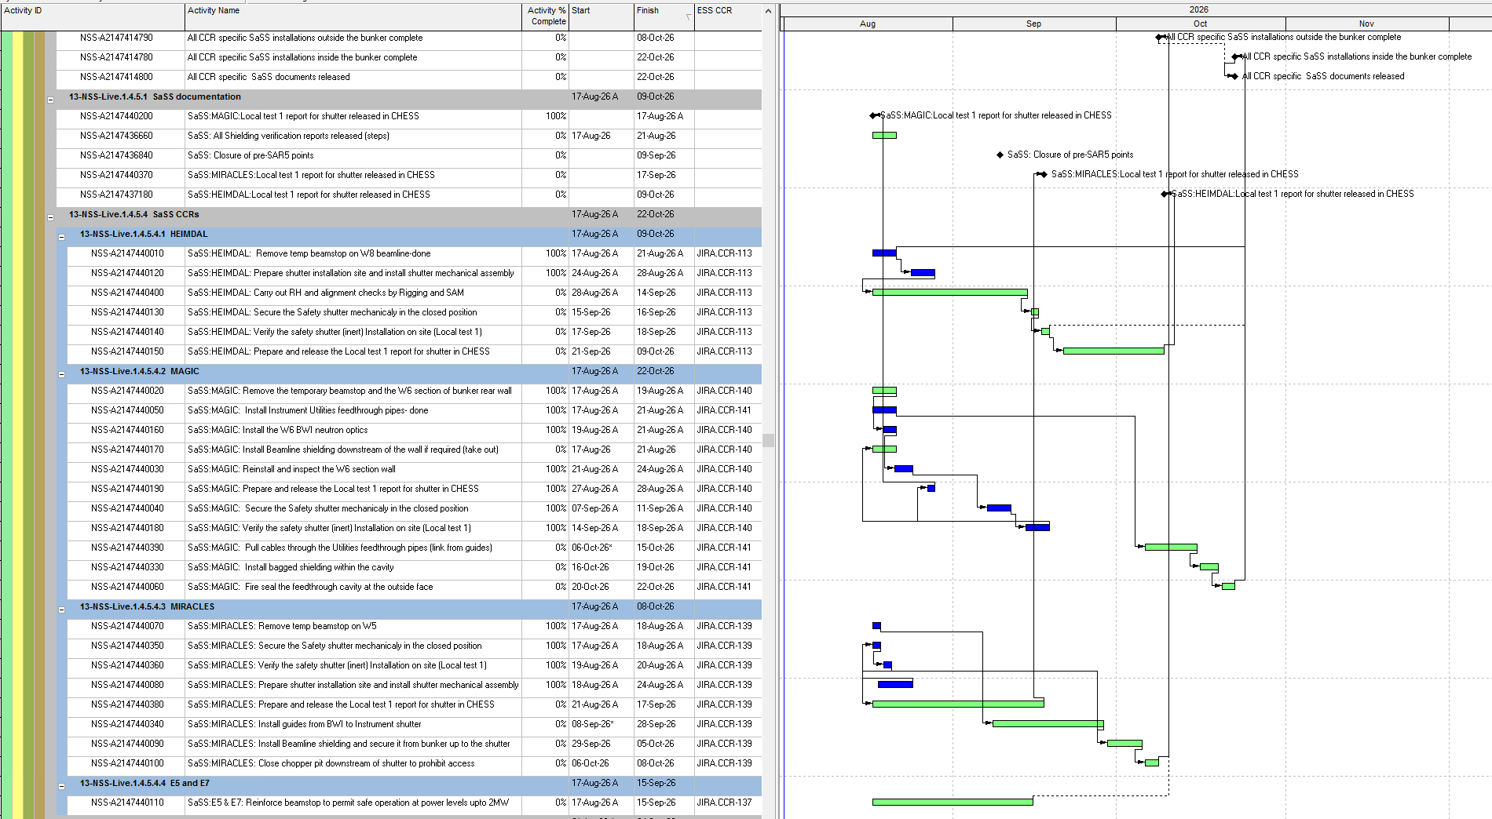
High-Level Plan
Key milestones / activities leading to BoT and during commissioning
Show only the milestones and activities needed to understand your path to BoT. Avoid detailed task lists.

Slide 5
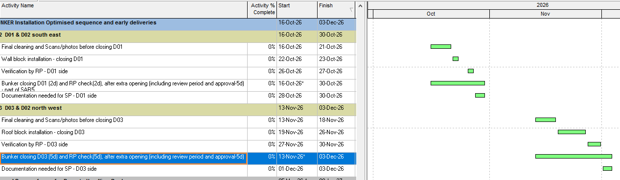
High-Level Plan
NSS Bunker closing for BOT
Links to
System Permit
(B&F)
Show only the milestones and activities needed to understand your path to BoT. Avoid detailed task lists.

Slide 6
Main Schedule Risks / Concerns
Describe the issue and its schedule consequence. Consider resources, technical uncertainty, duration estimates, readiness, and important dependencies.
 | Risk / Concern (Resources, Technical, Duration, Readiness, Dependencies) | Schedule impact | Proposed action / decision
1 | All S&SS SAR actions identified for SAR5 will not be ready for SAR5. | none, will be completed in November | staff are assigned and prioritized
2 | Building access changes | must be done before BoT | WIP, assigning staff to work on it
…
Bring forward issues requiring investigation, prioritisation or cross-organizational action.
We will not solve detailed technical problems in the room.
Notes:
CONCERN → SCHEDULE IMPACT → ACTION / DECISION NEEDED

Slide 7
BoT Scope Not covered by SAR5
Identify BoT activities or deliverables not covered by SAR5
 | Activity / deliverable | Status | Owner | Action or decision needed
1 | The changes to S&S System (Bunker plus) that we are doing AFTER the S&SS SAR. Covered in CCRs: 113, 137, 139, 140, 141 113: Heimdal Beamstop -> Shutter 137: Vespa & E5 beamstop reinforcement up to 2MW 139: Miracles Beamstop -> shutter 140: MAGIC beamstop -> BWI 141: MAGIC installation of Utilities feedthrough and bagged shielding | Work ongoing (all have started) Should be complete by December. | NSS (Rob, Iain) | Assigning internal NSS resources to help with both installations and documentation. Aligning with instruments and partners.
2

Slide 8
Template slides

Slide 9
High-Level Plan
Key milestones / activities leading to BoT and during commissioning
Show only the milestones and activities needed to understand your path to BoT.
Avoid detailed task lists.

Slide 10
Main Schedule Risks / Concerns
Describe the issue and its schedule consequence. Consider resources, technical uncertainty, duration estimates, readiness, and important dependencies.
 | Risk / Concern (Resources, Technical, Duration, Readiness, Dependencies) | Schedule impact | Proposed action / decision
1
2
3
…
Bring forward issues requiring investigation, prioritisation or cross-organizational action. We will not solve detailed technical problems in the room.
Notes:
CONCERN → SCHEDULE IMPACT → ACTION / DECISION NEEDED

Slide 11
BoT Scope Not covered by SAR5
Identify BoT activities or deliverables not covered by SAR5
 | Activity / deliverable | Status | Owner | Action or decision needed
1
2
3

