Slide 2
RFQ Overview
Domenic Nicosia lINAC gROUP

Slide 3
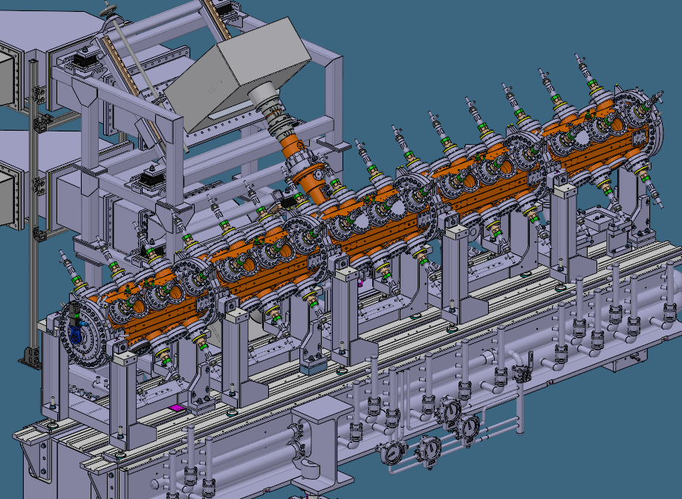
ESS RFQ
Introduction
RF frequency | 352.21 MHz
RF Pulse structure | 14 Hz, 3.2 ms
Nominal Fwd Pwr | ≈800 kW
Vane Voltage | ≈120 kV
Input energy | 75 keV
Output energy | 3.6 MeV
Length | 4.5 m
Design beam current | 62.5 mA
Duty factor | ≈4%
In-kind Partner | CEA Saclay
Installation at ESS | Delivered and installed in 2019

Slide 4
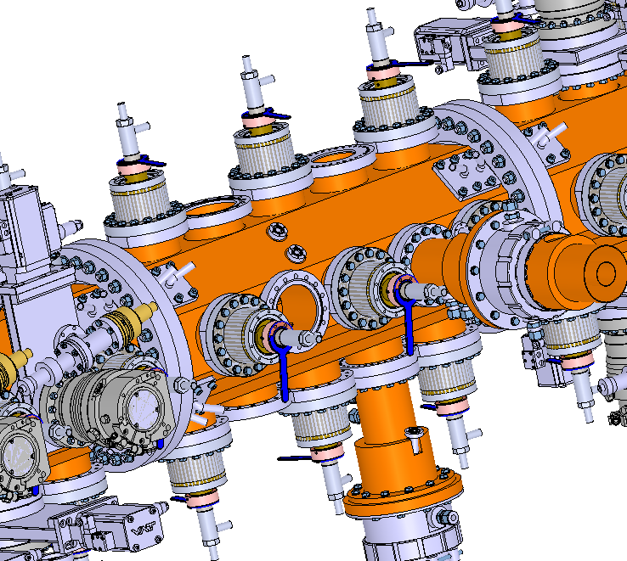
ESS RFQ
Pick up
Major Vane
Minor Vane
Tuner
Power Coupler

Slide 5
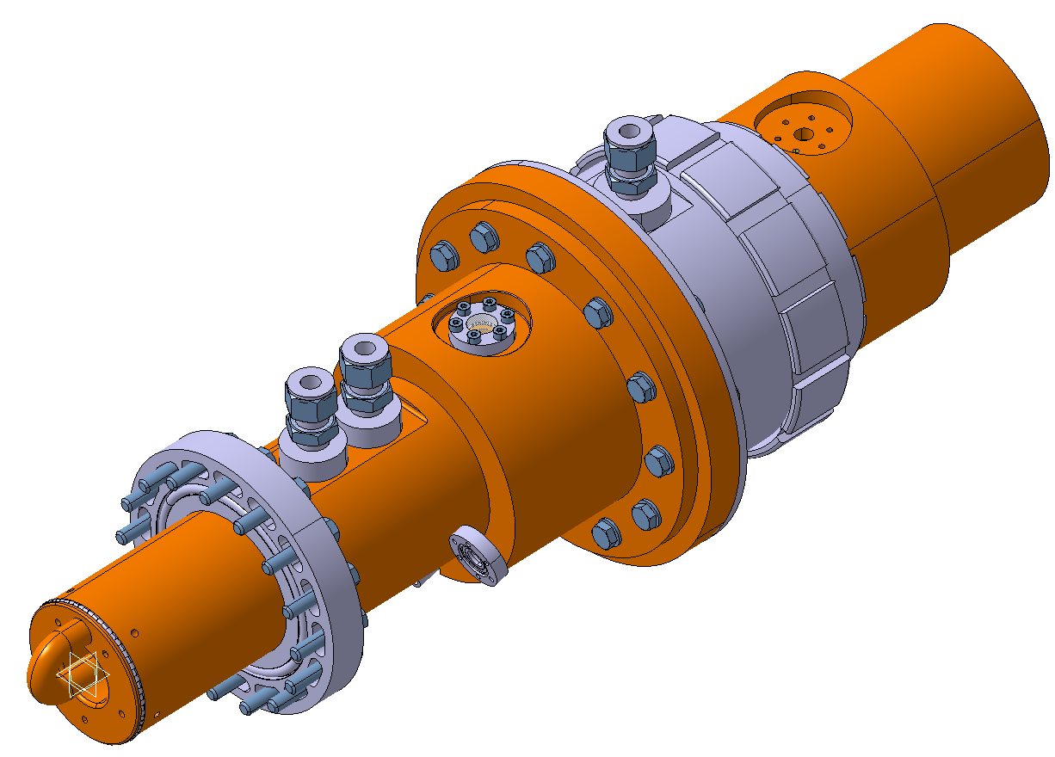
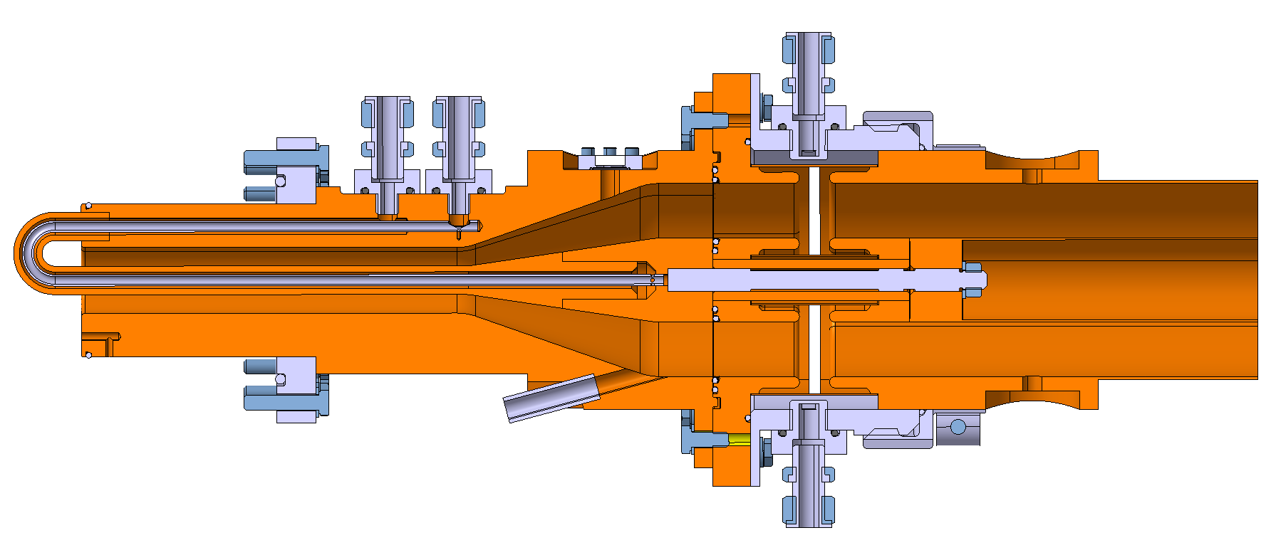
ESS RFQ
RF Power Coupler
Water Cooling circuits
RF Window

Slide 6
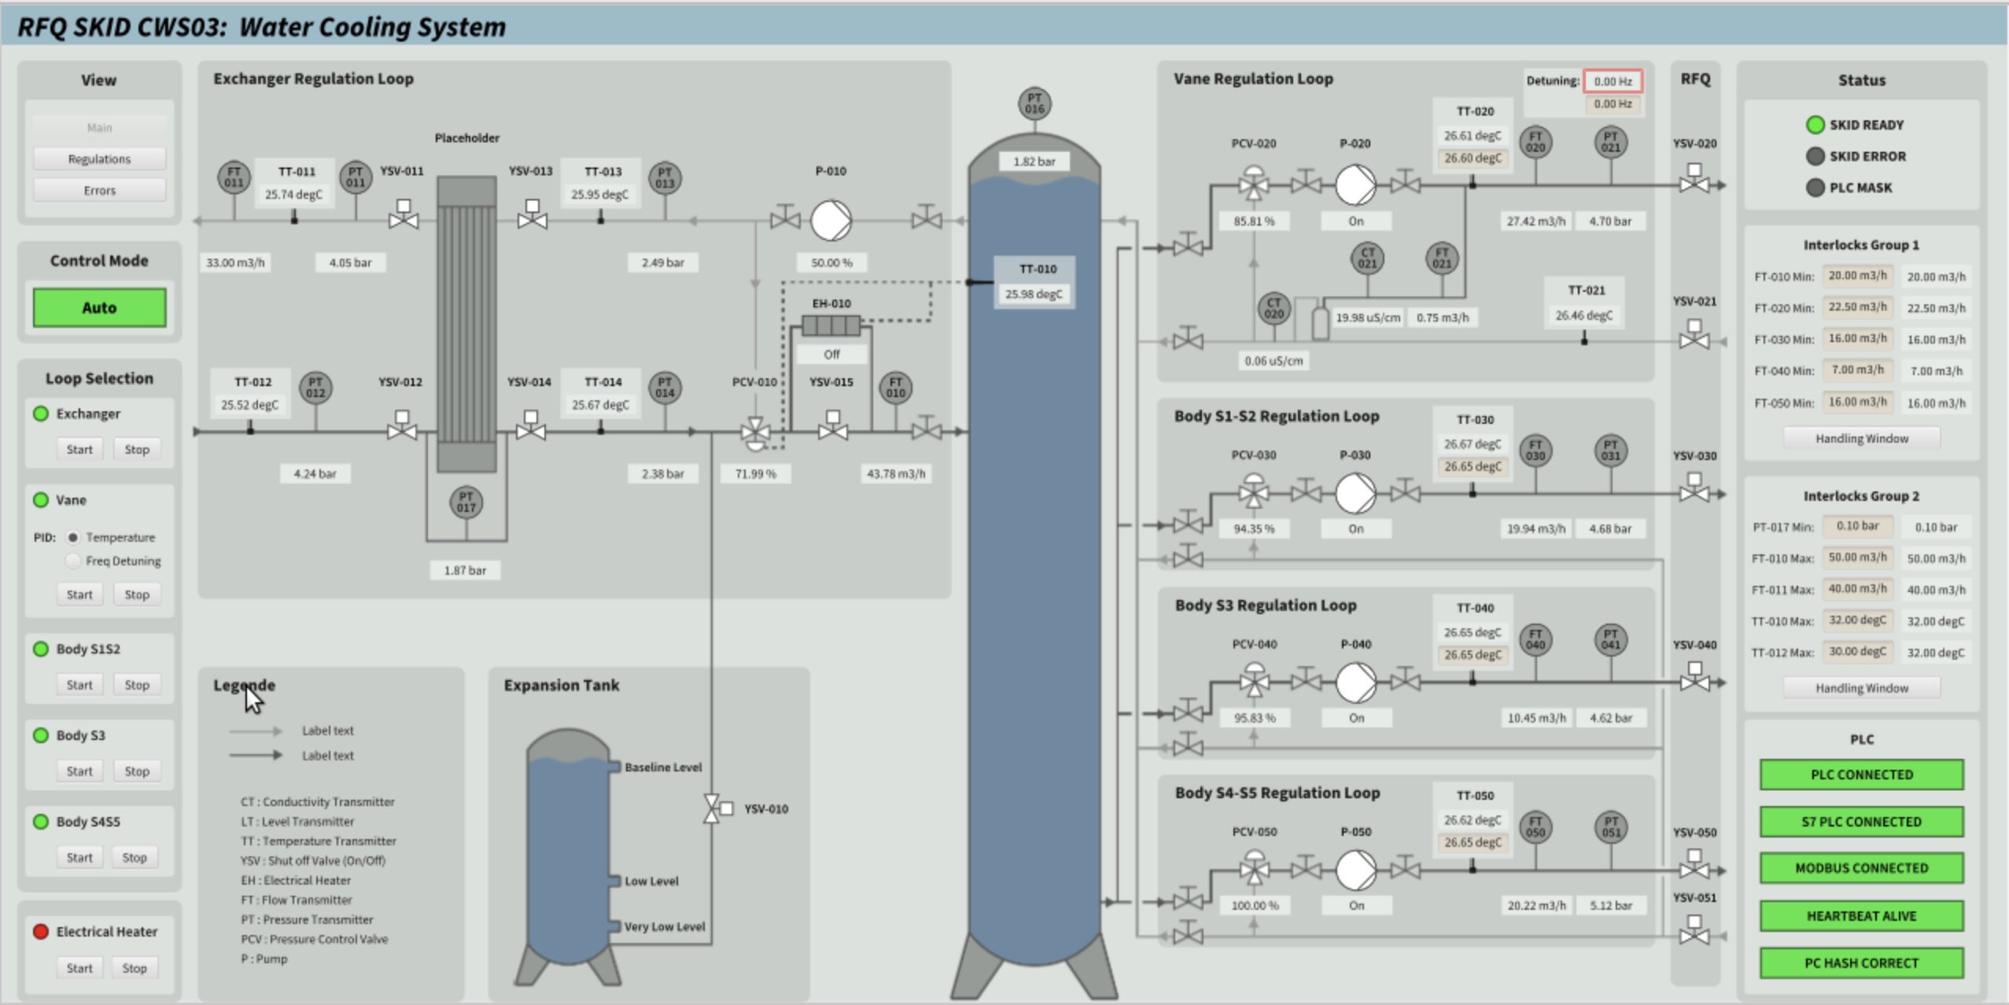
ESS RFQ
Cooling Skid

Slide 7
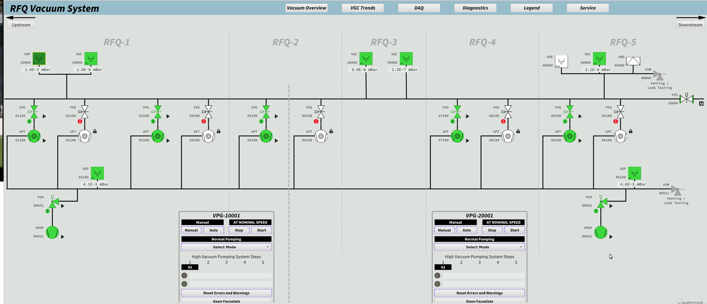
ESS RFQ
Vacuum System

Slide 8
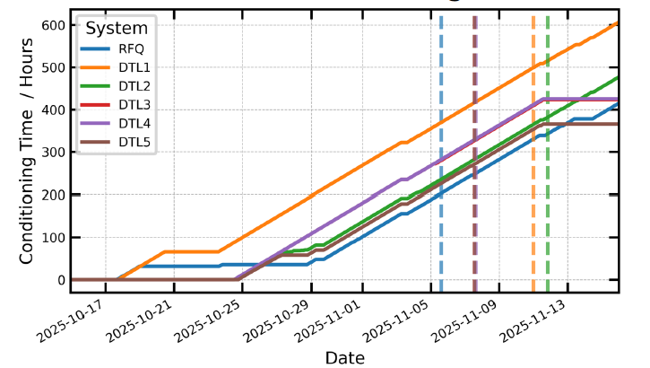
ESS RFQ
RF Operation
First Conditioning in 2020, 49 days
BOD1 Conditioning time 44 days
BOD2 Conditioning time 9 days
BOD3 Conditioning time ~7 days (TBC)
BOD 2 RF Conditioning

Slide 9
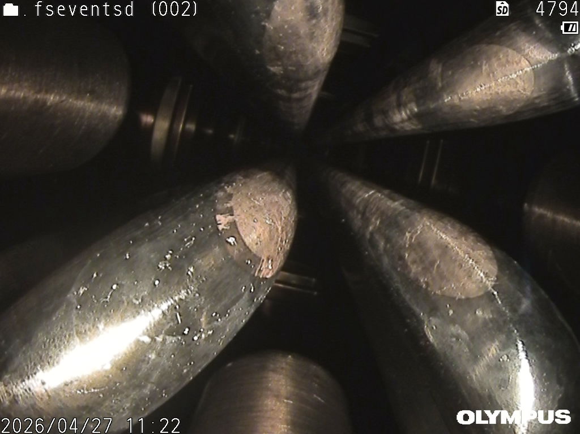
ESS RFQ
Endoscopy

Slide 10
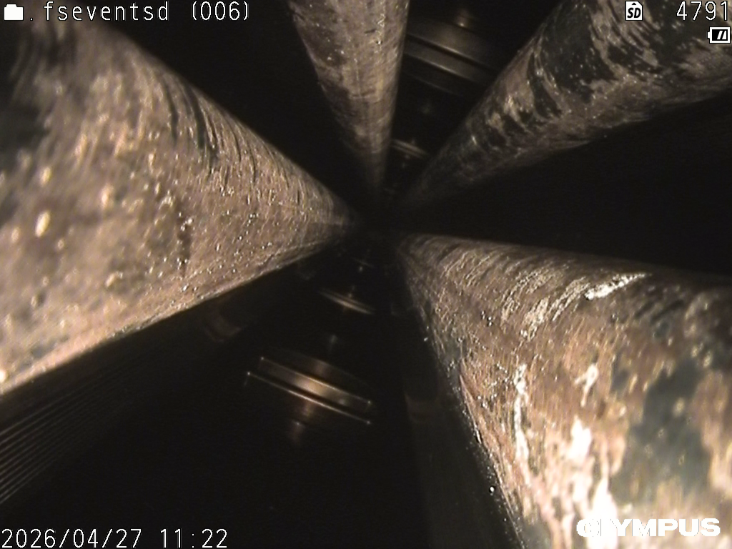
ESS RFQ
Endoscopy

Slide 11
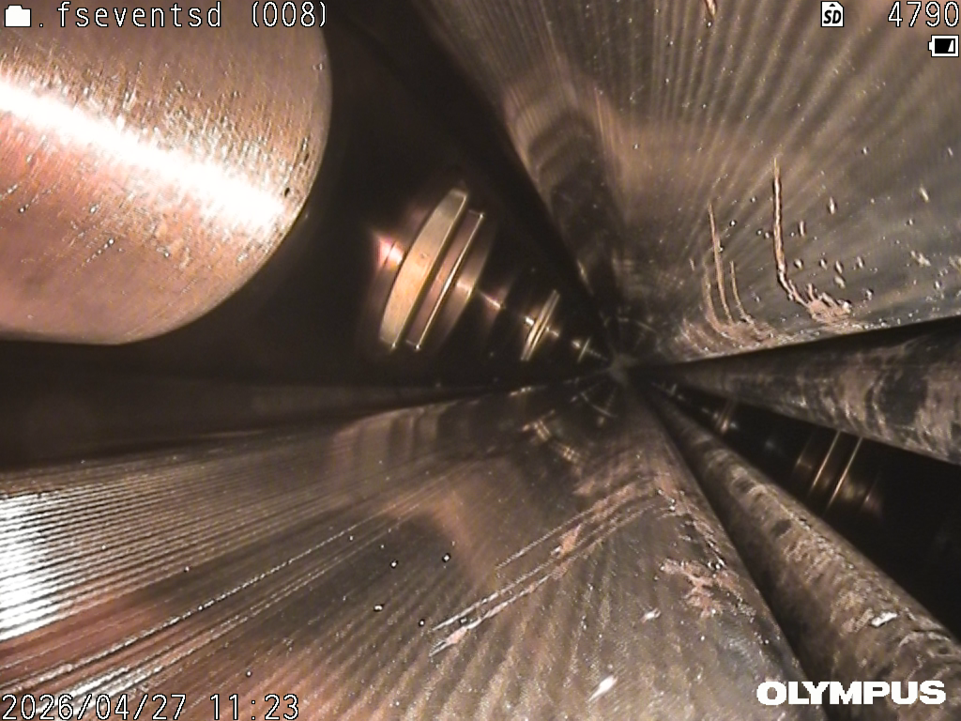
ESS RFQ
Endoscopy

Slide 13
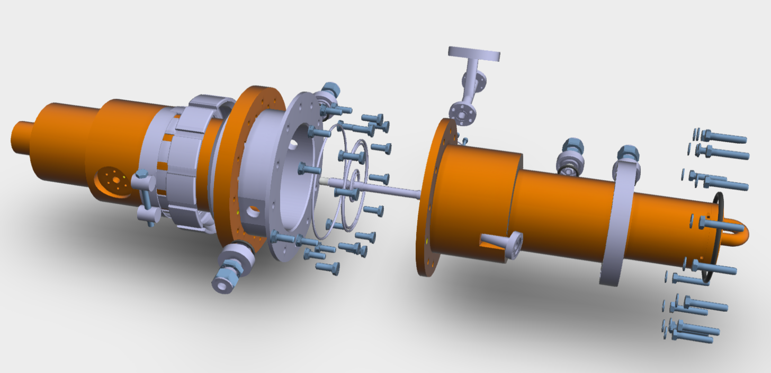
ESS RFQ
RF Power Coupler

Slide 14
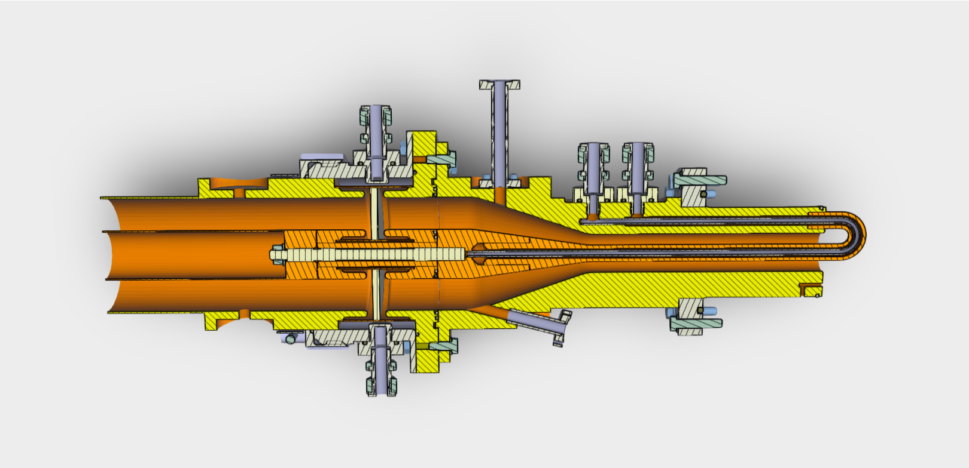
ESS RFQ
RF Power Coupler

