Slide 1
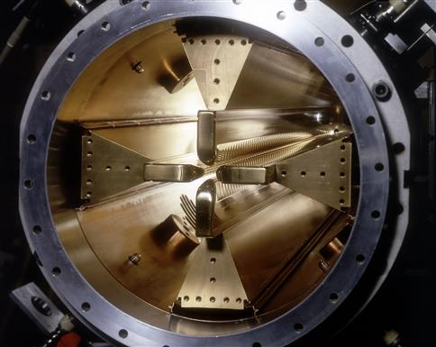
45 years of CERN RFQs: challenges, technologies, failures, spares
Maurizio Vretenar CERN Honorary Associate ESS 31 August 2026

Slide 2
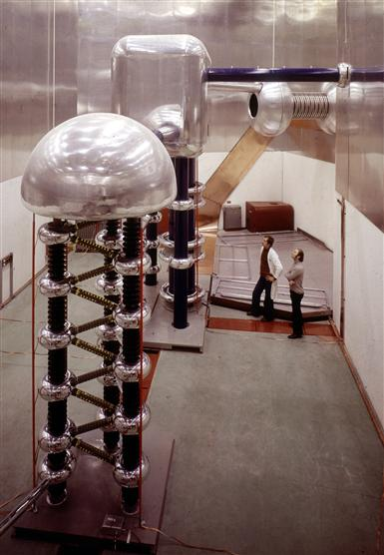
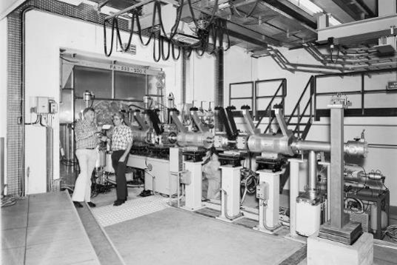
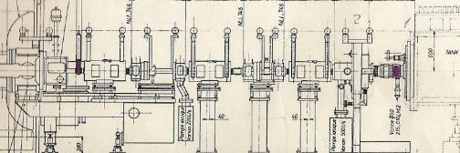
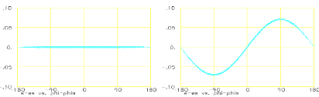
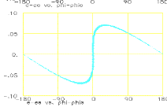
Before RFQ’s: the CERN Linac2 Cockroft-Walton and LEBT
5.6m
Double harmonic buncher (200-400 MHz)
DTL
W
Useful beam (inside DTL acceptance)
φ
Large and expensive HV column
Maintenance and reliability (750 kV operation)
Low bunching efficiency (~50%)
Long LEBT line with inefficient magnetic focusing (∝ β)
Difficult DTL at low energy (short tubes and quads)
Emittance growth in long LEBT
The Linac2 Cockroft-Walton, 1978

Slide 3
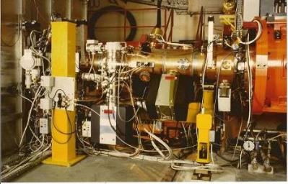
The CERN high-intensity RFQ (RFQ2, 200 mA, 1993)
The new RFQ2 pre-injector at CERN (1993):
Source+LEBT+RFQ
3.2m
Taking the place of the old LEBT

Slide 4
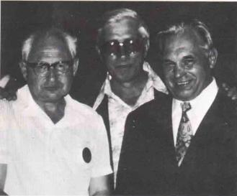

A short history of the RFQ
The driving force for the development of new solutions for the low-energy section was the research in URSS and USA on high-current proton accelerators. The goal was to break limitations to current coming from space charge and bunching losses.
1960’s: Early works of I. Kapchinski at ITEP (Moscow): electric quadrupole focusing channel, excited at RF frequency, and modulated to add a longitudinal field component providing adiabatic bunching and acceleration.
1969: an RF resonator designed around Kapchinski’s electrodes by V. Teplyakov (IHEP) and first paper by Kapchinski and Teplyakov (in Russian). Experimental RFQ in 1974.
1977: the idea arrives at Los Alamos (USA), introduced by a Czech refugee.
Atom, July 1980
1977-1980: the Los Alamos team works on the idea (for Fusion Material Irradiation), improves the original Kapchinski structure and develops a new resonator design. First complete RFQ is built at Los Alamos and successfully operated (for a few hours…) in February 1980.
1980’s: the RFQ principle spreads around the world, more RFQs are built worldwide. Long and difficult learning curve (RFQs are not simple devices…).
Atom, July 1980

Slide 5
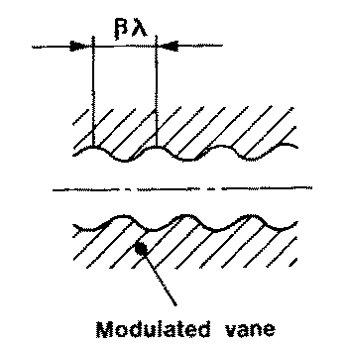
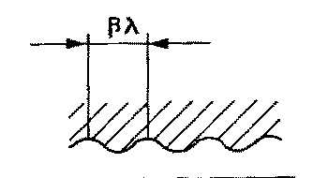
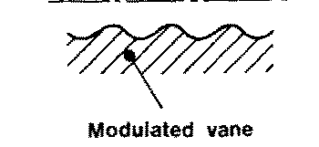
The basic RFQ principles
1. Four electrodes (called vanes) between which we excite an RF Quadrupole mode → Electric focusing channel, alternating gradient with the period of the RF. Note that electric focusing does not depend on the velocity (ideal at low β!)
+
−
−
2. The vanes have a longitudinal modulation with period = βλ → this creates a longitudinal component of the electric field. The modulation corresponds exactly to a series of RF gaps and can provide acceleration.
+
−
+
Opposite vanes (180º)
Adjacent vanes (90º)

Slide 6
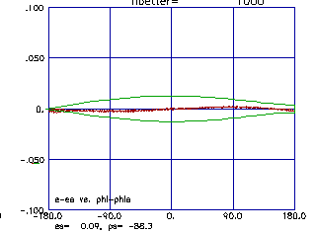
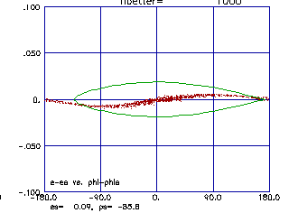
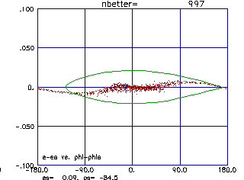
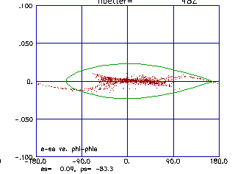
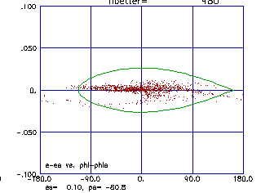
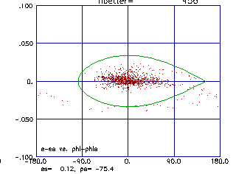
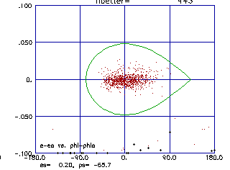
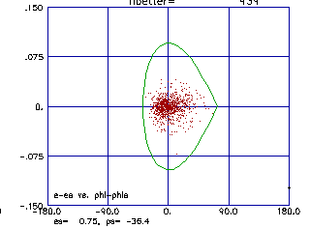
Bunching and acceleration
3. The modulation period (distance between maxima) can be slightly adjusted to change the phase of the beam inside the RFQ cells, and the amplitude of the modulation can be changed to change the accelerating gradient → we can start at -90º phase (linac) with some bunching cells, progressively bunch the beam (adiabatic bunching channel), and only in the last cells switch on the acceleration.
☞ An RFQ has 3 basic functions:
Adiabatically bunching of the beam.
Focusing, on electric quadrupole.
Accelerating.
Longitudinal beam profile of a proton beam along the CERN RFQ2: from a continuous beam to a bunched accelerated beam in 300 cells.

Slide 7
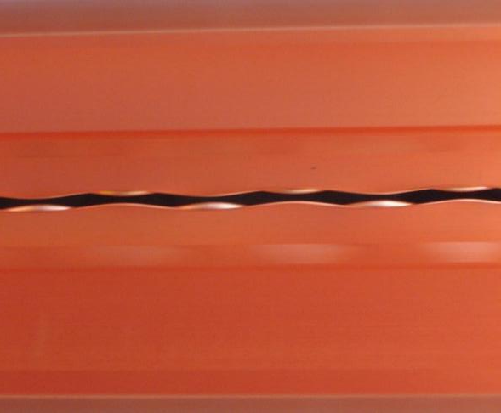
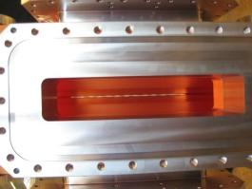
Peeping into an RFQ…
Looking from the RF port into the new CERN RFQ (Linac4, 2011)

Slide 8
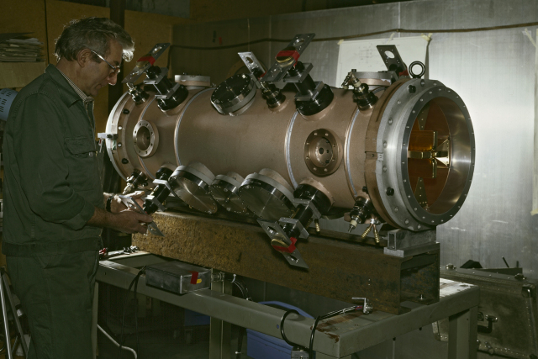

The first RFQ at CERN
RFQs resulted from an “unplanned” URSS-USA collaboration, and CERN was well placed to interact with both!
RFQ1: 202.56 MHz, copper plated mild steel (with “gold flashing on the vanes), built following the Los Alamos 4-vane design in 1981-83 (1.2 m, 500 keV energy to replace Cockroft-Walton of old Linac1).

Slide 9
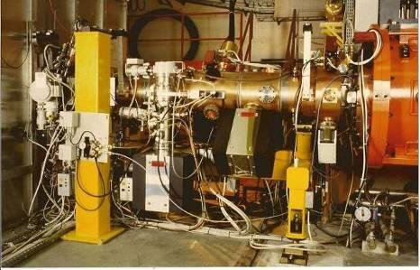
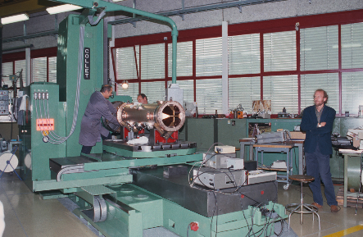
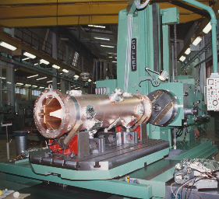
RFQ2 – the high current RFQ for Linac2
1988: approved the construction of a new “high-current” RFQ intended to increase intensity from the injectors for the future LHC – entirely built at CERN.
Key parameter: >200 mA current (needed because CERN at the time was accelerating protons and not H-)
To deal with the space charge, was need a peak surface field up to 35 MV/m, or 2.4 times Kilpatrick.
Operating at this field level was very challenging, even at the low duty cycle of CERN (0.1%).
Main parameters:
  RF frequency 202.56 MHz
  Beam energy 90 – 750 keV
  Design output current 200 mA
  Measured current ~225 mA
  Transmission ~90%
  RFQ length ~1.8 m
  Electrode/vane voltage 178 kV
  Peak surface field 2.4 × Kilpatrick
  Duty cycle 0.1%

Slide 10
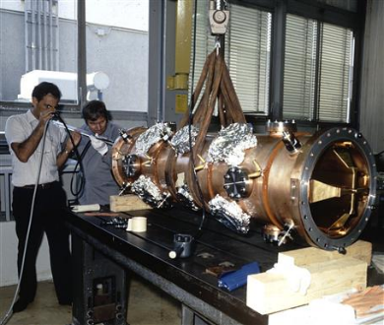
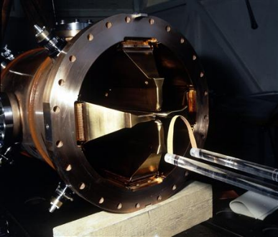
Problems with RFQ2 and the 1st spare RFQ
1990: the RFQ2 installed on the test stand was polluted by oil coming from a vacuum pump because of a faulty vacuum valve. Heavy breakdowns, not able to hold the voltage. Mechanically (vane tips) and chemically (tank) cleaned in the workshop, was able to operate again at nominal voltage, but never as high as before the accident.
1991: decision to build a new RFQ2 and keep the old one as a spare during operation for Linac2.
The new RFQ2 was built in 1991/92 and installed at Linac2 in 1993 – with many problems during construction…
Successful routine operation for 25 years, until decommissioning of Linac2 in 2018. Spare was never used.

Slide 11
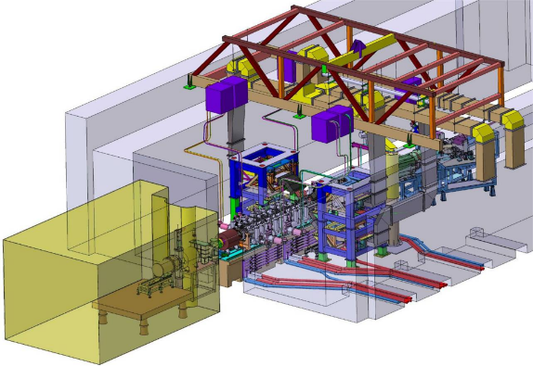
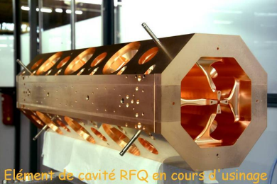
The RFQ for Linac4: early collaborations
Original idea: in the frame of a collaboration with CEA, (to save money) CERN should have got the CEA IPHI RFQ to be used as the front end of the future Linac4.
IPHI was an overkill for Linac4: high duty cycle (100% instead of max. 10%), high energy (5 MeV), high RF power (1.3 MW), complex and expensive construction.
IPHI commissioning was late: CERN authorised construction of a new RFQ dedicated to Linac4.
Basic criterion: reliability
Main problem:
design the RFQ before knowing the ion source parameters.

Slide 12
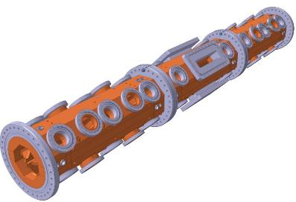
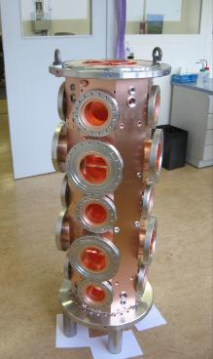
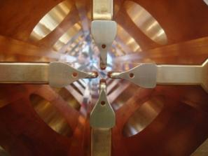
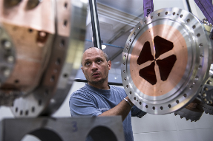
The Linac4 Radio Frequency Quadrupole
Energy 3 MeV (below radiation threshold).
Length 3m, 3 section of 1 m each.
Maximum design duty cycle 10% (for future SPL).
Simplicity and reliability as main design principles: constant voltage, no resonant coupling, waveguide-iris couplers with external windows, tuning by cooling water temperature.
Brazed 4-vane design with simplified shape and cooling.
CERN-developed process for sequence of thermal treatments and brazing steps, to avoid vane deformation.
Collaboration with CEA Saclay (some thermal simulations, RF design and tuning).
Construction entirely done at CERN: machining (10μm on vane modulation) metrology, brazing.
RFQ was ready for RF tests in 2011.
module #1

Slide 13
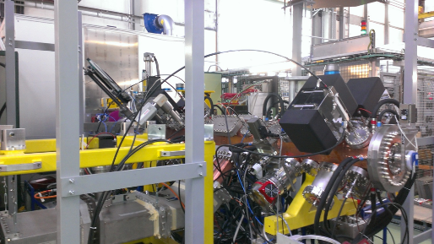
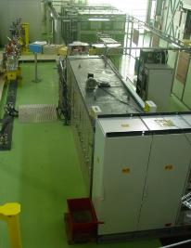
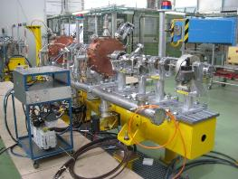
An RFQ needs a test stand
3 MeV TEST STAND installed in the PS South Hall: ion source, klystron, RFQ+MEBT, diagnostics.
Large investment (cooling, electricity, access control, cabling) but invaluable experience in operating the systems and strategic tool for commissioning of RFQ and ion source independently from other schedules.
Notes:
Excellent playground

Slide 14
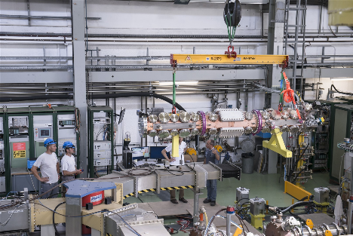
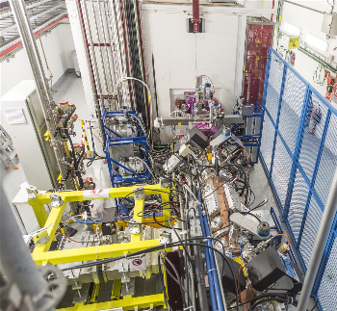
Parameters and operational experience of Linac4 RFQ
Ion species: H⁻
Input energy: 45 keV
Output energy: 3.0 MeV
Operating frequency: 352.20 MHz
Peak design current: 80 mA
Length: 3.06 m
Vane voltage: 78.27 kV
Maximum field on pole tip: 34 MV/m
Kilpatrick value: 1.84
Total peak RF power: 600 kW
Average aperture (r₀): 0.33 cm
Minimum aperture (a): 0.18 cm
Repetition rate: 1.2 s
Max. pulse length: 600 μs
Duty cycle: 0.72%
Output current (meas.): 30 mA
RF conditioning to nominal level in only 80 hours.
Beam transmission only 75% because source emittance factor 4 larger than design emittance (RFQ acceptance had only a factor 2 safety margin) - needed years to study the problem and redesign source extraction before reaching the nominal 95% transmission.
On test stand March-June 2013, moved to tunnel at end 2013.
Routine and uneventful operation during Linac4 commissioning. Operating from 2014 (12 years).

Slide 15
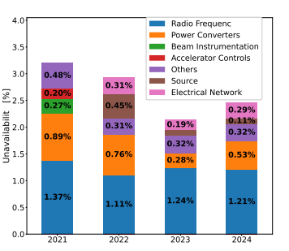

More in general, performance of Linac4
After an extensive off-line testing period, since 2020 Linac4 is connected to the PS Booster and provides particles to all CERN.
Ion source current was increased to 40 mA (RFQ transmission 82%). Measured normalized r.m.s. emittance at 160 MeV is
0.26 𝜋mm mrad in both transverse planes.
Linac4’s yearly availability systematically between 97% and 98%, with no repeated failures of single elements.
Yearly downtime driven by unpredictable breakdowns leading to equipment exchanges: klystrons (1-2 days), transformers (<1 day), hydrogen valve (0.5 day).
Some RF problems in 2026 due to repeated breakdown recovery cycles on the PIMS modules 11-12 (end of linac) – originated from a corner cube reflector from survey found inside the PIMS 11 !

Slide 16
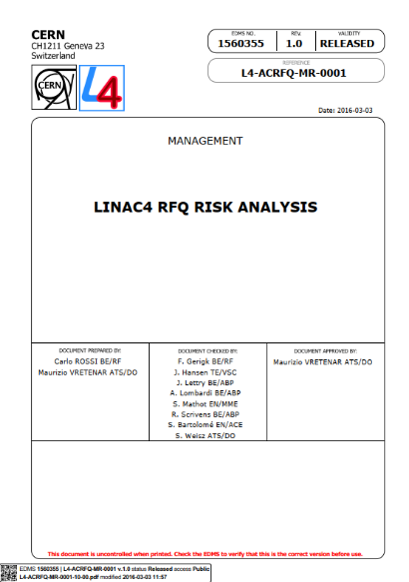
Do we need a spare RFQ? The 2015 risk analysis
  CERN EDMS1560355 (2016-03-03): LINAC4 RFQ RISK ANALYSIS
As the connection of Linac4 to the LHC injectors was approaching, CERN management started to be worried for the RFQ being a Single Point of Failure (SPOF) and asked the question of considering a spare.
2015: Risk analysis conducted, using the methodology applied for the Linac4 construction project in 2009: a) external information collected from laboratories operating RFQs; b) internal risk-analysis workshop for common identification and rating of risks and mitigations (people involved in RFQ construction and operation, including facilities and ancillaries).
The goal was to identify failure modes, evaluate their likelihood and impact, and define possible mitigations.
As final result, a decision on the spare was expected.

Slide 17
Input from RFQ laboratories
CERN (has a spare): RFQ2 at Linac2 suffered from vacuum accidents resulting in hydrocarbon pollution with strong impact on voltage holding because of high operating level (2.4 K). Mitigation: operation at lower voltage at reduced beam transmission.
JPARC (was planning a spare): sparking in the cavity induced by contaminants from the LEBT pumping system and instabilities coming from the stabilizing scheme. Report from JPARC: “RFQ is a consumable, it is working as a kind of beam dump. No one knows its lifetime, but it has definitely a finite lifetime.” 20% of beam is permanently dumped on the RFQ.
SNS (ordered a spare): frequency drifts from thermal accidents (cooling). Some sparking that might come from H- loading.
ISIS (has a spare): 10 years of stable operation, Cesium accidents from ion source with no consequences.

Slide 18
Risk evaluation and ranking – proposed mitigations
 | Risk | P | I | S | Analysis | Mitigation | P' | I' | S'
1 | Electrode damage (sputtering of copper) due to beam loss at the RFQ entrance | 5 | 1 | 5 | Certainly occurring, effect is limited because of the low duty cycle of Linac4 (0.08%) and of the presence of a pre-chopper | Mitigation measures are already present: a) surveillance on beam transmission; b) pre-chopper cutting unused beam. Additional measure can be a mask in the LEBT to scrape the beam out of RFQ acceptance. | 3 | 1 | 3
2 | Electrode contamination due to Cs deposition / normal caesiation. | 5 | 1 | 5 | Certainly occurring, effect is limited because Cs penetrating in the RFQ immediately oxidises (oxide is not e- emitter) | Implement a hard-wired interlock on top of existing procedure to assure that the amount of Cs that can enter the RFQ is always a controlled quantity. | 3 | 1 | 3
3 | Electrode contamination due to Cs deposition / caesiation accident. | 2 | 4 | 8 | Might happen (ISIS); in the worst case, would require a cleaning of the RFQ. The normal level of Cs in the ion source is 25 mg. | Implement a hard-wired interlock on top of existing procedure to assure that the amount of Cs that can enter the RFQ is always a controlled quantity. | 1 | 4 | 4
4 | Damage of the RF power coupler (mechanical deformation or surface effects) | 1 | 4 | 4 | Already well protected mechanically, surface problems quite unlikely | A "box" around the coupler is already implemented. Additional mitigation would be to build a spare Ridge 1 | 1 | 2 | 2
5 | Vacuum degradation due to a cooling circuit water leak (e.g. from erosion of the brazed joints of the water circuit caps). | 1 | 2 | 2 | The caps on the cooling circuits are brazed over a long distance, if happens differential pumping can be applied | No mitigation measure can be envisaged; the risk is evaluated as low. | 2 | 1 | 2
6 | Mechanical deformation of the RFQ (cooling accidents or other). | 2 | 4 | 8 | No stresses present on the cavity, field can be corrected | Build 12 additional tuners or variable tuners. | 2 | 3 | 6
7 | Vacuum contamination of the RFQ from hydrocarbons. | 2 | 3 | 6 | Pumps are dry, oil quantity is minimal, voltage is not too high | Accept reduced beam transmission during re-conditioning. | 2 | 2 | 4
8 | Flanges for RF tuner or RF pick-up are broken because of mechanical stress. | 4 | 2 | 8 |  | Install a protection on critical elements. | 2 | 3 | 6

Slide 19
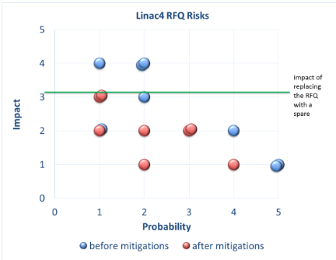
Conclusions (2016)
Set of (not expensive) mitigations proposed for the 8 identified risks. After mitigation the impact (in term of loss of beam time in case of accident) is lower than the impact of the time to replace the RFQ with a spare.
The management compared 3 options:
Build a full spare: 32 months, high construction cost, needs >2 weeks beam stop for exchange , and requires personnel and material cost to keep the test stand operational.
Apply only the small mitigation measures identified.
Intermediate solution: since about 1/3 of construction time is needed for procurement of forged copper and special steel, launch the order for material (20% of cost) and store it to be used in case of need to produce a new RFQ in house.
After some discussions, it was (wisely) decided to follow solution c).

Slide 20
New arguments for a spare – the 2020 inspection
RFQ inspection on 7 and 8 January 2020:
Endoscopy of RFQ via entry at pre-chopper, beam stopper, vacuum valve and solenoid
Endoscopy through vacuum ports of RFQ
Various worrying images – but it was impossible to judge the relevance
RFQ inspection on 1 February 2020:
Solenoid removal, pictures taken by normal camera:
Presumed damage turns out to be mostly variations in surface texture
No profound features were found but surface profile could not be measured through aperture
Since then: Study on beam exposure with breakdown tests.
Possible mechanism of surface texture change due to hydrogen implantation in Cu.
These observations indicate that even for the CERN low duty cycle, risk #1 in the previous list (vane damage from beam loss) has higher probability than estimated in the risk analysis – but did not lead to any performance degradation!

Slide 21
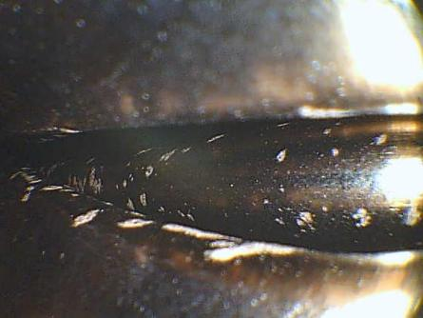
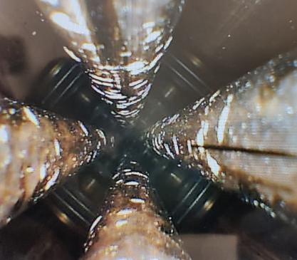
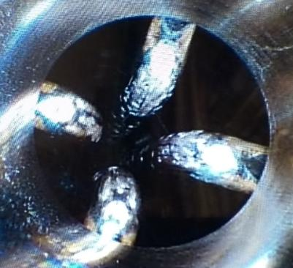
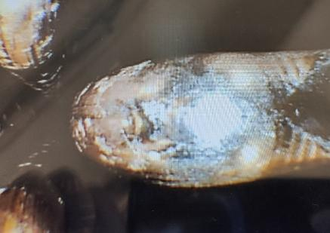
Camera images – 02/2020 (5 year operation)
Really scary…
But similar to what observed on other operating RFQs (e.g. RFQ2 of Linac2)

Slide 22
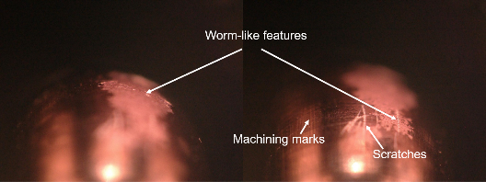
Observation and conclusions after the analysis
  No imminent issue with the damage for operation
  Tests showed: breakdown rate did not depend on beam
  Voltage holding of RFQ did not degrade with operation
No clear signs that the RFQ performance has degraded.
A Working Group was called in 2021-22, to analyse the situation and support decisions.
Two options for using the copper and steel procured after first risk analysis:
Build an identical RFQ (RFQ2) to the existing one;
Build a new RFQ (RFQ3) with higher transverse acceptance and/or using materials more resistant to beam damage.
Option a) was taken, because of: a) time (no need for redesign and material studies); b) the new source extraction was working well, and c) first analysis of alternative materials did not show notable improvements.
An additional argument was that operation of the test stand had been already extended, to support studies of current improvement on the ion source.

Slide 23
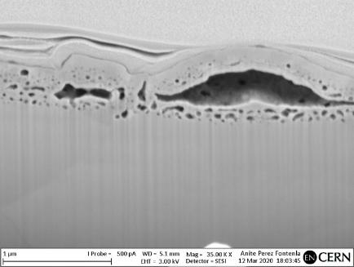
Blistering as main cause of vane degradation
Concern of the process of blistering (reported in literature): hydrogen implantation into copper that accumulates, causing dislocations and eventually ruptures. Implanted ions recombine into molecular hydrogen beneath the metal surface, creating high internal gas pressure that swells the material and forms microscopic blisters.
Concerns this could be a seeding problem for RF breakdowns or peel off.
Test irradiations of copper at the source test stand showed the effect exists, and was incorporated into a material test programme.
It is questionable whether the observed damage on the RFQ surfaces was due to blistering or was some other (or optical?) effect.
Possible blistering damage depends on: beam energy (Bragg peak in copper), beam current, duty cycle, amount of particles lost on the vanes (halo, other species from ion source, LEBT type and length). Is it really a long term concern? Linac4 RFQ run for 5 years with up to 20% beam loss at the entrance because of mismatched emittance…
References: A. Lopez-Cazalilla et al. “Effect of surface orientation on blistering of copper under high fluence keV hydrogen ion irradiation“, "Effects of H⁻ low beam irradiation and high field pulsing...“.

Slide 24
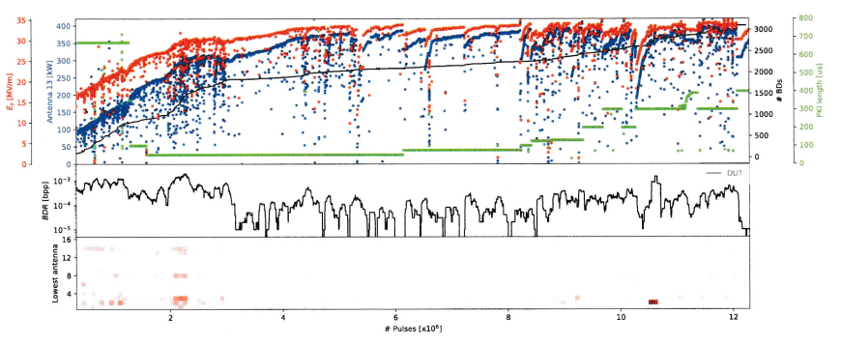


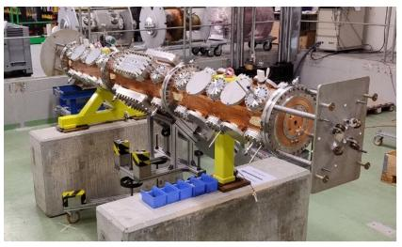
Linac4 RFQ2 (spare): conditioning and early operation
New RFQ2 was commissioned in 2025 on the test stand
RFQ during field tuning
Linac4 RFQ2 conditioning history: 3,300 hours (about 140 days)
To be compared with 80 hours for RFQ1 (less than 4 days) – more sensitive to vacuum conditions, pulse length, requiring time to recuperate after an interruption.
Decision: Linac4 will continue to operate with RFQ1, to avoid the risks and the personnel effort of an exchange.
The spare will be kept operational at the test stand (on the beam line or outside, depending on the source tests)

Slide 25
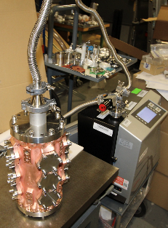




Outlook: the RFQs of the future…
Started in 2020 the development of Additively Manufactured RFQ modules, within the EU projects I.FAST and EPITA - laser powder bed fusion (LPBF).
750 MHz frequency, 35 cm diameter, length 400 mm (fitting into present AM printers).
Vacuum and voltage tests successful, developed a process for improving inner surface roughness, combining mechanical mass finishing with abrasive media and chemical polishing.
Beam tests foreseen in EPITA.
Test passed, threshold value at: 1∙10⁻¹⁰mbar∙l∙s⁻ ¹
Advantages:
No brazing, relaxed tolerances
Freedom in defining the geometry
Ideal cooling channel geometry
Fast production at lower cost

Slide 26

RFQ failures: to spare or not to spare?
Initial quotation, (wrongly) attributed to Franz Kafka:
Better to have, and not need, than to need, and not have!
Ranking the risk of RFQ failure is extremely difficult, because the two main sources of RFQ failures have very low probability:
accidental failures because of lack of cooling, mechanical damage, contaminations (leading to frequency shifts, vacuum leaks, increase in breakdown rate) may lead to total beam loss, but can be avoided by proper interlocks and accurate protection.
failures due to aging of materials, e.g. copper degradation due to beam loss: possible, but so far, a failure was never observed. Expected to proceed slowly leading to progressive performance degradation, leaving time for RFQ replacement.
But, loss of the RFQ would be catastrophic (Single Point of Failure for all the accelerator)
One of the most difficult risks to evaluate:
very low probability × very high impact (at the limit, 0 x ∞ undefined) → “Titanic-type” risks.

Slide 27

RFQ lifetime: to spare or not to spare?
However, a clear conclusion is that the RFQ is expected to have a shorter lifetime than other linac components, because of risks related to its complexity, and because it is exposed to the beam coming from the source.
The decision on the spare is often more related to managerial decisions than to clear risk evaluation and takes into account building a spare when team and competences are still present.
This was the case at CERN after the pollution of Linac2 RFQ, and again after the observations at the entrance of Linac4 RFQ.
A final quotation, my own (based on managerial experience):
Whatever gives you a good night’s sleep is priceless!

Slide 28

Thank you for your attention
Picture credit:
Elwood Smith

Slide 29


Beam evolution through a RF quadrupole focusing channel
The electrodes change polarity with the RF period:
Strong focusing channel with alternating gradients in time and not in space!

Slide 30



The “4-vane” RFQ – TE11 (dipole) and TE21 (quadrupole)
B-field
In the empty cylindrical cavity, we have the TE21 (quadrupole) mode – very close in frequency to the TE11 (dipole) mode.
Introducing into the cavity 4 electrodes (the “vanes”) we can “load” the TE210 mode, with 2 effects:
  Concentrate the electric field on the axis, increasing the focusing efficiency.
  Lower the frequency of the TE210 mode, separating it from the other modes of the cylindrical waveguide.
Unfortunately, the dipole mode TE110 is lowered as well, and remains as a perturbing mode in this type of RFQs.
E-field

Slide 31


The 4-vane RFQ - longitudinally
The RFQ will result in cylinder containing the 4 vanes, which are connected to the cylinder along their length.
The loaded cylindrical waveguide sustaining the TE11 and TE21 mode bands will be closed at the 2 ends → on the dispersion curve are selected only the modes where the length contains an integer number of (half) longitudinal wavelengths.
For focusing and acceleration, we need a mode with longitudinally constant electric field.
We need to operate in the TE210 mode
But a TE mode with 0 longitudinal variation cannot exist in a waveguide short-circuited at the ends.
We need a “trick” to establish a TE210 mode!

Slide 32


The 750 MHz RFQ

Slide 33


The ELISA RFQ at the CERN Science Gateway

