Slide 1
RFQ FTA & FMEA
Preliminary analyses derived from the discussions during Maurizio Vretenar’s visit

Slide 2
RFQ FTA & FMEA
Intro
Objective: establish a structured view of the main RFQ failure mechanisms and their consequences for ESS operation.
Basis: workshop discussions, CERN Linac4 experience, and available ESS RFQ design documentation.
Approach: develop a top-down TE-1 fault tree, then translate the identified mechanisms into an FMEA.
Special attention: scenarios that could cause permanent RFQ damage, loss of operating margin, difficult reconditioning or significant accelerator downtime.
Scope: Analysis keeps the RF chain outside the system boundary.

Slide 3
RFQ Fault Tree Analysis
Top Event 1: RFQ unable to deliver required beam performance
RFQ unable to deliver required beam performance
OR
Required RF electromagnetic state cannot be maintained
Required operating voltage cannot be sustained
Vacuum or structural integrity incompatible with operation
Beam interaction causes unacceptable RFQ degradation
OR
OR
OR
OR
Resonant frequency outside acceptable range
Field distribution (long/trans) outside tolerance
RF breakdown or discharge in RFQ cavity prevents nominal voltage
RF power transmission through RFQ couplers cannot be sustained
RF operating or conditioning configuration prevents stable operation
RFQ vacuum pressure cannot be maintained
Vacuum contamination event
Structural state outside acceptable limits
Excessive beam interception at RFQ entrance
Excessive beam interception within RFQ
Beam-induced material degradation

Slide 4
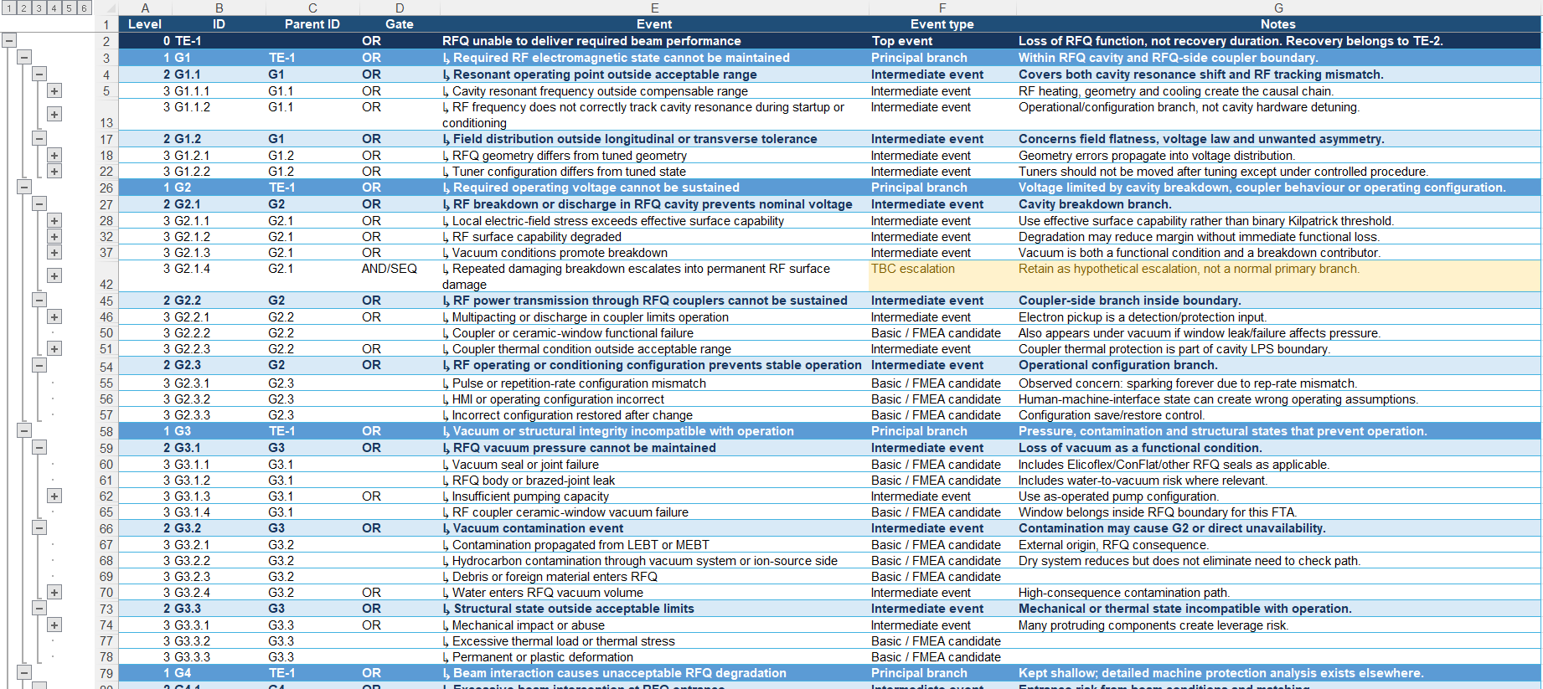
RFQ Fault Tree Analysis
Top Event 1: RFQ unable to deliver required beam performance
More details in the “ESS RFQ FTA TE-1.xlsx” spreadsheet

Slide 5
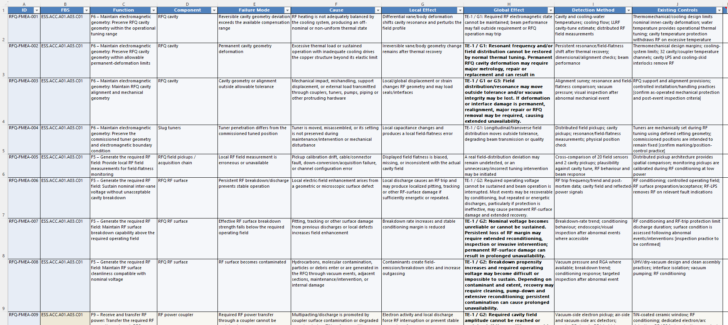
RFQ Failure Modes & Effects Analysis
More details in the “ESS RFQ FMEA.xlsx” spreadsheet

Slide 6
RFQ functions
F1 – Transverse focusing | Confine and transport the injected proton beam within the RFQ aperture using the RF quadrupole electric field.
F2 – Longitudinal bunching | Transform the incoming continuous proton beam into bunches synchronized with the RF field.
F3 – Acceleration | Increase proton-beam energy to the required RFQ output energy with acceptable energy spread.
F4 – Beam transmission / preservation | Transmit the required fraction of the injected beam while preserving acceptable transverse/longitudinal beam quality and limiting losses.
F5 – Generate the required RF field | Establish and maintain the specified quadrupole RF field amplitude, phase, frequency and longitudinal field distribution.
F6 – Maintain electromagnetic geometry | Maintain vane-tip position, modulation, aperture, alignment and tuned geometry sufficiently accurately to produce the required electromagnetic field.
F7 – Thermal management | Remove deposited heat and control RFQ temperature and thermal deformation so geometry and resonant behaviour remain within allowable limits.
F8 – Maintain vacuum | Maintain the RFQ beam vacuum and vacuum boundary compatible with beam transport and RF operation.
F9 – Receive and transfer RF power | Receive RF power at the RFQ boundary and transfer it through the couplers so the required operating field can be established.
F10 – Tune / stabilize resonance | Establish and maintain the required resonant operating point and field flatness under operating and startup conditions.
F11 – Protect the RFQ | Detect abnormal conditions and withdraw RF/beam permissions as required to prevent unacceptable RFQ damage.
Primary
Performance
Enabling
Protection

Slide 7
Follow-up
Status: working draft for expert review, intended to challenge assumptions, identify gaps, and prioritize further verification and mitigation.
Review the FTA spreadsheet for missing events.
  Consider performing another FTA for the Top Event “TE-2 RFQ unavailable beyond acceptable recovery time”, under the logic that prolonged unavailability occurs when TE-1 has happened AND restoration within the allowed time fails.
Review the FMEA spreadsheet for correctness and to be confirmed [TBC] statements.
  Start populating missing columns in the FMEA spreadsheet.
  Compare the result to the CERN LINAC4 RFQ equivalent document.
Define and decide on control actions and mitigations (spares…).
Remaining risks to be imported into the Technical Risks Registry (in Safran).

