Slide 1















LSS Detector update
Dorothea Pfeiffer on behalf on the ESS detector group
Thanks to G. Croci and F. Piscitelli for their slides
18.02.2016

Slide 2





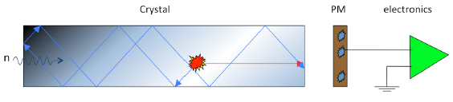

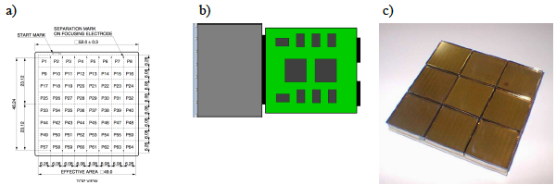
Detectors for SKADI: SoNDe grant
SKADI SANS instrument needs detectors which can take
higher rates than existing Anger Cameras
H2020 4MEUR Grant: Julich + LLB + IDEAS(NO) + Lund U +ESS
See Sebastian Jaksch's talk this afternoon in the detector session

Slide 3

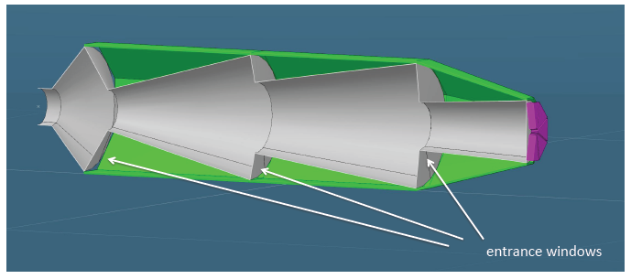
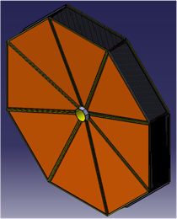
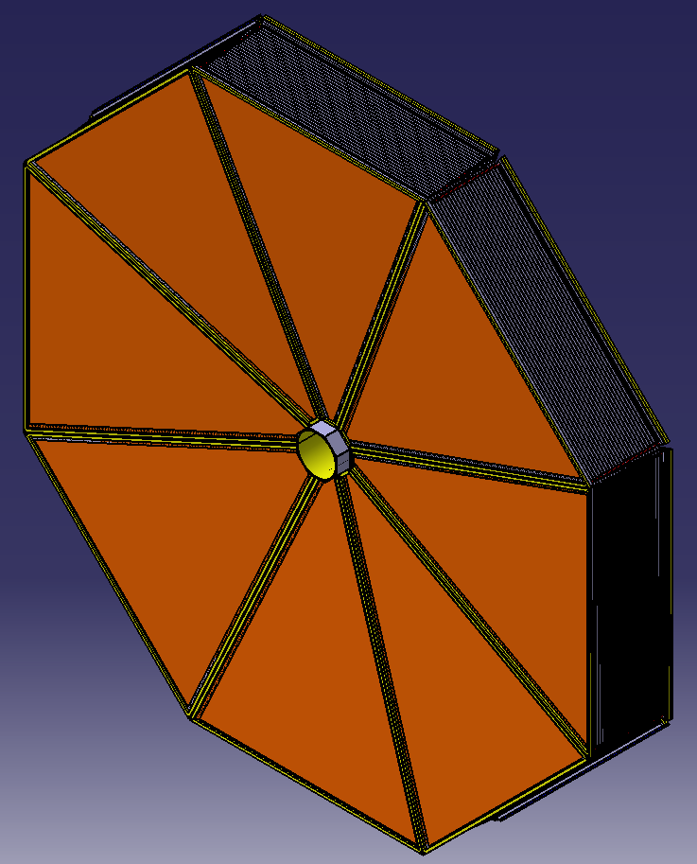
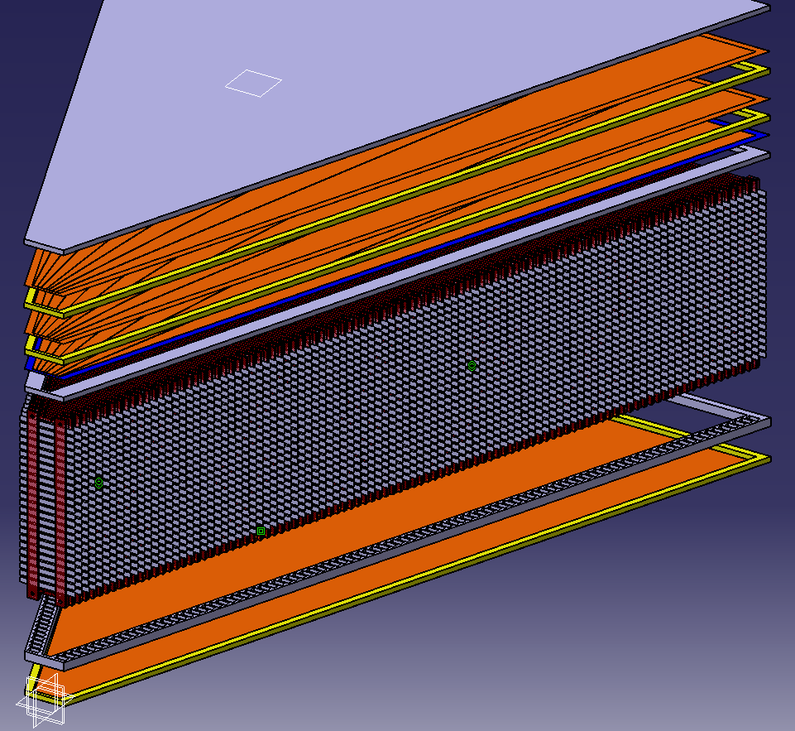
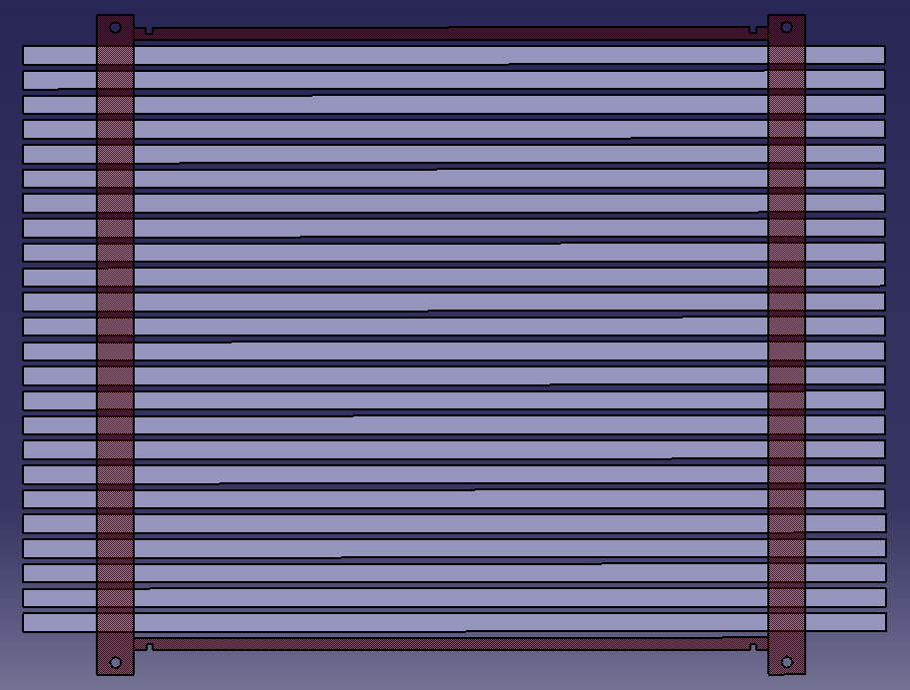

LOKI detectors
For further information, please refer to the poster by G. Groci et al.
LOKI rear detector UMBRELLA
Detector Top and Exploded view – 3D Cathode
Readout anode
Triple GEM
One Lamella element: 24 Al/Ti strips coated by 1 µm 10B4C on both sides
337 mm
¹⁰B₄C Lamellae system
Cathode
400 mm
Total of 100 lamellas (separated by 4 mm gap) are foreseen to realize the demonstrator
Tilting the detector by few degrees ensures high detection efficiency
Geometrical dimensions of the demonstrator defined in order to equip all the rear area by using 8 modules

Slide 4
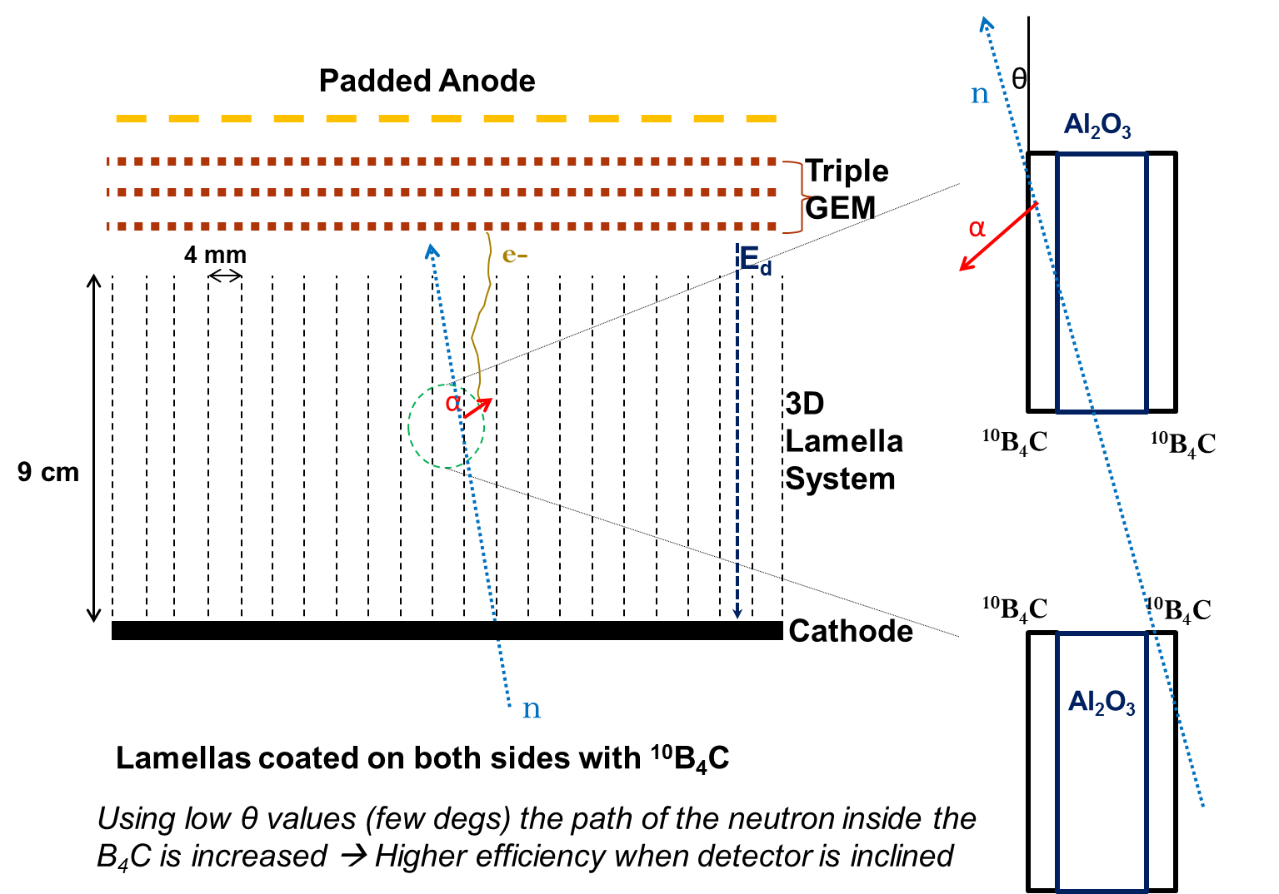
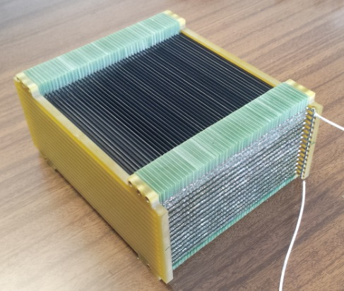
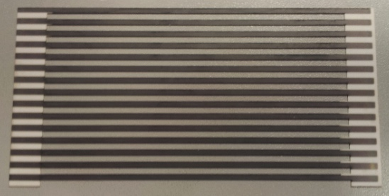
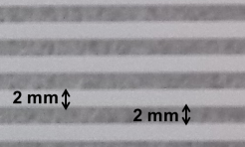
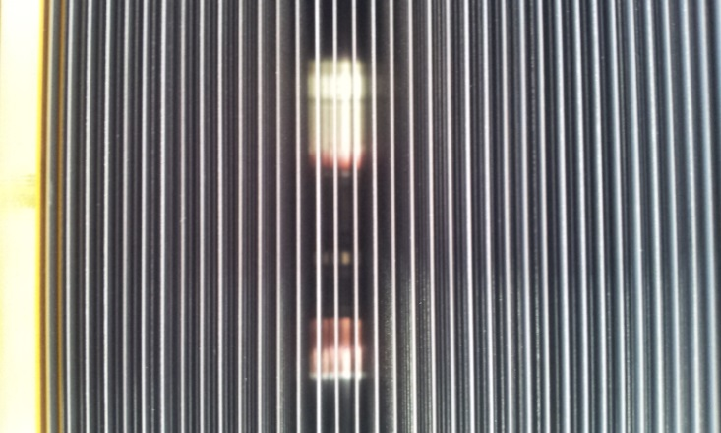
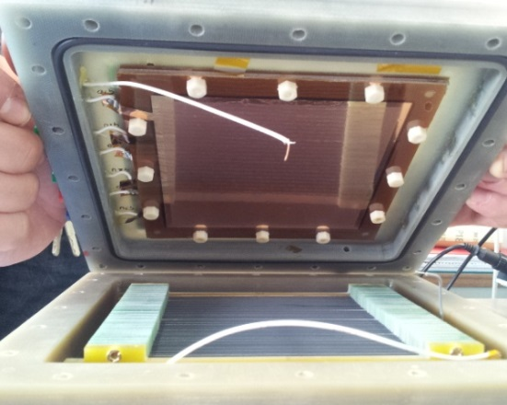
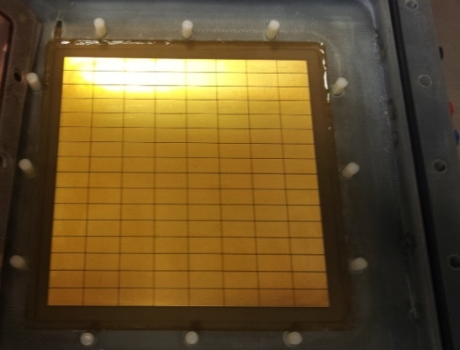
Boron Array Neutron Detector (BAND) - GEM
2 mm
6 cm

Slide 5
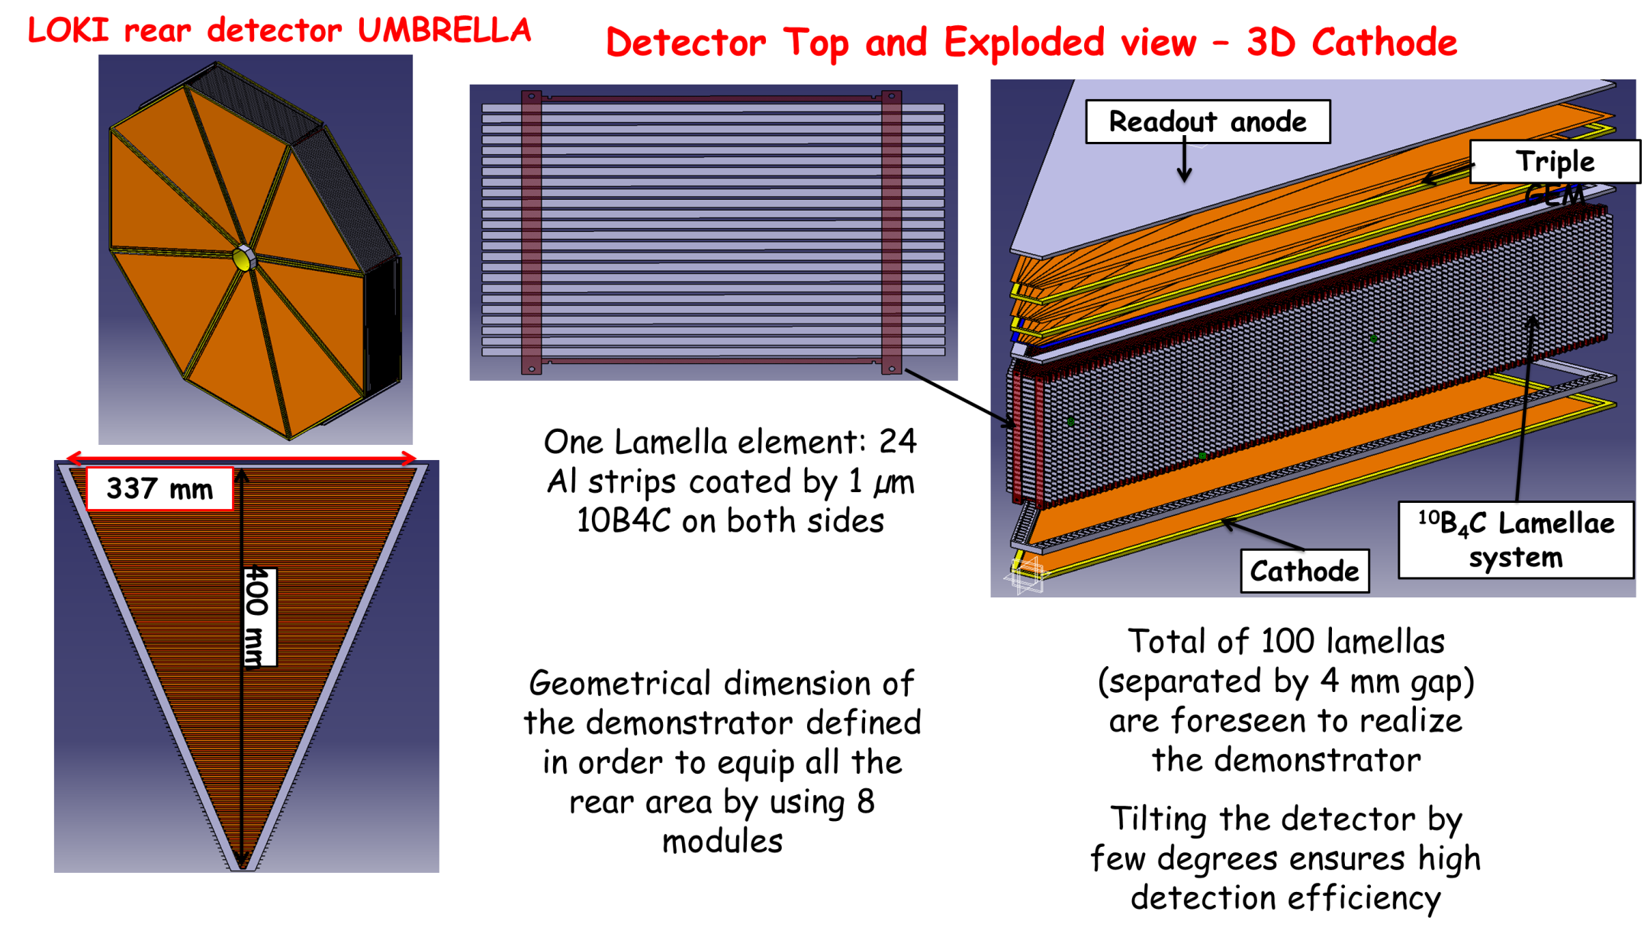
BandGEM Demonstrator Design 1/2

Slide 6
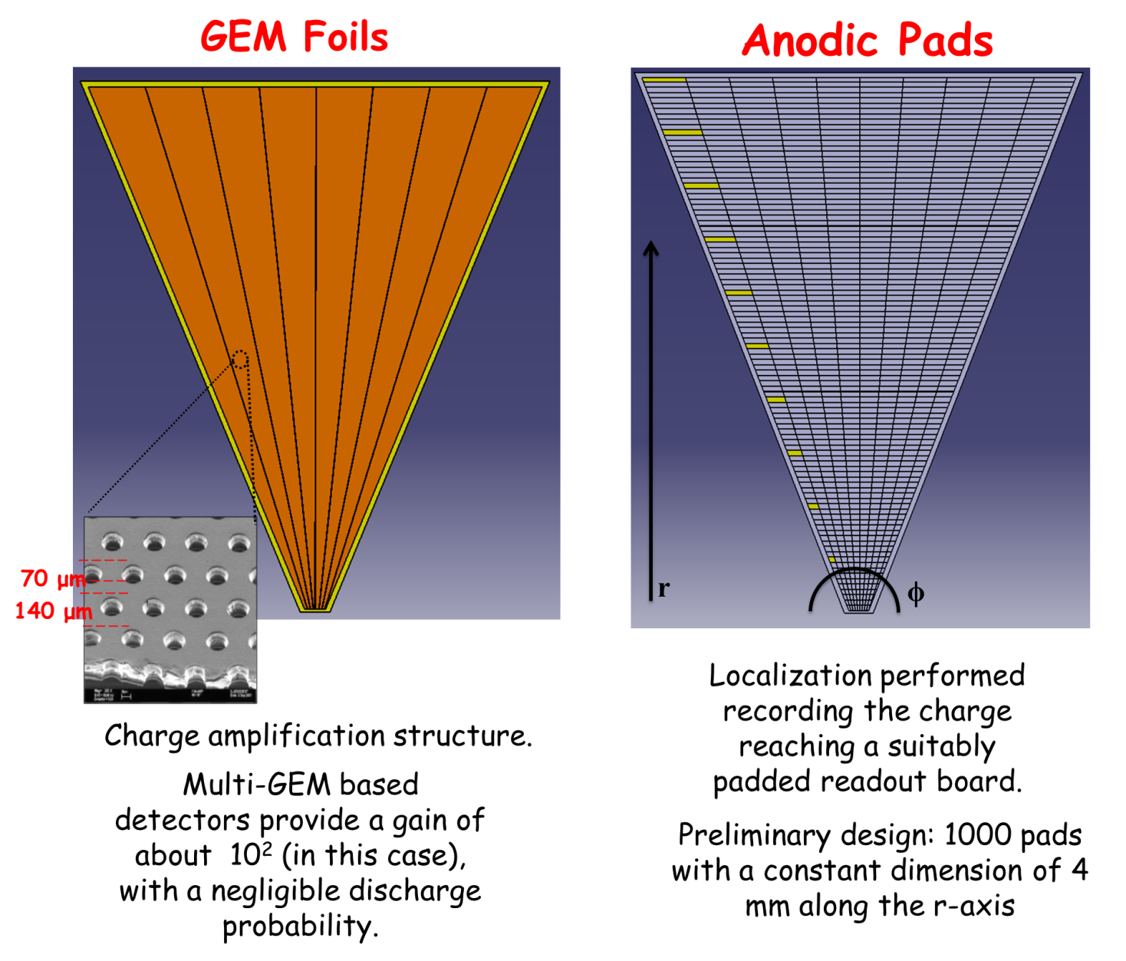
BandGEM Demonstrator Design 2/2

Slide 7
Performance: Prototype and Demonstrator
 | Prototype - Achieved | Demonstrator - Simulated
Lamella Distance | 2 mm | 4 mm
B₄C/empty ratio on lamellas | 1 | 3
Full Lamella System lenght | 6 cm | 9 cm
Lamella Thickeness | 250 µm | 100 µm
Lamella Material | Aluminium Oxide | Aluminium/Titanium
Optimal tilt angle | 7 degrees | 2.4 degrees
Pulse Height Threshold | 70 keV | 100 keV
Cathode geometry | 10x10 cm2 - Square | Trapezoidal
Count Rate Capability | 10 MHz/cm² | 12 MHz/cm²
Gamma Ray Sensitivity | 5*10⁻⁵ | 10⁻⁷
Measured Efficiency @ 1.5 Å | 18.5% | //
Expected Efficiency @ 2.0 Å | // | 37%
Expected Efficiency @ 6 Å | // | 55%
Expected Efficiency @ 12 Å | // | 61%
Resolution FWHM @ 2,6,12 Å | // | 5.5 – 6 mm
Front-end ASIC | CARIOCA – 8 channels/chip | GEMINI – 16 channels/chip

Slide 8
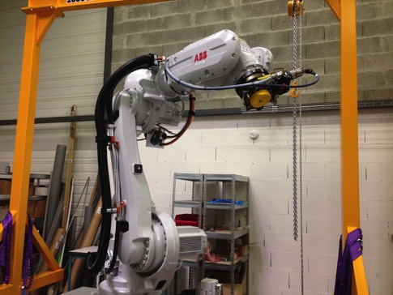
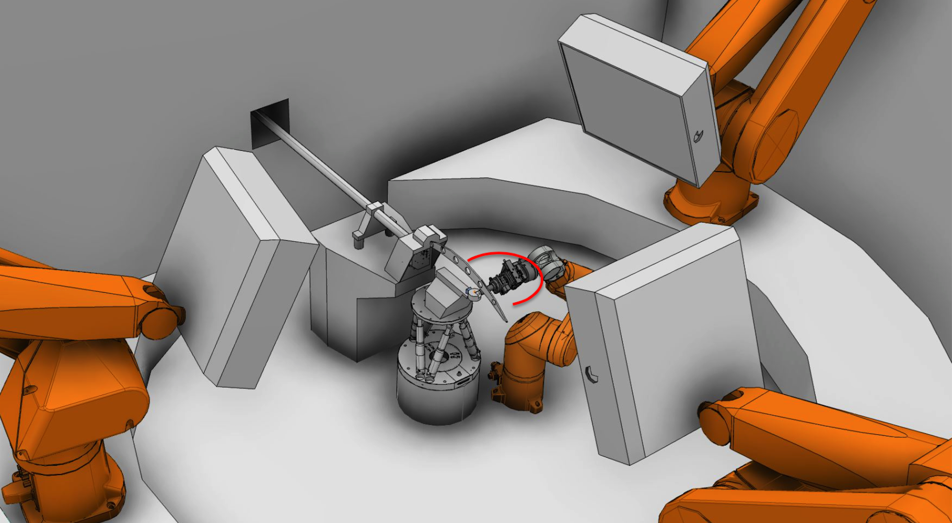
NMX detectors

Slide 9



The Gd-GEM project
Task 4.1 Neutron Detectors – The Resolution Challenge
The key objective of WP4 is the technological
evolution of neutron detectors in terms of
resolution, intensity and dimensions.
3 years
Sept. 15
Sept. 16
Sept. 17
Sept. 18
Deliverable
Milestone

Slide 10
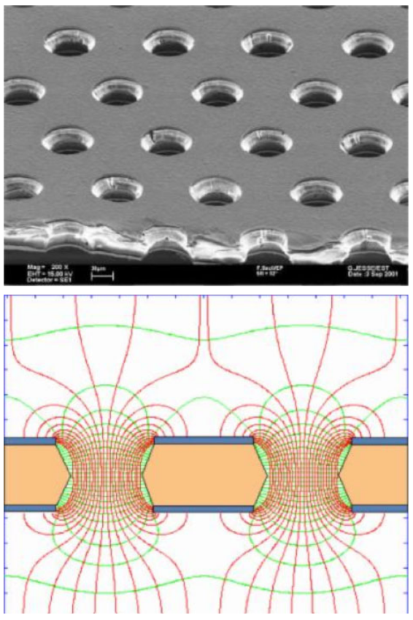
Requirements and challenges
GEM foil
200 μm position resolution (beyond state of art for time resolved neutron detectors)
High rate requirements with up to MHz/cm²
High gain stability and count rate stability
Mechanical robustness (detectors mounted on freely movable robotic arms)
Reasonable gamma suppression
=> Gd-GEM detector
Electrical field in holes

Slide 11
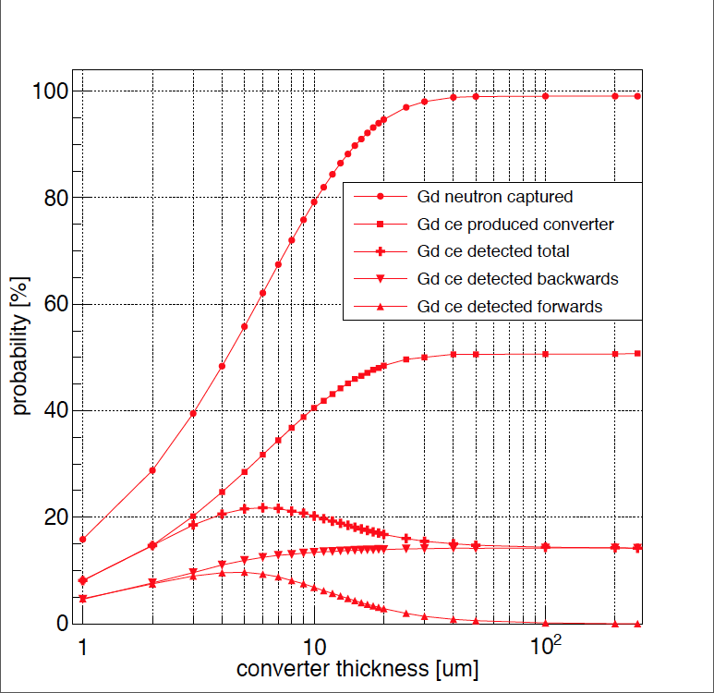
Natural Gadolinium converters
Baseline: Backwards and forwards mode. Optimum thickness 6 um, thinnest available foil 10um:
20% efficiency at 1.8 A
28% efficiency at 3.5 A
Alternative: Backwards mode, one detector: Optimum thickness >=50 um
14% efficiency at 1.8 A
20% efficiency at 3.5 A
Efficiency at 1.8 Å
neutron
Backwards detector
e-
Gd
Upgrade with 157 Gd: up to 38% efficiency at 1.8 A
and 42% efficiency at 3.5 A
Forwards detector
e-

Slide 12
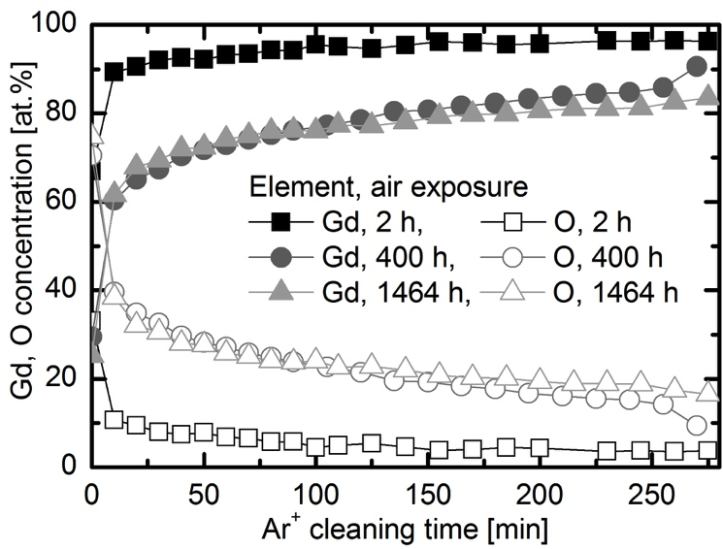
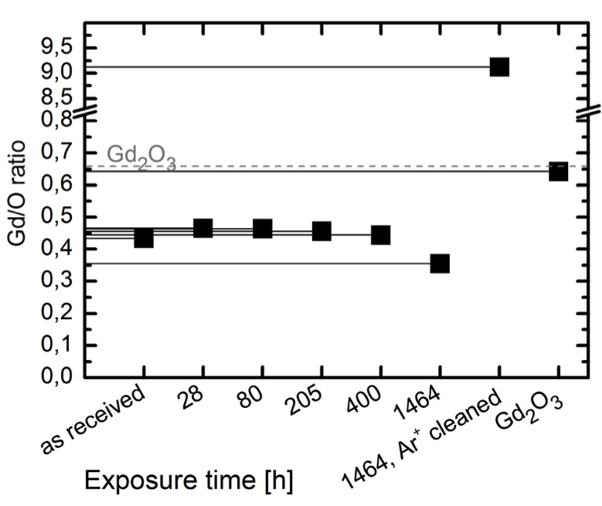
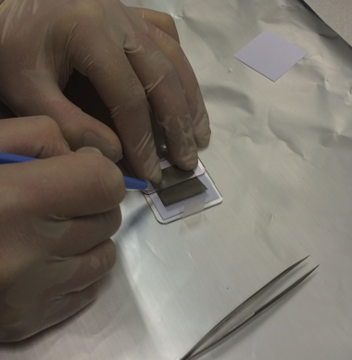
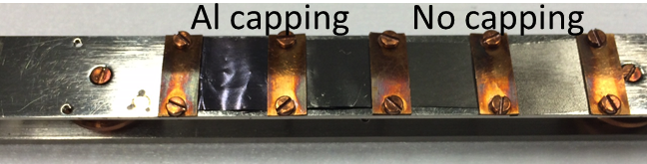
Capping layer for Gd foil not needed
XPS measurements w/o Al capping layer
- no benefit with Al capping
- capping process “adds” O
- foils are stable
- GdO layer with O surplus builds up but does not grow significantly
Thanks to Susann Schmidt

Slide 13
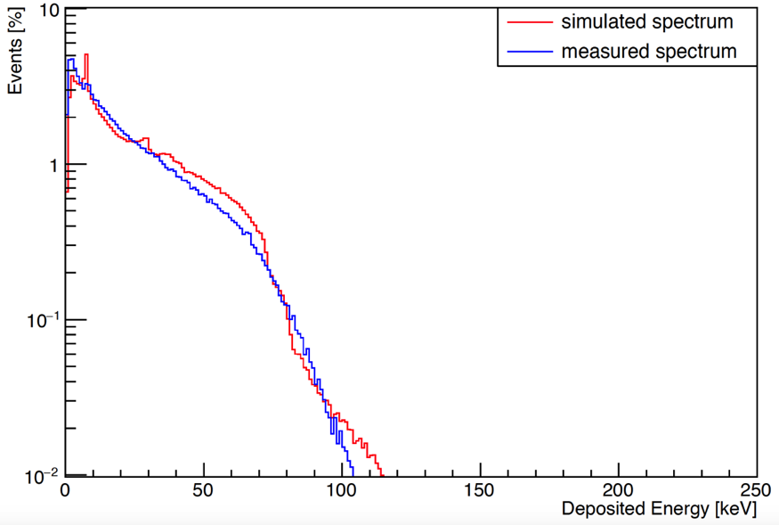
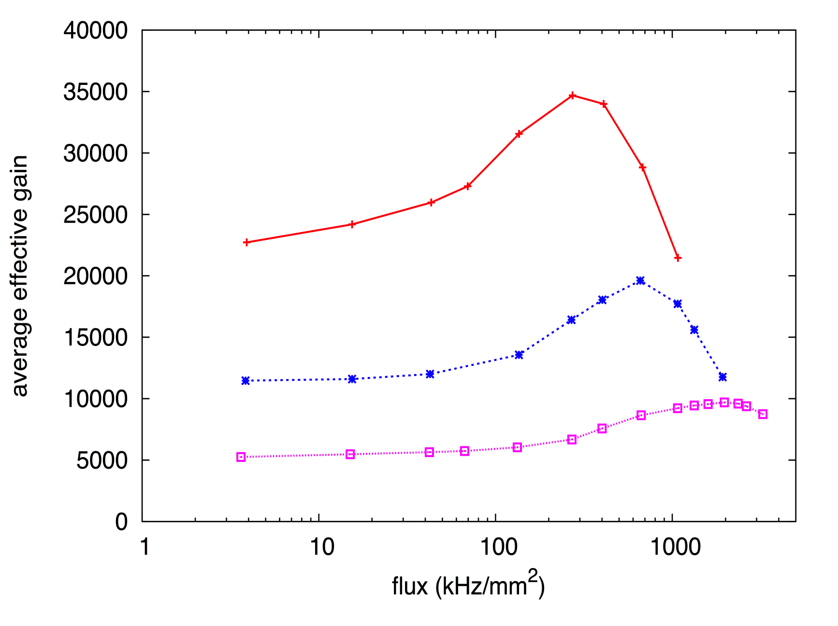
GEM Rate capabilities with Gd
Gd ce deposit on average
28 keV in 10 mm drift space
Standard Triple GEM
Ar/CO₂ 70%/30%
Cu X-rays ~ 8 keV
Gain modification
caused by charge density
For Gd: 3 MHz/cm²
Thanks to Filippo Resnati
E. Perelli Cippo et al., A GEM-based thermal neutron detector for
high counting rate applications”, JINST 10(2015) 10, P10003

Slide 14
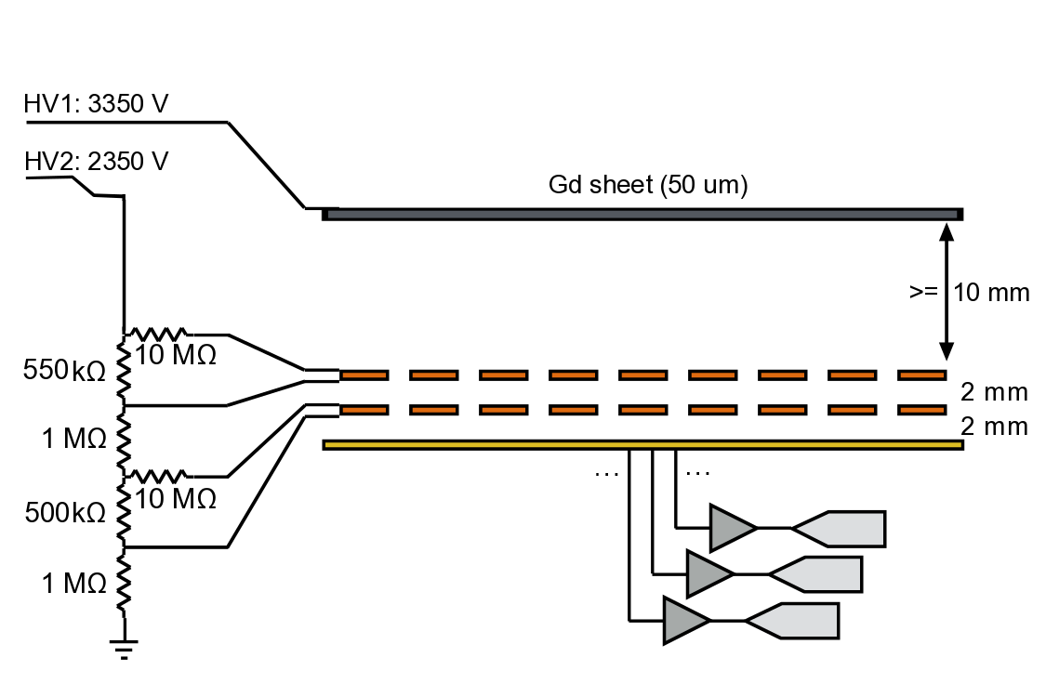
Gd-GEM backwards setup
conversion electron
Start of track
neutron

Slide 15
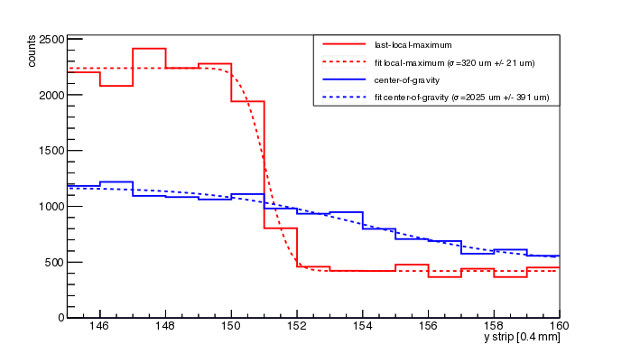
Position resolution
Intrinsic position resolution: σ <= 400 um
Scales with strip width (200 um strips possible)

Slide 16
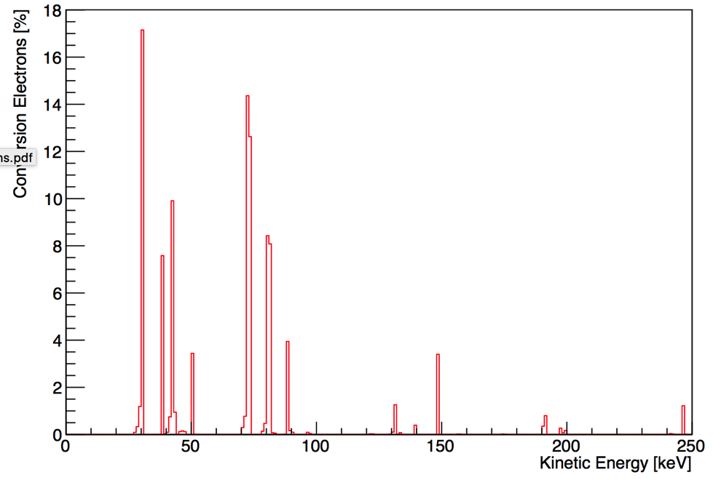
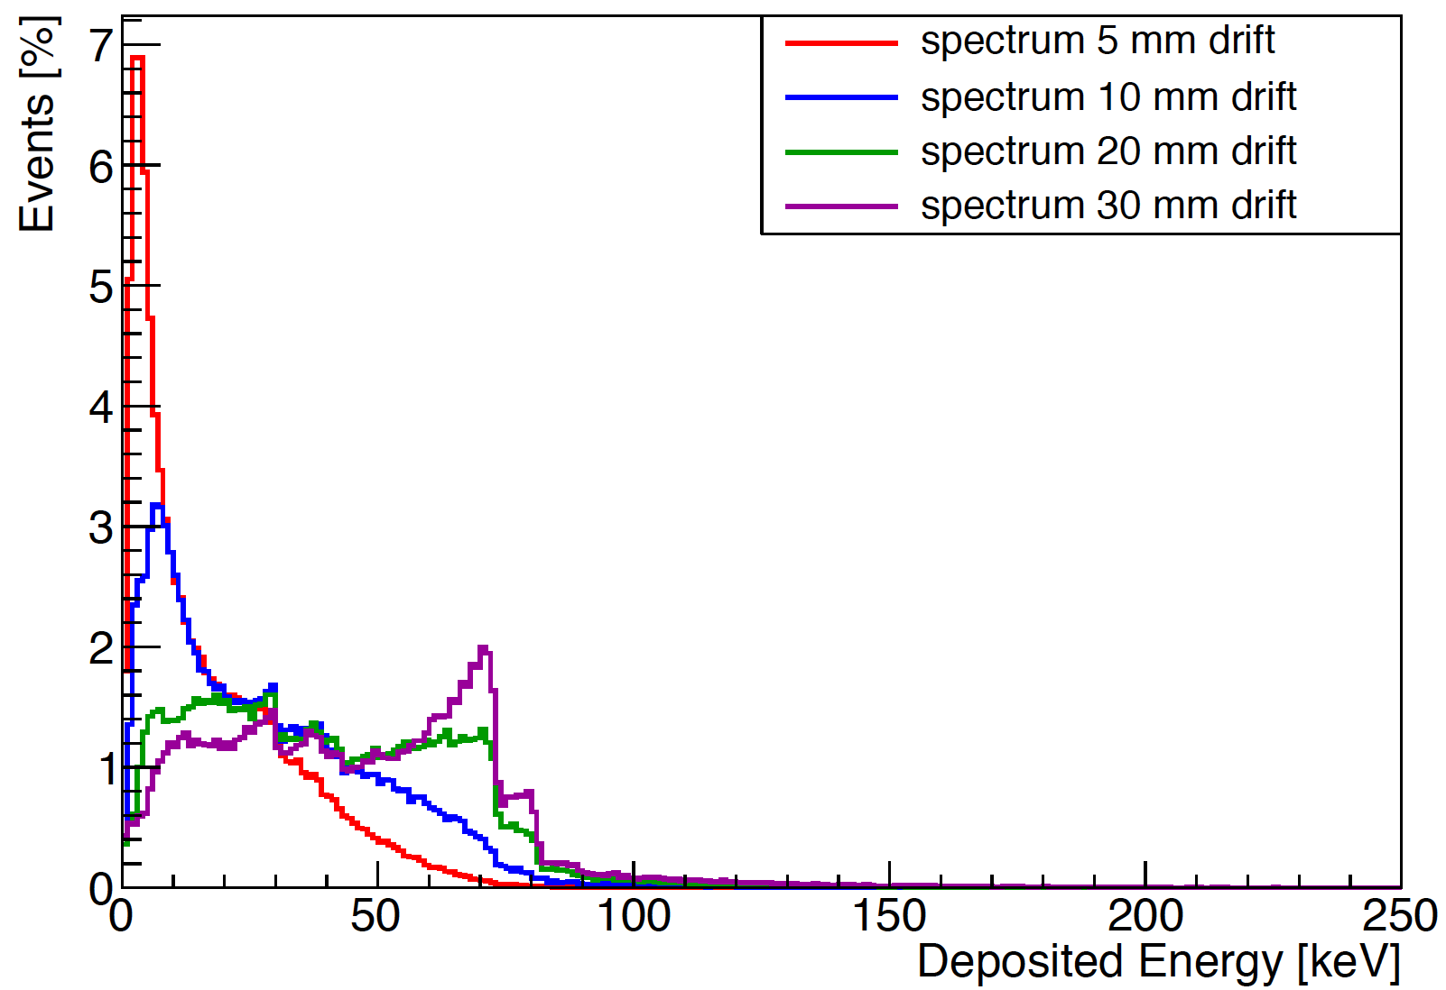
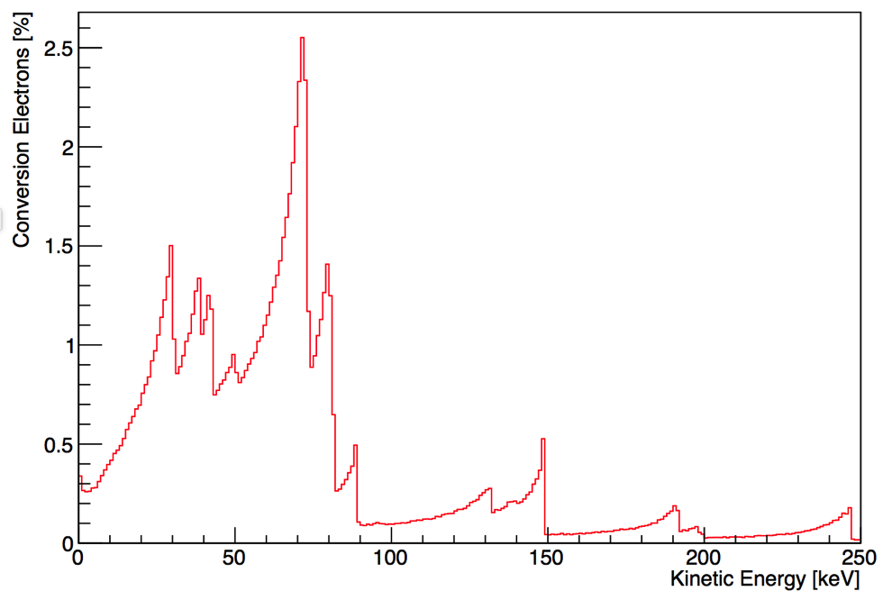
Optimum drift size of Gd-GEM
E_{kin} in converter
E_{dep} in drift
Ideal drift thickness: 10 mm – 20 mm
E_{kin} leaving converter

Slide 17
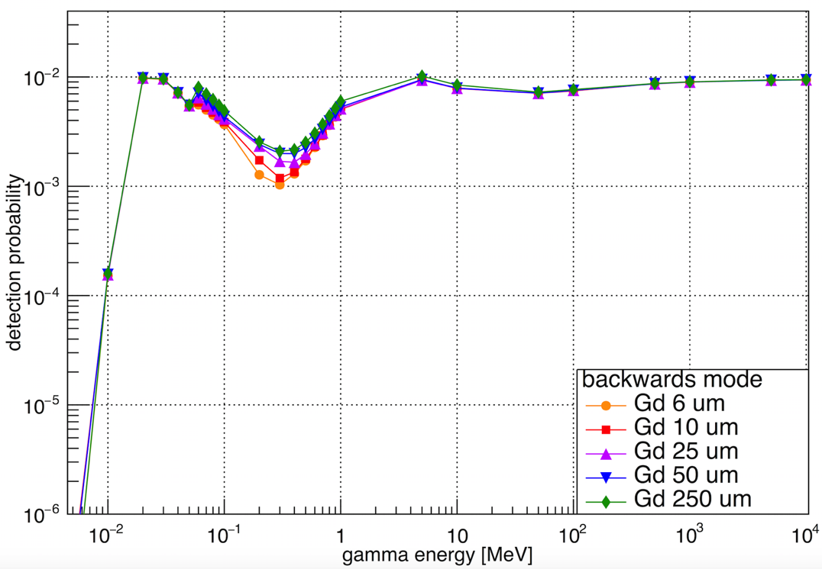
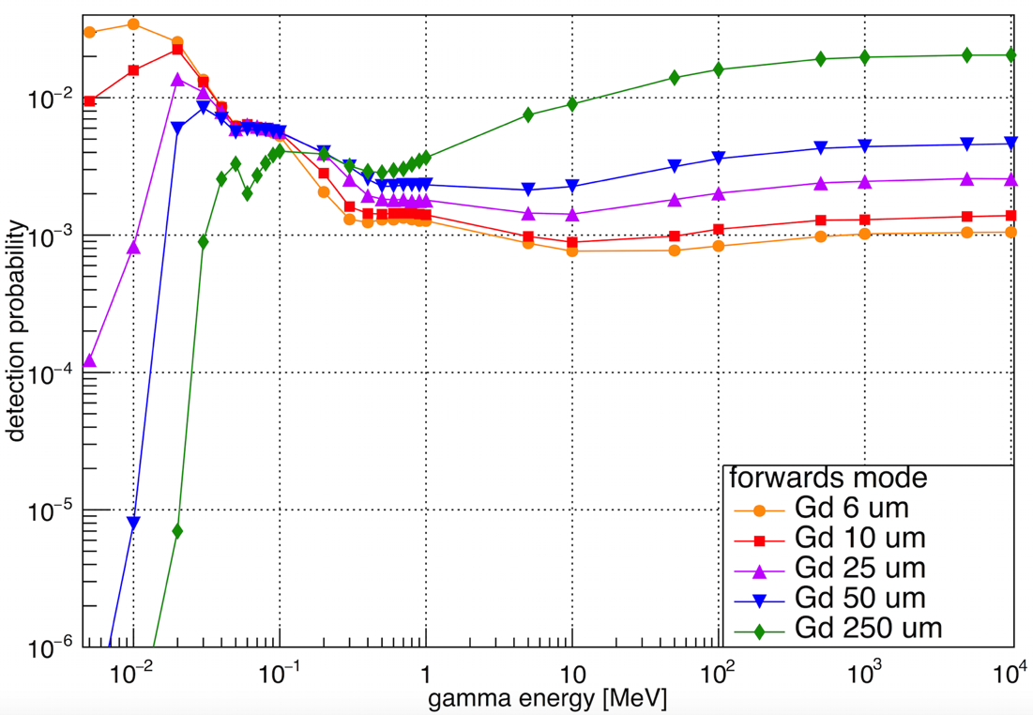
Simulated and measured gamma sensitivity in 10 mm drift
Backwards without threshold
Forwards without threshold
Measured values 250 um Gd and 3 keV threshold
backwards forwards
6E-03 241 Am 59.5 keV gamma 1E-03 241 Am 59.5 keV gamma
2E-03 22 Na 511 keV/1274.5 keV gamma 2E-03 Na 511 keV/1274.5 keV gamma

Slide 18
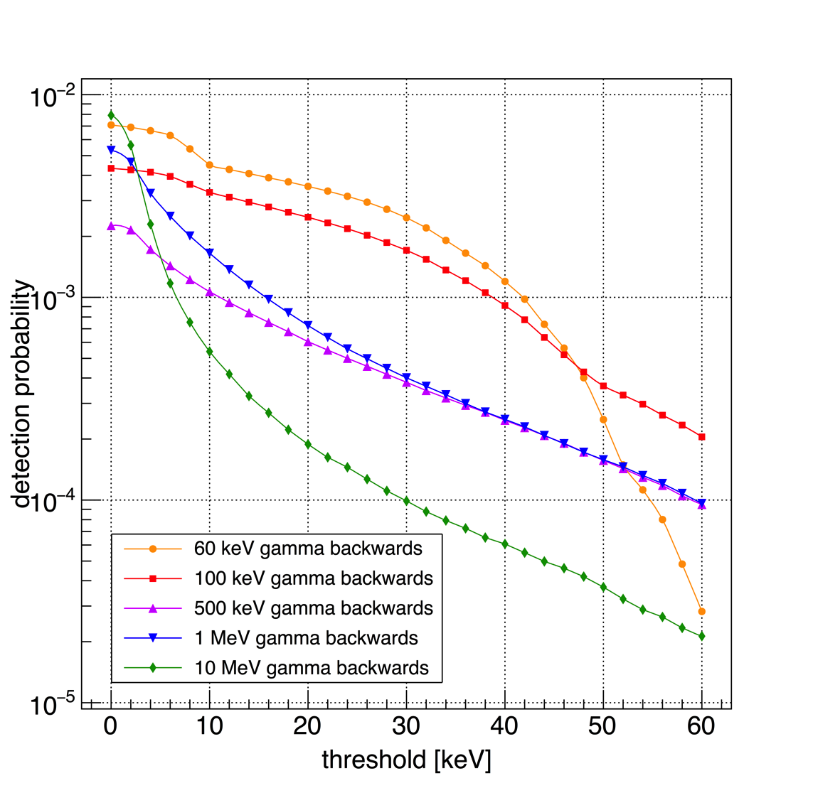
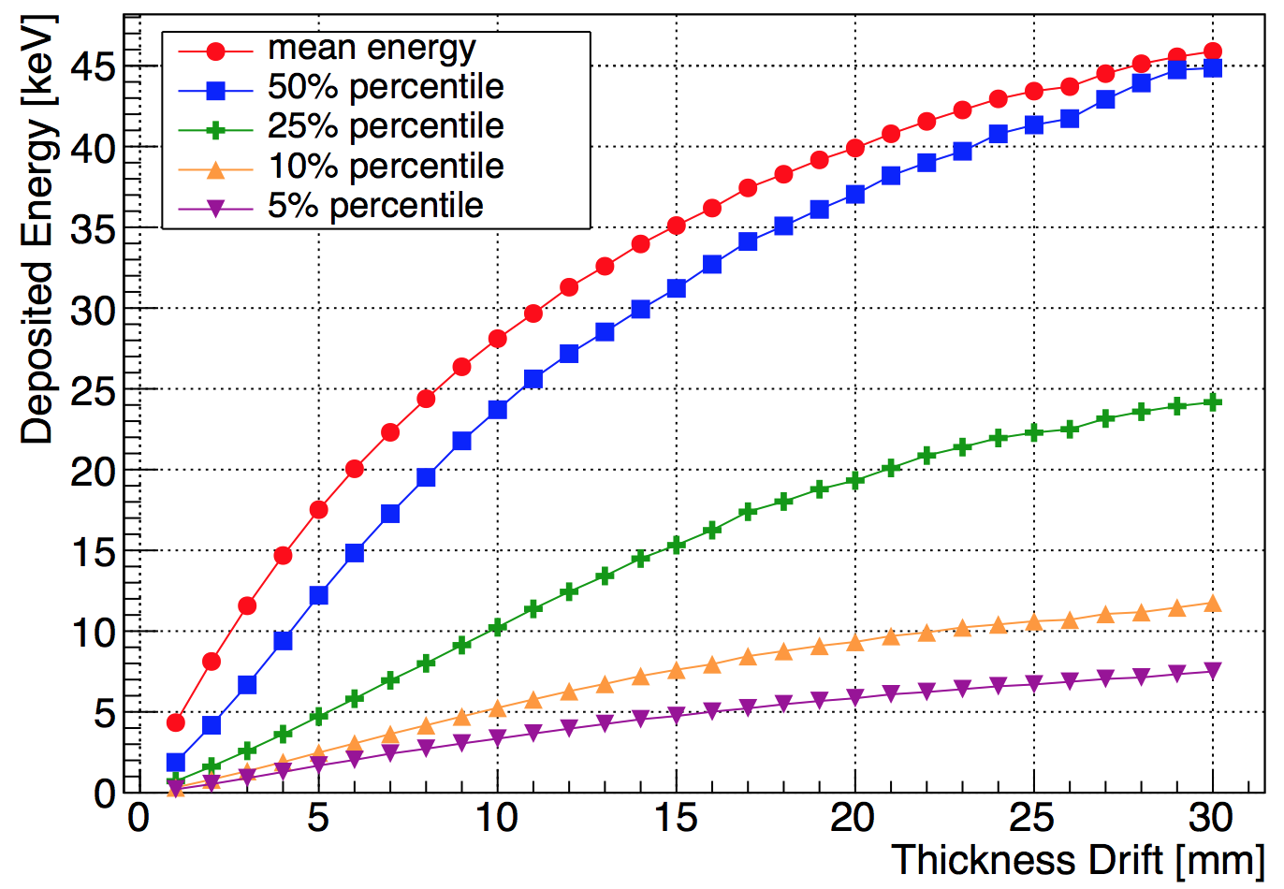
Neutron and gamma sensitivity of 50 um Gd in backwards configuration
Neutrons
Gammas
10 mm drift
Depending on threshold and gamma energy,
gamma sensitivity around 10⁻³

Slide 19
Results from 2015
Gd-GEM detector works
Detection efficiency (2 Å neutrons) is with 12% as expected from simulations (without scattering 15%)
Tracking of electrons works
Intrinsic position resolution of σ <400μm (relates directly to 400 μm strip pitch)
With smaller pitch σ = 200 μm achievable
Fast readout electronics are under development, VMM2 being tested at the moment
Gamma sensitivity with reasonable energy threshold around 10⁻³, 50 keV – 500 keV gammas are the biggest problem since their energy deposit is identical to the Gd conversion electrons

Slide 20
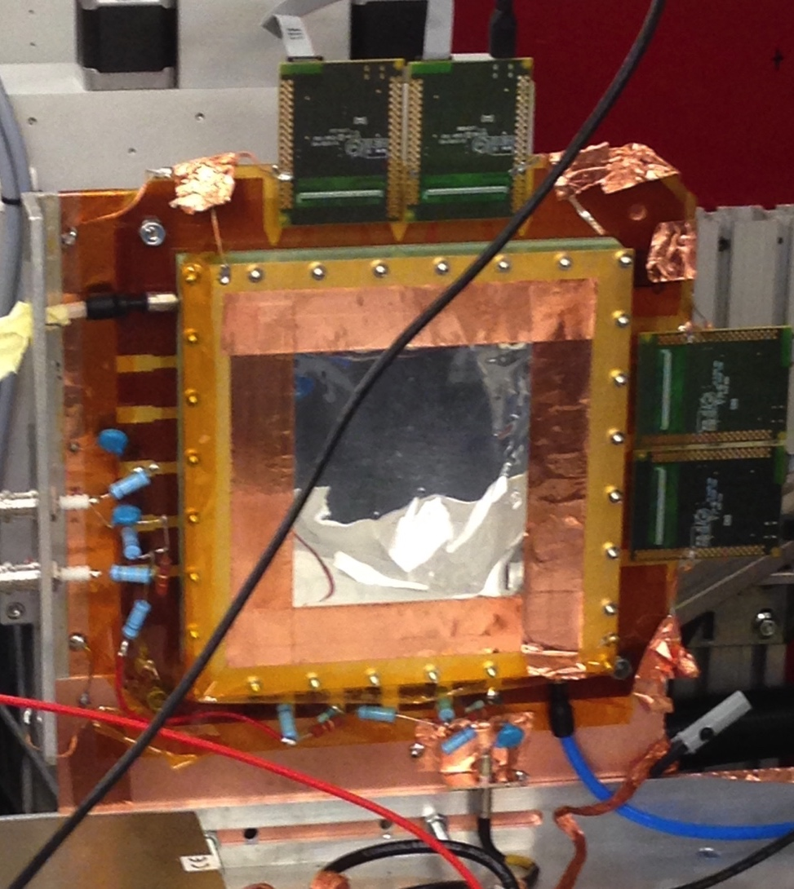
Gd-GEM Outlook for 2016
Further study gamma sensitivity
Determine optimum drift thickness
Study stability with 2 GEM foils
Evaluate low scatter readout material
Study smaller strip pitch
Build 10cm x 10 cm prototype to participate in neutron scatter experiment to show performance

Slide 21
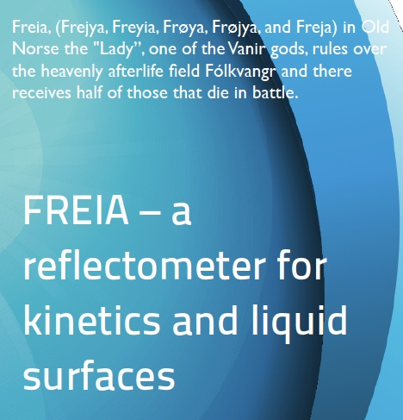
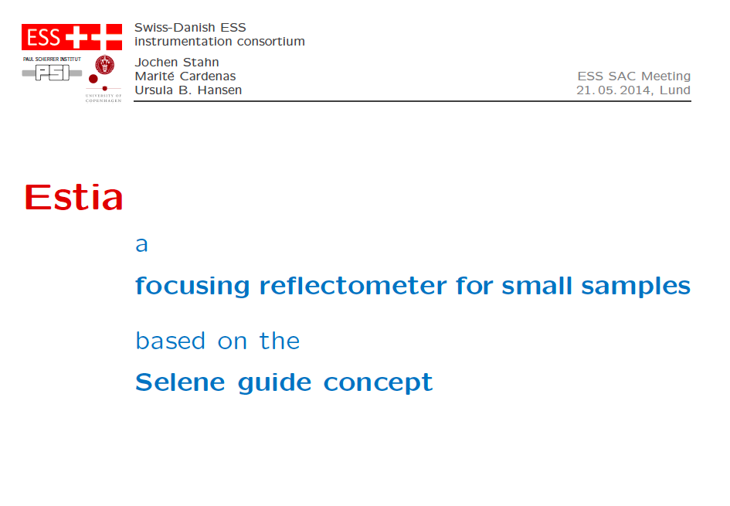

Slide 22
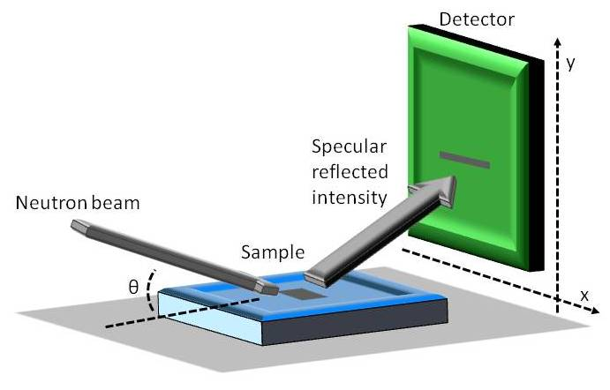

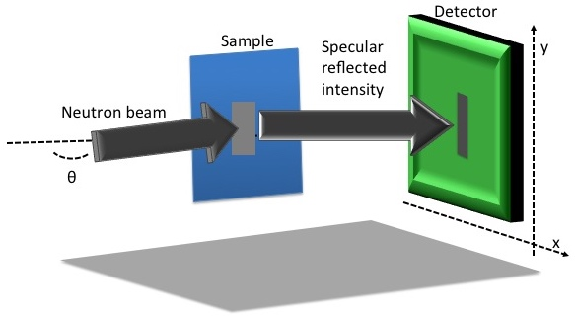

Reflectometry at ESS: FREIA and ESTIA
Horizontal Reflectometer
(FREIA)
Suitable for liquids
(limited angular range)
Vertical Reflectometer
(ESTIA)
Not suitable for liquids
More versatile
(wide angle range)

Slide 23
The Multi-Blade project
Task 4.2 Neutron Detectors – The Intensity Frontier
The key objective of WP4 is the technological
evolution of neutron detectors in terms of
resolution, intensity and dimensions.
Wigner Research Institute
Budapest Neutron Centre
3 years
Sept. 15
Sept. 16
Sept. 17
Sept. 18
Deliverable
Milestone

Slide 24
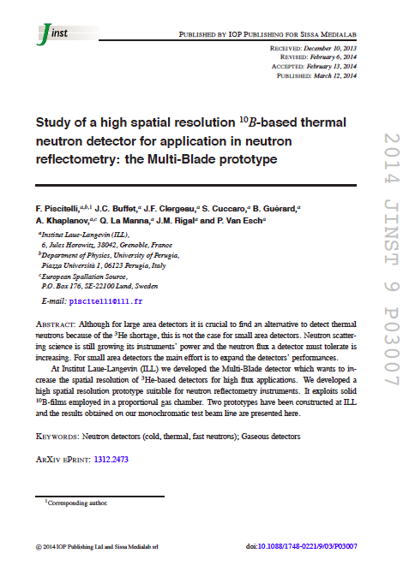
The Multi-Blade project
concept introduced in 2005
proof of concept in 2012
Institut Laue-Langevin
Institut Laue-Langevin
University of Perugia

Slide 25
Efficiency
5 degrees
Efficiency 45% at 2.5Å
A single Boron layer inclined at 5 degrees
The intensity is spread over a wider surface
(5 degrees = factor x10)
substrate
¹⁰B₄C
neutrons
θ

Slide 26
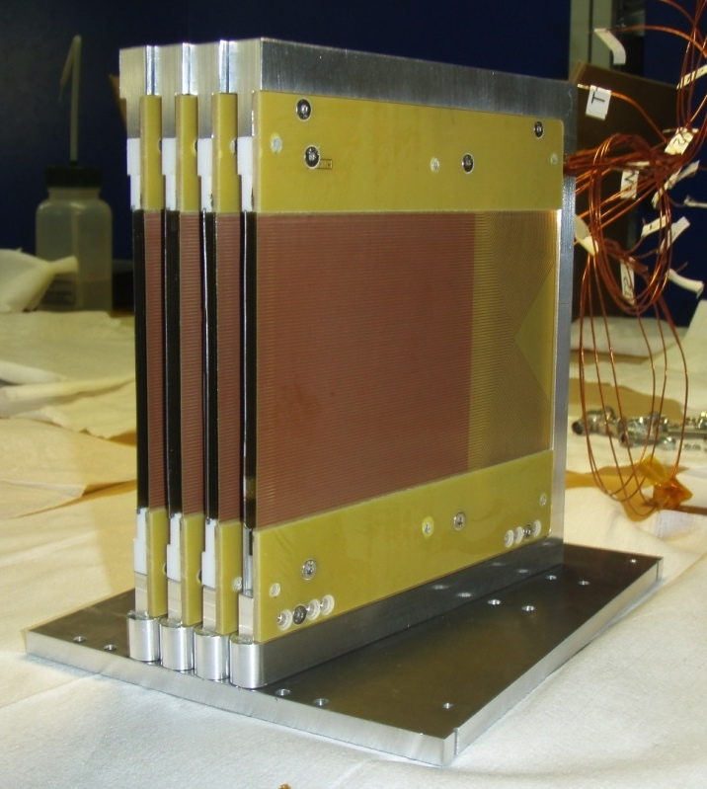
4 cassette demonstrator:
proof of concept in 2012
neutrons
Multi-Blade
sample
neutrons
hit the layers at 5˚

Slide 27
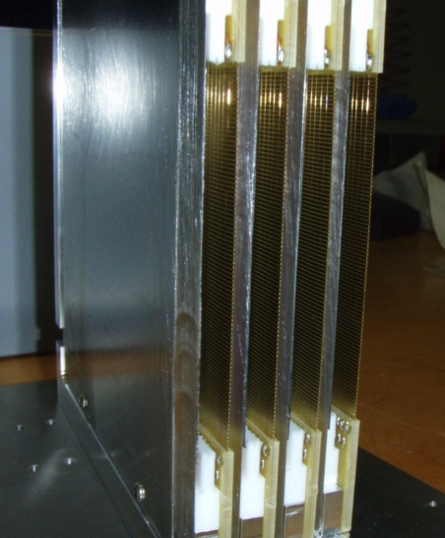
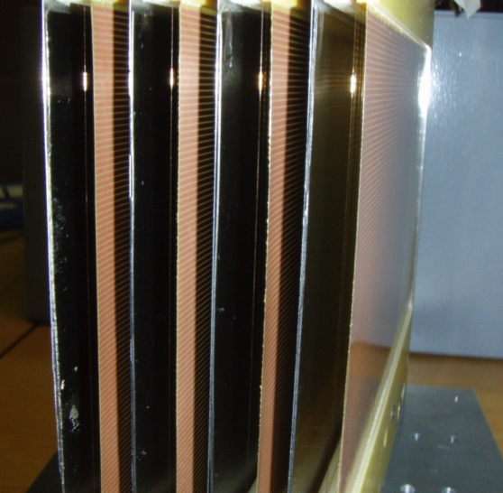
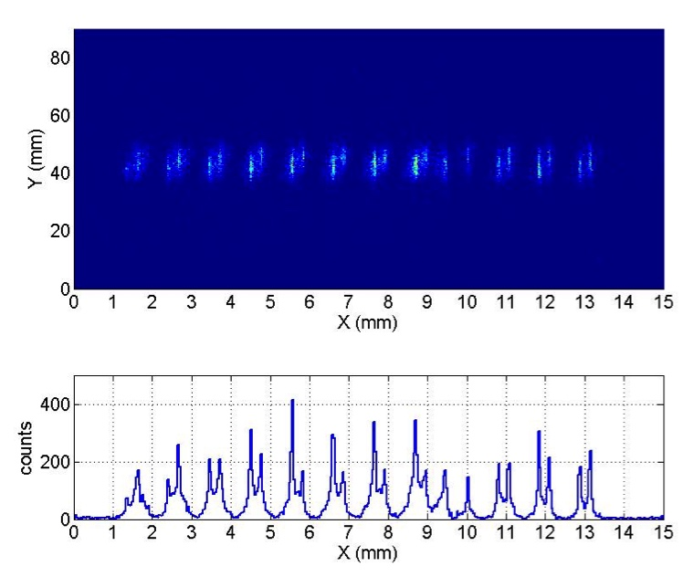


4 cassette demonstrator:
Results:
Measured Efficiency 45% at 2.5Å
Spatial Resolution 4mm x 280μm
Counting rate capability ~5000 n/s/mm² at 2.5Å
(limited by the electronics)
Atmospheric pressure operation
  (thin vessel window, low scattering)
  (cost effective materials)
Δx = 280μm
Efficiency
0.9mm
Neutron beam (~0.2mm)

Slide 28
4 cassette demonstrator:
Results:
Measured Efficiency 45% at 2.5Å
Spatial Resolution 4mm x 280μm
Counting rate capability ~5000 n/s/mm² at 2.5Å
(limited by the electronics)
Atmospheric pressure operation
  (thin vessel window, low scattering)
  (cost effective materials)
The ESS requirements
Max local rate | 10⁵ n/s/Å/mm² | Conventional refl. 10⁵ n/s/Å/mm² High intensity mode 10⁴ n/s/Å/mm²
Spatial resolution | 4mm x 1mm | 4mm x 0.5mm

Slide 29
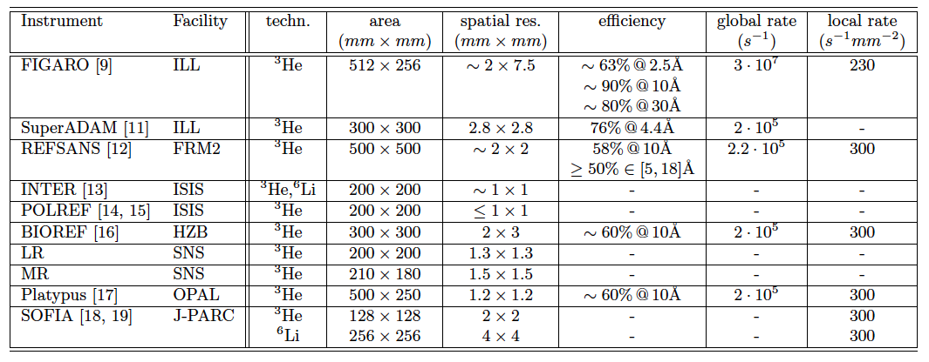
4 cassette demonstrator:
Results:
Measured Efficiency 45% at 2.5Å
Spatial Resolution 4mm x 280μm
Counting rate capability ~5000 n/s/mm² at 2.5Å
(limited by the electronics)
Atmospheric pressure operation
  (thin vessel window, low scattering)
  (cost effective materials)
x10
The state of the art
x20
The ESS requirements
Max local rate | 10⁵ n/s/Å/mm² | Conventional refl. 10⁵ n/s/Å/mm² High intensity mode 10⁴ n/s/Å/mm²
Spatial resolution | 4mm x 1mm | 4mm x 0.5mm
x300

Slide 30
4 cassette demonstrator:
Results:
Measured Efficiency 45% at 2.5Å
Spatial Resolution 4mm x 280μm
Counting rate capability ~5000 n/s/mm² at 2.5Å
(limited by the electronics)
Atmospheric pressure operation
  (thin vessel window, low scattering)
  (cost effective materials)
x10
The state of the art
x20
The ESS requirements
Max local rate | 10⁵ n/s/Å/mm² | Conventional refl. 10⁵ n/s/Å/mm² High intensity mode 10⁴ n/s/Å/mm²
Spatial resolution | 4mm x 1mm | 4mm x 0.5mm
x300

Slide 31
4 cassette demonstrator:
Results:
Measured Efficiency 45% at 2.5Å
Spatial Resolution 4mm x 280μm
Counting rate capability ~5000 n/s/mm² at 2.5Å
(limited by the electronics)
Atmospheric pressure operation
  (thin vessel window, low scattering)
  (cost effective materials)
Next demonstrator:
Counting rate capability
Overlap and uniformity
The ESS requirements
Max local rate | 10⁵ n/s/Å/mm² | Conventional refl. 10⁵ n/s/Å/mm² High intensity mode 10⁴ n/s/Å/mm²
Spatial resolution | 4mm x 1mm | 4mm x 0.5mm

Slide 32
Next demonstrator (9 cassettes):
Counting rate capability
Overlap and uniformity
Build technology prototype
Tests at both beam line and Reflectometry beam line
Electric filed modeling
Testing and availability of beam line
Build technology prototype
Data analysis
Detailed GEANT4 on detector performance
All three partners will work together on the final detector for the ESS Reflectometers

Slide 33
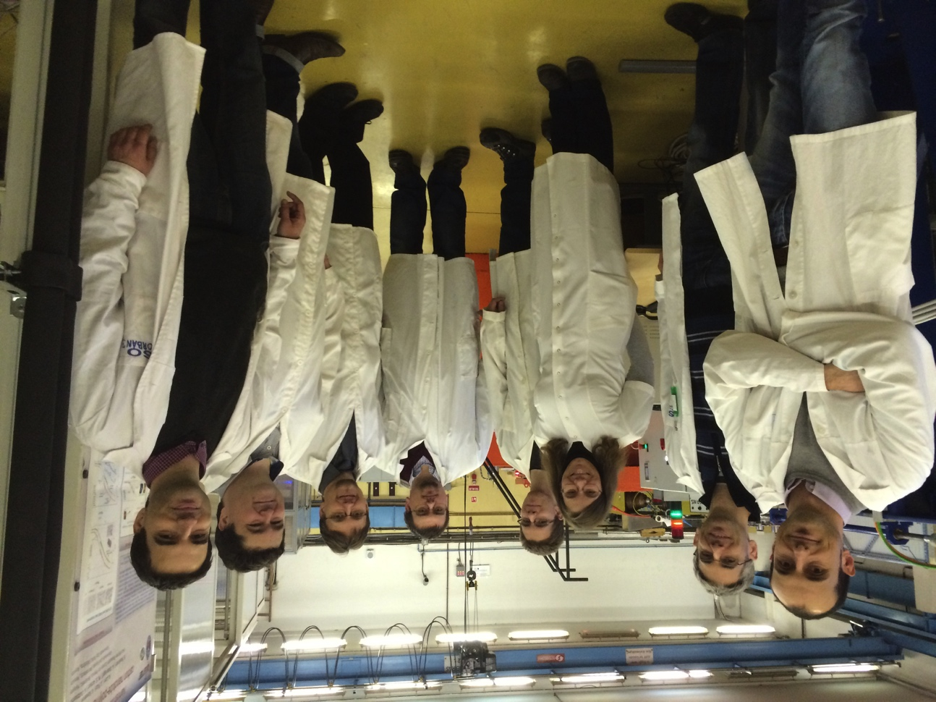
Meeting at BNC - December 2015
Wigner Research Institute
Budapest Neutron Centre
Tibor Zsíros
Eszter Dian
Gábor Kiss
Péter Pázmándi
Dezső Varga
János Orbán
Francesco Piscitelli
Richard Hall-Wilton

Slide 34
Electric field modeling
neutrons
substrate
wires X
¹⁰B₄C
strips Y

Slide 35
Materials evaluation
Old Design
scattered or absorbed flux
cassette
neutrons
strips Y
substrate
¹⁰B₄C
wires X
Any material holding the strips at 5deg scatters too much!

Slide 36
Materials evaluation
New Design
Substrate as thick as necessary
Kapton (strips) shielded by ¹⁰B₄C
cassette
Efficiency saturated (5degrees)
neutrons
At 5deg not much survives to the ¹⁰B₄C
substrate
wires X
¹⁰B₄C
strips Y

Slide 37
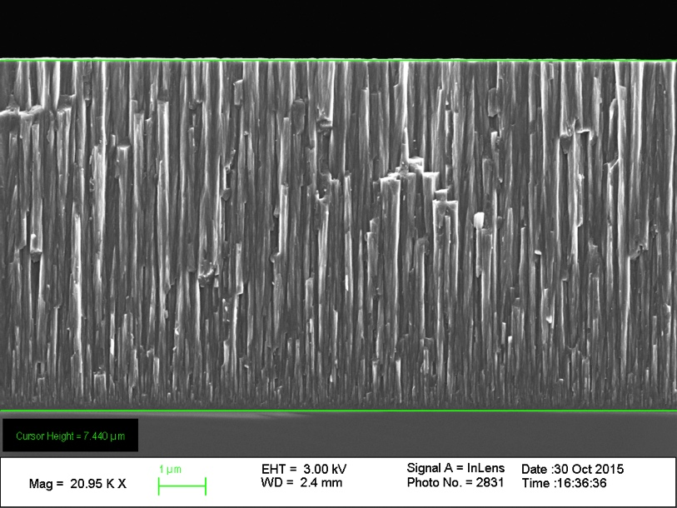
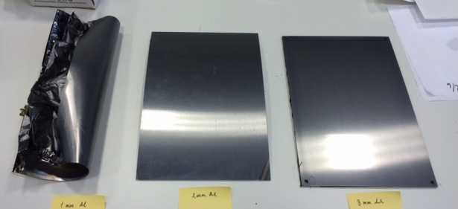
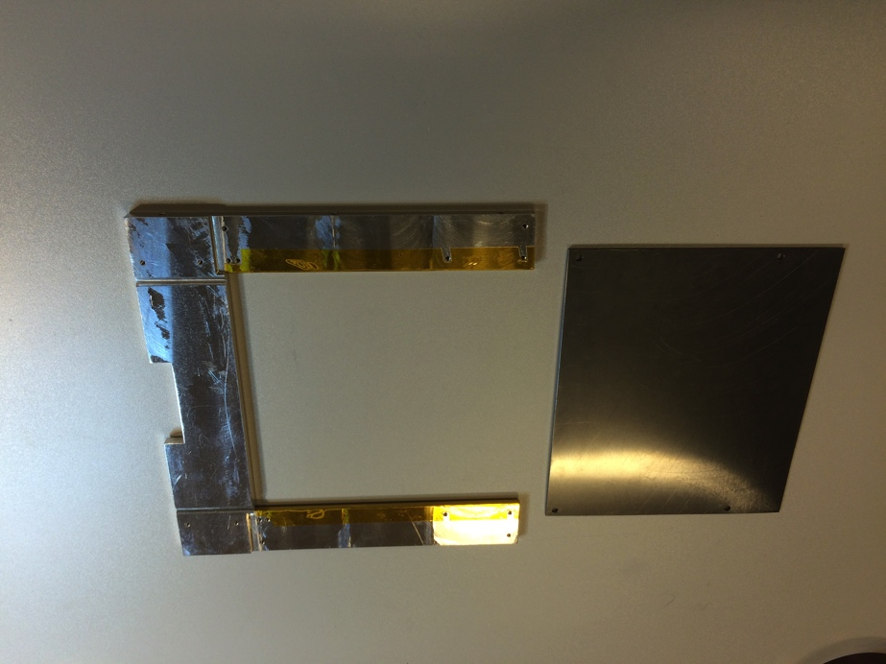

Materials evaluation
Planarity is an issue on large surfaces
¹⁰B₄C
~7 μm single-side
200x300mm² Al-plates single-side coated
Si
1mm 2mm 3mm
1mm
2mm
2mm
3mm

Slide 38



Multi-Blade mechanical design
10x10cm² demonstrator
amplifier board
¹⁰B₄C substrate
amplifier board
cathode strips
holding frame
anode wires
neutrons

Slide 39




Assembly completed in December 2015
1 blade area: ~120x120 mm²
9 cassettes (10 blades)
Coating area: ~ 10x120x120 mm² (single side)
Detector active area: ~10x9x120mm²=90x120mm²

Slide 40



Demonstrator ready!
Tests to come:
  SF (Lund University) - Now
  BNC (Budapest) - February
  Real instrument - …

Slide 41

Thank you for your attention !
Very..
Life is tiring..

Slide 42

You say it..
No point in getting up..

