Slide 1
Status of the French Sweedich cooperation agreement
Pierre Bosland

Slide 2
Project 1 : Injector realibility test
Project 2 : 352 MHz power coupler bunker
Project 3 : 8 equipped and tested superconducting cavities
Project 4 : contribution to the TDR
Project 5 : engineering design effort
Project 6 : (IPNO) Cryomodule spoke
Project 7 :(IPNO) New infrastructure for SRF cavities
Project 8 : ECCTD (CEA-Irfu & CNRS-IPNO)
The progress of these projects is monitored by ad hoc franco-suédois coordination committee
Next ccordination commity meeting: November the 7th

Slide 3
Progress of the projects since last coordination commitee - 25 April 2012
(Presentation made by G. Devanz)

Slide 4
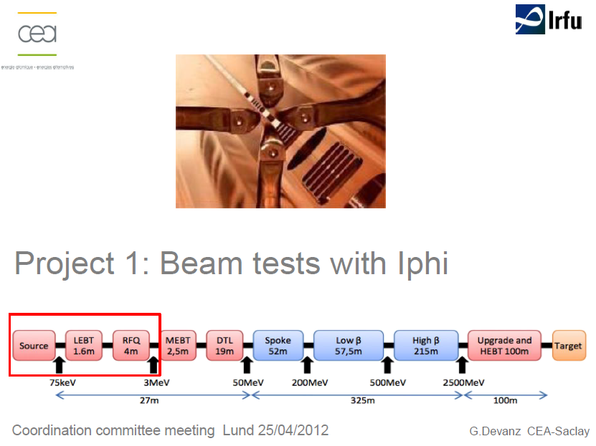

Slide 5
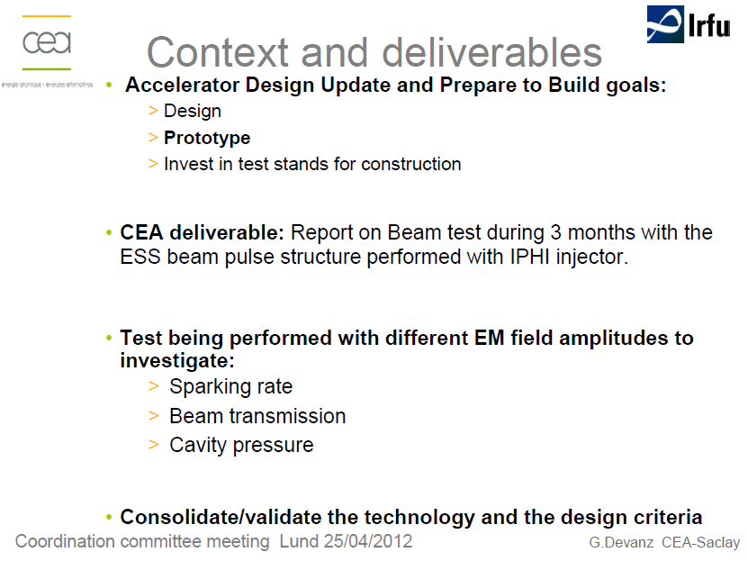

Slide 6
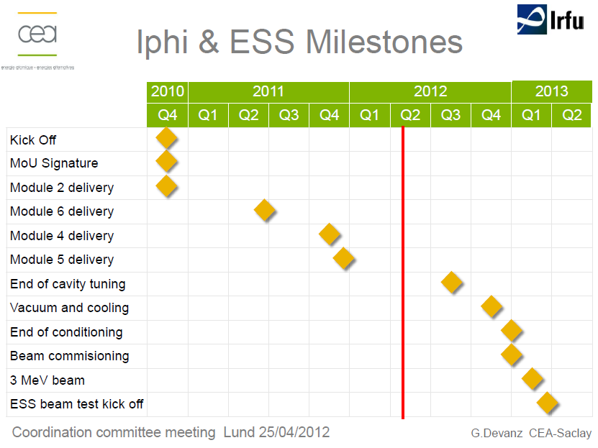

Summer 2013

Slide 7
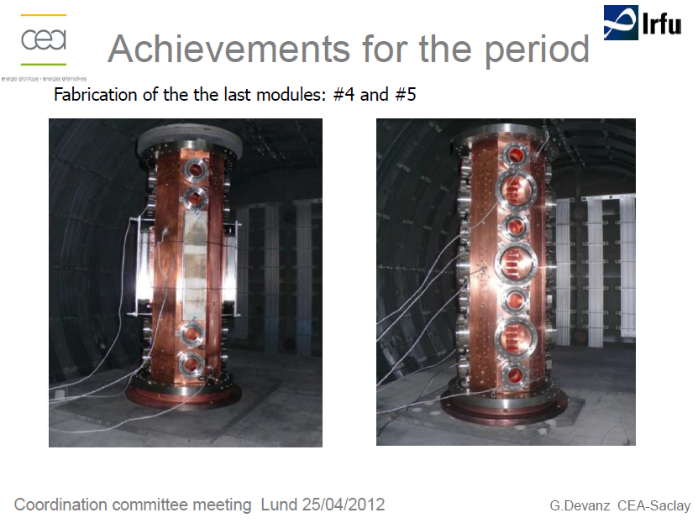
Delivered and mounted

Slide 8
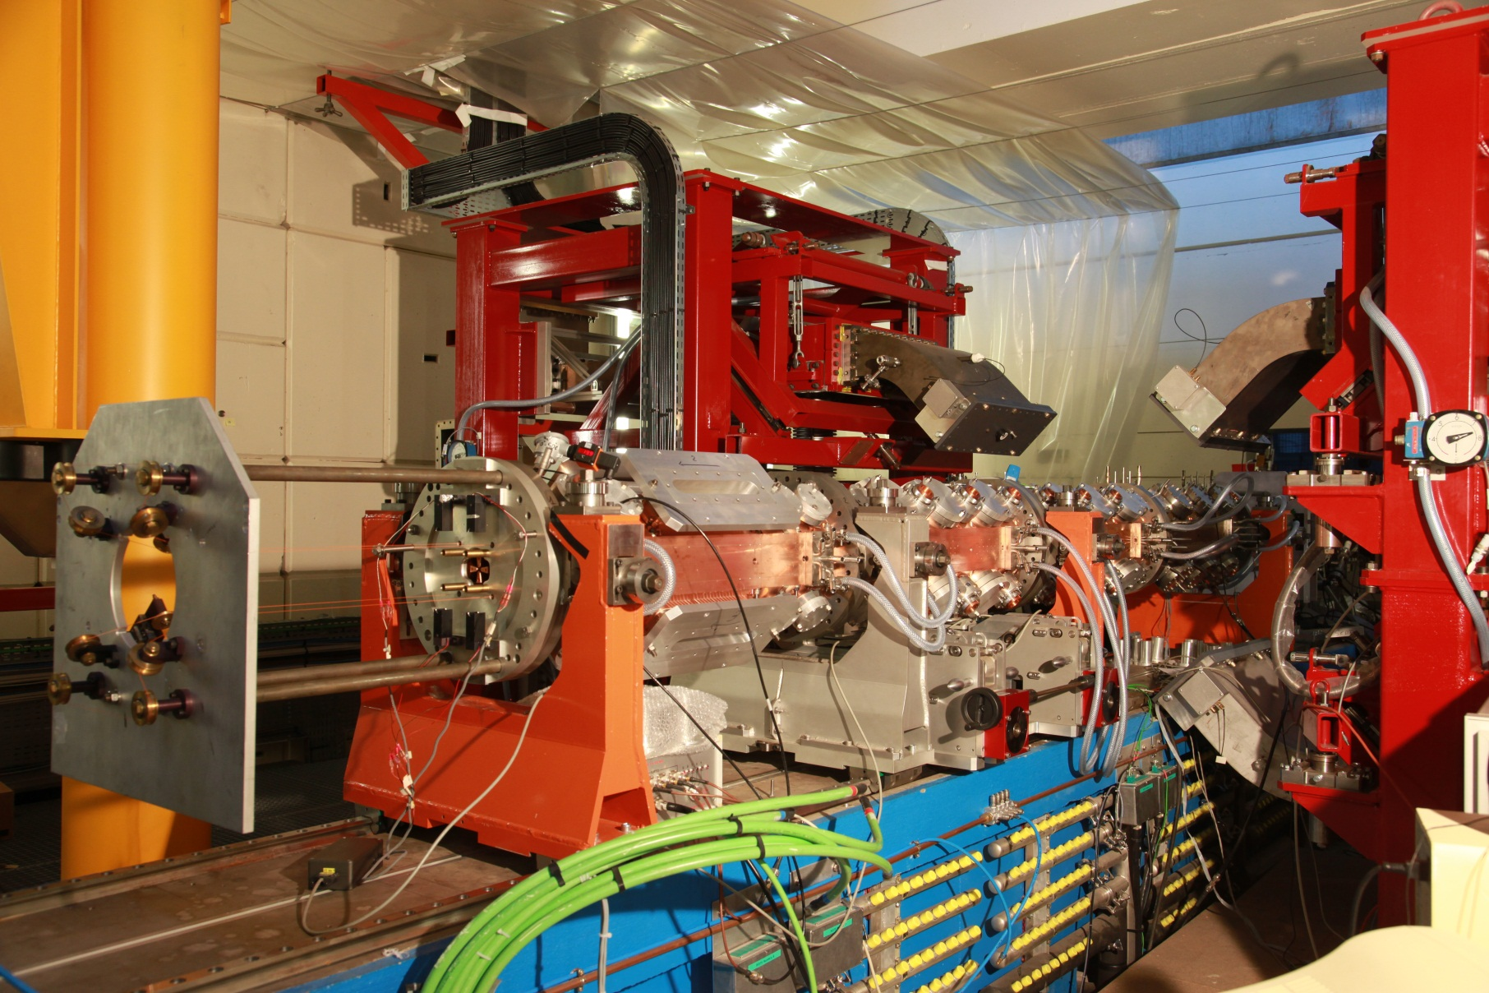
RF measurements for 4 modules
RF adjustments on the first coupling plate (rods)
IPHI EPICS Control System

Slide 9
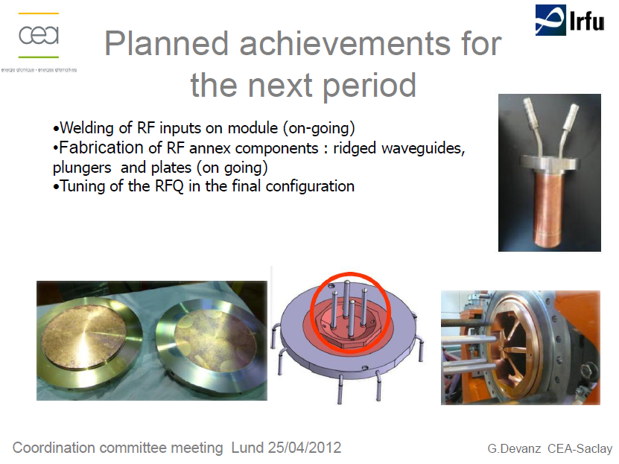

Slide 10
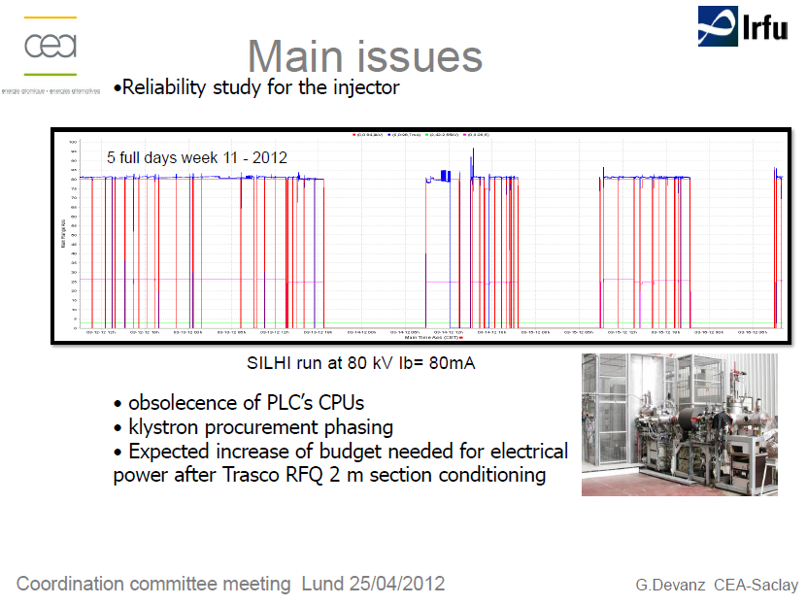

Slide 11
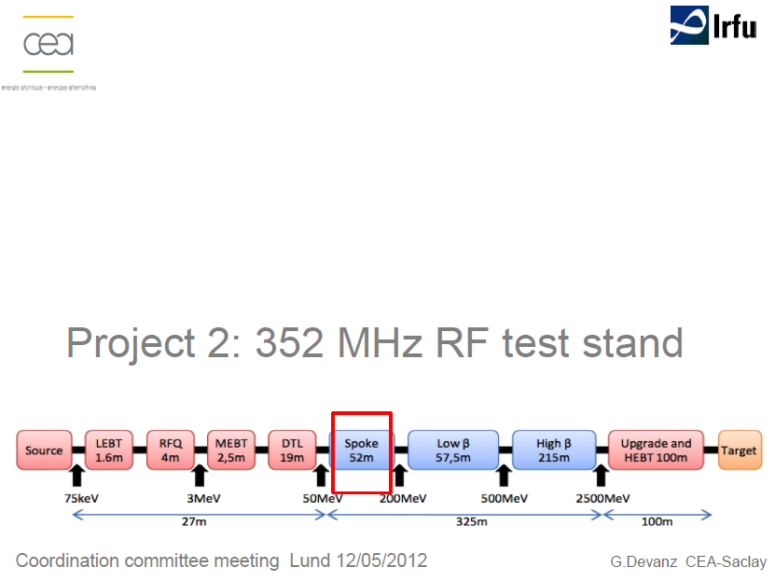

Slide 12
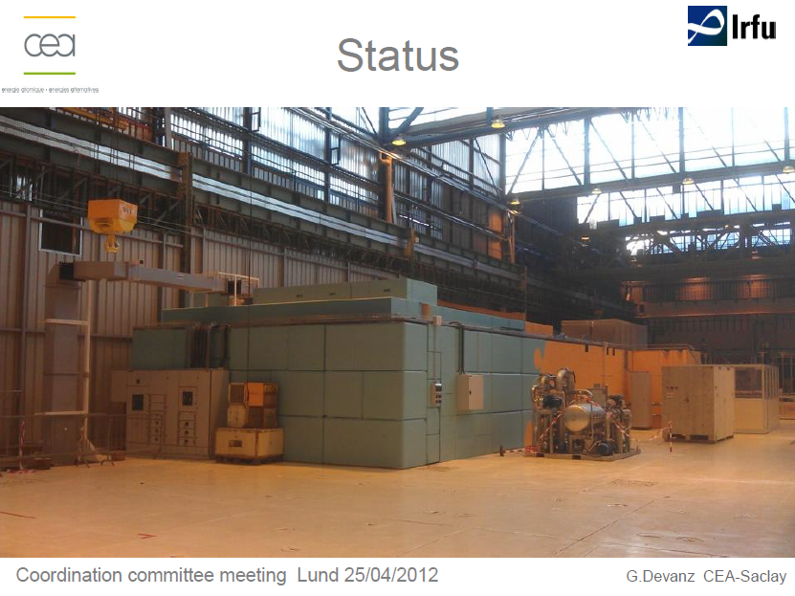

Slide 13
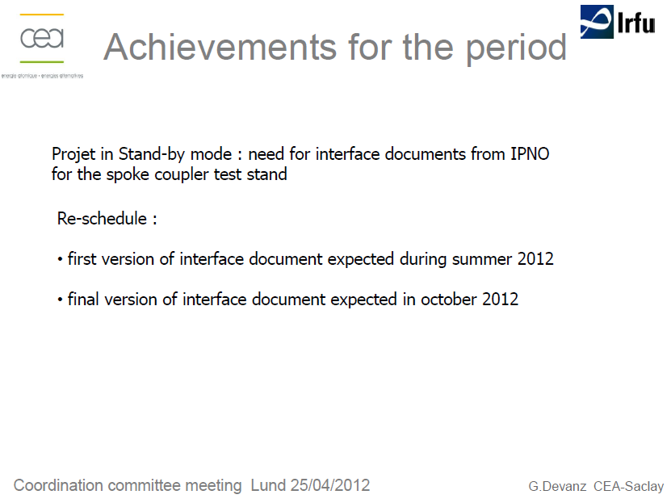

Slide 14
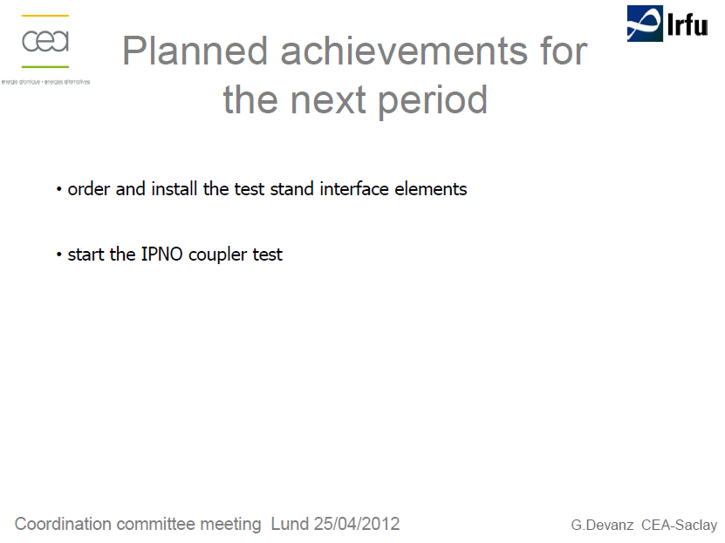

Slide 15
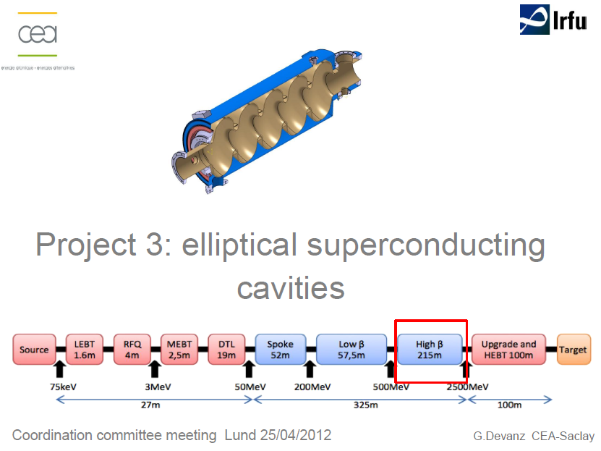

Slide 16
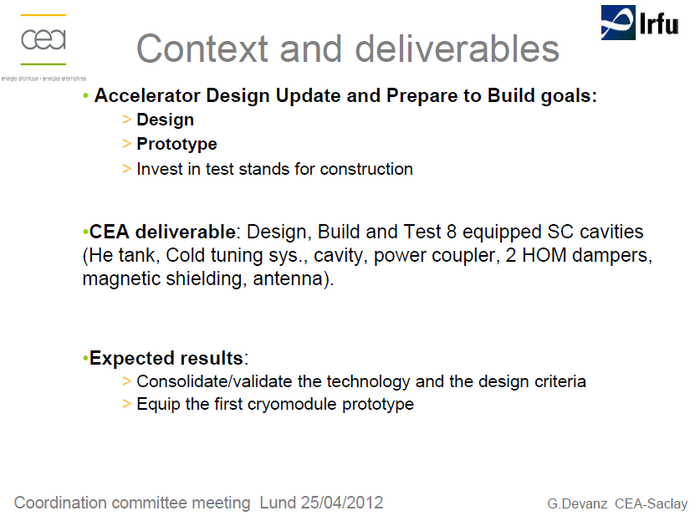

Slide 17
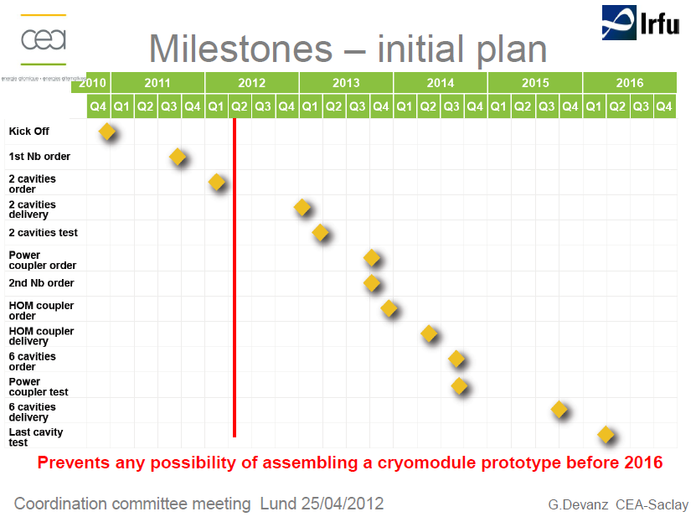

Slide 18
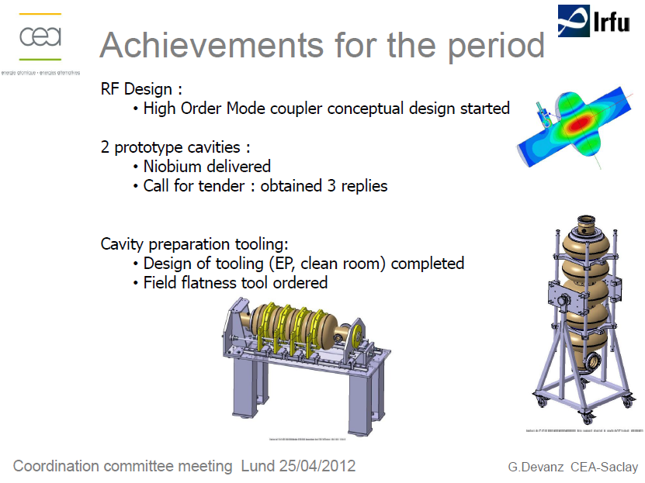
Finished
Ordered – Kick off meeting done
ordered
delivered

Slide 19
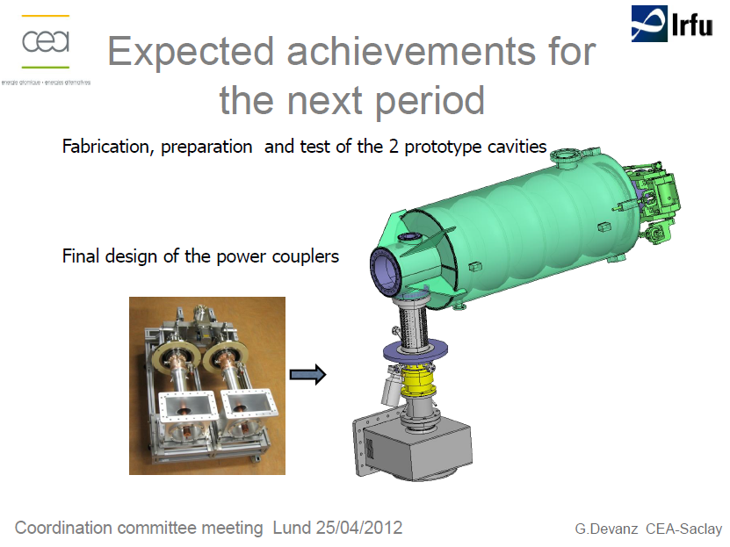
OK
RF design of couplers OK
Interfaces with the vacuum tank to be defined

Slide 20
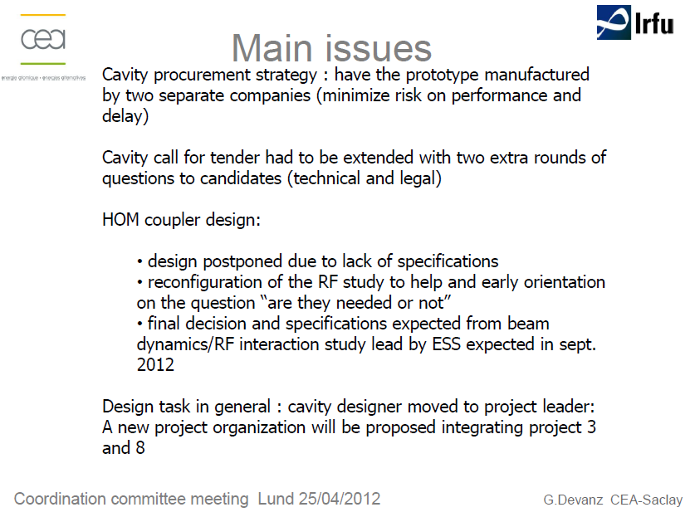
No HOM

Slide 21
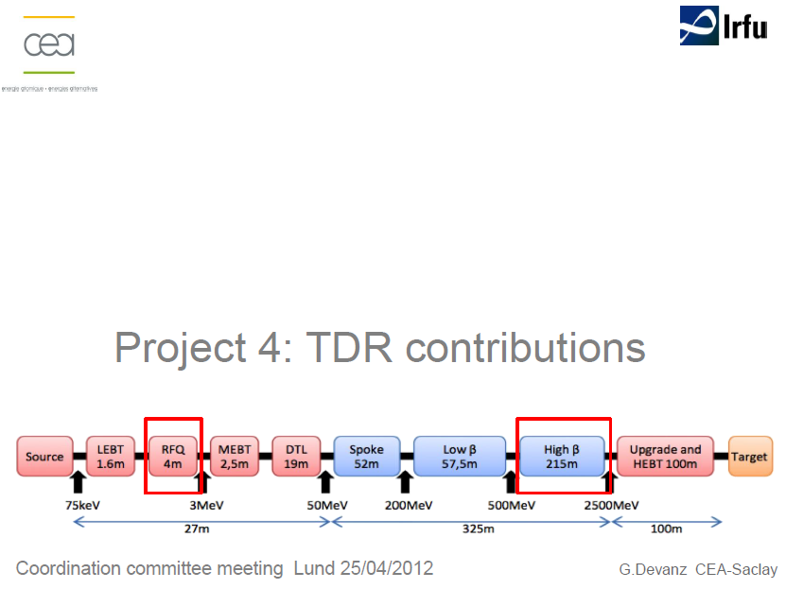

Slide 22
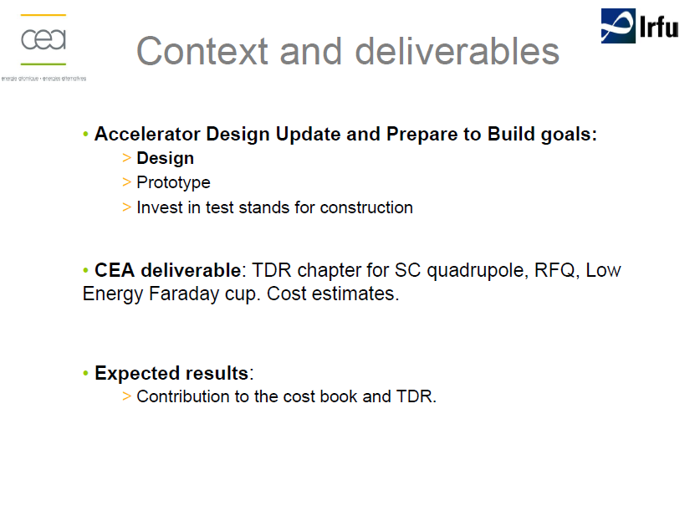

Slide 23
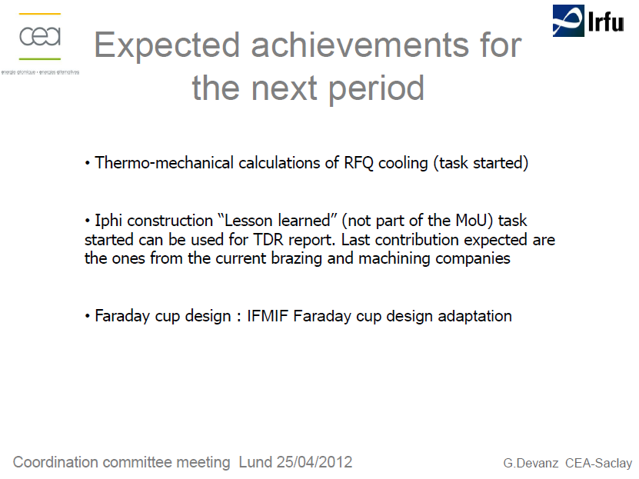
Stopped until the final decision 4 ⬄ 5 meters

Slide 24
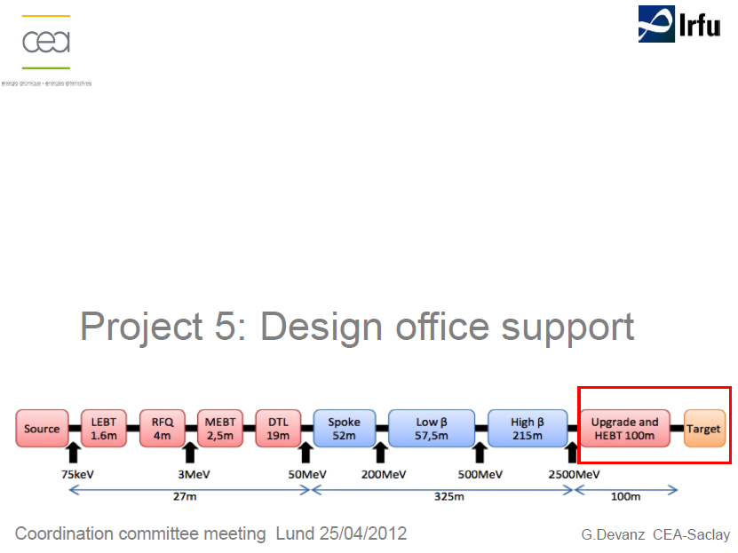

Slide 25
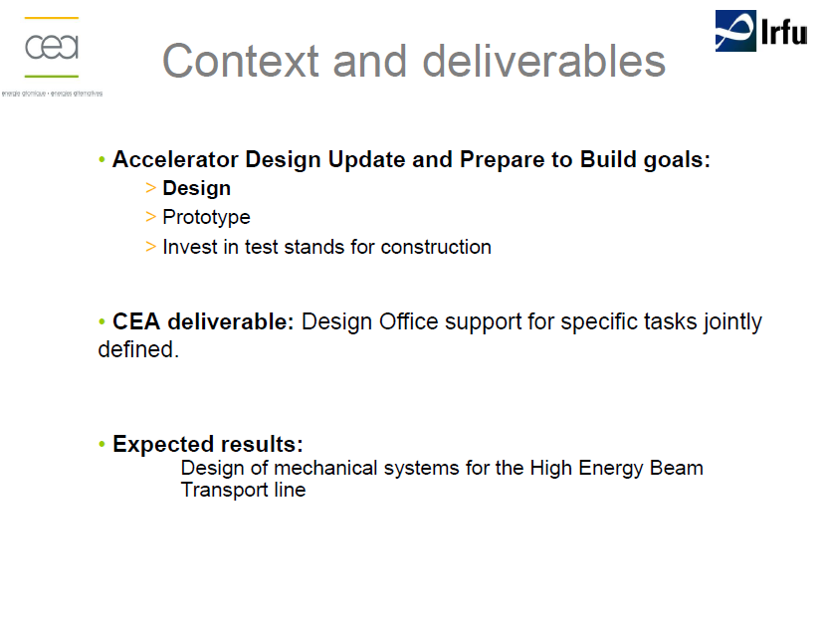

Slide 26
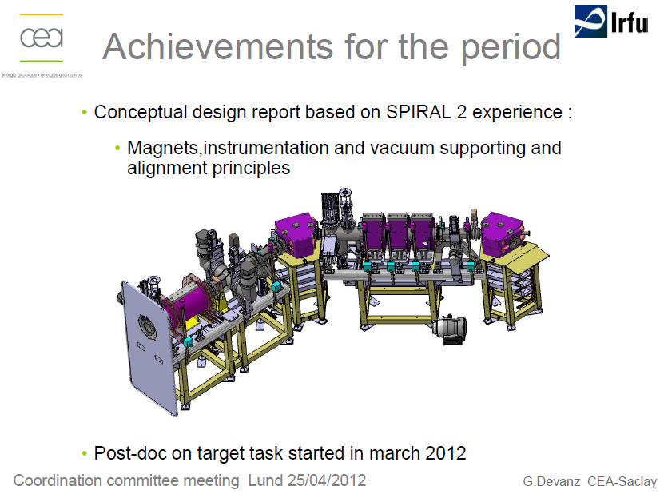

Slide 27
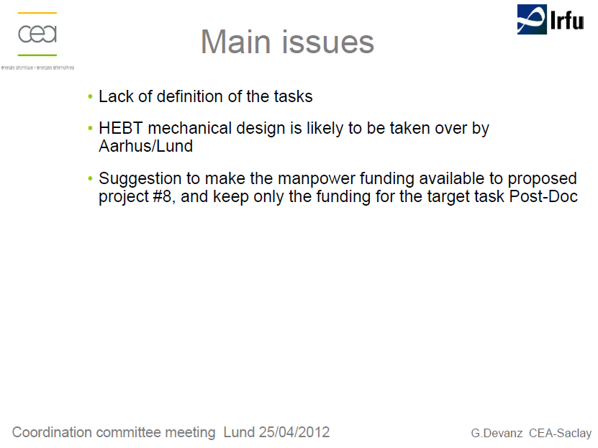

Slide 28
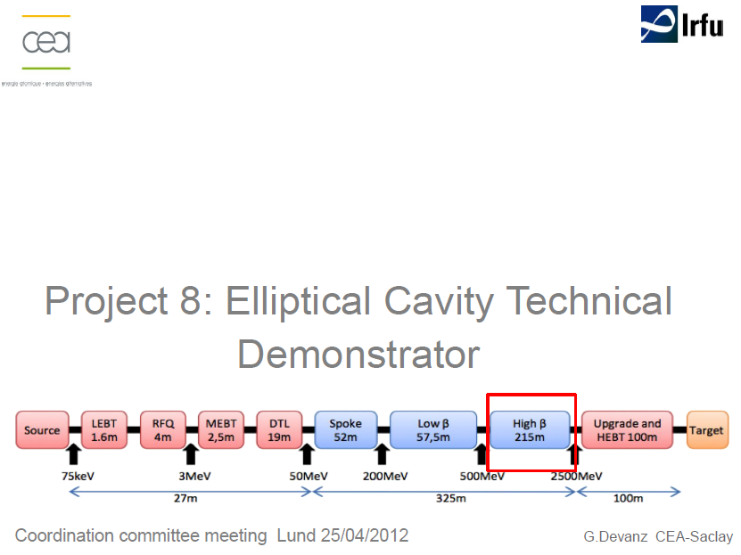

Slide 29
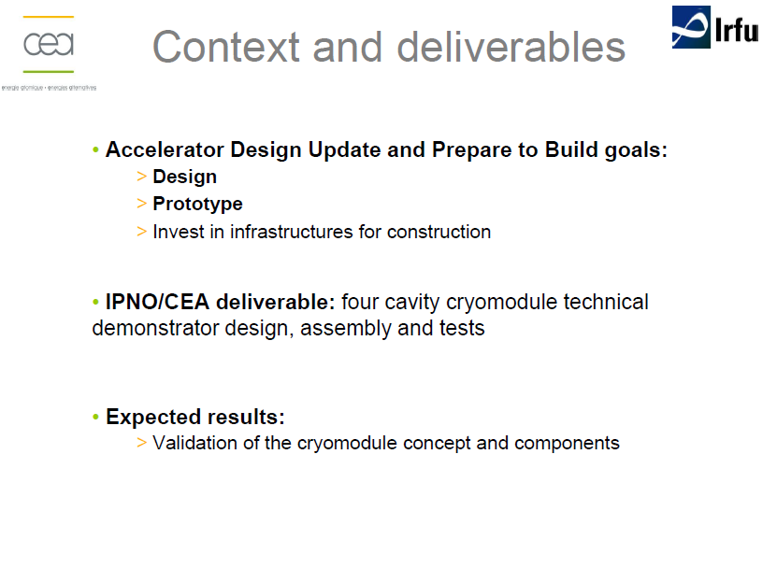

Slide 30
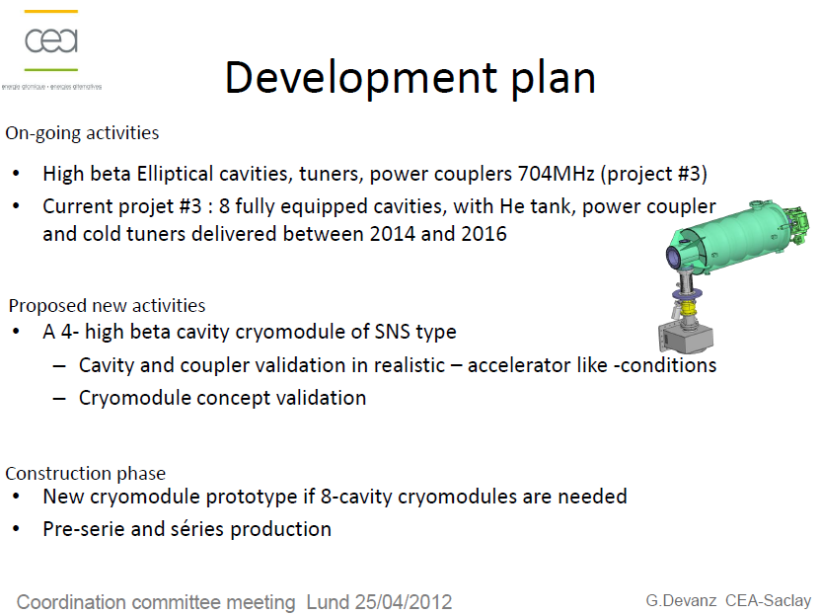

Slide 31
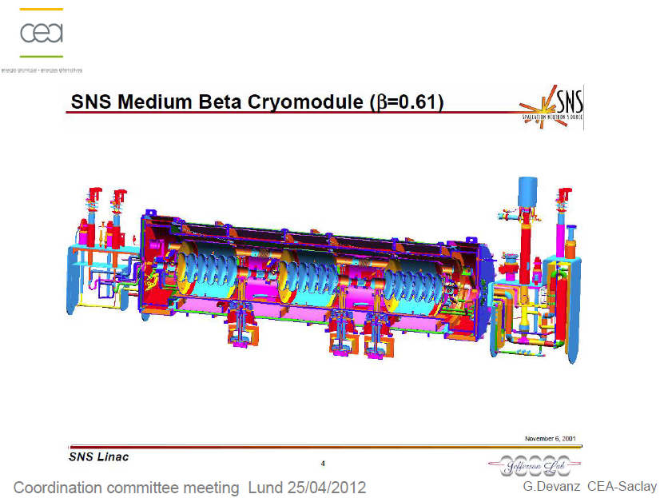

Slide 32
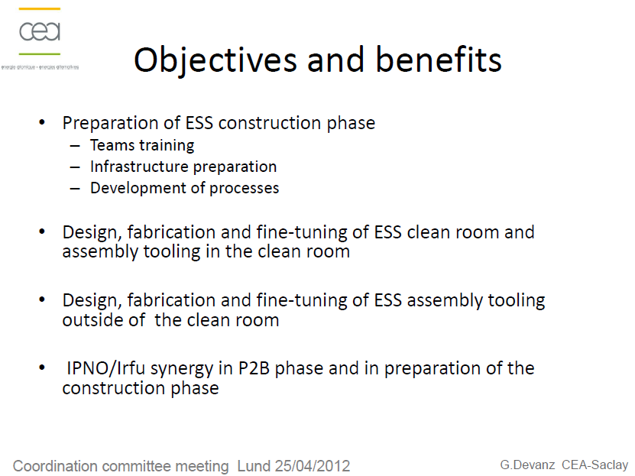

Slide 33
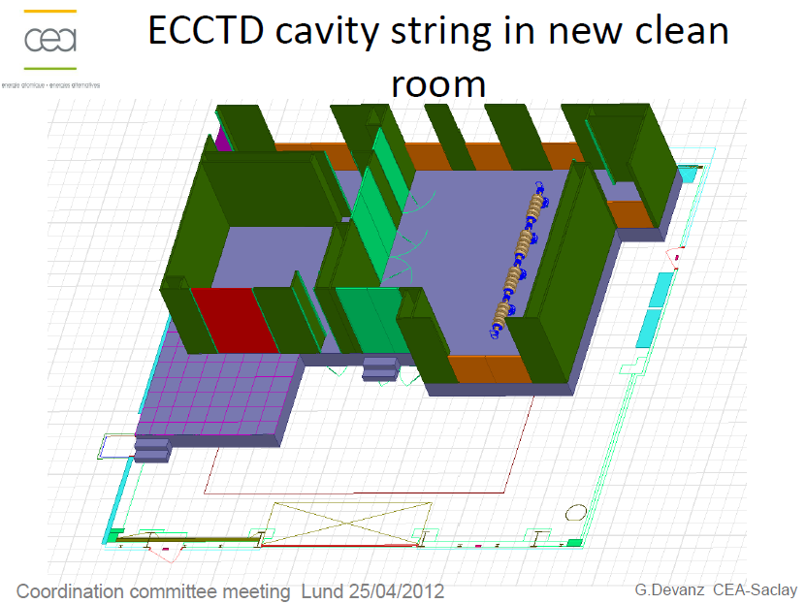

Slide 34
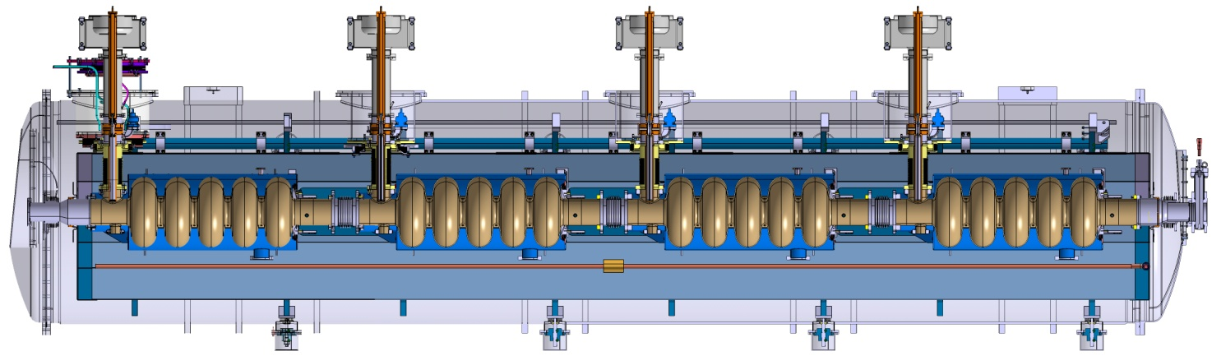
Achievements for the period
Clean room: call for tender finished – analysis of the offers
Status of the engineering study of the cryomodule
Design in progress based on the SNS type structure with a space frame
Present studies:
Stiffening of the space frame
Cavity supports by Ta6V rods – fixed points at the coupler location
Vacuum tank – coupler interface to be
Extremity tubes
…

