Slide 1


Status of the French-Swedish Cooperation Agreement
10th Oct, 2012
Christine Darve

Slide 2
“Cooperation Agreement in the field of neutron and accelerator sciences to the ESS Design Phase“:
December 13th, 2010: Contract signed
  CEA responsible officer: Romuald DuPerrier
  IPNO responsible officer: Sebastien Bousson
  ESS responsible officer: Mats Lindroos
April 25th, 2012: Lund meeting Coordination meeting
Add project 8th Elliptical Cavity Cryomodule technology demonstrator
  Gabriele Fioni (CEA-Saclay) - Patrik Carlsson (ESS AB)
  Jacques Martino (CNRS-IN2P3) - Kjell Möller (ESS AB)
  Philippe Chomaz (CEA-Irfu/DSM) - Mats Lindroos (ESS AB)
  Alex Mueller (CNRS-IN2P3) - Christine Darve (ESS AB)
  Colin Carlile (ESS AB) - Sébastien Bousson (French responsible officer)
  Patrik Carlsson (ESS AB) - Guillaume Devanz (French responsible officer)
By December 2012: Amendment # 1 to be signed
  CEA responsible officer: Pierre Bosland (since June 2012)

Slide 3
Contract scope
“Cooperation Agreement in the field of neutron and accelerator sciences to the ESS Design Phase”
The purpose of the Agreement is to define the framework under which the Parties shall cooperate to the ESS design phase under the following projects:
  Project 1: injector reliability test,
  Project 2: 352 MHz power coupler bunker,
  Project 3: eight equipped and tested superconducting cavities,
  Project 4: contribution to the TDR,
  Project 5: engineering design effort,
  Project 6: design, construction and test of a complete spoke cryomodule,
  Project 7: new infrastructure for superconducting cavity hydrogen outgazing.
  Project 8: Elliptical Cavity Cryomodule Technology Demonstrator

Slide 4
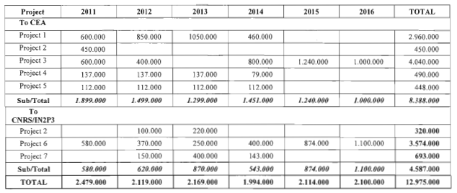
Contract Cost & Schedule (original 2010)

Slide 5
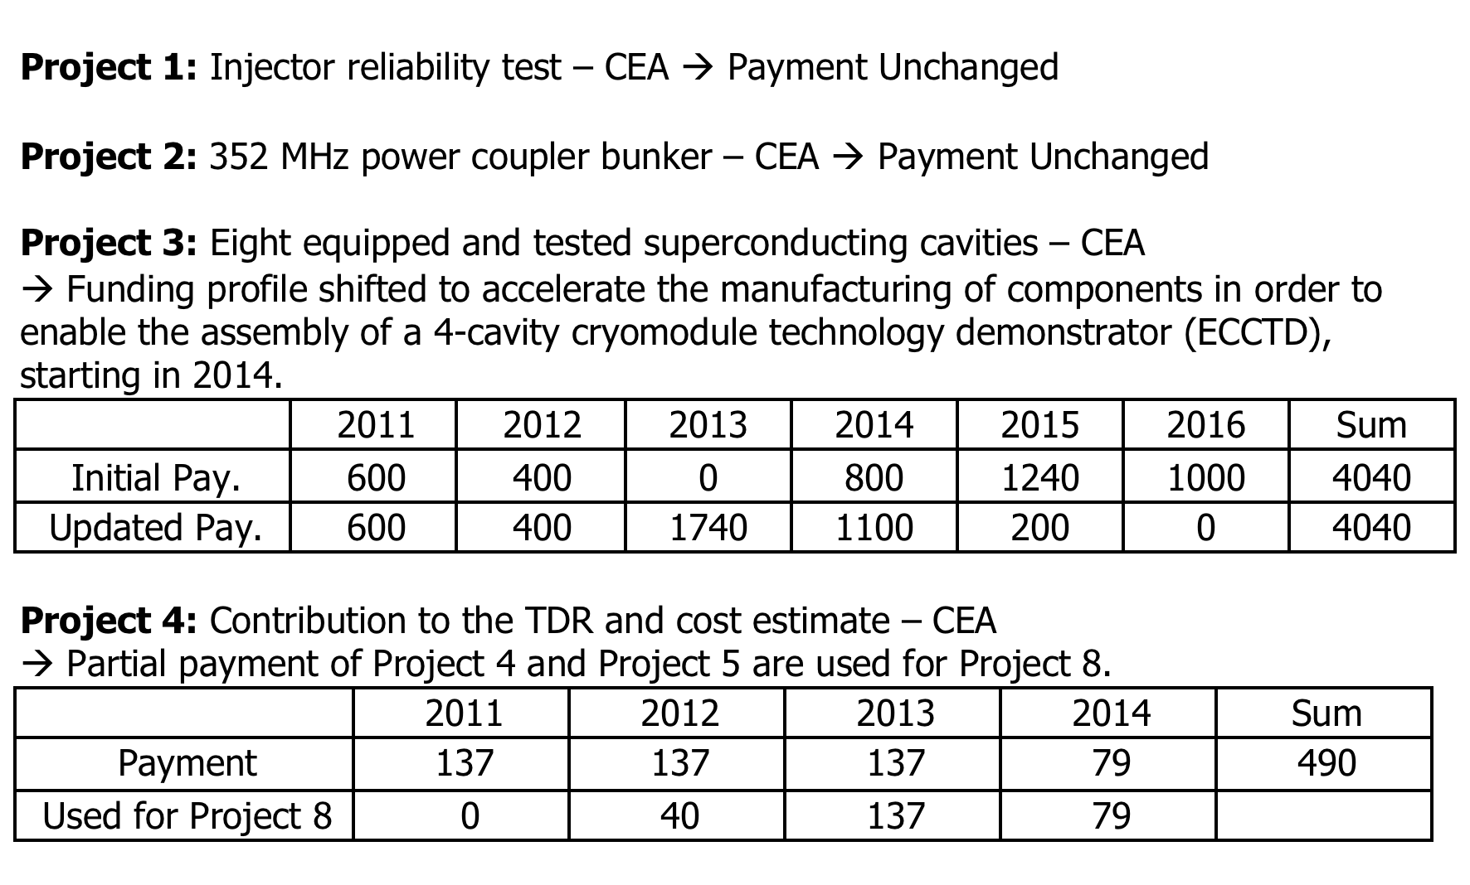
Contract Cost & Schedule (Amendment 2012)

Slide 6
Contract Cost & Schedule (Amendment 2012)

Slide 7
Cryomodule project flow
Assess:
Mitigate:
Identify:
Linac Layout, Flow Scheme, Breakdown Structures
Infrastructures using. clean room, assembly hall, RF
Prototype Test Requirements (Technology Demonstrator)
Life Cycles
Feasibility of different Technologies and Assemblies
Risks and Manage Interfaces
Component Requirements, Specifications
Develop DAQ and Control, Operating Modes
Extrapolation to Production
Quality Assurance
Risks (Project Risk and Technical Risk)
Cost Estimate
Use lessons learned from PX, X-FEL, SNS, J-PARC.

Slide 8
WPL - Strategies
The project will follow a common sequence of activities for the most of the work units’ deliveries. The main steps of this are
Functional analysis and requirements
Requirement analysis
Concept design and review
Design (ICDs and Technical Reports)
Prototype and test

Slide 9
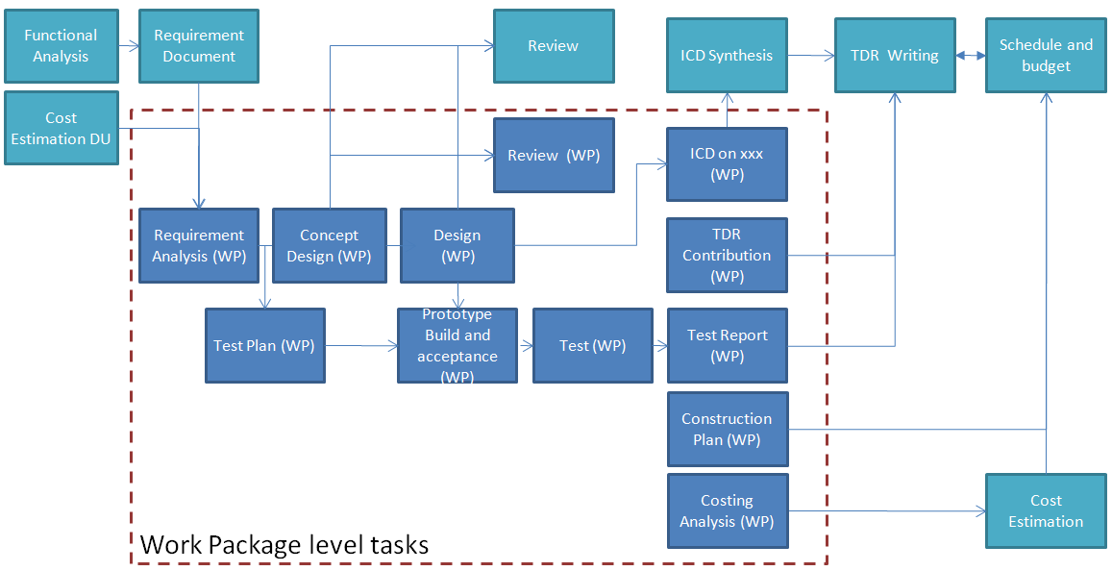
WPL - Strategies

Slide 10
  Project Stakeholders
Preliminary list of high-level major stakeholders:
Neutron users
ESS AB
STC (Steering Committee)
EU (European Union)
Host states
Member states
Skåne region
Collaboration institutes
Other institutes

Slide 11
    List of participants
The ESS Accelerator Design project will be addressed as ESS a joint European effort in which several countries from all over the world will contribute with the best of their technical and scientific resources in a collaborative project. The list of participating institutes in the collaboration is as follows:
Aarhus University (DK)
CEA Saclay (FR)
University of Lund (SE)
CNRS Orsay (FR)
ESS- Bilbao (ES)?
INFN (IT)
Uppsala University (SE)
→ Adding new potential partners in an iterative process of merging tasks and partners

Slide 12
How do we track progress ?
Accelerator Internal Review – Cavity
July 5th 2012, In Orsay, lead by Sebastien/Dave
Cryomodule Proof of concept - Workflow checking
October 26th , 2012 ?, later ?
Check point - internal
What: Review the conceptual design:
  Confirm CEA management organization
  Review all technical documents (requirements, 3D Design, interfaces, etc)
  Review main function (cryomodule, Jumper connection (incl. HX, JT), CTS, Power coupler, supporting system)
  Review requested document: Integration, flow scheme, thermo-mechanical analysis, heat load, Assembly techniques, functional analysis, alignment, conditioning.

Slide 13
How do we track progress ?
Accelerator Internal Review and Preliminary Safety review panel – Cryomodule
TBD
Safety Review – when, where: TBD
What:
Follow ESS policy inspired from [FNAL – 5032]
System Design Documents
Safety Analysis Documents
System Operating Documents
Engineering Documents
Maintaining Safe Operation
Inspections
Continuous goal for CEA
→ Produce documentation (tracking)

Slide 14
Details of the Cooperation Agreement Projects

Slide 15
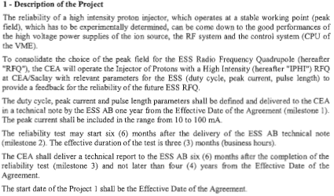
Project 1: Injector reliability Test

Slide 16
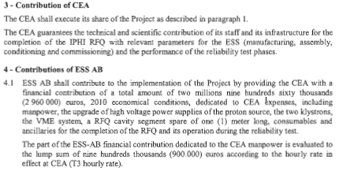
Project 1: Injector reliability Test

Slide 17
Project 1: Injector reliability Test
Discussion: Aurelien, Pierre [See Guillaume presentation April 25th ]
1/ What has been achieved till now
2/ What remains to be done
3/ Tracking progress and possible mitigation
 | 2011 | 2012 | 2013 | 2014 | 2015 | 2016 | Sum
Initial Payment | 600 | 850 | 1050 | 460 |  |  | 2960
Updated Payment | 600 | 850 | 1050 | 460 |  |  | 2960

Slide 18
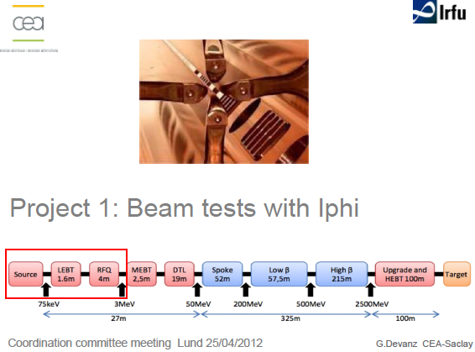
Project 1: Injector reliability Test

Slide 19
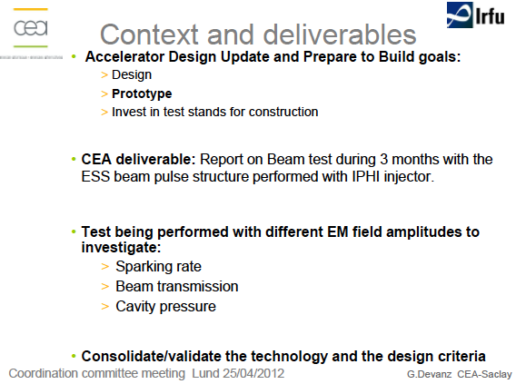
Project 1: Injector reliability Test

Slide 20
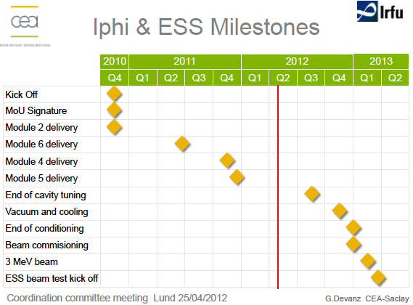
Project 1: Injector reliability Test

Slide 21
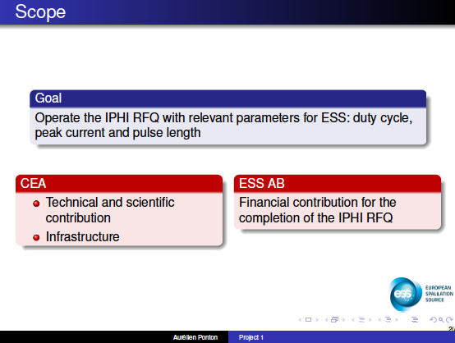

Slide 22
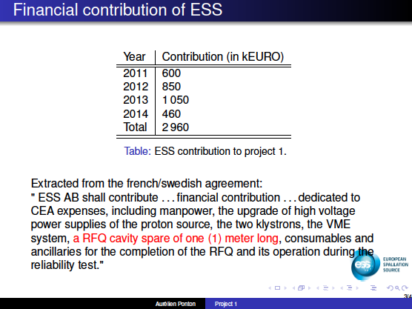

Slide 23
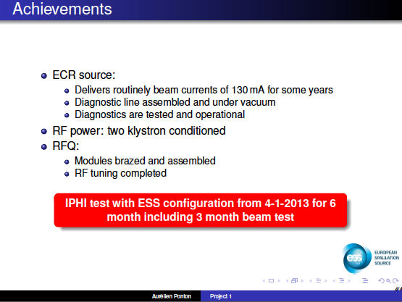

Slide 24
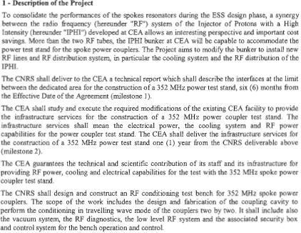
  Project 2: 352 MHz power coupler bunker

Slide 25

  Project 2: 352 MHz power coupler bunker

Slide 26
Project 2: 352 MHz power coupler bunker
Discussion: Steve Molloy, Pierre Bosland [See Guillaume presentation April 25th ]
1/ What has been achieved till now
2/ What remains to be done
3/ Tracking progress and possible mitigation
 | 2011 | 2012 | 2013 | 2014 | 2015 | 2016 | Sum
Initial Payment | 450 | 100 | 220 |  |  |  | 770
Updated Payment | 450 | 100 | 220 |  |  |  | 770

Slide 27
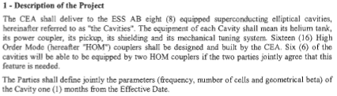
Project 3: eight equipped and tested superconducting cavities

Slide 28
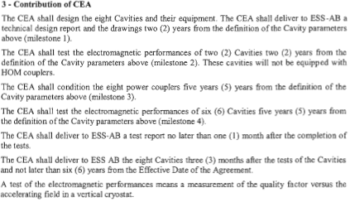
Project 3: eight equipped and tested superconducting cavities

Slide 29
Project 3: eight equipped and tested superconducting cavities
Discussion: Steve Molloy, Pierre [See Guillaume presentation April 25th]
1/ What has been achieved till now
2/ What remains to be done
3/ Tracking progress and possible mitigation
 | 2011 | 2012 | 2013 | 2014 | 2015 | 2016 | Sum
Initial Payment | 600 | 400 | 0 | 800 | 1240 | 1000 | 4040
Updated Payment | 600 | 400 | 1740 | 1100 | 200 | 0 | 4040

Slide 30

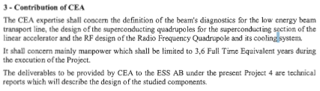
Project 4: contribution to the TDR

Slide 31
Project 4: contribution to the TDR
Discussion: Steve Peggs, Pierre
1/ What has been achieved till now
2/ What remains to be done
3/ Tracking progress and possible mitigation
 | 2011 | 2012 | 2013 | 2014 | 2015 | 2016 | Sum
Payment | 137 | 137 | 137 | 79 |  |  | 490
Used for Project 8 |  | 40 | 137 | 79

Slide 32

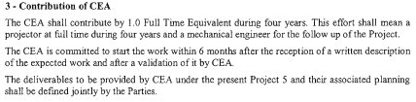
Project 5: engineering design effort

Slide 33
Project 5: engineering design effort
Discussion: Pierre, Steve Molloy [See Guillaume presentation April 25th]
1/ What has been achieved till now
2/ What remains to be done
3/ Tracking progress and possible mitigation
 | 2011 | 2012 | 2013 | 2014 | 2015 | 2016 | Sum
Payment | 112 | 112 | 112 | 112 |  |  | 448
Used for Project 8 |  |  | 112

Slide 34
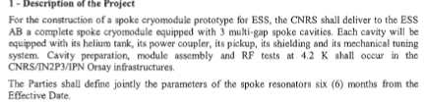
Project 6: design, construction and test of a complete spoke cryomodule,

Slide 35
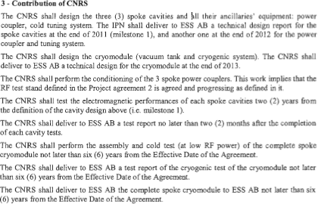
Project 6: design, construction and test of a complete spoke cryomodule,

Slide 36
Project 6: design, construction and test of a complete spoke cryomodule,
Discussion: Pierre, Steve Molloy [See Sebastien presentation April 25th]
1/ What has been achieved till now
2/ What remains to be done
3/ Tracking progress and possible mitigation
 | 2011 | 2012 | 2013 | 2014 | 2015 | 2016 | Sum
Initial Payment | 580 | 370 | 250 | 400 | 874 | 1100 | 3574
Updated Payment | 580 | 370 | 1240 | 820 | 360 | 204 | 3574

Slide 37

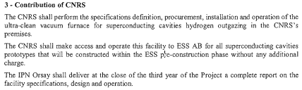
Project 7: new infrastructure for superconducting cavity hydrogen outgazing

Slide 38
Project 7: new infrastructure for superconducting cavity hydrogen outgazing
Discussion: Pierre, Steve Molloy [See Sebastien presentation April 25th]
1/ What has been achieved till now
2/ What remains to be done
3/ Tracking progress and possible mitigation
 | 2011 | 2012 | 2013 | 2014 | 2015 | 2016 | Sum
Initial Payment |  | 150 | 400 | 143 |  |  | 693
Updated Payment |  | 150 | 400 | 143 |  |  | 693

Slide 39
Project 8: Elliptical Cavity Cryomodule Technology Demonstrator
Discussion: Christine, Pierre[See Guillaume presentation April 25th]
1/ What has been achieved till now
2/ What remains to be done
3/ Tracking progress and possible mitigation
 |  | 2012 | 2013 | 2014 | 2015 | 2016 | Sum
To CEA |  |  | 993 | 1384 | 926 |  | 3303
to IPNO |  |  | 740 | 440 | 90 |  | 1270
 |  |  |  |  |  |  | 4573

Slide 40
ADU re-baseline Jorgen Andersson (9/12)
ADU_1.5 | Elliptical superconducting linac
ADU_1.5.2 | Medium beta cavities
ADU_1.5.2.6 | RF detailed design report | 2013-05-31 | 2012-07-31
ADU_1.5.3 | Cold tuning system
ADU_1.5.3.6 | Cold tuning system detailed design report | 2013-01-31 | 2012-08-17
ADU_1.5.4 | High beta cavities
ADU_1.5.4.8 | RF detailed design report | 2012-10-30 | 2012-10-30
ADU_1.5.5 | Power coupler
ADU_1.5.5.6 | Power coupler detailed design report | 2012-10-31 | 2012-07-27
ADU_1.5.9 | Prototypes and tests
ADU_1.5.9.1.2 | Test box design report | 2012-11-30 | 2012-10-10
ADU_1.5.9.1.10 | Test bench acceptance report | 2013-11-30 | 2013-05-13
ADU_1.5.9.2 | Power coupler pair
ADU_1.5.9.2.10 | High power test report | 2013-11-01 | 2013-11-01
ADU_1.5.9.3 | Cavity tuning bench
ADU_1.5.9.3.8 | Bench acceptance report | 2013-05-31 | 2012-09-14
ADU_1.5.9.4 | Cavity tooling for preparation and tests
ADU_1.5.9.4.6 | Tooling acceptance report | 2013-04-30 | 2012-08-27
ADU_1.5.9.5 | Cavities
ADU_1.5.9.5.3 | Cavity 1 fabrication and acceptance test | 2013-06-30 | 2012-12-20
ADU_1.5.9.5.8 | Cavity 1 vertical cryostat test report | 2013-09-30 | 2013-04-03
ADU_1.5.9.5.9 | Cavity 2 fabrication and acceptance test | 2013-07-31 | 2012-11-15
ADU_1.5.9.5.14 | Cavity 2 vertical cryostat test report | 2013-10-31 | 2013-04-08

Slide 41
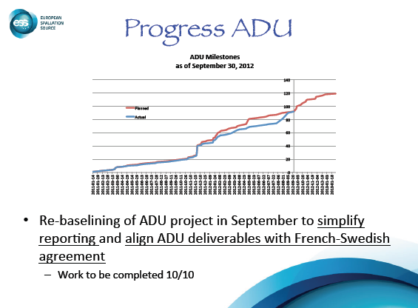

Slide 42
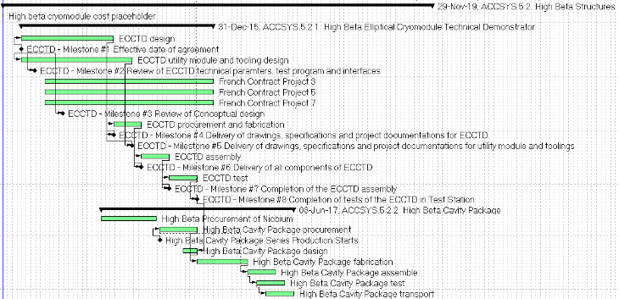
Construction phase – Suzanne Gysin (11/9/12)
High beta elliptical cavity cryomodule

Slide 43
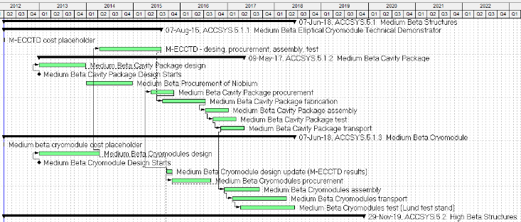
Construction phase – Suzanne Gysin (11/9/12)
Medium-beta elliptical cavity cryomodule

Slide 44
