Slide 1


Identify possible issues for the ESS construction
10th Oct, 2012

Slide 2
Possible issues and Risk for the construction
In-kind contract postponed → Schedule and cost
Delay Acceptance Test of Technology Demonstrator → Schedule
Delay in Nb delivery → Schedule & cost
Fabrication drawing late → Schedule
Requirements change → Schedule and cost
No availability of the clean-room → Schedule
Cavity production at saturation → Schedule
Vertical test stand not availability → Schedule
Failure in cavity/coupler conditioning → Schedule & cost
Failure in the assembly process → Schedule & cost

Slide 3
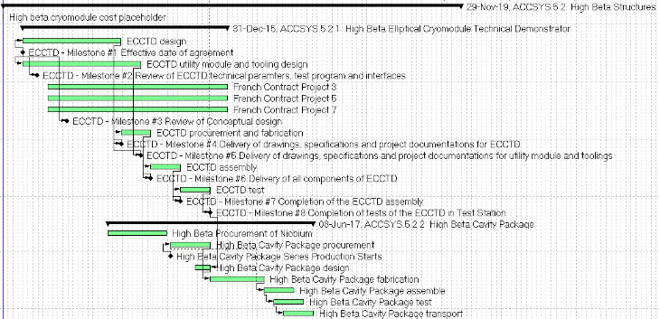
Construction phase – tight schedule
High beta elliptical cavity cryomodule

Slide 4
