Slide 1
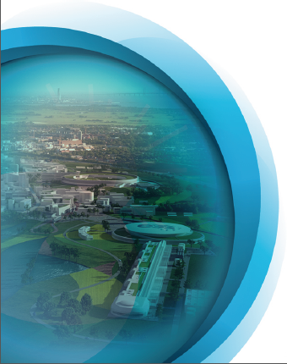

Project 8: Elliptical Cavity Cryomodule Technology Demonstrator
Christine Darve
10th Oct, 2012

Slide 2

Cryomodule Prototype Requirements
Scope : Validate the technologies used to assemble and operate the
4 high beta elliptical cavities installed in a cryostat
→ We need A Technology Demonstrator to validate the following points:
Installation of the cryomodule: e.g. cleaning, tooling, procedures, QA;
The performance of the RF design:
e.g. characterize the cavity RF signature; validate RF results obtained in vertical cryostat;
The performance of the thermal design:
eg. cool-down rate, operating conditions; heat loads; cooling scheme efficiency;
The performance of the vacuum design: e.g. leak tightness, bake-out;
The performance of the mechanical design: e.g. MAWP, stability, alignment;
The safe operation of the cryomodules:
e.g. process variables, control loops, operating modes, relieving system and interlock;
Training: e.g. to assemble, to operate.
ESS will apply the same strategy & requirement for the medium beta
→ Limit risks and interface and optimize linac

Slide 3
Elliptical Cavity Cryomodule Technology Demonstrator (ECCTD) contains:
Four Elliptical Cavity Packages, ECP
The supporting and mechanical systems that interface the ECP in the test area.
The vacuum vessel, thermal and magnetic shieldings that insulate the ECP from the ambient condition,
The cryogenic systems (distribution boxes and hydraulic circuits) that interface the ECP with the cryogenic distribution system in the test area,
The instrumentation (diagnostics) and the safety devices
ESS Integrated Control System Plateform (control Box, MPS) ?

Slide 4
High-beta Elliptical Cryomodule Technology Demonstrator
Management
The aim of this work unit is to coordinate, organize and monitor the work to be performed within this WP. The other important aspect is to handle the quality insurance required for the fabrication, preparation, assembly and test of the cryomodules.
Design
A high-beta Elliptical Cavity Cryomodule Technology Demonstrator has to be tested in order to get feedback on the design before the complete SC linac construction.
The design of the utility module and the tooling are requested.
Clean room string assembly tooling. Covers the handling of individual cavities, power couplers, SC quadrupoles and other components forming the boundary of beam vacuum, and the assembly of these components into a cavity string.
Cryomodule assembly and alignment tooling: Needed to handle the sub assemblies in the assembly halls, actually assemble them together, and perform the cavities and cryomodule alignment.
Cryomodule handling tools: needed to handle the fully assembled cryomodules, from the assembly hall to either the test place. This may require special supports for cryomodule shipping.

Slide 5
High-beta Elliptical Cryomodule Technology Demonstrator
Procurement and fabrication.
The Niobium shall be ordered at least one year before the beginning of the cavity package fabrication.
The fundamental power coupler and the cold tuning system shall be procured.
The cavity is conditioned (EP, HPR, etc) and equipped. The fabrication includes the RF testing and cryogenic testing in a vertical cryostat. Acceptance tests shall be provided.
The tooling shall be received before the cavity can be assembled.
The utility modules shall be received before the cryomodule is tested.
Assembly
The cavity shall be dressed in its helium tank, the fundamental power coupler, the cold tuning system and the diagnostic shall be assembled in a string in the clean-room, using dedicated tooling.
Finally, the assembly of the four elliptical cavity string in its cryomodule shall be completed in a clean atmosphere.
Test
The ECCTD is transported to a test area, connected to the RF system, the cryogenic system, the control and acquisition system. The test results will be reported in a complete report.

Slide 6
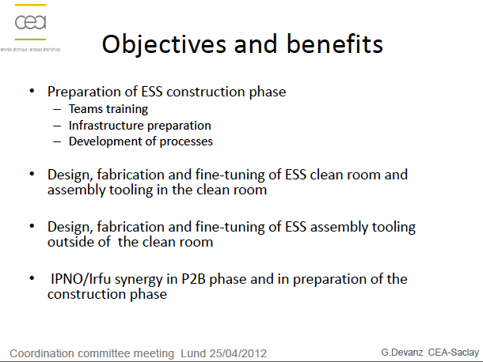

Slide 7
ESS goal for the Elliptical Cavity Cryomodule Technology Demonstrator
Existing ESS development based on CEA/IPNO work package (incl. cavity, cryomodules, toolings)
Test the same technologies than for series
Input:
Fundamental power coupler: Test 1.4 MW at CEA/Saclay
Cold tuning system: CEA
Collaboration: CEA/IPNO designs and hardware available
Use existing industry capacity
Optimize transfer of knowledge and technology (existing design expertise, safety codes and procedures)

Slide 8
Status
Proof of concept
Requirements
3D drawings by IPNO
Flow schematic
Thermo-mechanical studies
Example of to-do list:
7 | Elliptical cost - review bottom up | Pierre
8 | WBS to complete - time | Christine
9 | WBS to complete - validate | Pierre/Sebastien
10 | ECCTD - plan | Christine/Pierre
11 | ECCTD - XFEL - industrialisation - O. Napoly | Christine/Pierre
12 | Agenda for the October 26th check point | christine
13 | Elliptical - WP5 -organigrame | Pierre
14 | Assembly sequences - | Pierre
15 | Safety review preparation | Christine
16 | Optimization of the operating TS pressure | Jean-Pierre
17 | Vacuum vessel sizing - SNS | Patxi - jean-pierre
18 | Pressure code- European directive | Christine
19 | SPL - reduction for flow | Patxi
20 | 3D model in .step file | Fabien
21 | Sizing the CM piping (send cern sizing) | Jean-Pierre
22 | Coupler heat load - get from Guillaume the reference | Pierre
23 | coupler pressure drop - get from Guillaume | Pierre

Slide 9
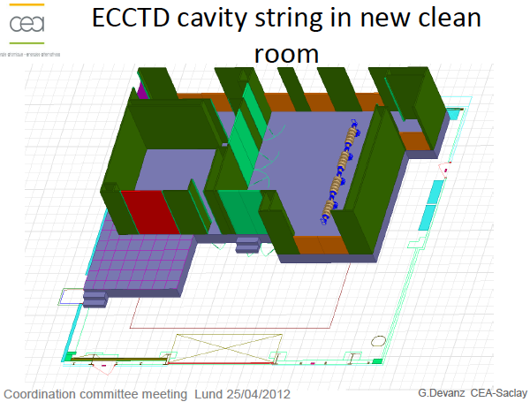

Slide 10
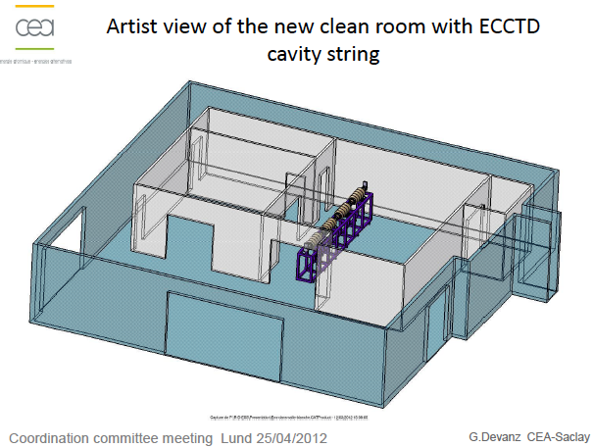

Slide 11
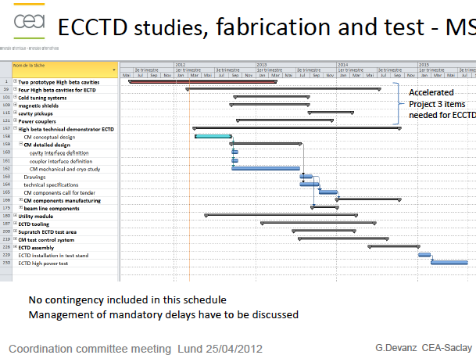

Slide 12
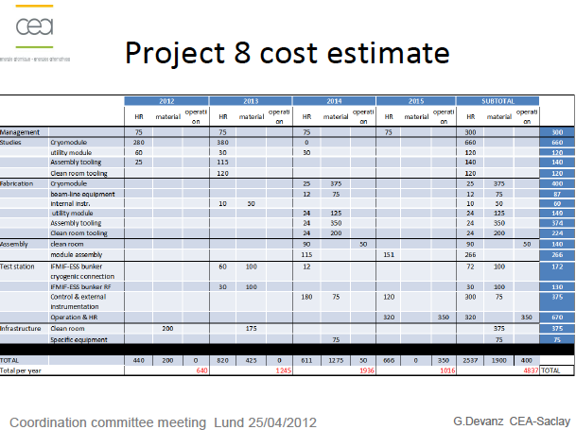

Slide 13
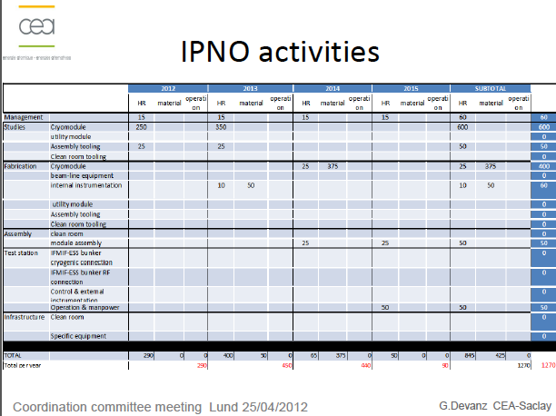

Slide 14
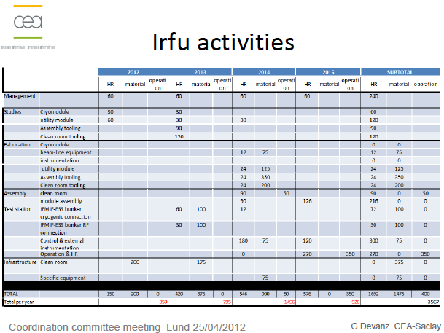

Slide 15
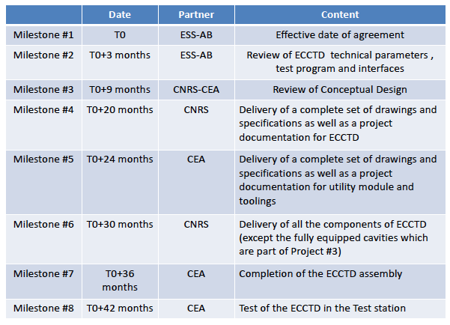

Slide 16
Cryomodule Break Down Structure and Interface
Cryomodule
Tunnel
SRF Cavity Package
SRF cavity (spoke or elliptical) in helium tank
Vacuum station
Safety equipment
Fundamental Power Coupler
HOM Couplers
Supporting system
Alignment system
Coupler cooling Sys.
Cold tuning system
Cryo-distribution Lines
Cryo valve box
Waveguide and RF eq.
Magnetic shielding
Thermal shielding
Diagnostic Inst. & Valves
Diagnostic Inst. & Valves
Instrum., BPM etc.
Corrector magnet
Jumper connection
Beam pipe
Beam pipe
Safety equipment
Safety equipment
Ext. supporting system
Control system eq.
Notes:
Mechanical interface using bellows, flanges, etc…

Slide 17
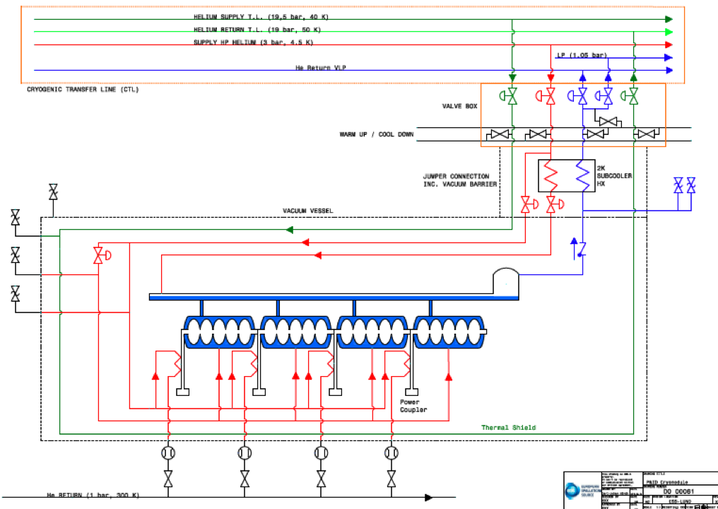

Slide 18
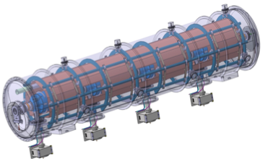
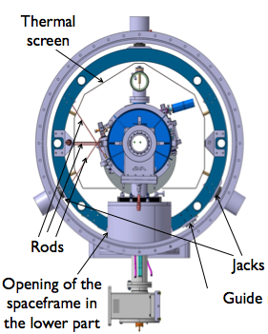
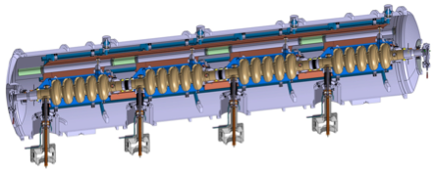
Elliptical Cryomodules
Space-frame
5-cell elliptical cavity
Helium tank
Power coupler
Cold tuner
Elliptical Cavities Cryomodule Technology Demonstrator results by the end of 2015 → start pre-series
Notes:
ii) Plans for the remaining part of 2012 (and beginning of 2013 if appropriate)
Cryo → Freeze the cold Linac operating parameters
→ ESS Linac flow scheme
→ Sizing of components (e.g. distribution lines)
Spokes → Complete technical design detail (proto test expected 2015)
Elliptical →Develop component stand alone test to verify the expected heat load
→ Complete the conceptual design and Initiate the fabrication drawing
iii) Issue that needs attention
Spoke → Prototype development depends on the availability of resonator
Elliptical → Critical path for current ESS schedule
e.g. availability of the infrastructure
→ Freeze the parameters of the medium- and high-beta cavities packages in order to freeze the cryomodule design
e.g. HOM use

Slide 19
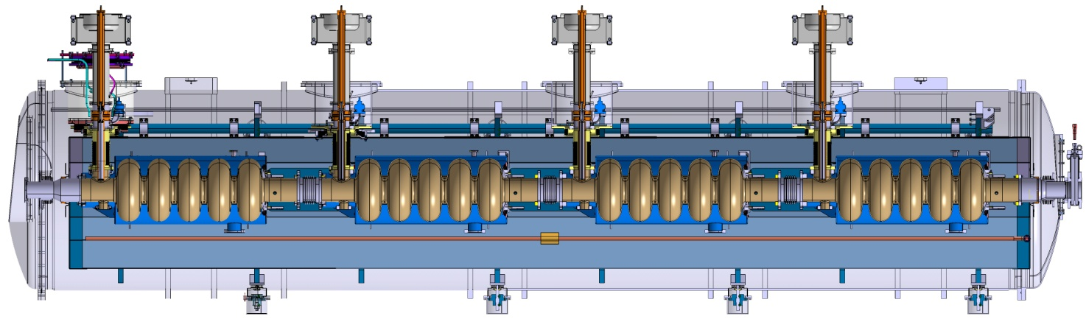
Current development
6533

Slide 20
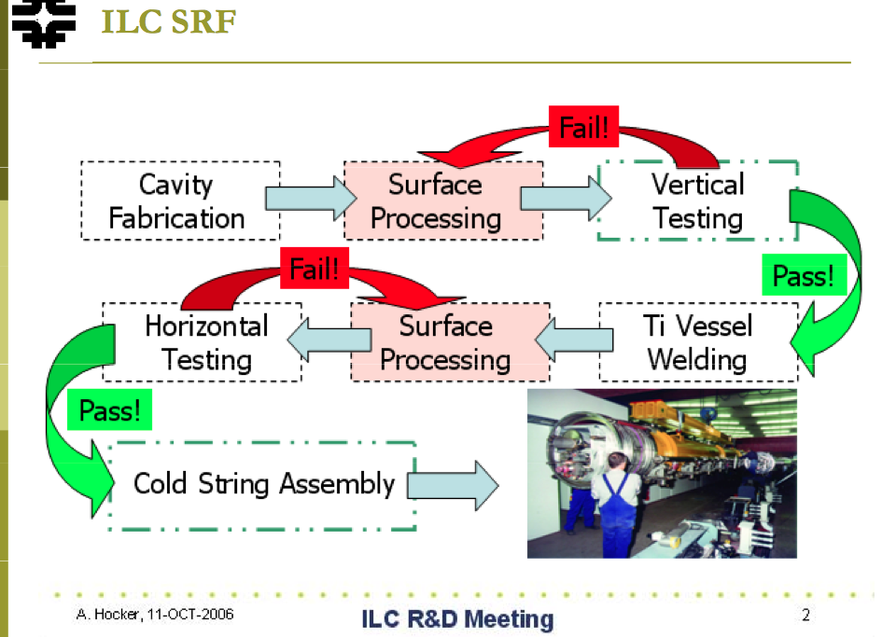
The work flow process

Slide 21
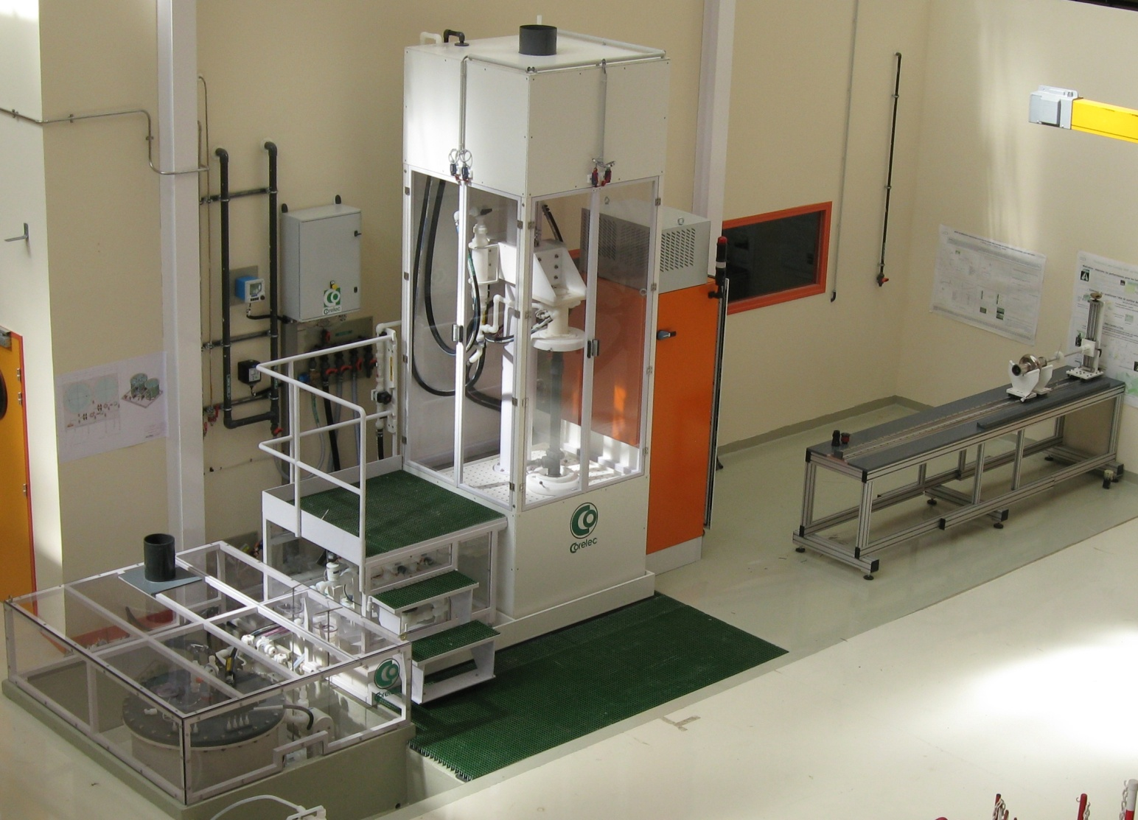
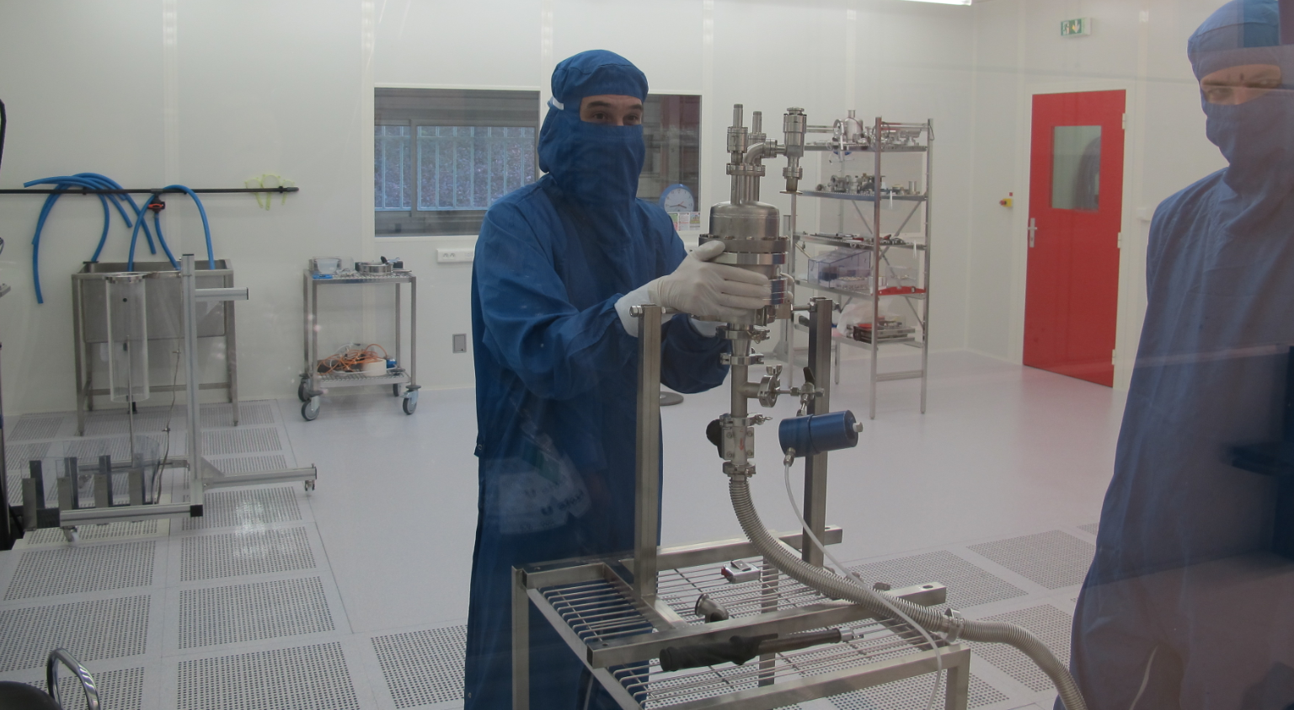
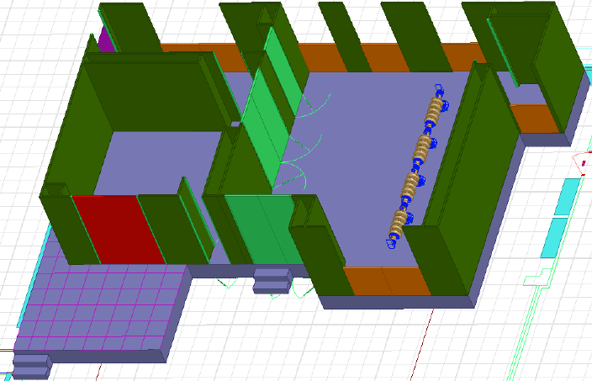
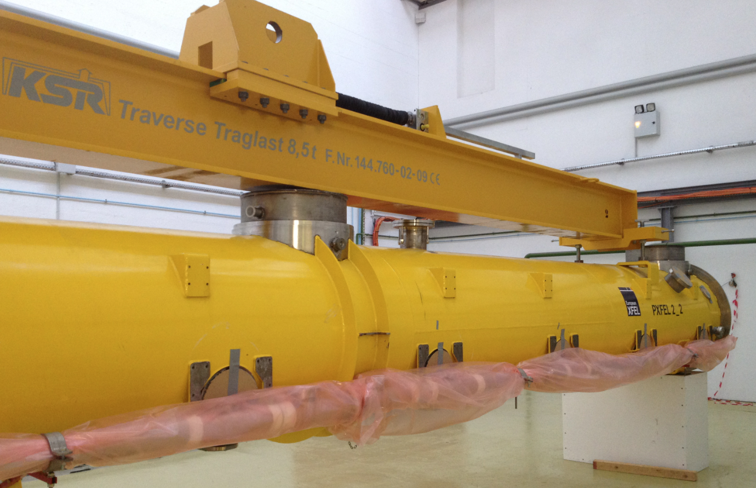
Elliptical Cavity Cryomodule Technology Demonstrator
April 2012 : Modification of the French-Swedish collaboration agreement
Broadening the IPNO and CEA/Irfu activities:
Mechanical and thermal design of the cryomodule components
Design of the requested tooling
Procurement and follow-up of manufacturing in industry
Development of infrastructure (clean-room, assembly hall and test area)

Slide 22
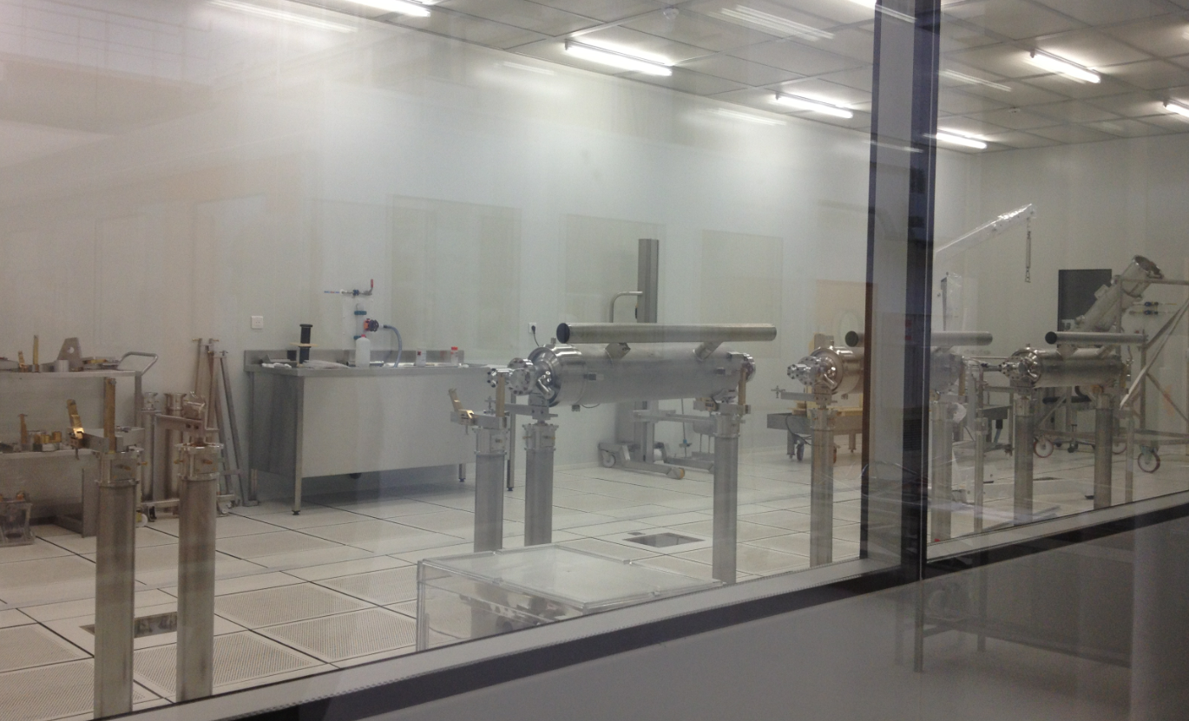
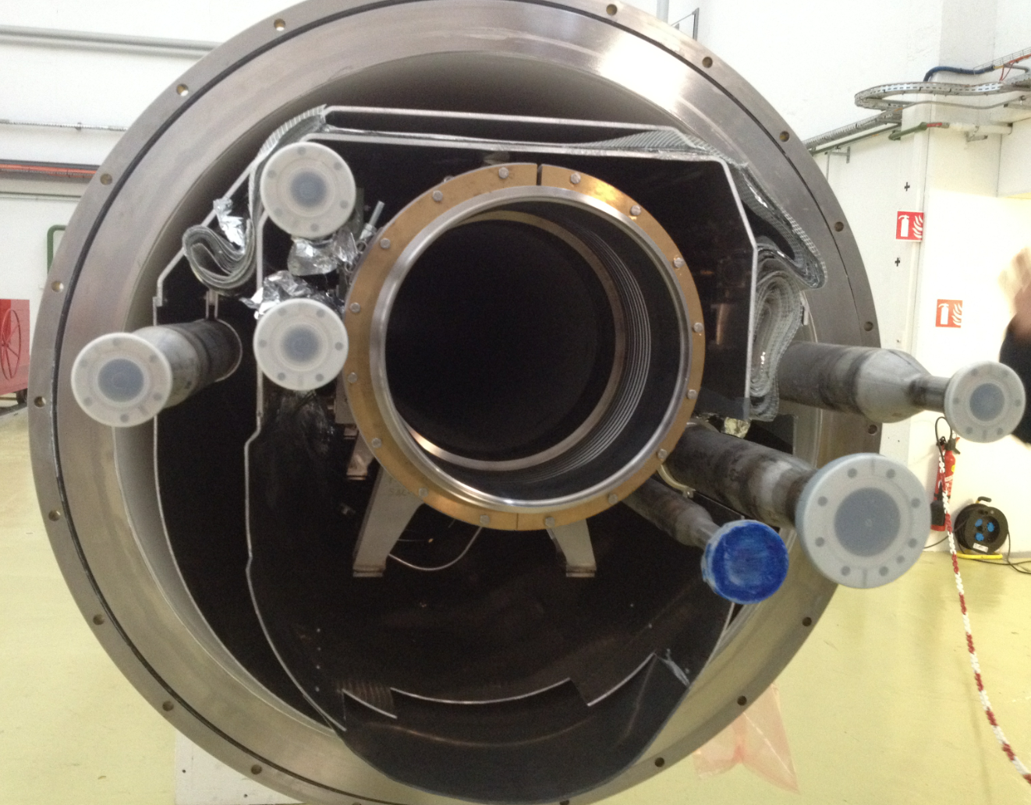
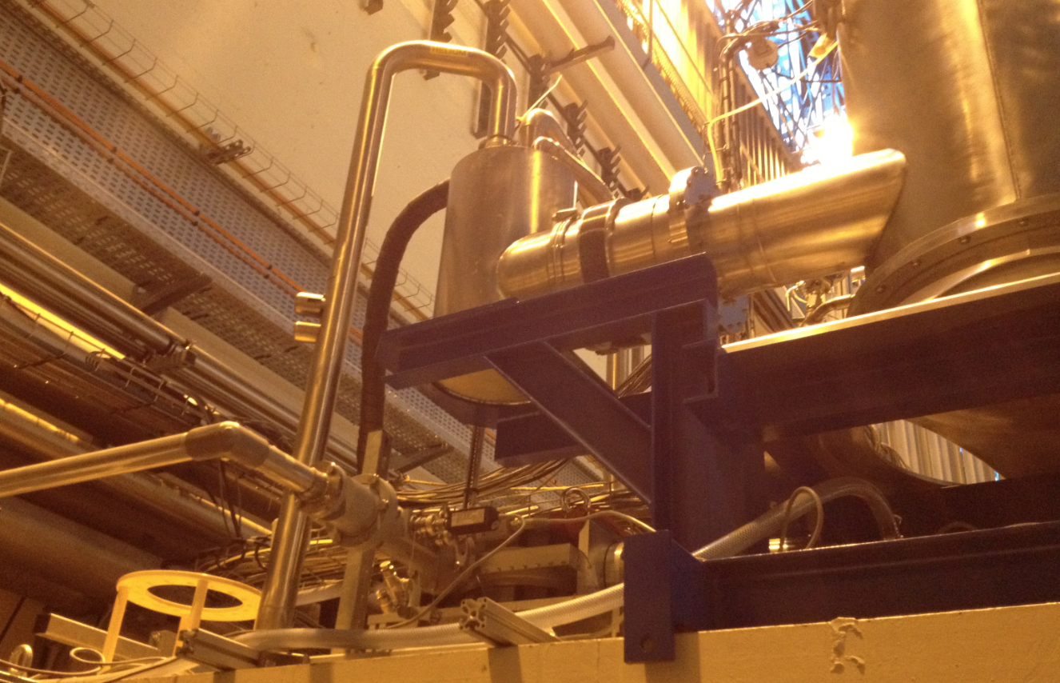
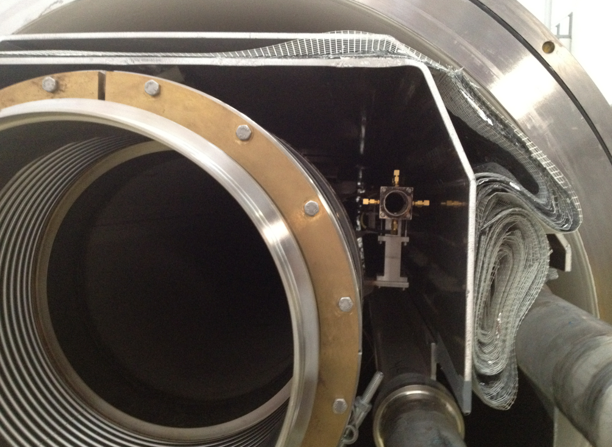
CEA Infrastructures
+ 1 new cleanroom

Slide 23
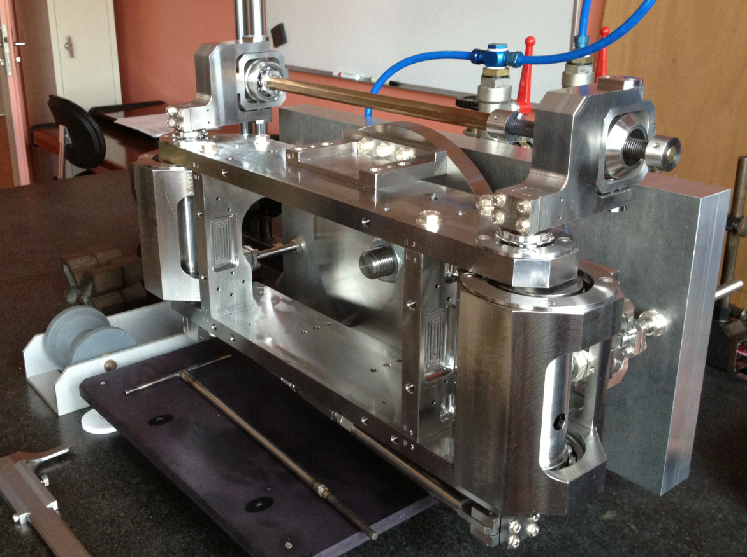
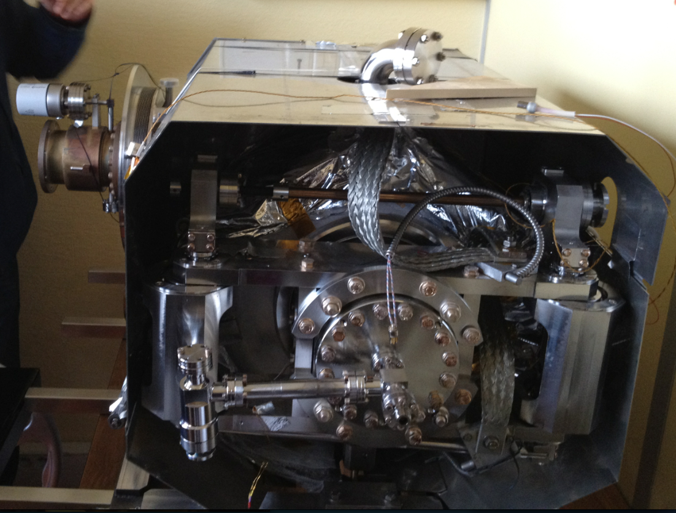
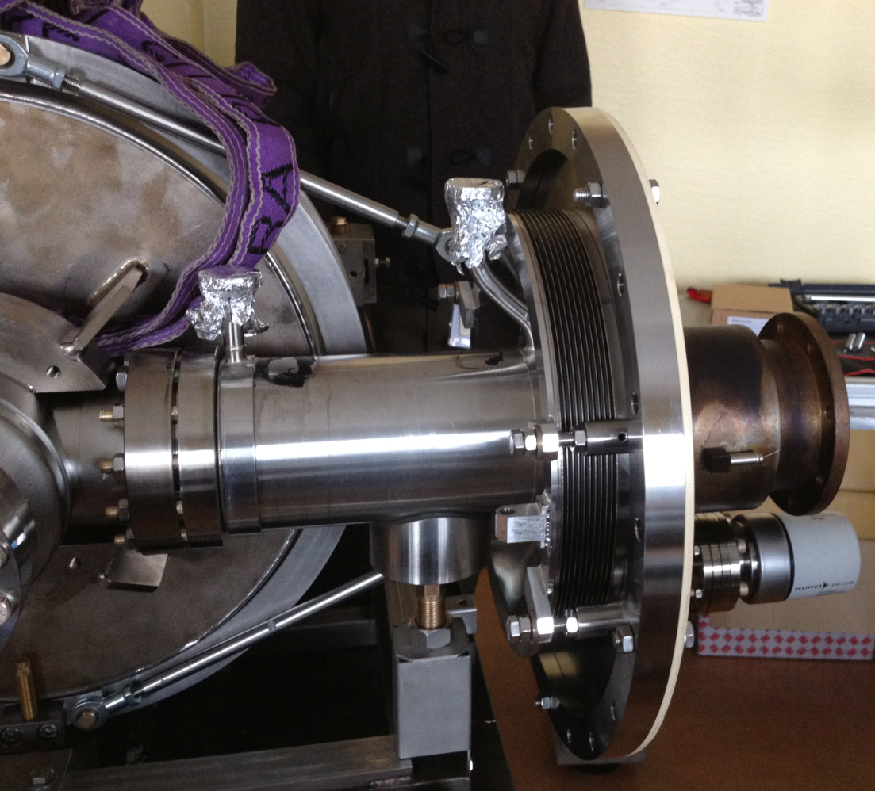
Cryomodule Components developed by CEA

Slide 24
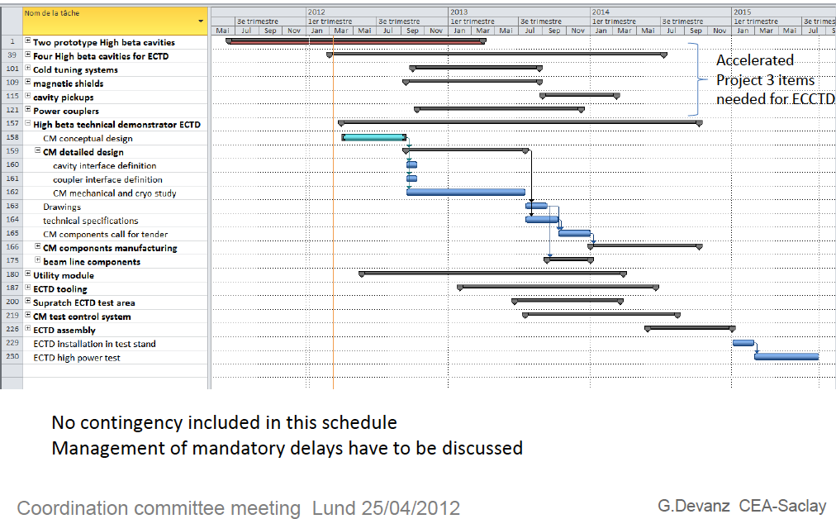
ECCTD - Tentative schedule

Slide 25
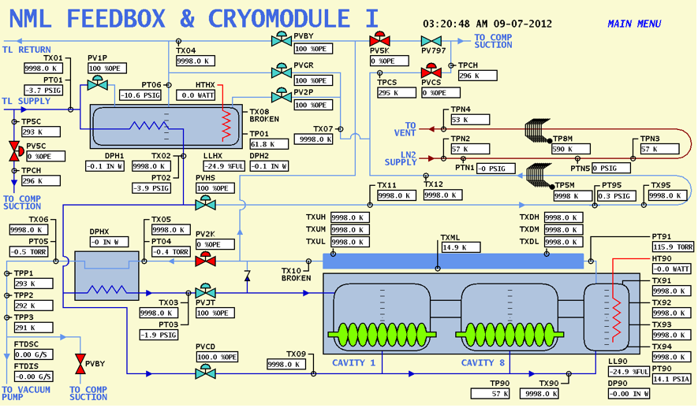
Proposed synoptic based on FNAL experience

Slide 26
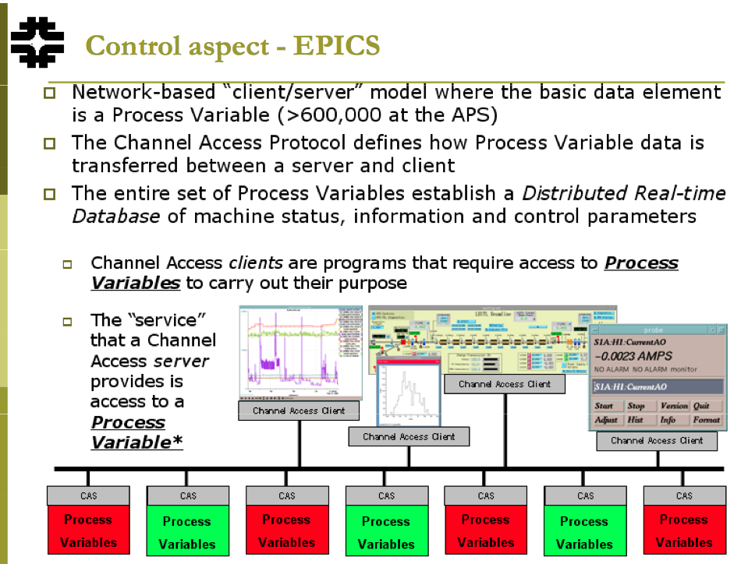
ESS Integrated Control System, using EPICS

Slide 27
Other lab experiences and installations

Slide 28
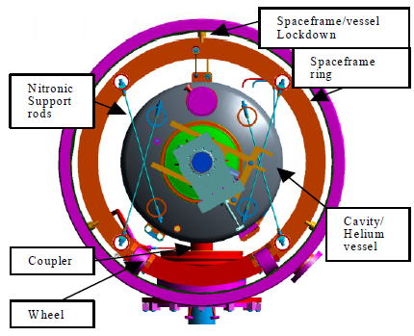
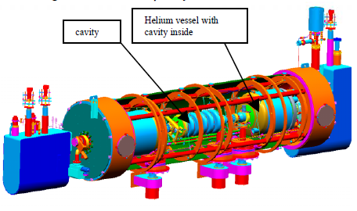
SNS
- Thermal shield inside the Space frame
2 magnetic shielding inside and outside the space frame
Stainless steel rod
Axial stoppers
Courtesy of IPNO / F. Leseigner – G. Olivier

Slide 29
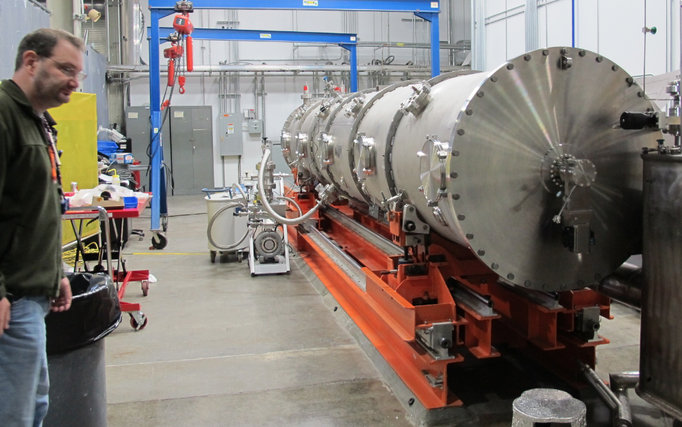
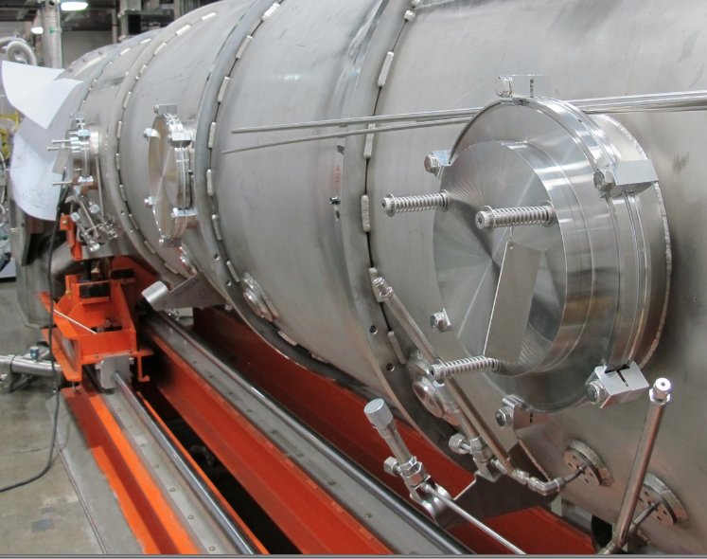
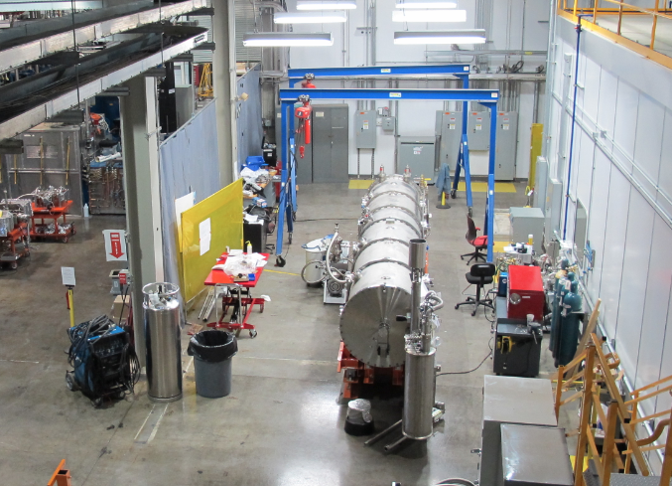
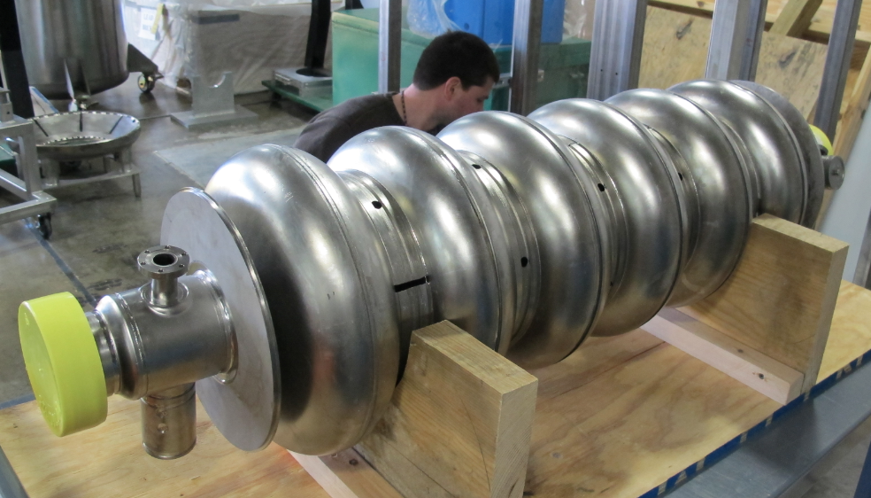
Update of the SNS – Prototype test

Slide 30
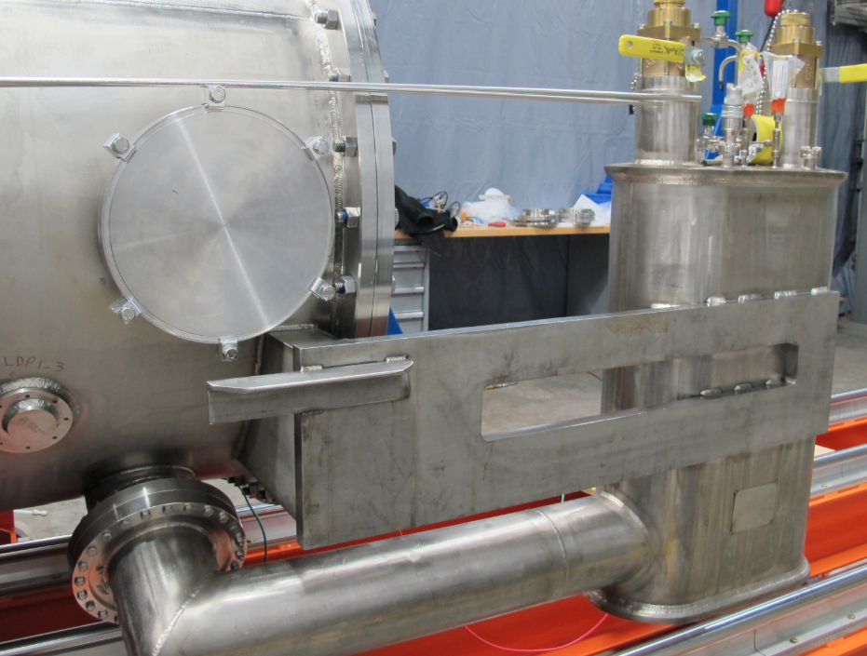
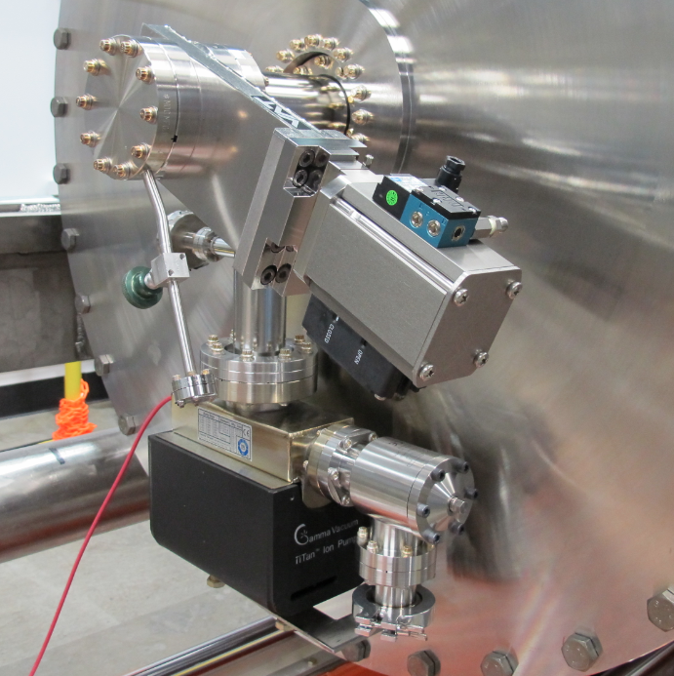
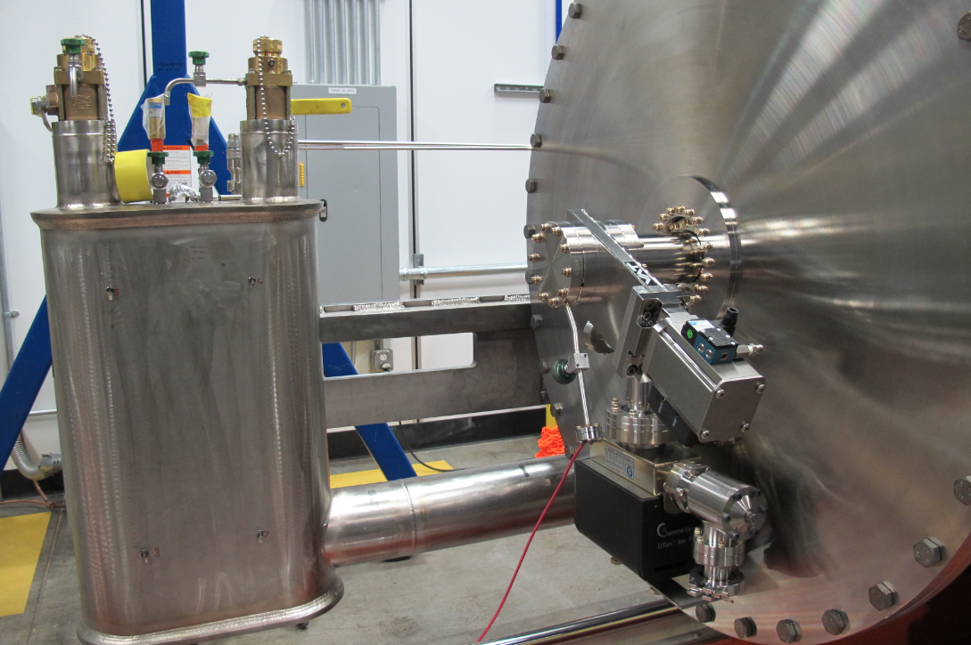
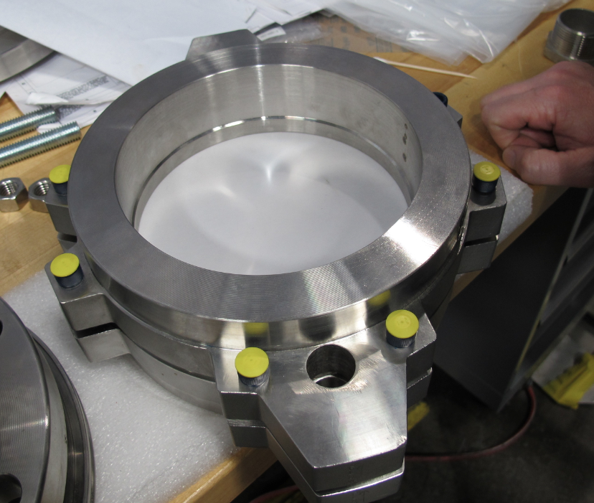
SNS prototype

Slide 31
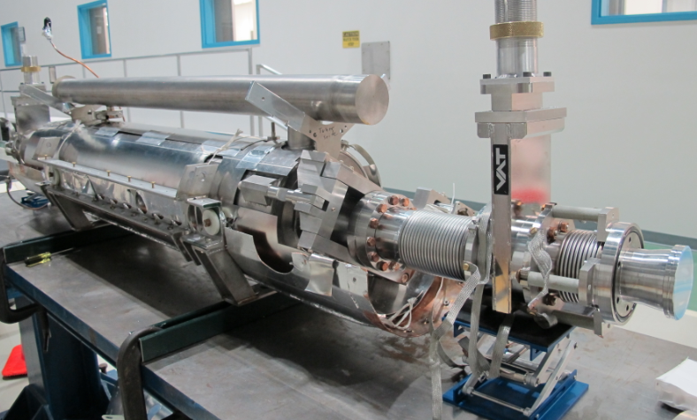
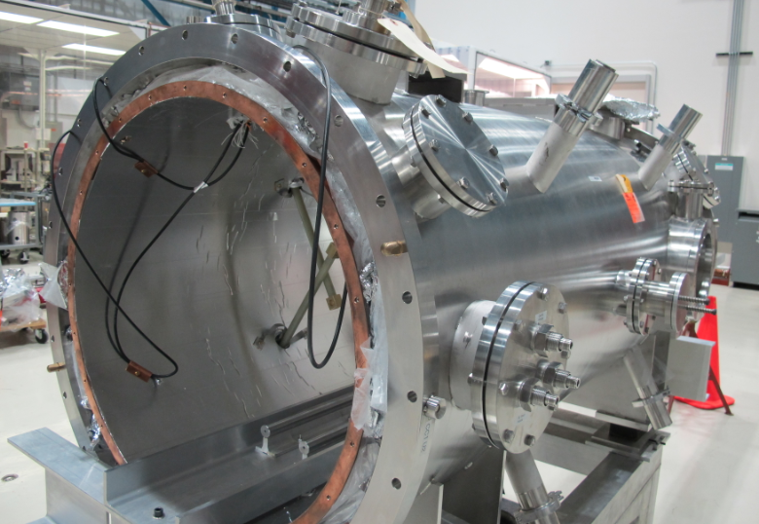
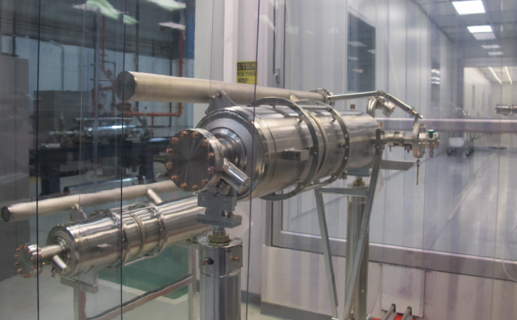
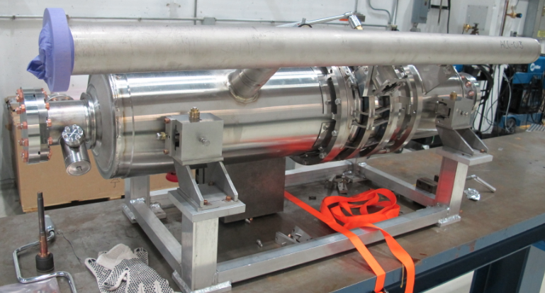
MP9 assembly hall and Clean-Room

Slide 32
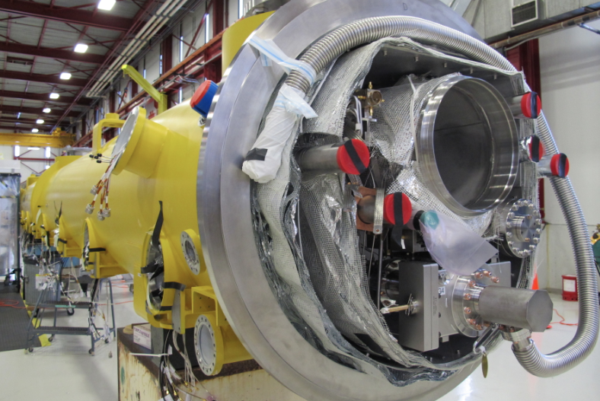
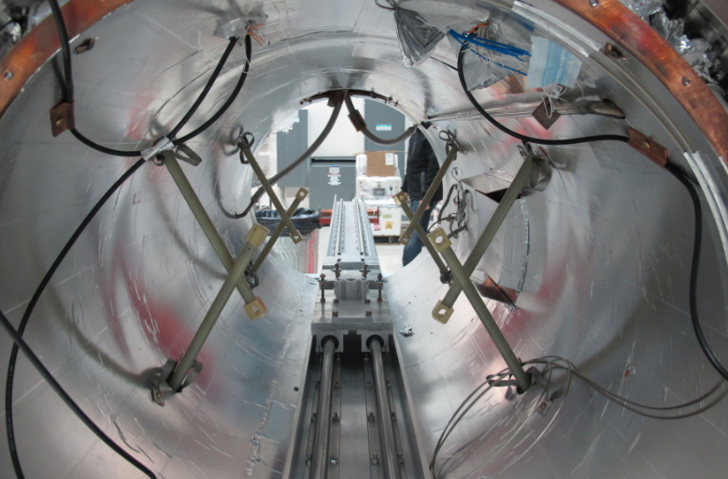
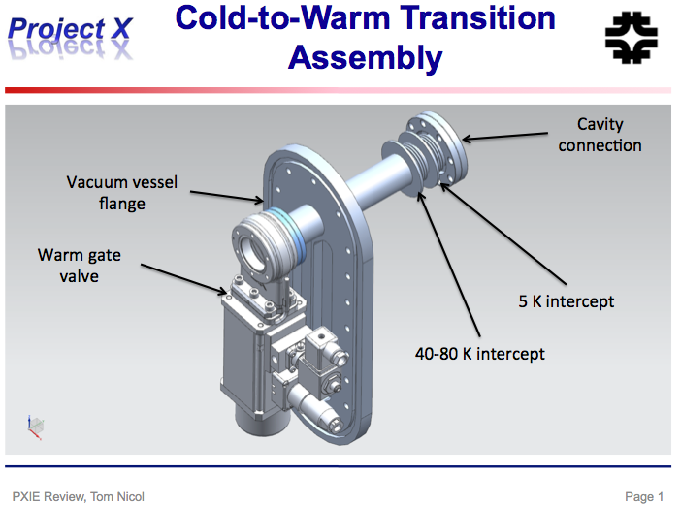
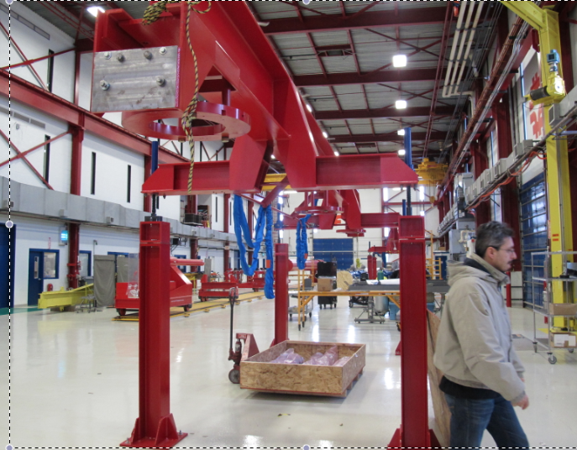
MP9 and ICB

