Slide 1


Planning the French in-kind contribution
10th Oct, 2012

Slide 2
Construction– WBS elliptical medium and high
  WU 5.1.2 Medium-beta Cavity Package
    Design
The RF and mechanical design of the medium beta cavity package has been initiated during the ADU phase. The engineering design consists in producing the drawing of the cavity equipped with its helium tank while taking into account the cryomodule and equipment interfaces. Engineering calculations will validate the cryomodule components mechanical, thermal and hydraulic designs.
The fabrication drawing of the medium beta cavity package is completed for the call-for-tender.
The design of the tooling shall permit the SRF cavity conditioning and assembly.

Slide 3
Construction– WBS elliptical medium and high
Procurement
Because of the large number of accelerating cavities, the long lead time for procurement of the cavities, and the limited number of vendors for the cavities, the procurement process will involve multiple vendors supplying cavities over a period of five years or more. Because of the demanding technical requirements, these vendors will have to go through a stringent selection and monitoring process. This work unit holds the procurement plan and schedule along with the resources necessary to perform and manage the procurement of the cavities.
Besides the cavities, the procurement of major components of the cryomodule will be done with several qualified industrial partners. This work unit also holds the procurement plan and schedule along with the resources necessary to perform and manage the procurement of cryomodule components.
The procurement of the Niobium shall be completed at least one year before the cavity fabrication start is expected.
Power coupler and cold tuning system part procurement shall be completed in parallel to the cavity fabrication.
Procurements of the tooling requested for the fabrication of the cavity package.

Slide 4
Construction– WBS elliptical medium and high
Fabrication and conditioning
Series cavities shall be manufactured in view of integrating them into the medium-beta serie cryomodules.
Tooling shall be fabricated to permit the conditioning of the cavity package.
The cavity packages (i.e. elliptical cavities, power couplers, cold tuning systems) require preparation and tests prior to their installation in the cryomodules. Preparation consists in specific cleaning, chemical etching, ultra pure high pressure rinsing and clean room assembly for some of the cavity packages parts. After preparation, the cavities will be qualified for acceptance by a vertical cryostat test at 2 K. For power couplers, an RF surface conditioning will be performed and serves also as a qualification for acceptance. For cold tuning systems, testing is a simple operation of the assembled tuner at room temperature.
This WU integrates the following tasks and deliverables:
Manufacturing specification for the medium-beta cavities with helium tank.
Manufacturing specifications for the cold tuning system.
Manufacturing specifications for the fundamental power coupler system.
Series Medium-beta cavities with helium tank manufactured and delivered.

Slide 5
Construction– WBS elliptical medium and high
Fabrication and conditioning .../…
Elliptical cavity chemical etching, clean room assembly and cryogenic test in vertical cryostat.
Elliptical cavity power couplers surface preparation, clean room assembly and conditioning at high RF power at room temperature
Cold tuners assembly and operation at room temperature
Series cold tuning systems delivered and resulting acceptance test reports.
A report describing the procedure for the cryomodule assembly.
    Test in vertical cryostat
Test of the series medium-beta cavities in vertical cryostat for qualification purposes.
Deliverables:
Tooling for medium-beta preparation and test
Series cavity preparation
Cryogenic medium-beta cavity vertical tests
Complete individual test reports
    Transport
Transport of the series medium-beta cavity to the clean room and for string assembly.

Slide 6
Construction– WBS elliptical medium and high
Similar WBS approach for the cryomodule package
  Design
  Fabrication
  Assembly
  Test transport

Slide 7
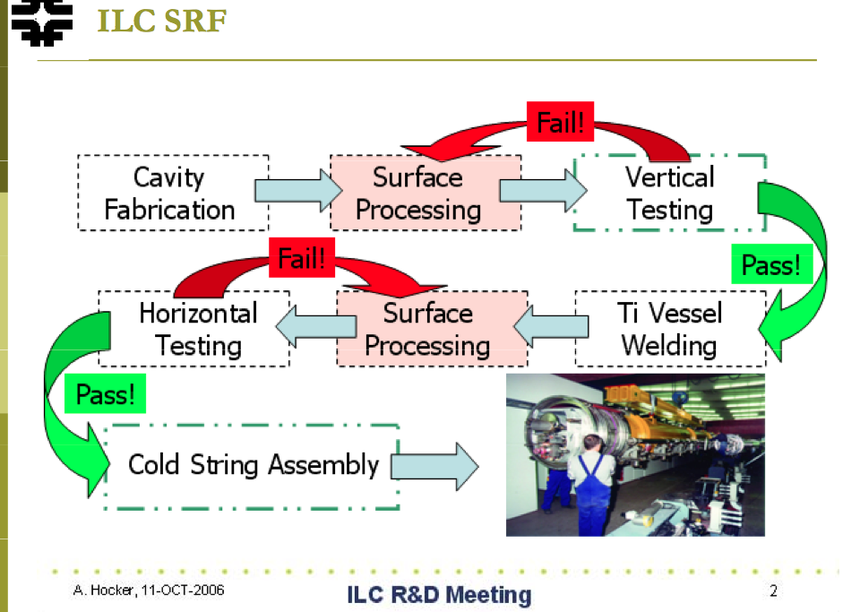
The work flow process

Slide 8
Construction phase – Expected cost

Slide 9
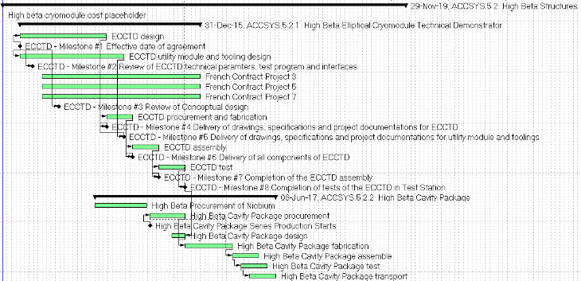
Construction phase – Suzanne Gysin (11/9/12)
High beta elliptical cavity cryomodule

Slide 10
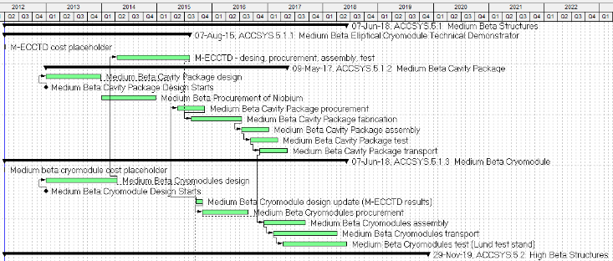
Construction phase – Suzanne Gysin (11/9/12)
Medium-beta elliptical cavity cryomodule

Slide 11
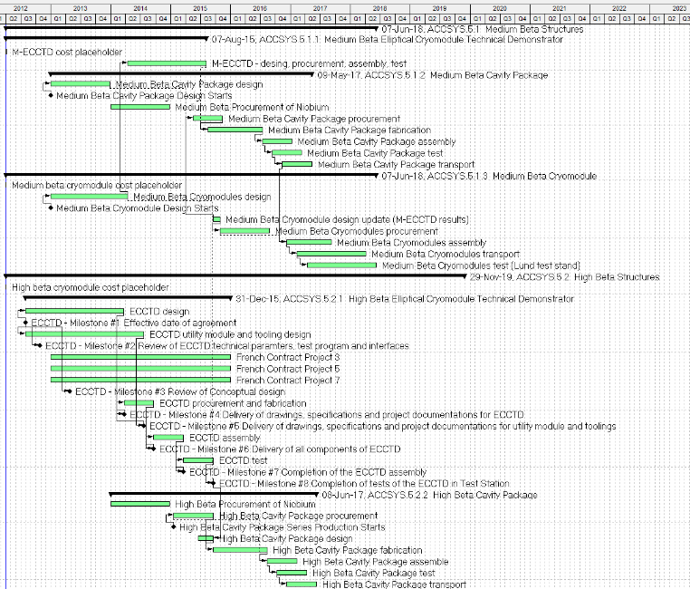

Slide 12
Foreseen issue and Risk
  Delay in Nb delivery → Schedule & cost
  No availability of the clean-room → Schedule
  Saturation in manufacture for the cavity production → Schedule
  No availability of the vertical test stand → Schedule
  Failure in the element conditioning → Schedule & cost
  Failure in the assembly process → Schedule & cost

Slide 13
Extra slides

Slide 14
Cryomodule project flow
Assess:
Mitigate:
Identify:
Linac Layout, Flow Scheme, Breakdown Structures
Infrastructures using. clean room, assembly hall, RF
Prototype Test Requirements (Technology Demonstrator)
Life Cycles
Feasibility of different Technologies and Assemblies
Risks and Manage Interfaces
Component Requirements, Specifications
Develop DAQ and Control, Operating Modes
Extrapolation to Production
Quality Assurance
Risks (Project Risk and Technical Risk)
Cost Estimate
Use lessons learned from PX, X-FEL, SNS, J-PARC.

Slide 15
Cryomodule Break Down Structure and Interface
Cryomodule
Tunnel
SRF Cavity Package
SRF cavity (spoke or elliptical) in helium tank
Vacuum station
Safety equipment
Fundamental Power Coupler
HOM Couplers
Supporting system
Alignment system
Coupler cooling Sys.
Cold tuning system
Cryo-distribution Lines
Cryo valve box
Waveguide and RF eq.
Magnetic shielding
Thermal shielding
Diagnostic Inst. & Valves
Diagnostic Inst. & Valves
Instrum., BPM etc.
Corrector magnet
Jumper connection
Beam pipe
Beam pipe
Safety equipment
Safety equipment
Ext. supporting system
Control system eq.
Notes:
Mechanical interface using bellows, flanges, etc…

Slide 16
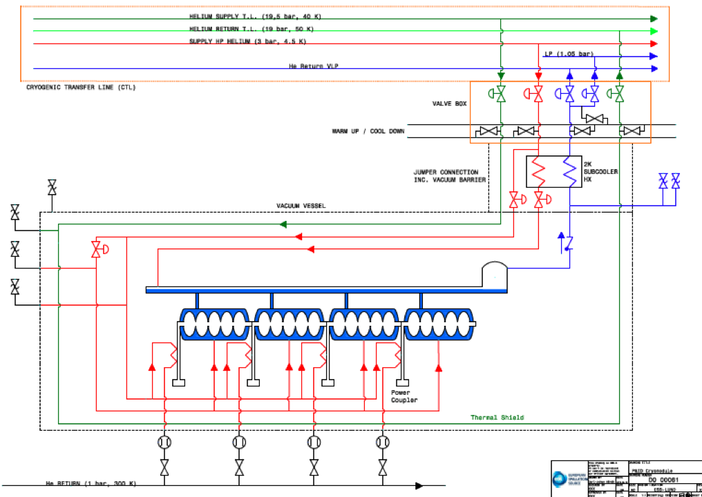

Slide 17
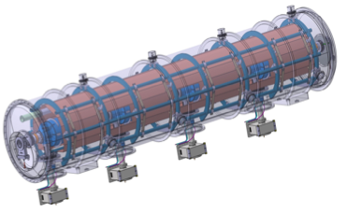
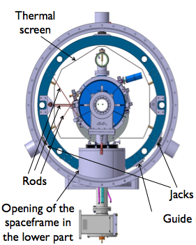
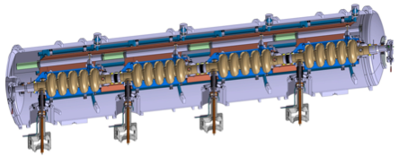
Elliptical Cryomodules
Space-frame
5-cell elliptical cavity
Helium tank
Power coupler
Cold tuner
  Elliptical Cavities Cryomodule Technology Demonstrator results by the end of 2015 → start pre-series
Notes:
ii) Plans for the remaining part of 2012 (and beginning of 2013 if appropriate)
Cryo → Freeze the cold Linac operating parameters
→ ESS Linac flow scheme
→ Sizing of components (e.g. distribution lines)
Spokes → Complete technical design detail (proto test expected 2015)
Elliptical →Develop component stand alone test to verify the expected heat load
→ Complete the conceptual design and Initiate the fabrication drawing
iii) Issue that needs attention
Spoke → Prototype development depends on the availability of resonator
Elliptical → Critical path for current ESS schedule
e.g. availability of the infrastructure
→ Freeze the parameters of the medium- and high-beta cavities packages in order to freeze the cryomodule design
e.g. HOM use

Slide 18
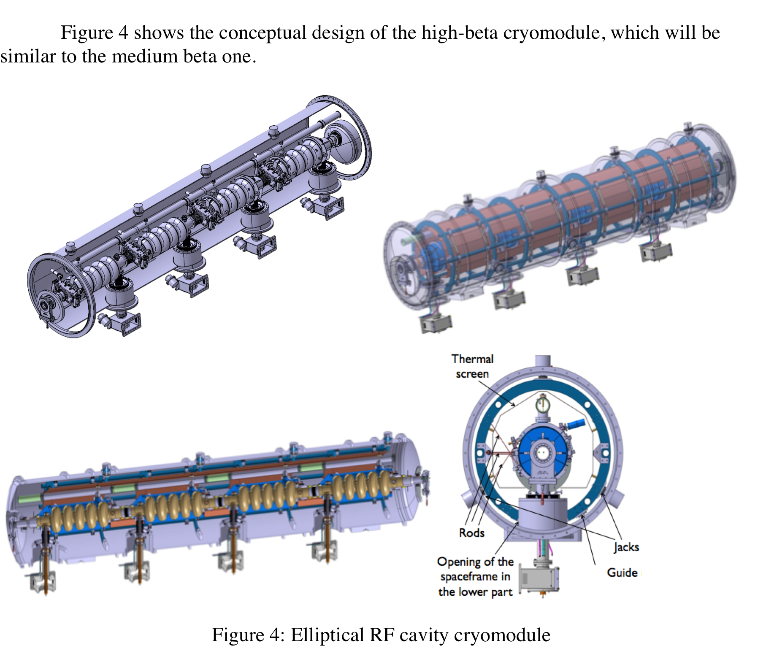
Elliptical Cavity Cryomodule Work in progress

Slide 19
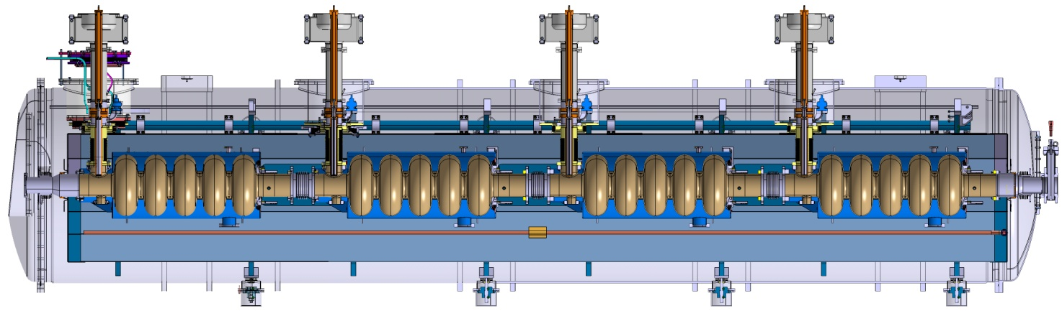
Current development
6533

Slide 20

Cryomodule Prototype Requirements
Scope : Validate the technologies used to assemble and operate the 4 ESS-type cavities installed in a cryostat
→ A Technology Demonstrator to validate the following points:
Installation of the cryomodule: e.g. cleaning, tooling, procedures, QA;
The performance of the RF design:
e.g. characterize the cavity RF signature; validate RF results obtained invertical cryostat;
The performance of the thermal design:
eg. cool-down rate, operating conditions; heat loads; cooling scheme efficiency;
The performance of the vacuum design: e.g. leak tightness, bake-out;
The performance of the mechanical design: e.g. MAWP, stability, alignment;
The safe operation of the cryomodules:
e.g. process variables, control loops, operating modes, relieving system and interlock;
Training: e.g. to assemble, to operate.

Slide 21
Elliptical Cavity Cryomodule Technology Demonstrator (ECCTD)
The Elliptical Cavity Cryomodule Technology Demonstrator (ECCTD) contains:
  Four Elliptical Cavity Packages, ECP
  The supporting and mechanical systems that interface the ECP in the test area.
  The vacuum vessel, thermal and magnetic shieldings that insulate the ECP from the ambient condition,
  The cryogenic systems (distribution boxes and hydraulic circuits) that interface the ECP with the cryogenic distribution system in the test area,
  The instrumentation (diagnostics) and the safety devices

Slide 22
The work flow process

Slide 23
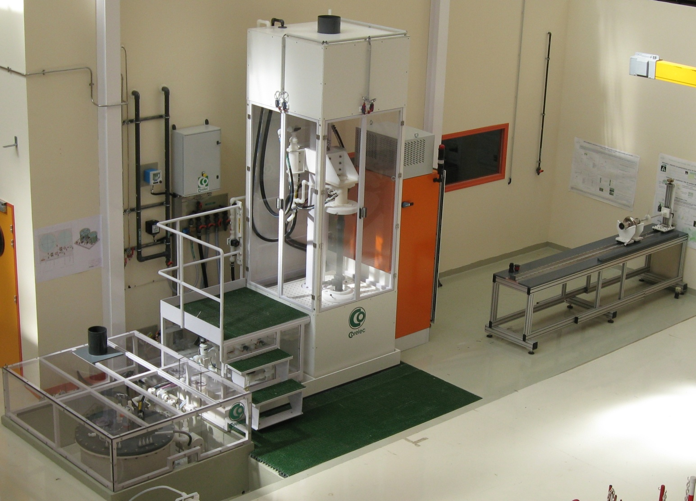
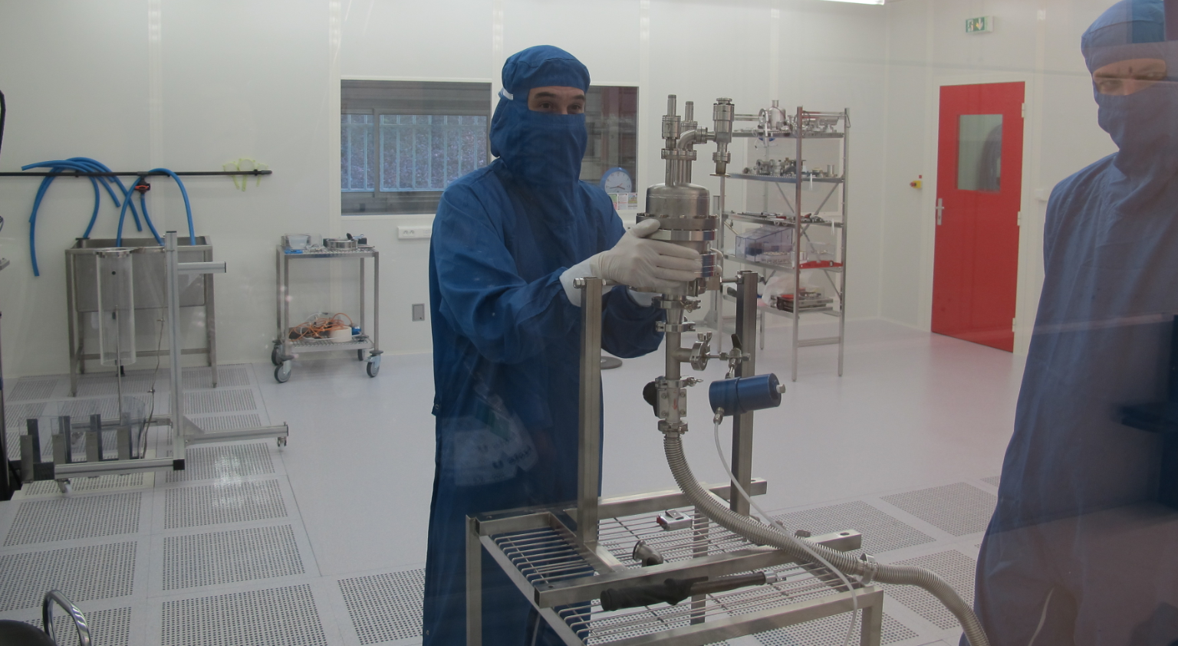
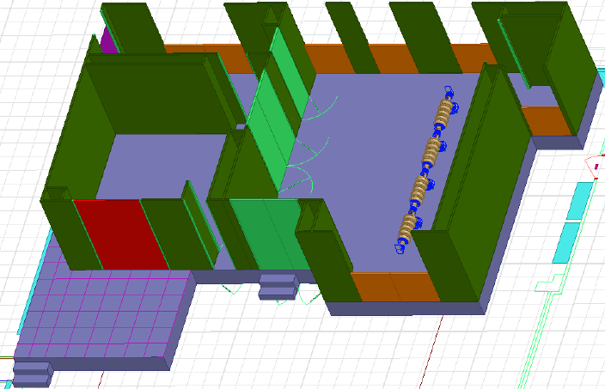
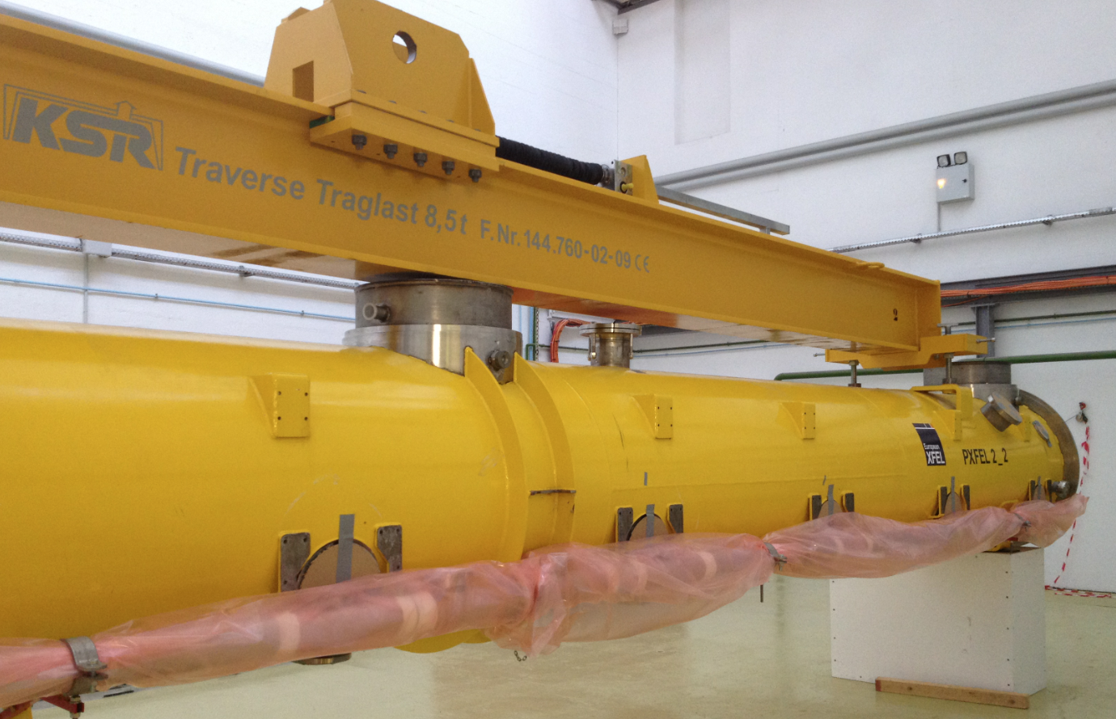
Elliptical Cavity Cryomodule Technology Demonstrator
April 2012 : Modification of the French-Swedish collaboration agreement
Broadening the IPNO and CEA/Irfu activities:
Mechanical and thermal design of the cryomodule components
Design of the requested tooling
Procurement and follow-up of manufacturing in industry
Development of infrastructure (clean-room, assembly hall and test area)

Slide 24
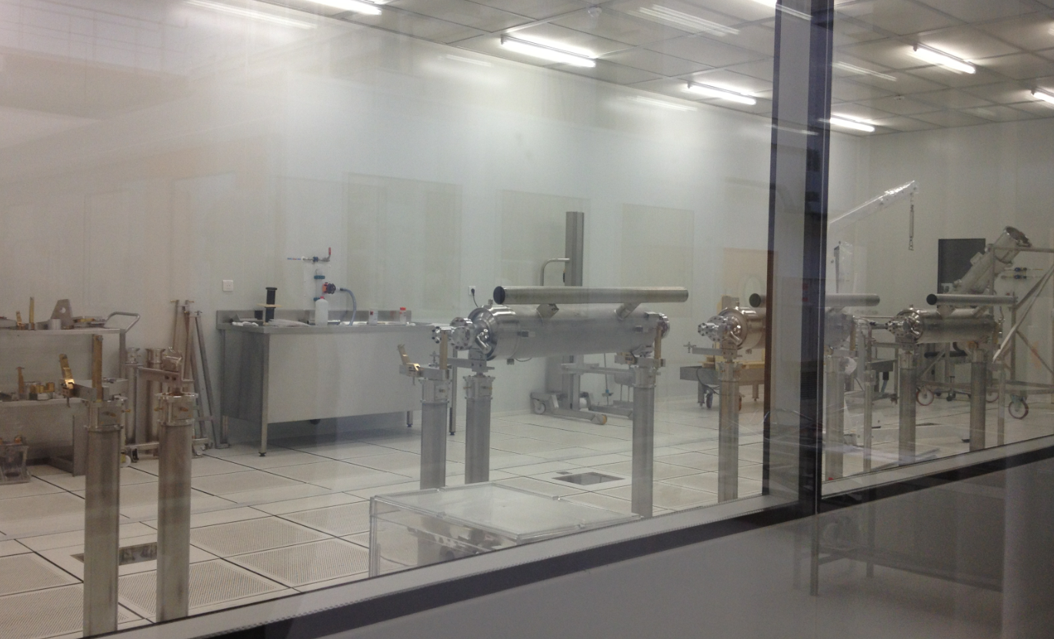
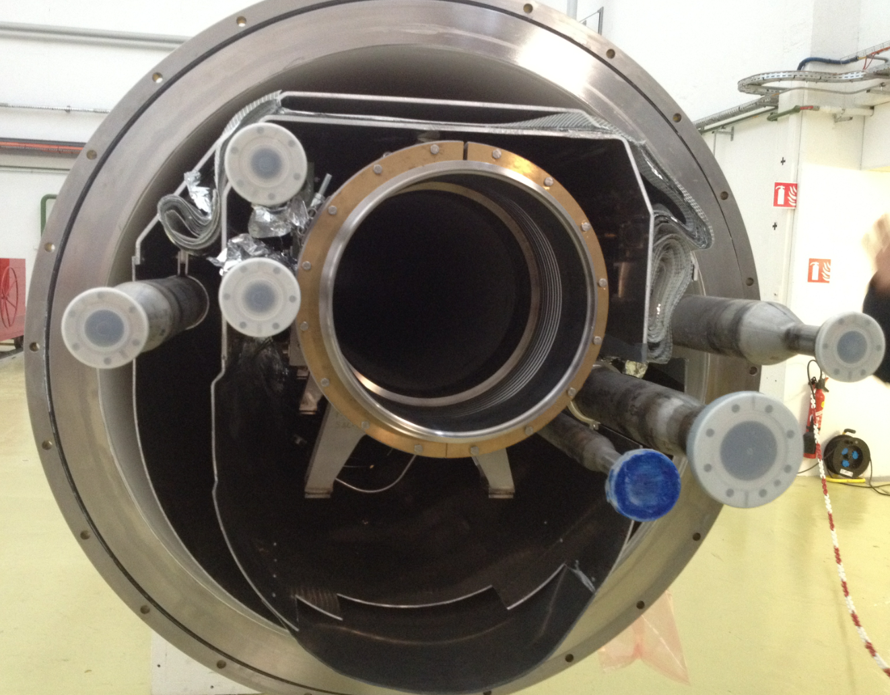
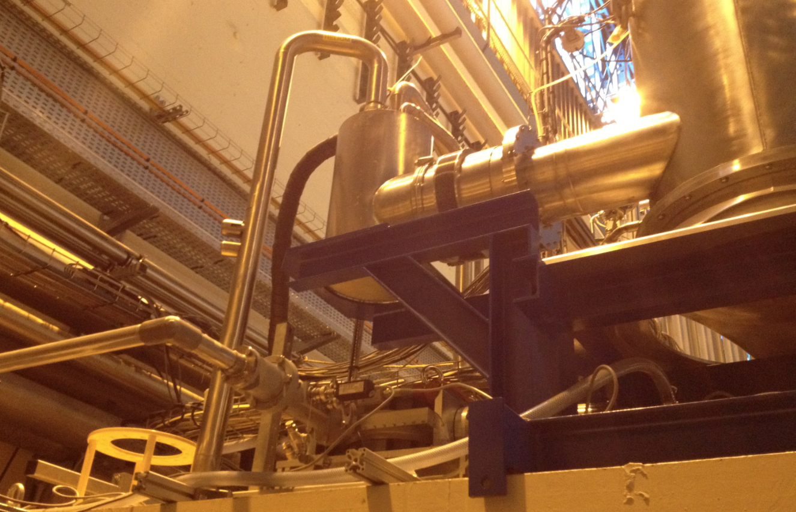
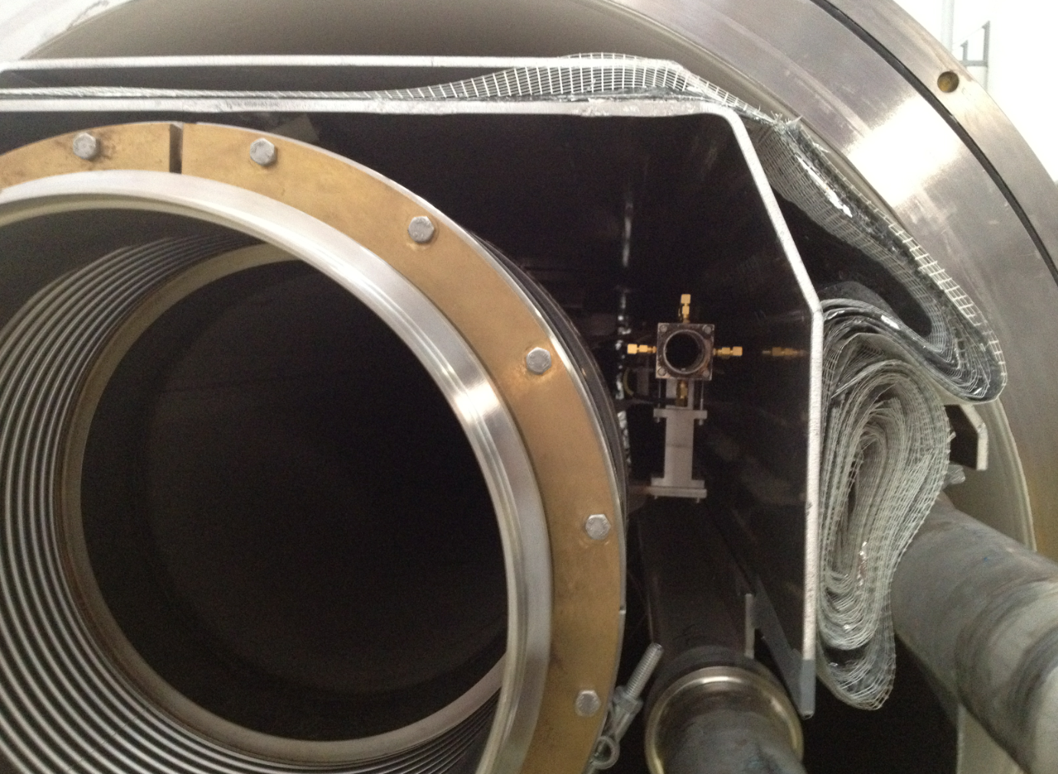
CEA Infrastructures
+ 1 new cleanroom

Slide 25
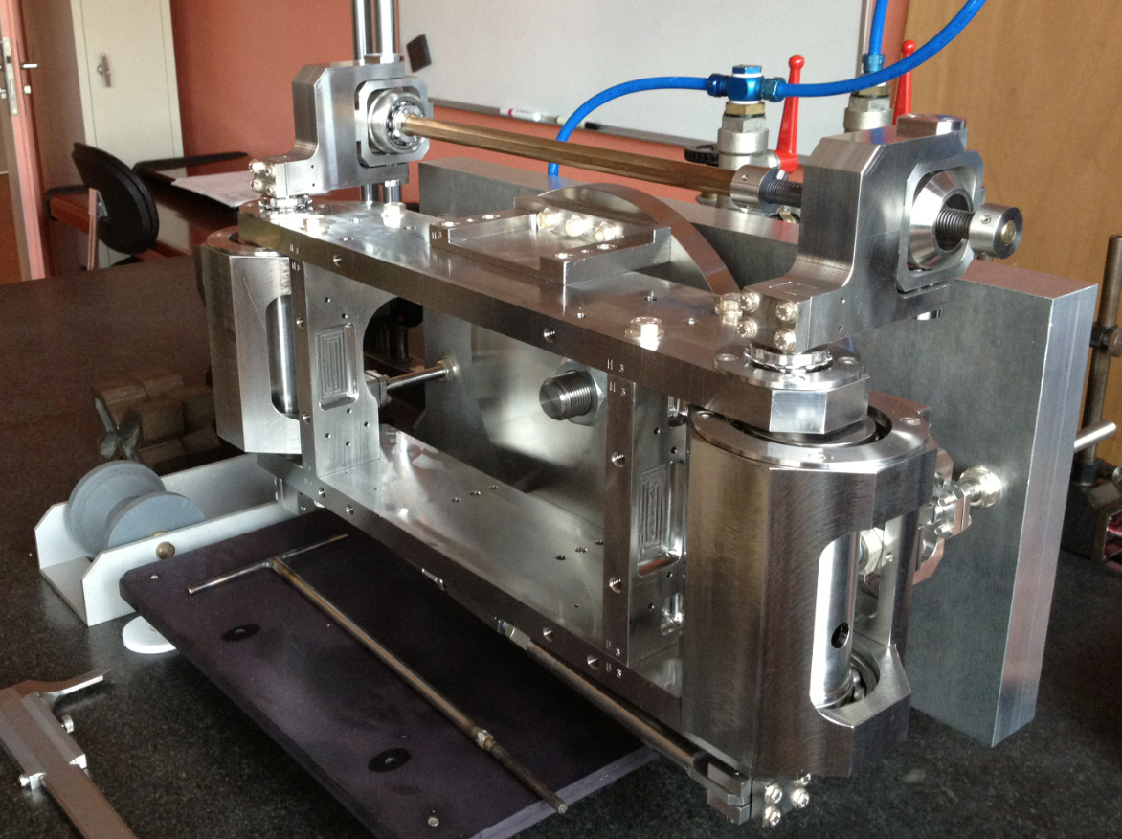
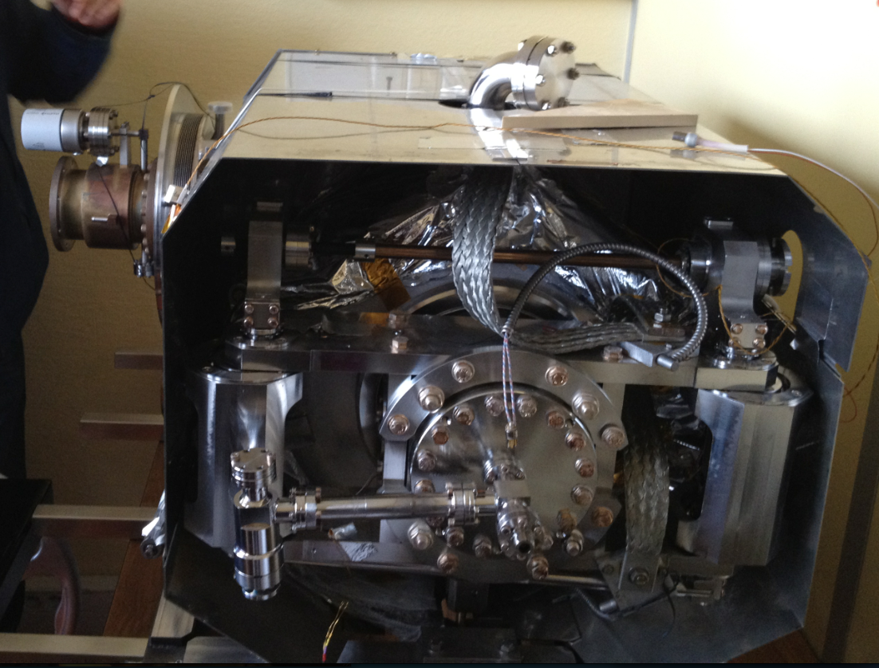
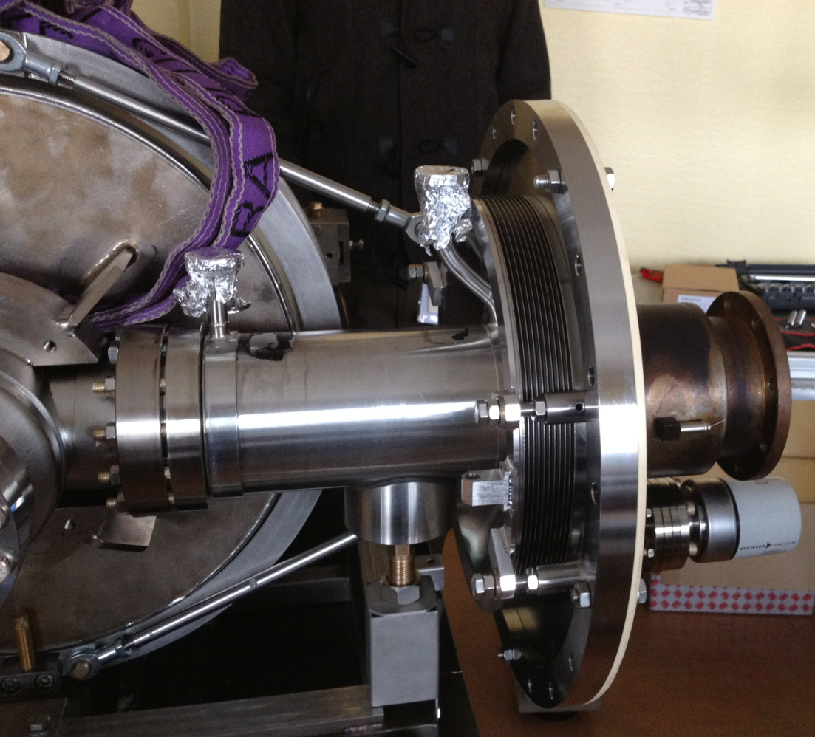
Cryomodule Components developed by CEA

Slide 26
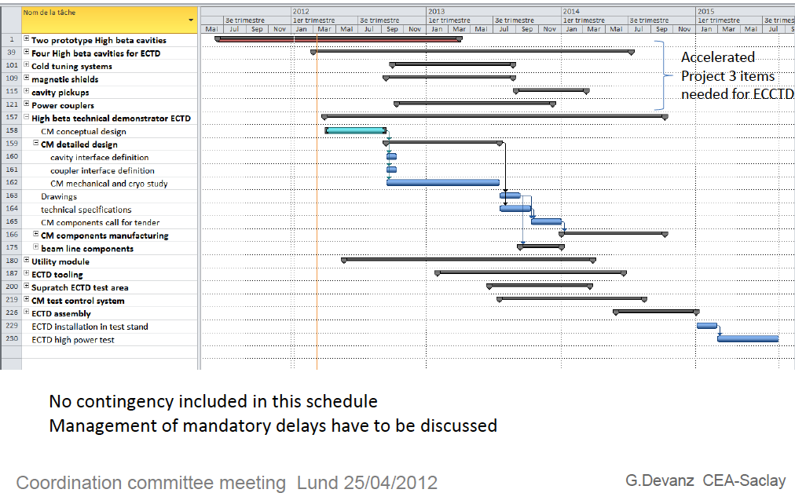
ECCTD - Tentative schedule

Slide 27
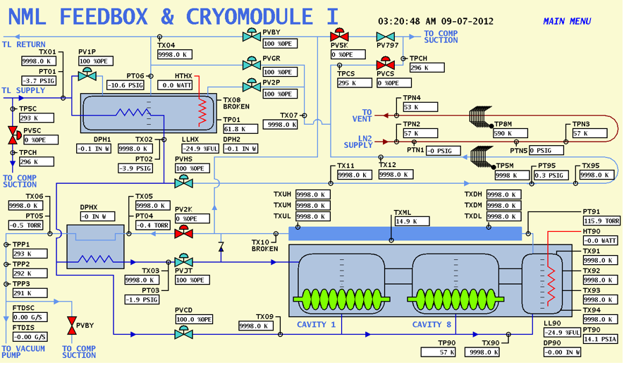
Proposed synoptic based on FNAL experience

Slide 28
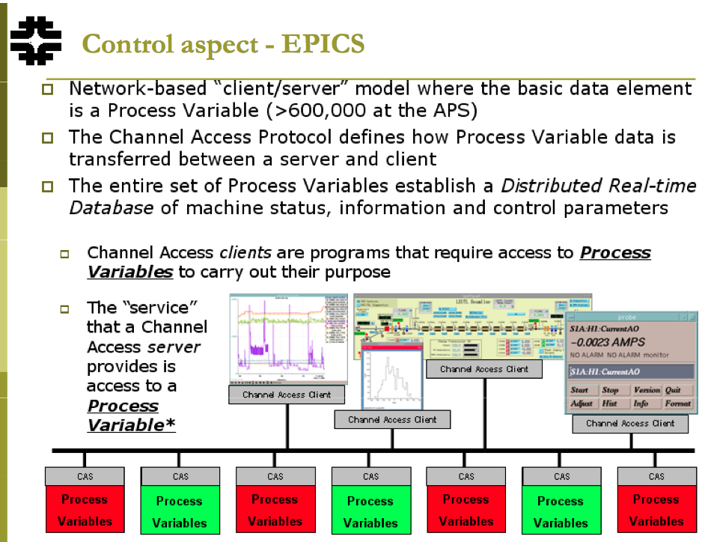
ESS Integrated Control System, using EPICS

Slide 29
ESS goal for the Elliptical Cavity Cryomodule Technology Demonstrator
Use existing ESS development based on CEA/IPNO work package (incl. cavity, cryomodules, toolings).
Test the same technologies than for series [Steve]
Input:
Fundamental power coupler: Test 1.4 MW at CEA/Saclay
Cold tuning system: CEA
Collaboration: CEA/IPNO designs and hardware available
Use existing UK industry capacity
Optimize transfer of knowledge and technology (design expertise, safety codes)

Slide 30
Other lab experiences and installations

Slide 31
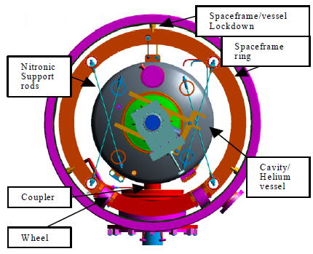
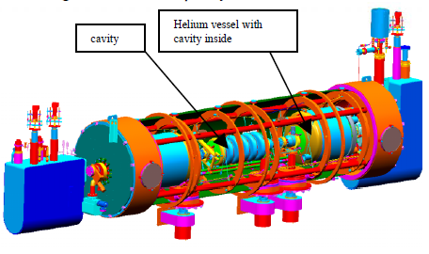
SNS
- Thermal shield inside the Space frame
2 magnetic shielding inside and outside the space frame
Stainless steel rod
Axial stoppers
Courtesy of IPNO / F. Leseigner – G. Olivier

Slide 32
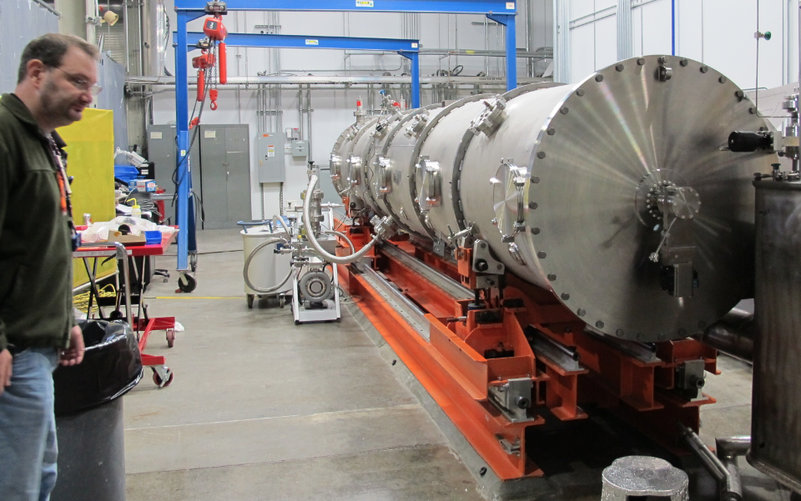
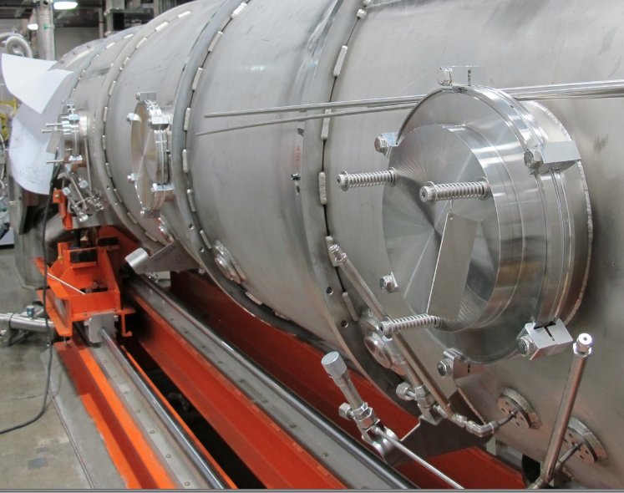
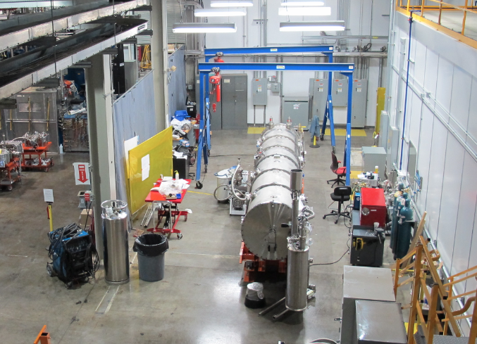
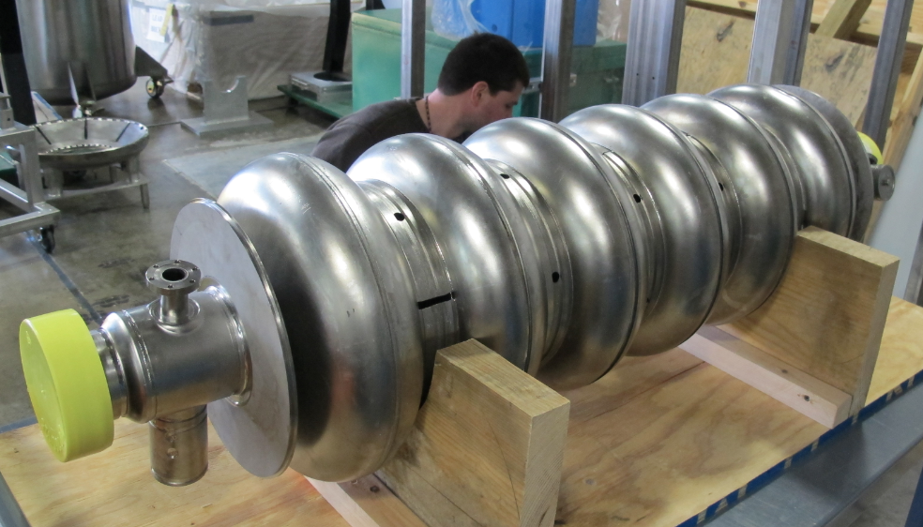
Update of the SNS – Prototype test

Slide 33
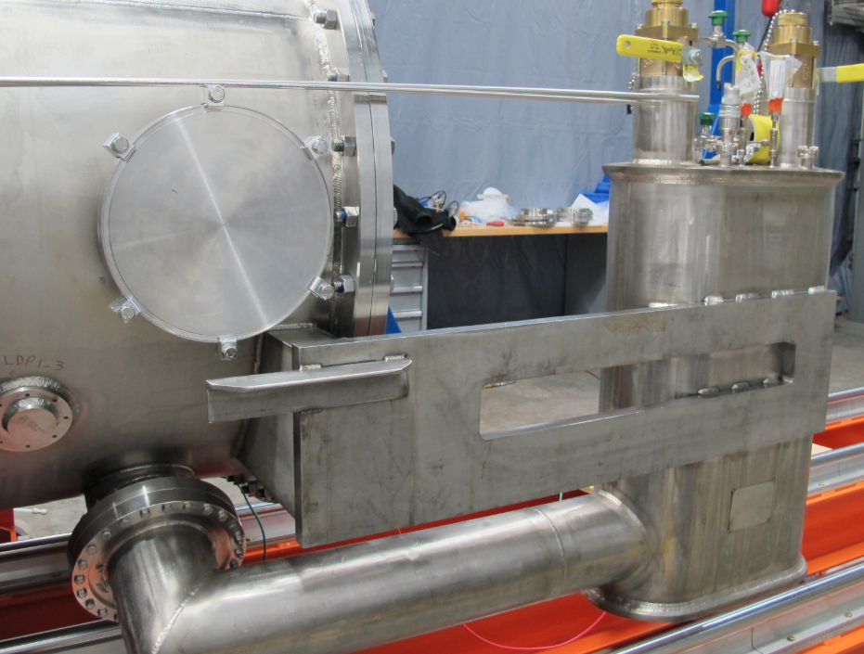
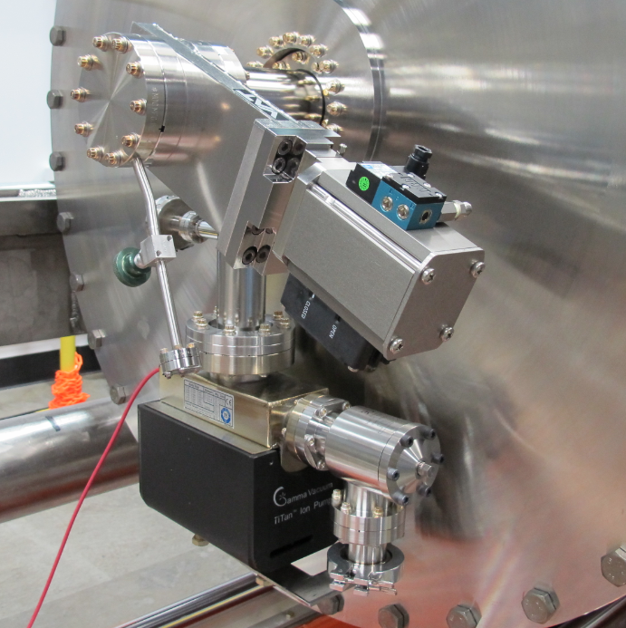
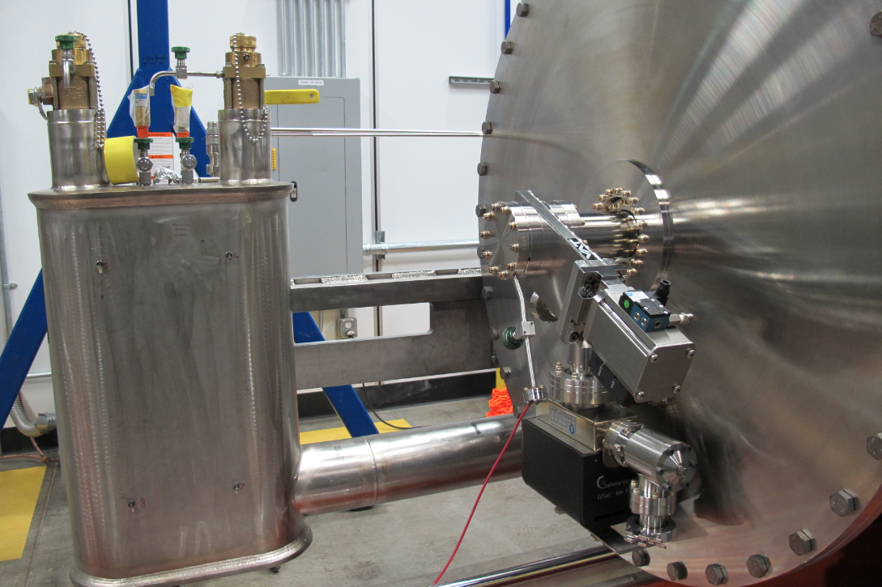
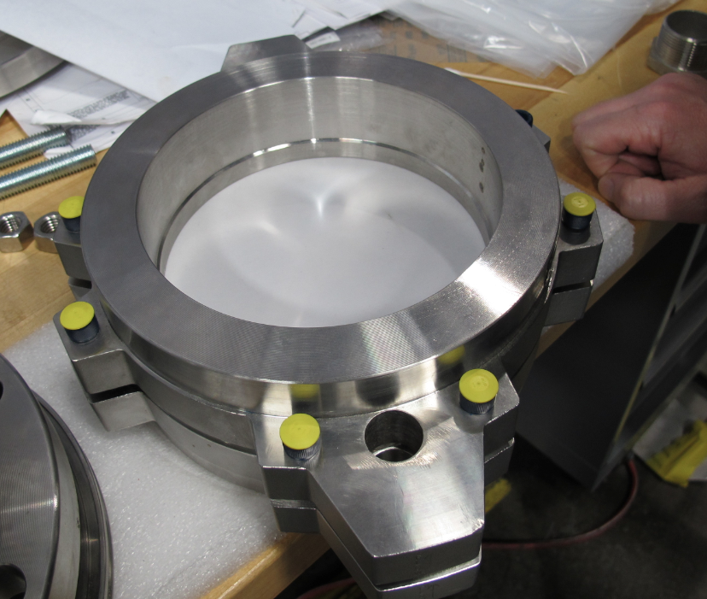
SNS prototype

Slide 34
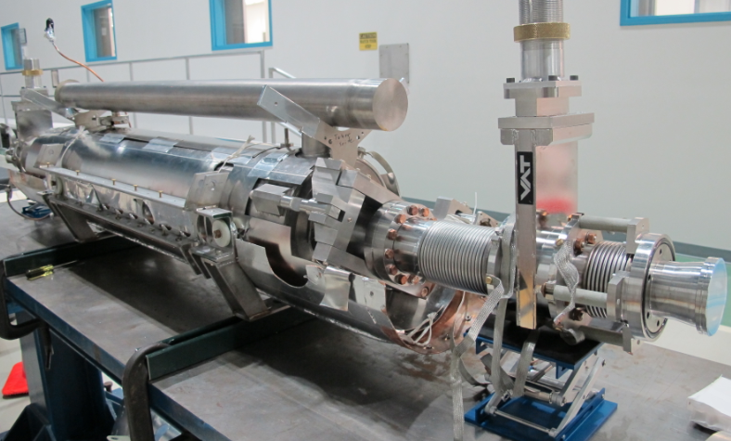
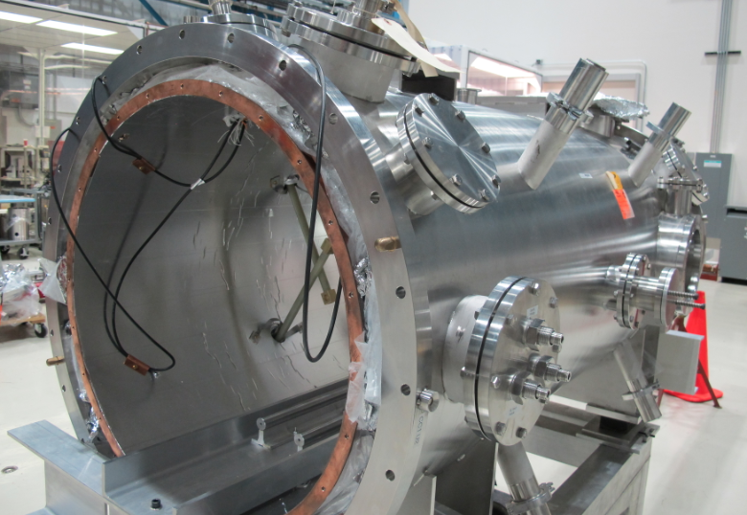
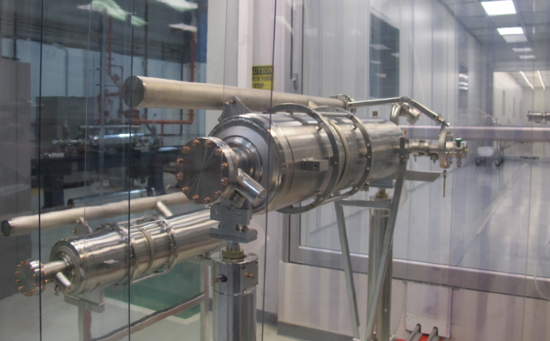
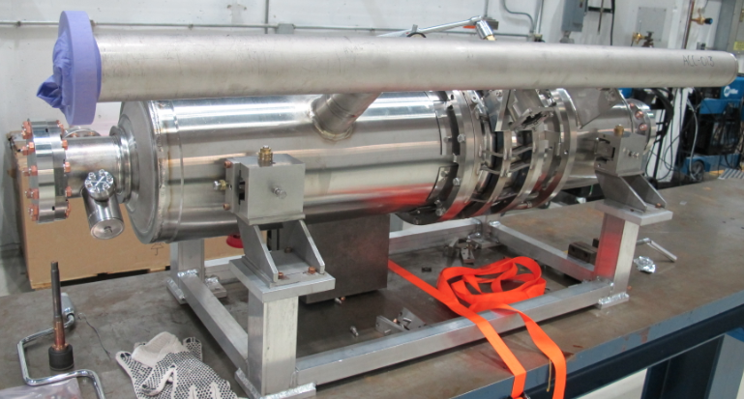
MP9 assembly hall and Clean-Room

Slide 35
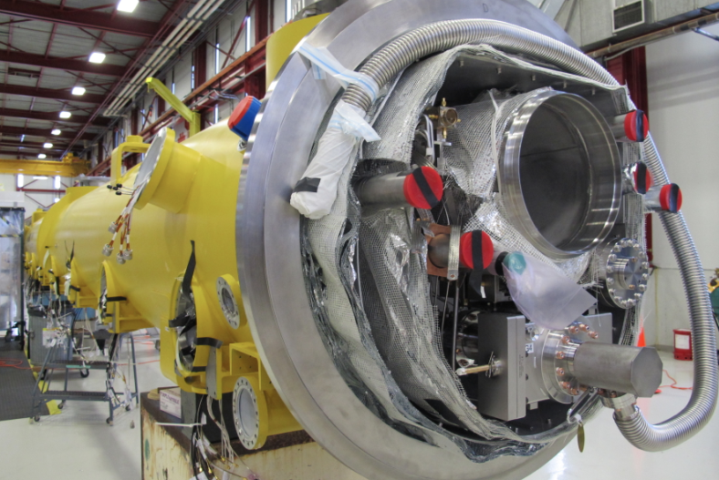
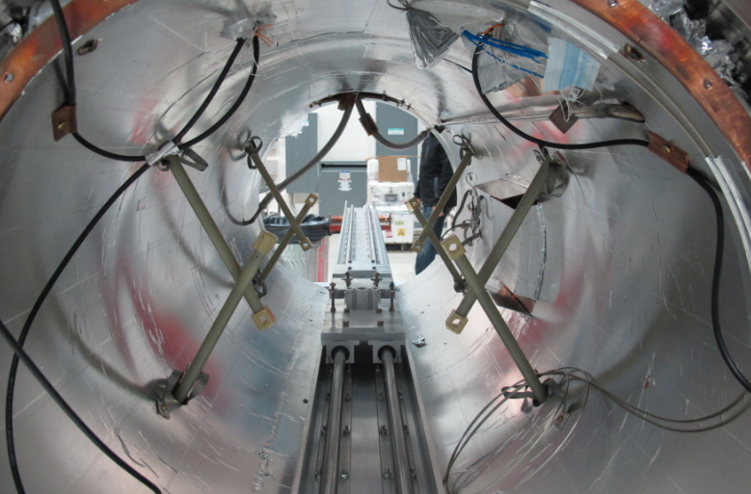
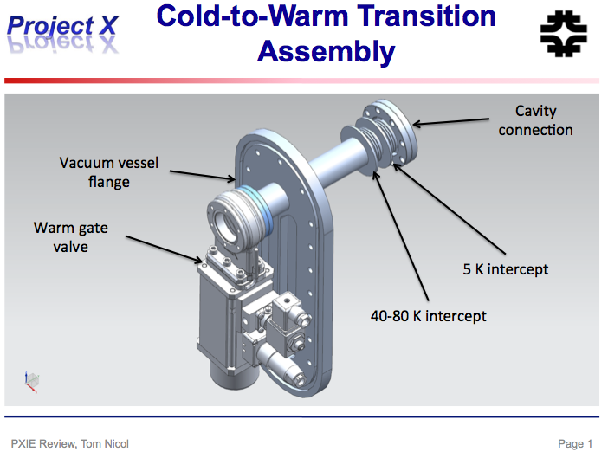
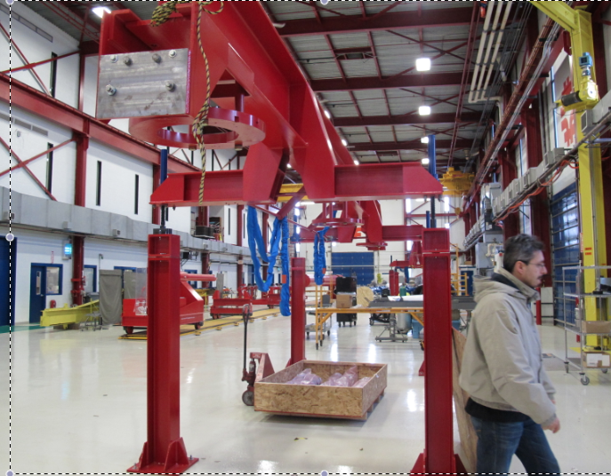
MP9 and ICB

