Slide 1
Mitigation Devices
External Interface
ICS
Nick Levchenko
Lund
Date: 2015-12-09

Slide 2
Scope
Magnetron
LEBT Chopper

Slide 3
Magnetron (Overview)
Provides microwaves to generate plasma in the plasma chamber
Model: Sairem GMP 20 KE/D
Disabling magnetron will stop microwaves generation, therefore collapsing plasma and stopping the beam production
Beam stop time: relatively slow, approximately 100 µs
Details of magnetron internal circuit boards drawings are expected from Sairem to be reviewed by ESS

Slide 4
Magnetron (Interfaces)
Timing System (Triggering)
Integrated Control System (Control & Monitoring)
Beam Interlock System (Machine Protection)

Slide 5
Magnetron (Architecture)
Magnetron HV Supply
Timing System
Modbus Gateway
ICS
BIS
External
Interfaces:
Magnetron Head
HV Fast Shutdown Rack
Fault Control
BIS
HV Fast Shutdown
Power Supply

Slide 6
Magnetron(External Interfaces)
Signal | Type | Format | Connector
On/Off | Digital In | Optical Fibre | HFBR
On/Off | Digital Out | Optical Fibre | HFBR
Fast Stop | Digital In | Optical Fibre | HFBR
On/Off | Digital Out |  | M12
On/Off | Digital Out |  | M12
Fault | Digital In |  | M12
Fault | Digital In |  | M12
Control & Monitor | Various | Modbus | RJ45

Slide 7
LEBT Chopper (Overview)
Chops the beam pulses
Custom made by INFN (Catania), based on the design for Spiral2 (France)
Enabling high voltage (10 kV) will deviate the beam to the beam dump preventing it from travelling any further to the target
Beam stop time: approximately 300 ns
Using chopper to stop the beam is an additional measure to improve the slow response time of primary beam stop method (magnetron)
Primary method (magnetron) must be deployed, as chopper will overheat beam dump
Details of chopper external interface and internal circuit boards drawings had been provided by INFN and are being reviewed by ESS at the moment

Slide 8
LEBT Chopper (Interfaces)
Timing System (Triggering)
Integrated Control System (Control & Monitoring)
Beam Interlock System (Machine Protection)

Slide 9
LEBT Chopper (Architecture)
LV Module
HV Module
Timing System
PS
External
Interfaces:
HV PS (0 – 10 kV)
ICS
Control, monitoring and alarm circuit boards
HV Switch
BIS
Feedthrough
Vacuum chamber with deflecting electrodes
Beam

Slide 10
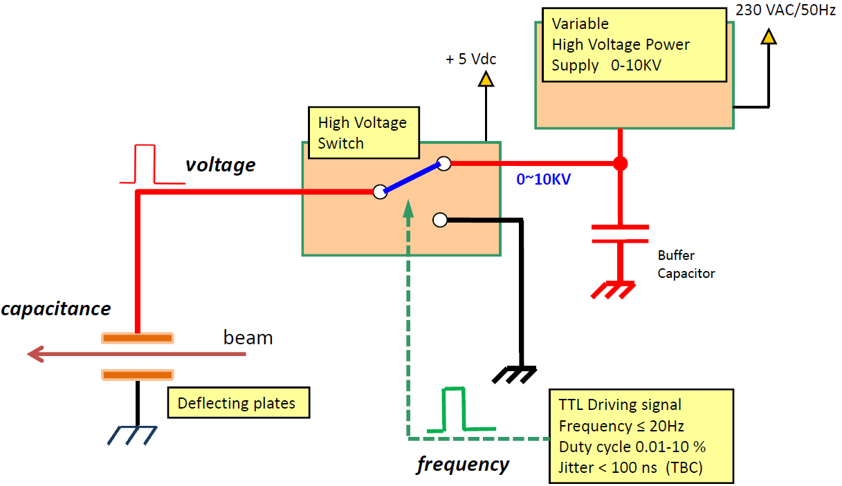
LEBT Chopper (HV Module)

Slide 11
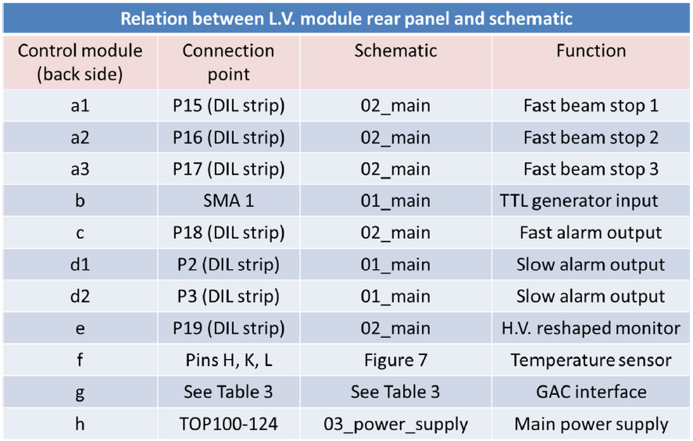
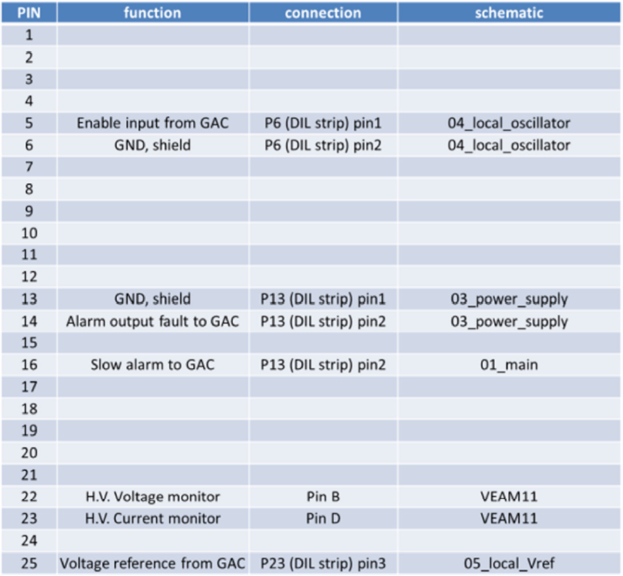
LEBT Chopper (External Connections)

Slide 12
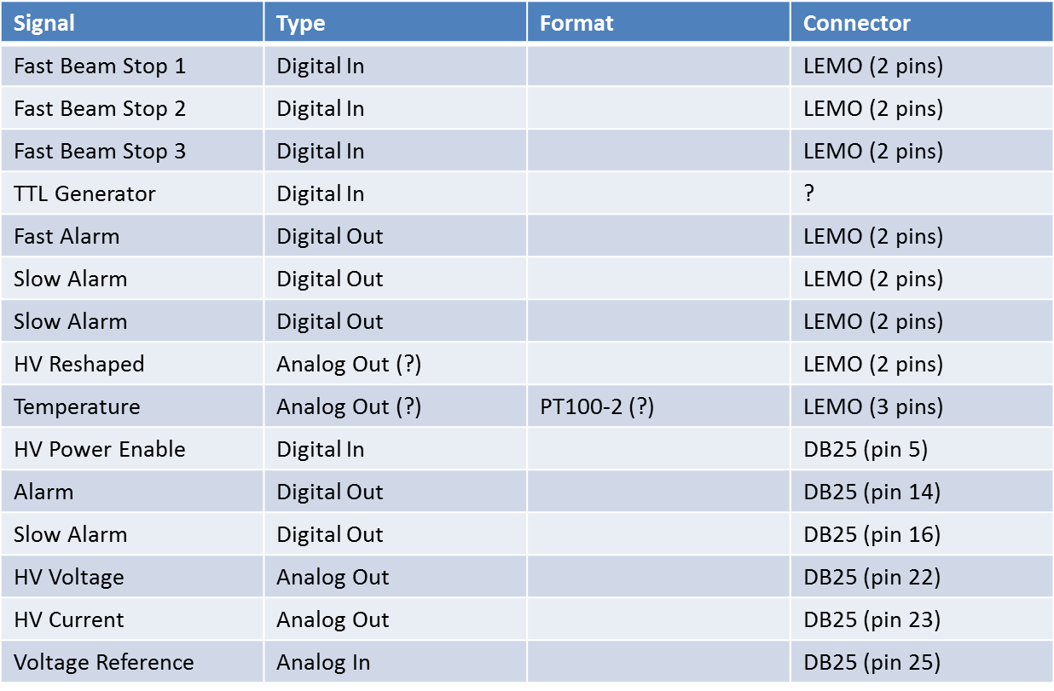
LEBT Chopper (External Interfaces)

