Slide 1
FMEDA of the Fast Beam Interlock System
Riccard Andersson
Machine Protection Review
2015-12-09

Slide 2
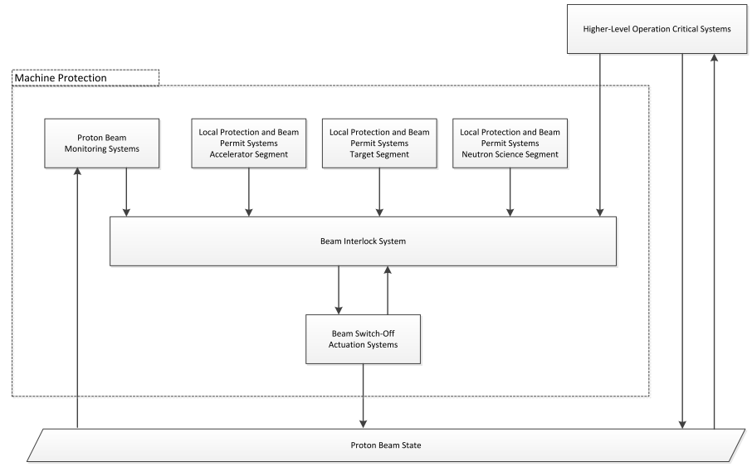
The Beam Interlock System

Slide 3
Analysis Approach
FBI_D
FBI_DIF
FBI_MASTER
FBI_ACTUATOR
Input Signal (BLM, BCM etc)
Actuators (Choppers, PS)
Failure Modes, Effects, and Diagnostics Analysis
Greatly inspired by Ben et al.’s analysis for LHC
One FMEDA per module
Gives overall failure rate, per failure mode
ReliaSoft BlockSim for system-level calculation

Slide 4
Analysis Approach
Military Handbooks (MIL-HDBK-217F and 338B)
Component manufacturer documentation
System Effects are
Negligible
Maintenance
Trip
Blind
To Be Tested (TBT)
Detection ways are
Hidden
Inspection
Diagnostics
Test

Slide 5
Failure Sheet – Excerpt from FBI_DIF
Color coded cells for quick overview
System Effect and Detection
Name | Location | Description | Supplier | Supplier ID | Component Failure Rate | Reference | Failure Mode | Ratio | Mode Failure Rate | System Effect | Detection
 |  |  |  |  | [1/1E9 hours] | MIL-HDBK-217F | MIL-HDBK-338B | MIL-HDBK-338B | [1/1E9 hours] | Blind, Trip | Test, Diagnostics
 |  |  |  |  | Sheet:Calculator |  |  |  |  | Maintenance, Negligible | Inspection, Hidden
 |  | THICK FILM RESISTOR |  |  | 27.17 |  | Open Circuit | 0.59 | 16.03 | Trip | Diagnostics
R4_T | Test | 100 OHM, 125mW | Farnell | 1632456 | 27.17 | 9.2 | Value Drift | 0.36 | 9.78 | Negligible | Hidden
 |  | 150 V |  |  | 27.17 |  | Short Circuit | 0.05 | 1.36 | Trip | Diagnostics
 |  | Surface Mount Thick Film Resistor |  |  | 27.17 |  | Open Circuit | 0.59 | 16.03 | Negligible | Hidden
R5_T | Test | MCWR Series, 1 kohm | Farnell | 2447587 | 27.17 | 9.2 | Value Drift | 0.36 | 9.78 | Negligible | Hidden
 |  | 125 mW, ± 1%, 150 V |  |  | 27.17 |  | Short Circuit | 0.05 | 1.36 | Trip | Test
 |  | Surface Mount Thick Film Resistor |  |  | 27.17 |  | Open Circuit | 0.59 | 16.03 | Trip | Diagnostics
R2_P | Permit | 20 kohm, 125 mW | Farnell | 2447603 | 27.17 | 9.2 | Value Drift | 0.36 | 9.78 | Negligible | Inspection
 |  | 150 V |  |  | 27.17 |  | Short Circuit | 0.05 | 1.36 | Trip | Diagnostics
 |  | Surface Mount Thick Film Resistor |  |  | 27.17 |  | Open Circuit | 0.59 | 16.03 | Trip | Diagnostics
R3_P | Permit | 20 kohm, 125 mW | Farnell | 2447603 | 27.17 | 9.2 | Value Drift | 0.36 | 9.78 | Negligible | Inspection
 |  | 150 V |  |  | 27.17 |  | Short Circuit | 0.05 | 1.36 | Negligible | Inspection
 |  | IC, INVERTING SCHMITT TRIGGER |  |  | 264.70 |  | Fails Low | 0.5 | 132.35 | Trip | Test
U5_T | Test | 5 pins, 2/6 V | Farnell | 1468757 | 264.70 | 5.1 | Fails High | 0.5 | 132.35 | Trip | Diagnostics
 |  | Trip at Test | No Effect | Maintenance | Trip | Blind | To Be Tested | Sum | 16863.48
 |  | 1676.85 | 6571.14 | 1743.42 | 8084.61 | 372.57 | 91.74

Slide 6
Hardware Draft Results
Failure rate per hour versus design prototype
DRAFT
15% of PIL2

Slide 7
Hardware Draft Results (extended)
A few more design options
DRAFT
15% of PIL2

Slide 8
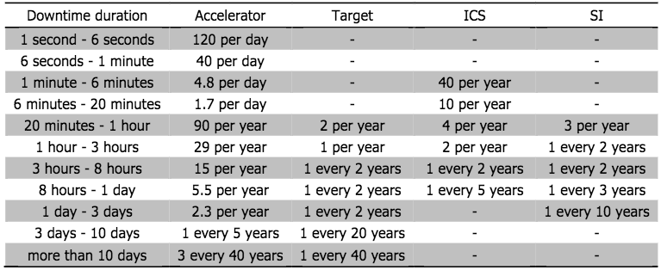
Reliability
Beam trip allocation from RAMI group
50 per year for all of ICS 34 per year from BIS only
DRAFT

Slide 9
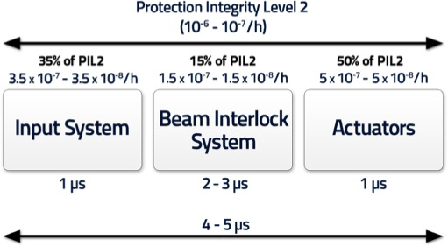
Summary and Discussion Points
Trade off between
Protection Function
Highest is a PIL2 PF
Reliability
“95% user happiness”
Expand the analysis to
Monitor inputs (BCM, BLM, BPM)
Actuators
How to include e.g. firmware and operational errors?
Reliability analysis without complete schematics

Slide 10
Thank You

Slide 11
PROTECTS THIS MACHINE

