Slide 1
Fast Beam Interlock System
Angel Monera Martinez
FPGA Engineer
www.europeanspallationsource.se
15-12-08
Notes:
Hello….
My name is Angel…
I am an FPGA… Working For Machine…

Slide 2
Acronyms
FBI : Fast Beam Interlock
FBI_D : FBI Driver
FBI_DIF : FBI Device Interface
FBI_M : FBI Master
FBI_MoM : FBI Master of Masters
IDev: Input Devices: Devices connected to the FBI as permit sources
  LPS: Local Protection Systems
  BI: Beam Instrumentation
PSU: Power Supply Unit
S/N: Serial Number
Notes:
Just a reminer of Acronims that you will see on the presentation.
I will try to do not use them but just in case,
The most importants are
FBI as fast beam interlock
IDev as Input devices: Devices connected at the input of the FBI system.
When I use IDev I will be talking about both, LPS and BI systems.

Slide 3
Overview
ENVIRONMENT
  FBIS MAIN REQUIREMENTS
FBIS COPPER LINKS
  FBIS ARQUITECTURE
  FBIS DRIVER
  FBIS DEVICE INTERFACE
  FBIS MASTER AND MASTER OF MASTERS
  FBI ACTUATOR
IMPROVING THE COPPER SYSTEM
FBIS OPTICAL LINKS
  FBI ARCHITECTURE
  FBI DIF
  FBI M
  FBI MoM
  FBI ACTUATOR
IMPROVING OPTICAL LINK
CONCLUSIONS
ANNEX1: INITIAL RESULTS OF THE FIRST ENGINEERING MODEL OF THE FBIS COPPER
Notes:
DO NOT READ make it fast.
I will show you where FBI is installed
I will talk about the main Requirements
And about the two approaches that we have in mind to design this system
The FBIs based in Copper link
And the FBI Optical Link, both with their main elements
Together with some ideas to increase to improve the design.
And the conclusions of this presentation..
And If there is time..
Then I will show the initial results of the analysis of the first engineering model of the fbia copper link

Slide 4
ENVIRONMENT
Located in the Klystron Gallery (Radiation Free)
Klystron Gallery is organized by alternating Rack Enclosures and rows of klystrons amplifiers.
Each Enclosure is composed by two 2 rows of racks
Each row contains 18 racks
There are 24 racks enclosures spread around the 500m long gallery.
The rack blocks are dust proof and waterproof
Notes:
From top to bottom
add note:
Waterproof means hard to send cables in and out of the racks.
Need to minimize cabling in and out of the enclosures.

Slide 5
ENVIRONMENT - KLYSTRON GALLERY
Outside the racks blocks:
  Klystron power: > 40KW
  Illumination
  Wireless communications
Inside the Rack Blocks:
  Other RF Systems
  Pulsed power supplies with high voltage and high current
  etc
Notes:
We are not alone in the klystron gallery, we share it with devices like
High power klystrong amplifier
pulse power supply for magnets
vacuum pums and others
The Enviroment may be clean of radiation but its full of Electromagnetics interferences

Slide 6
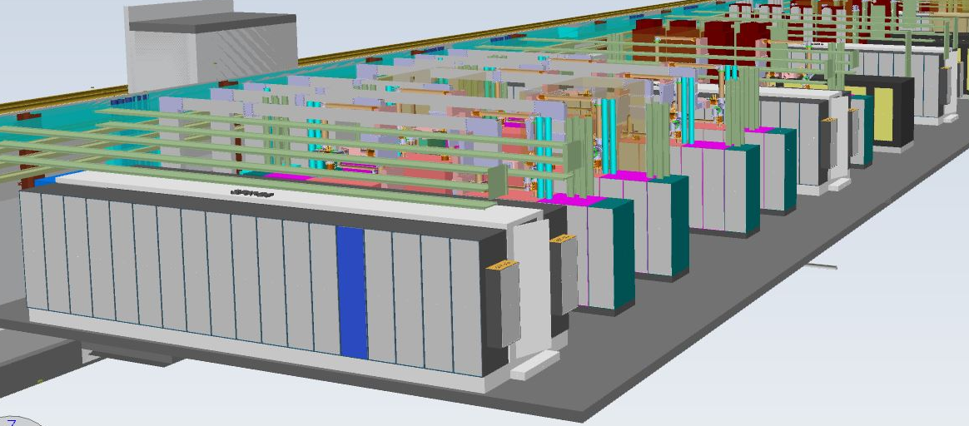
ENVIRONMENT – KLYSTRON GALLERY
Notes:
A 3d model of the klystron gallery…

Slide 7
ENVIRONMENT – HOW IT WORKS
COLLECT SYSTEM READINESS SIGNALS OR “BEAM_PERMIT” FROM DIFFERENT MACHINE PROTECTION RELEVANT DEVICES.
DECIDE DEPENDING ON THE MACHINE STATE
STOP THE PROTON BEAM IF NEEDED.
Notes:
An unnecessary slide but in any case.. The FBIS should work in this way…
Collect the Beam Permit from the Input devices
Decide to stop
And Stop if needed

Slide 8
ENVIRONMENT - FBI REQUIREMENTS
High compatibility with all input devices (PLC and FPGA systems)
Fast reaction time (<3uS for the first 30m)
Fast reaction time (<9us for the following 570m)
Flexible
Safe (1.5E-7/h dangerous failure rate per hour)
  Equivalent to PIL3
Highly available
Ready for installation end of 2017
Notes:
Here a small list of the main requirements…
Compatibility with PLC and FPGA system
It need to be fast for any distance of cable
It need to be safe
And allow to high beam availability (no false triggers)
And ready to be installed at the end of 2017.

Slide 9
FBI COPPER SYSTEM
Based on CERN Beam Interlock for LHC and Linac4
  Definition of one common Interface to standardize the connection with the BIS.
  Use multiple masters (Concentrate and decide)
  Actuator interface to adapt the signal from the Interlock to the desired actuator.
  BEAM PERMIT is a DC Signal (Linac4)
Optimized for ESS Needs
  Tree / Star architecture to fit klystron gallery.
  Smaller Footprint, thinner cables smaller connectors (MicroD).
  Different standard (uTCA or Pizza Box)
  Updated Bill Of Materials
  Faster response time.
  Replaced BEAM_PRESENCE signal by PERMIT_TEST
Notes:
Lets talk about the first design proposal.
Based in CERN design for LHC and Linac4
standard interface
multiple master
actuator to interface the beam actuators
beam permit is DC signal (Linac4)
Optimized for ESS needs
adapted to the klystron gallery
Smaller size due to RESTRICTED SPACE
Different base system (we will use probably pizza box or micro TCA)
Updated component list
Faster
Replaced the information signal by a testing signal

Slide 10
FBI COPPER SYSTEM ARCHITECTURE
ENCLOSURE x
LPS
BI
LPS
BI
Device Inputs ~300
ENCLOSURE y
5 to 20 FBI_DIF per enclosure
1 inputs to 1 output
FBI DIF
DIF
DIF
DIF
FBI_M
FBI_M
1 per enclosure
15 inputs, 1 output
Master of Masters
1 Master of Masters
24 Inputs 8 Outputs
8 Actuator Interfaces
1 Input + 1 Redundant, 1 output
Actuator Interfaces
Actuators
4 Actuators: Source, LEBT Chopper, MEBT Chopper and Timing
Notes:
In order to fit the FBIs in to the Gallery,
1 MASTER PER ENCLOSURE means 1 cable out of each enclosure (two if redundant)
THE IDev CONNECT TO THE MASTER THROUGH THE FBI_DIF
ALL THE MASTER CONVERGE IN TO THE MASTER OF MASTER
THAT WILL TRIGGER THE ACTUATOR THROUGH THEIR INTERFACES

Slide 11
FBI DRIVER
Made to drive the FBI_DIF
Implemented within the fast electronics or
  Developed like a module that can be plug in to the “of the shelf” boards
Small footprint
High Sensibility: 1.7V Min to give permit for modern FPGA
Notes:
Implemented within the fast electronics (like ioxos)
Or in a pluggable module (for Struck or BI boards)
High sensibility to enable beam.

Slide 12
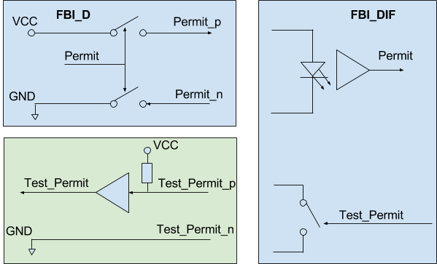
FBI DRIVER
Notes:
The FBI Driver can be though as a switch that is used to light up a led (photodiode)
This switch can never be only low (short in cable will produce easily a dangerous failure)

Slide 13
FBI DIF
Translate Beam Permit to a RS485 to have higher immunity and reach.
Input compatible with PCL and FPGAs
  Wide Input Voltage range (From 1.8V to 36V)
  Low current (< 15mA)
RS485 at the output
Electrically Isolated from the IDev
Permit only passes through logic
Modern components
Higher Integration
Self Testing onboard.
Notes:
Compatible with FPGA and PLCS
RS485 at the output
Electr… IDEV with an optocoupler in Both beam permit and Test Permit
Permit doenst pass through programmable devices
Higher integration => Many FBI_DIF per box
Built in – SELF TEST function

Slide 14
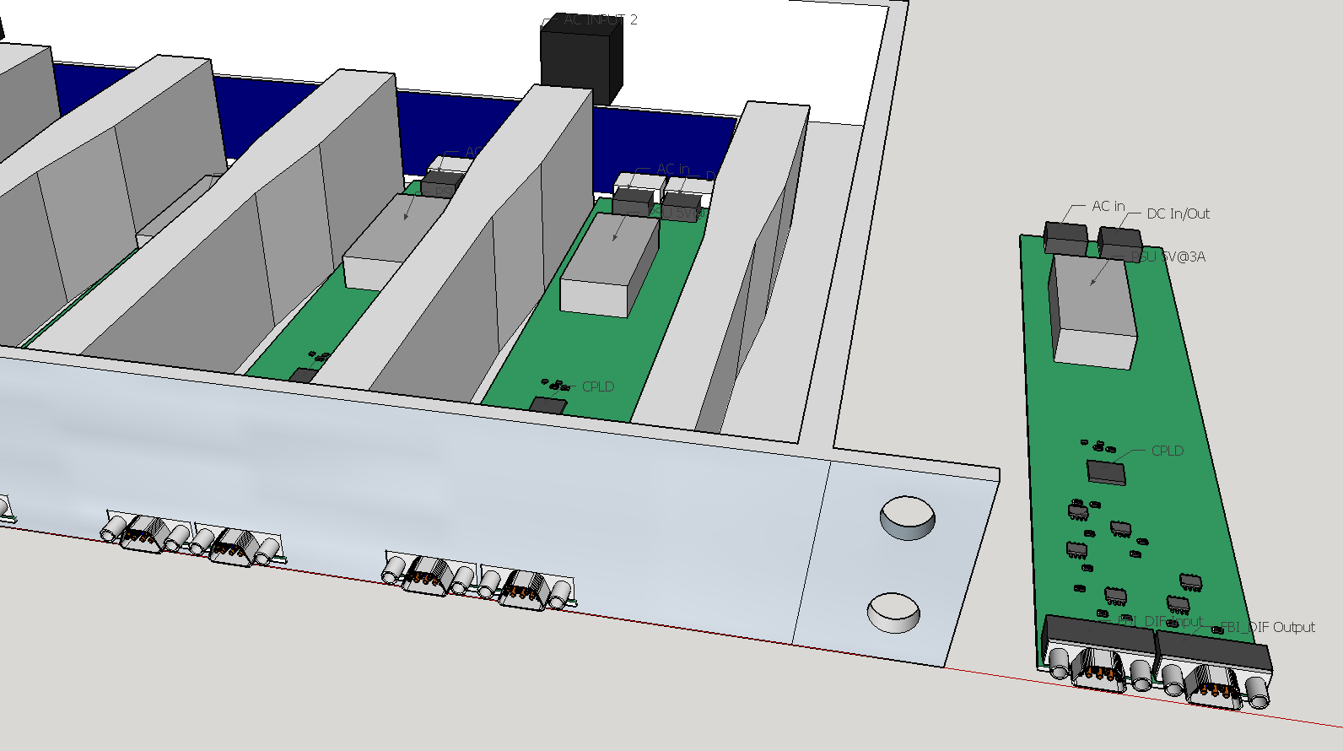
FBI_DIF
Notes:
3d model of what could be..
Each fbi dif with its own supply
All plug to a box (probably 4 or 6 fbi_dif per box)
Shared PSU voltage through the backplane, so if one supply fails, the others will keep the device powered up.

Slide 15
FBI Master and Mastor of Master
Based on uTCA or Pizza box
Permit pass through an FPGA
Operative system within each box
Fail safe
Fast response
Programmable digital filter @ inputs
Notes:
Implemented in a pizza box or microTCA crate
Permit pass through FPGA due to the need of flexibility
Exclusive operative system within the box for easy monitoring. (operative system do not decide, just monitor)
For the long cable traces => programmable filter for removing glitches

Slide 16
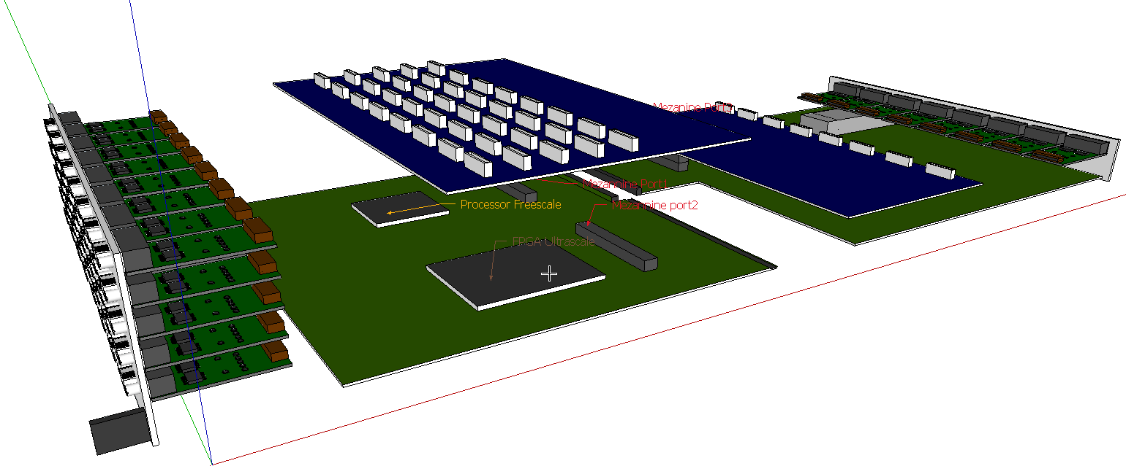
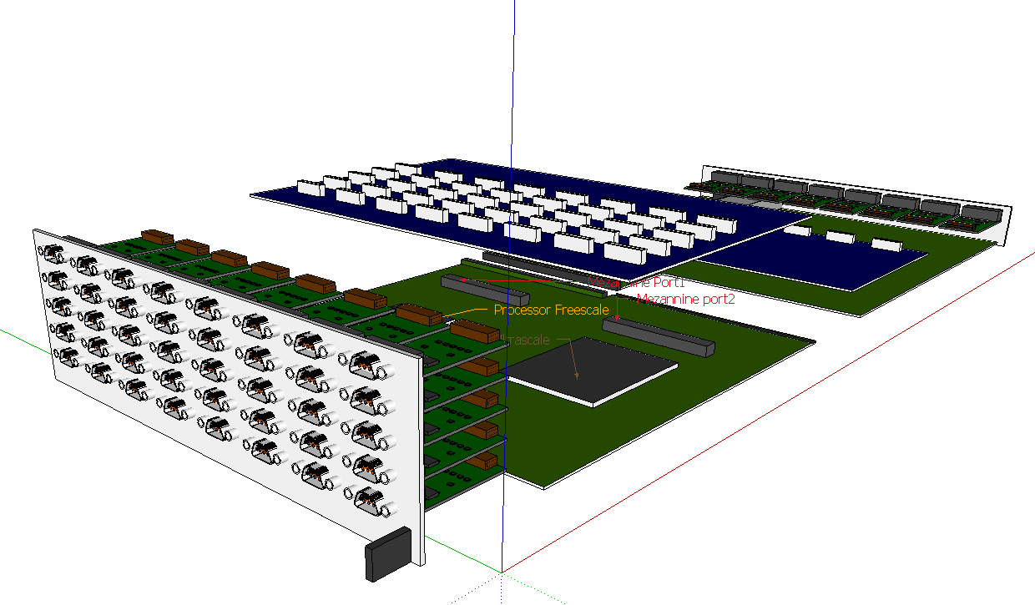
FBI_MASTER in uTCA
Notes:
3d model of what could be the master based on the IOxOS IFC 1410
ioxos with its processor and big fpga
rtm module
FBI inputs and outputs modules will be implemented in small boards that will be escrewed to the connector that is screwed to the front panel
ALL OF THEM connected to the main board through flexible cables and expansion modules connected to the mezannine ports.

Slide 17
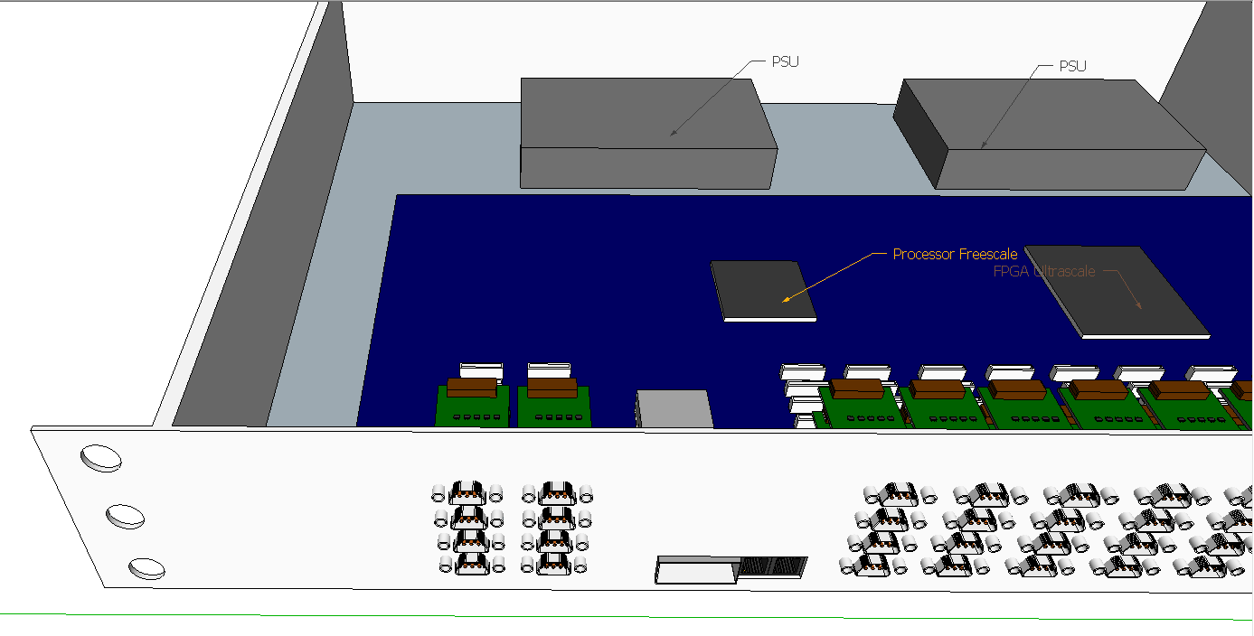
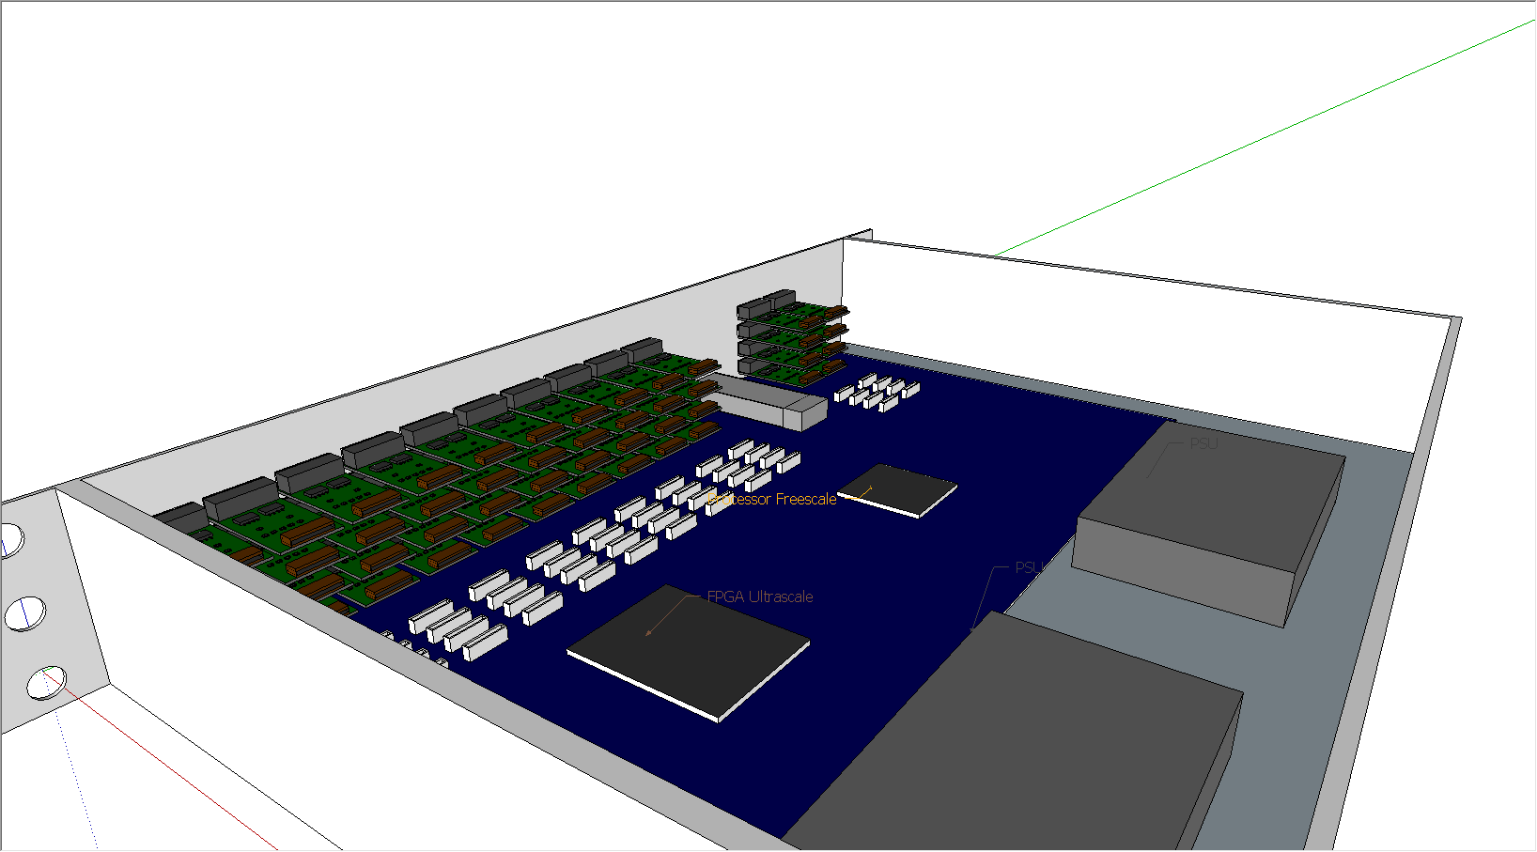
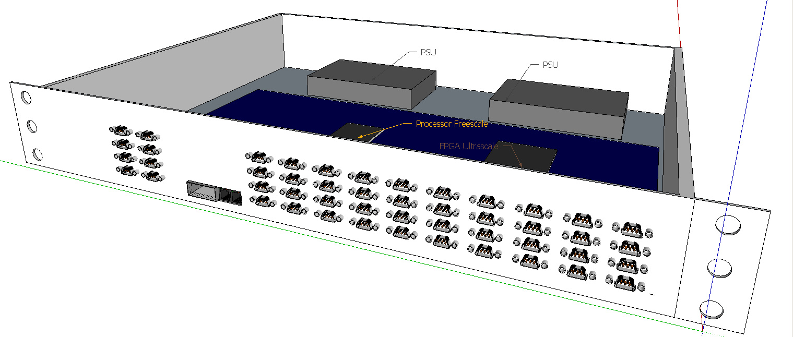
FBI MASTER Pizza box
Notes:
Same here in a pizza box. Same elements just in less boards, but FBI I/O still in modules for easy maintenance
Of course, redundant power supplu.

Slide 18
FBI_ACTUATOR
Tailor made for Each Actuator
Ensures redundant control even if there is one input
Allows many devices to control the actuator
Failsafe
No blind failures
Permit only passes through logic
CPLD monitors the permit and Inform the master
Redundant Power Supply.
19 inch pizza box format
Notes:
This is probably the most critical element, and for this it has been:

Slide 19
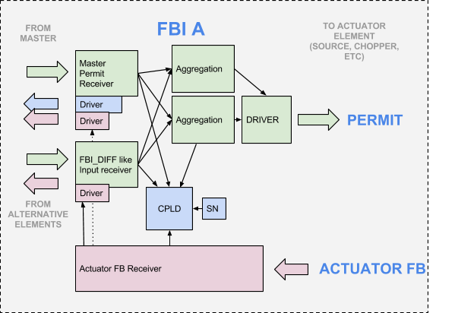
FBI ACTUATOR
Notes:
Small diagram of the actuator..
Double rs485 driver (side by side)
Permit is distributed in two separate paths
Two different agretation areas of all the permits
One aggregation will control the supply of the final driver
The other aggregation will control the “enable” signal
As it was said before, CPLD monitores and transmit the information back to the master

Slide 20
FBIs COPPER REVIEW
THE GOOD
  Small footprint
  Simple electronics
  Cheap circuits
  Very reliable connectors
THE UGLY
  Connectors are hard to install “on the field”
THE BAD
  Expensive connectors
  Found weak points in the connection between the IDev and FBI_DIF
Notes:
Small size
Simple and cheap electronics
The connector chosen for the moment (Micro D connector)….
However, these connectors are hard to install (it takes more than 30 minutes per connector done by specialized technicians)
And they are quite expensive

Slide 21
IMPROVING THE COPPER SYSTEM
Redundancy maybe added in case of needed additional level or protection to reach the desired protection level.
Self testing sequence built into and outside the FBIs to remove the Blind failures and increase the protection level of the system.
  FAST TEST
    REALIZED BETWEEN PULSES
  SLOW TEST
    REALIZED AFTER TECHNICAL STOPS
  ACTUATOR TEST
    REALIZED AFTER SLOW TEST

Slide 22
FAST TEST
Realized between pulses
Check the integrity of the connections from IDev to MoM
Generated by the FBI_MoM
Requires ~20us to execute
Propagated through FBI_M to FBI_DIF
  Answered by FBI_DIF if SLOW connected at the input
  Propagated to the Input Device if FPGA
While Permit_Test is on, Input device should remove the Beam_Permit signal

Slide 23
FAST TEST
SLOW LPS
FAST
BI
Fast hardware removes permit when TEST PERMIT is ON
TEST IN DIF (Slow Electronics)
TEST ON Idev (Fast Electronics)
HARDWARE SELECTION FOR
TEST IN DIF (Slow Electronics)
TEST ON Idev (Fast Electronics)
FBI DIF
DIF
DISTRIBUTE THE TEST SIGNAL
WHILE TEST, FBI_M ONLY REMOVE PERMIT AFTER ALL INPUTS HAVE REPLIED
FBI_M
Master of Masters
GENERATES TEST
AND CHECK THAT ALL REPLY
Notes:
This is how it would work

Slide 24
SLOW TEST
Executed after Technical stop
Check the integrity of the whole system, not only the links and the FBIs but also the Protection functions described by Machine Protection
Realized with no beam
Generated by Timing System
ALL input devices should simulate a trigger in their protection functions and remove the beam_permit

Slide 25
ACTUATOR TEST
Generated by the Machine Operators
Two stage test:
  WITH LONG BEAM AND LEBT FC IN
    TO TEST THE SOURCE AND LEBET CHOPPER
  WITH SHORT AND SAFE BEAM AND LEBT FC OUT
    TO TEST THE MEBT CHOPPER AND ANY OTHER BEAM ACTUATOR
Beam will be generated and the FBI_MoM will trigger one by one the different beam actuator at half of the pulse time to ensure correct behavior.
Notes:
It is not clear if this would be automatic process or not but is based on:
Having the accelerator with a safe beam and conditions, make the FBIs chop the beam in half with the different actuators (one by one)

Slide 26
FBIs OPTICAL
EVOLUTION of the FBI Copper version
Links between ID and FBI_DIF still been copper for compatibility
Copper links replaced by Gbit OPTICAL LINK:
  FBI_DIF to FBI_M
  FBI_M to FBI_MoM
  FBI_MoM to FBI_A
Uses FPGA with Internal serializers for all communications
Notes:
Kind of Evolution
The main difference is that the system uses a more dynamic

Slide 27
FBI OPTICAL ARCHITECTURE
Follows same distribution as copper
FBI_DIF will concentrate signals instead of just adapting levels
Copper links uses DC signals as before
Optical links uses Gbit connection with BEAM_PERMIT packed into DATA
BEAM_PERMIT path becomes dynamic, no blind failures if bit is stock

Slide 28
FBI OPTICAL ARCHITECTURE
LPS
BI
LPS
BI
Device Inputs ~300
ENCLOSURE
ENCLOSURE
5 FBI_DIF per enclosure
8 copper inputs to 1 optical
FBI_DIF
FBI_DIF
FBI_M
FBI_M
1 per enclosure
5 Optical inputs 1 Output
1 Master of Master
24 Optical Inputs 8 Outputs
Master of Masters (MoM)
Actuator Interfaces
8 Actuator Interfaces
1 Optical Input + 1 Redundant, 1 output
Actuators
4 Actuators: Source, LEBT Chopper, MEBT Chopper and Timing
Notes:
In red you can see the optical links, while black are the copper links.

Slide 29
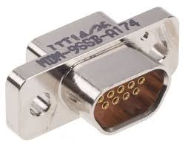

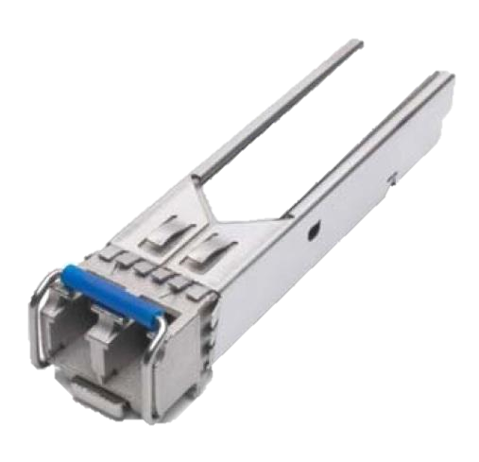
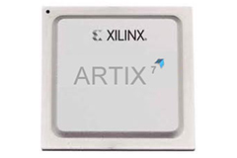

FBI DIF Optical
Notes:
THE FBI_DIF do not evaluate the permit
Copper Input (Micro D connection)
Remember is just an interface and what is doing is serializing all the information from copper inputs into a optical link.

Slide 30



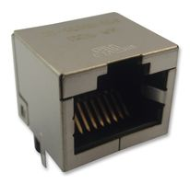

FBI MASTER OPTICAL
Notes:
The master, the one inside the enclosure will have 5/6 inputs, remember each input will have 8 permits/virtual channels => 40/48 Virtual channels
Cheap FPGA
The Master will evaluate the permit following the protection matrix defined for each beam.
Redundant supply
Operative system (Linux)
and connected to epics for monitoring and local network

Slide 31

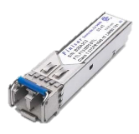
FBI MASTER of MASTER OPTICAL
Notes:
The Master of Master: similar to the Master but more inputs and outputs
One input -> One Permit (from enclosure master)

Slide 32

FBI ACTUATOR OPTICAL
?
Notes:
Optical input together with copper for sharing the access to the Actuator with different systems
Whatdog at the output to ensure a safe disconnection in case that the FPGA stops responding.
Dual clock and dual supply for maximum availability

Slide 33
FBI OPTICAL CONCLUSIONS
THE GOOD
  Increased Speed compared to Copper System
  Dynamic path for BEAM PERMIT
  Increased noise immunity
THE UGLY
  Optical transceiver are as expensive as MICRO D connectors
  Test still need to be performed between the Input device and FBI_DIF
  BEAM PERMIT depends of programmable devices (complex analysis)
THE BAD
  Fiber optics have shorter lifespan than copper

Slide 34
IMPROVING OPTICAL (ideas)
Separate Slow and Fast beam Interlock
  Remove FBI_DIF and use Optical from IDev till FBI_Master.
Fast TEST to warranty full FBIS functionality all time
Dancing Permit (Next Slide)
Slow and Actuator TEST will still need to be executed after every technical stop
Notes:
The Slow and Actuator test will still to be executed
And then decide if to:

Slide 35
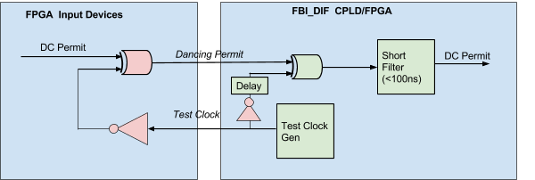
IMPROVING OPTICAL - DANCING PERMIT
Based on the detection of a phase change of a signal generated by the FBI_DIF
  No free oscillation
  Delay can be set automatically
  Test signal can by any one (even random)
(BAD)
  Its more intrusive in the Device Electronics Firmware
  Requires extra settings for the FBI_DIF
Notes:
This is how it would work:

Slide 36
CONCLUSIONS
NO CONCLUSIONS ☹
  WE STILL TRYING TO CHOOSE WHAT IS BEST
CHARACTERISTIC | COPPER | FIBER
PRICE |  | X
SPEED | X | X
NOISE IMMUNITY |  | X
FAST DESIGN | X
KNOWLEDGE | X
MAINTENANCE | X
WE NEED AN ENGINEERING MODEL OF THE FBIS OPTICAL TO COMPARE

Slide 37
THE END
THANKS

Slide 38
ANNEX1
ENGINEERING MODEL of
FBIs COPPER

Slide 39
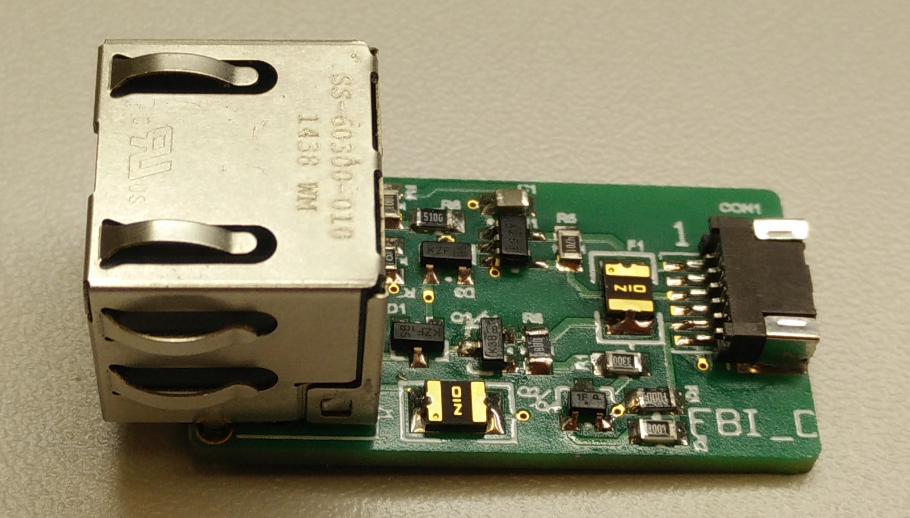
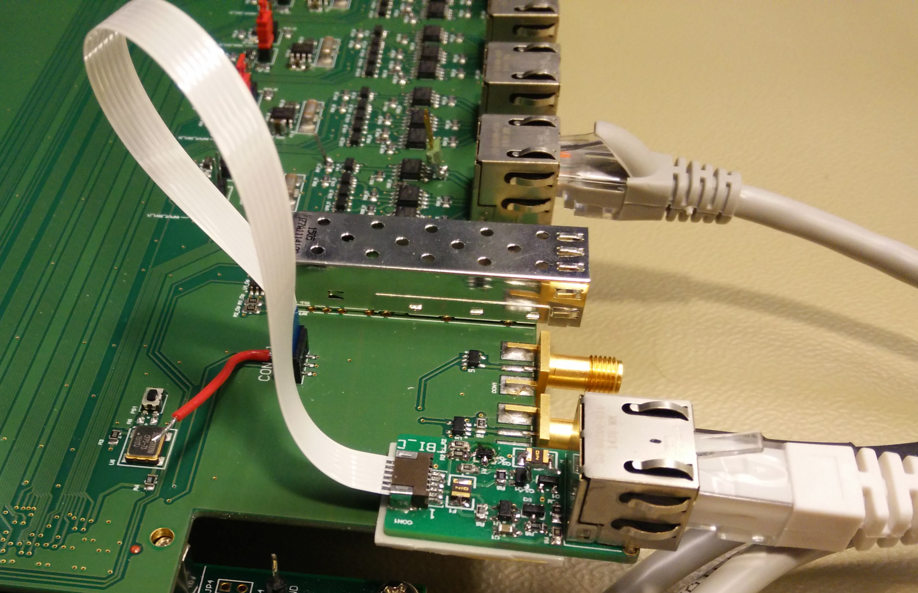
FBI DRIVER (on pluggable module)

Slide 40
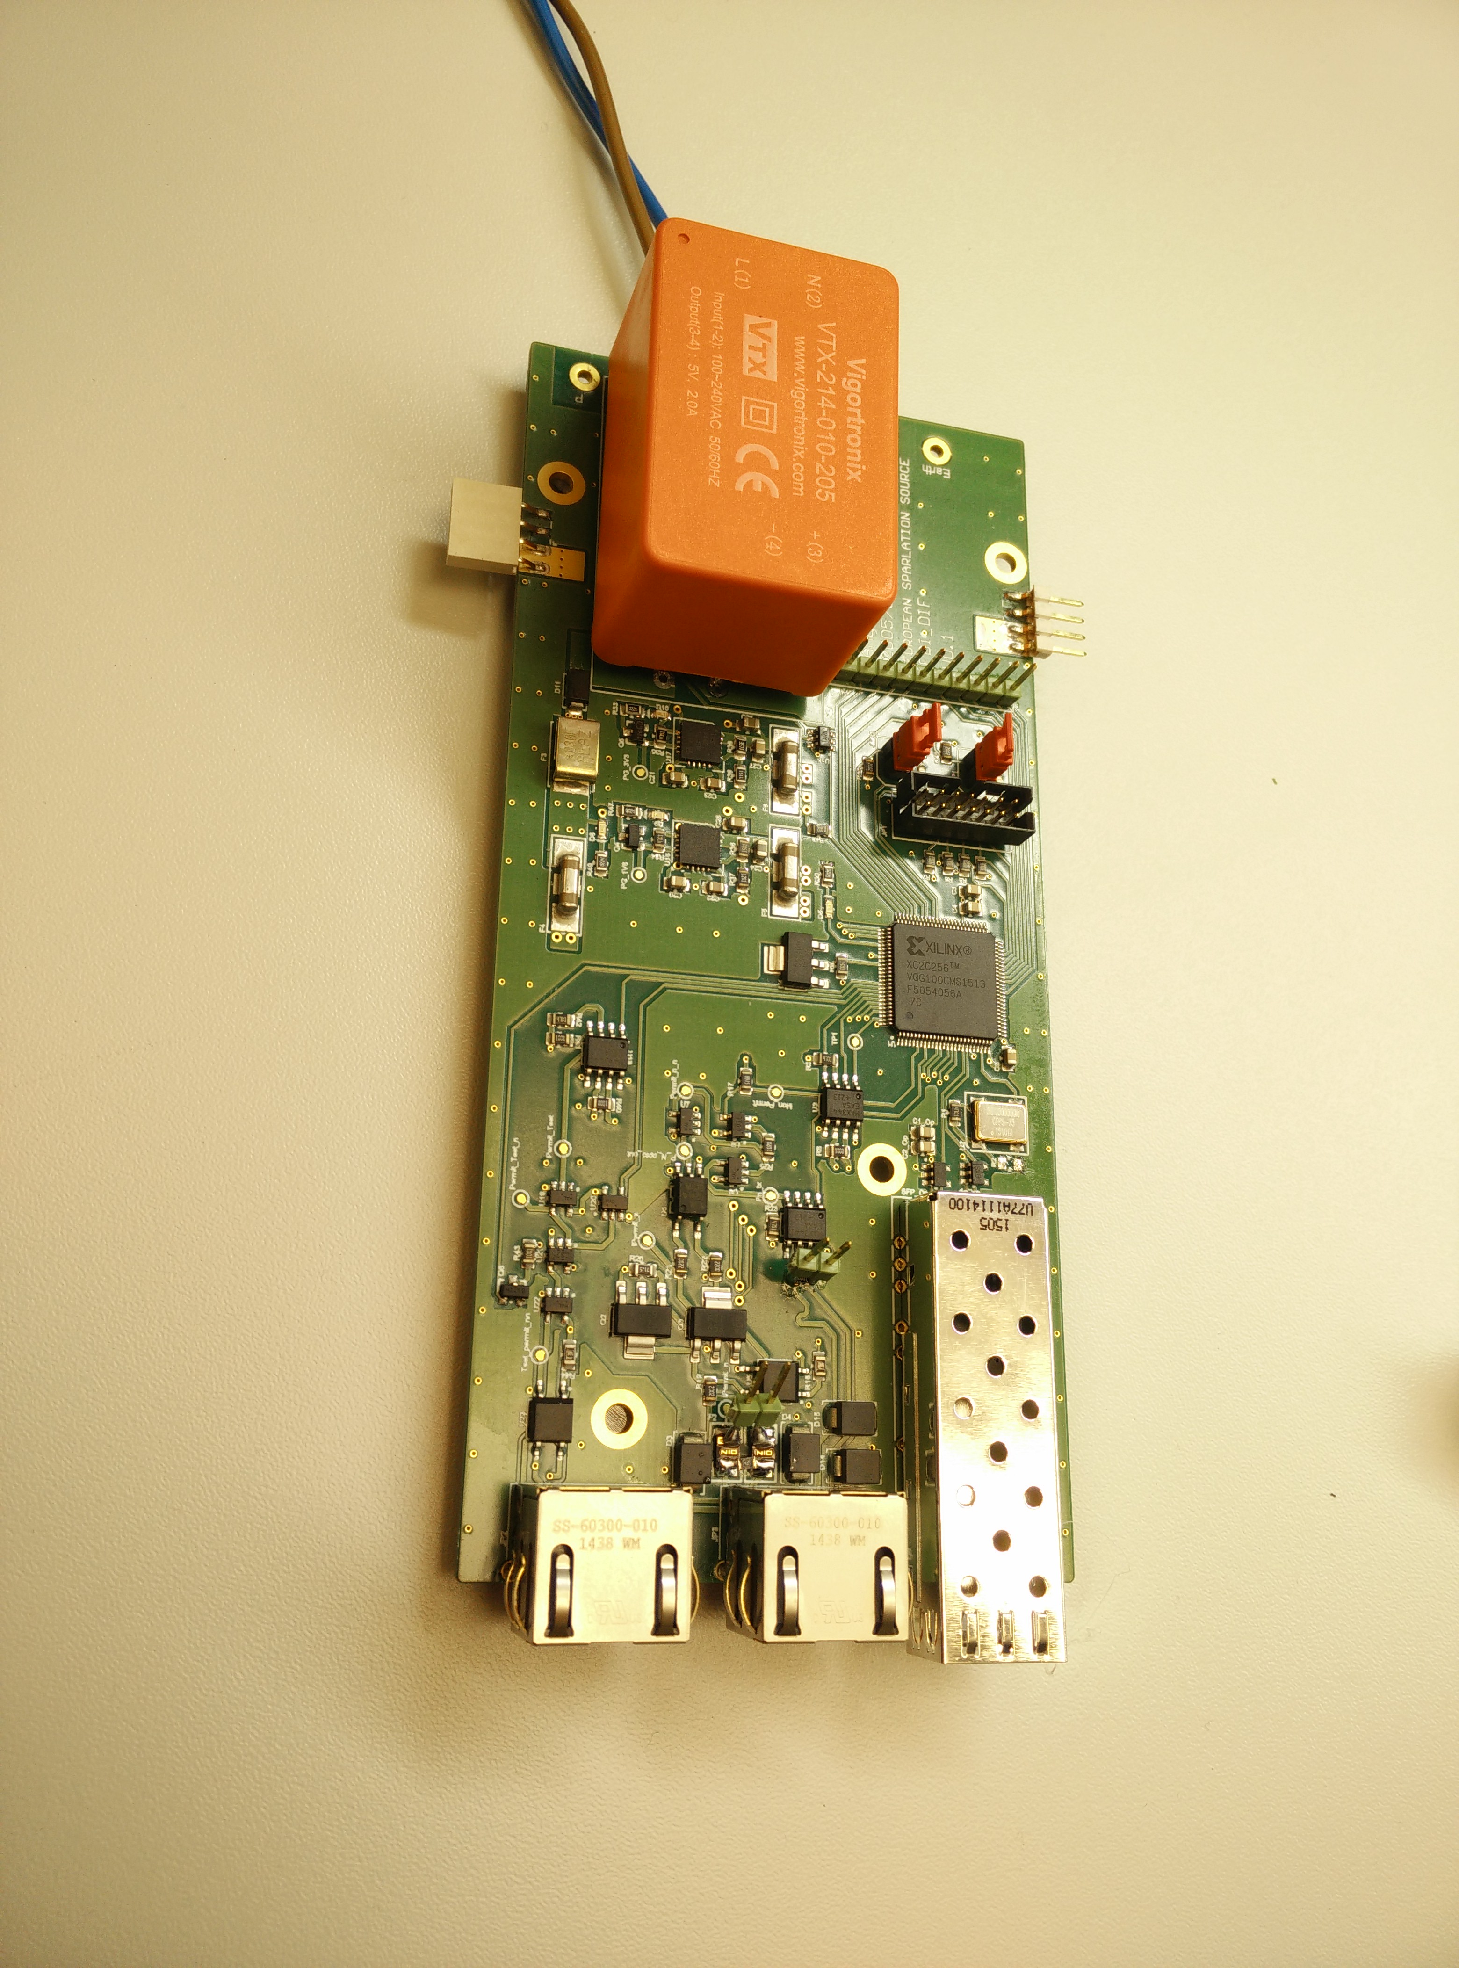
FBI DEVICE INTERFACE

Slide 41
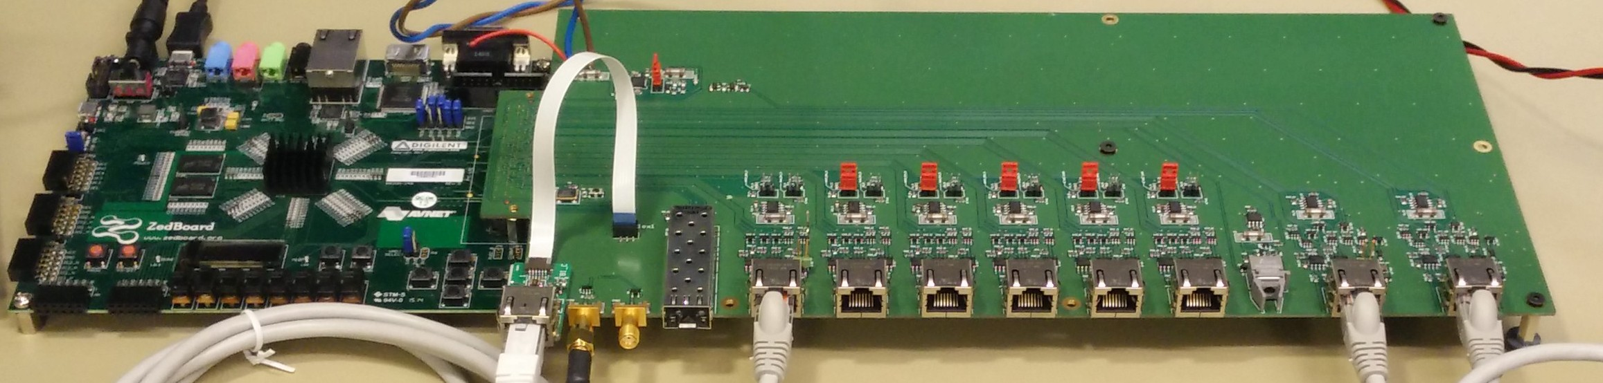
FBI MASTER

Slide 42
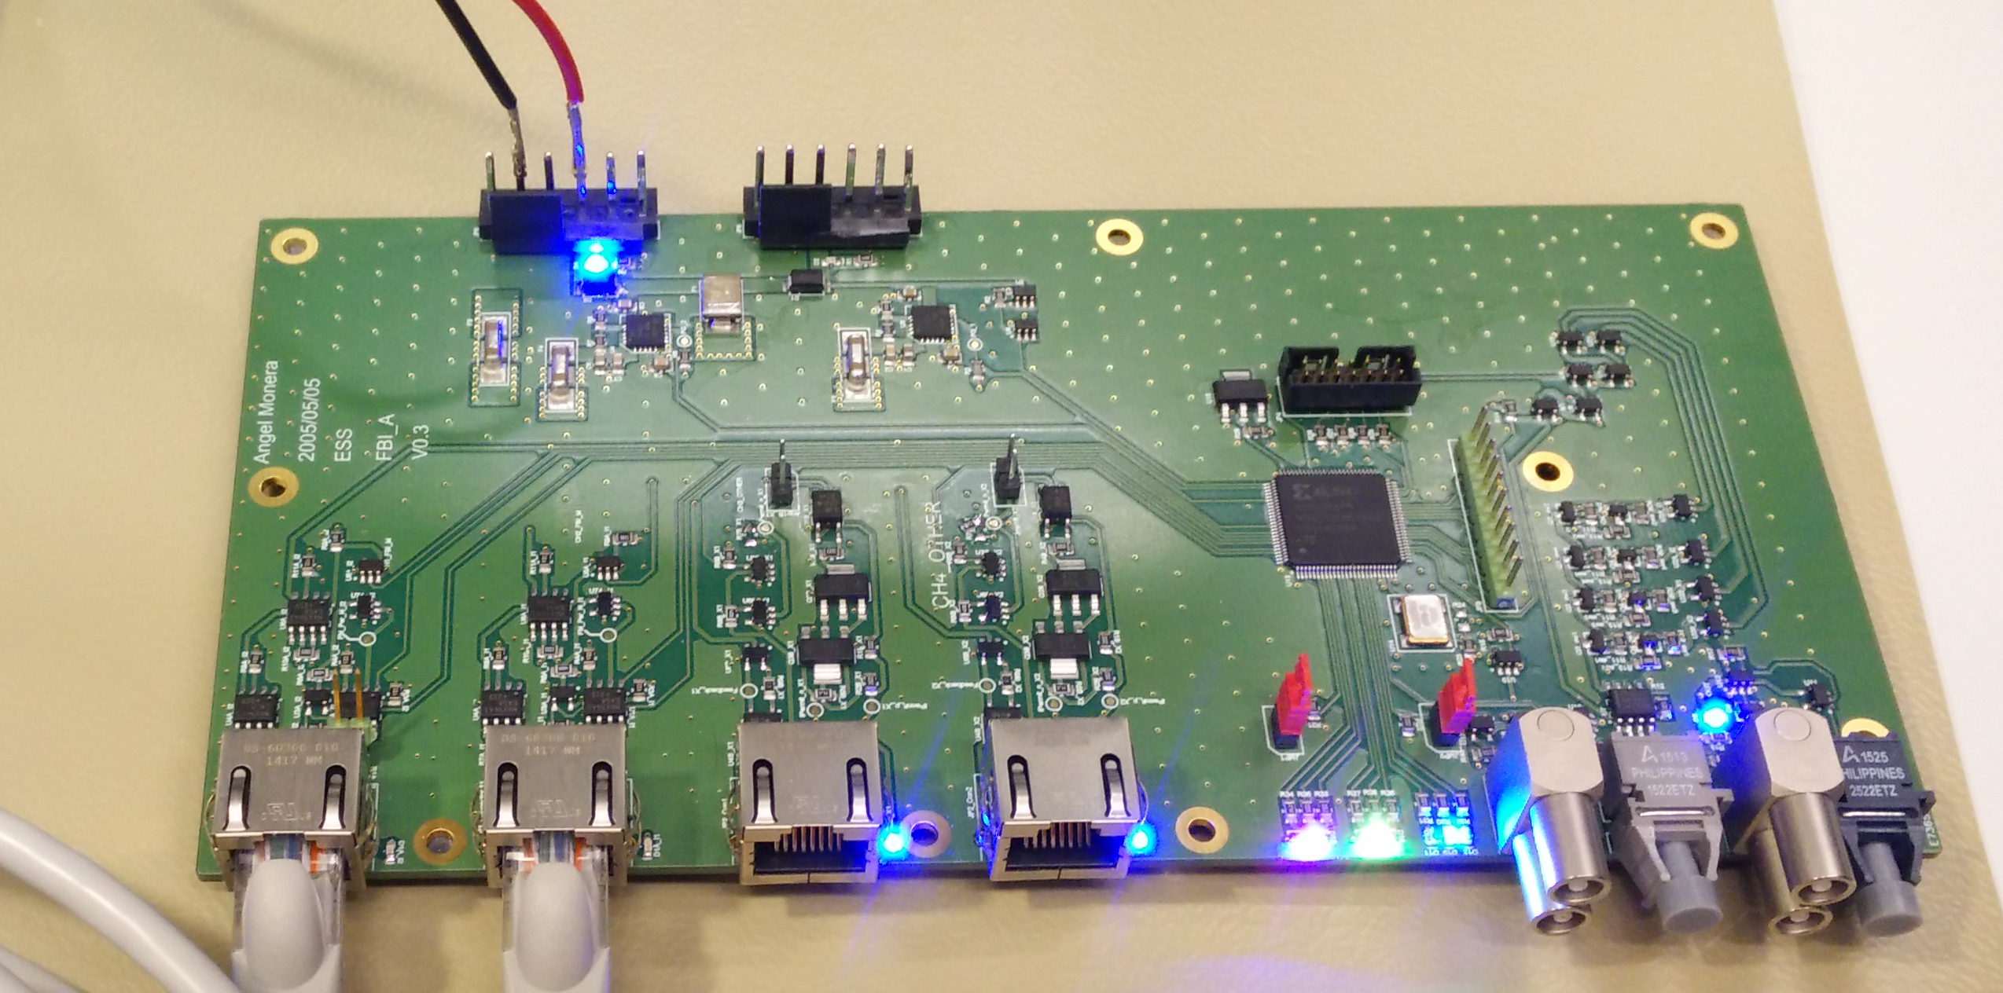
FBI ACTUATOR

Slide 43
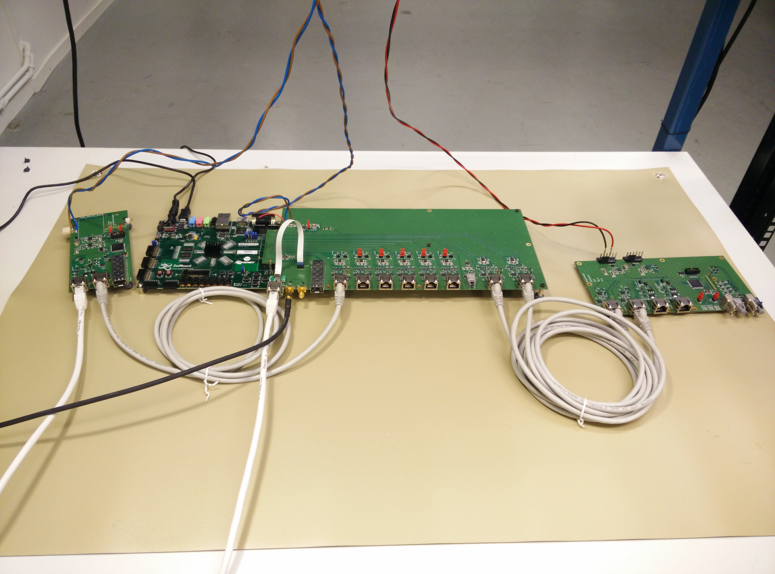
FBIs SYSTEM

Slide 44
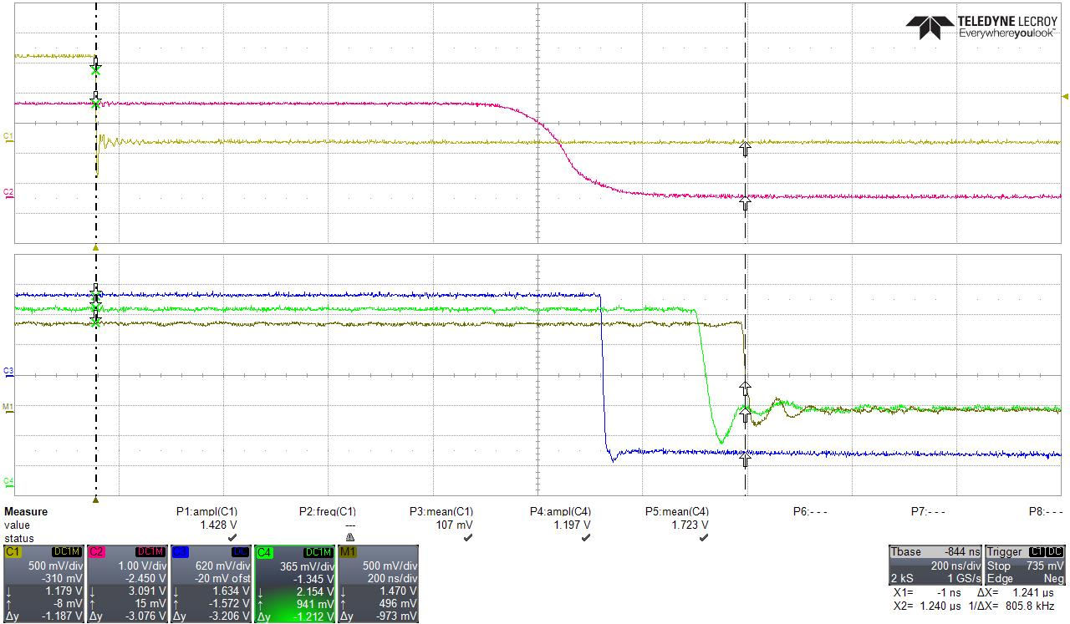
RESPONSE TIME
Notes:
Response time From FPGA in IDev to actuator Output (electrical) is 1.24us
(Cable delay approximately 20ns)

