Slide 1
How to Monitor Beam: Beam Current Monitors (for the Machine Protection Review)
Hooman Hassanzadegan
(ESS, BI section)
ESS, Lund
Date: 2015-12-08

Slide 2
What can/cannot be measured with the BCMs?
The ACCTs will be used to measure the beam current and charge. This includes:
Continuous measurement of the beam current (pulse + gap)
Average current over the pulse width
Pulse profile
The current will be integrated to calculate the per-pulse and cumulative charge.
The ACCTs cannot measure:
DC or slowly-varying current
Bunch current
The FCT can have a bandwidth of up to 2 GHz. It will be used to measure the pulse profile after the MEBT chopper.

Slide 3
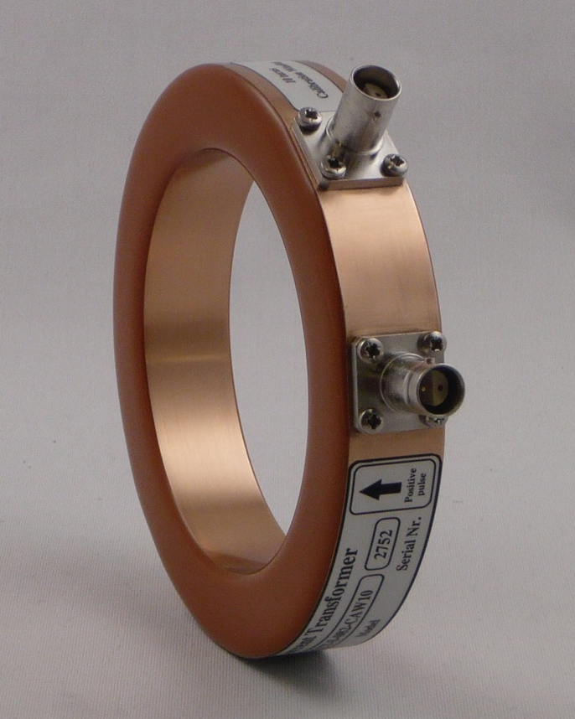
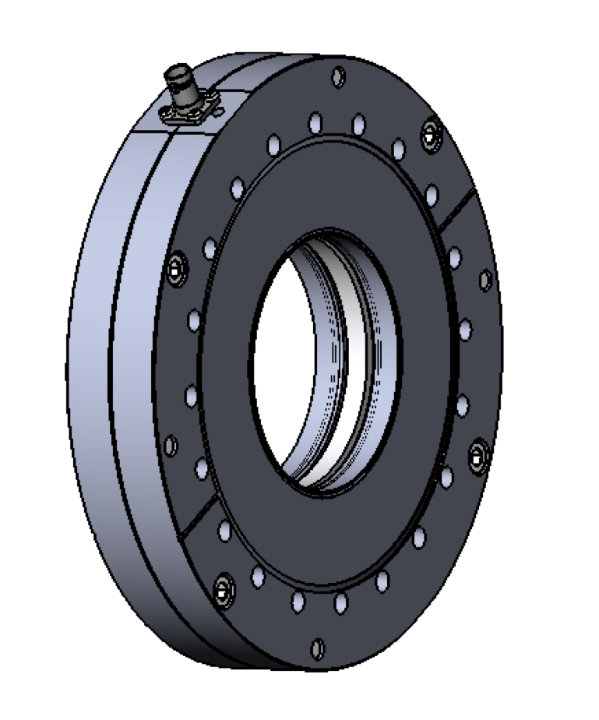
Bergoz ACCT toroids
With the current Bergoz design, the ceramic will be exposed to the beam (ex. after particles are deflected by quad). The ceramic may then break as a result of charge building up on it (happened two times at SNS as reported by Tom Shea). This can be prevented by putting a thin conductive plate in front of the ceramic leaving a little gap on one end so that it doesn’t make a path for the image current.
Based on the current design, the calibration cable needs to be terminated in 100 Ohm near the toroid.
Examples of Bergoz in-air (left) and flanged (right) ACCT toroids. Both sensors include a calibration winding. The later also includes shielding and ceramic break.

Slide 4
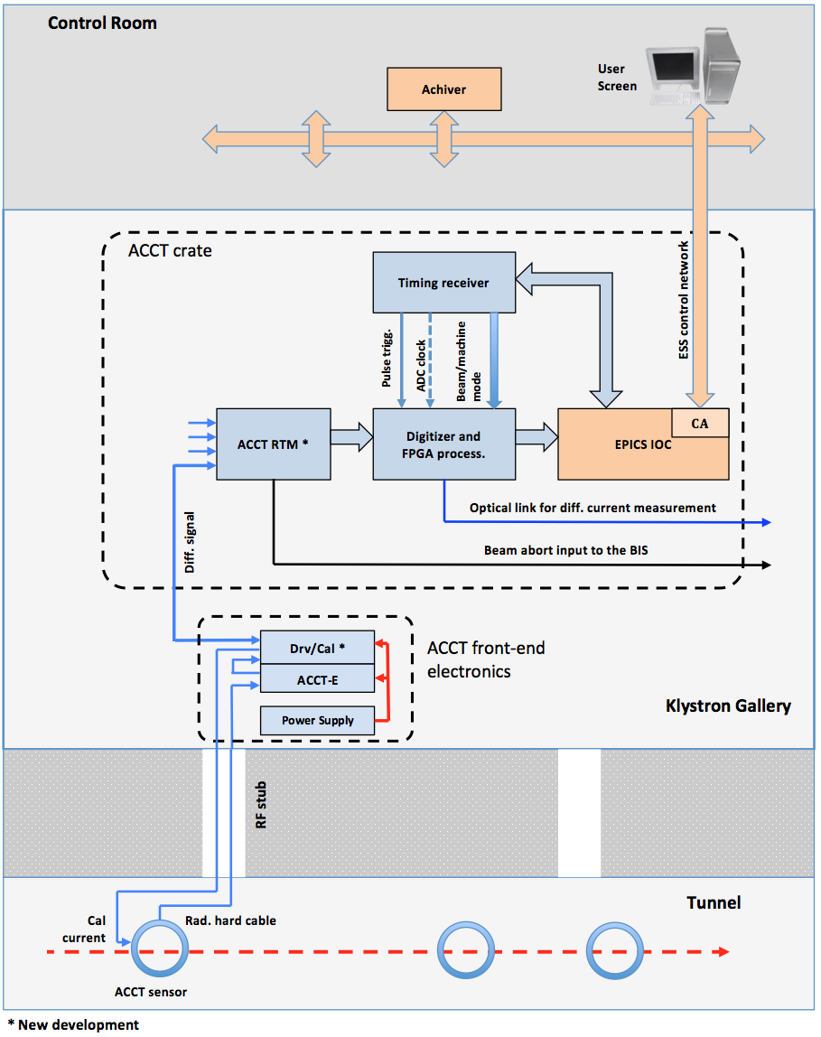
Simplified BCM system layout
(current plan)

Slide 5
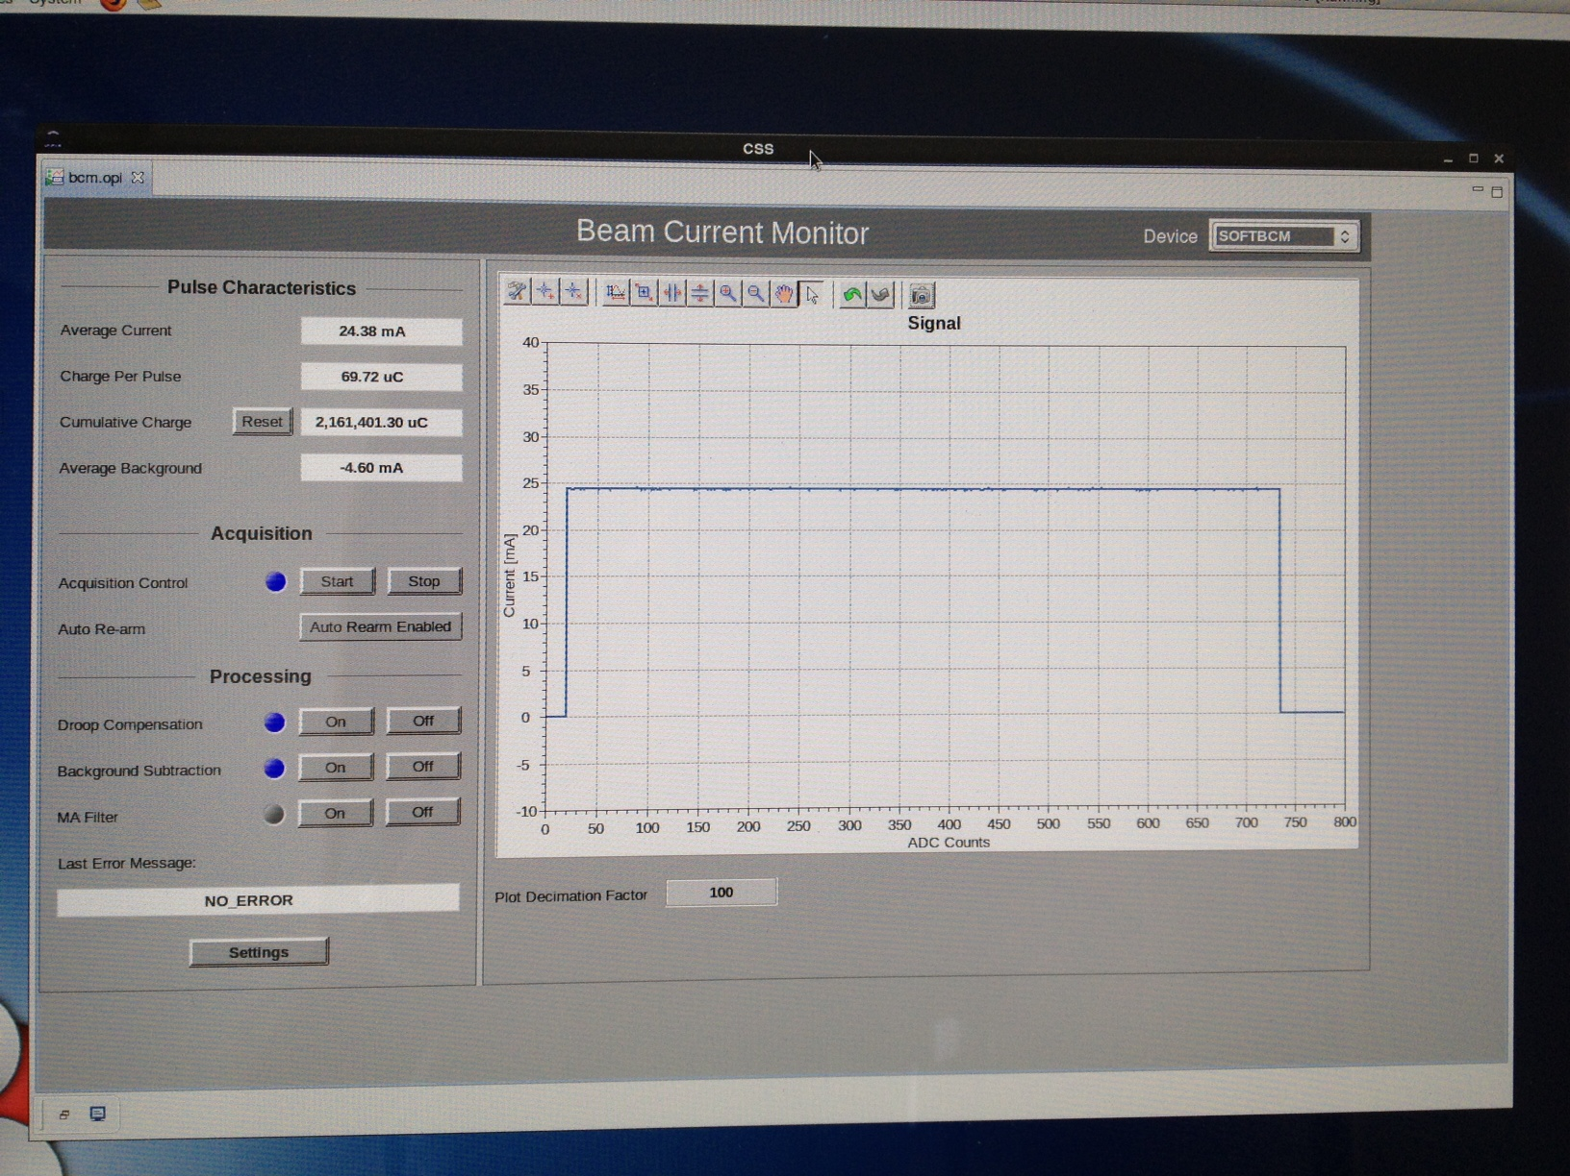
Beam current and charge measurement with an ACCT
5
EPICS-integrated ACCT prototype showing pulse current, charge and profile

Slide 6
BCM no. and distribution (draft)
Section name | ACCT no. | FCT no. | Comments
LEBT | 1 | 0
RFQ and MEBT | 1 | 1 | Numbers updated based on the Bilbao scope dated Oct. 26th 2015
DTL | 5 | 0 | ACCT integration in the inter-tanks
SPK | 0 | 0
MB | 1 | 0 | Integration into the 1st MB LWU
HB | 1 | 0 | Integration into the 1st HB LWU
HEBT | 2 | 0 | Integration into the 1st HEBT LWU
DgLg | 1 | 0 | Integration into the 1st DgLg LWU
A2T | 2 | 0
DmpL | 2 | 0
Total | 16 | 1

Slide 7
Fault cases to be detected by the BCMs
We foresee to use the BCM system to abort the beam if any of the following faults happen:
Pulse duration exceeds its MPS threshold.
Pulse current exceeds its MPS threshold.
Pulse frequency exceeds its MPS threshold.
Absolute current difference of an ACCT pair exceeds its MPS threshold.
Special blocks are foreseen in the firmware for the areas where a significant portion of the beam current will be lost by default (ex. RFQ and MEBT chopper).
The BCM electronics will receive beam and machine mode information from the timing system. This includes pulse width/amplitude and beam destination. This information will then be used to correctly configure the electronics, and avoid generating false beam abort signals.

Slide 8
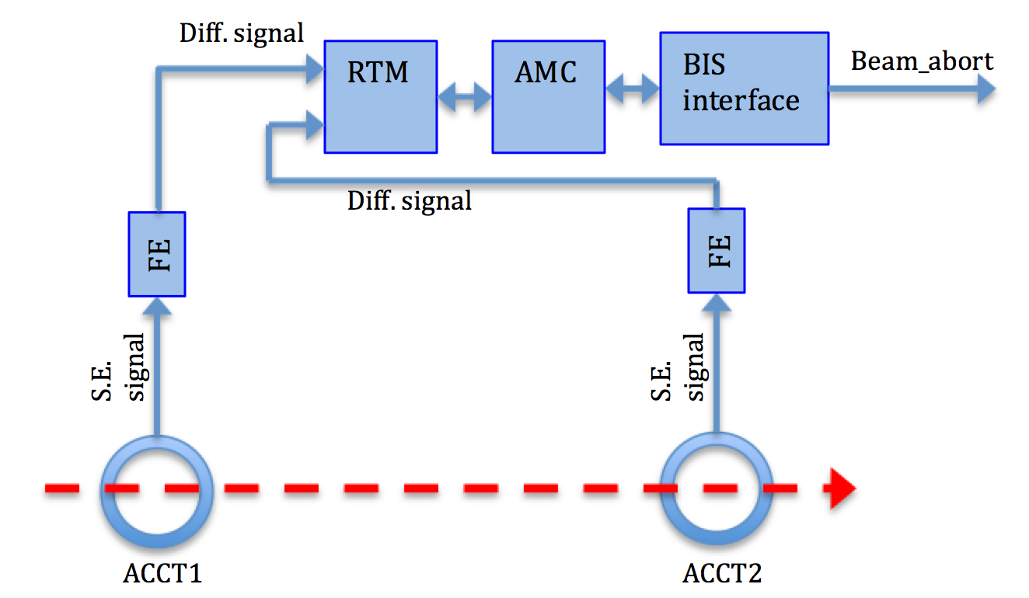
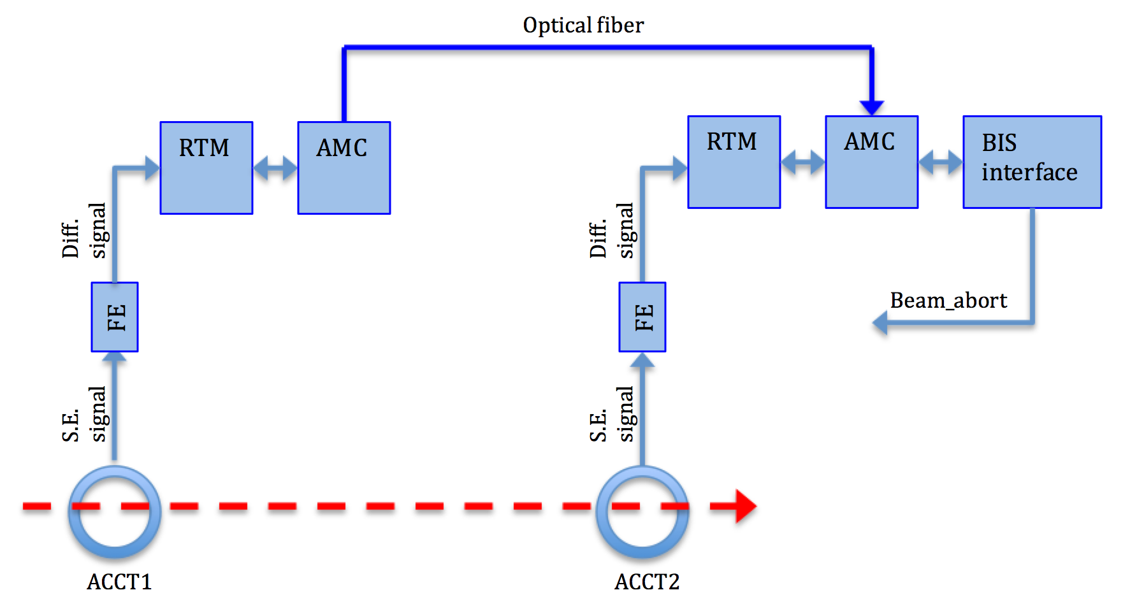
Differential current measurement with the ACCTs
The implementation of the optical line needs significant effort. The idea is to start with the differential line (Solution A) that should be sufficient for the low-energy linac sections. The optical line can be added later if needed. The use of the optical line also depends to a large extent on final differential ACCT layout.
Solution A - differential ACCT signal transmission over differential lines
8
Solution B - differential ACCT signal transmission over optical fiber

Slide 9
BCM redundancy
beg. A2T
end. A2T
Differential BCM is main loss
detector in warm linac
beg. DGLG
beg. MB
beg. HB
beg. HEBT
end. HEBT
beg. DMPL
end DMPL
LEBT
MEBT
DTL
Configuration destination dependent
v
NB. Configuration to be refined by analysis. Also need to handle
intermediate faraday cups/ beam stops (presumably by masks)
This particular layout could potentially be handled by 2 independent 8ch boards
Slide taken from Andreas Jansson’s presentation during the last Technical Advisory Committee on Beam Instrumentation

Slide 10
Differential ACCT layout (preliminary)
LEBT
MEBT
DTL
LEDP…
2.4? m
6.4? m
10.0? m
42.4? m
IS
LEBTCHOP
FC
RFQ
MEBTCHOP
FC
FC
FC
1
2
3
4
5
6
7
valve
valve
valve
FCT
valve
valve
valve
Beam
destination:
1
S
S
2
S
3
S
S
S
4
S
>4
Explanation:
ADC/FPGA module
PERMIT
BIS
FC
Faraday Cup
Signal splitter
at ACCT-E box
ADC/FPGA module
PERMIT
S
Redundancy by two ADC/FPGA modules in parallel.
Beam destination has to be communicated to the ADC/FPGA modules (over backplane).
This scheme assumes that valves are always open during beam operation.
Signal splitter: the output of the ACCT-E box is connected to a dual output differential signal transmitter. Attention: a power supply with higher current may be necessary!
Draft differential interlock layout provided by M. Werner (DESY)

Slide 11
Permit handler
From ADC
Baseline & droop
Scaler
Cross-bar-switch
Diff-Interlock
Check shape
From ADC
Baseline & droop
Scaler
Diff-Interlock
Check shape
From ADC
Baseline & droop
Scaler
Number of diff. Interlock stages: see description!
Check shape
From ADC
Baseline & droop
Scaler
Check shape
Diff-Interlock
Test signals
From ADC
Baseline & droop
Scaler
Check shape
Diff-Interlock
BIS-Interface
BIS
From ADC
Baseline & droop
Scaler
Check shape
Diff-Interlock
provided by
ESS / MPS
From ADC
Baseline & droop
Scaler
Check shape
From ADC
Baseline & droop
Scaler
MEBT chopper protection
FPGA pins
Check shape
From ADC
Baseline & droop
Scaler
PERMIT
BIS Backbone
Check shape
From ADC
Baseline & droop
Scaler
Not all connections are shown!
Check shape
BCM Firmware block diagram (draft) V03
01.12.2015
Trigger
Serial Timing data receiver (provided by ESS)
Manual calibration support
FPGA pins
Data interface to DDR memory
(provided by ESS)
11
Draft BCM firmware block diagram layout provided by M. Werner (DESY)

Slide 12
Summary of the current status
A prototype BCM system consisting of a Bergoz ACCT and uTCA electronics has already been made and successfully tested. For this prototyped, Cosylab provided the firmware and ESS ICS provided the software.
Draft BCM specifications are under discussion with the IK partners.
Details of the FPGA code of the LEBT, MEBT and DTL BCMs are being discussed with M. Werner (DESY) and these are close to being finalized.
Prototyping and implementation of part of the BCM analog electronics are being discussed with the Polish.
Details of the protocol for beam/machine more data transfer to the BCM electronics are under discussion with the MPS group and the ICS.
Commissioning of the LEBT ACCT is planned for Oct. 2016 in Catania. We have recently started with the procurement of part of the LEBT ACCT electronics.

Slide 13
Supporting slides…

Slide 14
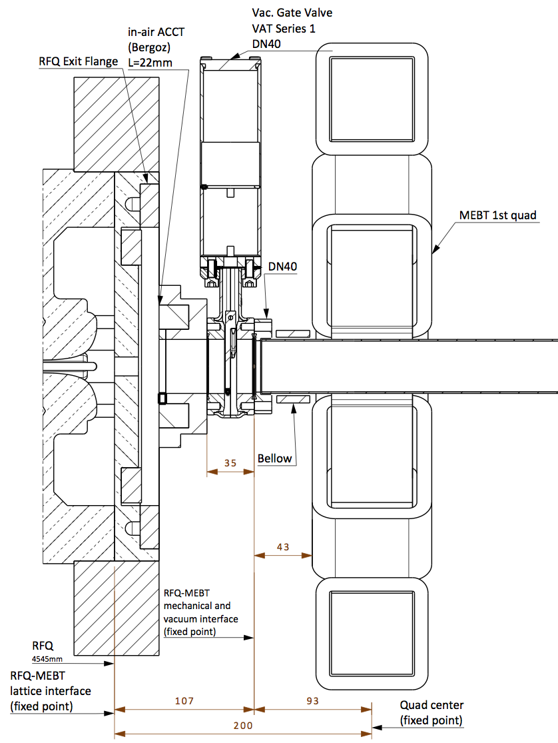
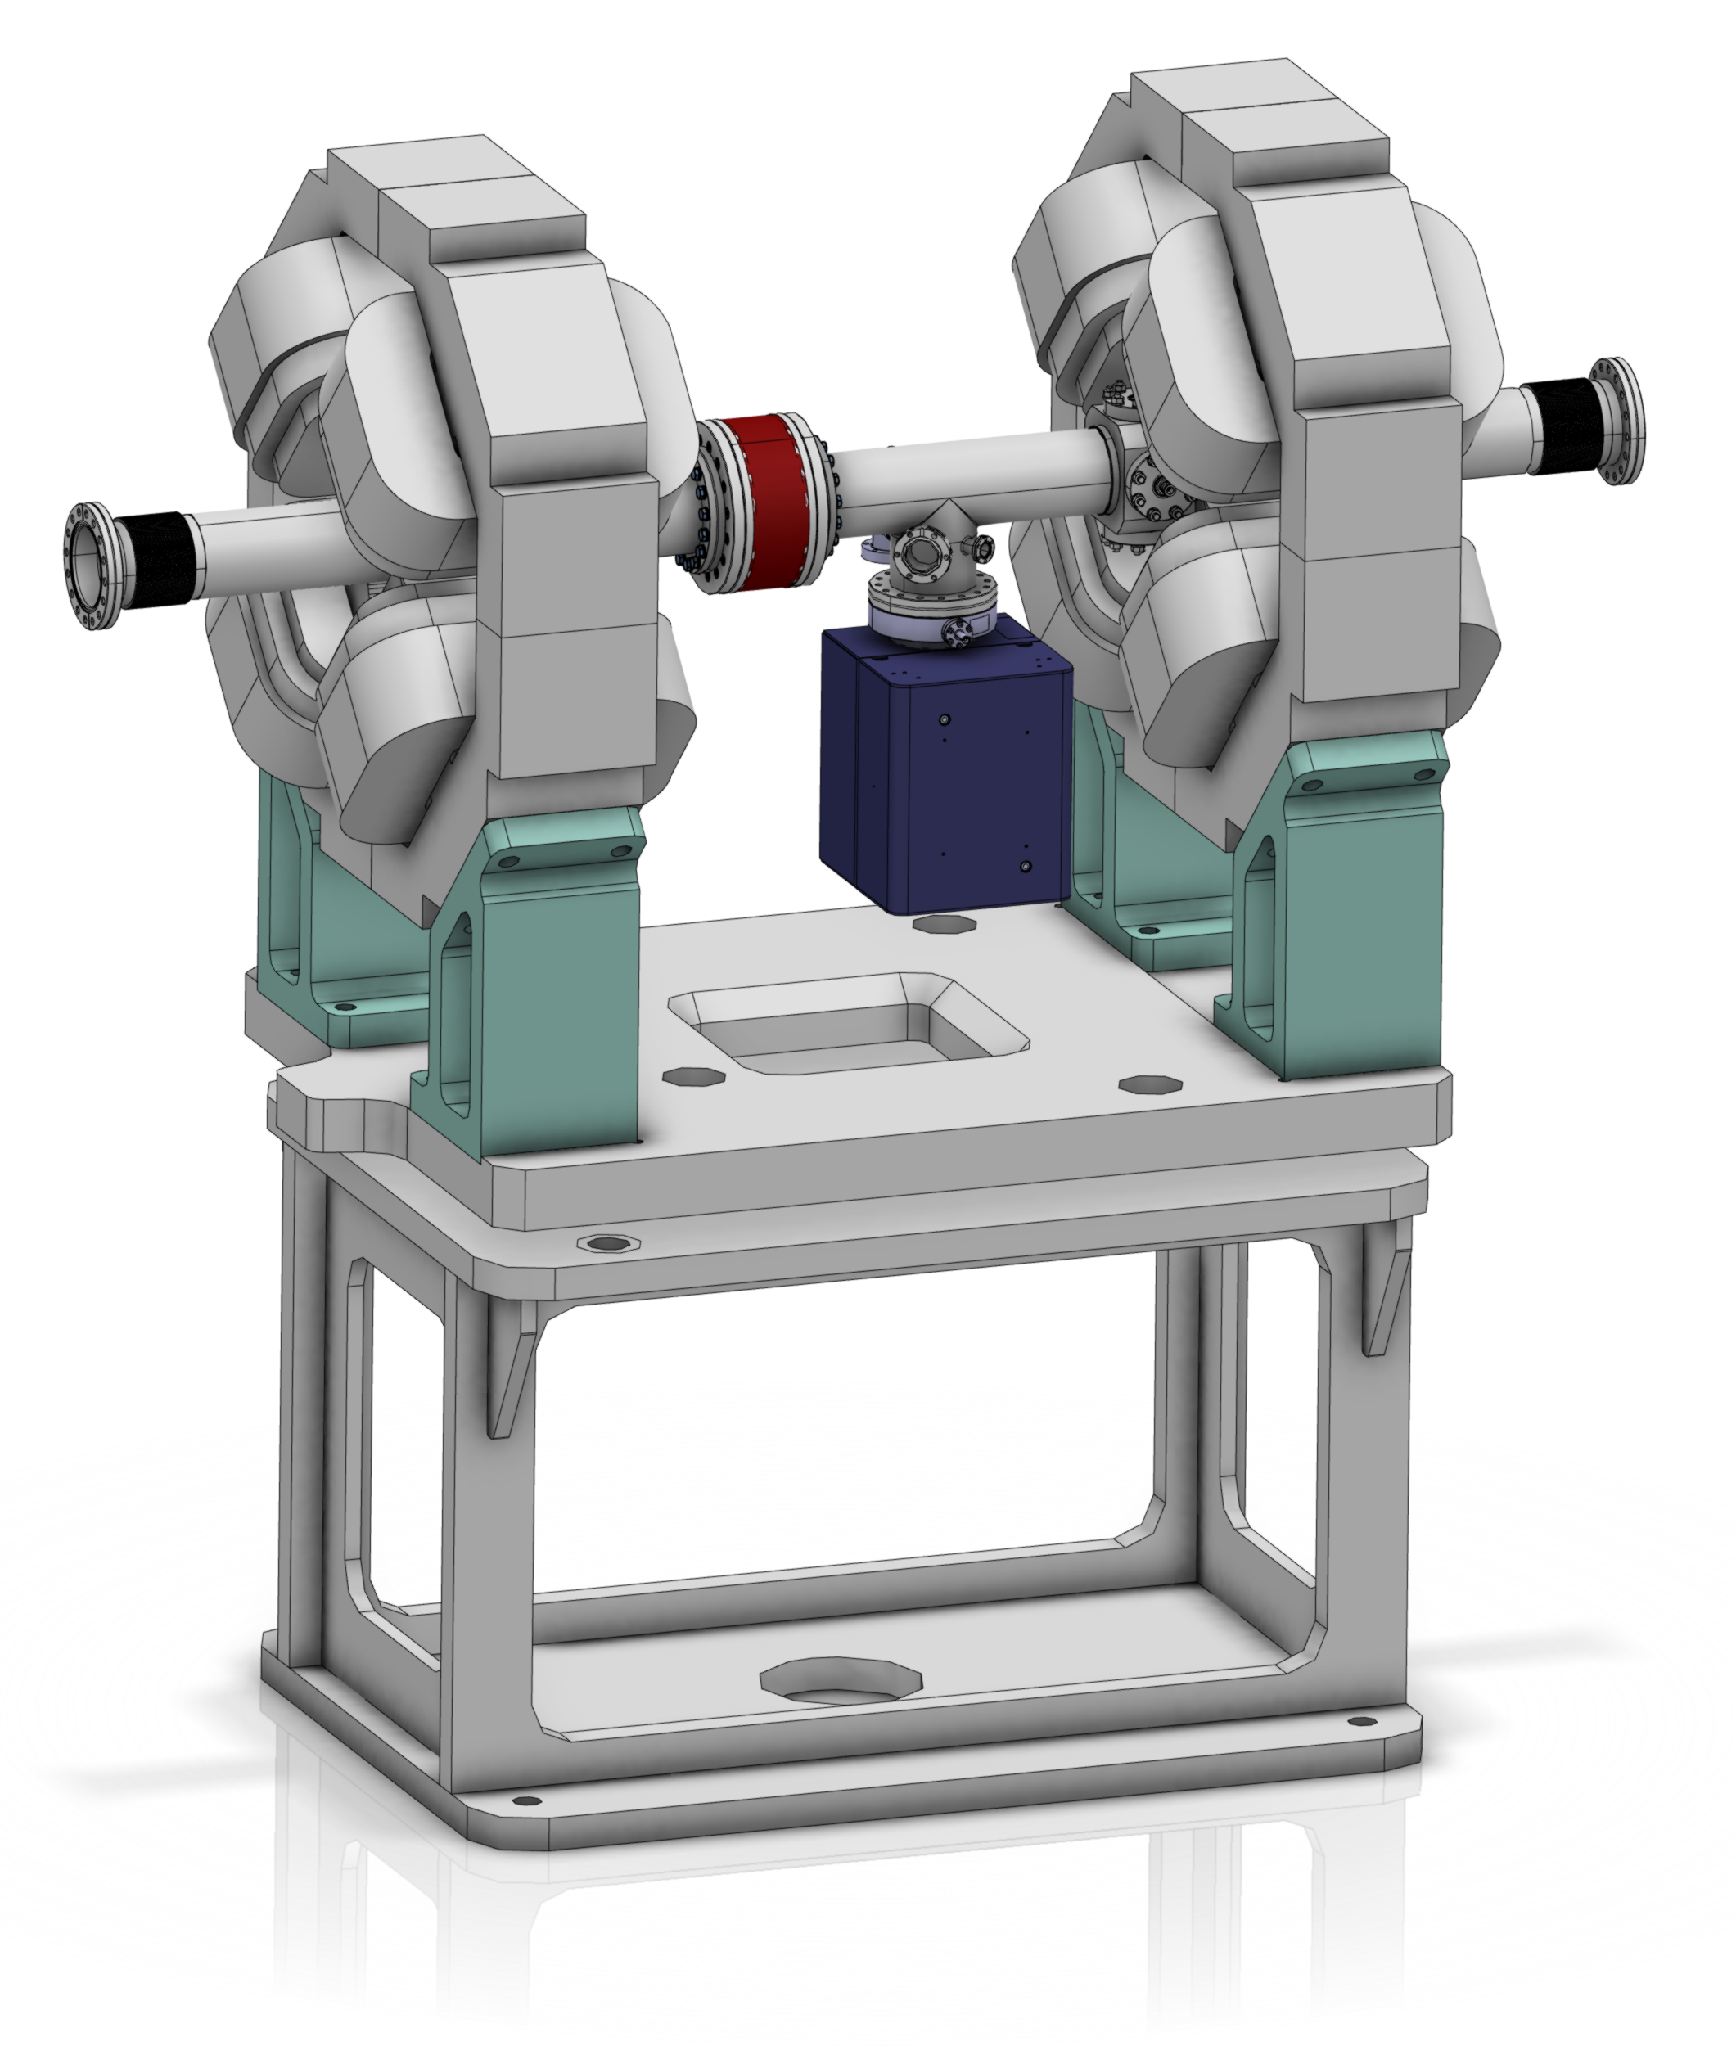
ACCT mechanical integration
Layout of the elliptical LWU including one in-flange ACCT sensor
Layout of the RFQ end flange including one “in-air” toroid.

Slide 15
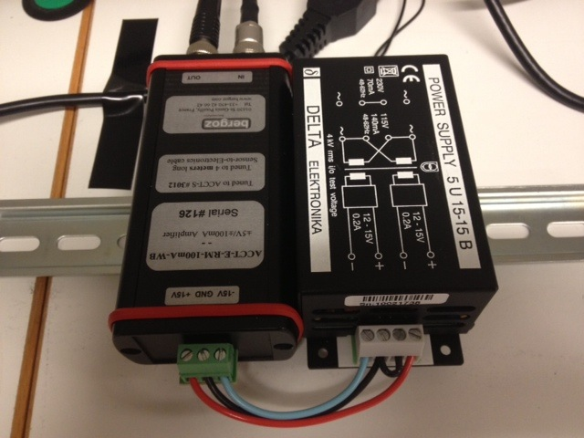
Bergoz front-end electronics
The Bergoz front-end unit (i.e. ACCT-E-RM) converts the ACCT output current into a proportional voltage with a full-scale range of +/-10 V.
It is important to connect the ACCT-E-RM output to high impedance.
The ACCT-E-RM is supplied by a Bergoz +/-15 V power supply.
Both the ACCT-E-RM and power supply are rail mount
The front-end electronics should be installed in a small wall-mount box in the klystron gallery at the head of the RF stub.

Slide 16
Drv/Cal module
The ACCT-E-RM output is fed into the Drv/Cal module that should sit next to the ACCT-E-RM and supplied by the same power supply.
The Drv/Cal module will then convert the single-ended output of the ACCT-E-RM to differential and feed this signal into a CAT-8A cable that is terminated in 100 Ohm at both ends.
The Drv/Cal module will also generate a calibration current pulse out of the digital calibration pulse from the ACCT RTM. The Drv/Cal module will then convert this pulse to have a fixed amplitude of 50 mA and feeds it into the ACCT calibration winding.
The Drv/Cal module will be a new development. Circuit schematics has been received form M. Werner (DESY) based on an ESS-DESY MoU and technical annex.
Preliminary discussions have started with the Polish institutes for prototyping and fabrication of the Drv/Cal module as Polish IKC.

Slide 17
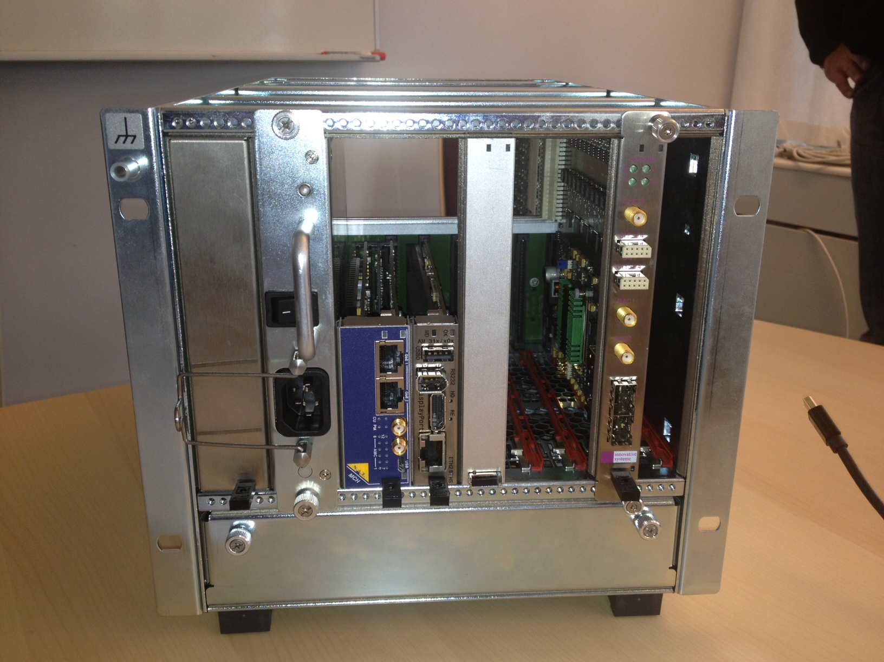
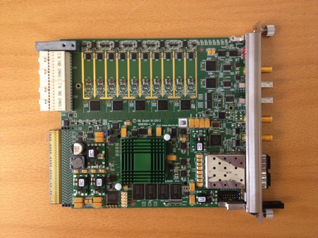
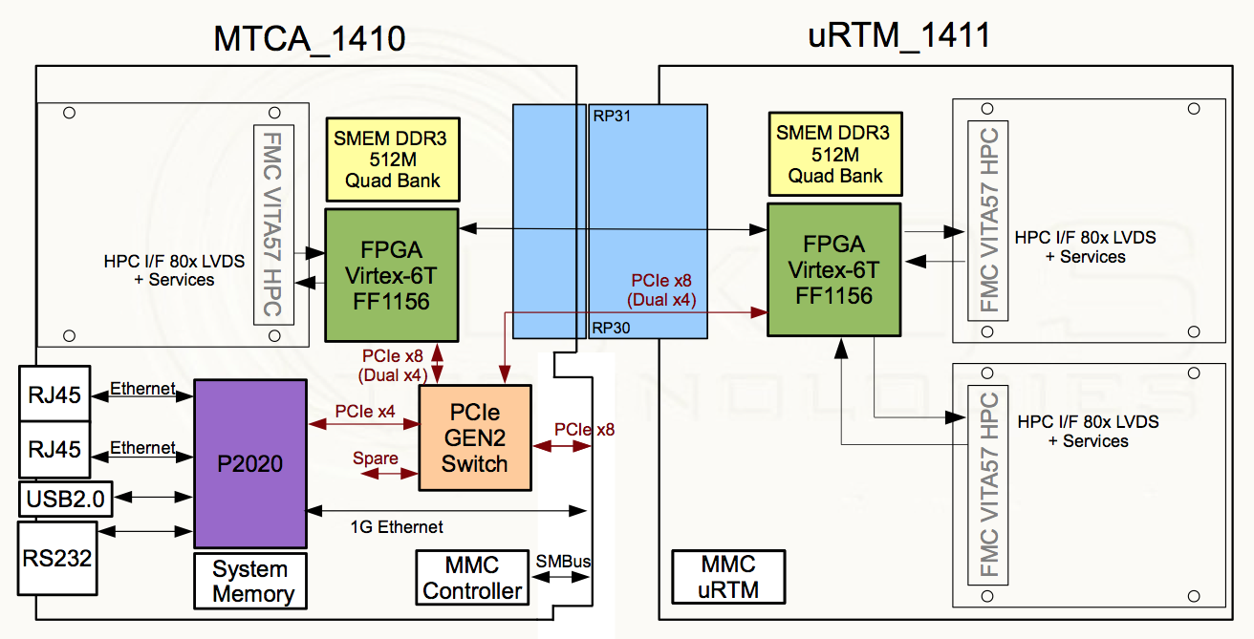
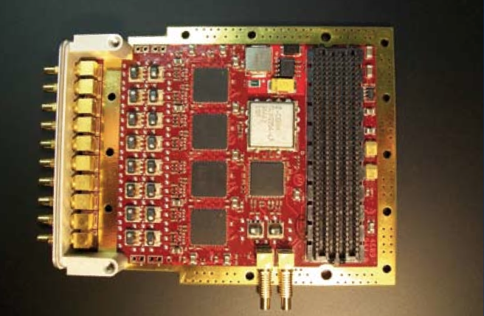
AMC/RTM
Solution A – Struck (or similar) digitizer/FPGA AMC to be paired with a custom ACCT RTM:
MTCA.4 demo crate with a Struck digitizer and RTM
+ custom ACCT RTM
Advantages of Solution A:
Includes ACCT calibration
Diff. drivers fits well with the receiver
In-house RTM knowledge
Already-existing, tested and verified AMC
Solution B – IOxOS (or similar) FMC-carrier AMC with a COTS differential receiver FMC:
+

Slide 18
Struck SIS8300-L specifications
Ten 16-bit/125 MSPS ADC input channels
4x4 Gbit (default) DDR3 memory
Two Gigabit transmitter/receiver SFP slots
Two dedicated user clock inputs (TCLKA and TCLKB)
8 bidirectional differential interfaces to the backplane bus
Virtex 6 FPGA

Slide 19
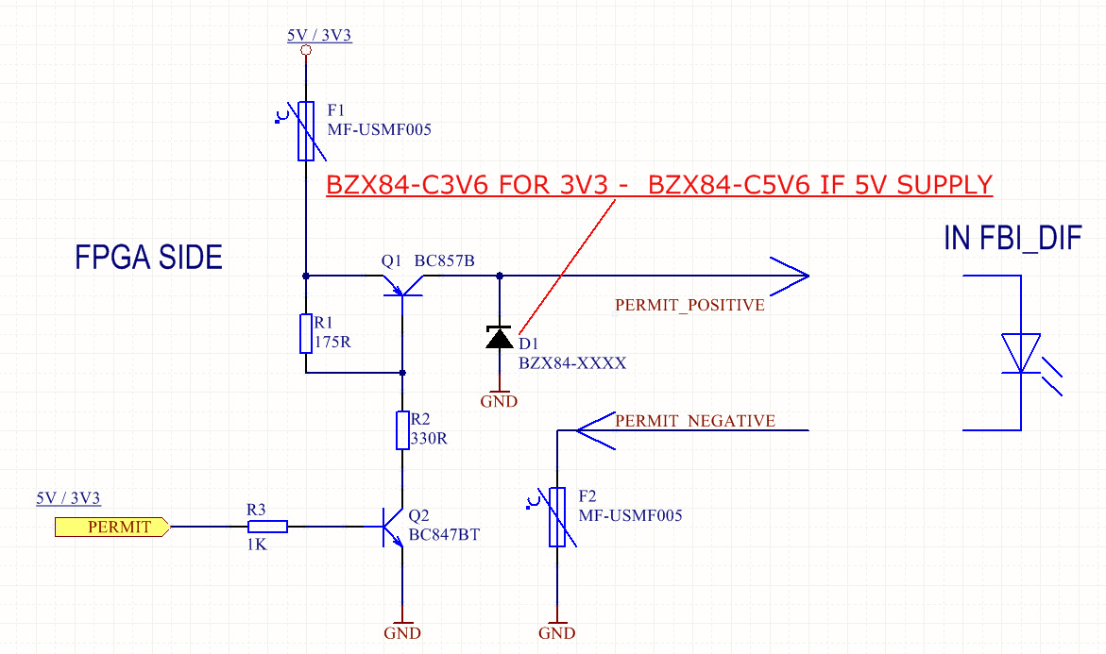
BIS interface
Based on the ESS MPS requirements, the BIS interface should consist of a beam_permit interface that is driven by the ACCT FPGA and a permit_test interface driven by the BIS.
With the ACCT RTM option, both the both beam_permit and permit_test interface circuits will be implemented on the RTM.
There will be one or two (for redundancy) of these interfaces on the ACCT RTM. Aggregation will then be done at firmware level.
With the FMC option, the interface circuits should be replaced by another FMC with similar electrical specifications (details TBD).
circuit schematics of the beam_permit and permit_test interfaces (source: ESS MPS group)

Slide 20
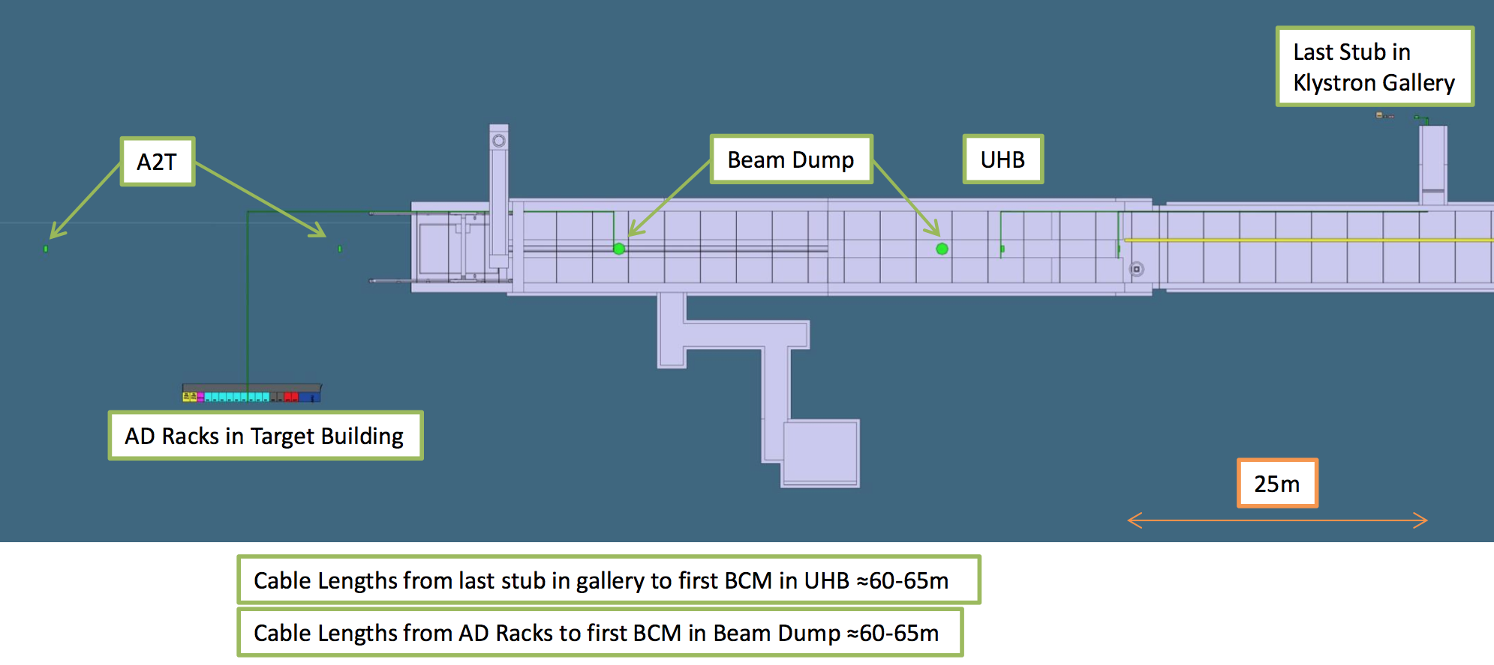
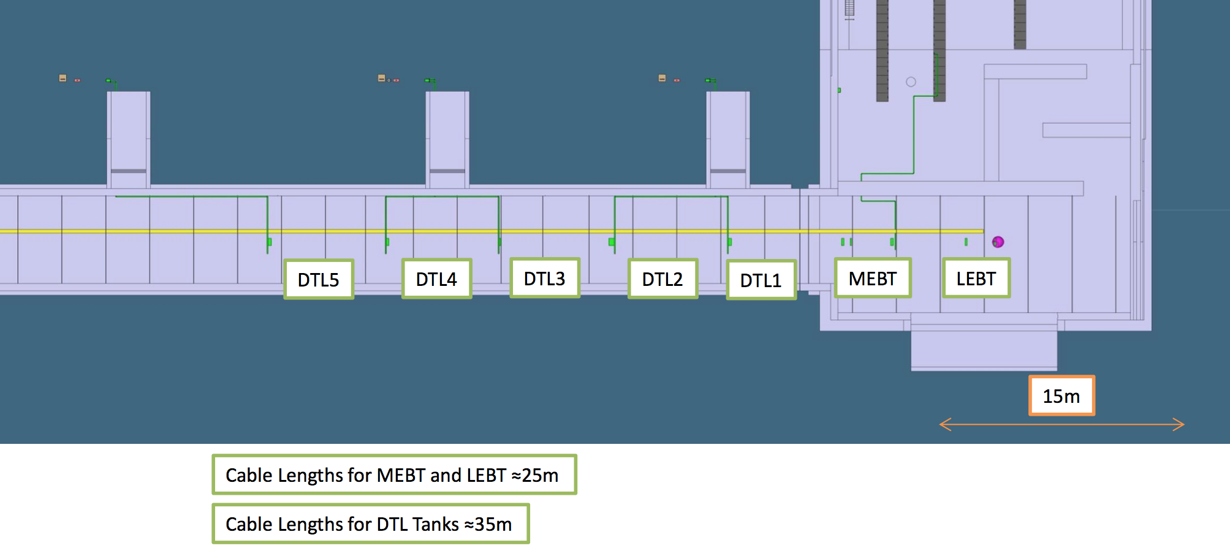
ACCT cabling
Based on the Bergoz ACCT specifications, the ACCT-to-FE cable length should not be longer than 25 m. In areas where this will not be possible, the FE electronics can be slightly modified by the manufacturer to allow longer cable lengths at the expense of degrading the ACCT response time, rise time and bandwidth to some degree.
The ACCT-FE cable length is expected to be about 25 m in the LEBT and MEBT sections. The length then increases to about 35 m in the DTL and 60-65 m in the high-energy end of the linac.
We need to talk to Bergoz to see how much the ACCT response will become slower as a result of the increased cable length.

Slide 21
Timing requirements for the electronics
Trigger/consistency check:
Although the ACCT firmware will include a self-trigger mechanism that will trigger on the edge of the beam pulse, an external trigger will still be needed for the purpose of consistency check. The beam can then be stopped if the frequency of the trigger is not within the acceptable range, or if a beam pulse does not arrive shortly after each trigger.
Beam/machine mode data:
The beam/machine mode data need to be transferred to the ACCT readout electronics using the timing system. The ACCT readout electronics will know the expected pulse current/width from the beam mode and the expected beam destination from the machine mode. This information will then be used to correctly configure the electronics including the width of the averaging filters and the masking/unmasking of some interlocks.
ADC clock:
Although this is not strictly required, it is generally preferred that the ADC clock frequency be locked to RF. An external ADC clock of 88.0525 MHz (¼ of the 352.21 MHz RF frequency) can be provided by the timing receiver module and transferred to the ACCT AMC through a dedicated clock line of backplane.

Slide 22
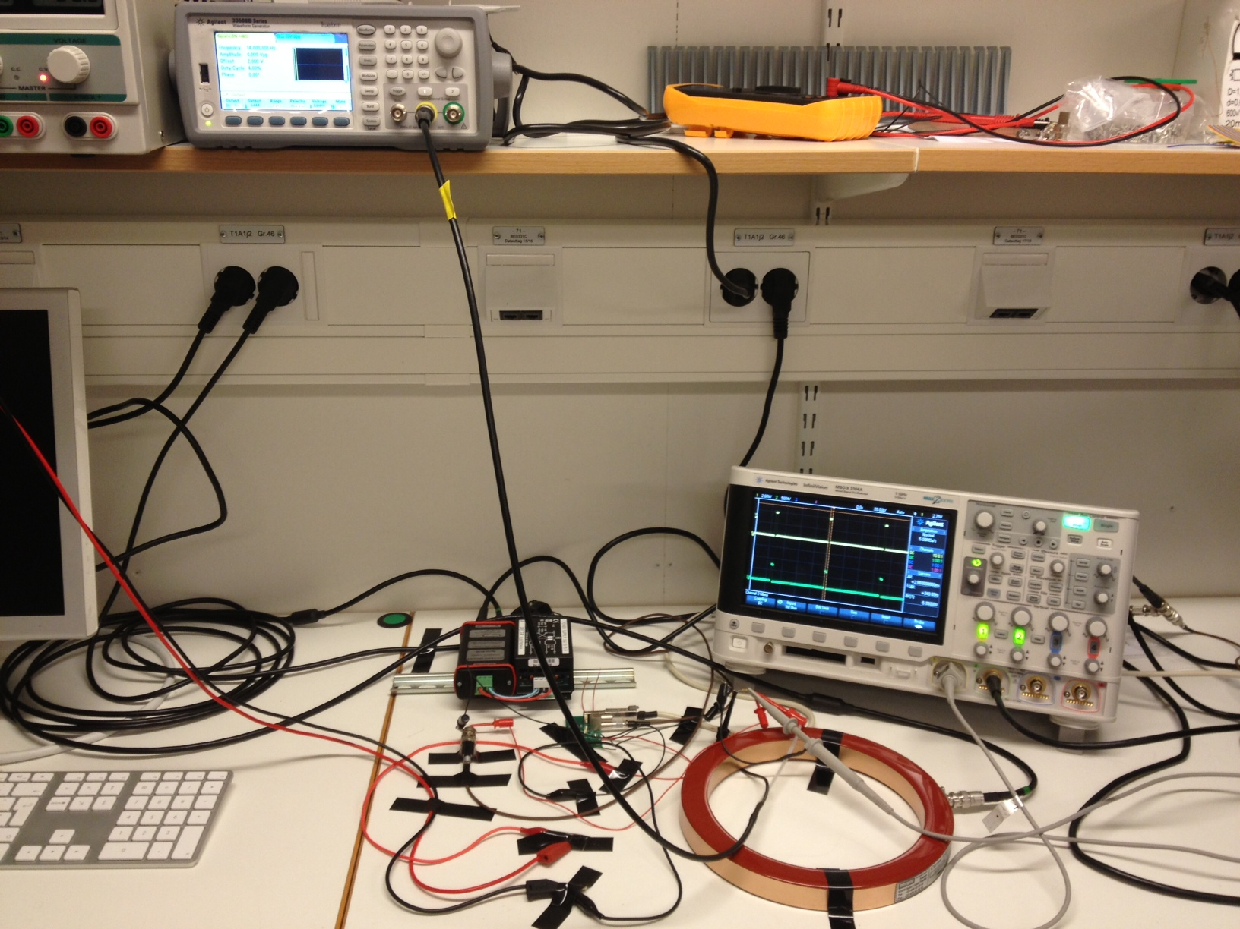
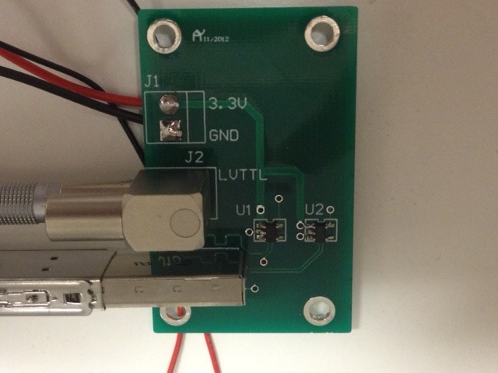
ACCT prototyping at ESS
MTCA.4 demo crate hosting a Struck digitizer card and RTM
ACCT test setup with a Bergoz toroid
TTL – LVDS converter board
(trigger input for the digitizer)

