Slide 1
Machine Protection Requirements and Concept
Annika Nordt et al.
European Spallation Source ERIC
Machine Protection Review, December 2015
Lund, Sweden

Slide 2
Overview
Transition from previous talks to this one
Damage Potential of the Proton Beam at ESS
Machine Protection Goals
Machine Protection General Requirements
Machine Protection SoS Architectural Framework
Summary

Slide 3
Transition from Previous Talks to This One
So far we heard that:
A lot of equipment is built by in-kind partners,
Installation of accelerator equipment will start end of 2017,
First beam tests (front end) start right after that,
Hardly time for “cold” commissioning (without beam),
Ongoing commissioning and further installation during 2018 and 2019,
Ramp up to 680 MeV in a staged approach & be done by June 2019,
In short: Time allocated to commissioning is quite restricted,
But, the damage potential of the proton beam is higher in the lower energy part (warm linac) than in the cold linac,
Its enough to overlook 1 vacuum valve! → 1 closed valve + inject beam→ we start melting in a few μs!→ would cause delay of project.

Slide 4
Damage Potential of the Proton Beam I
Assuming worst case scenario:
Proton beam impinging perpendicularly on copper or steel (3mm beam size).
https://ess-ics.atlassian.net/wiki/download/attachments/60031539/Time_Response_Requirements_BLM.pdf?version=1&modificationDate=1449271471425&api=v2
Fastest reaction time required to stop proton beam is 4-5μs (within the first 50m).
This includes detecting, processing and actual stopping of the proton beam.
It’s a challenging task, requiring fast systems!

Slide 5
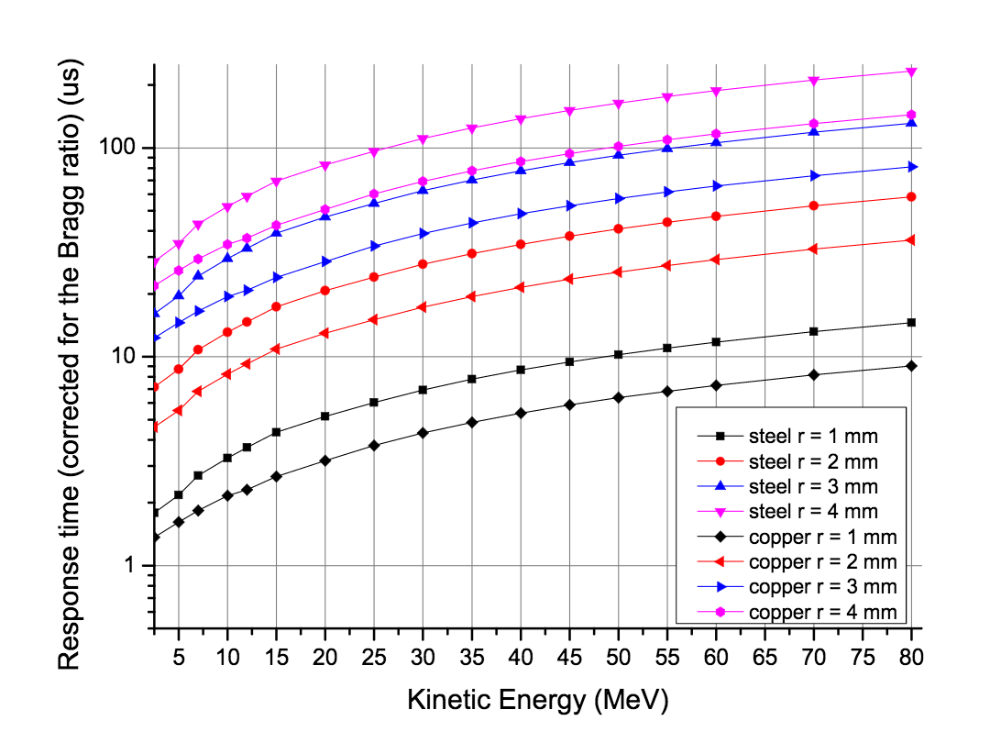
Damage Potential of the Proton Beam II
But…Can it be worse?? → YES !
Assuming 1 mm beam size, then melting starts in 1 μs
Basically no “active” protection possible, thus we must rely on other “passive” ways to protect, and that is:
A well orchestrated way of implementing machine protection relevant systems!

Slide 6
Machine Protection Goals
Machine protection shall, in that order, prevent and mitigate damage to the machine, be it beam-induced or from any other source, in accordance with beam and facility related availability requirements.
Machine protection shall protect the machine from unnecessary beam-induced activation having a potential to cause long-term damage to the machine or increase maintenance times, in accordance with beam and facility related availability requirements.

Slide 7
Machine Protection General Requirements I
Machine protection shall:
detect all off-nominal states that can lead to relevant damage to the machine.
take all the necessary actions needed to, in that order, prevent and mitigate damage in case of detection of a relevant off-nominal state, including switching-off of the proton beam.
detect all off-nominal states that can lead to relevant unwanted beam-induced activation.
take all the necessary actions needed to, in that order, prevent and mitigate unwanted beam-induced activation in case of detection of a relevant off-nominal state, including switching-off of the proton beam.

Slide 8
Machine Protection General Requirements II
Machine protection functions shall be implemented:
with timing and protection integrity levels in accordance with damage risk reduction requirements.
such that the probability of spurious trips is reduced in accordance with availability and damage risk reduction requirements.

Slide 9
Machine Protection General Requirements III
Machine protection shall:
transmit all necessary information to the responsible staff allowing them to take adequate actions to resume facility operation within a minimum amount of time.
record all information about detected off-nominal states and performed prevention and mitigation actions to allow for a-posteriori event reconstruction and analysis.
support operation during all foreseen lifecycle phases of the machine, including, but not limited to assembly and installation, commissioning, tuning, operation, fault-finding, maintenance, and dismantling.

Slide 10
Machine Protection General Requirements IV
Machine protection shall support:
all foreseen operating modes of the machine, including but not limited to proton-beam up to intermediary targets, proton-beam with reduced beam power or alternative beam envelopes, and proton-beam with alternative duty cycles.
operation in case of degraded mode of operation of equipment under control, if required for reaching the availability goals and if compatible with damage risk reduction requirements.
operation in case of degraded protection functions, if required for reaching the availability goals, and still be compatible with damage risk reduction requirements.

Slide 11
Machine Protection SoS Architectural Framework
Machine Protection has been recognized to be a System-of-Systems (SoS).
It is composed of five classes of constituent systems:
Local MP-related systems located in the accelerator, the target station and the neutron science segment of the ESS facility,
MP-related proton beam monitoring systems,
Beam Interlock System,
MP-related beam switch-off actuation systems,
MP management systems.

Slide 12
Local MP Related Systems I
The local MP-related systems located in the accelerator, target station and neutron science segments of ESS implement the needed local protection functions to:
keep the local system protected from non-beam-induced damage,
prevent beam from being switched on/injected to the linac or sent to the target if the local system is not ready to support beam operation,
If a local damage risk gets detected, these local protection functions will result in a locally protected state for the affected system,
If such an action has a potential to negatively influence the state of the proton beam, the local protection functions additionally trigger a switch-off of the proton beam.

Slide 13
Local MP Related Systems II
If the local system is not ready to support beam production, the local protection functions will not permit beam.
If other systems depends on the operation, then necessary actions will need to be taken to prevent damage to that other system.
MP-related systems will implement a:
LOCAL-PERMIT: state variable that is internal to the system and represents whether it is correctly functioning or an off-nominal state has been detected.
BEAM-PERMIT: communicated to the Beam Interlock System and tells whether the system is in a state where beam production is safe.

Slide 14
Proton Beam Monitoring Systems
MP related Proton Beam Monitoring Systems:
The MP-related proton-beam monitoring systems detect any off-nominal states of the proton beam itself that might cause damage to or unnecessary activation of any equipment.
The corresponding protection functions will trigger a switch-off of the proton beam by means of a BEAM-PERMIT signal transmitted to the Beam Interlock System.
Beam Instrument Protection Systems:
detect off-nominal states that might lead to damage to the beam instrumentation itself,
detect states where the monitoring systems are not ready for beam

Slide 15
Beam Interlock System
The Beam Interlock System evaluates the BEAM-PERMIT signals from all local MP-related systems and MP-related proton-beam monitoring systems.
If required, the Beam Interlock System initiates the switch-off of the beam by triggering a set of MP-related beam switch-off actuation systems in a specific sequence, allowing for a painless recovery to normal operation.
The BIS will verify the correct reaction of the actuation systems and, in case beam is not switched-off, an emergency sequence disregarding any recovery requirements will be triggered.
After an interlock, beam production will only be allowed to resume once all BEAM-PERMIT input signals are in the expected state and all affected MP-related systems as well as the Beam Interlock System have been actively reset.

Slide 16
Actuators
Timing System: Beam Pulse inhibit
Proton pulse generation is controlled by the Timing System. Preventing the timing system from generating the events leading to a proton beam pulse would prevent proton beam from being injected and accelerated.
Proton Source Switch-Off “Soft”:
Prevent the proton source from injecting protons into the Linac (remove the RF signal from the magnetron) [100 μs until no plasma is created].
Proton Source Switch-Off “Hard”:
Switch off the HV power to the proton supply using redundant contactors to prevent protons from being injected into the Linac [~500 ms].
LEBT Chopper Activation:
Activate the LEBT Chopper to deflect the beam onto the LEBT dump [300]
MEBT Chopper Activation:
Activate the MEBT Chopper to deflect the beam onto the MEBT dump [10 ns].

Slide 17
Further Requirements
MP Event Logging and Diagnostics System
collects logged data from all MP-SoS constituent systems and provides means to perform automated of manual event analysis for diagnostic purposes. As the ESS operating procedures might require an operator to acknowledge the event analysis result before beam injection is allowed to proceed, the performance of this system might have a large impact on beam availability.
MP Operating Mode Configuration System
sets and reads configuration data to and from all MP-SoS constituent systems.
MP Status and Configuration Monitoring System
performs online monitoring of the status and configuration of all MP-related systems. Configuration data include: the current operating mode, hard-, firm- and software identifiers.
can request to switch the beam off in case it detects a problem.

Slide 18
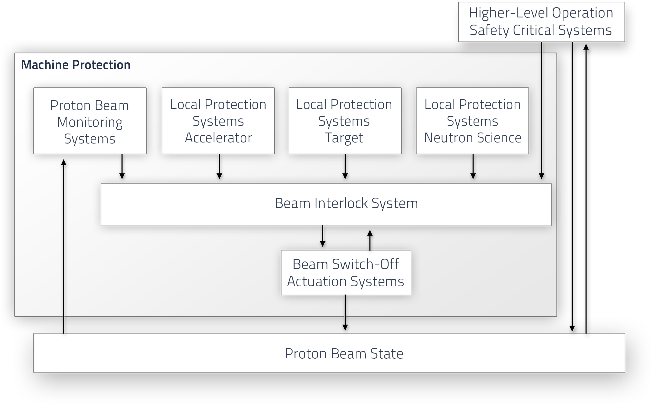
Functional MP Architecture Concept

Slide 19
Functional Review of MP
During this first day of the review we will try to walk you through this concept!
There will be presentations related to the:
Proton Beam Monitoring Systems (e.g. Beam Current Monitors, Beam Loss Monitors)
Local MP Related Systems or Local Protection Systems (e.g. RF, Magnets, Interceptive devices)
Actuator Systems (Proton Source, LEBT chopper)
Please note:
This review is NOT about those systems! And it does not cover all LPS, all actuator systems, etc.
This first part of the review is about the concept of Machine Protection.

Slide 20
Summary
The challenge is not only to build a Beam Interlock System
that is fast, reliable and highly available,
but also to make sure all MP relevant systems connected to the BIS provide sufficient protection integrity.
Completeness and traceability of requirements as well as
standardized documentation of all systems relevant for Machine Protection is very important (and hard to achieve without awareness of the consequences).

Slide 21
BackUp Slides

Slide 22
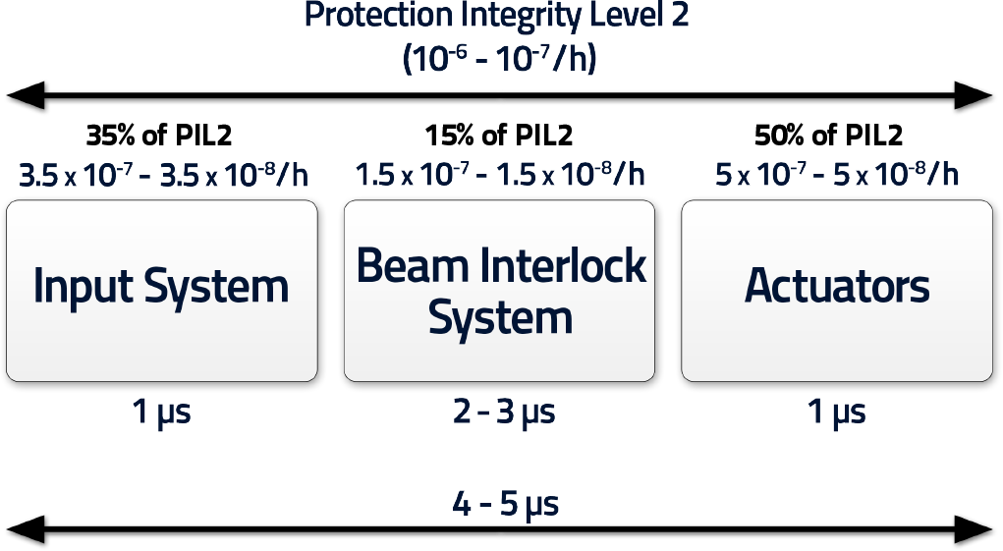
Example of a Protection Function
Based on preliminary risk analysis (IEC61508, IEC61511)
These are the most stringent requirements in terms of response time and PIL level.

Slide 23
Governance of Machine Protection
Machine Protection Committee: Take on responsibility and take decisions
MPC domain/
responsibilities:
Approval of concept, overall scope,
Coordination of hazard risk analysis,
Approval of overall machine protection requirements,
Coordination of machine protection requirements allocation.
(Corresponding to analysis part of IEC61508)
Operations
Accelerator
Controls
Target
CF
NSS
PSS
TSS
- Requirements on work procedures, checklists, training for personnel
…
- Provide systems suitable for allocated machine protection functions
….
- Provide systems suitable for allocated machine protection functions,
- Provide systems suitable for machine protection functions,
XY,……
XY,……
Provide run permit signal according to MP interface specification
Provide run permit signal according to MP interface specification
Stakeholder
Requirements
- Requirements for Proton Source
- Requirements for LEBT chopper
- ….
- Beam Interlock System
- ….
Specification of signal, cable, connector type
Specification of signal, cable, connector type
System
Requirements

