Slide 1
Local Protection Systems: Magnets and Interceptice Devices interlocks
Manuel Zaera-Sanz
ICS/Machine Protection Systems – Slow Interlocks
www.europeanspallationsource.se
6 December 2015

Slide 2
Table of contents
Introduction
Mission statement
Protection Functions
Our proposal of LPS for Magnet Powering
Our proposal of LPS for Interceptive Devices
Conclusions
Further work

Slide 3
1. Introduction
Machine Protection shall provide global protection of the ESS machine
Base document: “Preliminary hazard analysis of the ESS Machine Protection System with emphasis on production and property losses in the ESS-LINAC”
Identification of protection functions, PIL and response time
Additional protection functions defined during meetings with the relevant experts
Several Local Protection Systems are needed for e.g. Magnets, Target, Vacuum, interceptive devices (collimators, FCs, wire scanners,…)
Slow Local Protection Systems => PLC based
High availability requirements for ESS must be fulfilled

Slide 4
2. Mission statement
(Slow) Local Protection System for Magnet Powering:
“ To protect equipment (investment) in case of a failure in the cooling or powering systems, taking the appropriate action to minimize risk for damage and time for recovery”
(Slow) Local Protection System for Interceptive Devices:
“To protect equipment (investment) in case of wrong machine configuration, preventing damage to the devices, pollution in the LINAC or even destruction of cavities in case of e.g. a wire that is destroyed due to too high beam power”
How?
- Using PLC technology: safety and/or standard due to the low response time required
- Critical protection functions: require hardwired signals (current loops)

Slide 5
3. Protection Functions
LPS for Magnet Powering Interlocks:
Loss of power supply: misaligned beam (dipole), PIL3
Loss of water cooling: magnets overheating, PIL2
Malfunction of power supply: misaligned beam (dipole), PIL3
Malfunction of local sensors (temperature, flow switch), PIL1-2
Malfunctions of the LPS-MPI itself: SW, HW, parameterization, PIL3
LPS for Interceptive Devices Interlocks:
Pulse “too long” and an interceptive device is IN, PIL2-3
Full beam power and interceptive device is IN, PIL3
Malfunction of the interceptive device position sensor, PIL3
Malfunction of the interceptive device itself, PIL2
Malfunction of the LPS-IDI itself: SW, HW, parameterization, PIL3

Slide 6
4. Our proposal of LPS for magnet powering
ESS magnets and power supplies (approx):
Description | Magnet op. mode | Magnet cooling | #Magnets | #Power Supplies
Ion Source solenoid coils | DC | Water | 3 | 3
LEBT solenoid | DC | Water | 2 | 2
MEBT quadrupole | DC | Water | 10 | 10
DTL PMQ (50mm AND 80mm) | Permanent | Water | 89 | 0
DTL single-plane corrector | DC | Water | 30 | 30
Spoke LWU quadrupole | Pulsed | Air | 26 | 26
Spoke LWU dual-plane corr. | DC | Air | 13 | 26
Elliptical LWU quad | Pulsed | Air | 95 | 95
Elliptical LWU dual-plane corr. | DC | Air | 55 | 110
Dogleg quad | Pulsed | Air | 12 | 12
Dipole | DC | Water | 2 | 1
A2T dual-plane corrector | DC | Air | 4 | 8
A2T quad | DC | Water | 6 | 6
Raster | Pulsed | Air | 8 | 8
TOTAL | 125 DC 141 Pulsed 89 Permanent | 142 Water 213 Air | 355 | 337
DTL PMQ do NOT require power converter Dogleg dipoles are powered by a single power converter (not decided yet)
A2T dual-plane correctors are powered by two power converters
All other magnets are powered by a single power converter
Courtesy from Edgar Sargsyan and Carlos Martins

Slide 7
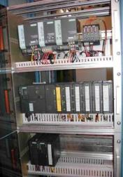
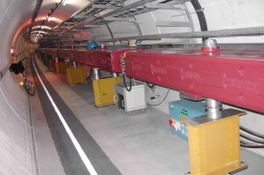
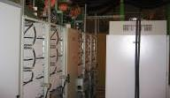
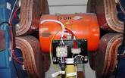
Our proposal of LPS for magnet powering
Use same principle that is currently used at CERN for warm magnets interlocks
Power Converter
Warm magnet
Interlock
Controller
Status info
Power Permit
Several thermo-switches @ 60°C
Thermoswitches
Water Flow
Red button…
Magnet 1
Magnet 2
Courtesy from Pierre Dahlen(CERN)

Slide 8
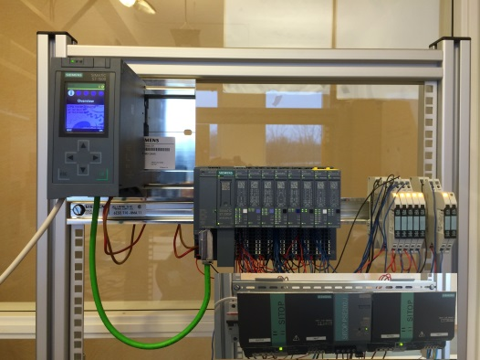
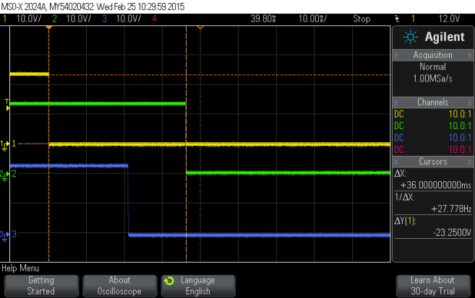
Our proposal of LPS for magnet powering
HW signals between LPS for Magnets Powering – Slow Beam Interlock
magnets/flow status
Essential/Auxiliary
circuits signals
LPS for Magnet Powering
Slow Beam Interlock
Beam Permit
Stop Beam
Powering Permit/Abort
Powering Failure
Power Converter

Slide 9
5. Our proposal of LPS for interceptive devices
ESS interceptive devices (approx)
 | Faraday Cups | Allison Scanners | Wire Scanners | Slit & Grid | LBM | Vacuum gate valves | TOTAL
LEBT | 1 | 2 |  |  |  | 2 | 5
RFQ |  |  |  |  |  | 1 | 1
MEBT | 1 |  | 3 | 2 | 1 |  | 7
DTL | 2 |  |  |  |  | 5 | 7
Spokes | 2(BS) |  | 3 |  | 1 | 26 | 32
Medium Beta | 1(BS) |  | 3 |  | 1 | 18 | 23
High Beta |  |  | 1 |  |  | 42 | 43
HEBT |  |  | 3 (fast wire) |  | 1 | 12 | 16
A2T |  |  | 1 |  |  | 4 | 5
TOTAL | 7 | 2 | 14 | 2 | 4 | 110 | 139
Courtesy from B. Cheymol, I. Kittelmann, H. Spoelstra, M. Eshraqi and E. Laface

Slide 10
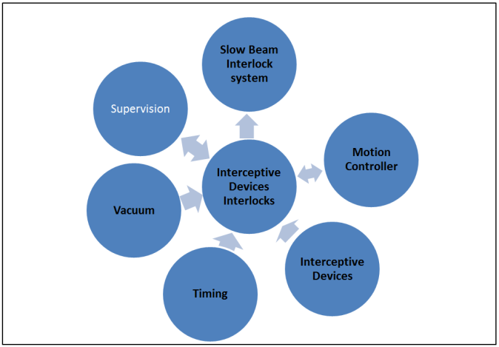
Our proposal of LPS for interceptive devices
Relationship between the Local Protection System for Interceptive devices and other systems

Slide 11
Our proposal of LPS for interceptive devices
States Machine

Slide 12
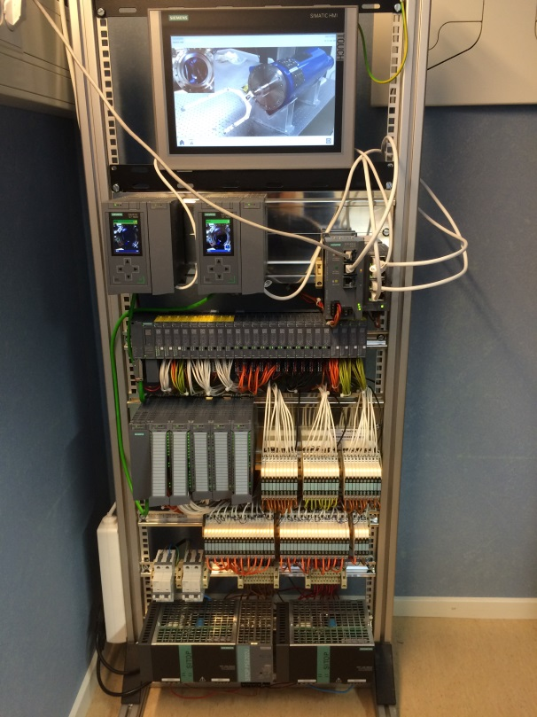
Our proposal of LPS for interceptive devices
Full Power Interlocks
Prototype

Slide 13
6. Conclusions
Our proposal for Local Protection Systems is
Simple
Mostly hardware based (use of current loops 15 to 20mA)
Current loops mechanism works well (proof of concept from other facilities)
These architectures fulfill the protection functions requirements
These architectures fulfill the mission statements
Our solution provides the needed flexibility
Increases the availability requirements for ESS LINAC

Slide 14
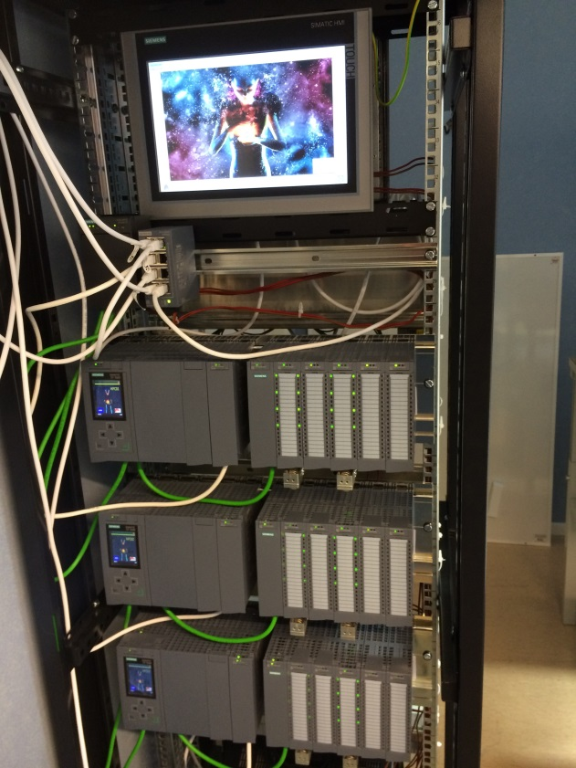
7. Further work
Continue prototyping, programming and measuring response times of our local protection systems
Start developing the local protection system for the Target as soon as the protection functions are defined, with potential use of ITER RT-CIS (currently under development) as base architecture of our Target Local Protection system
Possible presentation of the main results in our third PLC workshop at CERN in Feb 2016

Slide 15
THANK YOU !!!

