Slide 1
Non-invasive Profile Monitors for the ESS Linac
Cyrille Thomas (ESS)
Jacques Marroncle (CEA)
www.europeanspallationsource.se
10th February 2016

Slide 2
ESS Linac and NPMs
BIF
IPM
BIF
NPM:
Transverse profile measurement up to full power
Tuning and operation diagnostic
Commissioning tool: profile and measured size for matching beam and lattice parameters to the model predicted nominal values, emittance measurement and measure emittance growth
Operation: monitor beam nominal parameters
Performance:
Profile measurement per pulse (14Hz)
Intra-pulse measurement bonus (highly desired)
Baseline:
BIF: 1st choice, everywhere it is possible
IPM: where BIF cannot deliver expected performance

Slide 3
BIF
IPM
Residual gas – beam interaction: fluorescence
Residual gas – beam interaction: ionisation
Imaging system
Profile readout system
Beam long. axis
Beam long. axis
Beam trans. axis
Beam trans. axis
E (V/m)
Transverse beam profile

Slide 4
BIF: Design Studies
Source: selection of the gas specie(s), and spectral bandwidth
COSY experiment and collaboration
Radio-spectrometry of gas-proton interaction: measure of cross sections and fluorescence yields over UV-Vis-IR
Readout profile: selection of the imaging system
Design of the optical system
Selection of the single photon counting 1D/2D electronics
PMT array, EMCCD camera, Intensified camera, etc.
Coupling to fibre bundle for image transportation to camera
Design calibration: monitor degradation
Radiation environment:
Analysis of the perturbation to the BIF
Maintenance plan
Lifetime of the system in operation
Can eliminate a initially favoured system
operation cost

Slide 5
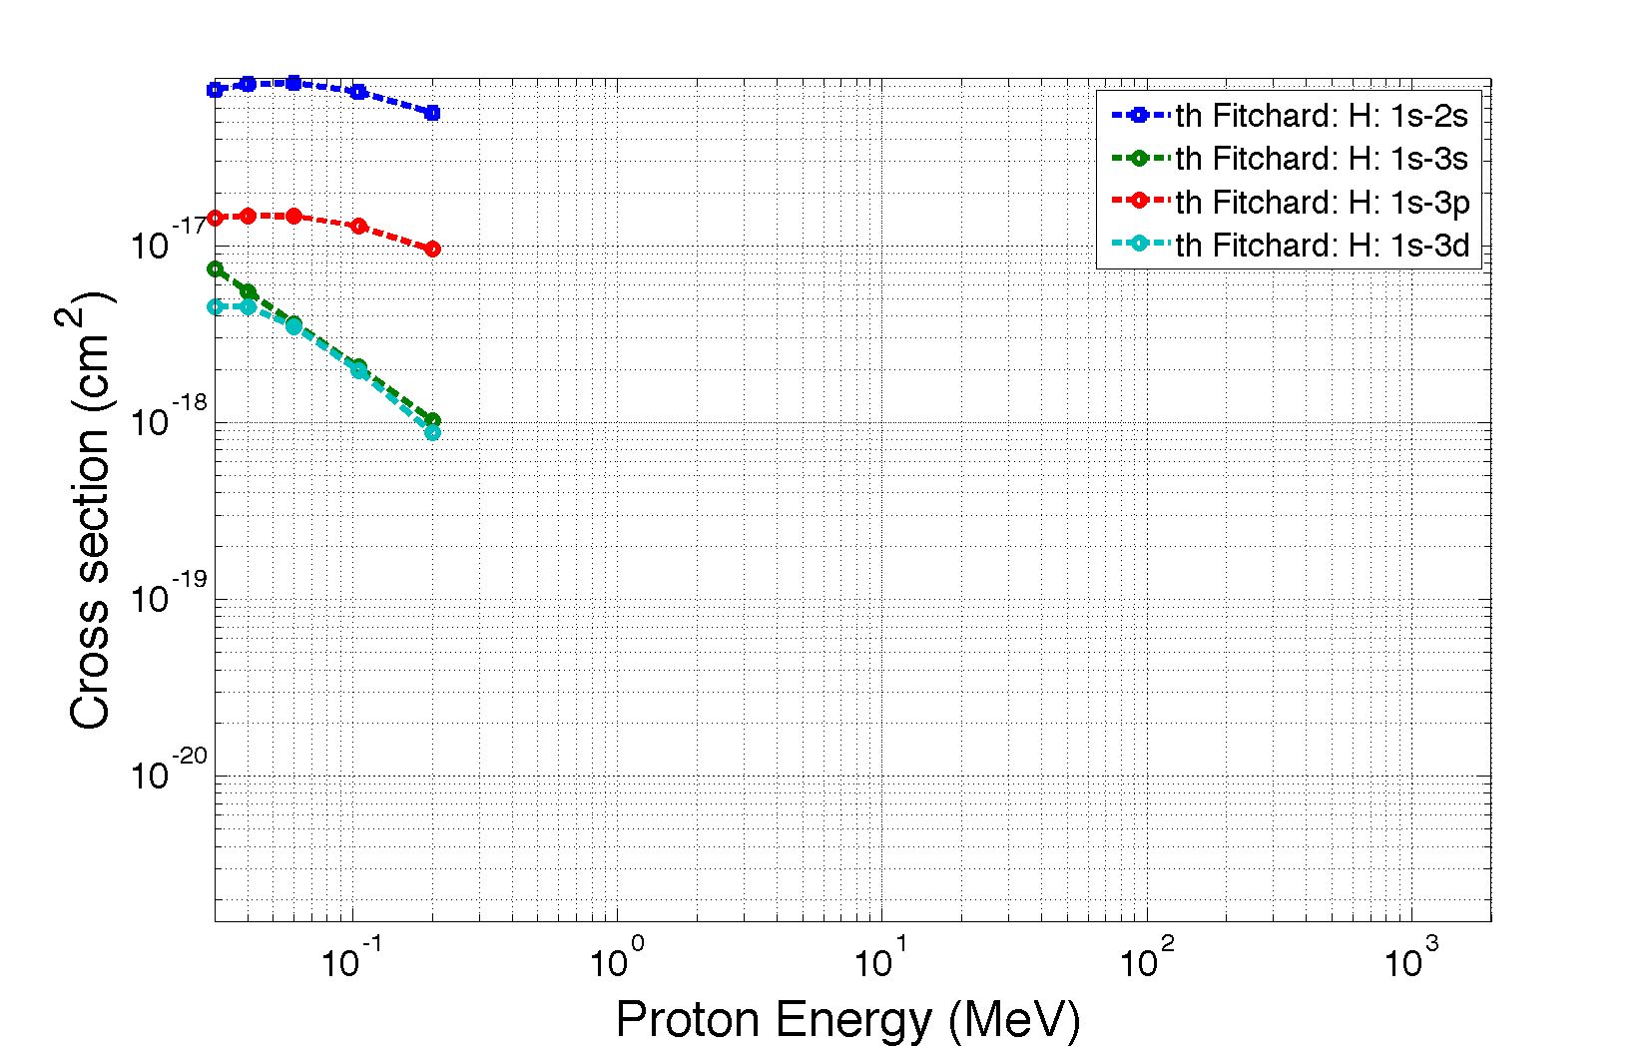
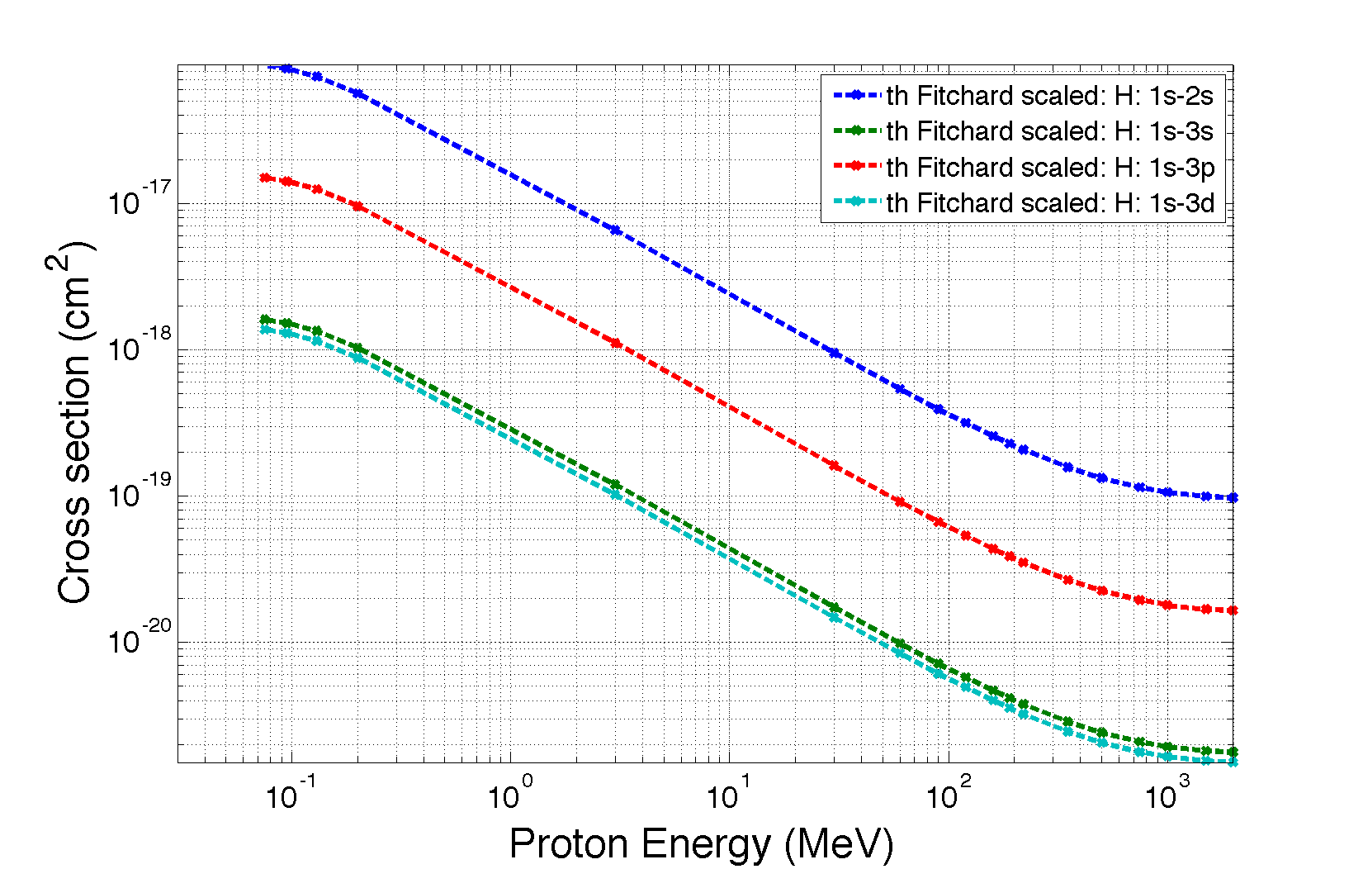
BIF: Source Studies
Case of hydrogen
P + H₂ -> P + H₂* + γ
∞
∞
4
4
3
3
2
2
Lyman: n to 1: λ=121nm to 91nm
Balmer: n to 2: λ=656nm to 364nm
n=1
n=1
Paschen: n to 3: λ=1875nm to 820nm
s
p
d
f
s
p
d
f

Slide 6
ESS gas composition
Typical gas composition for ESS Linac:
H₂ (~<80%)
CO (~10%)
CO₂ (~10%)
N₂ (~1%)
Other
Note: cross section: CO > 7 H₂ ➔ 10% CO > 70% H₂
Gas jet injection: potential scheme
Studies to specify requirements for the vacuum chamber pumping performance and contamination of the cryo-cavities
Studies to design a gas jet injector within the Diagnostics vacuum chamber fixed geometry
Measure spectra for each species
Measure fluorescence yield for each rays in the UV-Vis-IR spectra

Slide 7
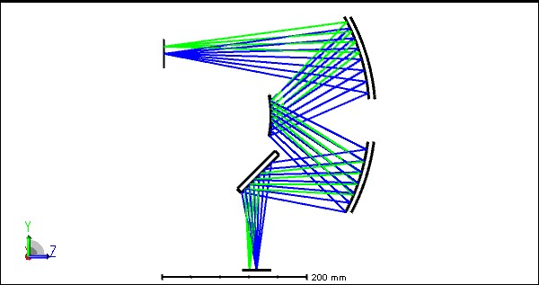
Optical Assembly
Conceptual design: reflective assembly
No chromatic aberration
Large spectral band for operation
Radiation hard
1D profile assembly
Field of view: 20mm: large sensor camera
Fibre bundle must be tapered
Could be preferred solution as it reduces the cost of the readout unit
Or additional system must be used to reduce magnification to focus on ≈1mm diameter
Solution to be compared with the cost of the fibre taper (performance and manufacturing cost)
Spherical mirrors
M=1
NA=0.18
Camera, etc.
Source
Optics
readout
Fibre Bundle
Camera, etc.

Slide 8
Readout image unit
Single photon sensing unit:
EMCCD camera: cheaper than Intensified cameras
Cooled camera with ≈1e noise floor: CMOS camera, CCD camera designed for spectroscopy
Choice based on dedicated tests with cameras to demonstrate sensitivity and acquisition schemes (single shot 3ms, 30 shots burst mode over 3ms, etc.)
PMT Array: almost excluded, but not yet
Radiation hard
Highly sensitive to radiation
Imposes a higher than 1 magnification: smaller field of view, less photons / pixel
Inhomogeneity larger than 10% for each channel

Slide 9
Management of Radiation Environment and Maintenance
Cameras, PMTs, most electronic readout image units will not live long or may not operate properly in the tunnel
Solution: provide shielding:
In the tunnel: >>1m³ steel is necessary for a camera to live and operate one year (average rate for 1W/m loss): this solution is not practical so it is likely to be abandoned
In the stubs: enough shield for cameras to live and operate properly (based on shield calculation in stubs): this solution may work, but temperature and humidity condition must be investigated. It imposes almost the usage of a fibre bundle to transport image from optics image plane to the camera
In the Klystron Gallery: best shield, but as above requires usage of a fibre bundle. In this case, the fibre must be radiation hard for low maintenance
<1 /cm² /s
Lifetime: years
Gallery
tunnel
Lifetime: 20’
Stub
>10⁵ /cm² /s
Lifetime: >1 year
linac
<10² /cm² /s

Slide 10
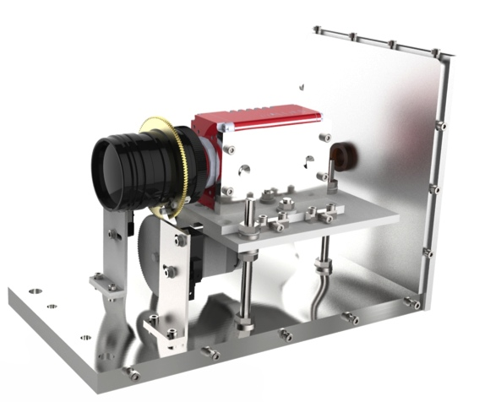
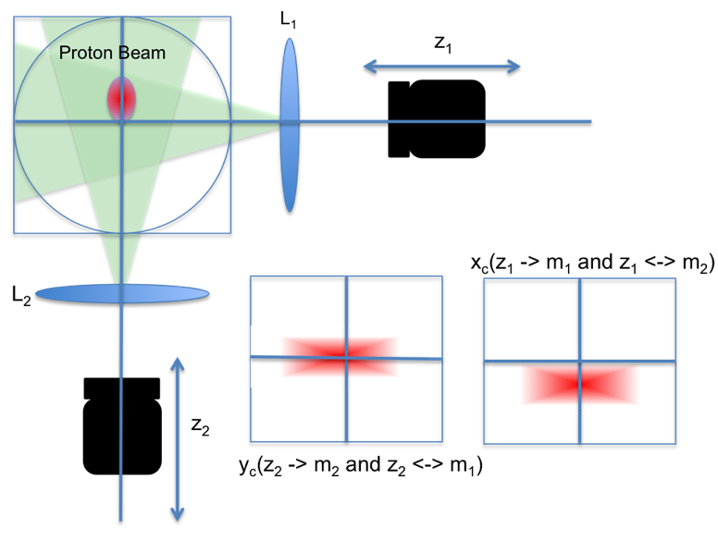
LEBT Design, Production, Integration, Commissioning (2 NPMs)
Team work:
Vacuum (Marcelo, Simone): gas composition
Requirements (Benjamin, Aurélien)
Mechanical assembly design (Thomas)
Conceptual design (Cyrille)
Vertical integration
Motor control (Klemen, Alex, Ander)
Camera control (Klemen, Hinko)
Software design (Klemen, Hinko)

Slide 11
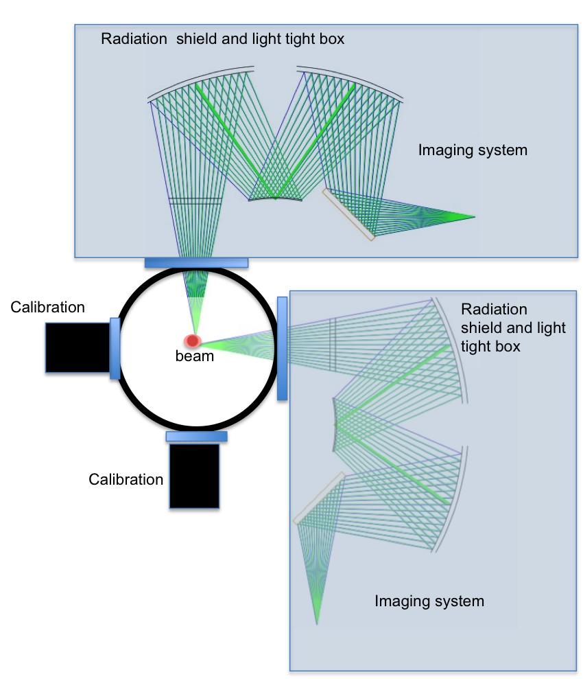
MEBT/A2T Design
Interface viewport defined
Optical system: first possible design done
Readout system: selection of several potential cameras
Looking into fibre bundles and tapered optical coupler
Remaining: mechanical assembly
Calibration system: for monitoring lifetime of the system

Slide 12
Cold Linac NPM
IK Collaboration (Jacques Marroncle – CEA Saclay)
Baseline: IPM
Feasibility Studies:
Space Charge issues
Development of numerical model of an IPM and benchmark collaboration: J. Storey, B. Dehning (CERN), K. Sato (J-Parc)
Radiation environment issues
Selection of the readout profile detector:
Timepix3: 10MGrey, time and energy of particles
Pure glass Fibre coupler + fibre bundle + single photon sensitive camera
Etc.
High Voltage cage design
Constraint due to allocated space in LWU
Constraint of the high voltage imposed by IPM model
Interface documentation
Maintenance plan

Slide 13
IPM
Space Charge:
3D IPM model (Matlab – Cyrille Thomas)
Benchmarking (collaboration CERN, J-PARC, CEA, GSI)
Study ESS case with ions/electrons
Screen for stopping calculation
Bunches motion
Sign(x)
Set of particles with initial condition
Q₀Q_{b} < 0 : focussing
Q₀Q_{b} > 0 : defocussing
3D field analytical expression
Moving frame at bunch speed
Periodic bunch
Equation of motion solve with Runge-Kutta non-linear solver

Slide 14
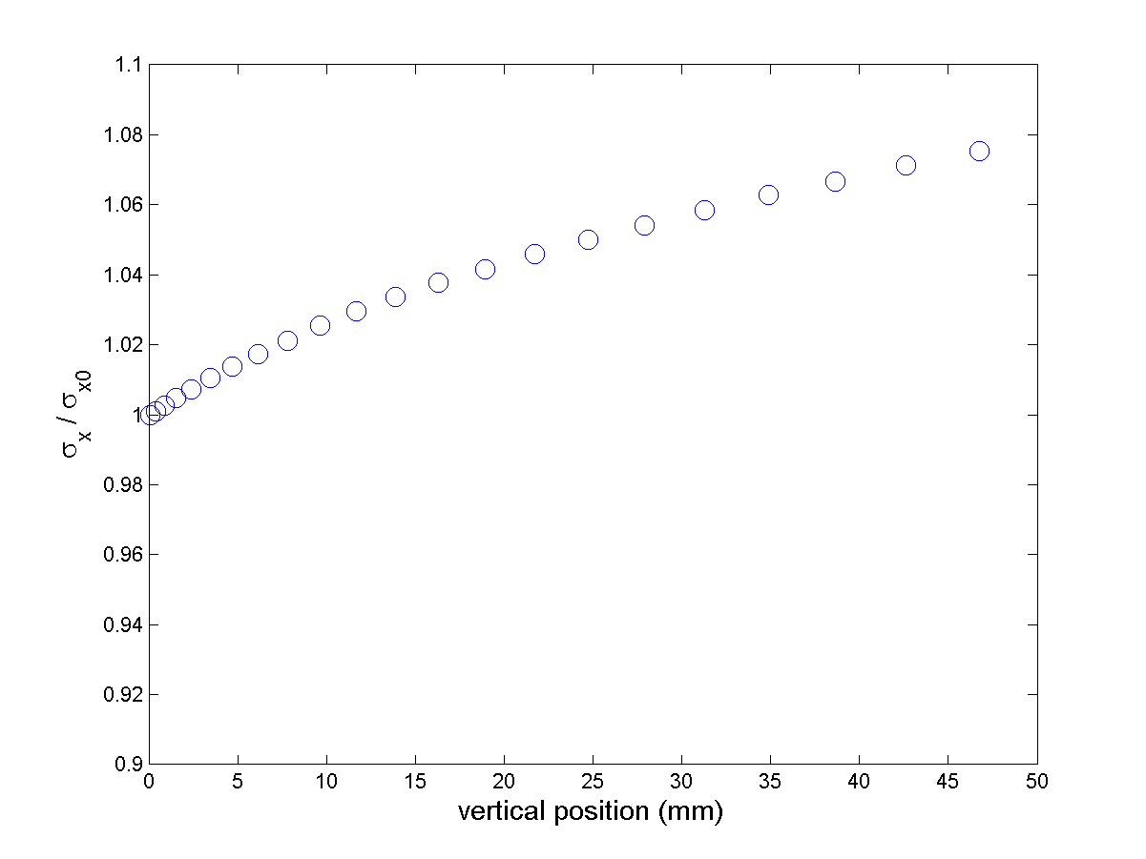
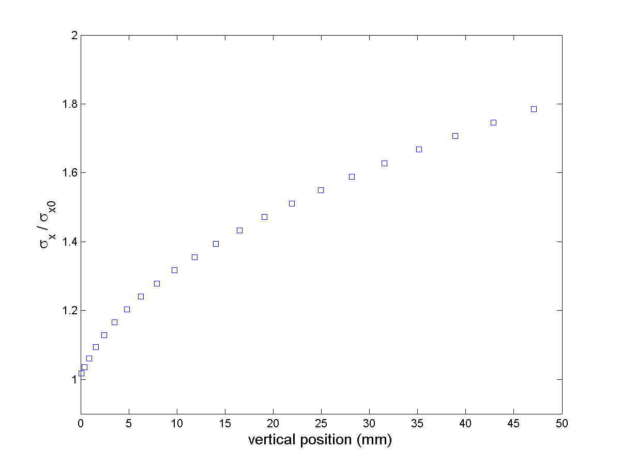
IPM
Preliminary results from the IPM model
ESS bunches:
2 GeV
σ_{xyz} = 2, 1.6, 2.1 (mm)
F = 25 kV / 0.1m
Uniform Zero speed at start time
No Magnetic Field taken into account
No differential cross-section
ESS bunches:
2 GeV
σ_{xyz} = 0.5, 0.4, 2.1 (mm)
F = 25 kV / 0.1m
Uniform Zero speed at start time
No Magnetic Field taken into account
No differential cross-section

Slide 15
IPM
Detector and readout
Timepix3:
Silicon pixel detector (2D image)
Position, arrival time and energy discrimination
10MGy radiation hard
Readout ADC (1MGy): copper cable to transport digital signal to the readout electronic
All pixels individually addressed, can be interrogated, and calibrated / tested
50mm pixel size or less depending on model
Integration into EPICS control requires a full driver development
High sensitive Camera based solution:
Radiation hard and luminescent glass fibre bundle (as used in streak cameras), fibre bundle, and high sensitive camera (photon counting)
Radiation hard, but some of the elements should be demonstrated to be
High sensitivity (single particle to produce > 500 photons)
High resolution (fibre diameter)
Integration into EPICS straightforward
MCP:
Radiation tolerant, but known to decay rapidly while operated under radiation
High sensitivity
High resolution
Analogue signal to be transported outside the tunnel
Requires expensive electronics (many channel ADC) and large effort in control integration
Metallic strips
Radiation hard
Possibly not sensitive enough (single particle?)
Expensive electronic similar to MCP
Analogue signal to be transported outside the tunnel
Large effort in control integration

Slide 16
Last words
NPM project is half-way
Conceptual designs in progress and soon to be achieved
Detail designs production will follow, with the objective to deliver all the systems for the commissioning and 1MW on target milestone
In-kind collaboration starts in April with a challenging project for the Cold Linac NPM:
Feasibility studies and full conceptual design within a year
Full design the following year for matching the project milestone and high power commissioning

Slide 17
Thank you to all our partners, collaborators and colleagues, for great support, good spirit and attitude facing the many difficult situations and challenges such a large scale project can generates.

Slide 18
Additional slides

Slide 19
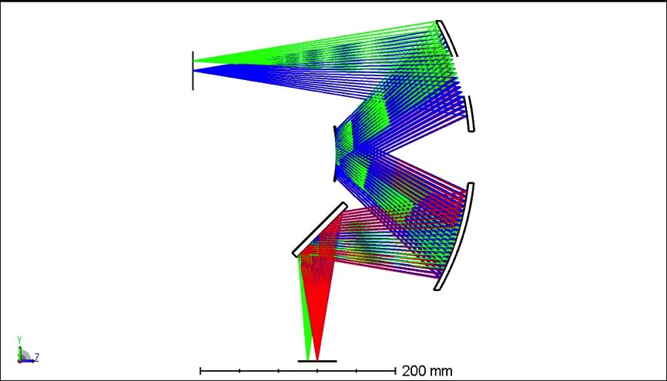
Optical Assembly
2D profiles
Advantage of real 2D image as opposed to 2x 1D profiles
Divide the cost by almost 2, since only one imaging system is requires
Feasibility and Reliability must be proven and demonstrated
Beam

Slide 20
Transverse profile monitors in “high-energy” sections for Beam Commissioning and Operation
Courtesy of Ryoichi Myamoto
Spoke: 1 WS/NPM + 2 WS
Monitors are located as close to the DTL-spoke interface.
The aim is to match the beam from DTL to the periodic lattice structure of the spoke section.
3 locations measurement method to measure emittance, beta, and alpha.
MB: 3 WS/NPM
Monitors are located close to the spoke-MB interface.
The aim is to match the beam from the spoke section to the periodic lattice structure of the MB sections.
3 locations measurement method to measure emittance, beta, and alpha. (Quad scan is also possible, but want to avoid if possible to avoid losses in SC cavities.)
The spoke-MB interface is the location of the frequency jump (352.21 MH => 704.42 MHz) and one of the most delicate location within the linac to preserve beam quality.
HB: 1 WS/NPM (placeholder)
MB and HB have the same lattice structure so, ideally, no need of matching the beam. Thus, only 1 placeholder at the beginning in case problems are identified in MB.
If we have monitors here, we rely on the quad-scan method.
Contingency: 3 WS
Monitors are located close to the dogleg.
The contingency section has the same lattice structure as MB and HB so, ideally, no need to match the beam at the HB-contingency interface.
The aim is to send the matched beam to the dogleg and A2T.
Dogleg: none
A2T: 1 WS/NPM
Located in the middle of the raster magnets.
The aim is to check the profile at this location as well as the cross-over point (180 deg separated).
Notes:
I’m asking questions to Heine about the argument of having these 3 WS so I ‘ll send you more once I’ve got a reply from him.

Slide 21
Table of RMS beam sizes at the locations of the transverse profile monitors
 | Sigx [mm] | Sigy [mm] | Sigz [mm]
SPK#1 | 2.4667 | 1.8439 | 2.3014
SPK#2 | 2.7995 | 2.1518 | 1.8631
SPK#3 | 2.1961 | 2.6880 | 2.0237
MB#1 | 2.6798 | 3.3621 | 1.4715
MB#2 | 2.4696 | 2.7221 | 1.3750
MB#3 | 2.7216 | 2.4701 | 1.5072
HB#1 | 2.2712 | 1.7594 | 1.2034
Contingency#1 | 1.3037 | 1.7387 | 3.2097
Contingency#2 | 1.1619 | 1.1730 | 4.5839
Contingency#3 | 1.1944 | 1.6647 | 6.0959
A2T#1 | 0.8658 | 0.6494 | 11.5544
From the 2015 lattice baseline

