Slide 1
Accelerator Status
Håkan Danared
www.europeanspallationsource.se
10 February 2016

Slide 2
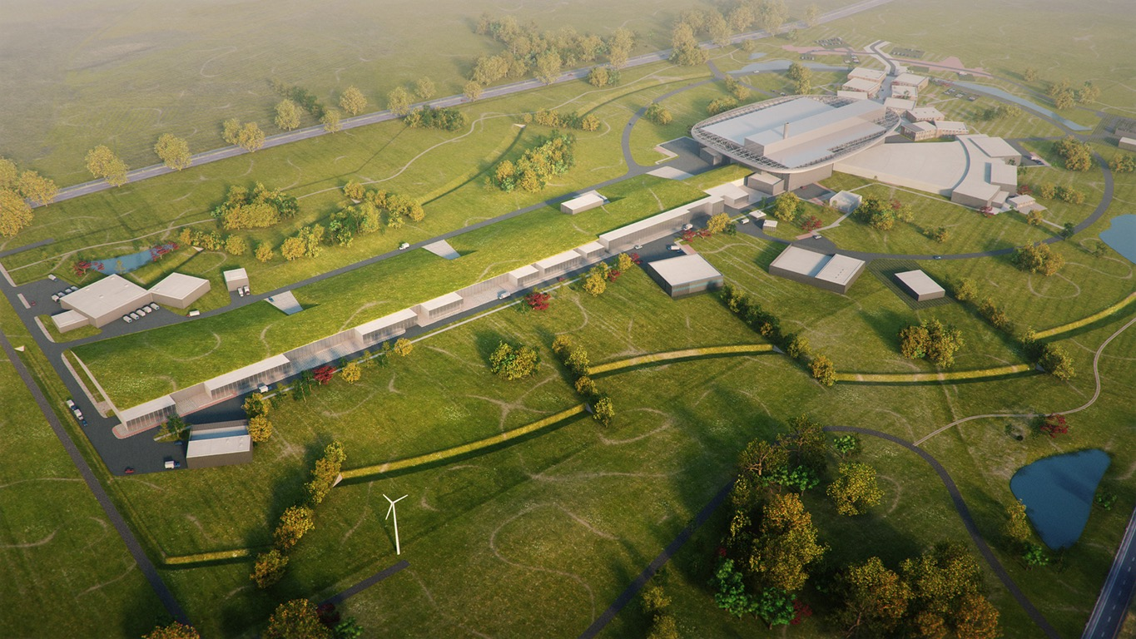
Top-Level Parameters
Target Station
Rotating W target
He-gas cooled
5 MW average power
42 beam ports
Proton Accelerator
Energy: 2 GeV
Rep. rate: 14 Hz
Current: 62.5 mA
Neutron Instruments
Construction budget
contains 16 instruments
Committed to deliver 22
instruments by 2028
Total cost: 1,843 M€ ₂₀₁₃

Slide 3
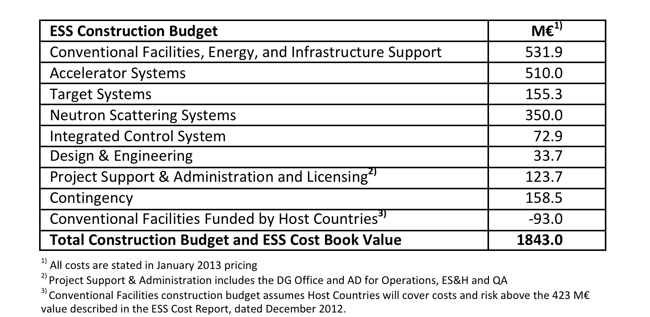
Cost Baseline

Slide 4
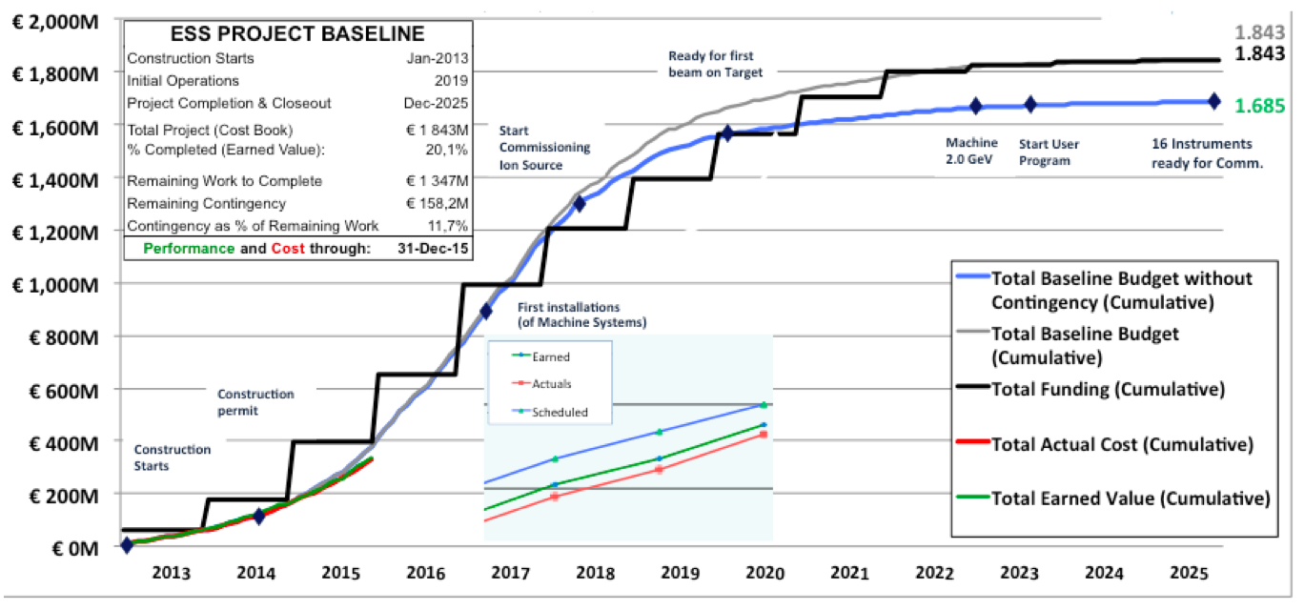
Construction Funding and Budget Profile

Slide 5
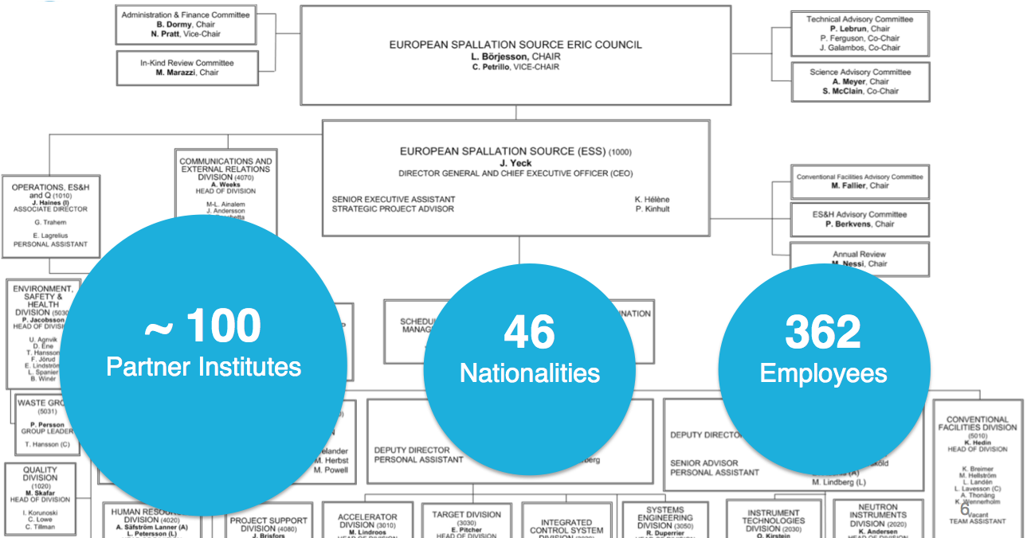
Organisation

Slide 6
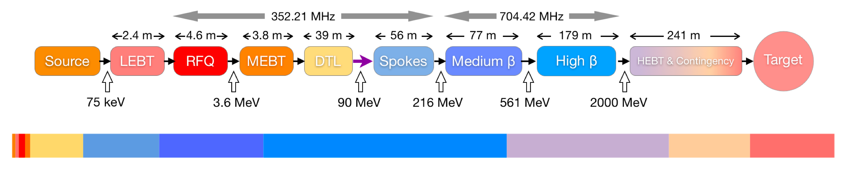
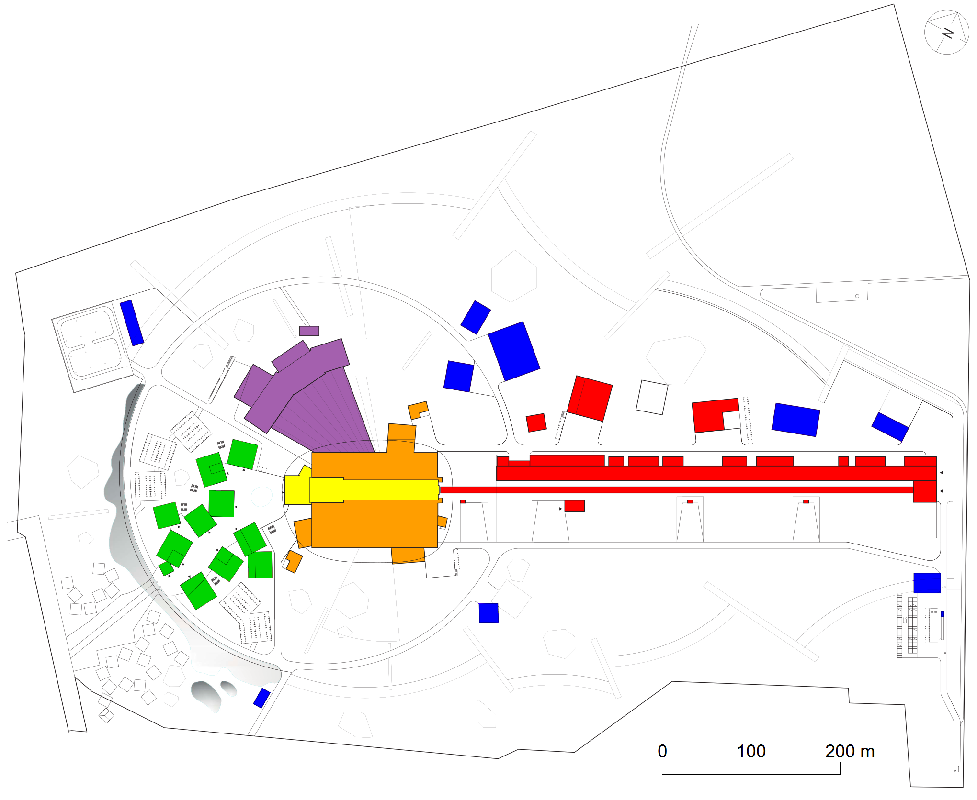
Linear Accelerator
Particle species p
Energy 2.0 GeV
Current 62.5 mA
Average power 5 MW
Peak power 125 MW
Pulse length 2.86 ms
Repetition rate 14 Hz
Operating time 5200 h/year
Reliability (all facility) 95%

Slide 7
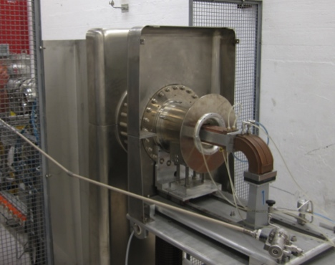

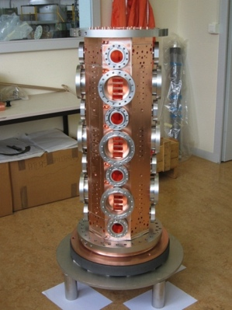
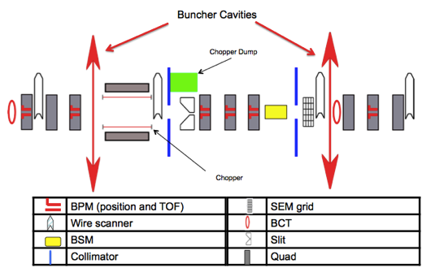
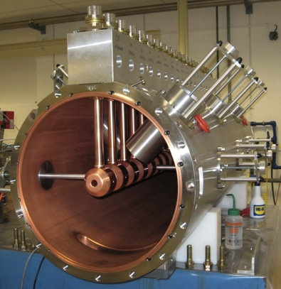
Ion Source and Normal-Conducting Linac
Prototype proton source operational, and under further development, in Catania. Output energy 75 keV.
Design exists for ESS RFQ similar to 5 m long IPHI RFQ at Saclay. Energy 75 keV->3.6 MeV.
DTL design work at ESS and in Legnaro, 3.6 ->90 MeV.
Picture from CERN Linac4 DTL.
Design work at ESS Bilbao for MEBT with instrumentation, chopping and collimation.

Slide 8
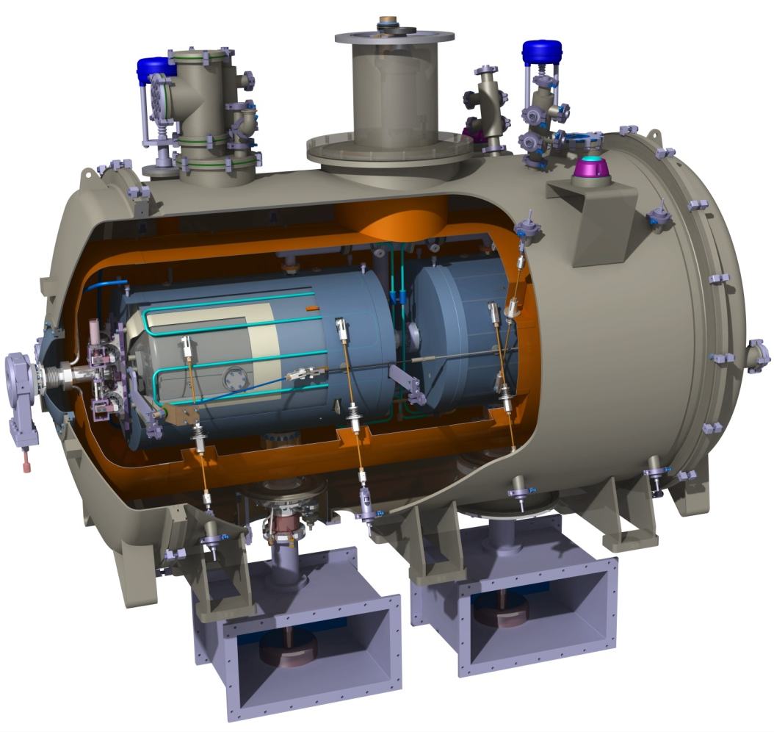
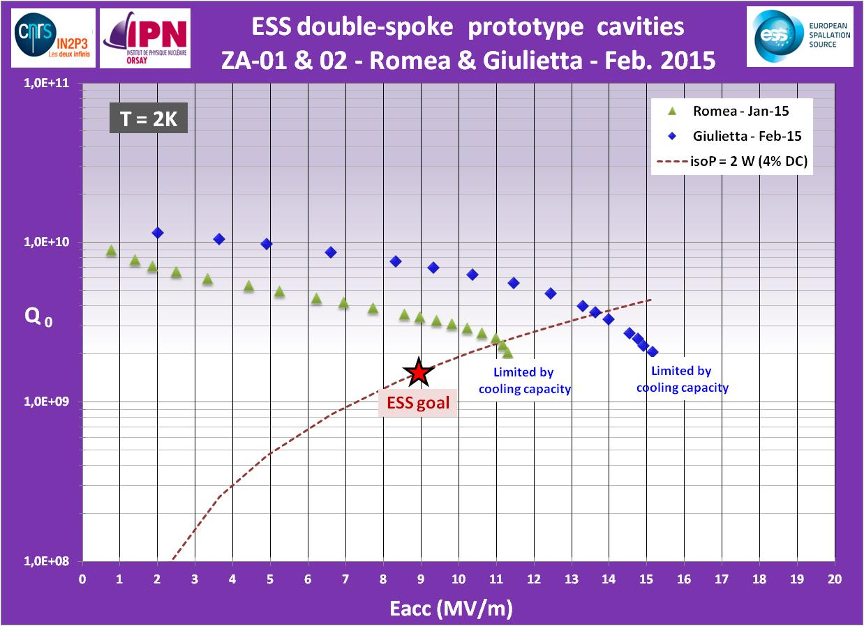
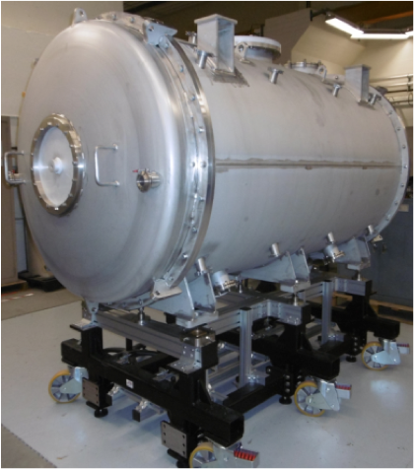
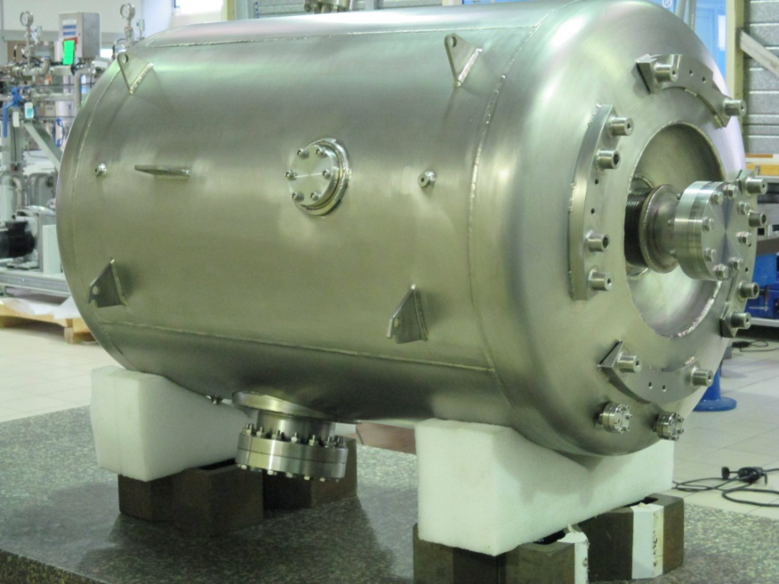
Spoke Cavities and Cryomodules
Cryomodule with two double-spoke cavities
at 2 K. Beta 0.5, energy 90->216 MeV, length 2.9 m, diameter 1.3 m. From IPN, Orsay
First tests of prototypes 2 and 3, exceeding ESS requirements in accelerating gradient
Vacuum vessel, mechanical support
First prototype cavity

Slide 9
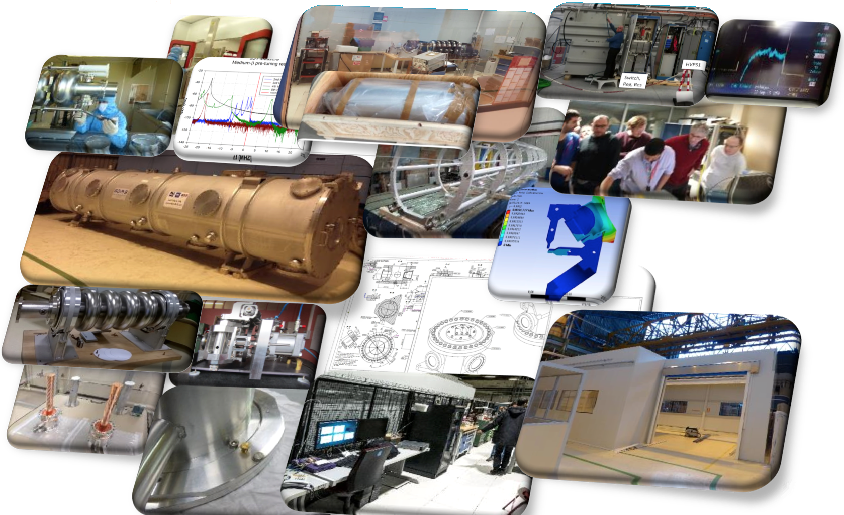
Elliptical Cavities and Cryomodules

Slide 10
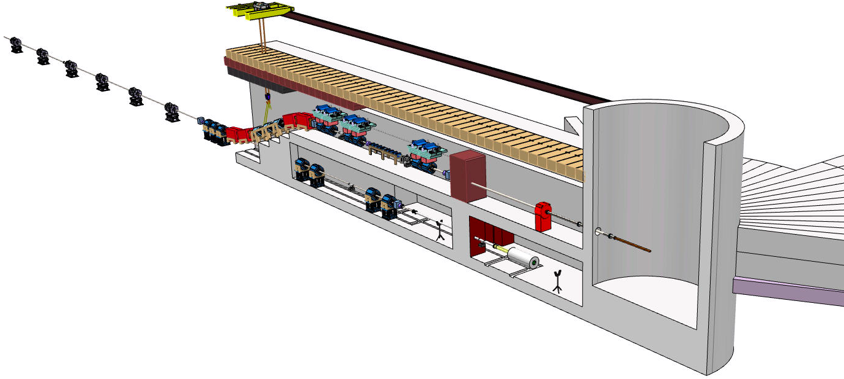
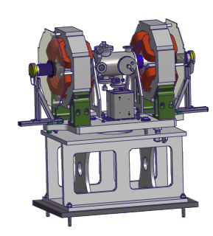
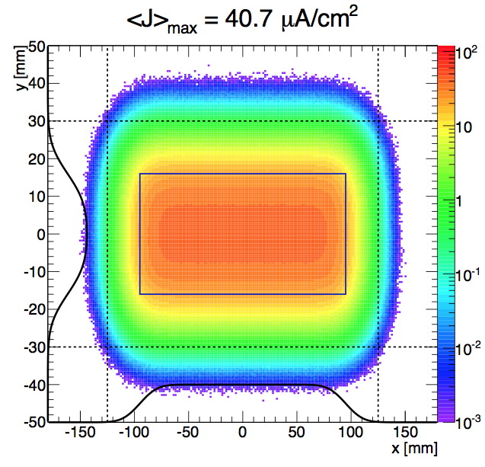
High-Energy Beam Transport
Fast rastering magnets expands the beam onto the proton-beam window and the 250 mm × 60 mm
beam entrance window on the target wheel
The HEBT design and beam-delivery system are contributions from ISA, Århus.

Slide 11
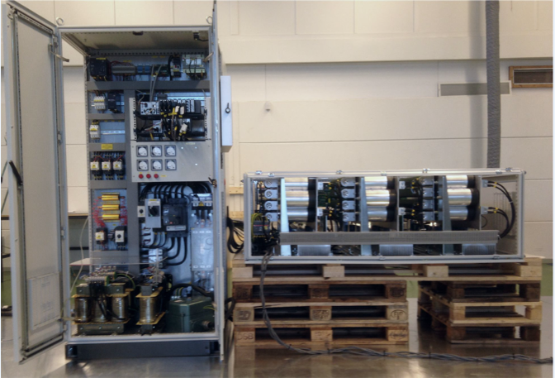
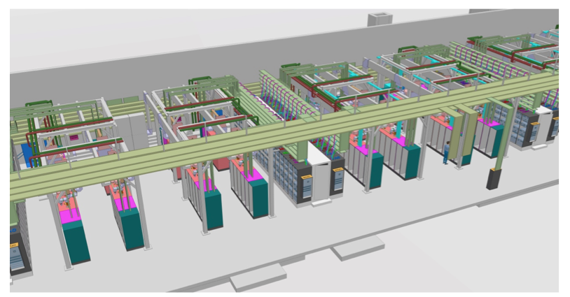
RF Sources
Main features:
One RF power source (klystron, IOT, ...) per resonator
Two klystrons per modulator for ellipticals
Pulsed-cathode klystrons for RFQ, DTL
Tetrode amplifiers for spokes
Klystrons for med-beta ellipticals, backup for high-betas
Developments with industry for high-power IOTs
LLRF, RF distribution, energy recovery,...
Development of novel high-power long-pulse modulators taking place at ESS
Part of spoke section of RF gallery (~10% of total gallery)

Slide 12

In-Kind to Accelerator
Since the launch of Expressions of Interest in spring 2013, discussions on in-kind are going on with 25 organizations.
Possible partners to Accelerator have been identified in Denmark, Estonia, France, Germany, Hungary, Italy, Norway, Poland, Spain, Sweden, Switzerland, and UK.
Value of items discussed with in-kind partners represents 50% of the accelerator budget.
Host countries cannot formally give in-kind contributions, contracts represent 3% of budget.
Another 15% possible as in-kind.
Important for ESS budget to find partners also for the ”possible”.
Not IKC, 32%
Planned IKC, 50%
Possible IKC, 15%
SE,DK, 3%

Slide 13
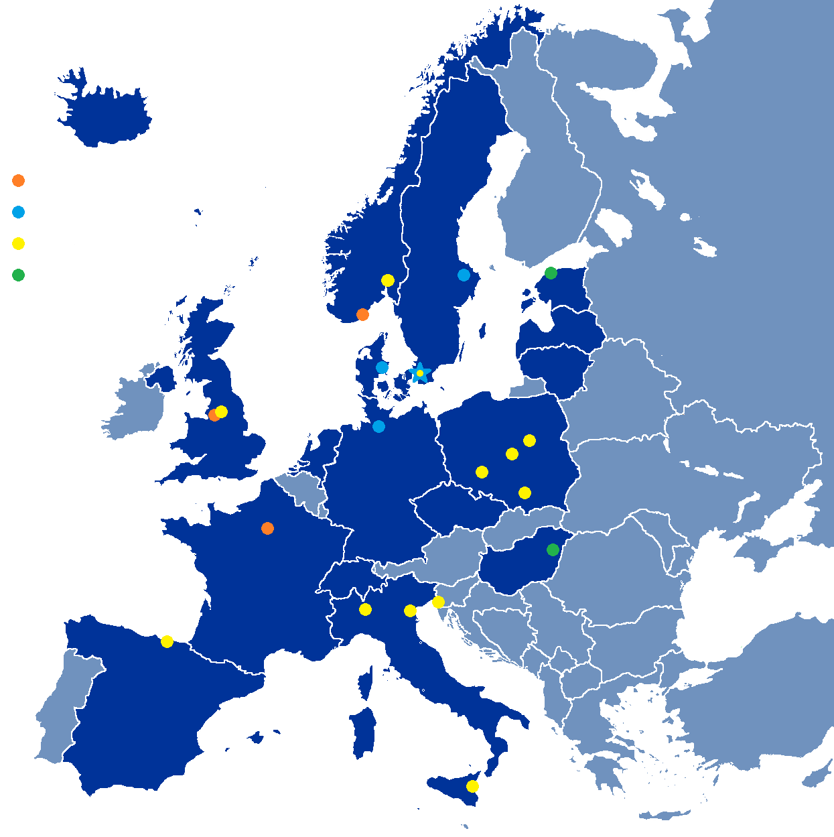
Partner Institutions
In-kind (main contributions)
ATOMKI (RF-LPS)
CEA (RFQ, SRF, Diagn)
CNRS (SRF, Cryo)
Daresbury Lab (SRF, Vacuum)
Elettra (RF, Magn, PS, Diagn)
ESS-Bilbao (MEBT, RF)
Huddersfield Univ (RF distrib)
IFJ PAN (Installations)
INFN Catania (Source, LEBT)
INFN Legnaro (DTL)
INFN Milan (SRF)
Lodz UT (LLRF)
NCBJ (LLRF, gamma blockers)
Tallinn UT (RF)
Univ Agder (Seconded staff)
Univ Oslo (Diagn)
Warsaw UT (LLRF)
Wroclaw UT (Cryo)
Not yet signed
Contract
HoA/Cover page
IKC
Paid contracts
Aarhus Univ (Beam delivery)
DESY (Diagn)
Lund Univ (LLRF, RF)
Uppsala Univ (Tests)

Slide 14
High-Level Accelerator Schedule
There are many “close critical paths” in the project, notably RFQ, DTL, cryomodules and RF system

Slide 15
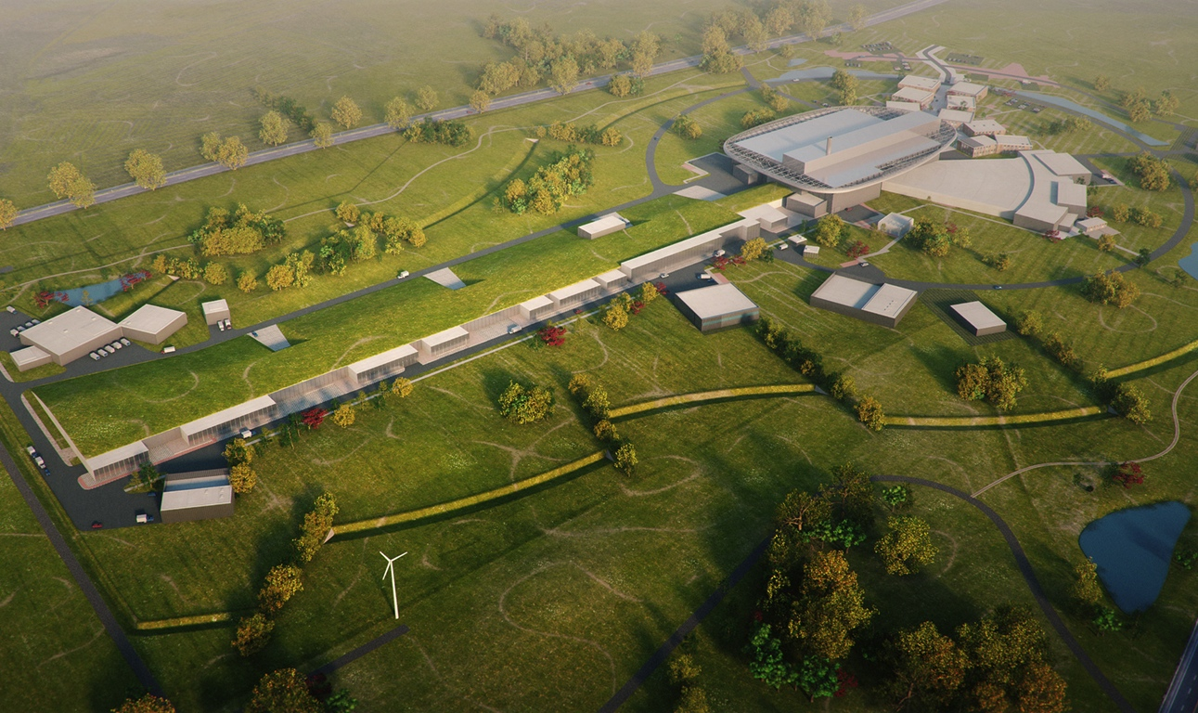
Journey to deliver the world’s leading facility for research using neutrons
2025
ESS construction complete
2014
Construction work starts on the site
2023
ESS starts
user program
2009
Decision: ESS will be built in Lund
2019
First beam on target
2012
ESS Design Update phase complete
2003
First European design effort of ESS completed

