Slide 1
ESS Beam Diagnostics Forum
Andreas Jansson
ACCSYS WP7 Leader
www.europeanspallationsource.se
10 February 2016

Slide 2
Beam Diagnostics – Lund Section
Name | Role
A. Jansson | WP7 Leader
I. Kittelmann | BLM & LBM system lead
H. Hassanzadegan | BCM system lead
R. Baron | BPM system lead, hardware platform coordination w ICS
B. Cheymol | FC, WS & EMU system lead
C. Thomas | NPM system lead, WP planning coordination
T. Shea | Target Imaging, Aperture & Grid system lead
M. Donna | FPGA Development
H. Kocevar | Software & EPICs integration, software and database coordination with ICS
T. Grandsaert (DO) | Mechanical Design Support
V. Grishin | ESS-CERN BLM project coordinator (at CERN)
J. Norin (consultant) | Project Documentation Support (CHESS/DOORS)
C. Roose | Halo studies (PhD student)

Slide 3
Partners and scope (confirmed and under discussion)
Saclay – LEBT EMU and Doppler, Cold linac NPM, neutron monitors
Bilbao – MEBT diagnostics, Insertable stops, DTL FCs
Elettra - Wire scanner electronics
Legnaro – DTL BPM & BCM
Olso – Target Imaging
Polish Electronics Group – BCM & BPM electronics components
Daresbury – LWU BCM, BPM integration
DESY – LWU BPM electrodes, BCM electronics conceptual design and firmware development

Slide 4
Schedule
Building access
Full tunnel
access
Partial gallery
access
Full gallery
access
Exact dates TBC, will be confirmed by Annual review (April) once replanning exercise concluded.
Notes:
2 May 2017 full tunnel access
1 sept 2017 partial gallery access (inc 2 stubs)
31 May 2018 full access gallery

Slide 5
Agenda
Project overview
Commissioning plan
Vacuum and controls standards
17 short presentations on diagnostics work (with main focus on partners)
Time for discussion (and coffee)
Lunch tickets will be provided for external guests. Tables are reserved at the Medicon Inspira Canteen

Slide 6
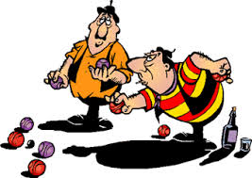
This evening
Food and friendly competition!
Joint transport organized from ESS office.
Easy individual return by train from Malmo.

Slide 7
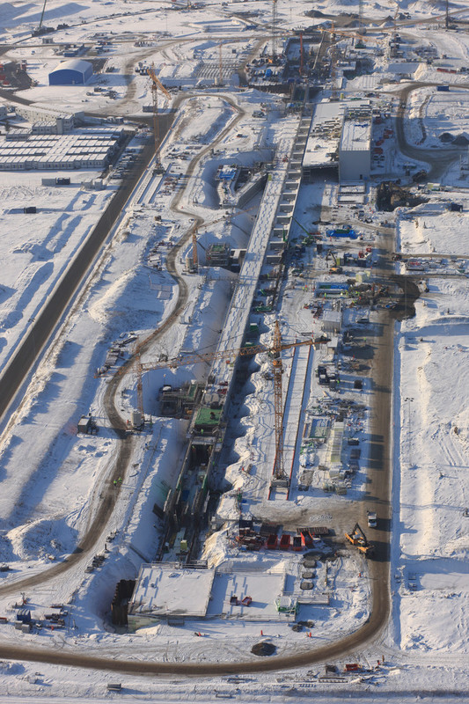
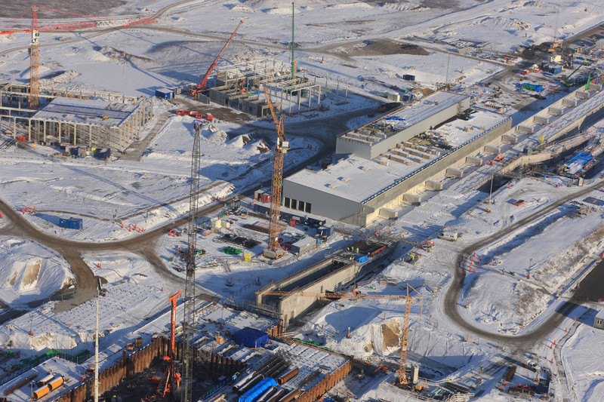
Tomorrow morning
Pick up from Concordia: 8:15
Pick up at ESS office: 8:35

Slide 8
Welcome!

