Slide 1
Controls standards and support
Daniel Piso Fernández
Hardware and Integration Group Leader
www.europeanspallationsource.se
10 February 2016

Slide 2
The Integrated Control System (ICS)
Integrated Control System Division (ICS) Scope
    Conventional facilities control integration
      Site infrastructure: cooling water, power distribution, etc.
  the accelerator control system
  the neutron target control system
  EPICS layer for the neutron instruments (in cooperation with the colleagues from science directorate)
  Global systems (next slide)
Combination of
  On-site developments
  in-kind contributions (up to 50% of total value)
  e.g., proton source and LEBT controls by CEA, Saclay (France)

Slide 3
Organization – ICS team 2016-02-01
Henrik Carling
Division head
Anna Gillberg
Team assistant
?
IT/Infrastructure ?
(Vacant?)
Annika Nordt
Safety and protection
Daniel Piso
Hardware and integration
Hector Novella
Deputy project manager
Susanne Regnell
Control Software
Timo Korhonen
Chief engineer
Angel Monera
FPGA Engineer
Benedetto Gallese
Integrator
Ben Folsom
PhD student
?
Deputy chief engineer
(Vacant)
Denis Paulic
PLC Engineer
David Brodrick
Integrator
Emanuele Laface
Accelerator physicist
Julen Etxeberria
Intern
François Bellorini
Integrator
Karin Rathsman
Senior scientist
Manuel Zaera-Sanz
PLC Engineer
Javier Cerejo
PhD Student
Leandro Fernandez
Senior software engineer
Morteza Mansouri
Safety Engineer
Jeong Han Lee
Integrator
Vacant
Software engineer
Riccard Andersson
PhD student
Nick Levchenko
Integrator
Ricardo Fernandes
Senior software engineer
Stuart Birch
Senior safety engineer
Alexander Söderqvist
Integrator
Remy Mudingay
Infrastructure engineer
Yong Kian Sin*
IEC61508 engineer
Klemen Strnisa
Lead integrator
Thilo Friedrich
PhD Student
Vacant
Engineer?
Niklas Claesson
Integrator
Consultants
Vacant
Engineer?
Urša Rojec
Integrator
Vacant
Engineer?
Employee
Consultant
* Starts 2016-02
Vacant
Engineer?
Vacant
Engineer?
Temporary employee
Consultant
off-site
Position under consideration
Vacant
Engineer?

Slide 4
Hardware & Integration Scope
The scope of the Integration Team is to perform the development of control systems from requirements engineering, design, implementation, procurement and delivery for installation, verification and support by using the components provided by other teams.
“The objective of the Integration Team is to unify I&C components and processes into a whole. Ensuring that the hardware, software and human elements will interact to achieve the system purpose. And considering system integration as a part of the system engineering process.”

Slide 5
The Integration team. Where to find support…..
Technology Reference Person
Motion control David Brodrick, Jeong Han Lee
Timing system Alexander Soderqvist
FPGA n. a.
IFC (IOxOS) Jeong Han Lee
ESS EPICS Environment Jeong Han Lee
MTCA4 Infrastructure - Firmware (MCH,Power Module, Cooling Unit) Jeong Han Lee & Timo Korhonen.
PLC Nick Levchenko
s7plc (EPICS Device Support, IOC ,OPI) Nick Levchenko
d-tacq(Linux Kernel Driver, EPICS Device Support, IOC ,OPI) Niklas Claesson
ADC 3110(Linux Kernel Driver, EPICS Device Support, IOC ,OPI) Niklas Claesson
ADC 3170(Linux Kernel Driver, EPICS Device Support, IOC ,OPI) n. a.
Digital IO n. a.
Struck (Linux Kernel Driver, EPICS Device Support, IOC ,OPI) Niklas Claesson (Linux Kernel Driver, EPICS Dev. Support), Alexander Soderqvist (IOC,OPI)
AreaDetector (EPICS Device Support, IOC ,OPI) Alexander Soderqvist
StreamDevice (EPICS Device Support, IOC, OPI)
Discipline Reference Person
Vacuum Controls Francois Bellorini
Cryogenics Systems Benedetto Gallese
Beam instrumentation Jeong Han Lee
RF LLRF RF LPS Jeong Han Lee
Target Diagnostics Jeong Han Lee
RF Reference Line Alexander Soderqvist
NSS David Brodrick
Target Benedetto Gallese
Conventional facilities Nick Levchenko
Main Power Supply Nick Levchenko
Water Cooling Nick Levchenko
PS & LEBT Integration Nick Levchenko
RFQ, DTL, Spokes, Elliptical Daniel Piso
Lab Management David Brodrick
Magnets & Power Supplies n. a.

Slide 6
ICS Global Systems
Control system networks and servers
Global timing system for site-wide synchronization
  Synchronization of devices
  Distribution of time, time stamping
  Operation sequencing
  Using MRF event system, latest generation (see next slides)
Protection and Safety systems
  Machine protection - High demands for reliability and speed
  Personnel Safety
    Designed according to IEC61508 standard, safety-credited

Slide 7
Timing System (I)
Functions
Distribute synchronous triggers to a (very) large number of devices
  Triggers can be pulses, electrical or optical, with different configurable properties
  Triggers can also be software, triggering some action in the IOC by “processing” EPICS channels (e.g. read out data, write values, calculate).
Distribute (limited amounts of) data to many receivers synchronously
  This happens in parallel to the trigger distribution, no effect on accuracy.
  Limited amount (2 kilobytes per transmission, up to 125 MB/sec.
Distribute synchronous timestamps
Generate (programmable) sequences of triggers (events)
Accept asynchronous inputs to generate events
Synchronize to an external input trigger with optional phase adjustmen
And other things…(distribute clock signals, take in interlock inputs,…)

Slide 8

Timing System (II)
Structure of the system
RF Generator
88 MHz
Master Event Generator
fanout
Event
receiver
Event
receiver
fanout
Event
receiver
Event
receiver
Event
receiver
Event
receiver
Event
receiver
Event
receiver
The (accelerator) synchronization frequency (of 88 MHz) will be fed into the master event generator and used as the system clock. Downstream will be synchronized to that.
The 14 Hz operating frequency will be generated at the Master Event Generator.
Events and (limited amounts of) data can also flow upstream (optionally)
Fan-out system can (and will) have many levels in the latest version of the fanout system
Notes:
Remember: eye pattern
14 Hz will be generated internally in the EVG. De facto decision.

Slide 9
Timing System (III)
Integration
Event receivers will be fully supported in the EPICS framework
  On ESS platforms: MTCA, on PC hardware (Linux) if required
  We try to provide solutions for other platforms like PLCs
Different electrical standards (LVTTL, PECL, CML, (slow) optical….
Frequently asked question: can I embed and EVR in my FPGA?
  .

Slide 10
Timing System (IV)
Synchronous data collection
88 MHz
RF Generator
Master Event Generator
fanout
Event
receiver
Event
receiver
fanout
Event
receiver
Event
receiver
CPU
Event
receiver
CPU
Event
receiver
CPU
Event
receiver
I/O
I/O
I/O
Each IOC (control box) receives the same events
Event triggers reading out a piece of data (detector, AD converter, status bit/word)
Data is time stamped and put into a “silo”
Data can be streamed out (continuous recording) or read out as chunks (finite length)

Slide 11
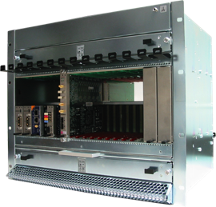
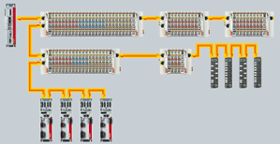
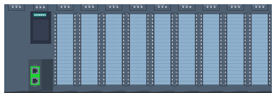
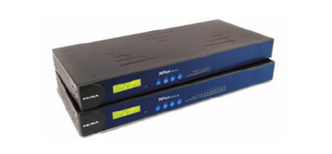
Hardware Strategy. Threefold structure for generic I/O
Control System Hardware Platforms (ESS-0017971)
  Fast real-time processing, FPGAs
    MTCA.4
    Use only where needed (high cost, specialization)
    Extensively use FMC (Vita-57) mezzanine cards
  Real-time industrial-type I/O
    EtherCAT, on IOC
    Low cost, distributed, good real-time performance
    Moderate speed (e.g. up to 100 kSPS A/D conversion)
  Process I/O with no tight syncronisation requirements
    PLCs (Siemens)
  In addition, prepare integration of off-the-shelf devices
    Serial and LAN interfaces

Slide 12
Hardware Strategy. I/O Controller variants
  MTCA.4 based digital front-end platform
  Industrial PCs where appropriate
  Virtualized IOCs running on server infrastructure
    No tight real-time requirements or pulse-to-pulse data
    Site infrastructure systems, cryogenics, vacuum
    Redundant fail-over clusters
    Typically interfacing PLC-based systems
  possible mini-IOC
    Concept study ongoing
    Integrated timing and processing unit

Slide 13
Fast real-time processing standards
Finalise the standardisation of MTCA infrastructure (crates, PS, MCH, CPU within the first 3Q of 2016. Procurement to select preferred vendors
All the developments will be based on a digital front-end platform (IFC_1410), currently under development.
Agreement with BI: ‘+ 10 ADCs (zone 3 compatible to Struck - class A.1)’
Starter kit – based on IFC_1210 for in-kind partners

Slide 14
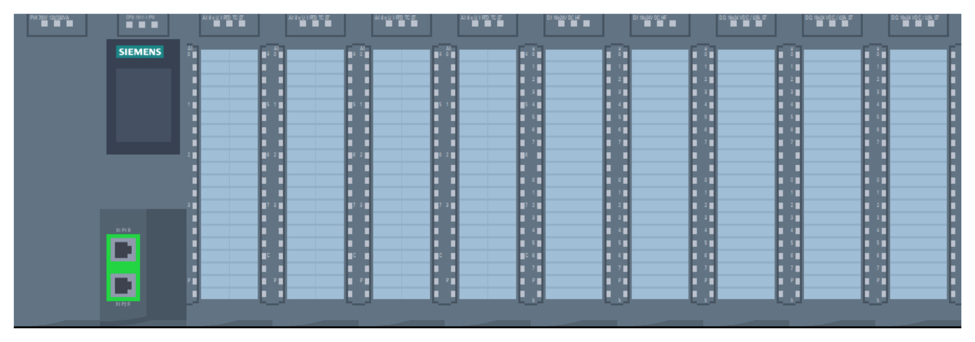
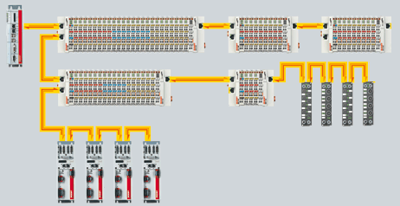
Standards for Real-time industrial-type I/O, Process I/O with no tight synchronization requirements
PLC Technology standardization completed: Siemens Simatic S7-1500.
  List of Standard Components
  s7plc
Real-Time, industrial type I/O.
  Ethercat

Slide 15
Software Technologies
EPICS as the system backbone, for all controls I/O
  Use exclusively EPICS 4
  Model for distributed development (next slide)
Services based on Web/RESTful interfaces
  Configuration data management
    Controls Configuration Database (CCDB)
  Cable Database
  Naming service
IOC Factory for IOC management
  Create, maintain, audit IOCs

Slide 16
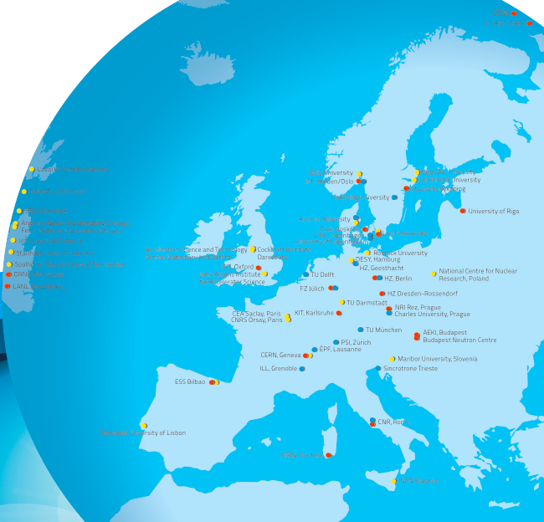
Distributed development
Issue: support of off-site developers
An (incomplete) map of collaborating institutes
Potentially any/all of these could be developing or integrating control system components for ESS
Development and testing happens at the institutes
Finally all of this has to be integrated into ESS in Lund
How to manage that?
We cannot afford long release cycles

Slide 17
Distributed development. Development Environmet
Web-based infrastructure tools
  Naming, configuration, cabling, IOC configuration
  Collaborative tools
  IOC Factory tool to manage IOC configuration (set-up, deployment, audit)
Network-synchronized development cycle
  Ansible playbooks for development (virtual, real) machine configuration
  ESS EPICS Environment (EEE). Pre-built, loadable EPICS modules (concept courtesy of Dirk Zimoch, PSI)
  EPICS tools and libraries on network drives (next slide)

Slide 18
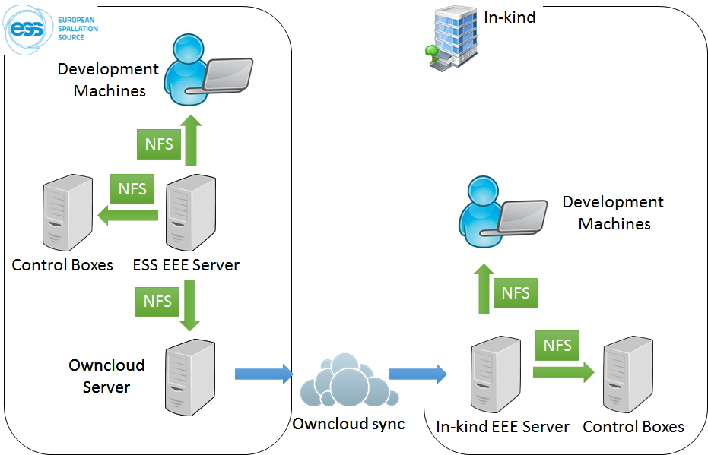
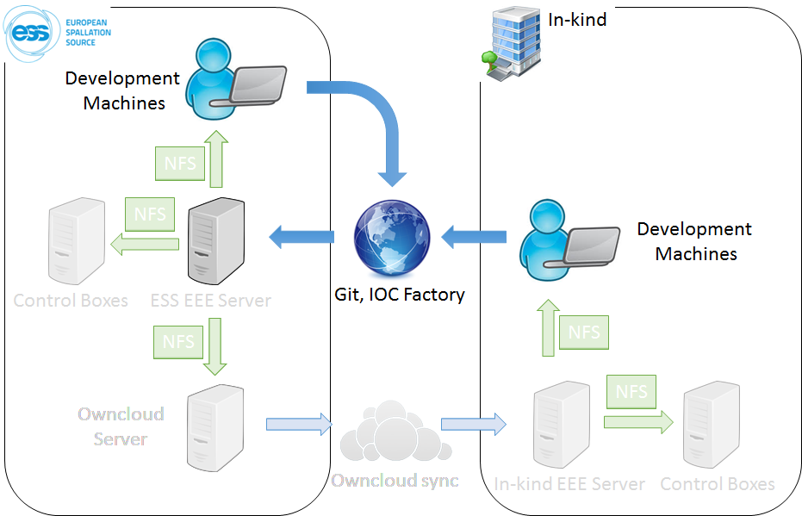
Distributed development (3)
All software hosted in a central repository
Full cycle can be reproduced at Lund anytime
All developers work with exactly the same versions of tools
Deployed, first user feedback is very positive (still needs work, though)

Slide 19


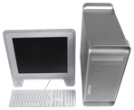

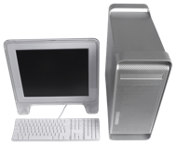

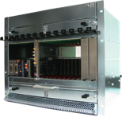
EPICS Integration Workflow using our Development Environment
EPICS Base
EPICS modules (community)
EPICS modules (ESS)
Continuous integration, tests, etc.
CCDB
Compilation, maintenance
EPICS core
EPICS modules
(RT)OS image
File system (NFS)
IOC Factory
File system (NFS)
OwnCloud
st.cmd
Synchronization
System integration
Boot
Boot
19

Slide 20
EPICS Support
ESS EPICS Environment
EPICS s7plc
EtherCAT
AreaDetector
EPICS Training
Interceptive Device Test Stands
Etc…..

Slide 21
Summary
Construction has started
  On and off Lund site
  Controls support needed now
Try to use the best from the community
  Borrow & contribute
  Invent ourselves things to cover the special needs
Project management is a challenge
  Standardization should help
More to come – in the next meetings!

