Slide 1
Short Overview of ESS
Beam Commissioning and
Linac Modes
Marc Munoz
10 February 2016

Slide 2
Accelerator overview
352.21 MHz
704.42 MHz
2.4 m
4.6 m
3.8 m
39 m
56 m
77 m
179 m
204 m
Target
Source
LEBT
RFQ
MET
DTL
Spokes
Medium β
High β
HEBT & Contingency
75 keV
3.6 MeV
90 MeV
216 MeV
571 MeV
2000 MeV
Tuning Dump
Parameter | Value | Units
Max energy | 2 | GeV
Peak current | 62.5 | mA
Repetition Rate | 14 | Hz
Pulse length | 2.86 | ms
Average Power | 5 | MW
RF Frequency | 352/704 | MHz
Maximum losses | 1 | MW/m
Species | Proton
Device | Total Number
RFQ | 1
DTL tanks | 5
Spokes Tanks | 13
Spokes Cavities | 26
Cryo tanks (M-β) | 9
RF cavities (M-β) | 36
Cryo tanks (H-β) | 21
RF cavities (H-β) | 84
Klystrons/IOTs | 120
Modulators | 30-60

Slide 3
Overview of the ESS LINAC
Target, up to 5 MW
Bending magnets
Rastering system
Tuning Dump, up to 12 kW

Slide 4
Commissioning and licensing stages
28th June 2019, first neutrons
Notes:
adjust the font size

Slide 5
Linac Modes

Slide 6
Linac modes
Accelerator Mode, providing an overview of the planned activity for the ESS Linac
  Status Submode (from the Accelerator mode), providing the actual status of the ESS Linac
P-Beam mode, providing a description of a pre-defined set of beam characteristics
Destination mode, providing the intended destination of the proton beam
Tunnel mode, providing the status of the Linac tunnel access

Slide 7
Accelerator mode
Name | Description
Shutdown
Source | Ion source operation, access to the rest of the Tunnel
StudiesDump | P-beam on, to the tuning dump; tunnel close; access to the Line-of-Sight instruments only if primary shutters are closed
StudiesTarget | P-beam on, to the target; tunnel close; no access to the LoS instruments
StartUp Target Test | P-beam on, to the target; Target areas “searched and Locked”tunnel “searched and locked”; no access to the LoS instruments.
StartUp Low Power | P-beam on, to the target; Target areas “searched and Locked”tunnel “searched and locked”; no access to the LoS instruments
StartUp Ramping | P-beam on, to the target; Target areas “searched and Locked”tunnel “searched and locked”; no access to the LoS instruments
Production | P-beam on, to the target; tunnel searched and locked; Ready for neutron production

Slide 8
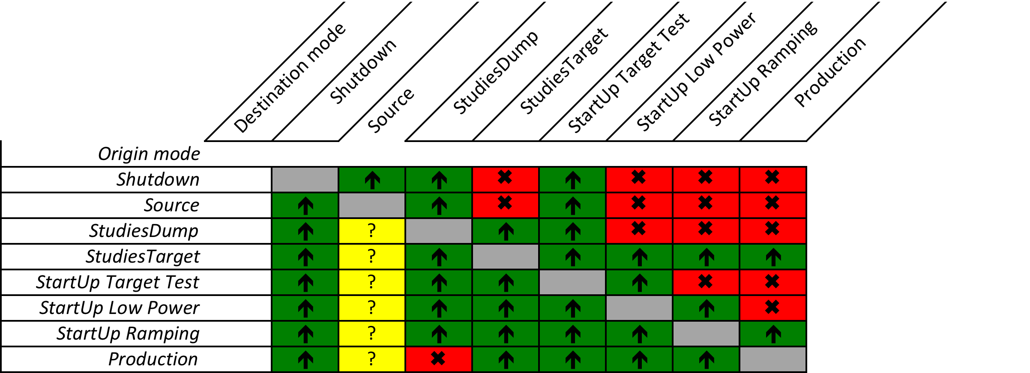
Allowed transitions

Slide 9
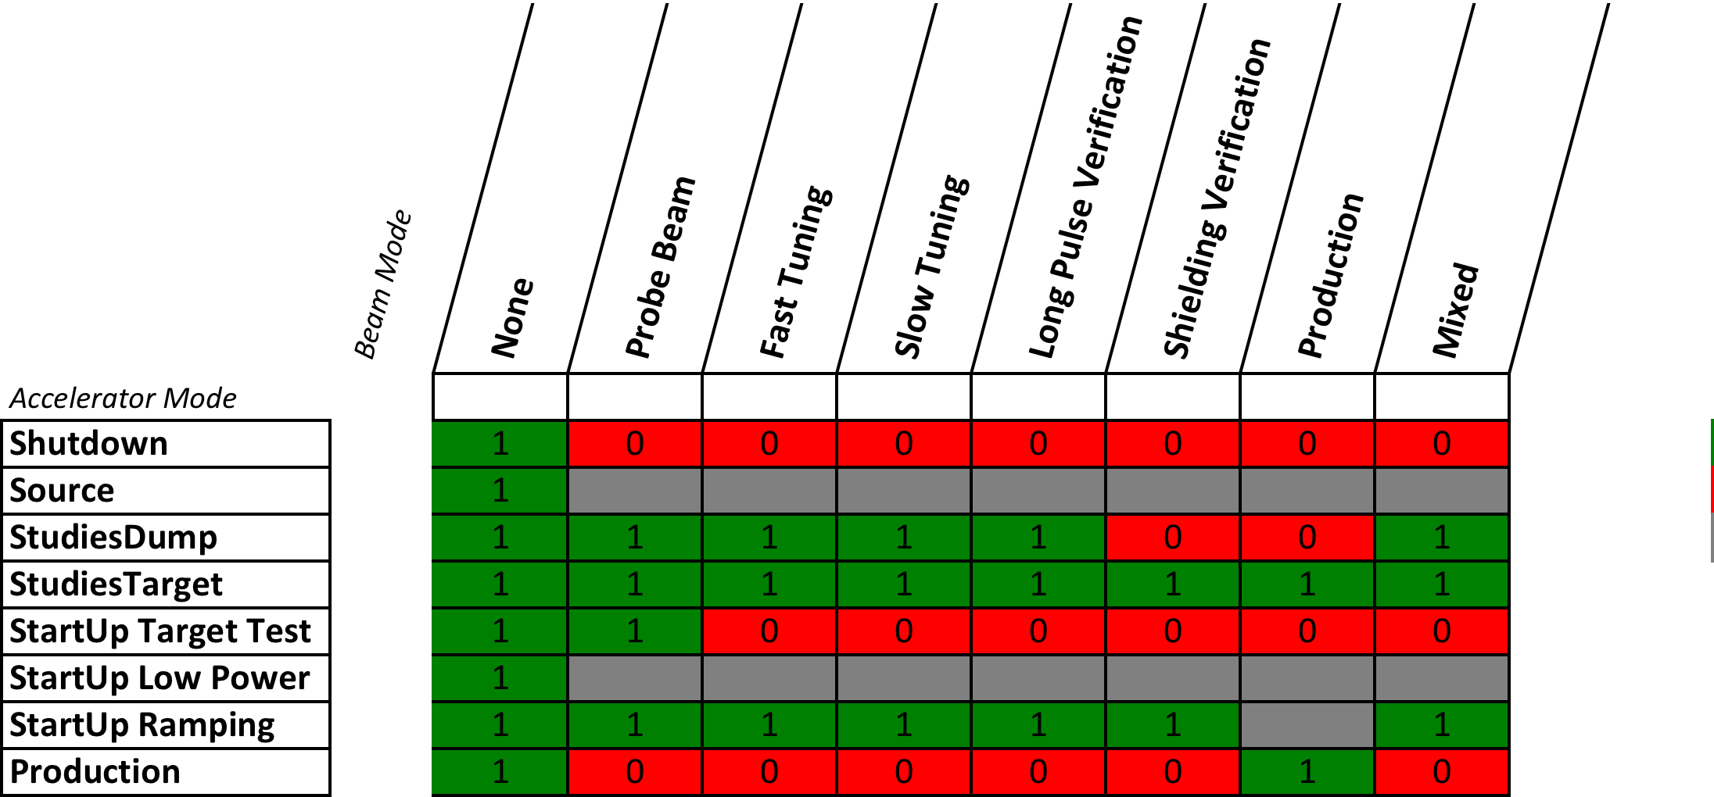
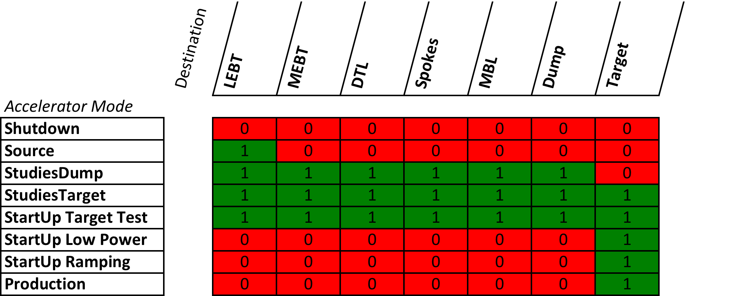
Combination matrices

Slide 10
Status submode
Name | Description
Beam Off | No proton beam
Beam On | Proton beam (IS on)
Fault | Fault detected, no proton beam
Recovery | Recovering from a fault, proton beam for tune up. Possible neutron production, but not intended for users

Slide 11
Proton beam mode
Name | Characteristics | Description | Average power at 2 GeV
None | No beam | No Beam
Probe Beam | 5 us, 1Hz | first beam through a particular section; non-damaging even in the case of total beam loss (even repeated); used to verify that machine configuration is not grossly incorrect | 0.6 kW
Fast tuning | 5 us, 14 Hz | limited beam loading; used for fast scans to rapidly determine/verify RF setpoints and measure beam profiles with wire scanners. | 8.5 kW
Slow tuning | 50 us, 1 Hz | longest pulses that allow operation of invasive proton beam instrumentation devices like wire scanners; long enough beam pulses to diagnose and monitor RF feedback and the onset of beam loading; used to perform more precise single-pulse measurements | 6 kW
Long pulse verification | 2.86 ms, 1/30 Hz | only used when machine reasonably tuned to the tuning dump or the target; slowly-increasing pulse lengths are used to tune RF feedforward, verify beam loading and Lorentz force detuning compensation, and tune for low beam losses. | 12 kW
Shielding verification | Low power (~30 kW), nominal energy and peak current | to be defined better once the exact requirements for the shielding verification (power, pulse length) are know | ~ 30 kW
Production | 2.86 ms, [1-14] Hz | Production | 5 MW
Mixed mode | 2.68 ms @ 1/60 Hz, 50 us @ 1 Hz | long pulse at a very low rep rate with a slow tuning beam mixed. Useful for stability studies. | ~12 kW

Slide 12
Destination mode
Name | Location | Current Limits
LEBT |  | Full beam
MEBT |  | 1 Hz, 50 us / 14 Hz, 5 us
DTL |  | 1 Hz, 50 us / 14 Hz, 5 us
Spokes |  | 1 Hz, 50 us / 14 Hz, 5 us
MBL |  | 1 Hz, 50 us / 14 Hz, 5 us
Dump |  | 12 kW
Target |  | 5 MW

Slide 13
Tunnel mode
Name | Description
Controlled Access | Access to the tunnel, some non-hazardous systems remain “on”. Maximum 30 persons. 15 per entrance[1]
Rad Cooldown | No access to the tunnel, on a countdown timer to allow access to the tunnel.
Restricted Access | Tunnel “searched and locked”, but limited access to 2 personnel only. The search is not broken on entry.
Closed | Tunnel “searched and locked”, no access.
Open
IS on | Ion source on, but access to some section of the tunnel

Slide 14
Beam Commissioning

Slide 15
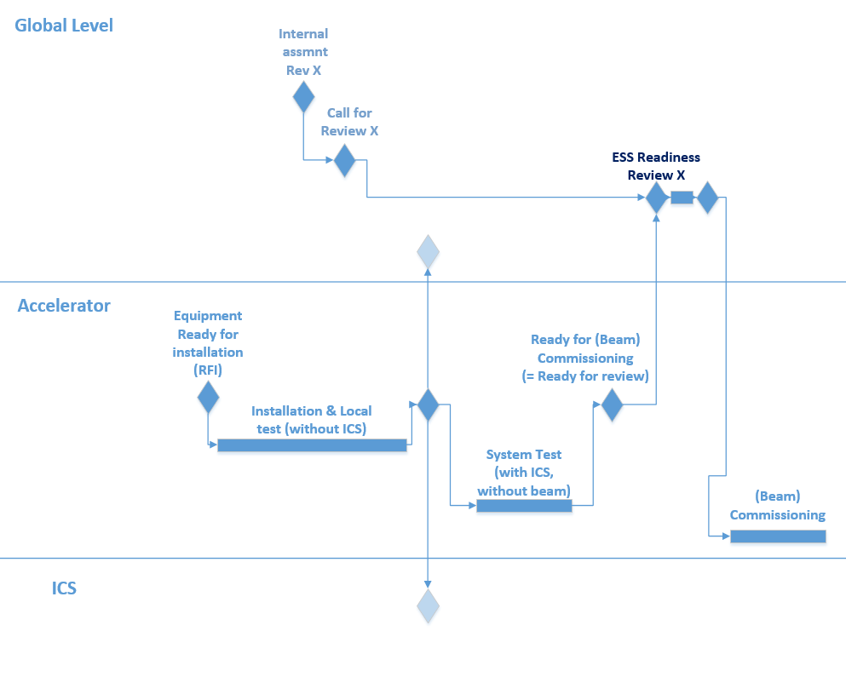
Logic and Milestones (P6)

Slide 16
Considerations about the commissioning
ESS would operate with a long pulse (2.86 ms).
High peak current: 62.5 mA-> space charge dominates at low energy
Only 1.4 MW at end of commissioning
Only beam stop to accept the nominal parameters is the Target
Most of the (invasive) diagnostic could not cope with the long pulse
Large percentage of In-Kind contribution
Start using a Local Control Room

Slide 17
Systems should be fully tested and commissioned before start of BC
  Beam diagnostic, Low level RF, would need the beam
Staged Commissioning, in parallel to installation
  We would require temporary dumps and diagnostic
  Extra shielding for parallel installation
HEBT cavities not installed, low power (0.57 GeV) at the end of commissioning

Slide 18
Installation and shielding
Extra shielding after DTL4
  Limits the beam modes to be used
Shielding before DTL 2 under consideration
  Conditioning in parallel to commissioning

Slide 19
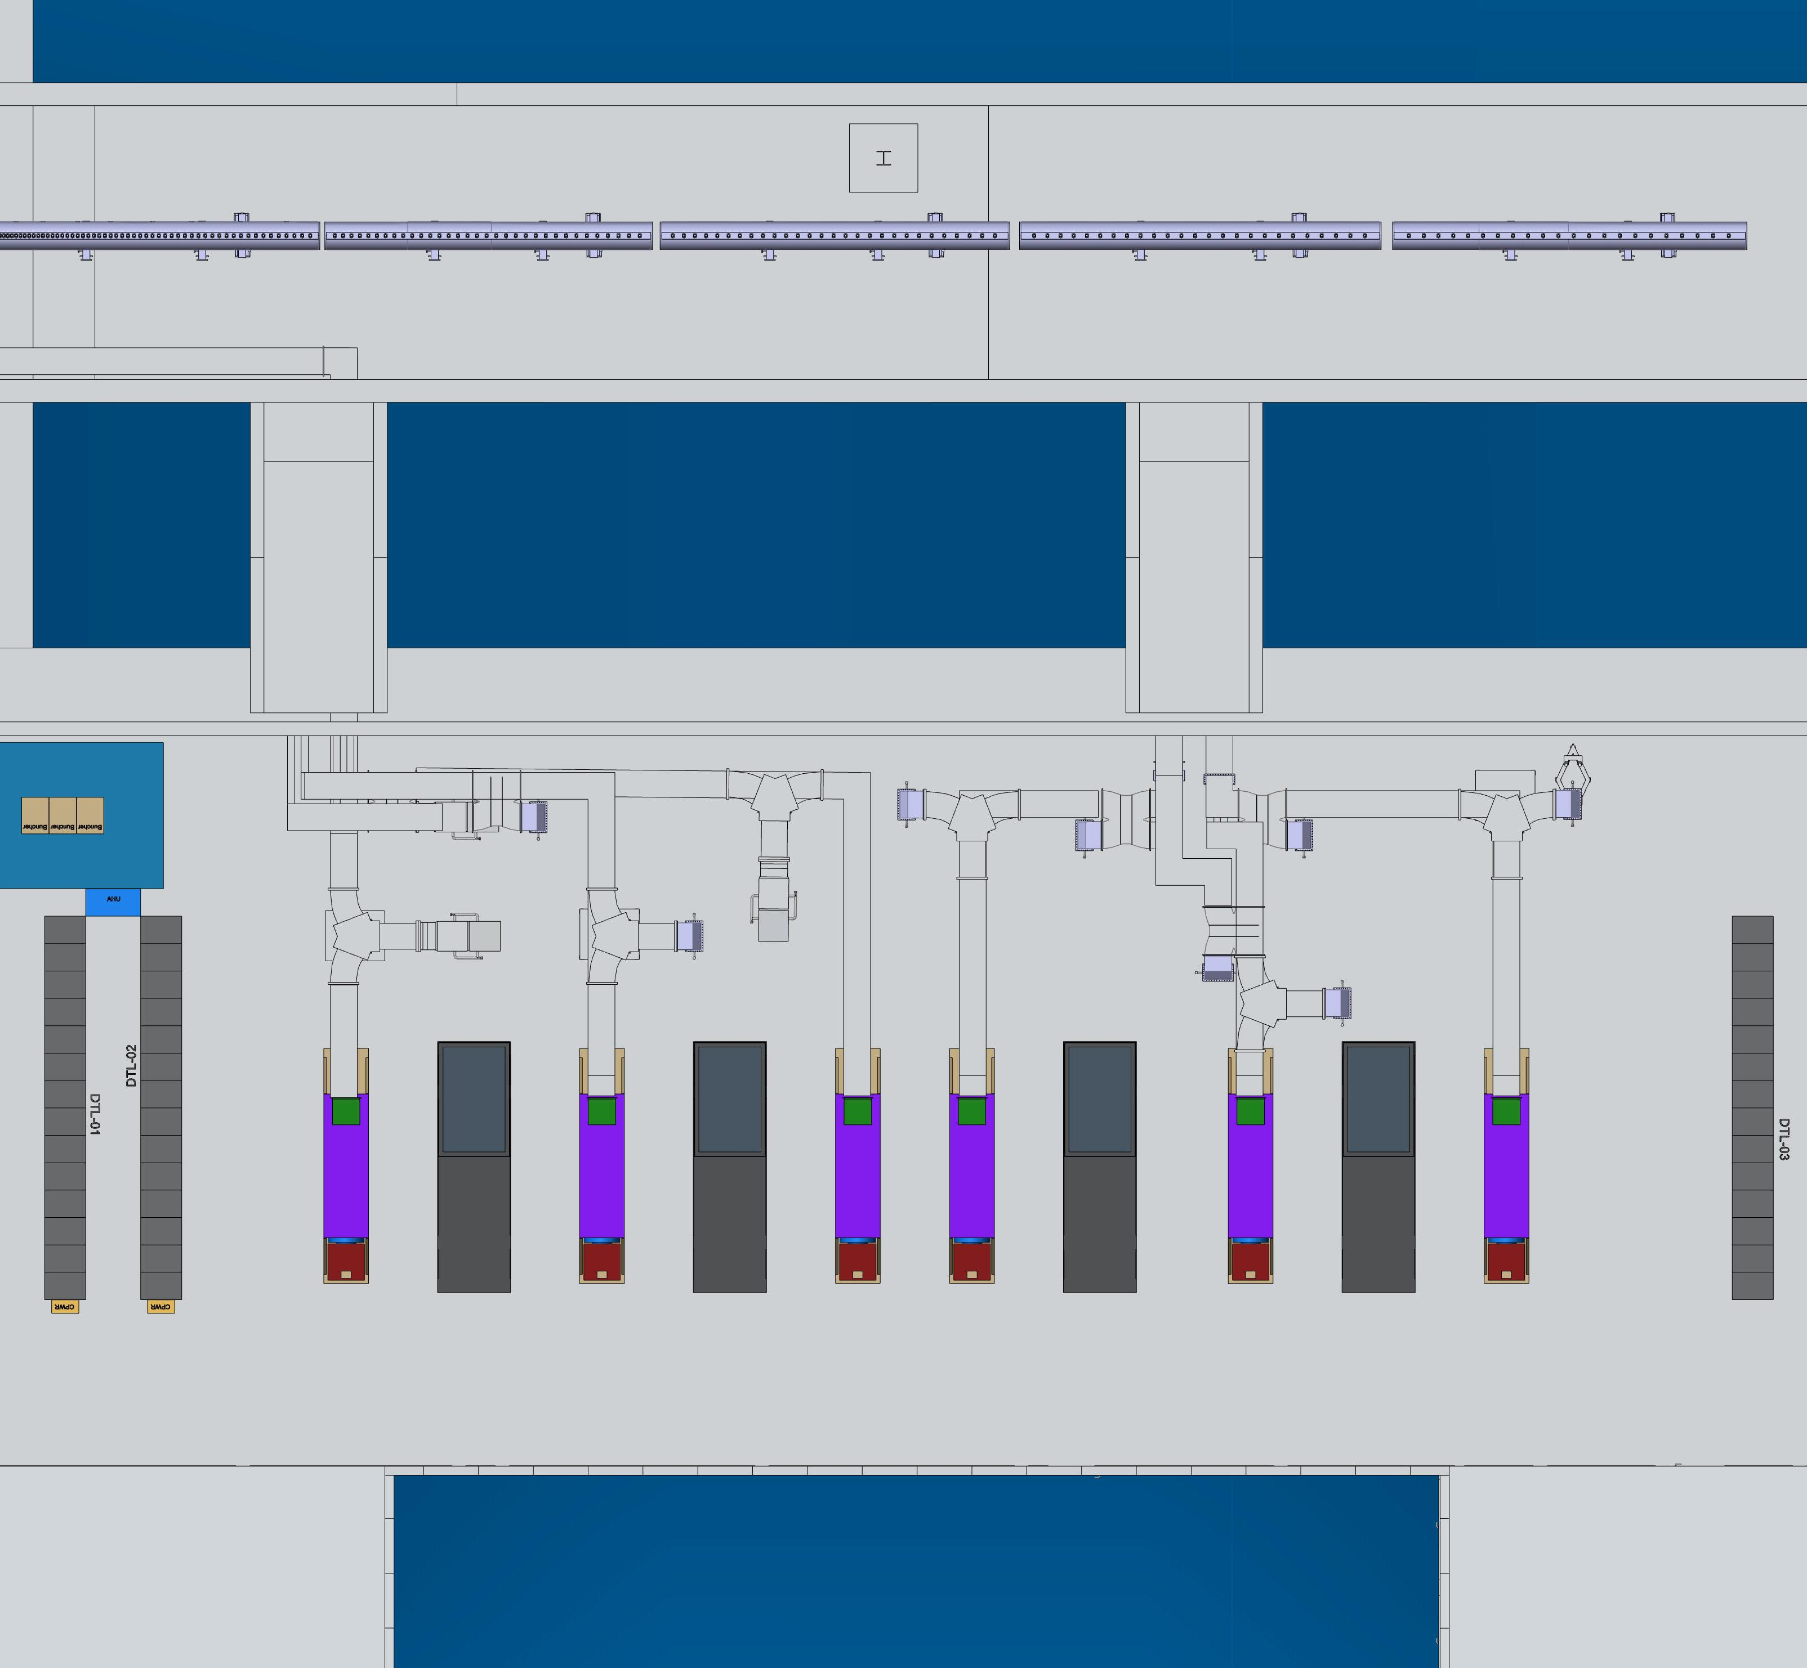
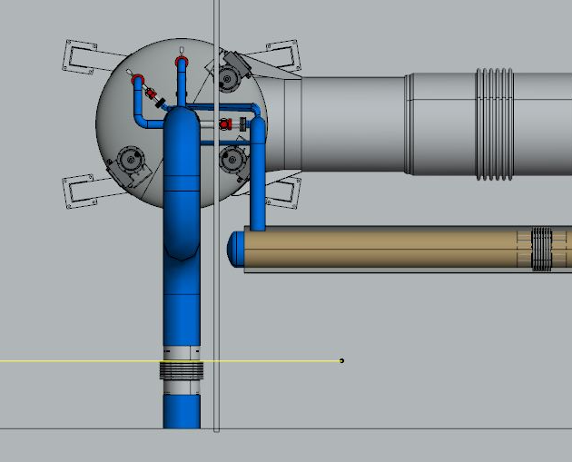
Temporary tunnel configuration for
warm linac staged commissioning
Installation operations
Front End Building (FEB)
Beam direction
Temporary Front-end
equipment access
(with removable
shield blocks)
Stubs and cable penetrations
with final shielding configuration
Regular front end
personnel access
Temporary shield wall
separating warm and cold
linac activities
Notes:
Need statement on the status of design and shielding assessment of this shield wall (Lali)
Also need to consideration for temporary equipment access (Lali)
If possible, a picture showing the integration of the shield wall with other equipment (Nick)

Slide 20
Optional intermediate shield wall and access zoning
Front End Building
Beam direction
ISRC+LEBT
DTL3
DTL4
Two temporary shield walls imply need for two separate temporary access zones, allowing
independent access
Intermediate shield wall door/chicane could likely be limited to emergency egress only
(implies access to DTL tanks 3 &4 from cold linac end)
Front End Building
Beam direction
ISRC+LEBT
DTL3
DTL4
One temporary shield wall need only one temporary access zones
Shield wall door/chicane could likely be limited to emergency egress only
Notes:
NB. Need to figure out if equipment access has PPS door, or is temporary shielding with configuration control.
we don’t think there is need for temporary access zones, the concrete walls are inside the zoning fences. Stuart may want doors installed on the chicanes, but not sure.

Slide 21
Beam Modes (Operational Envelopes) used for early commissioning (NC)
Name | Description | Characteristics | Notes
B0 | No Beam | No beam | No beam
B1 | Probe Beam | 5 µs @ 1Hz | Used for initial tune up
B2 | Fast Tuning | 5 µs @ 14 Hz | limited beam loading; used for fast scans (e.g. RF and Wire scanners)
B3 | Slow tuning | 50 µs @ 1 Hz | Beam loading studies, limit of invasive diagnostics
B4 | Long pulse verification | 2.86 ms @ 1/30 Hz | Only use when tunes up. RF feed forward, Beam loading, Lorenz detuning compensation. Beam loss minimization
B5 | Production | 2.86 ms @ 14 Hz | Normal operation with high power
B6 | Mixed mode | 2.86 ms @ 1/60 Hz, interleaved with 50 µs @ 1 Hz | TBC. May want to keep low power pilot beam on between high power pulses if running “pulse on demand”.
Ion source is capable of ~ 90mA * 6ms @ 14Hz.
Investigating hardware methods to limit rate and pulse length for commissioning.
The temporary shielding wall will set the limit of the beam modes to use. IS limited to 1 Hz, 3 ms pulse
Supporting document: ESS-ESS-0038258
Notes:
Should there be a current limitation on the probe beam? (Marc)
Assume all other beam modes are limited only to nominal current? Correct (Marc).
Long pulse is at 50 µs and the rep rate for mixed is 1/60 Hz

Slide 22
Beam Stops
Name/Location | Current Limits
LEBT | Full beam
MEBT | 1 Hz, 50 us / 14 Hz, 5 us
DTL | 1 Hz, 50 us / 14 Hz, 5 us
Spokes | 1 Hz, 50 us / 14 Hz, 5 us
MBL | 1 Hz, 50 us / 14 Hz, 5 us
Dump | 12 kW
Target | 5 MW
Commissioning beam dump | Under study (Linac4 dump)

Slide 23
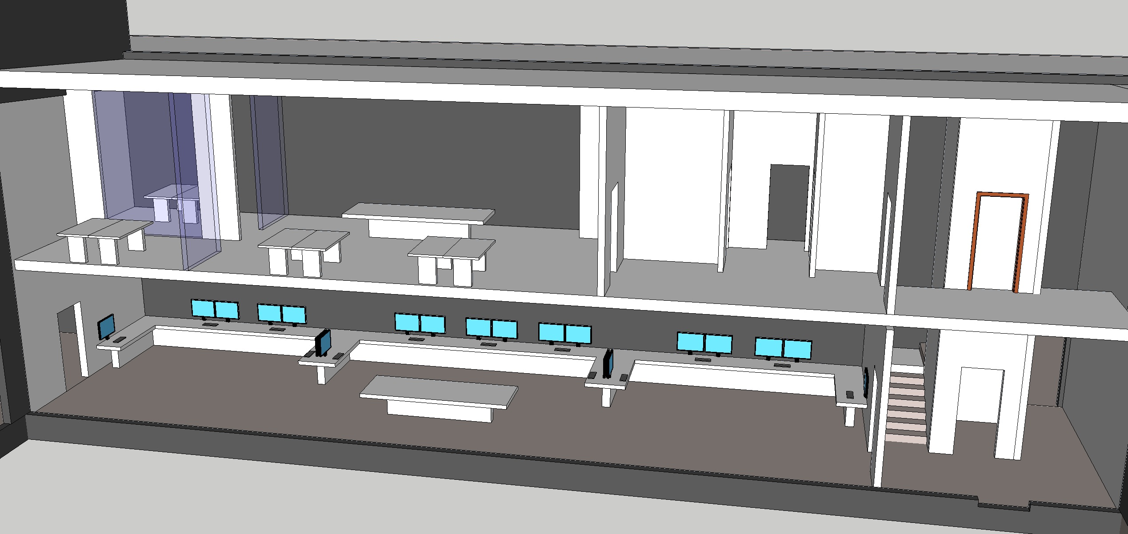
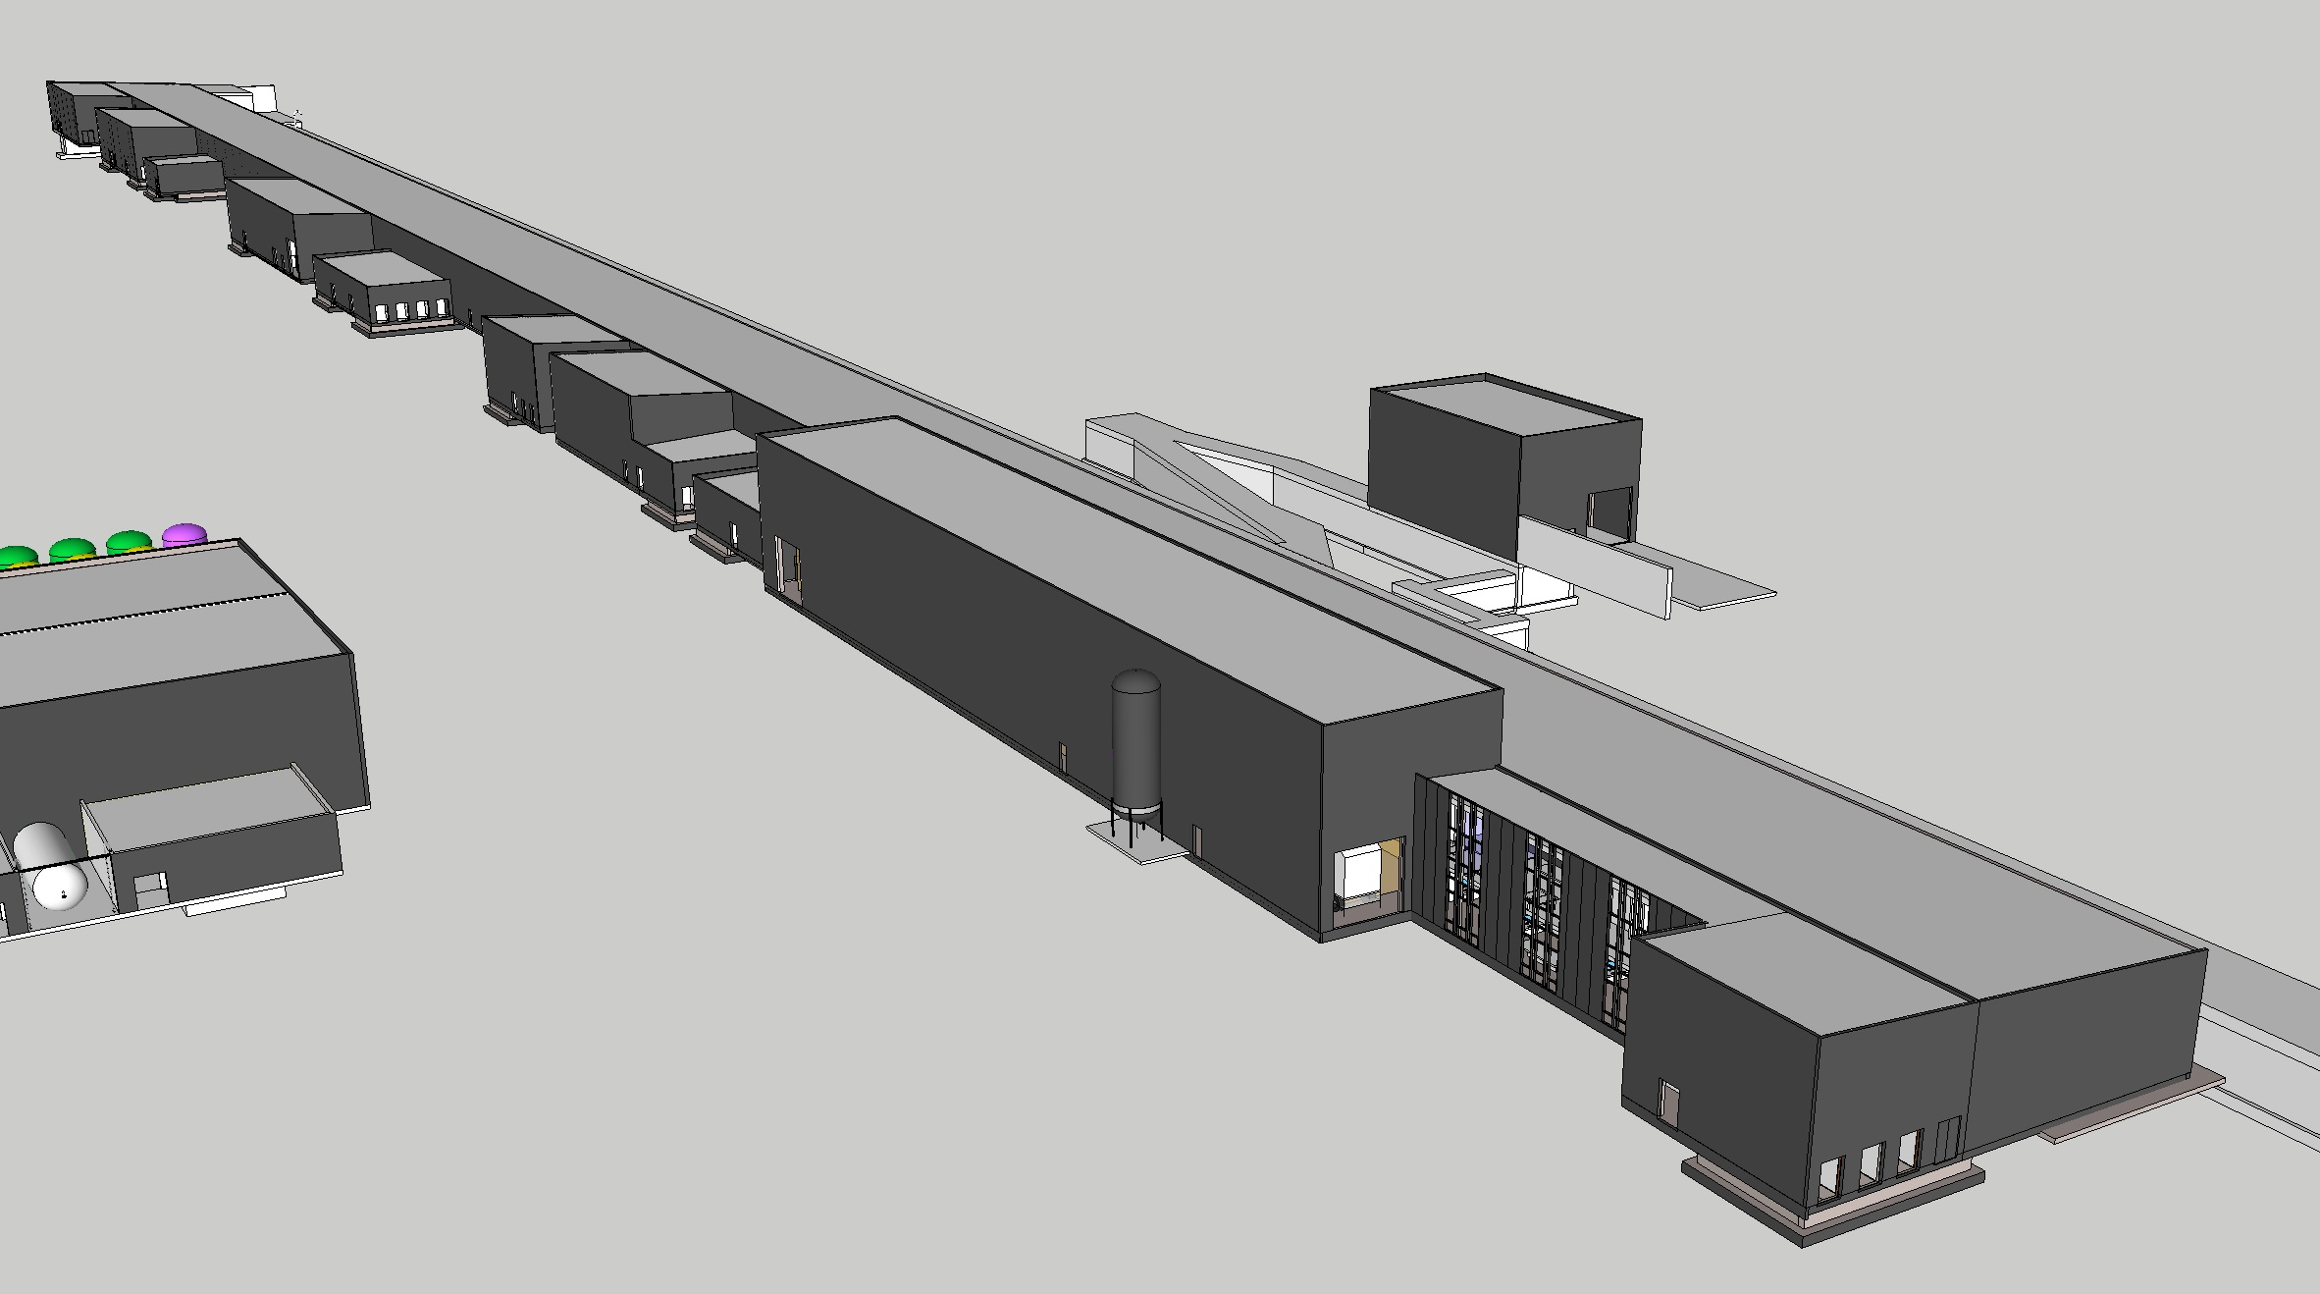
Local Control Room
MCR will not be ready in time for BC
We will use the Local Control Room, located at the end of the Gallery

Slide 24
Staged Commissionig
Warm Linac:
  Mostly at 1 Hz, 5/50 µs beam (limited by the shielding wall)
SC to Dump
  Mostly at 1 Hz, 5/50 µs beam, some test with longer bunches at slow repetition rate (limited by tuning dump)
Linac to Target
  Starting with 1 Hz, 5 µs beam, ramping up to 2.86 ms

Slide 25
Sequence for commissioning to Target (no HBL cavities)
Staged commissioning, in parallel to installation!
IS-LEBT
IS-LEBT-RFQ-MEBT
IS-LEBT-RFQ-MEBT-DTL1
IS-LEBT-RFQ-MEBT-DTL1-DTL2-DTL3-DTL4
IS-LEBT-RFQ-MEBT-DTL1-DTL2-DTL3-DTL4-DTL5-SC Linac–HEBT-Dump
IS-LEBT-RFQ-MEBT-DTL1-DTL2-DTL3-DTL4-DTL5-SC Linac–HEBT-A2T-Target
Temporary Test Bench
Dates are somewhat in flux, under optimization.
The goal is to get 1st Proton on Target 28 Jun 2019

Slide 26
Temporary diagnostic
Temporary Test Bench for DTL and MEBT commissioning?
Integrates a beam dump, based in the Linac4 one
The space is very limited after DTL4
For IS+LEBT, the diagnostic box with the FC will be move to the end of the LEBT during commissioning
From S. Molloy

Slide 27
Warm Linac Commissioning steps and beam parameters:
Name | Maximum energy | Beam duration | Beam power* | Total number of protons**
IS-LEBT | 75 keV | 1600 h | 230 W | 1.1 × 10²³
RFQ-MEBT | 3.7 MeV | 720 h | 16 W | 6.9 × 10¹⁹
DTL 1 | 23 MeV | 960 h | 101 W | 1 × 10²⁰
DTL2-4 | 75 MeV | 1000 h | 328 W | 1 × 10²⁰
NB. 10kW beam currently not foreseen under the terms of the 2nd SSM license!
(full pulse length at MEBT energy would be 9kW)
* time average to dump (including duty cycle), not peak
** to temporary dump (does not include chopping dumps and expected LEBT loss)
ESS
ESS-0043907

Slide 28
Operators, shifts, etc
We should get some operators in 2017/18
Shift and working hours under study. A first proposal is:
  IS/LEBT: 24 h/day at the start, later 8 h/day (after checking source thermal stability)
  RFQ/MEBT: 24h/day
  DTL1: 12 h/day
  DTL2-4: 12 h/day
  SC Linac: 24 h/day
Running 20 days per month (3 weeks on, 1 shutdown)

Slide 29
Note: All dates are according to P6, but they will change!
For example: the installation of the new shielding wall could affect all the dates!

Slide 30
Commissioning: IS+LEBT
BC window: January 2018 - 15th June 2018
Beam: Up to 14 Hz rep rate, 6 ms, ~90 mA peak current
Max Energy: 75 keV
Beam destination:
  LEBT Faraday Cup, when using the Allison Scanner to characterize the IS. The diagnostic box with the FC and the Allison Scanner will be moved to the end of the LEBT from its design position during this beam commissioning stage.
  Part of the beam (the chopped part) will be lost in the dump after the chopper
  Part of the beam will be block by the Iris when selecting the peak current

Slide 31
LEBT Proposal
Doppler Measurement for species fraction. For commissioning, possibly relocated to test-stand during operations. Not yet decided.
From S. Molloy
Allison Scanner
Transverse x & y position & profile. Gated to suppress signal from chopped beam.

Slide 32
Commissioning: RFQ+MEBT
BC window: 30th August 2018 - 02th October 2018
Beam: 1Hz rep rate, up 50 us, 62.5 mA peak current (Probe and Slow tuning)
Max Energy: 3.62 MeV
Beam destination: Faraday Cup in the MEBT and a temporary beam dump
Temporary beam stop

Slide 33
Commissioning: DTL1
BC window: 3rd October 2018 - 1st February 2019
Beam: Up to 14 Hz rep rate, 50 us, 62.5 mA peak current (Probe, Fast and Slow tuning)
Max Energy: 21.3 (22) MeV
Beam destination: Faraday Cup in the MEBT and a temporary beam dump
Temporary beam stop

Slide 34
Commissioning: DTL2-DTL3-DTL4
BC window: 27th February 2019 - 7th May 2019
Beam: Up to 14 Hz rep rate, 50 us, 62.5 mA peak current (Probe, Fast and Slow tuning)
Max Energy: 73.8 (75.5) MeV
Beam destination: Faraday Cup in the MEBT and after DTL2 and a temporary beam dump
Temporary beam stop

Slide 35
Commissioning: SC Linac to Dump
BC window: 8th May 2019-27th June 2019
Beam: Probe, Fast and Slow tuning, Long pulse verification(?), hybrid(?)
Max Energy: 517 MeV
Beam destination: Tuning dump plus any beam stop in the Linac

Slide 36
Commissioning: SC Linac to Target
BC window: 28th June 2019 - 2020
Beam: Any (first time we will use the production beam mode).
First production of neutrons.
Max Energy: 571 MeV
Beam destination: Target and Tuning dump plus any beam stop in the Linac

