Slide 1
Mechanical & tunnel integration
Nick Gazis
Mechanical Integration Lead Engineer
www.europeanspallationsource.se
February 2016

Slide 2
Outline
Accelerator layout
Tunnel Integration
Integration Strategy

Slide 3
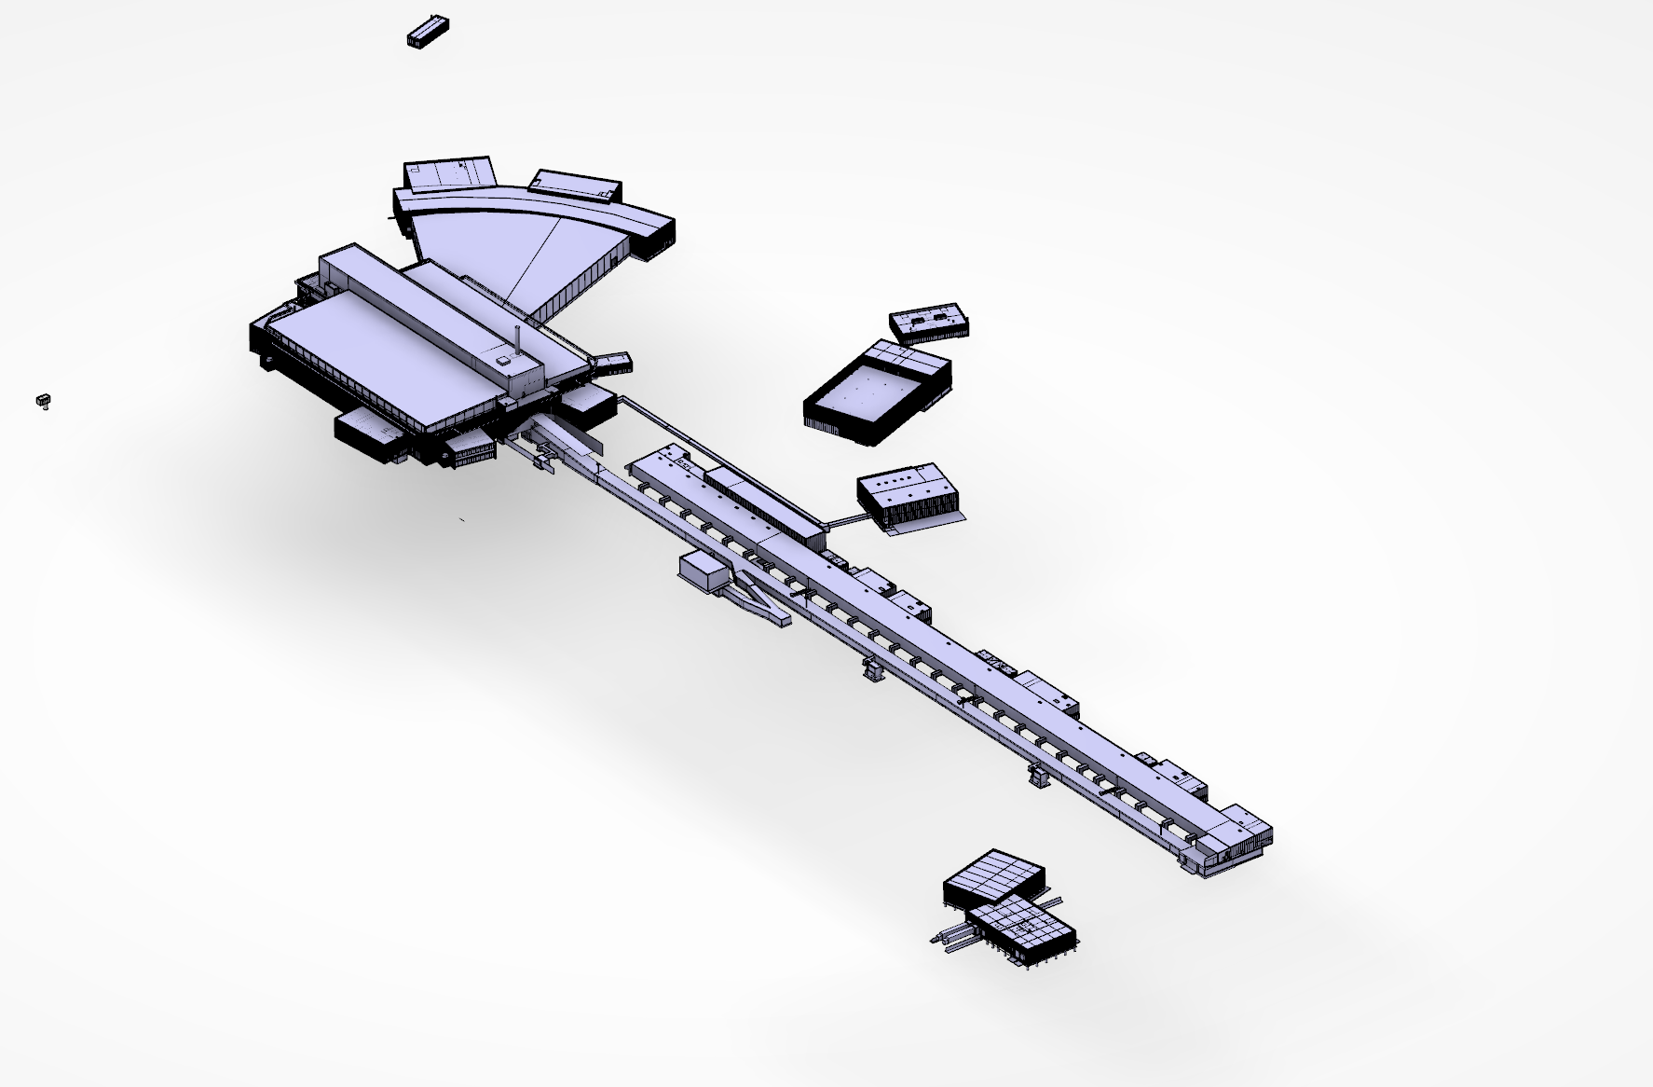
ESS buildings under construction (Feb. 2016)
Instruments
Electrical
Cryo compressor
Target
Klystron Gallery
HEBT Loading Bay
Front-End Building
Accelerator
Logistics

Slide 4
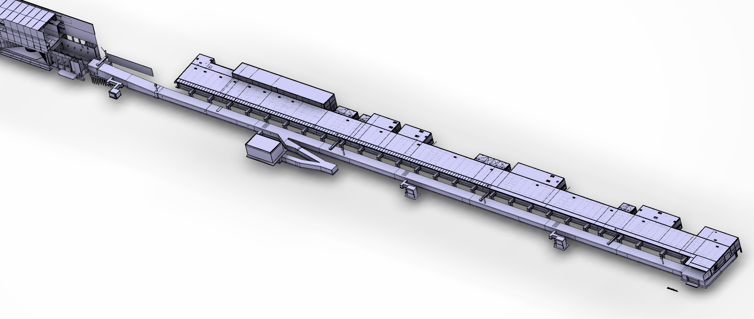
ESS accelerator layout
Target
A2T ← DgLg ← HEBT
2000 MeV
High β
Cryo
(179 m)
Medium β
571 MeV
(77 m)
Spoke
Warm
DTL
(56 m)
216 MeV
(39 m)
MEBT
90 MeV
(3.8 m)
RFQ
3.6 MeV
(4.6 m)
LEBT
(2.4 m)
Source
75 keV

Slide 5
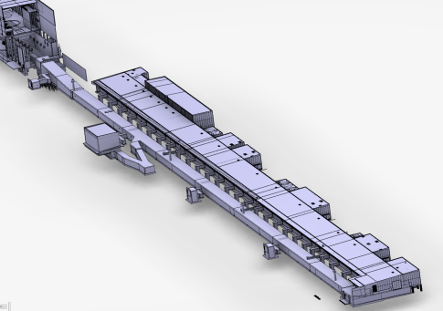
Accelerator Tunnel personnel entrances/exits
Overview
HEBT entrance (chicane)
FEB entrance (chicane)
A2T egress
Emergency exits

Slide 6
Accelerator Tunnel equipment access
Overview
HEBT Loading Bay
FEB drop hatch

Slide 7
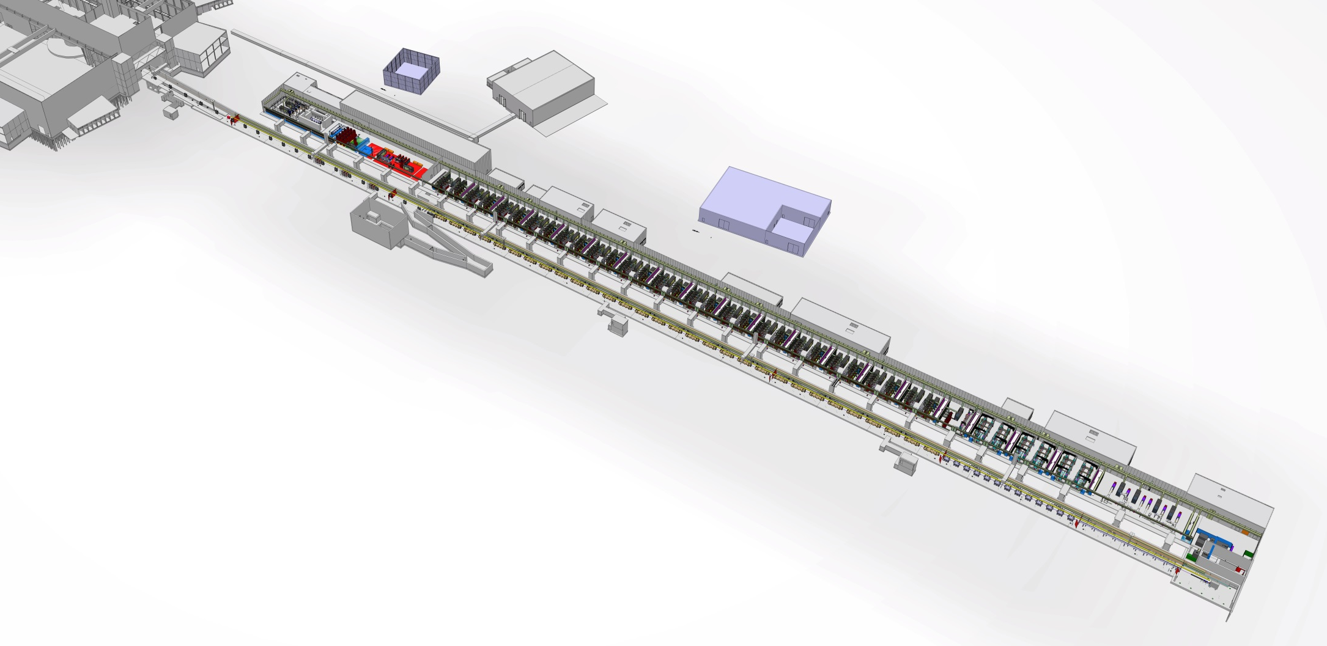
Tunnel Integration

Slide 8
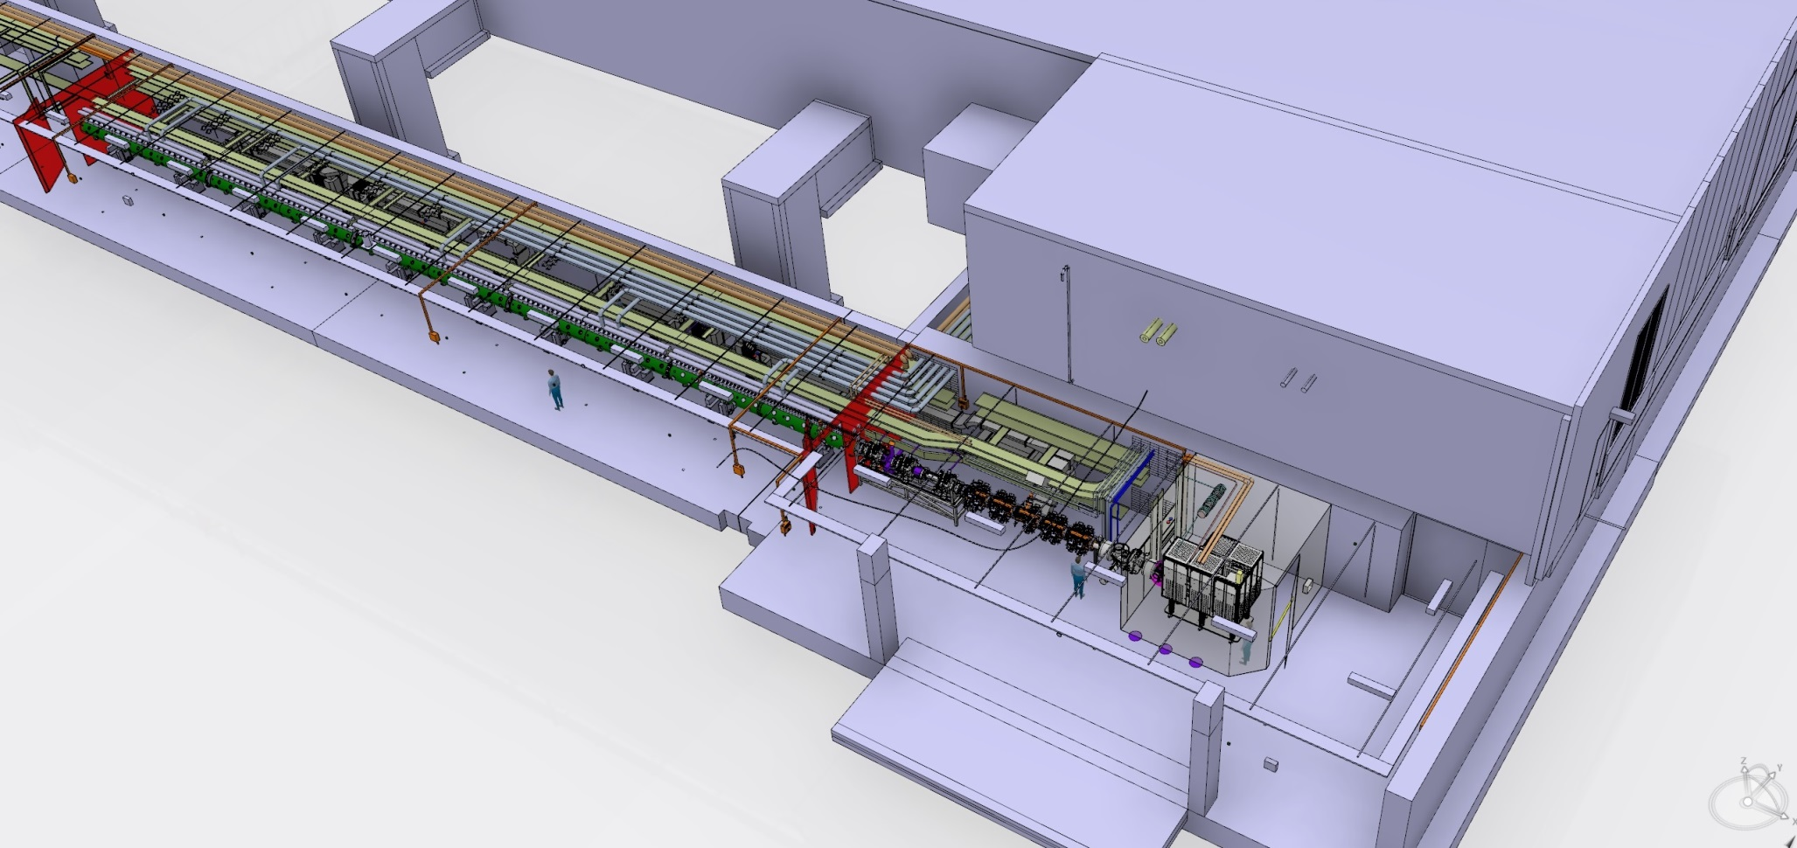
Warm linac

Slide 9
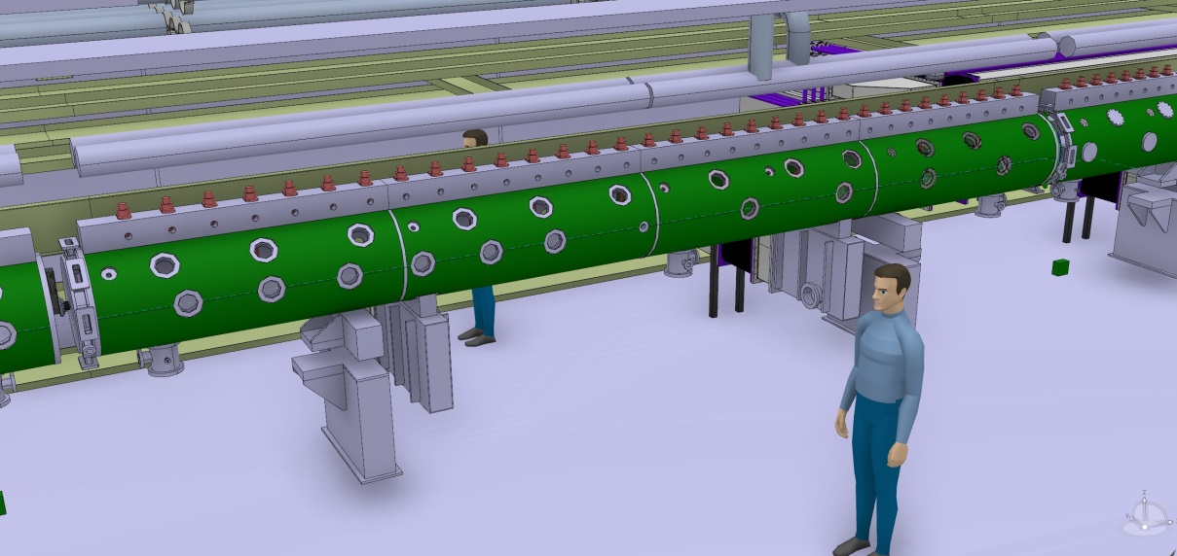
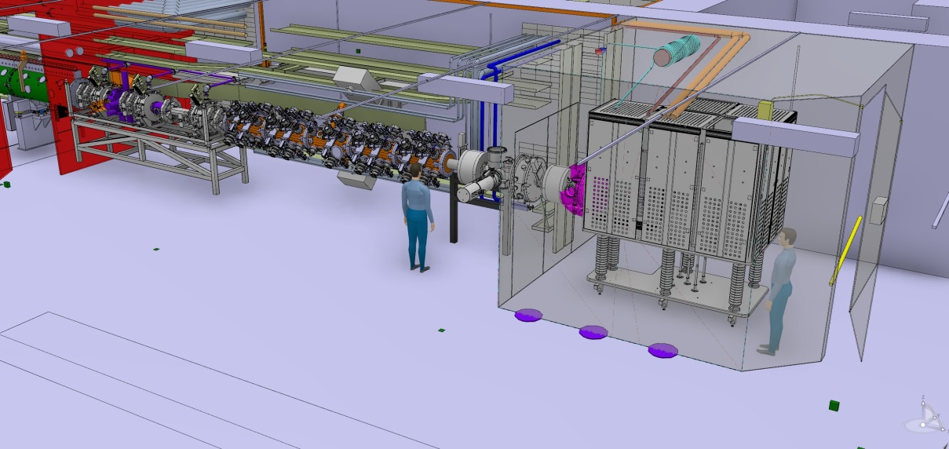
Warm linac
Access to the installations (north) tunnel wall is possible under the DTL
ISRC is situated inside the HV cage
Access to the installations (north) tunnel wall could be possible under the LEBT/RFQ/MEBT (t.b.d.)

Slide 10
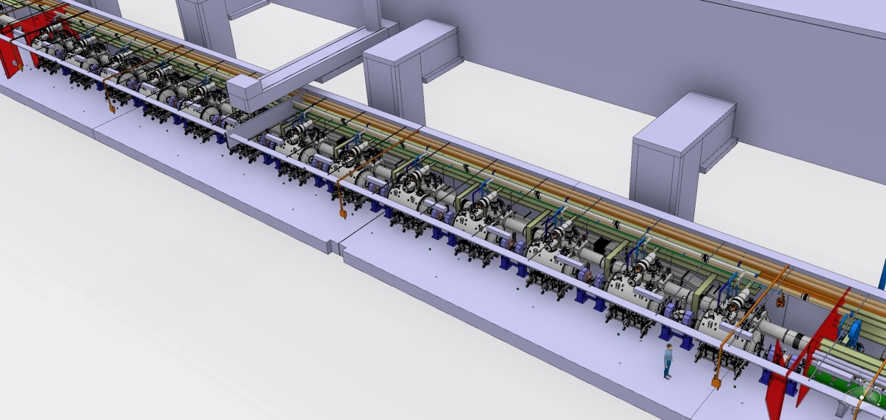
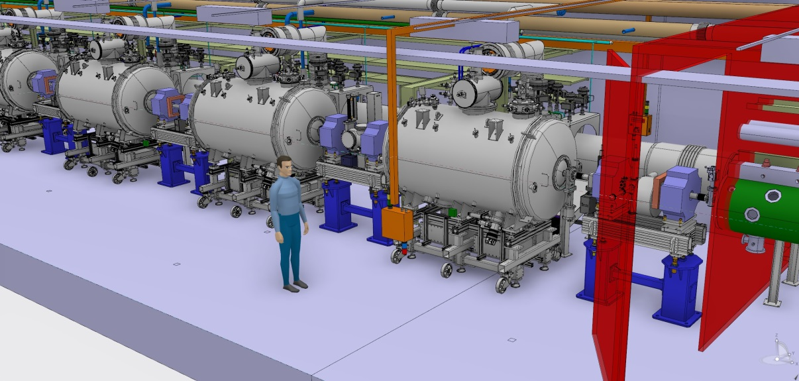
Spoke
SPK CM do not allow for access route to the installations (north) tunnel wall
Access to the installations (north) tunnel wall is possible under the LWU (through the LWU support table)
Temporary ladders can be installed on top of the LWU for access around it

Slide 11
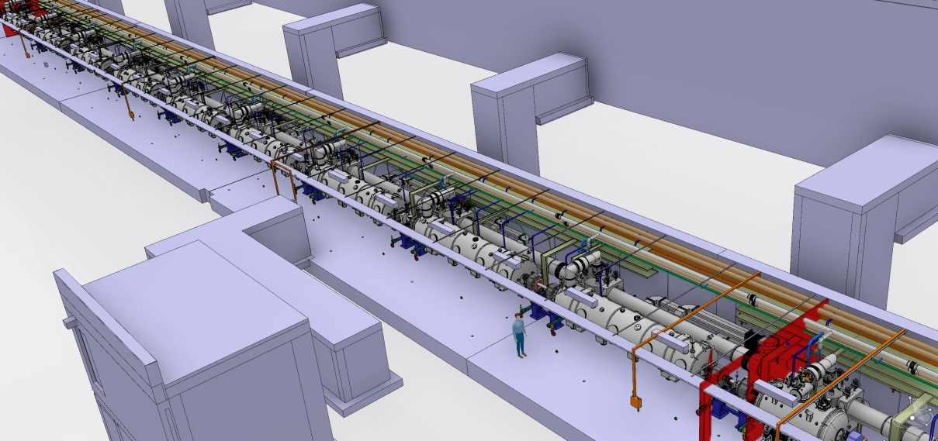
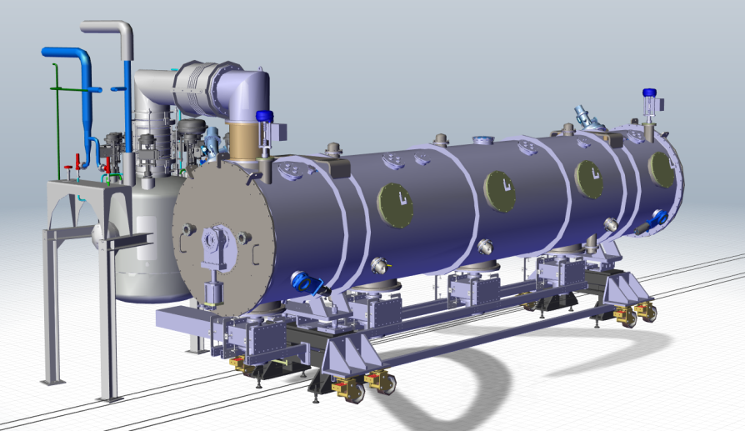
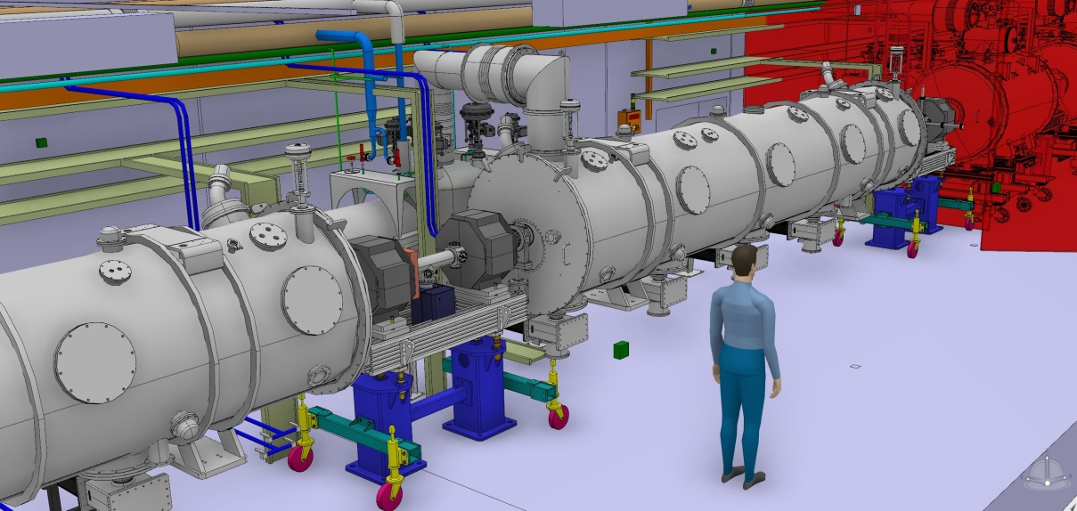
Medium & High Beta Linac (MBL & HBL)
Elliptical CM support design in progress
Access to the installations (north) tunnel wall is possible under the LWU (through the LWU support table)
Temporary ladders can be installed on top of the LWU for access around it

Slide 12
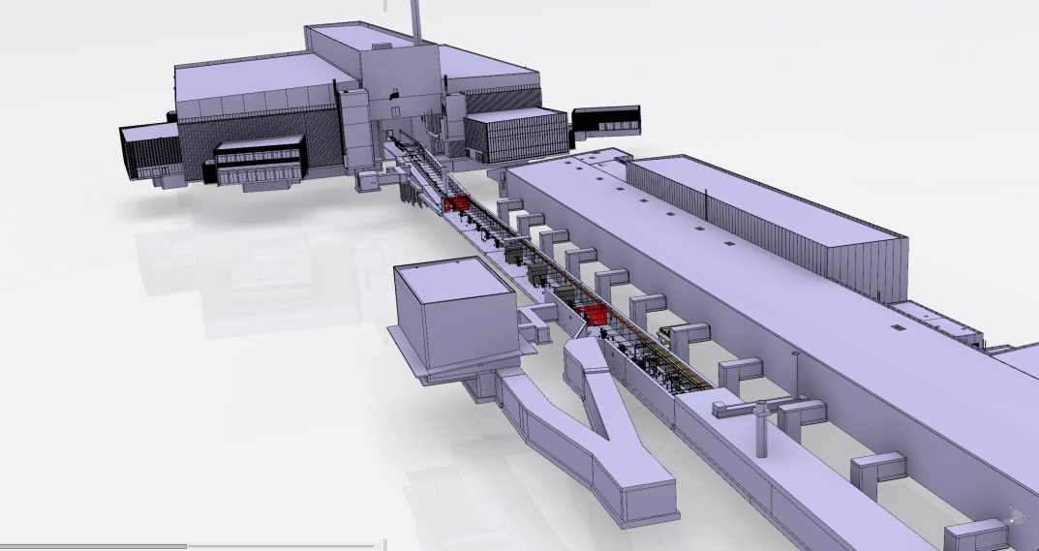
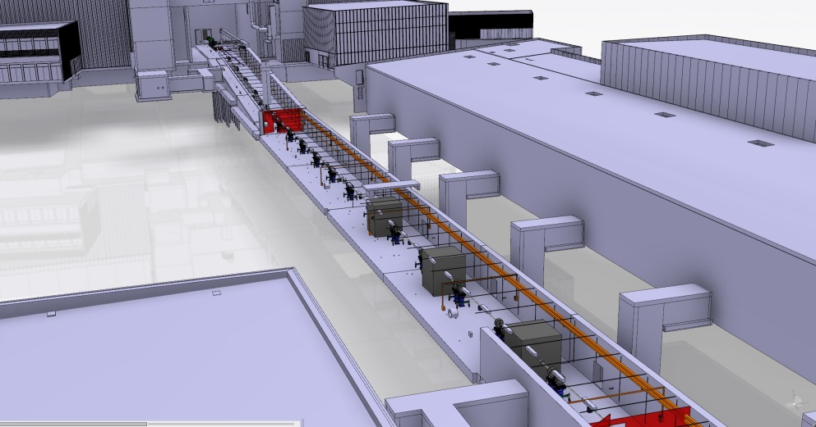
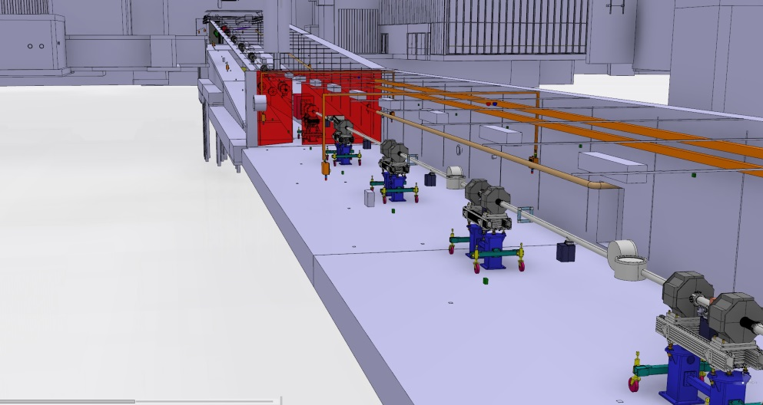
High Energy Beam Transport, Dog-Leg & Accelerator to Target (HEBT, DgLg & A2T)
Access to the installations (north) tunnel wall is facilitated throughout HEBT, DgLg and A2T

Slide 13
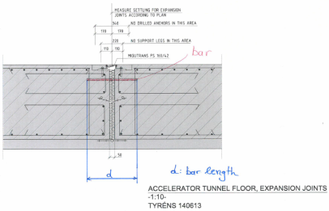
Tunnel issues discussed in the ESS cryogenics safety workshop (10-Feb-2016)
Red is reserved for Personnel Safety Systems (PSS)
Yellow is reserved for radiation safety
Transportation in the tunnel can be influenced by the floor expansion joints
Accelerator Tunnel has no overhead crane
20 tn overhead crane is situated on top of both HEBT and FEB drop-hatches
(for lowering components in the tunnel)
Entrance is not possible through the emergency exits (only exits!)
Entrance to the tunnel through the FEB is possible for equipment of W=2.3 m, H=2.2 m, L=3 m

Slide 14
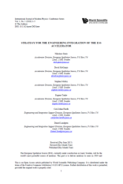
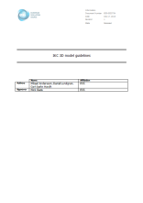
Integration strategy
“Strategy for the engineering integration of the ESS accelerator“
https://ess-ics.atlassian.net/wiki/download/attachments/33161992/4667-49_final.pdf?version=2&modificationDate=1453739145793&api=v2
“IKC 3D model guidelines” - ESS-0023754
https://chess.esss.lu.se/enovia/tvc-action/showObject/dmg_Information/ESS-0023754/valid
References for warm linac interface drawings included

Slide 15
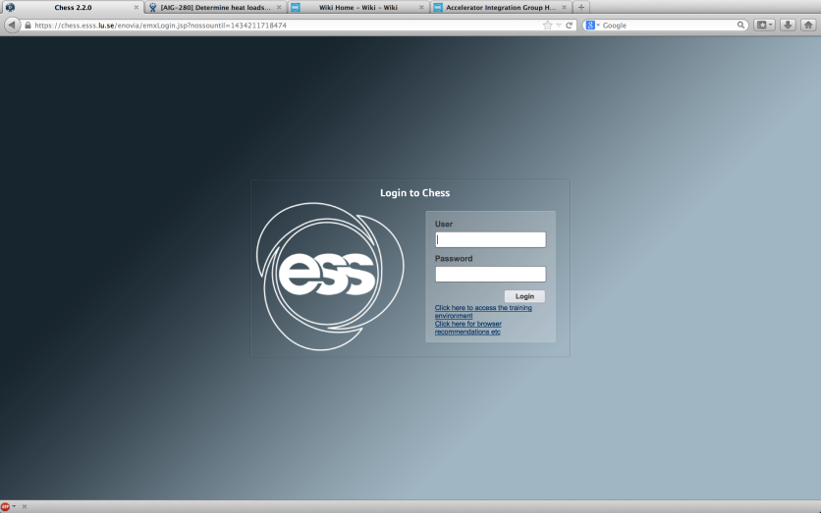
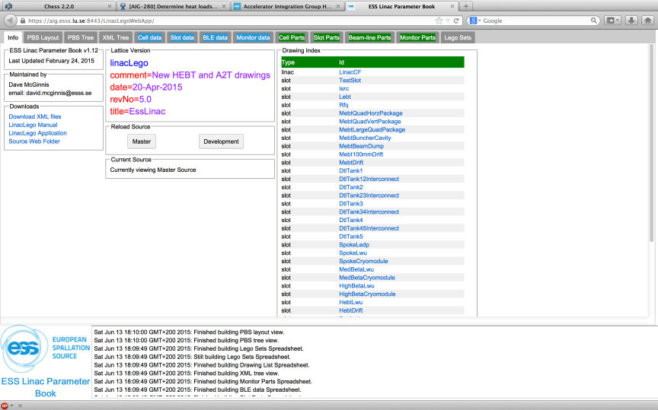
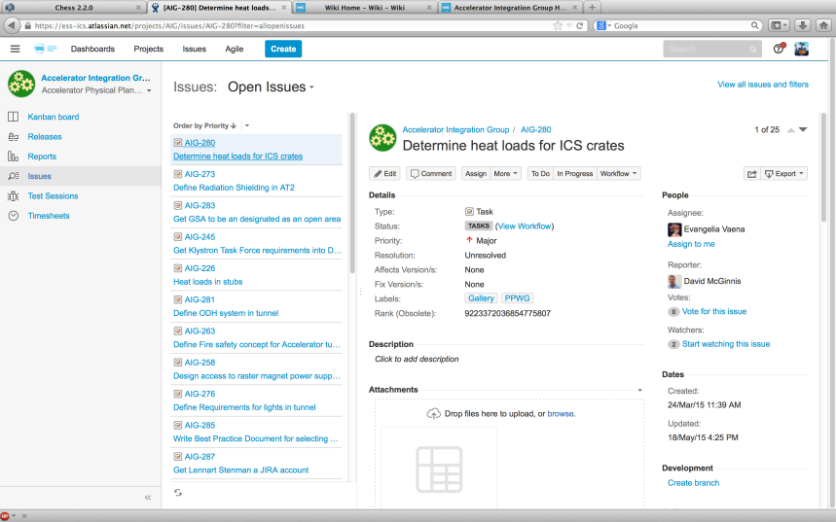
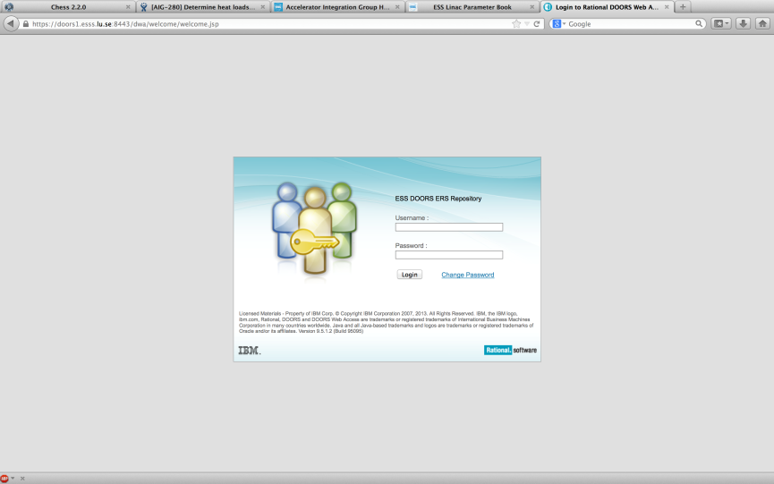
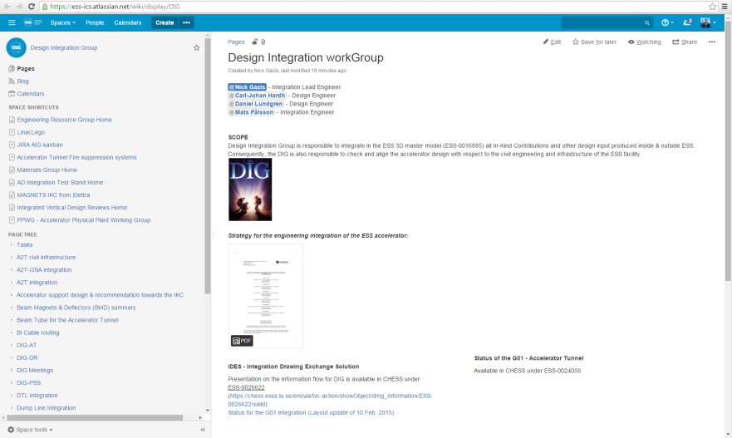
Strategy for the engineering integration of the ESS accelerator
3. CHESS
4. CATIA
Atlassian tool suite
5. JIRA
2. LinacLego
6. Wiki
1. DOORS

Slide 16
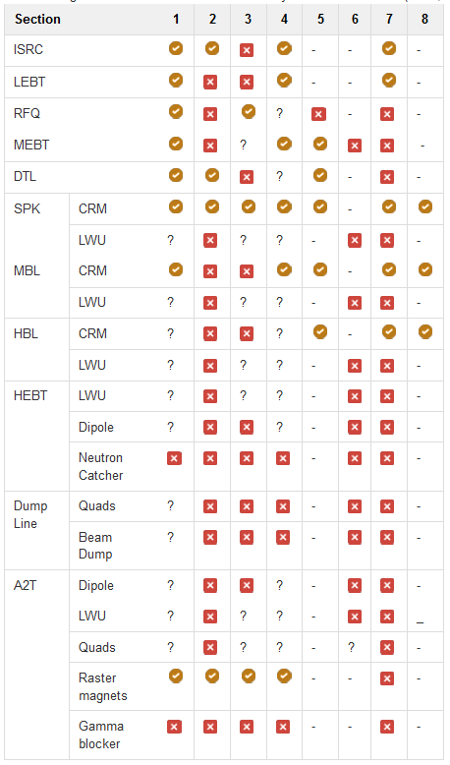
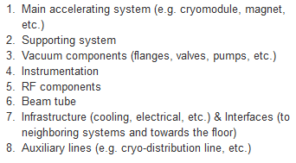
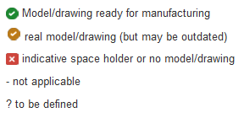
Reporting in JIRA: CAD Inventory (status as of Jan-2016)
The inventory of the CAD model for the accelerator is now summarized under a link:
https://ess-ics.atlassian.net/wiki/display/DIG/Inventory+of+integration+models+and+drawings+for+the+ACCSYS+components
Each tunnel section contains sub-systems:
Inventory is reported per tunnel section with one of the following statuses:
Current goal is to reach for all tunnel sections the level of:
Your feedback on the inventory status is needed

Slide 17
Strategy for the engineering integration of the ESS accelerator
SECTION
ISRC
LEBT
RFQ
DTL
SPK
MBL
etc…
CELL
SPK-01
SPK-02
SPK-03
…
SPK-13
SLOT
SPK-02-LWU
BEAMLINE ELEMENTS SPK-02-LWU-QH01, SPK-02-LWU-QH02, …
Level of exchange for the CAD files between IKC-ESS
SPK-02-CM

Slide 18
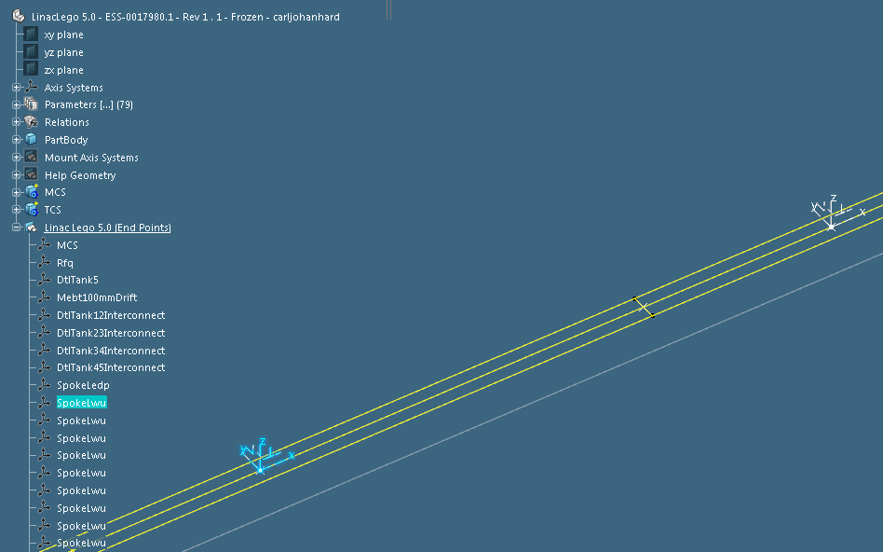
Strategy for the engineering integration of the ESS accelerator
[cell] SPK-1
[slot] SPK-LWU-2
[slot] SPK-CM-1
[End Point] SPK-LWU-1
Beam line
Beam line
Beam line
Beam line
SPK-CM-1
SPK-LWU-2

Slide 19
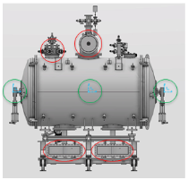
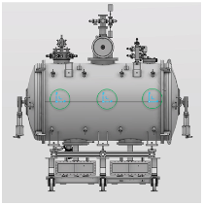
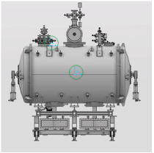
IKC 3D model guidelines - ESS-0023754
Export CAD model structure - 3D model export structure:
Product (assembly) at the top level
Skeleton part
IKC delivery unit
A dedicated axis system is needed on all above mentioned insertion points
CAD Integration reference points
Geometrical points | Mechanical points IN, OUT, MID of the slot on the beam plane Installation points e.g. support interface points Operation points centerpoints of interfaces e.g. flanges
Optical points | START, EXIT, MID of the lattice/optics reqs based on LinacLego (on the beam plane)
Reference points | Fiducial and alignment points

Slide 20
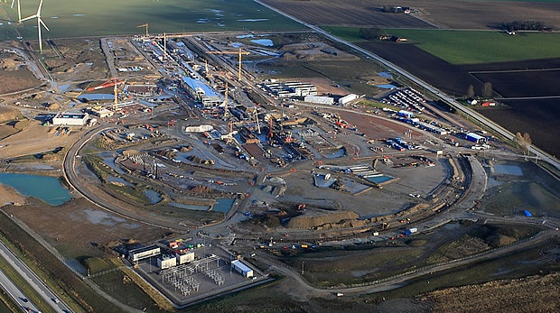
ESS

