Slide 1
INFN- Legnaro National Lab. Activity
on ESS DTL Diagnostics: BPM & BCM
Beam position monitor prototype development
Test bench Beam position monitor simulation
Beam Current monitor description
Conclusions
Marco Poggi INFN-LNL

Slide 2
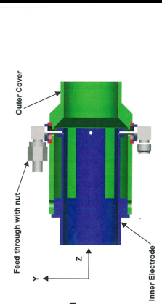
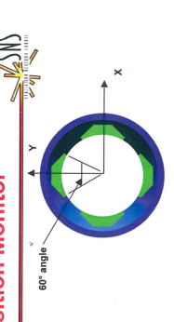
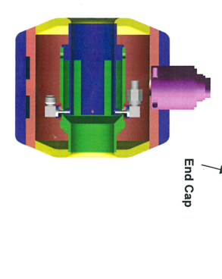
DTL - BPM
30 mm
20 mm
Beam direction
64 mm
Pictures from SNS project

Slide 3
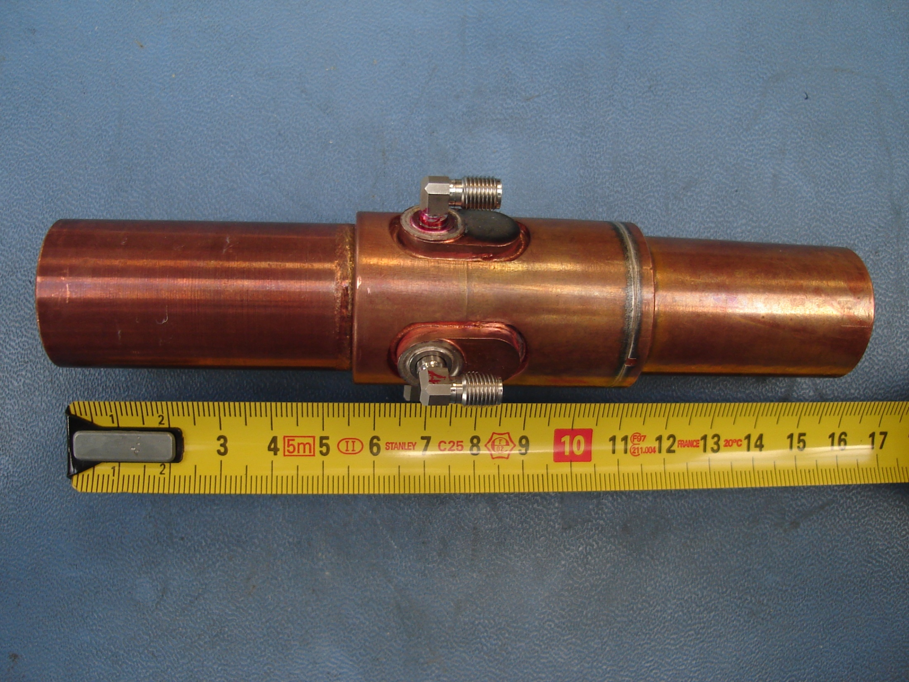
FIRST BPM PROTOTYPE

Slide 4
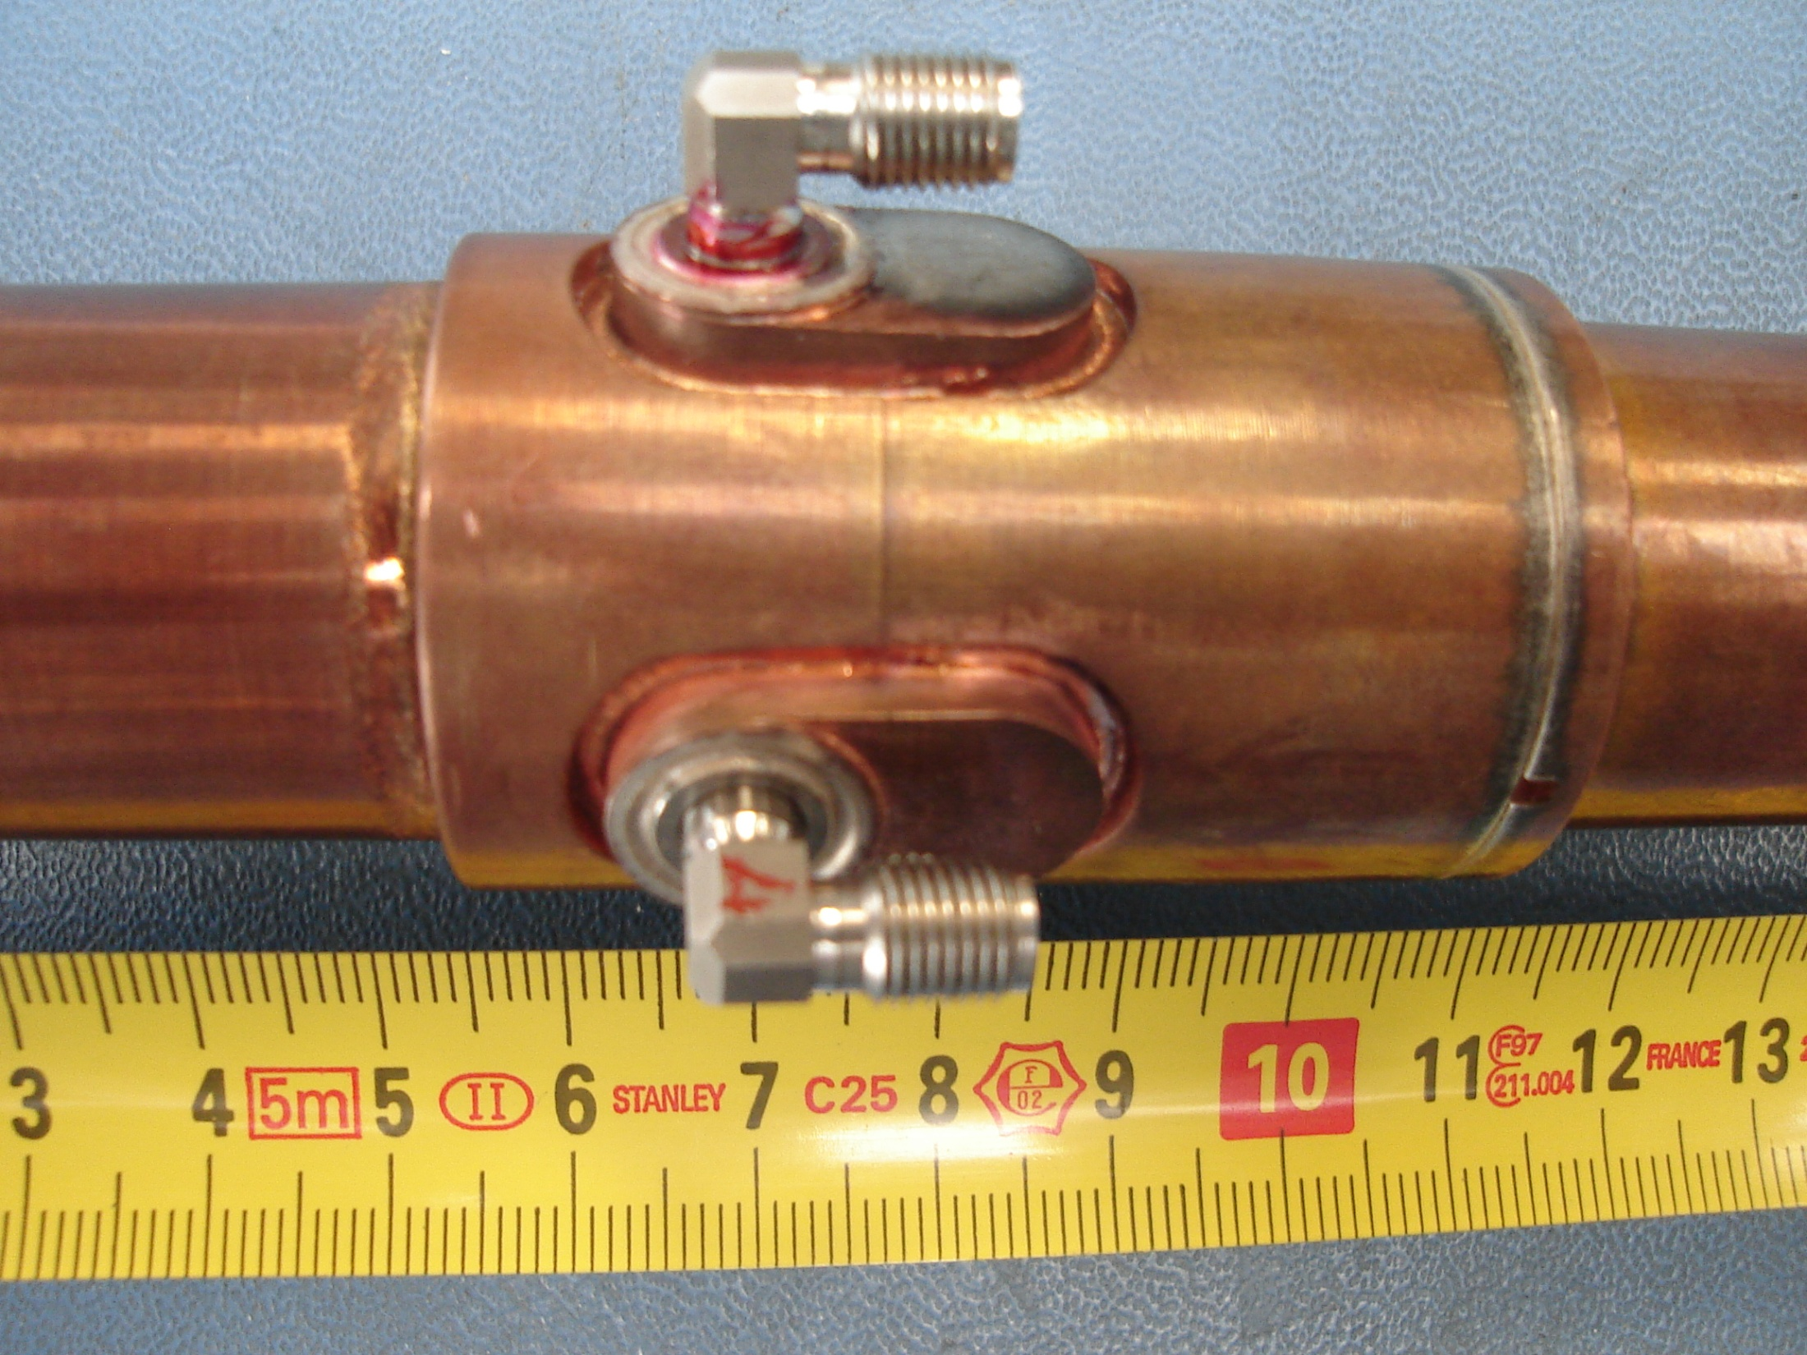
SMA female

Slide 5
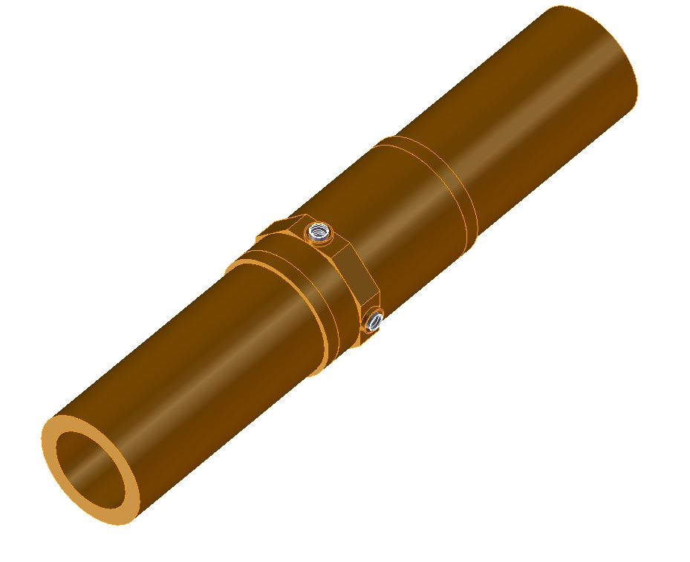
SMP male
feedthrough
NEW BPM PROTOTYPE

Slide 6
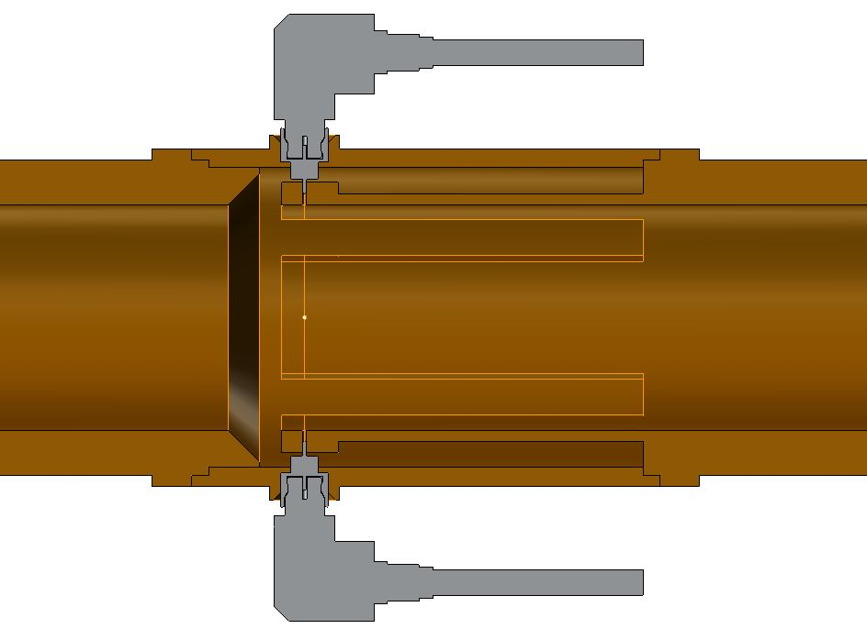
SiO2 cable-Φ=0.09”
SMP female connector
30 mm
54 mm

Slide 7
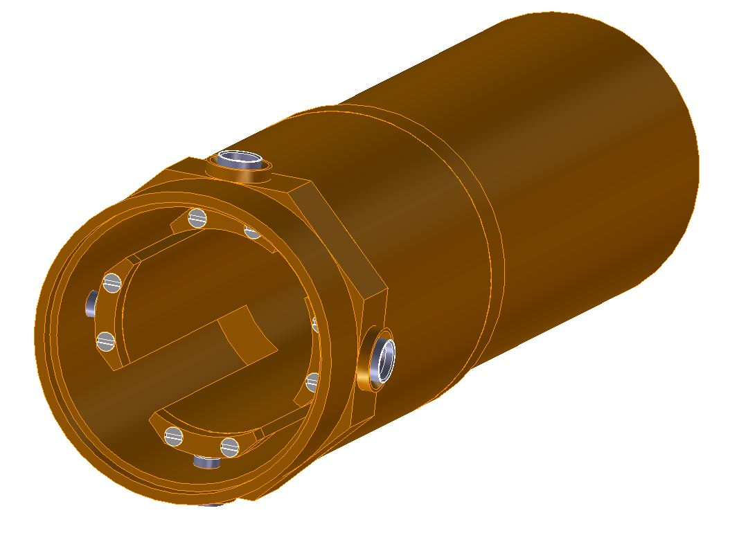

Slide 8
How do make BPM simulation at best with wire test bench.
Identify working frequency: 704 MHz
Simulate gaussian bunch signal with wanted charge inside: 140 pC
Simulate periodic signal with 1/RFfreq using PSPICE: 2.84 ns
FFT of the periodic signal with PSPICE: 75 mA
@ 704 MHz
5) Measure of the wire resistance: 20 Ω
6) RF Signal generator to produce 75 mA on 20Ω @ 704 MHz: 1.5 Vrms

Slide 9
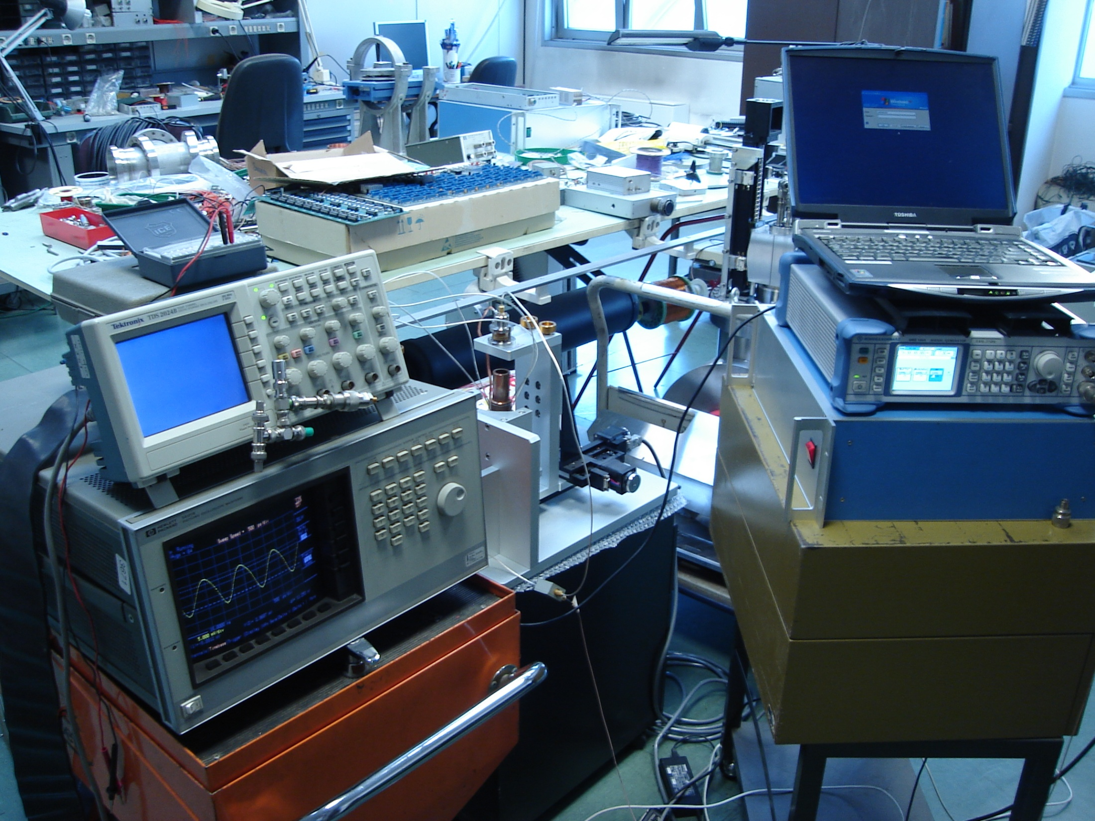
RF generator
Test bench
HP sampling osc.

Slide 10
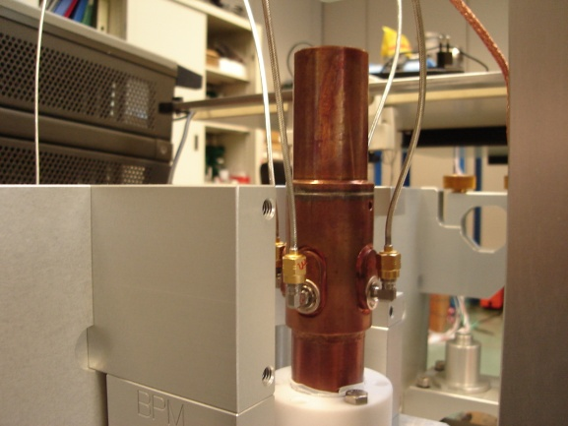
Input signal: 10 dBm @ 704 MHz
mm

Slide 11
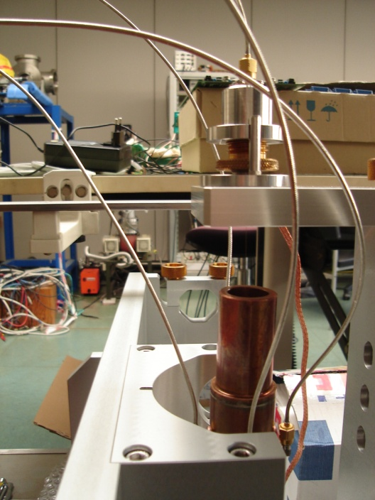
Problems in simulation (1)
Reflection due to a mismatching between
signal generator and wire
Solution:
Resistance network to match characteristic
impedances between signal output and wire
Input (not tested yet)
input wire
out signal
input wire
signa
0.1 mm wire + BPM under test (Φ =20mm)
50 Ω
39 Ω
Impedance wire + bpm
signal generator
output impedance
impedance matching network
27 Ω
318Ω
20 Ω
Resistance wire

Slide 12
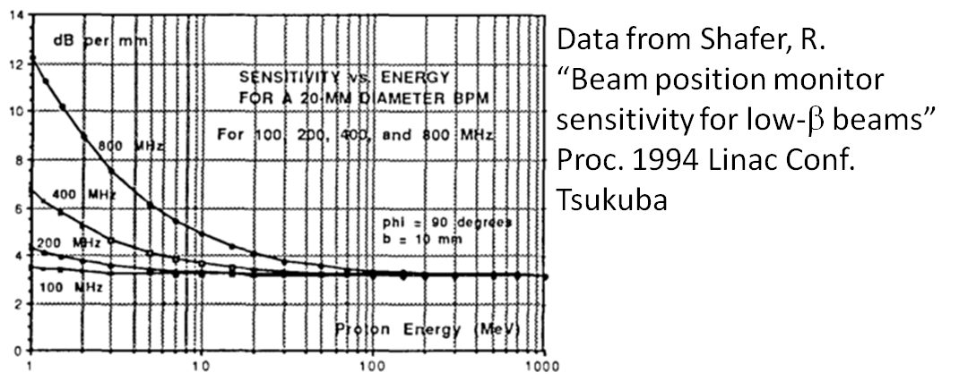
Problems in simulation (2)
Wire signal has β = 1 (εr = 1), but beam has 0.08 < β < 0.4
Solution:
Not really a solution but some hints from Shafer make us
thinking positive!!!
*dB/mm = 20log|V/Vopp.|/D(mm) D= wire diplacement from center

Slide 13
BPM position resolution
BPM resolution request: at least 100 μm
Signal 20 dBm ➔ 20 mA @ 704 MHz
Pos. 0 port 4 = 10.34 --- port 2 = 11.88
Pos. 50 μm port 4 = 10.43 --- port 2 = 11.79
Pos. 100 μm port 4 = 10.53 --- port 2 = 11.64
Signal 10 dBm ➔ 7 mA @ 704 MHz
Pos. 0 port 4 = 3.63 --- port 2 = 3.63
Pos. 50 μm port 4 = 3.65 --- port 2 = 3.60
Pos. 100 μm port 4 = 3.66 --- port 2 = 3.56
Results in mV, variation in tens on microvolt (red digits) at 10 dBm, but increase in
resolution if signal increase.
Remember: nominal bunch charge 140 pC if current about 70 mA @704 MHz
…..and don’t forget Shafer gift!!

Slide 14
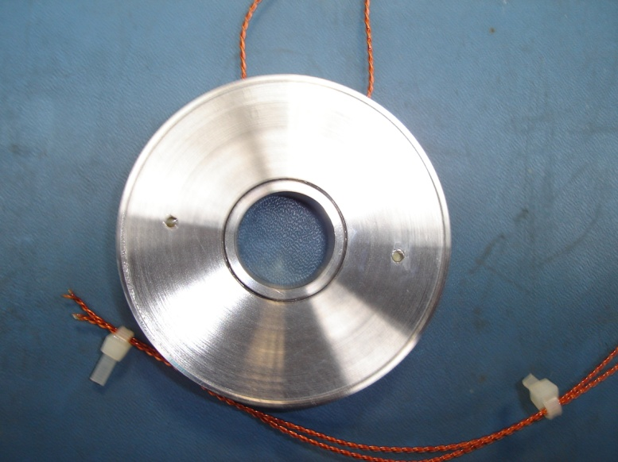
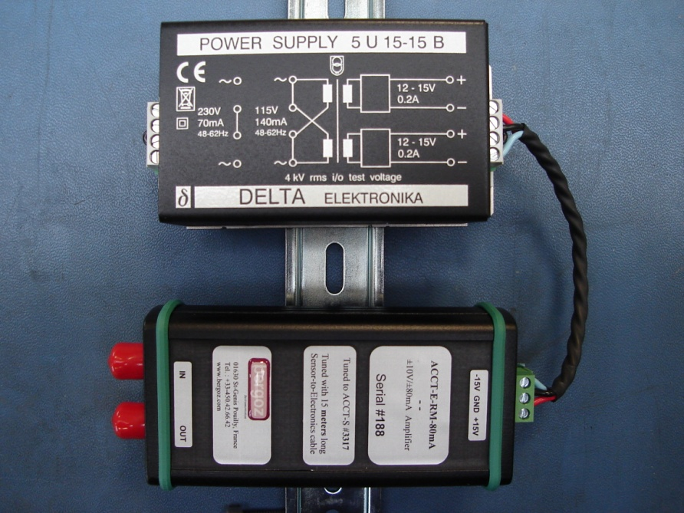
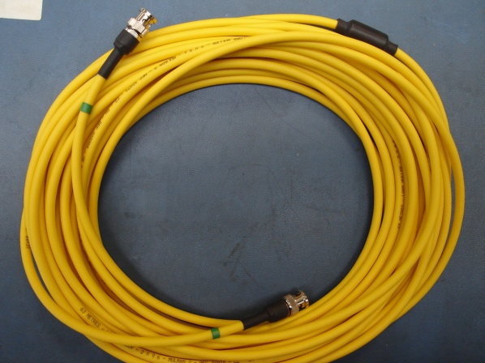
Beam current monitor purchases
In vacuum sensor:
22 mm height, ID=30 mm, OD=102 mm
Front-end electronics
Cable
Low cutoff frequency: 3Hz High cutoff frequency: 1MHz Droop: <2%/ms Full scale output voltage: +/-10V Full scale range: 80 mA

Slide 15
Conclusions
Some problem with first BPM prototype: feedthrough welding not so easy
New prototype design, with different feedthrough and different connection (no pin soldering)
First BPM simulations using wire test bench
List of purchases about the beam current monitor
Method to simulate better the beam characteristics: not a tutorial but only my ideas . IT WOULD BE NICE TO HAVE OTHER SUGGESTIONS ON THIS SPECIFIC TOPIC.
Thank you

